Slide 1
PRIVACY: Part 2
David Millard
dem@soton.ac.uk

Slide 2
The value of Privacy
Attitudes, definitions and rights

Slide 3
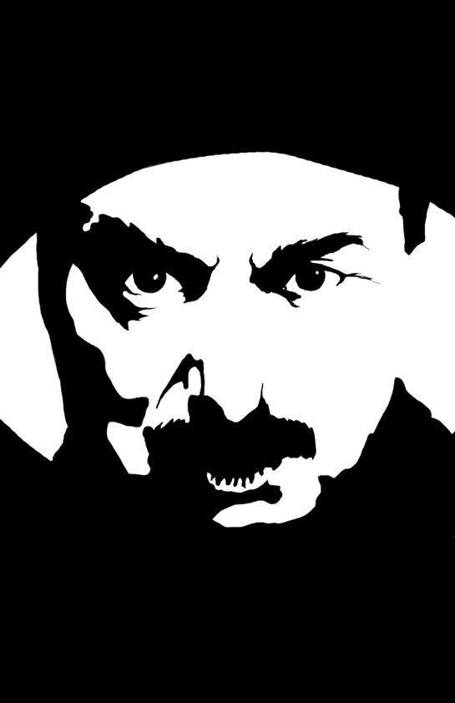
Big Brother?

Slide 4
Big Brother?
Are you very concerned about threats to your personal privacy today?
Yes
No

Slide 5
Big Brother?
Are you very concerned about threats to your personal privacy today?
Yes
No
Do you strongly agree that business organizations seek excessively personal information from consumers?
Yes
No

Slide 6
Big Brother?
Are you very concerned about threats to your personal privacy today?
Yes
No
Do you strongly agree that business organizations seek excessively personal information from consumers?
Yes
No
Do you strongly agree that the government is invading the citizen’s privacy?
Yes
No

Slide 7
Big Brother?
Are you very concerned about threats to your personal privacy today?
Yes
No
Do you strongly agree that business organizations seek excessively personal information from consumers?
Yes
No
Do you strongly agree that the government is invading the citizen’s privacy?
Yes
No
Do you agree that consumers have lost all control over circulation of their information?
Yes
No

Slide 8
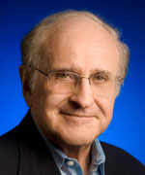
Big Brother?
Dr. Alan Westin - Professor of Public Law & Government Columbia University.
Conducted over 30 studies of attitudes to privacy from 1970 onwards.
This data from Harris-Equifax Consumer
Privacy Survey. Tech. rep., 1991. Conducted for Equifax Inc. 1,255 adults of the U.S. public.
P. Kumaraguru and L. F. Cranor. Privacy indexes: A Survey of Westin’s Studies. Technical report,Carnegie Mellon University, Dec 2005.

Slide 9
Big Brother?
Yes
Yes
Yes
Yes
The Privacy Fundamentalists
25%
Yes
Yes
Yes
No
The Privacy Fundamentalists
Fundamentalists are generally distrustful of organizations that ask for their personal information, worried about the accuracy of computerized information and additional uses made of it, and are in favor of new laws and regulatory actions to spell out privacy rights and provide enforceable remedies. They generally choose privacy controls over consumer-service benefits when these compete with each other.
P. Kumaraguru and L. F. Cranor. Privacy indexes: A Survey of Westin’s Studies. Technical report,Carnegie Mellon University, Dec 2005.

Slide 10
Big Brother?
Yes
Yes
Yes
Yes
The Privacy Fundamentalists
25%
The Pragmatic:
They weigh the benefits to them of various consumer opportunities and services. They look to see what practical procedures for accuracy, challenge and correction of errors the business organization or government agency follows. They believe that business organizations or government should “earn” the public’s trust rather than assume automatically that they have it. And, they want the opportunity to decide whether to opt out of even non-evaluative uses of their personal information as in compilations of mailing lists.
Yes
Yes
Yes
No
Yes
Yes
No
No
The Pragmatic
57%
P. Kumaraguru and L. F. Cranor. Privacy indexes: A Survey of Westin’s Studies. Technical report,Carnegie Mellon University, Dec 2005.

Slide 11
Big Brother?
Yes
Yes
Yes
Yes
The Privacy Fundamentalists
25%
The Unconcerned:
The Unconcerned are generally trustful of organizations collecting their personal information, comfortable with existing organizational procedures and uses are ready to forego privacy claims to secure consumer-service benefits or public-order values and not in favor of the enactment of new privacy laws or regulations.
Yes
Yes
Yes
No
Yes
Yes
No
No
The Pragmatic
57%
Yes
No
No
No
The Unconcerned
18%
No
No
No
No
P. Kumaraguru and L. F. Cranor. Privacy indexes: A Survey of Westin’s Studies. Technical report,Carnegie Mellon University, Dec 2005.

Slide 12
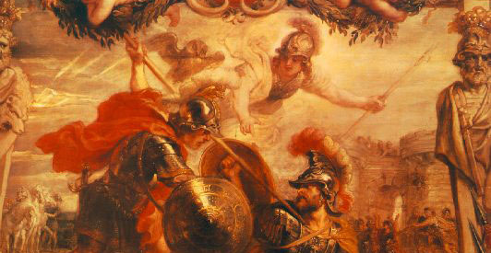
Privacy, n.
1. The state or condition of being alone, undisturbed, or free from public attention, as a matter of choice or right; seclusion; freedom from interference or intrusion.
3. a. Absence or avoidance of publicity or display; secrecy, concealment, discretion; protection from public knowledge or availability. Now rare, or merging with sense 1.
- Oxford English Dictionary
“ACHILLES Of this my privacy
I have strong reasons.
ULYSSES But 'gainst your privacy
The reasons are more potent and heroical:
'Tis known, Achilles, that you are in love
With one of Priam's daughters.”
William Shakespeare, Troillus and Cressida (1609)

Slide 13
Conceptualising PrIvacy
The Right to Be Let Alone | Warren & Brandeis, 1890
Limited Access | Godkin, 1890
Privacy as Personhood | Freund, 1975
Control over Information | Fried, 1984
Intimacy | Farber, 1997
Secrecy | Posner, 1998
Solove, D.J., 2008. Understanding Privacy, Harvard University Press

Slide 14
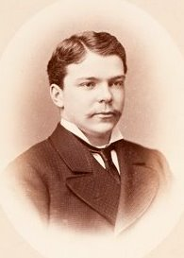
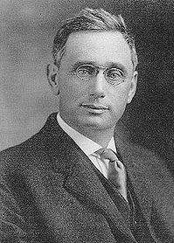
Right to Privacy?
“... the existing law affords a principle from which may be invoked to protect the privacy of the individual from invasion either by the too enterprising press, the photographer, or the possessor of any other modern device for rewording or reproducing scenes or sounds. For the protection afforded is not confined by the authorities to those cases where any particular medium or form of expression has been adopted, not to products of the intellect... If, then, the decisions indicate a general right to privacy for thoughts, emotions, and sensations, these should receive the same protection, whether expressed in writing, or in conduct, in conversation, in attitudes, or in facial expression.”
Samuel D. Warren
Louis Brandeis
Warren and Brandeis “The Right to Privacy”, Harvard Law Review.
Vol. IV , No. 5, December 15, 1890

Slide 15
Right to Privacy?
“... the existing law affords a principle from which may be invoked to protect the privacy of the individual from invasion either by the too enterprising press, the photographer, or the possessor of any other modern device for rewording or reproducing scenes or sounds. For the protection afforded is not confined by the authorities to those cases where any particular medium or form of expression has been adopted, not to products of the intellect... If, then, the decisions indicate a general right to privacy for thoughts, emotions, and sensations, these should receive the same protection, whether expressed in writing, or in conduct, in conversation, in attitudes, or in facial expression.”
Samuel D. Warren
Louis Brandeis
Property
Writing and Art
Warren and Brandeis “The Right to Privacy”, Harvard Law Review.
Vol. IV , No. 5, December 15, 1890
Private Information

Slide 16
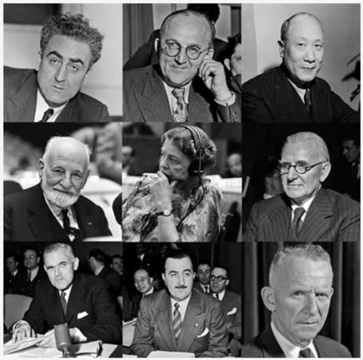
Right to Privacy?
Universal Declaration of Human Rights – United Nations (1948)
Article 12
No one shall be subjected to arbitrary interference with his privacy, family, home or correspondence, nor to attacks upon his honour and reputation. Everyone has the right to the protection of the law against such interference or attacks.
The Drafting Committee
(Lebanon, USSR, China, France, US, UK, Australia, Chile, Canada)

Slide 17
The Value of Privacy
Intellectual privacy “is a zone of protection that guards our ability to make up our minds freely… the protection from surveillance or unwanted interference by others when we are engaged in the process of generating ideas and forming beliefs”
“Privacy is the fundamental barrier that stands in the way of complete State control and domination. Without it, the social contract is broken, and individuals cannot recognize their democratic rights to participate, build, grow and think.”
Richards, N. (2014). Intellectual privacy: Rethinking civil liberties in the digital age. New York: Oxford University Press.
Nyst C. Two sides of the same coin – the right to privacy and freedom of expression. (2013) Translation by Privacy International. Cuestión de Derechos
Notes:
Cary Nyst - Privacy International's Head of International Advocacy

Slide 18
How we Manage Privacy
Trade offs and paradox

Slide 19
The Privacy Trade-Off
Trading private information in exchange for some value
Acquisi and Grossklags. What Can Behavioral Economics Teach Us About Privacy? Digital Privacy: Theory, Technologies and Practices Auerbach Publications pp. 363-377 (2007)

Slide 20
How Do You Make Privacy Choices?
What is Being Traded?
You are shopping in town using an app on your smart phone that has info about bargains. The app asks for permission to use your location to locate nearby bargains.
Acquisi and Grossklags. What Can Behavioral Economics Teach Us About Privacy? Digital Privacy: Theory, Technologies and Practices Auerbach Publications pp. 363-377 (2007)

Slide 21
How Do You Make Privacy Choices?
What is Being Traded?
You are shopping in town using an app on your smart phone that has info about bargains. The app asks for permission to use your location to locate nearby bargains.
Last night you went to a great party. This morning lots of your friends have posted pictures of the party, including ones with you in. They are having lots of fun discussing the photos. You could post your own photos too.
Acquisi and Grossklags. What Can Behavioral Economics Teach Us About Privacy? Digital Privacy: Theory, Technologies and Practices Auerbach Publications pp. 363-377 (2007)

Slide 22
PRIVACY CALCULUS
Trading private information in exchange for some value
(a risk management decision)
RISK
BENEFIT
Acquisi and Grossklags. What Can Behavioral Economics Teach Us About Privacy? Digital Privacy: Theory, Technologies and Practices Auerbach Publications pp. 363-377 (2007)

Slide 23
How Do You Make Privacy Choices?
What is the Risk/Benefit?
You are shopping in town using an app on your smart phone that has info about bargains. The app asks for permission to use your location to locate nearby bargains. Do you give it?
Acquisi and Grossklags. What Can Behavioral Economics Teach Us About Privacy? Digital Privacy: Theory, Technologies and Practices Auerbach Publications pp. 363-377 (2007)

Slide 24
How Do You Make Privacy Choices?
What is the Risk/Benefit?
You are shopping in town using an app on your smart phone that has info about bargains. The app asks for permission to use your location to locate nearby bargains. Do you give it?
Last night you went to a great party. This morning lots of your friends have posted pictures of the party, including ones with you in. They are having lots of fun discussing the photos. Do you post your own photos from the night and join in?
Acquisi and Grossklags. What Can Behavioral Economics Teach Us About Privacy? Digital Privacy: Theory, Technologies and Practices Auerbach Publications pp. 363-377 (2007)

Slide 25
The Privacy Paradox
Something doesn’t add up…
Scenario
Info
Phase 1 (week 0)
Phase 2 (week 7)
High-trust (Bank)
7 high sensitivity
7 mod sensitivity
2 low sensitivity
Behavioral Intention
Actual Disclosure
Low-trust (Pharma)
7 high sensitivity
7 mod sensitivity
2 low sensitivity
Behavioral Intention
Actual Disclosure
Norberg PA, Horne DR and Horne DA. The Privacy Paradox: Personal Information Disclosure Intentions vs. Behaviors. The Journal of Consumer Affairs (2007) vol. 41 (1) pp. 100-127

Slide 26
The Privacy Paradox
Something doesn’t add up…
Compare Intention to Action
Scenario
Info
Phase 1 (week 0)
Phase 2 (week 7)
High-trust (Bank)
7 high sensitivity
7 mod sensitivity
2 low sensitivity
Behavioral Intention
Actual Disclosure
Low-trust (Pharma)
7 high sensitivity
7 mod sensitivity
2 low sensitivity
Behavioral Intention
Actual Disclosure
Norberg PA, Horne DR and Horne DA. The Privacy Paradox: Personal Information Disclosure Intentions vs. Behaviors. The Journal of Consumer Affairs (2007) vol. 41 (1) pp. 100-127

Slide 27
The Privacy Paradox
Big Numbers: if p<0.05 (5%) it is considered significant
Compare Intention to Action
Scenario
Info
Phase 1 (week 0)
Phase 2 (week 7)
High-trust (Bank)
7 high sensitivity
7 mod sensitivity
2 low sensitivity
Behavioral Intention
Actual Disclosure
Low-trust (Pharma)
7 high sensitivity
7 mod sensitivity
2 low sensitivity
Behavioral Intention
Actual Disclosure
Norberg PA, Horne DR and Horne DA. The Privacy Paradox: Personal Information Disclosure Intentions vs. Behaviors. The Journal of Consumer Affairs (2007) vol. 41 (1) pp. 100-127

Slide 28
Privacy
paradox
People’s privacy intentions do not match their behavior

Slide 29
How Do You Make Privacy Choices?
Cognitive Effects
You are shopping in town using an app on your smart phone that has info about bargains. The app asks for permission to use your location to locate nearby bargains. Do you give it?
Last night you went to a great party. This morning lots of your friends have posted pictures of the party, including ones with you in. They are having lots of fun discussing the photos. Do you post your own photos from the night and join in?
Acquisi and Grossklags. What Can Behavioral Economics Teach Us About Privacy? Digital Privacy: Theory, Technologies and Practices Auerbach Publications pp. 363-377 (2007)
Acquisi and Grossklags. What Can Behavioral Economics Teach Us About Privacy?
Digital Privacy: Theory, Technologies and Practices Auerbach Publications (Taylor and Francis Group) pp. 363-377 (2007)

Slide 30
How Do You Make Privacy Choices?
Cognitive Effects
Bounded Rationality
Privacy choices are affected by incomplete and asymmetric information
Rational ignorance: when the cost of learning about a situation enough to inform a rational decision would be higher than the potential benefit
You are shopping in town using an app on your smart phone that has info about bargains. The app asks for permission to use your location to locate nearby bargains. Do you give it?
Last night you went to a great party. This morning lots of your friends have posted pictures of the party, including ones with you in. They are having lots of fun discussing the photos. Do you post your own photos from the night and join in?
Acquisi and Grossklags. What Can Behavioral Economics Teach Us About Privacy? Digital Privacy: Theory, Technologies and Practices Auerbach Publications pp. 363-377 (2007)
Acquisi and Grossklags. What Can Behavioral Economics Teach Us About Privacy?
Digital Privacy: Theory, Technologies and Practices Auerbach Publications (Taylor and Francis Group) pp. 363-377 (2007)

Slide 31
How Do You Make Privacy Choices?
Cognitive Effects
Bounded Rationality
Privacy choices are affected by incomplete and asymmetric information
Rational ignorance: when the cost of learning about a situation enough to inform a rational decision would be higher than the potential benefit
You are shopping in town using an app on your smart phone that has info about bargains. The app asks for permission to use your location to locate nearby bargains. Do you give it?
Behavioral Anomalies
Valence Effect: the tendency to over- estimate the likelihood of favorable events
Overconfidence: to be more confident in one’s knowledge or abilities than warranted by facts
Status quo bias. People prefer for things to stay the same
Reciprocity and fairness: the innate desire to act fairly in transactions with others
Inequity aversion: individuals express discontent when they feel others are unfairly getting rewards they do not deserve
Last night you went to a great party. This morning lots of your friends have posted pictures of the party, including ones with you in. They are having lots of fun discussing the photos. Do you post your own photos from the night and join in?
Acquisi and Grossklags. What Can Behavioral Economics Teach Us About Privacy? Digital Privacy: Theory, Technologies and Practices Auerbach Publications pp. 363-377 (2007)
Acquisi and Grossklags. What Can Behavioral Economics Teach Us About Privacy?
Digital Privacy: Theory, Technologies and Practices Auerbach Publications (Taylor and Francis Group) pp. 363-377 (2007)

Slide 32
Context and the Privacy Paradox
Participants asked to respond to specific location-based privacy scenarios
Answers converted into a WillingnessToShare score
Then asked two specific questions:
Question A. How concerned are you about threats to your online privacy?
Question B. How concerned are you about the fact that your location might be used for other purposes too?
Willingness
ToShare
Question A
(general)
Question B
(Specific)
Zafeiropoulou, Aristea M., Millard, David E., Webber, Craig and O'Hara, Kieron (2013) Unpicking the privacy paradox: can structuration theory help to explain location-based privacy decisions? In, ACM Web Science 2013 (WebSci '13), Paris, France, 02 - 04 May 2013.

Slide 33
Context and the Privacy Paradox
Participants asked to respond to specific location-based privacy scenarios
Answers converted into a WillingnessToShare score
Then asked two specific questions:
Question A. How concerned are you about threats to your online privacy?
Question B. How concerned are you about the fact that your location might be used for other purposes too?
Willingness
ToShare
No Significant Correlation
(Pearson’s
r = 0.067,
p = 0.492)
No Significant Correlation
(Pearson’s
r = 0.103,
p = 0.285)
Question A
(general)
Question B
(Specific)
Moderate Significant Correlation
(Pearson’s
r =0.527,
p = 0.001)
Zafeiropoulou, Aristea M., Millard, David E., Webber, Craig and O'Hara, Kieron (2013) Unpicking the privacy paradox: can structuration theory help to explain location-based privacy decisions? In, ACM Web Science 2013 (WebSci '13), Paris, France, 02 - 04 May 2013.

Slide 34
Why?
Zafeiropoulou, Aristea M., Millard, David E., Webber, Craig and O'Hara, Kieron (2013) Unpicking the privacy paradox: can structuration theory help to explain location-based privacy decisions? In, ACM Web Science 2013 (WebSci '13), Paris, France, 02 - 04 May 2013.

Slide 35
Agency
“Comfortable with sharing online”
Why?
“Not interested in publishing my location online”
Zafeiropoulou, Aristea M., Millard, David E., Webber, Craig and O'Hara, Kieron (2013) Unpicking the privacy paradox: can structuration theory help to explain location-based privacy decisions? In, ACM Web Science 2013 (WebSci '13), Paris, France, 02 - 04 May 2013.

Slide 36
Agency
“Comfortable with sharing online”
Why?
“Not interested in publishing my location online”
Contextual
“It was convenient”
“Didn’t trust the application”
Zafeiropoulou, Aristea M., Millard, David E., Webber, Craig and O'Hara, Kieron (2013) Unpicking the privacy paradox: can structuration theory help to explain location-based privacy decisions? In, ACM Web Science 2013 (WebSci '13), Paris, France, 02 - 04 May 2013.

Slide 37
Agency
“Comfortable with sharing online”
Why?
“Not interested in publishing my location online”
Contextual
“It was convenient”
“Didn’t trust the application”
Situated
“I was part of a group”
“It was a private event”
Zafeiropoulou, Aristea M., Millard, David E., Webber, Craig and O'Hara, Kieron (2013) Unpicking the privacy paradox: can structuration theory help to explain location-based privacy decisions? In, ACM Web Science 2013 (WebSci '13), Paris, France, 02 - 04 May 2013.

Slide 38
Agency
“Comfortable with sharing online”
Why?
23%
122
“Not interested in publishing my location online”
Contextual
“It was convenient”
“Didn’t trust the application”
77%
(405)
Situated
“I was part of a group”
“It was a private event”
Zafeiropoulou, Aristea M., Millard, David E., Webber, Craig and O'Hara, Kieron (2013) Unpicking the privacy paradox: can structuration theory help to explain location-based privacy decisions? In, ACM Web Science 2013 (WebSci '13), Paris, France, 02 - 04 May 2013.

Slide 39
Privacy and Structuration
Structure
(rules / conventions /social forces)
Agency
(free choice)

Slide 40
Privacy and Structuration
Structure
(rules / conventions /social forces)
Agency
(free choice)
Anthony Giddens, sociologist, coined the term Structuration in 1984: "social structures are both constituted by human agency, and yet at the same time are the very medium of this constitution.”

Slide 41
Privacy and Structuration
Social Media may have created new social forces around Privacy.
And normalised the sharing of what used to be private information.
Structure
(rules / conventions /social forces)
Agency
(free choice)
Anthony Giddens, sociologist, coined the term Structuration in 1984: "social structures are both constituted by human agency, and yet at the same time are the very medium of this constitution.”

Slide 42
SOLVING THE PROBLEM
Eight WAYS TO SAVE OUR PRIVACY

Slide 43
1
‘Sunlight is said to be the best disinfectants,
electric light the most efficient policeman’
- Louis Brandeis, American Supreme Court Justice
Transparency
E.g.
Data Controller Registers
Subject Access Requests
Open Access Data
But Power Imbalance works against the individual – information asymmetry, rational ignorance, etc.

Slide 44
2
Data must be collected for a defined purpose, and cannot be used later for another
Purpose
Limitation
Doesn’t include the Extended Digital Self, data transfers not covered, and what is a purpose anyway?

Slide 45
3
Giving users more direct control over their data
Self-Management
E.g.
Privacy Policies
Personal Data Managers
Privacy Policies are not readable/understandable, Data Managers lack integration and are a security risk

Slide 46
4
Established in the European Court of Justice in 2014
Became ‘The Right to Erasure’ in the GDPR
Right To Be Forgotten
Applies
to personal data that is considered:
inadequate,
irrelevant,
or no longer relevant
Can conflict with freedom of expression, or public interest,
Requires a proactive formal request

Slide 47
5
Societal forgetting - expiry dates attached to data after which it would decay in parts or be deleted
Data Amnesia
requires no intervention from individuals
What data would be excluded?
By policy or technical design?

Slide 48
6
The strategy to remove or encrypt information that can be used to identify an individual
Anonymity
E.g.
Network/Data modification
Entity Clustering
Complex and Cumbersome
Can Distort the data

Slide 49
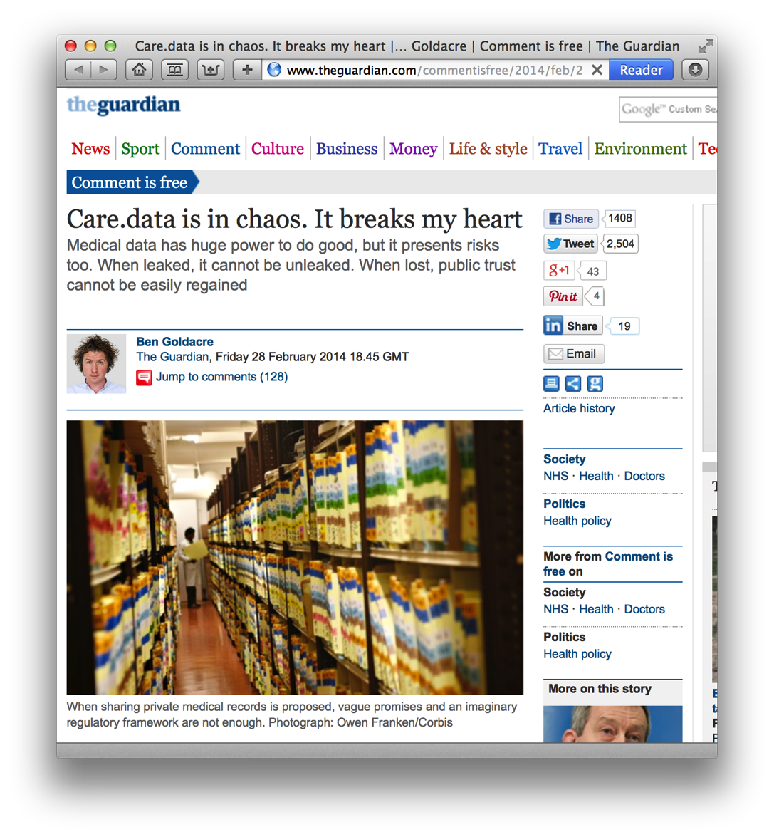
6
The strategy to remove or encrypt information that can be used to identify an individual
Anonymity
E.g.
Network/Data modification
Entity Clustering
“On Monday, the Health and Social Care Information Centre admitted giving the insurance industry the coded hospital records of millions of patients, pseudonymised…”
Complex and Cumbersome
Can Distort the data

Slide 50
7
Take data into archival custody, where it is kept under strict access controls until the information is made public
Safe Havens
E.g.
UK National Archives – Record of Government Data
30 Years – Government Documents
50 Years – Secret Intelligence Material
100 Years – Census Data
Reliant on Cybersecurity Measures
And strong legal consequences

Slide 51
8
Incorporate Privacy into every step in the software design and engineering process
Privacy By
Design
E.g.
Privacy Patterns (https://privacypatterns.org)
Location Granularity
Awareness Feed
Use of Dummies
Reciprocity
Privacy Labels
Places onus on software engineers
Implementation of some patterns very difficult

Slide 52
Is Privacy Dead Or Just Resting?
Notes:
My view – it is transforming, from a state where we have genuine privacy -> a state where we have legal privacy

Slide 53
Questions…
?
David Millard | @hoosfoos | davidmillard.org

