Slide 1
PRIVACY:
Part I
David Millard
dem@soton.ac.uk

Slide 2
ENEMY OF THE STATE (1998): What Technologies are used?

Slide 3

WAS THIS REALISTIC IN 1998?

Slide 4
IS IT REALISTIC NOW?

Slide 5

Think About Your Own Social Network
What Could I Find Out About You?
From Your Account

Slide 6
Think About Your Own Social Network
What Could I Find Out About You?
From Your Friend’s Accounts

Slide 7
Think About Your Own Social Network
How Do You Defend Yourselves?

Slide 8
Think About Your Own Social Network
Privacy
Protection
Strategies
F. Asiri and D. Millard, "Unpacking Privacy Practices in SNSs: Users’ Protection Strategies to Enforce Privacy Boundaries,"
2018 21st Saudi Computer Society National Computer Conference (NCC), Riyadh, 2018
Notes:
Meta-analysis of 60 publications

Slide 9
Think About Your Own Social Network
Technological
Segment Audience
Un-tag
Privacy
Protection
Strategies
Delete
Block
Deactivate
F. Asiri and D. Millard, "Unpacking Privacy Practices in SNSs: Users’ Protection Strategies to Enforce Privacy Boundaries,"
2018 21st Saudi Computer Society National Computer Conference (NCC), Riyadh, 2018

Slide 10
Think About Your Own Social Network
Technological
Social
Segment Audience
Social Stenography
Un-tag
Privacy
Protection
Strategies
Self Censorship
Delete
Falsification
Block
Multiple Spaces
Deactivate
White Walling
F. Asiri and D. Millard, "Unpacking Privacy Practices in SNSs: Users’ Protection Strategies to Enforce Privacy Boundaries,"
2018 21st Saudi Computer Society National Computer Conference (NCC), Riyadh, 2018

Slide 11
Information Asymmetry

Slide 12
Information Asymmetry
the system
knows more about
you than you have disclosed

Slide 13

Bob’s profile says he is 6 foobars tall
What has Bob told us; what do we know about Bob?

Slide 14


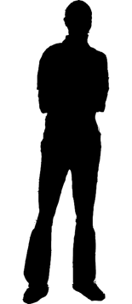


Bob’s profile says he is 6 foobars tall
What has Bob told us; what do we know about Bob?
COMPARISON

Slide 15

ANNE (24)
HOBBY:
HEFTUKA
BRIE (53)
HOBBY:
BUGDUF
CLARE (47)
HOBBY:
BUGDUF
DAVINA (28)
HOBBY:
HEFTUKA

Slide 16
ANNE (24)
HOBBY:
HEFTUKA
BRIE (53)
HOBBY:
BUGDUF
CLARE (47)
HOBBY:
BUGDUF
DAVINA (28)
HOBBY:
HEFTUKA
EMMA (?)
HOBBY:
BUGDUF
Inference

Slide 17
In 2013 researchers in Cambridge looked at the predictive power of Facebook likes…
Michal Kosinski, David Stillwell, and Thore Graepel. Private traits and attributes are predictable from digital records of human behavior. Proceedings of the National Academy of Sciences. 2013 110 (15) 5802-5805;

Slide 18
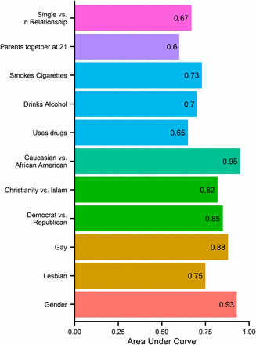
In 2013 researchers in Cambridge looked at the predictive power of Facebook likes…
Michal Kosinski, David Stillwell, and Thore Graepel. Private traits and attributes are predictable from digital records of human behavior. Proceedings of the National Academy of Sciences. 2013 110 (15) 5802-5805;

Slide 19
THE
DIGITAL SELF
Parkinson, Brian, Laurence, Millard, David, O’Hara, Kieron and Giordano, Richard (2017) The digitally extended self: a lexicological analysis of personal data. Journal of Information Science.

Slide 20


THE
DIGITAL SELF
Digital Footprints
Parkinson, Brian, Laurence, Millard, David, O’Hara, Kieron and Giordano, Richard (2017) The digitally extended self: a lexicological analysis of personal data. Journal of Information Science.

Slide 21
THE
DIGITAL SELF
Digital Footprints
3rd party footprints
Parkinson, Brian, Laurence, Millard, David, O’Hara, Kieron and Giordano, Richard (2017) The digitally extended self: a lexicological analysis of personal data. Journal of Information Science.

Slide 22
THE
DIGITAL SELF
Digital Mosaic
  Digital Footprints
  3rd party footprints
Parkinson, Brian, Laurence, Millard, David, O’Hara, Kieron and Giordano, Richard (2017) The digitally extended self: a lexicological analysis of personal data. Journal of Information Science.

Slide 23
THE
DIGITAL SELF
Digital Mosaic
  Digital Footprints
  3rd party footprints
Digital Persona
DP
Parkinson, Brian, Laurence, Millard, David, O’Hara, Kieron and Giordano, Richard (2017) The digitally extended self: a lexicological analysis of personal data. Journal of Information Science.

Slide 24
THE
DIGITAL SELF
Digital Mosaic
  Digital Footprints
  3rd party footprints
Digital Persona
DP
DP
Parkinson, Brian, Laurence, Millard, David, O’Hara, Kieron and Giordano, Richard (2017) The digitally extended self: a lexicological analysis of personal data. Journal of Information Science.

Slide 25
THE
DIGITAL SELF
Digital Mosaic
  Digital Footprints
  3rd party footprints
Digital Persona
  3rd party data
DP
DP
DP
DB
Parkinson, Brian, Laurence, Millard, David, O’Hara, Kieron and Giordano, Richard (2017) The digitally extended self: a lexicological analysis of personal data. Journal of Information Science.

Slide 26
THE EXTENDED
DIGITAL SELF
Digital Mosaic
  Digital Footprints
  3rd party footprints
Digital Persona
  3rd party data
All together is the
Extended Digital Self
Note: Your EDS includes
footprints and data that belongs to others!
DP
DP
DP
DB
Parkinson, Brian, Laurence, Millard, David, O’Hara, Kieron and Giordano, Richard (2017) The digitally extended self: a lexicological analysis of personal data. Journal of Information Science.

Slide 27
Informed Consent
“Informed consent, according to the common view, is agent-centered and subjective. It has to be given freely, with sufficient knowledge and understanding of use, risks, consequences and alternative options.
Valid consent can only be given regarding specific parties and a specific offer at a specific moment of time.”
Pascalev, M. (2017). Privacy exchanges: restoring consent in privacy self-management. Ethics and Information Technology, 19(1), pp. 39-48.

Slide 28
244 hours
54 billion hours
6 million person years
time for average US Internet user to read
their relevant privacy policies for a year
for all US users
McDonald, A. and Cranor, L. The Cost of Reading Privacy Policies. I/S: A Journal of Law and Policy for the Information Society. 2008 Privacy Year in Review issue.

Slide 29
Is Consent Possible?

Slide 30
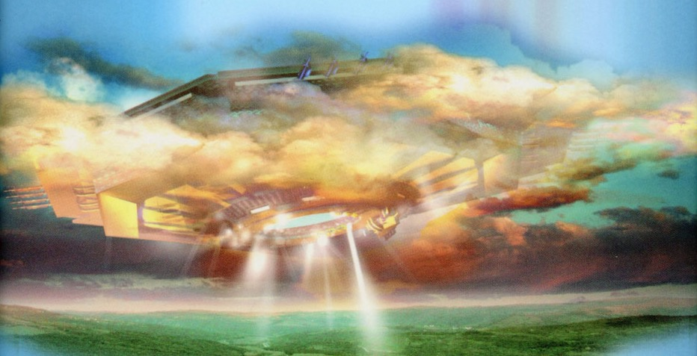
The Datavores
"Entertain us," it asks, "and we will give you what you want.”
- Singularity Sky (2003), Charles Stross

Slide 31
“If you’re not paying,
you’re the product”

Slide 32
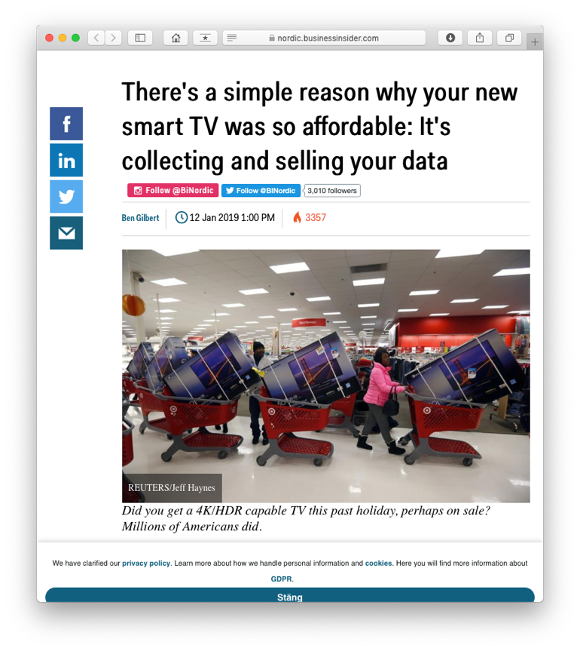
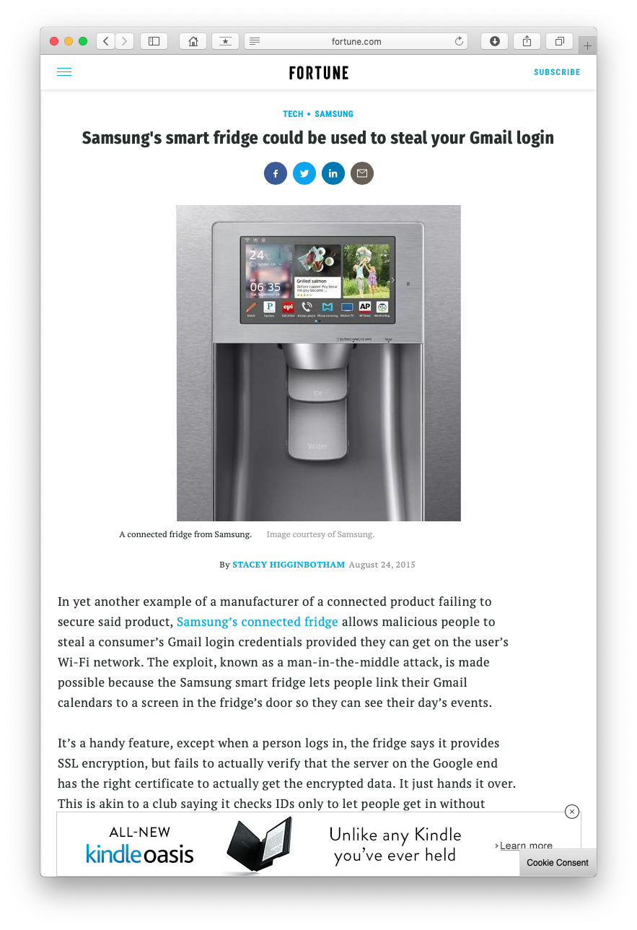
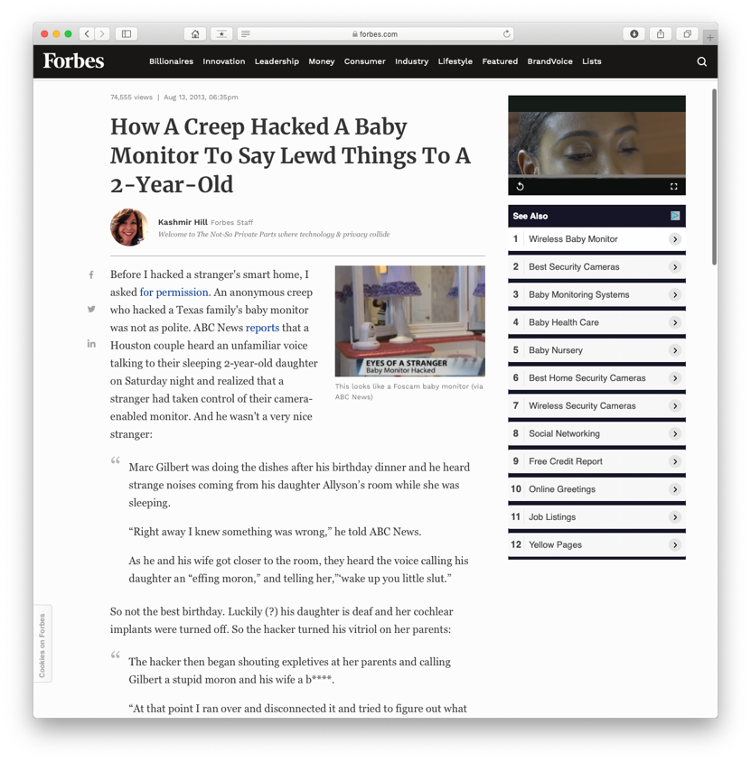
The Internet of Shit

Slide 33
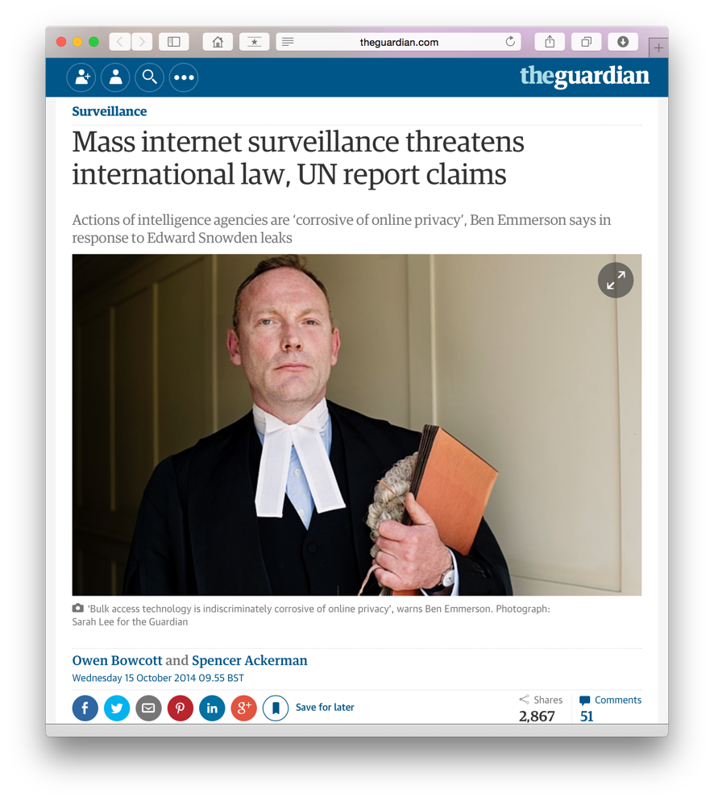
Mass Surveillance
  Mass surveillance, by commercial organisations and governments, have led some to proclaim the death of privacy

Slide 34
Mass Surveillance
“If you keep within the law,
and the government keeps within the law, and its employees keep within the law, and the computer holding the database doesn’t screw up, and the system is carefully designed according to well-understood software engineering principles and maintained properly, and the government doesn’t scrimp on the outlay, and all the data are entered carefully, and the police are adequately trained to use the system, and the system isn’t hacked into and your identity isn’t stolen and the local hardware functions well,
you have nothing to fear”
O’Hara, K. and Stevens, D. (2006). inequality.com: Power, Poverty and the Digital Divide. Oneworld, Oxford.

Slide 35
Mass Surveillance
2014 China announces plans for new social credit system

Slide 36
Mass Surveillance
Correctional Offender Management Profiling for Alternative Sanctions (COMPAS) – USA
Assesses risk of repeat crimes
Durham Constabulary’s Harm Assessment Risk Tool (HART) - UK
Assesses risk of repeat crimes
Angwin, J., Larson, J., Mattu, S. and Kirchner, L. (2016). Machine Bias: There’s Software Used Across the Country to Predict Future Criminals. And It’s Biased Against Blacks. Propublica. Available at: https://www.propublica.org/article/machine-bias-risk-assessments-in- criminal-sentencing
Oswald, Marion and Grace, Jamie and Urwin, Sheena and Barnes, Geoffrey, Algorithmic Risk Assessment Policing Models: Lessons from the Durham HART Model and ‘Experimental’ Proportionality (August 31, 2017). Information & Communications Technology Law

Slide 37
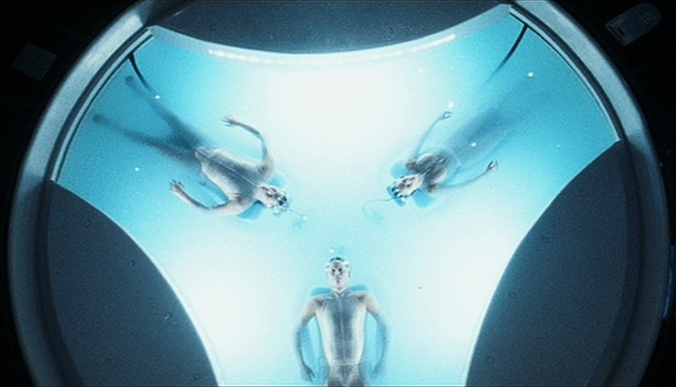
Mass Surveillance
Correctional Offender Management Profiling for Alternative Sanctions (COMPAS) – USA
Assesses risk of repeat crimes
Durham Constabulary’s Harm Assessment Risk Tool (HART) - UK
Assesses risk of repeat crimes
The Minority Report – Phillip K. Dick
MINORITY REPORT
Angwin, J., Larson, J., Mattu, S. and Kirchner, L. (2016). Machine Bias: There’s Software Used Across the Country to Predict Future Criminals. And It’s Biased Against Blacks. Propublica. Available at: https://www.propublica.org/article/machine-bias-risk-assessments-in- criminal-sentencing
Oswald, Marion and Grace, Jamie and Urwin, Sheena and Barnes, Geoffrey, Algorithmic Risk Assessment Policing Models: Lessons from the Durham HART Model and ‘Experimental’ Proportionality (August 31, 2017). Information & Communications Technology Law

Slide 38
Mass Surveillance
Correctional Offender Management Profiling for Alternative Sanctions (COMPAS) – USA
Assesses risk of repeat crimes
Discriminates against black people
Durham Constabulary’s Harm Assessment Risk Tool (HART) - UK
Assesses risk of repeat crimes
Discriminates against poor people
The Minority Report – Phillip K. Dick
MINORITY REPORT
Angwin, J., Larson, J., Mattu, S. and Kirchner, L. (2016). Machine Bias: There’s Software Used Across the Country to Predict Future Criminals. And It’s Biased Against Blacks. Propublica. Available at: https://www.propublica.org/article/machine-bias-risk-assessments-in- criminal-sentencing
Oswald, Marion and Grace, Jamie and Urwin, Sheena and Barnes, Geoffrey, Algorithmic Risk Assessment Policing Models: Lessons from the Durham HART Model and ‘Experimental’ Proportionality (August 31, 2017). Information & Communications Technology Law

Slide 39
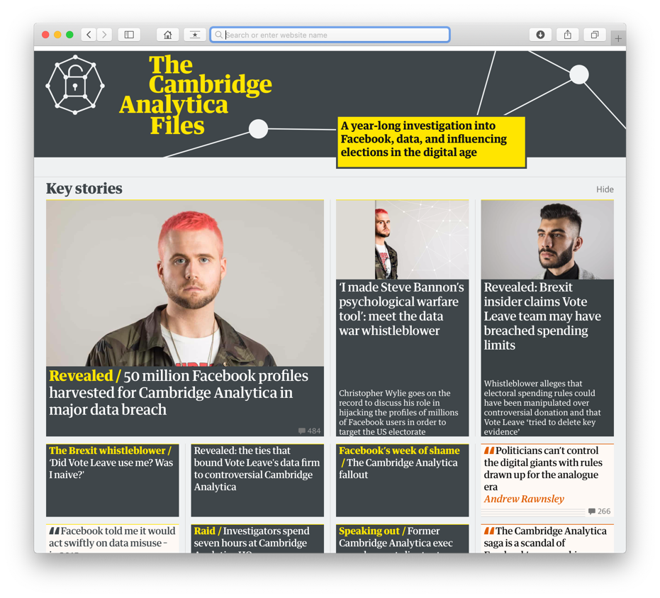
Mass Surveillance
  This is a Problem for Society as Whole

Slide 40
Richard Brautigan (1967)
I like to think
(it has to be!)
of a cybernetic ecology
where we are free of our labors
and joined back to nature,
returned to our mammal
brothers and sisters,
and all watched over
by machines of loving grace.

Slide 41
Questions…
?
Dave Millard (dem@ecs.soton.ac.uk)
@hoosfoos

