Slide 1
D3.js
Data Driven Documents
Dr Heather Packer
16/01/19

Slide 2
Version 3, 4 and 5
D3 version 5 is the latest
Significant differences between 3 and 4
Minor differences between 4 and 5
Beware which versions when using examples from the web
ALL of the following examples are version 4

Slide 3
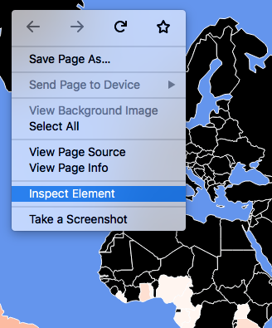
Dev Tools
Chrome: Browser menu -> More Tools -> Developer Tools
Firefox: Browser menu -> Web Developer -> Toggle Tools
Right click menu -> Inspect / Inspect Element

Slide 4
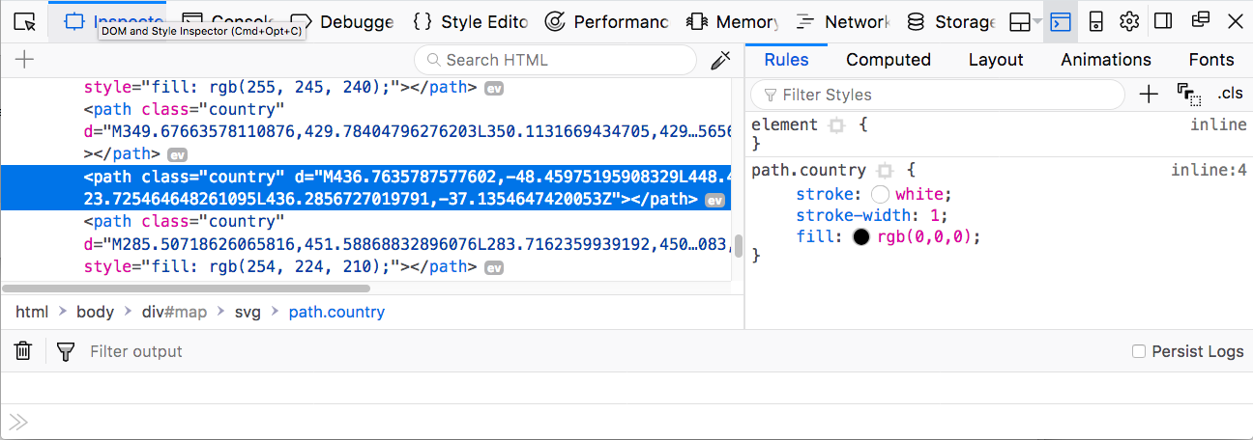
Dev Tools
Inspector
Console
Debugger

Slide 5
Setting up D3
Create a project folder
Write an html file and include in the head element:
<script src="https://d3js.org/d3.v4.min.js"></script>

Slide 6
Setting up D3
Create a project folder
Write an html file and include in the head element:
<script src="https://d3js.org/d3.v4.min.js"></script>

Slide 7
Loading CSV Data
dataset = d3.csv(csv_file, callback_function);
dataset = d3.csv(csv_file, data_function, callback_function);
csv_file - csv file path
callback_function - d3 code
data_function - OPTIONAL defines data structure used in callback_function

Slide 8
Loading TSV and JSON
dataset = d3.tsv(tsv_file, callback_function);
dataset = d3.tsv(tsv_file, data_function, callback_function);
dataset = d3.json(json_file,callback_function);

Slide 9
Loading More than Dataset in Version 4
d3.queue()
.defer(d3.csv, "/data/chocolate.csv")
.defer(d3.json, "/data/world.geo.json")
.await(analyze);
function analyze(error, chocolate, world) {
if(error) {
console.log(error);
return;
}
console.log(chocolate[0]);
console.log(world[0]);
}

Slide 10
OPTIONAL Data Cleaning and Structuring
d3.queue()
.defer(d3.csv, "/data/chocolate.csv”,
function(data, i) {
return {
company: data["Company"],
rating: +data["Rating"],
choconame: data["Company"]+"-"+data["Name"]
};
});
.defer(d3.json, "/data/world.geo.json")
.await(analyze);

Slide 11
Bar Chart

Slide 12
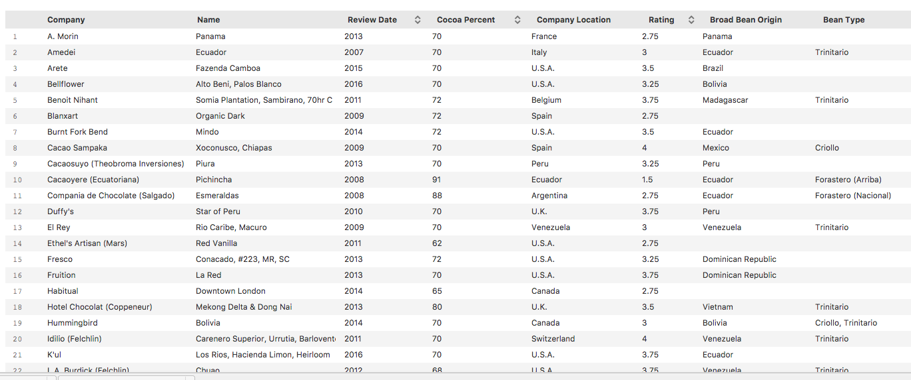
Chocolate Bar Dataset
https://public.opendatasoft.com/explore/dataset/chocolate-bars/export/

Slide 13
Chocolate Bar Dataset - Cleaning
Cleaned using Open Refine
Clustered and Text Facet
Company name
Company location
Broad Bean Origin
Bean Types
Deleted one duplicate entry

Slide 14
Selecting a Chart
Decide on the audience: Chocolate buyers, they want to know which chocolate to avoid and which to buy
Decide on purpose of chart: Compare ratings of different chocolate
Select the type of chart: horizontal bar chart
Y axis choconame long text file
X axis rating 1-5

Slide 15
Loading Data in version 4
d3.queue()
.defer(d3.csv, "/data/chocolate.csv”,
function(data, i) {
return {
id: i,
company: data["Company"],
name: data["Name"],
ref: data["Ref"],
percent: data["Cocoa Percent"],
loc: data["Company Location"],
origin: data["Broad Bean Origin"],
type: data["Bean Type"],
rating: +data["Rating"],
date: +data["Review Date"],
choconame: data["Company"]+"-"+data["Name”]
};
});
.await(anaylse);

Slide 16
Bar Chart in Version 4
function analyze(error, dataset) {
if (error) {
console.log(error);
return;
}
//add more code
}

Slide 17
Bar Chart – setting up the svg container
function analyze(error, dataset) {
//error code here see previous slide
dataset = dataset.slice(0,10);
var margin = { top: 30, right: 30, bottom: 30, left: 30 };
var width = 800;
var height = dataset.length*30;
var svg = d3.select('body')
.append('svg')
.attr('width', width + margin.left + margin.right)
.attr('height', height + margin.top + margin.bottom)
.append('g')
.attr('transform', 'translate(' + margin.left + ',' +
margin.top + ")");
}

Slide 18
DOM
<body>
<svg width="830" height="330" >
<g transform="translate(30, 30)"></g>
</svg>
</body>

Slide 19
Bar Chart
function analyze(error, dataset) {
//error code here see slide
//setting up svg container, see previous slide
var bars = svg.selectAll(".bar")
.data(dataset)
.enter()
.append("rect")
.attr("class", "bar")
.attr("height", 10)
.attr("width", function(d) { return 100 * d.rating; })
.attr("x", 0)
.attr("y", function(d, i) { return i*12; })
;
}

Slide 20
Bar Chart
svg.selectAll("bar")
Selects all bar divs DOM. Because none exist yet, this returns an empty selection. This empty selection represents bars that will soon exist.
.data(dataset)
Counts and parses our data values. There are 10 values in our array called dataset, everything past this point is executed 10 times, once for each value.
.enter()
To create new, data-bound elements, you must use enter(). This method looks at the current DOM selection, and then at the data being handed to it. If there are more data values than corresponding DOM elements, then enter() creates a new placeholder element. It then hands off a reference to this new placeholder to the next step in the chain.

Slide 21
Bar Chart
.append("rect")
Adds a svg rectangle shape
.attr("class", "bar")
Adds the class bar to the rectangle
.attr("height", 10) .attr(width, function(d){return 100*d.rating})
Adds the height and width of the bar, increasing the scale by 100
.attr(x, 0).attr(y, function(d,i){return i*12})
Sets the x and y coordinates to place the bar in the svg

Slide 22
Bar Chart

Slide 23
D3.js Scales
D3.js provides functions to perform data transformations.
D3.js Scales are functions, they can:
map one input domain to an output range,
convert a number in the domain to an output in the range.

Slide 24
D3.js Scales - Linear
Linear scales are most commonly used scale
The are suitable for transforming data values into positions and lengths
var width = 800;
var x = d3.scaleLinear()
.domain([0, d3.max(dataset, function(d){return d.rating;})])
.range([0, width]);
x(3.4) // 680

Slide 25
D3.js Scales - Bands
Band scales help determine the geometry of bars, including the padding
var height = 330;
var y = d3.scaleBand()
.domain(dataset.map(function(d) { return d.id;}))
.range([0, height])
.padding(0.1);
y(0) //32.8 (where there are 10 items in the dataset)
y(1) //65.5
y(2) //98.4

Slide 26
Using the Axes to Scale our Data
var bars = svg.selectAll(".bar")
.data(dataset)
.enter()
.append("rect")
.attr("class", "bar")
.attr("height", y.bandwidth())
.attr("width", function(d) { return x(d.rating); })
.attr("x", 0)
.attr("y", function(d) { return y(d.id); });

Slide 27
Adding Axes
// add the x Axis - Rating
svg.append("g")
.attr("transform", "translate(0," + height + ")")
.call(d3.axisBottom(x));
// add the y Axis - Chocolate Name
svg.append("g")
.call(d3.axisLeft(y)
.tickSize(0)
.tickFormat(function(d, i) {
return dataset[i].choconame;
})
);

Slide 28
Bar Chart with Axes

Slide 29
Adding Another Dimension: Cocoa Percentage
var colour = d3.scaleLinear()
.domain([0, 50, 100])
.range([d3.rgb("#d1a665"),
d3.rgb("#7d4e29"),
d3.rgb("#382001")])
var bars = svg.selectAll(".bar")
.data(dataset)
.enter()
.append("rect")
.attr("class", "bar")
.attr("height", y.bandwidth())
.attr("width", function(d) { return x(d.rating); })
.attr("x", 0)
.attr("y", function(d) { return y(d.id); })
.attr("fill", function(d) { return colour(d.percent); })
;

Slide 30
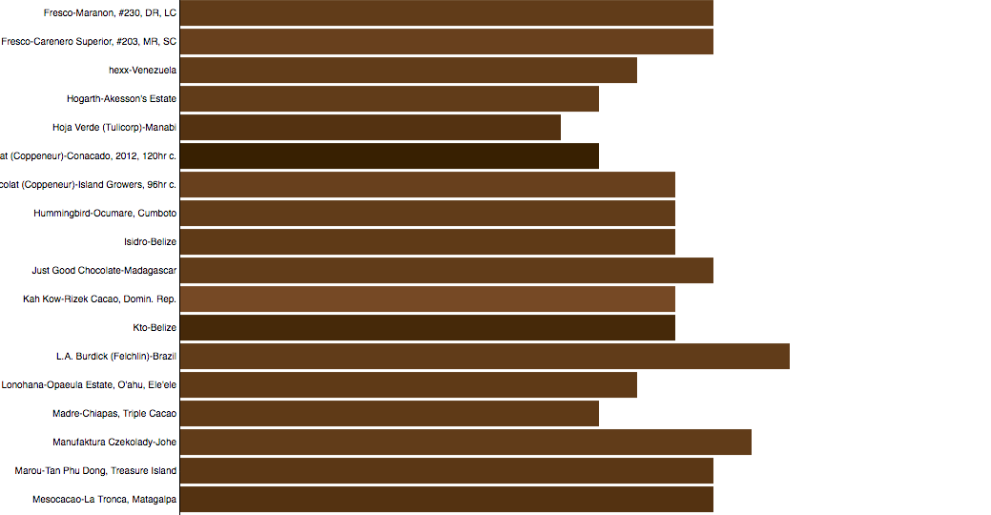
Cocoa Percentage

Slide 31
Making the Rating Clearer
bars.append("text")
.attr("class", "label")
.attr("y", function(d) {
return y(d.id) + y.bandwidth()/ 2;
})
.attr("x", function(d) {
return x(d.rating) + 3;
})
.text(function(d) { return d.rating; })
;

Slide 32
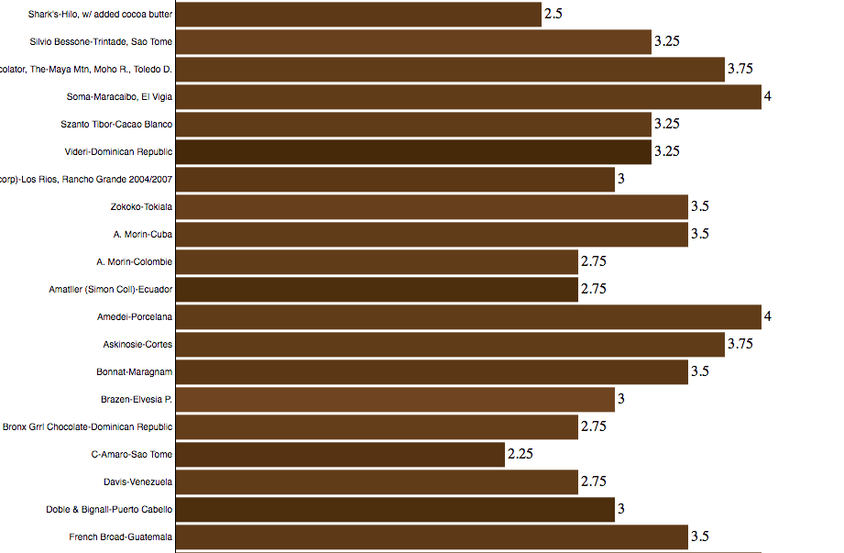
Bar Chart with Ratings

Slide 33
Scatter Chart

Slide 34
Selecting a Chart
Decide on the audience: Chocolate buyers, who are interested in trying different cocoa percentages
Decide on purpose of chart: Is there a correlation between the cocoa percentage and it’s rating?
Select the type of chart: Scatter chart, view the distribution

Slide 35
Scatter Chart – X/Y Scales
var x = d3.scaleLinear()
.domain([0, 100])
.range([0, width]);
var y = d3.scaleLinear()
.domain([0, 5])
.range([height, 0]);

Slide 36
Scatter Chart – adding points
var points = svg.selectAll(".point")
.data(dataset)
.enter()
.append("circle")
.attr("class", "point")
.attr("cy", function(d){ return y(d.rating); })
.attr("cx", function(d){ return x(d.percent); })
.attr("r", 5)
.attr("stroke", function(d){ return colour(d.percent); })
.attr("fill", "none")
.attr("opacity", 0.8)
;

Slide 37
Scatter Chart – add axes
// add the x Axis
svg.append("g")
.attr("transform", "translate(0," + height + ")")
.call(d3.axisBottom(x));
// add the y Axis
svg.append("g")
.call(d3.axisLeft(y));

Slide 38
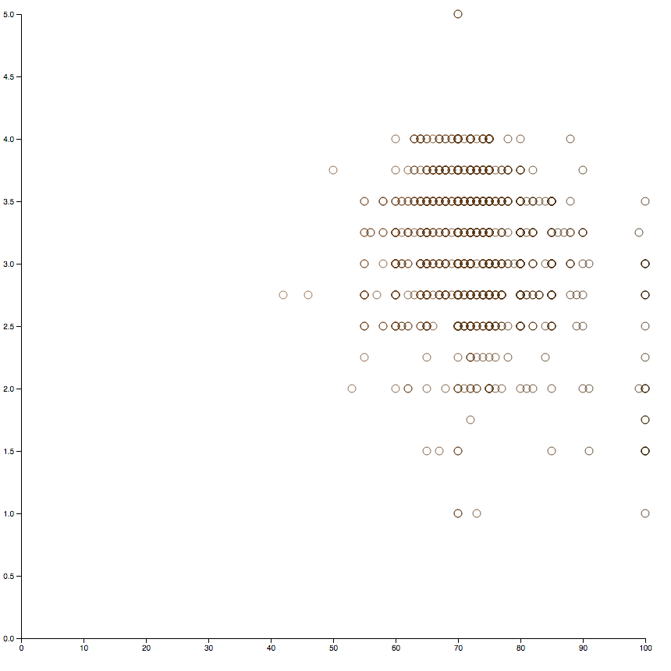
Scatter Chart

Slide 39
Scatter Chart – Adding Jitter
function jitter(v, vmin, vmax) {
var r = v + 0.01 * (vmax - vmin) * (Math.random() - 0.5);
return Math.min(vmax, Math.max(vmin, r));
}
var points = svg.selectAll(".point")
.data(dataset)
.enter()
.append("circle")
.attr("class", "point")
.attr("cy", function(d) {
return y(jitter(d.rating, 0, 5.0));
})
.attr("cx", function(d) {
return x(jitter(d.percent, 0, 100.0));
})
.attr("r", 5)
.attr("stroke", function(d) { return colour(d.percent); })
.attr("fill", "none")
.attr("opacity", 0.8)
;

Slide 40
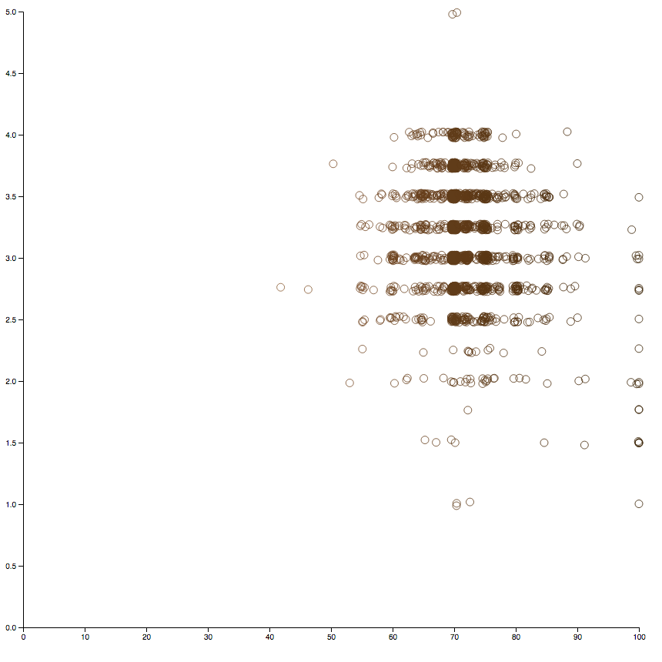
Scatter Chart with jitter

Slide 41
Maps

Slide 42
Loading CSS and Styling
<!DOCTYPE html>
<html>
<head>
<title>Leaflet GeoJSON Example</title>
<meta charset="utf-8" />
<link rel="stylesheet" href="http://cdn.leafletjs.com/leaflet-0.7.1/leaflet.css" />
<script src="https://d3js.org/d3.v4.min.js"></script>
<script src="https://d3js.org/d3-scale-chromatic.v1.min.js"></script>
<style type="text/css">
.leaflet-container{background-color:#c5e8ff;}
#map svg { background-color: cornflowerblue}
path.country{stroke:white; stroke-width: 1; fill: rgb(0,0,0)}
path.active{stroke-width: 5}
</style>
</head>
....
</html>

Slide 43
Map: Setting up map size, scale and projection
<body>
<div id="map" style="width: 1227px; height: 860px"></div>
<script>
var width = 1227;
var height = 860;
var map = d3.select("div#map").append("svg")
.attr("width", width)
.attr("height", height);
var scale = 200
var projection = d3.geoMercator()
.translate([600,500])
.scale(scale);
var path = d3.geoPath().projection(projection);

Slide 44
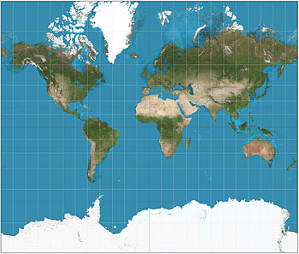
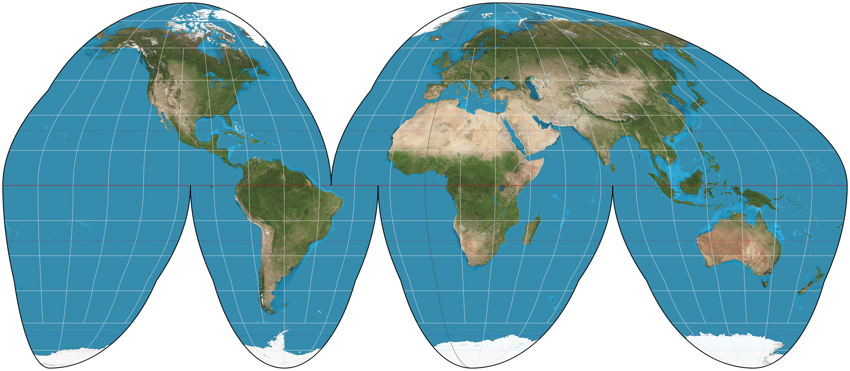
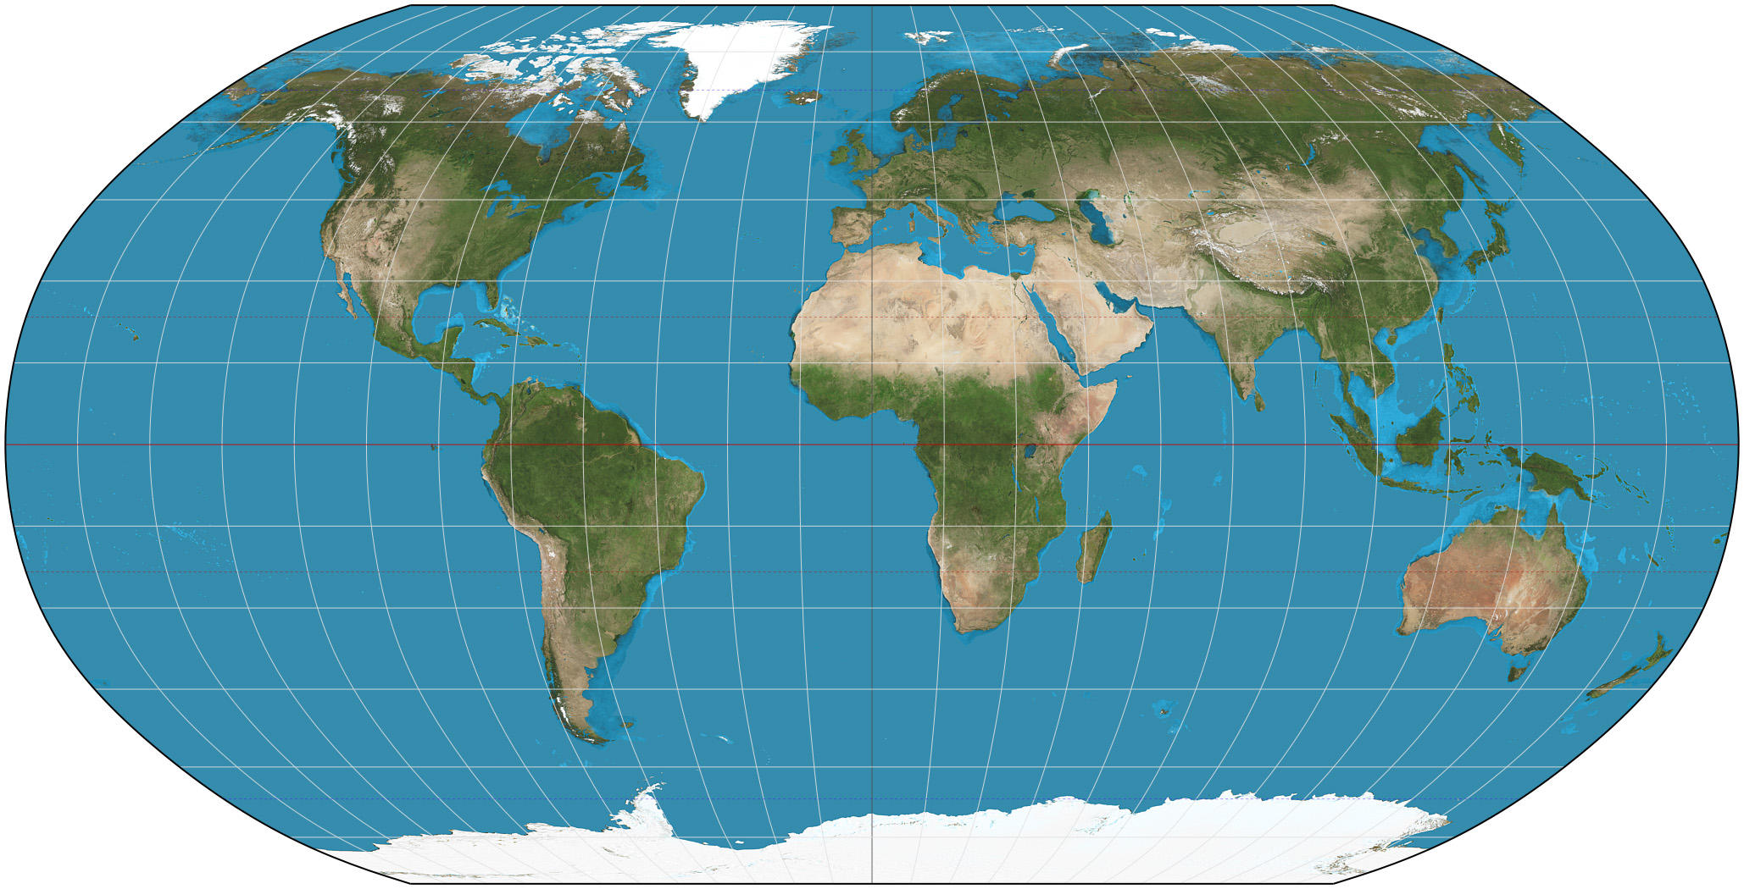
Map Projections
Mercator
Homolosine
Robinson
Etc..

Slide 45
Map: Load Data
d3.queue()
.defer(d3.csv, "/data/chocolate.csv”,
function(data, i) {
return {
id: i,
company: data["Company"],
name: data["Name"],
ref: data["Ref"],
percent: data["Cocoa Percent"],
loc: data["Company Location"],
origin: data["Broad Bean Origin"],
type: data["Bean Type"],
};
});
.defer(d3.json, "custom.geo.json”)
.await(anaylse);

Slide 46
Map: Transforming the Dataset
function analyse(error, dataset, world_map) {
map.selectAll("path")
.data(world_map.features)
.enter()
.append("path")
.attr("d", path)
.classed("country", true);
all_countries = [];
dataset.forEach(function(element) {
var bin_name = element["loc"];
if(all_countries[bin_name]){
all_countries[bin_name] = all_countries[bin_name]+1;
}else{
all_countries[bin_name] = 1;
};
});
countries = Object.keys(all_countries);

Slide 47
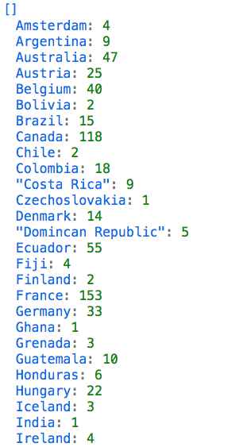
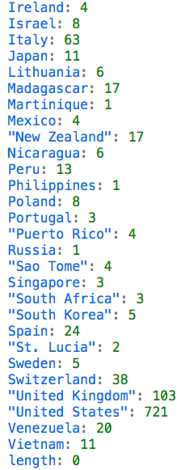
Map: Transforming the Dataset

Slide 48
Map: Colouring the map
var max_data =
d3.max(countries, function(d){return all_countries[d];})
var color = d3.scaleQuantize()
.domain([0, max_data])
.range(d3.schemeReds[9]);
map.selectAll("path")
.style("fill", function(d) {
var val = all_countries[d.properties.name];
d.visVal = val;
if (val) {
return color(val);
}
});
}
</script>
</body>

Slide 49
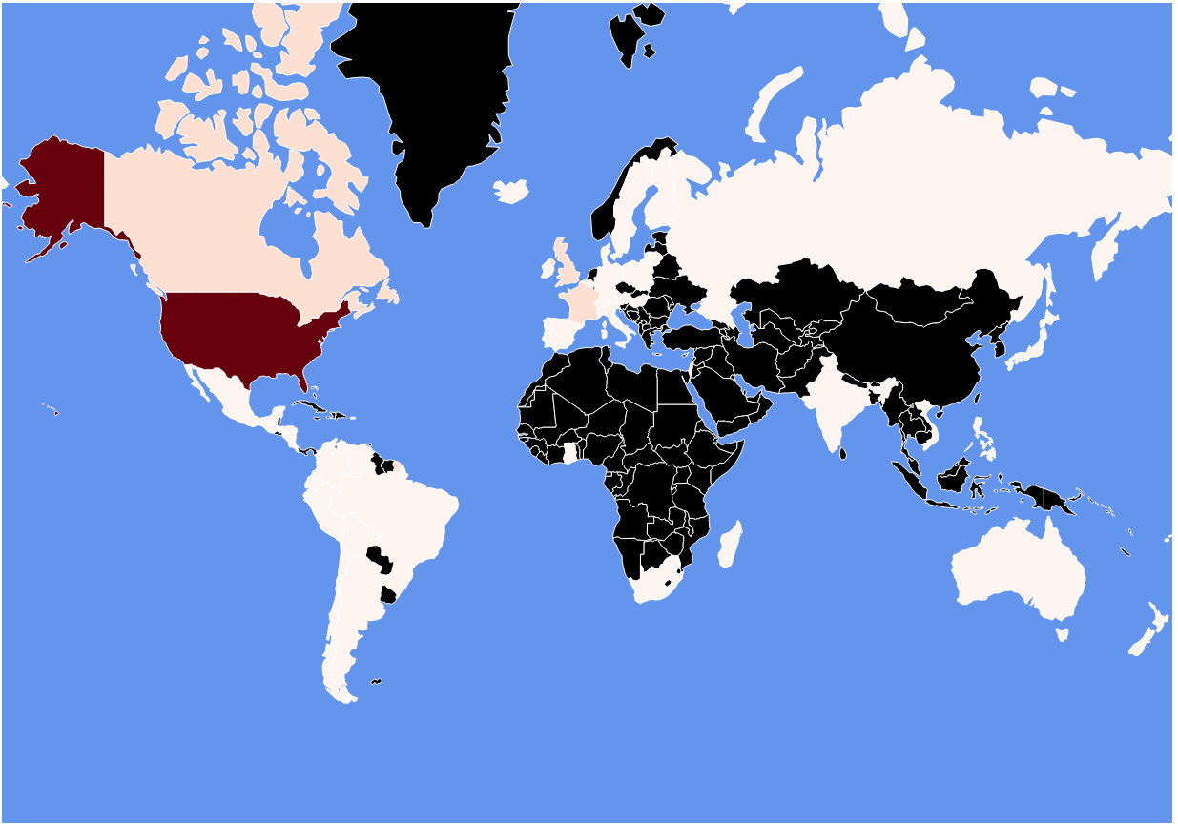

Slide 50
Map: Tooltip Style
<style type="text/css">
.leaflet-container{background-color:#c5e8ff;}
#map svg { background-color: cornflowerblue}
path.country{stroke:white; stroke-width: 1; fill: rgb(0,0,0)}
path.active{stroke-width: 5}
div.tooltip {
position: absolute;
text-align: center;
width: 60px;
padding: 2px;
font: 12px sans-serif;
background: lightsteelblue;
border: 0px;
border-radius: 8px;
pointer-events: none;
opacity: 0;
}
div.tooltip.active {
opacity: 0.9;
}
</style>

Slide 51
Map: Adding a tooltip
<body>
<div id="map" style="width: 1227px; height: 860px"></div>
<div id="map_tooltip" class="tooltip" ></div>

Slide 52
Map: Adding Interactivity to a Path
map.selectAll("path")
.data(world_map.features)
.enter()
.append("path")
.attr("d", path)
.classed("country", true)
.on("click", function(d) {
updateSelected(this, d);
});

Slide 53
Map: Updating Tooltip
function updateSelected(el, data){
// selecting and unselecting
if(d3.select(el).classed("active")){
d3.select(el).classed("active", false);
d3.select("#map_tooltip").classed("active",false);
return;
}
// reset all selections and activate clicked path
map.selectAll("path.active").classed("active", false);
d3.select(el).classed("active", true);
// text for tooltip
var msg = data.properties.name;
if (data.visVal) { msg += "<br/>"+data.visVal; }
// sets tooltip content, location, and visible
d3.select("#map_tooltip").html(msg)
.style("left", (d3.event.pageX) + "px")
.style("top", (d3.event.pageY - 28) + "px");
d3.select("#map_tooltip").classed("active",true);
}

Slide 54
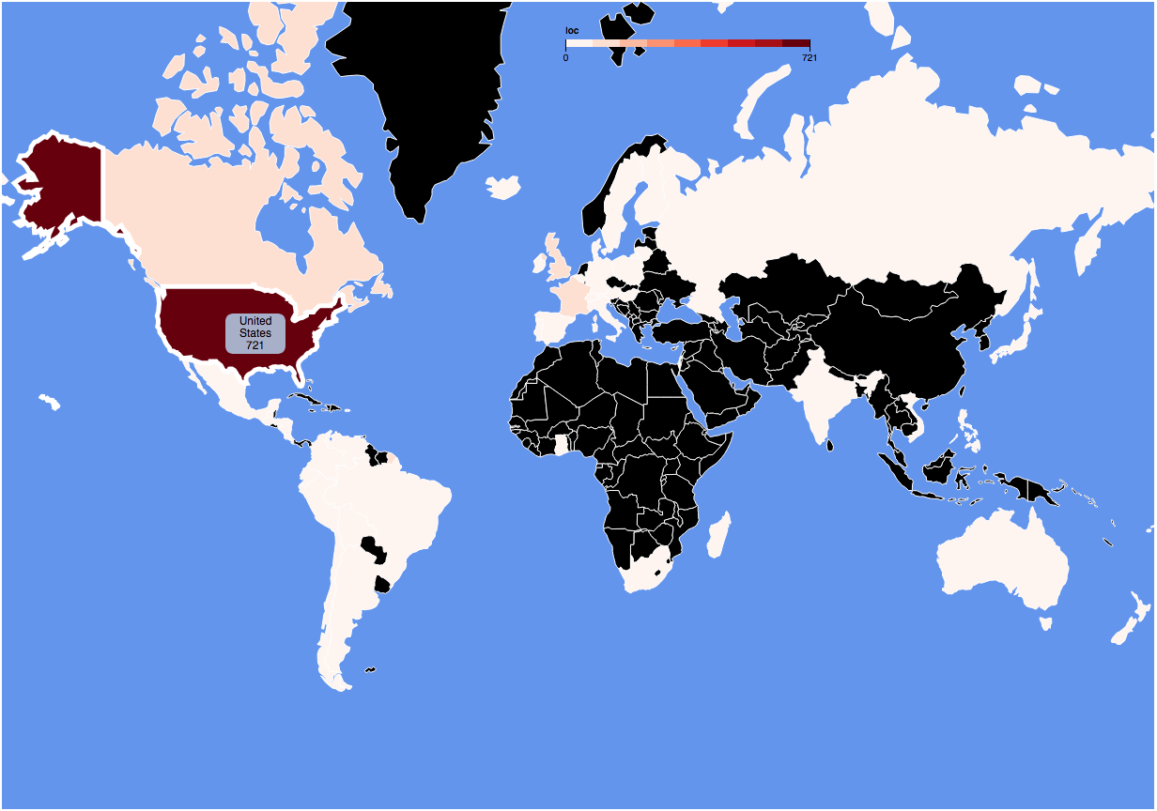
Screen shot

Slide 55
Map: Adding Radio Button
<body>
<div id="map" style="width: 1227px; height: 860px"></div>
<div id="map_tooltip" class="tooltip" ></div>
<div id="radio_button" class="radio">
<form>
<input type="radio" name="choco" checked value="loc">Company Location
<input type="radio" name="choco" value="origin”>Bean Origin
</form>
</div>

Slide 56
Map: Updating Map Colours
updateChoroplethColours();
d3.select("#radio_button form").on("change", updateChoroplethColours);
function updateChoroplethColours() {
all_countries = [];
var column_name = d3.select('input[name="choco"]:checked')
.node().value;
dataset.forEach(function(element) {
var bin_name = element[column_name];
if(all_countries[bin_name]){
all_countries[bin_name] = all_countries[bin_name]+1;
}else{
all_countries[bin_name] = 1;
};
});

Slide 57
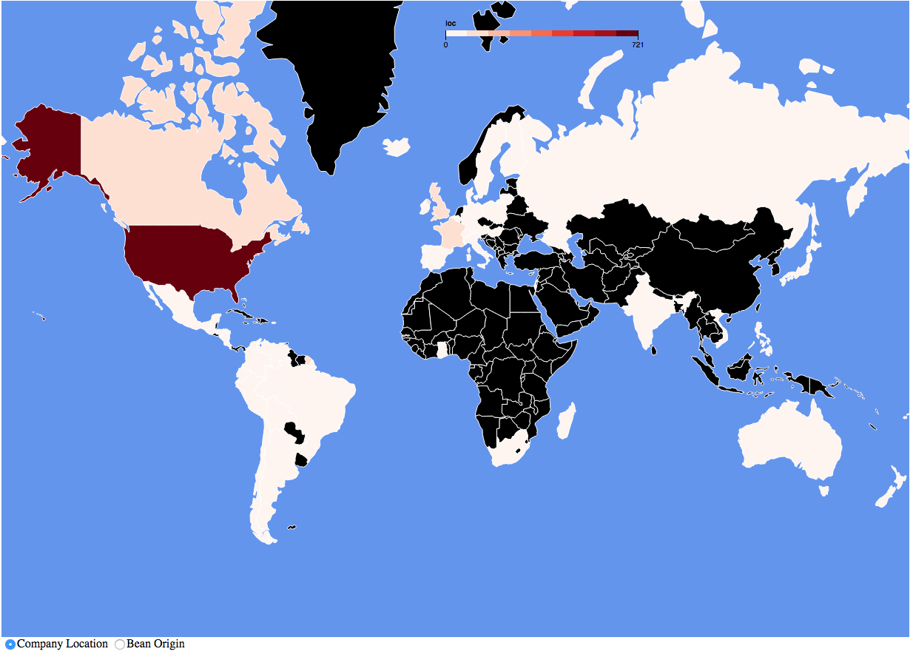

Slide 58
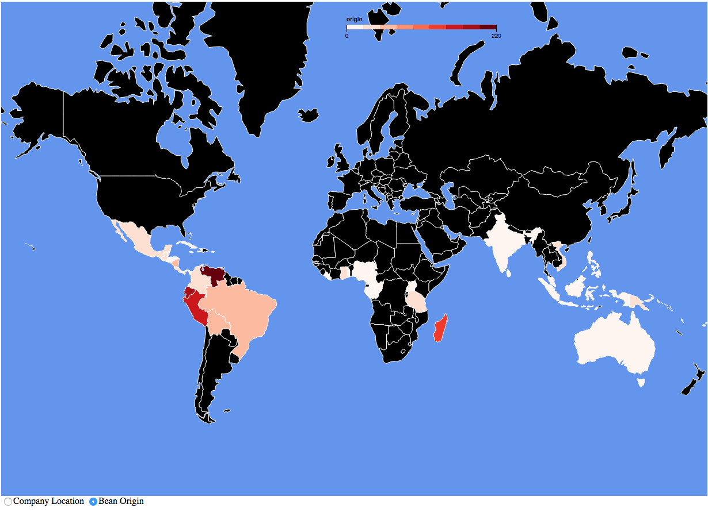

Slide 59
Other D3

Slide 60
D3 layouts
D3 layouts take data and transform it for a specific visual task
Main layouts
Bundle
Chord
Cluster
Force
Histogram
Pack
Partition
Pie
Stack
Tree
Treemap
Other more specific layouts are available

Slide 61
Pie Chart

Slide 62
Bubble Chart

Slide 63
Force-Directed Graph
https://bl.ocks.org/mbostock/4062045

Slide 64
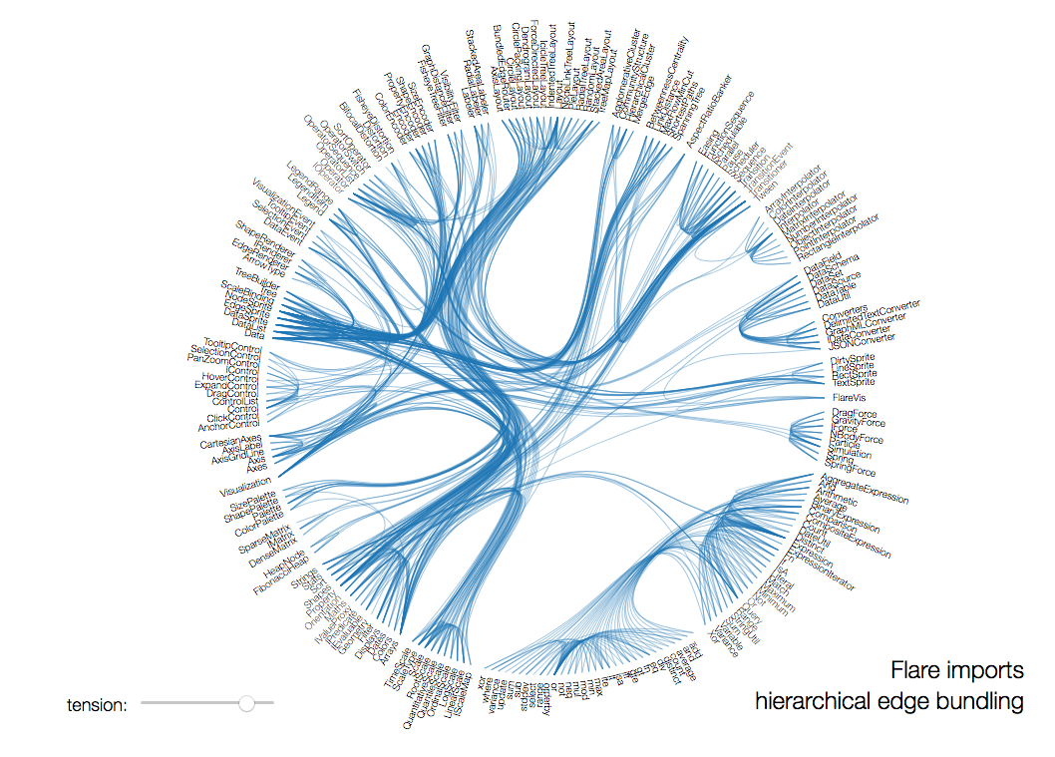
Chord Chart
http://mbostock.github.io/d3/talk/20111116/bundle.html

Slide 65
D3 Conclusions
Powerful visualisation library
Many types of visualisation
Plenty of tools and supporting libraries
Examples to borrow from

