Slide 1
Black Boxes and Abstraction or
A quick run through how computers work
Hugh Davis
Learning Societies Lab
ECS
The University of Southampton, UK
users.ecs.soton.ac.uk/hcd

Slide 2

What are Computers
Computers deal with (binary) numbers
They can store numbers
They can add, subtract, multiply and divide numbers
It can do logical operations (and/or/xor/not) on numbers
And compare numbers
  And depending on the result they can choose to execute one bit of code or another
That’s about it!
The rest is down to coding– we
have to represent the world in numbers

Slide 3
This Lecture
The purpose of this lecture is to give you a very quick understanding of what’s “under the hood”
At the same time we are going to see how computer scientists, having designed a working component then abstract it as a “black box” – and are no longer interested in what happens inside
  This approach was inspired by Andrew Tanenbaum’s “Structured Computer Organisation”

Slide 4
Prerequisit
ANY Number can be represented in binary (base 2)
Thus the number
11010₂ represents
1 * 2⁴ + 1 * 2³ + 0 * 2² + 1 * 2¹ + 0 * 2⁰
= 16 + 8 + 0 + 2 + 0
= 26₁₀
Because binary numbers can be long and difficult for humans, they are often represented in Octal or Hexedcimal
= 32₈
= 1A H
This is all covered in Chapter 1 of Brookshear

Slide 5
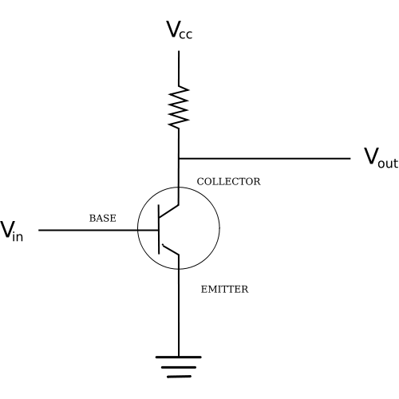
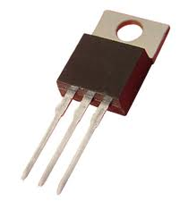
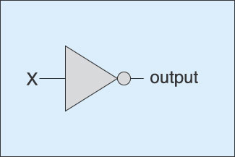
The Transistor
When there is no Voltage at V_{in} the transistor will not conduct.
So V_{out} will be same a V_{CC}
When a voltage is applied at Vin this will cause the transistor to conduct. Now V_{out} will be 0
So we have the following
Vin Vout
0 1
1 0
In the world of Logic this
is known as a NOT gate
and represented thus:

Slide 6
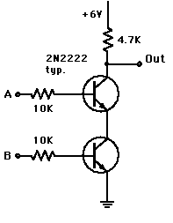
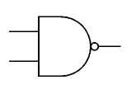
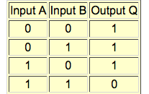
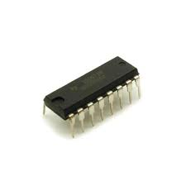
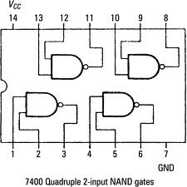
The NAND Gate
TTL chips integrate a number of transistors on a chip like this one.

Slide 7
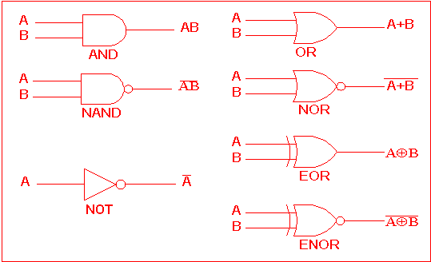
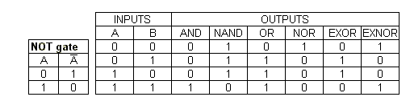
More Logic
You can make any logic gate from transistors in the same way as the NAND gate

Slide 8
Computers 101
To make a computer we are going to need to do a few essential things
  Compare numbers (if statements, branching relies on comparison)
  Add numbers
  Multiply/divide Numbers
  Store numbers

Slide 9
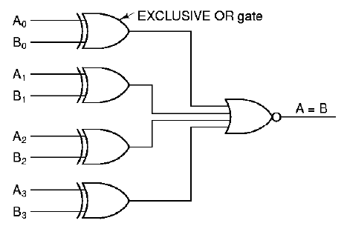
4 Bit Comparator
This circuit will return a 1 if the 4 bit number A is the same as the 4 bit number B

Slide 10
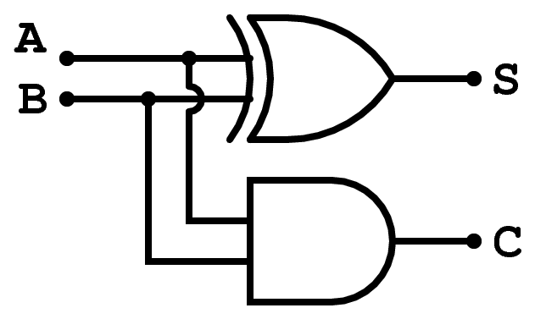
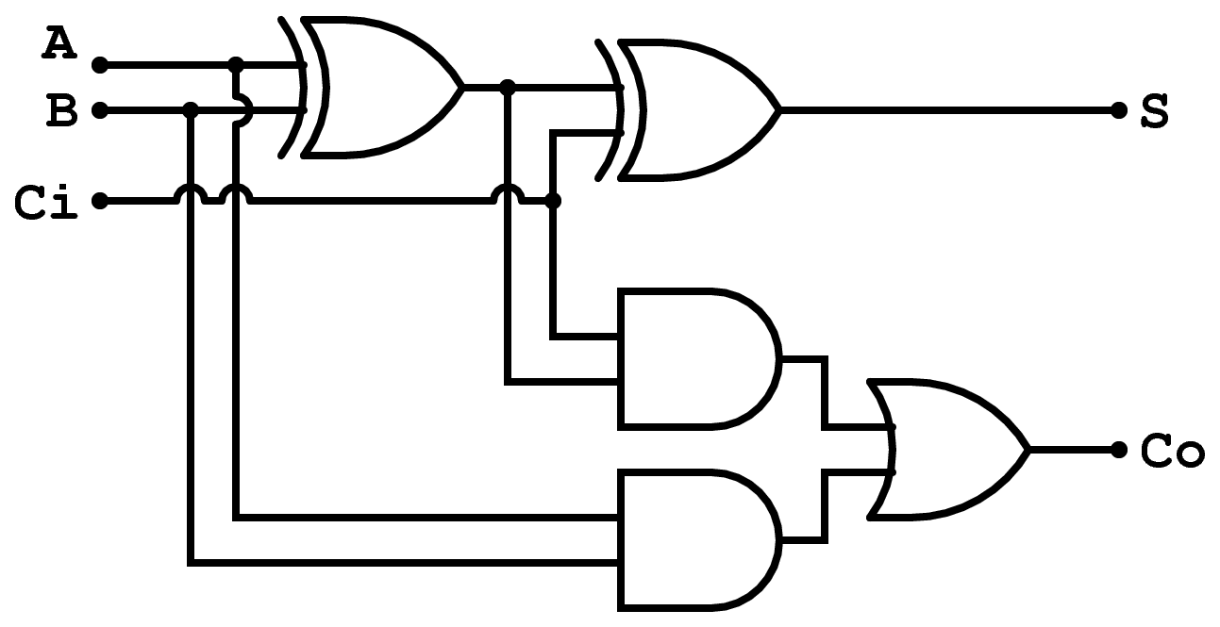
Adding
This half adder adds a
A and B and produces a SUM (S) and a CARRY (C)
This Full adder takes two bits A and B plus AND a Carry IN (Ci) and produces the SUM and Carry Out

Slide 11
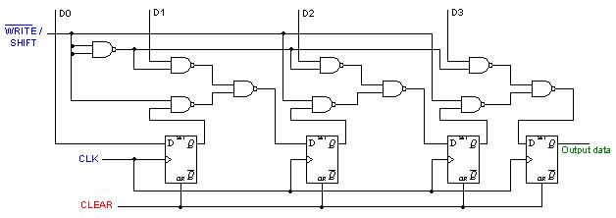
Multiplication
Multiplication is achieved by shifting. A shift 2 the left is multiplication by 2. A shift to the right is division by 2
0101 * 2 = 1010

Slide 12
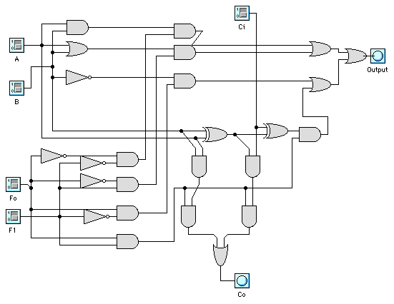
A 1 Bit ALU
F0 F1 Output
===============
0 0 A and B
0 1 A or B
1 0 Not B
1 1 A + B (with Carry)

Slide 13
A 1 Bit ALU
F0 F1 Output
===============
0 0 A and B
0 1 A or B
1 0 Not B
1 1 A + B (with Carry)
0
0

Slide 14
A 1 Bit ALU
F0 F1 Output
===============
0 0 A and B
0 1 A or B
1 0 Not B
1 1 A + B (with Carry)
0
1

Slide 15
A 1 Bit ALU
F0 F1 Output
===============
0 0 A and B
0 1 A or B
1 0 Not B
1 1 A + B (with Carry)
1
0

Slide 16
A 1 Bit ALU
F0 F1 Output
===============
0 0 A and B
0 1 A or B
1 0 Not B
1 1 A + B (with Carry)
1
1

Slide 17
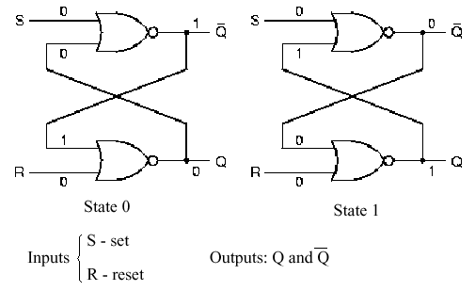
Memory
Memory can be made using a Latch – which will normally be clocked.
This latch remembers whether the last pulse was on S or R and remains in that state even when the pulse has gone
http://www.youtube.com/watch?v=7ruz82XpdUY&feature=related

Slide 18
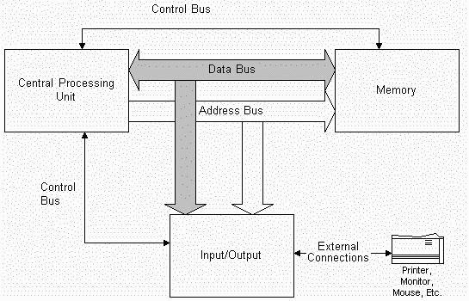
Making a Computer
Now we have all the components to make the Arithmetic Logic Unit of a computer and the memory.
In Memory is a stored program and data.
The CPU has an Accumulator and a Program Counter (the address of the next instruction)

Slide 19
Low Level Instructions
Our 1 bit ALU had 4 instructions. Real processors have many more instructions, and rather than remembering the number for each of these instructions we tend to remember mnemonics
LOAD <value > LOAD <address> | Place the value or the contents of the address named in the accumulator.
STORE <address> | Place the contents of the accumulator in the address
JUMP <address> | Put address into the Program Counter
JINEG <address> | Put address into the Program Counter if the accumulator contains a negative value.
JIZERO <address> | Put address into the Program Counter if the accumulator contains zero.
ADD <value> ADD <address> | Add the value or the contents of the address to the accumulator.
SUB, MULT and DIV | As with ADD

Slide 20
Fetch Execute Cycle
The contents of the PC are put on address bus
The PC is incremented
Memory responds by fetching the contents of that address and returning along the data bus
The CPU decodes that data as an instruction
The CPU decodes and executes that instruction (which might involve moving more data from to or from memory)
See YouTube Video

Slide 21
High Level Languages
Writing programs in machine code is difficult
  You need to know the instruction set of the target machine
  Dealing with representations of real numbers is complex
  You have to think about how things are organized in memory rather than how to solve the problem.
So we invent “high level languages” which allow us to concentrate on the problem (and move the program to any target machine that has a compiler)
Initial High Level languages had facilities targeted to the problem domain (e.g. COBOL, FORTRAN, ALGOL, LISP)
More recently languages have tended to reflect the “paradigm” (Imperative structured, functional, declarative, object oriented) which represent different preferences and approaches to software engineering and problem solving.

Slide 22
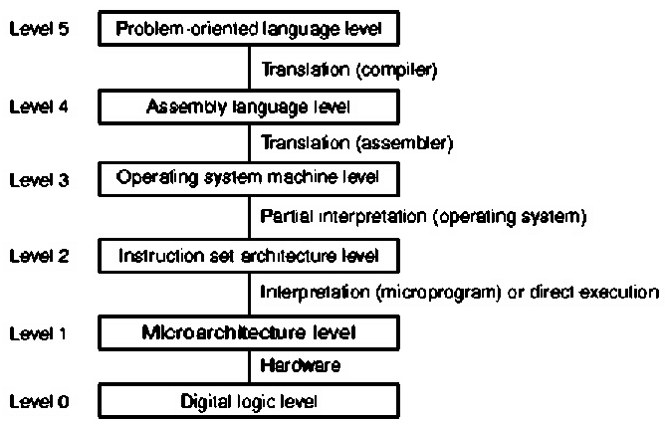
Successive Language Abstractions

