Slide 1
The NEW WEB literacy: Part II
David Millard
dem@soton.ac.uk

Slide 2
Literacy, n.
“The quality or state of being literate; knowledge of letters; condition in respect to education, esp. ability to read and write.”
- The Oxford English Dictionary
Discussion (5 min)
In small groups (3-4) what are the types of digital literacy that you can think of (skills concerning the use of ICT and Web 2.0 technology)?

Slide 3
What is Digital Literacy?
Exploring new technological concepts in a flexible way
Technological
Interacting through ICT in a responsible way
Ethical
Cognitive
Access, selection and critical evaluation of information
Adapted from: Calvani, A., Fini, A., and Ranieri, M. (2009). Assessing Digital Competence in Secondary Education – Issues, Models and Instruments. (M. Leaning, Ed.) Issues in Information and Media Literacy: Education, Practice and Pedagogy , 153-172.

Slide 4
What is Digital Literacy?
Digital Literacy is the awareness, attitude and ability of individuals to appropriately use digital tools and facilities to identify, access, manage, integrate, evaluate, analyse and synthesize digital resources, construct new knowledge, create media expressions, and communicate with others, in the context of specific life situations, in order to enable constructive social action; and to reflect upon this process.
LEVEL 3: Digital Transformation
(innovation/creativity)
LEVEL 2: Digital Usage
(professional/discipline application)
LEVEL 1: Digital Competence
(skills, concepts, approaches, attitudes, etc.)
Adapted from: Martin, A., Grudziecki, J. (2006). DigEuLit: Concepts and Tools for Digital Literacy Development, University of Glasgow, Scotland.

Slide 5
Digital Literacy
Eshet-Alkalai. Digital Literacy: A Conceptual Framework for Survival Skills in the Digital Era. Journal of Educational Multimedia and Hypermedia (2004) vol. 13 (1) pp. 93-106

Slide 6
Photo-Visual Literacy
"helps them to “read” intuitively and freely, and to understand the instructions and messages represented visually. People with photo-visual literacy have good visual memory and strong intuitive-associative thinking, which help them decode and understand visual messages easily and fluently."
Photo/Visual
Digital Literacy
Eshet-Alkalai. Digital Literacy: A Conceptual Framework for Survival Skills in the Digital Era. Journal of Educational Multimedia and Hypermedia (2004) vol. 13 (1) pp. 93-106

Slide 7
Reproduction Literacy
"Digital reproduction literacy is the ability to create a meaningful, authentic, and creative work or interpretation, by integrating existing independent pieces of information."
Photo/Visual
Reproduction
Digital Literacy
Eshet-Alkalai. Digital Literacy: A Conceptual Framework for Survival Skills in the Digital Era. Journal of Educational Multimedia and Hypermedia (2004) vol. 13 (1) pp. 93-106

Slide 8
Branching/Hypermedia Literacy
"People with good branching literacy are characterized by a good sense of multidimensional spatial orientation, that is, the ability to avoid loosing orientation when surfing through the labyrinth of lanes that characterizes the hyperspace."
Photo/Visual
Reproduction
Digital Literacy
Branching/
Hypermedia
Eshet-Alkalai. Digital Literacy: A Conceptual Framework for Survival Skills in the Digital Era. Journal of Educational Multimedia and Hypermedia (2004) vol. 13 (1) pp. 93-106

Slide 9
Information Literacy
"refers to the cognitive skills that consumers use to evaluate information in an educated and effective manner. Information literacy works as a filter: it identifies erroneous, irrelevant, or biased information […]
Information-literate people think critically, and are always ready to doubt the quality of information. They are not tempted to take information for granted, even when it seems ‘authoritative’ and valid."
Photo/Visual
Reproduction
Digital Literacy
Branching/
Hypermedia
Eshet-Alkalai. Digital Literacy: A Conceptual Framework for Survival Skills in the Digital Era. Journal of Educational Multimedia and Hypermedia (2004) vol. 13 (1) pp. 93-106
Information

Slide 10
Socio-Emotional Literacy
"socio- emotionally-literate users can be described as those who are willing to share data and knowledge with others, capable of information evaluation and abstract thinking, and able to collaboratively construct knowledge"
Photo/Visual
Reproduction
Digital Literacy
Socio-Emotional
Branching/
Hypermedia
Eshet-Alkalai. Digital Literacy: A Conceptual Framework for Survival Skills in the Digital Era. Journal of Educational Multimedia and Hypermedia (2004) vol. 13 (1) pp. 93-106
Information

Slide 11
In experiments which generations come out the strongest in these areas?
Photo/Visual
Reproduction
Digital Literacy
Socio-Emotional
Branching/
Hypermedia
Eshet-Alkalai. Digital Literacy: A Conceptual Framework for Survival Skills in the Digital Era. Journal of Educational Multimedia and Hypermedia (2004) vol. 13 (1) pp. 93-106
Information

Slide 12
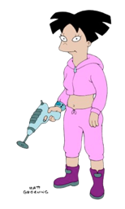
Older
Photo/Visual
Reproduction
Digital Literacy
Younger
Socio-Emotional
Branching/
Hypermedia
Eshet-Alkalai & Amichai - Hamburger (2004). Experiments with digital literacy. Cyber Psychology, 7 (4): 425-434
Eshet-Alkalai, Y. and Chaiut, E. (2005). Living books: On the acquisition of digital skills in multimedia environments. Learning in the Technology Era. Proc. of the Chais Conference, The Open University of Israel, Raanana,
Information

Slide 13
Digital Natives: The Experimental Evidence
False
No Evidence
True
Williams and Rowlands. Information behaviour of the researcher of the future. British Library / JISC Study (2007)

Slide 14
Digital Natives: The Experimental Evidence
False
Prefer Visual
Prefer Interactive
More Impatient
Trust Peers over Experts
Better at Learning by Doing
Only Learn in Short Chunks
See Virtual Reality as Reality
No Evidence
True
Williams and Rowlands. Information behaviour of the researcher of the future. British Library / JISC Study (2007)

Slide 15
Digital Natives: The Experimental Evidence
False
Prefer Visual
Prefer Interactive
More Impatient
Trust Peers over Experts
Better at Learning by Doing
Only Learn in Short Chunks
See Virtual Reality as Reality
No Evidence
Prefer Typing
Better at Multitasking
More (Web) Connected
Are Format Agnostic
True
Williams and Rowlands. Information behaviour of the researcher of the future. British Library / JISC Study (2007)

Slide 16
Digital Natives: The Experimental Evidence
False
Prefer Visual
Prefer Interactive
More Impatient
Trust Peers over Experts
Better at Learning by Doing
Only Learn in Short Chunks
See Virtual Reality as Reality
No Evidence
Prefer Typing
Better at Multitasking
More (Web) Connected
Are Format Agnostic
True
Lack of Respect for Intellectual Property
Williams and Rowlands. Information behaviour of the researcher of the future. British Library / JISC Study (2007)

Slide 17
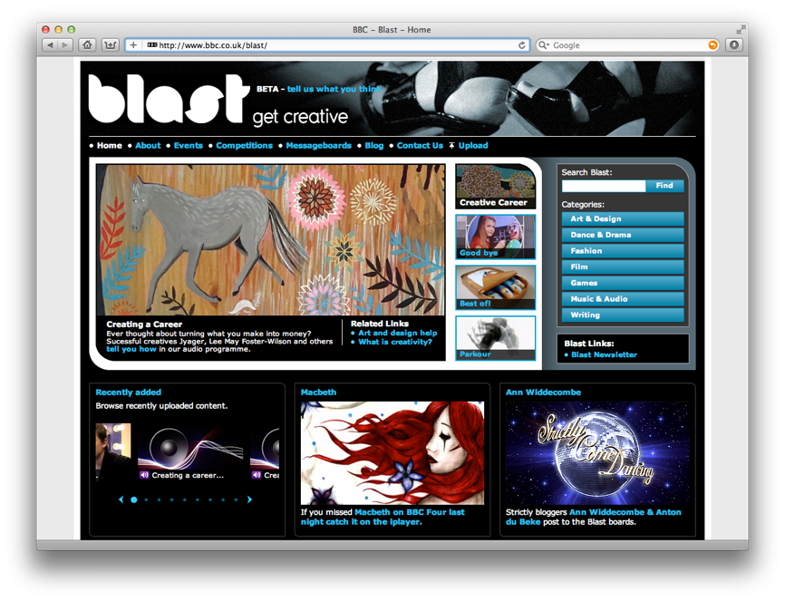
BBC Website where teenagers could engage with and share creative projects in fashion, art, film and media
“Adult organizers of Blast, the web designers, wider policy initiatives, youth arts, and pedagogy, all seem to assume a straightforward relationship between technological knowledge and the production of content.”
Helen Thornham, Angela McFarlane, ‘Discourses of the Digital Native’, Information, Communication & Society Vol. 14, Iss. 2, 2010

Slide 18
But study showed:
Technical Proficiency not a motivator for participation
Simplistic stand alone assertions over discussion or interaction
Productive contribution only happens when there is an incentive
“the presumption of ability or enthusiasm by the organizers and designers ultimately work as a barrier to actual engagement.”
Helen Thornham, Angela McFarlane, ‘Discourses of the Digital Native’, Information, Communication & Society Vol. 14, Iss. 2, 2010

Slide 19
Digital Natives considered harmful?

Slide 20
people engage somewhere on this continuum depending on their task and context
Digital Visitors
Digital Residents
Have defined tasks
Use tools JIT to help
Anonymous
Online to connect to people
Online identity is important
Are perceived as present
The Web is a tool
A mindset, not a skillset
The Web is a place
David S. White, Alison Le Cornu, Visitors and Residents: A new typology for online engagement, First Monday Volume 16, Number 9 (2011)

Slide 21
Pragmatism
Benefit | Example
Logistics | schedules, timetables, deadlines
Flexibility of Place | remote working
Time-saving | online assignment submission
Reviewing/Revising | catch up on missed content
Research | searching for resources
Support Basic Tasks | word processing, internet search
Collaborating | Facebook, Google docs
Augmenting University Materials | YouTube tutorials, Wikipedia
Different Views | videos, animation, annotation
Cost Saving | e-readers, online journals
Michael Henderson, Neil Selwyn & Rachel Aston (2017) What works and why? Student perceptions of ‘useful’ digital technology in university teaching and learning, Studies in Higher Education, 42:8,

Slide 22
Pragmatism
“While these data confirm digital technologies as central to the ways in which students experience their studies, they also suggest that digital technologies are not ‘transforming’ the nature of university teaching and learning. ”
Michael Henderson, Neil Selwyn & Rachel Aston (2017) What works and why? Student perceptions of ‘useful’ digital technology in university teaching and learning, Studies in Higher Education, 42:8,

Slide 23
Pragmatism
“While these data confirm digital technologies as central to the ways in which students experience their studies, they also suggest that digital technologies are not ‘transforming’ the nature of university teaching and learning. ”
“Put bluntly, then, the rather limited sets of digital practices highlighted in our data are those that best ‘fit’ the rather limited expectations and processes that currently constitute university teaching and learning.”
Michael Henderson, Neil Selwyn & Rachel Aston (2017) What works and why? Student perceptions of ‘useful’ digital technology in university teaching and learning, Studies in Higher Education, 42:8,

Slide 24
Digital Visitors
“While these data confirm digital technologies as central to the ways in which students experience their studies, they also suggest that digital technologies are not ‘transforming’ the nature of university teaching and learning. ”
Have defined tasks
Use tools JIT to help
Anonymous
The Web is a tool
Digital Residents
“Put bluntly, then, the rather limited sets of digital practices highlighted in our data are those that best ‘fit’ the rather limited expectations and processes that currently constitute university teaching and learning.”
Online to connect to people
Online identity is important
Are perceived as present
The Web is a place

Slide 25
Schoolkids and Social Media
Networked
Dyadic
Individual
Blair R. (2018). Exploring the barriers to use of social media in support of non-formal learning by pupils attending secondary education in UK: A mixed method approach. Thesis, Uni of Southampton, UK

Slide 26
Schoolkids and Social Media
Pupil
Social Capital
Trust
Risk
User Interface
Response Time
Affordance
Blair R. (2018). Exploring the barriers to use of social media in support of non-formal learning by pupils attending secondary education in UK: A mixed method approach. Thesis, Uni of Southampton, UK

Slide 27
Schoolkids and Social Media
Pupil
Teacher
Social Capital
Trust
Pupil Welfare
Institutional Responsibility
Professional Status
Risk
User Interface
Response Time
Institutional Moderation
Affordance
Blair R. (2018). Exploring the barriers to use of social media in support of non-formal learning by pupils attending secondary education in UK: A mixed method approach. Thesis, Uni of Southampton, UK

Slide 28
Schoolkids and Social Media
Pupil
Teacher
Social Capital
Trust
Pupil Welfare
Institutional Responsibility
Professional Status
Literacy
Policy
Risk
User Interface
Response Time
Institutional Moderation
Technology
Affordance
Blair R. (2018). Exploring the barriers to use of social media in support of non-formal learning by pupils attending secondary education in UK: A mixed method approach. Thesis, Uni of Southampton, UK

Slide 29
The Big Picture

Slide 30
The Digital Literacy Iceberg - Deeper
Naïve
‘All true’
The Naïve View
“It accepts the basic assumption that what we are dealing with is a number of separate skills.”
Questions:
Are the skills inclusive?
Are the skills independent?
Are the skills compatible?
Are the skills innate?
Aviram A. and Eshet-Alkalai. Towards a theory of digital literacy: three scenarios for the next steps. European Journal of Open, Distance and E-learning (2006)

Slide 31
The Digital Literacy Iceberg - Deeper
Naïve
‘All true’
Moderate Skeptical View
"the literature on digital literacy should become part and parcel of the body of work on learning styles, multiple intelligences, or personality types.”
Questions:
What are the personality traits?
Should designers teach these skills, or design around them?
Moderate Skeptic
‘All in the mind’
Aviram A. and Eshet-Alkalai. Towards a theory of digital literacy: three scenarios for the next steps. European Journal of Open, Distance and E-learning (2006)

Slide 32
The Digital Literacy Iceberg - Deeper
Naïve
‘All true’
Skeptical View
“[these skills] represent two different cultures. [...] the transition of western societies from book-based, rational, individualistic culture to the digital, audio-visual, culture characterized by saturation or disintegration of the self.”
Question:
Should education strive to achieve the enhancement of post modern values, or rather the preservation of modern values?
Moderate Skeptic
‘All in the mind’
Skeptical
‘Clash of Civilisations’
Aviram A. and Eshet-Alkalai. Towards a theory of digital literacy: three scenarios for the next steps. European Journal of Open, Distance and E-learning (2006)

Slide 33
Questions…
?
David Millard | @hoosfoos | davidmillard.org

