Slide 1
The NEW WEB literacy: PART i
David Millard
dem@soton.ac.uk

Slide 2
Literacy, n.
“The quality or state of being literate; knowledge of letters; condition in respect to education, esp. ability to read and write.”
- The Oxford English Dictionary

Slide 3
This is a story about: Empowerment vs. Control, Teaching vs. Learning, Conservatives vs. Edupunks. Welcome to 21st Century E-Learning…

Slide 4
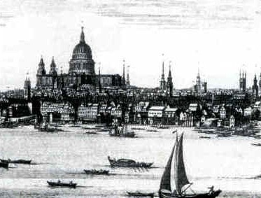
Consider the Nouveau Riche

Slide 5
Who are the Nouveau Technorati?

Slide 6
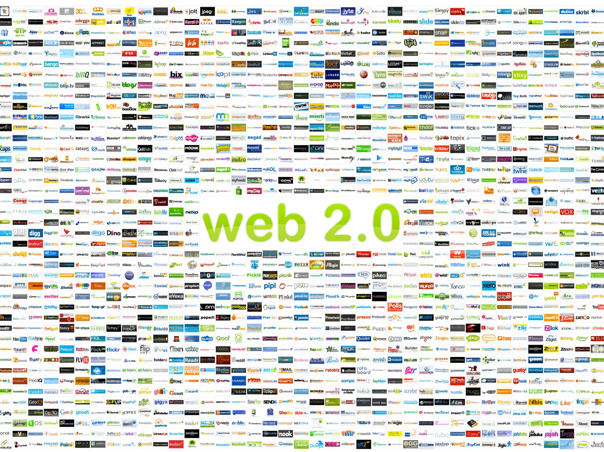
The New Web

Slide 7
"Who are these people? Seriously, who actually sits down after a long day at work and says, I'm not going to watch Lost tonight. I'm going to turn on my computer and make a movie starring my pet iguana? … Who has that time and that energy and that passion?”

Slide 8
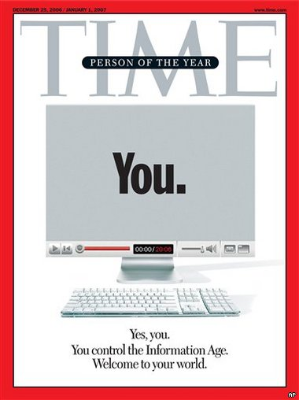
“The answer is, you do."
Time's Person of the Year: You
Wednesday, Dec. 13, 2006 By LEV GROSSMAN
http://www.time.com/time/magazine/article/0,9171,1569514,00.html

Slide 9
The Generation Game
Boomers
Gen-Xers
Millenials
Understanding the New Students,
Diana Oblinger, Educause Review Jul/Aug 2003

Slide 10
computers aren’t technology
reality no-longer real
typing rather than handwriting
multitasking way of life
internet better than TV
staying connected
nintendo over logic
The Information-Age Mindset,
Jason L. Frand, Educause Review Sept/Oct 2000

Slide 11
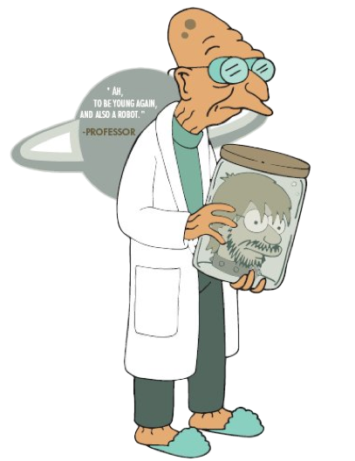
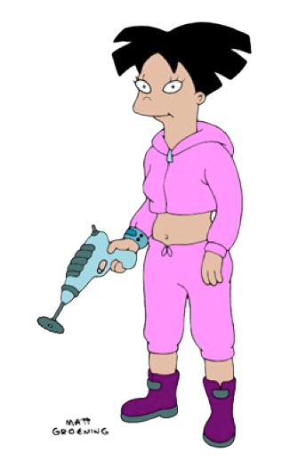
Digital Immigrants
Digital Natives
Passive Active
Serious Fun
Ordered Random Access
Prolonged Instant
Focused Multi-tasking
Individual Networked
Education Life
Digital Natives, Digital Immigrants
Marc Prensky, On the Horizon (NCB University Press, Vol. 9 No. 5, October 2001)

Slide 12
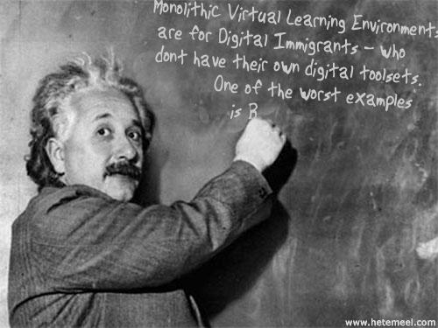
Virtual Learning Environments
http://generator.kitt.net/

Slide 13
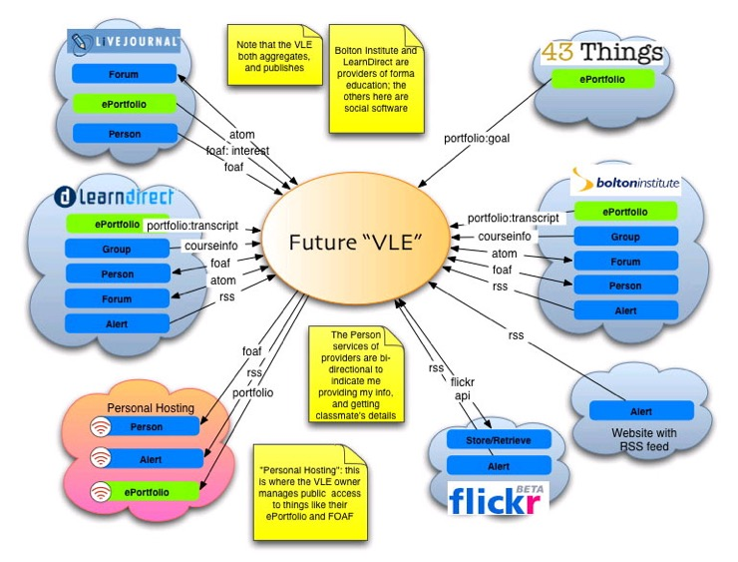
Future Learning Environments?
Scott Wilson, Future VLE (Personal Blog), Jan 2005
http://www.cetis.ac.uk/members/scott/blogview?entry=20050125170206

Slide 14
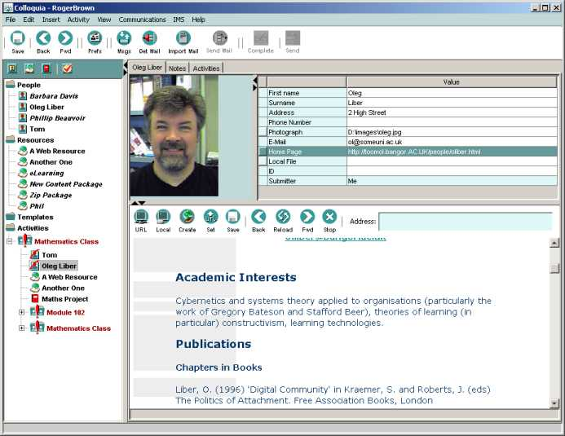
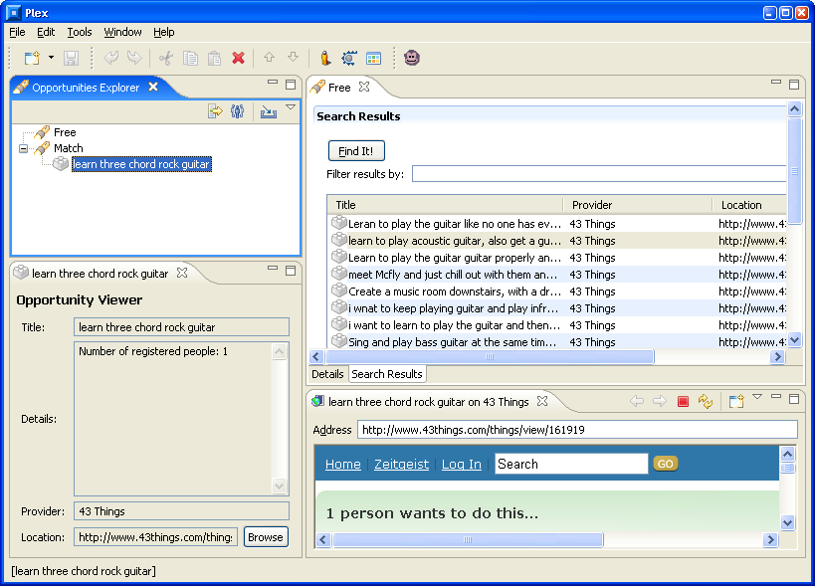
Colloquia
PERSONAL LEARNING ENVIRONMENTS
PLEX
University of Bolton
Phillip Beauvoir, Mark Johnson, Oleg Liber,
Colin Milligan, Paul Sharples and Scott Wilson (2005ish)
http://reload.ces.strath.ac.uk/plex/
Oleg Lieber, Colloquia - a Conversation Manager,
Campus Wide Information Systems, 17(2), pp 56-62, 2000

Slide 15
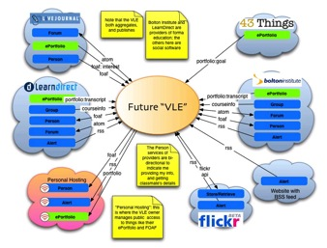
But Whose LE is it Anyway?
VLE
PLE
Web
Blackboard,
Moodle
Colloquia
PLEX, Elgg
NetVibes, Wikipedia
YouTube, Del.icio.us
Die LMS die! You too PLE!
Leigh Blackall, Personal Blog, Nov 2005
http://teachandlearnonline.blogspot.com/

Slide 16
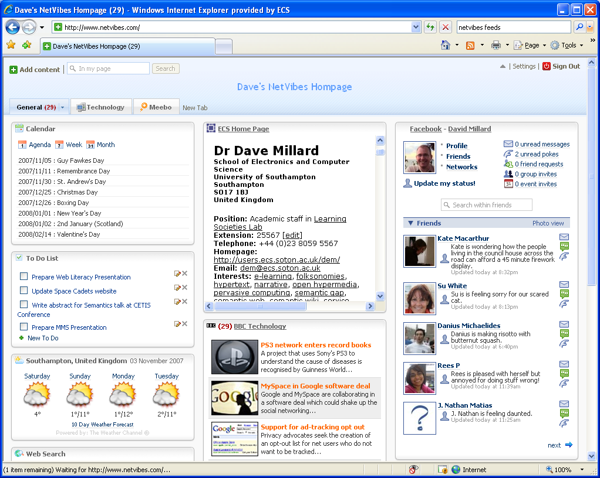

Slide 17
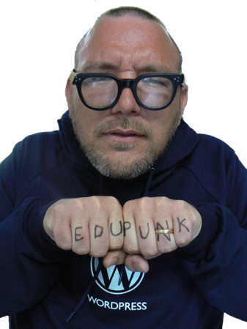
Jim Groom

Slide 18
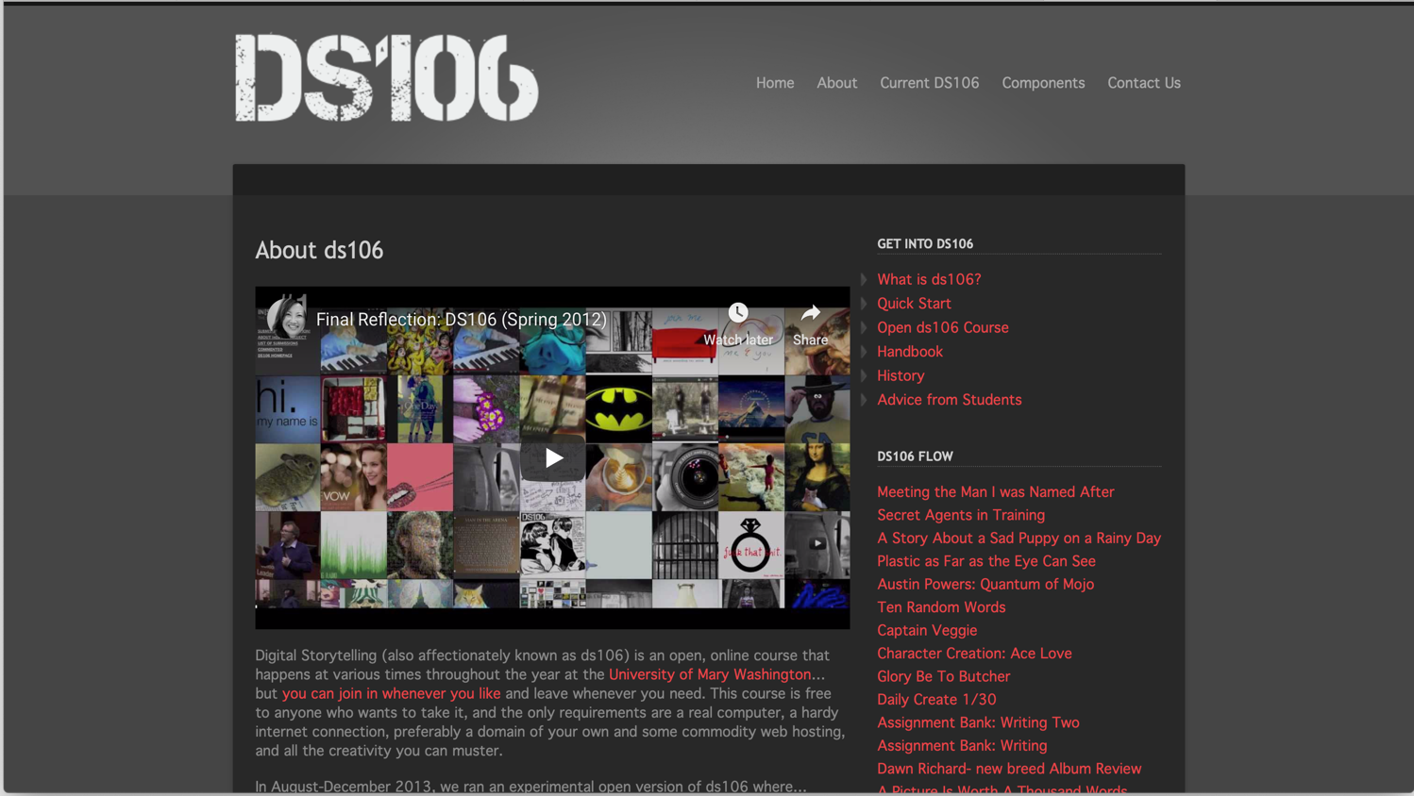
Notes:
Started in 2010 – Uni of Mary Washington, Virginia

Slide 19
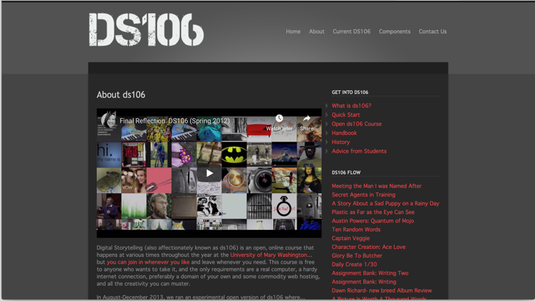
cMOOC
connectivism

Slide 20
A working group of Kansas State University students and faculty dedicated to exploring and extending the possibilities of digital ethnography.
A Vision of Students Today, Michael Wesch (2007). Slightly abridged

Slide 21
And Learning was Set Free!

Slide 22
And Learning was Set Free!
…or was it?

