Slide 2
COMP6215
Semantic Web Technologies
Dr Nicholas Gibbins - nmg@ecs.soton.ac.uk
2018-2019

Slide 3
Course Aims
Understand the key ideas and history behind the Semantic Web
Explain the state of the art in Semantic Web technologies
Gain practical experience of ontology design in OWL
Understand the future directions of the Semantic Web, and its relationship with other Web developments

Slide 4
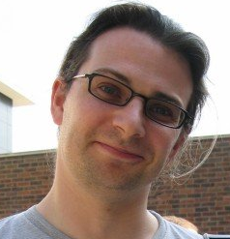
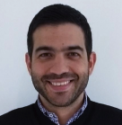
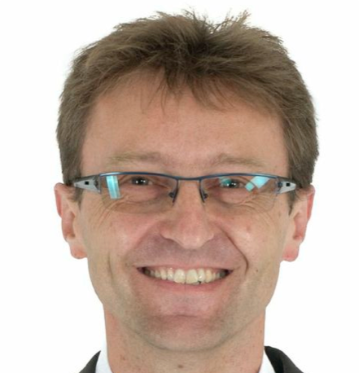
Lecturers
Dr Nicholas Gibbins
nmg@ecs.soton.ac.uk
Dr George Konstantinidis
g.konstantinidis@soton.ac.uk
Prof. Steffen Staab
srs2m14@ecs.soton.ac.uk

Slide 5
Course Structure
Three lectures per week:
Monday 1400 in 7/3023
Tuesday 0900 in 54/8031
Thursday 1500 in 7/3023

Slide 6
Teaching Schedule
Week 18: Introduction to the Semantic Web
Week 19: RDF and Linked Data
Week 20: Ontologies and RDF Schema
Week 21: Description Logics and OWL
Week 22: Ontology Engineering
Week 23: Design Patterns
Week 24: SPARQL
Week 25: Application Development

Slide 7
Teaching Schedule
Week 30: RDFa, POWDER and Microformats
Week 31: Rules and Ontology Mapping
Week 32: Streaming Data/Social Semantic Web
Week 33: Review

Slide 8
Assessment
Examination: 75% (120 minutes, 3 questions from 5)
Ontology design coursework: 25%
Specification published in week 23
Submission due week 30
Feedback due week 33

Slide 9
Introduction to the Semantic Web
Notes:
The World Wide Web was invented by Tim Berners-Lee (amongst others), a physicist working at CERN
TBL’s original vision of the Web was much more ambitious than the reality of the existing (syntactic) Web
TBL (and others) have since been working towards realising this vision, which has become known as the Semantic Web

Slide 10
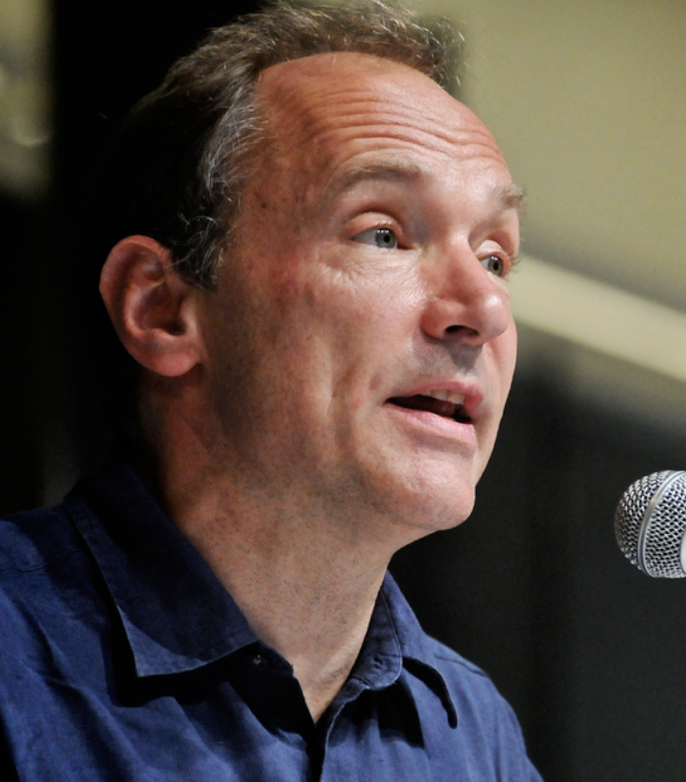
The World Wide Web:
Past, Present and Future
a goal of the Web was that, if the interaction between person and hypertext could be so intuitive that the machine-readable information space gave an accurate representation of the state of people's thoughts, interactions, and work patterns, then machine analysis could become a very powerful management tool, seeing patterns in our work and facilitating our working together
Berners-Lee, T. (1996) The World Wide Web: Past, Present and Future. https://www.w3.org/People/Berners-Lee/1996/ppf.html

Slide 11
Weaving the Semantic Web
I have a dream for the Web [in which computers] become capable of analyzing all the data on the Web – the content, links, and transactions between people and computers. A ‘Semantic Web’, which should make this possible, has yet to emerge, but when it does, the day-to-day mechanisms of trade, bureaucracy and our daily lives will be handled by machines talking to machines.
T. Berners-Lee (1999) Weaving the Web. San Francisco, CA: Harper

Slide 12

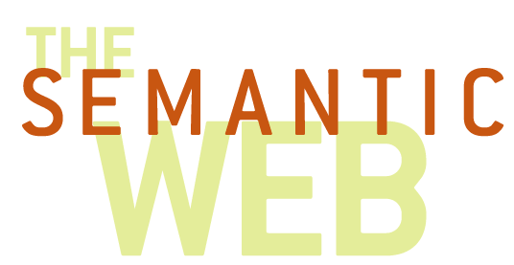
What is the Semantic Web?
“The goal of the Semantic Web initiative is as broad as that of the Web: to create a universal medium for the exchange of data. It is envisaged to smoothly interconnect personal information management, enterprise application integration, and the global sharing of commercial, scientific and cultural data. Facilities to put machine-understandable data on the Web are quickly becoming a high priority for many organizations, individuals and communities.
The Web can reach its full potential only if it becomes a place where data can be shared and processed by automated tools as well as by people.”
W3C (2013) Semantic Web Activity Statement. https://www.w3.org/2001/sw/Activity

Slide 13
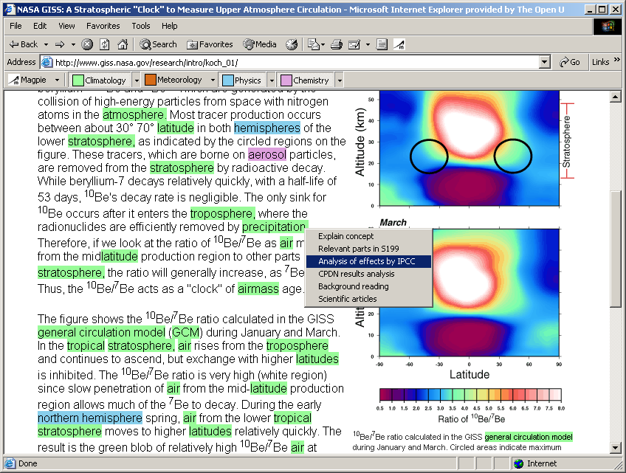
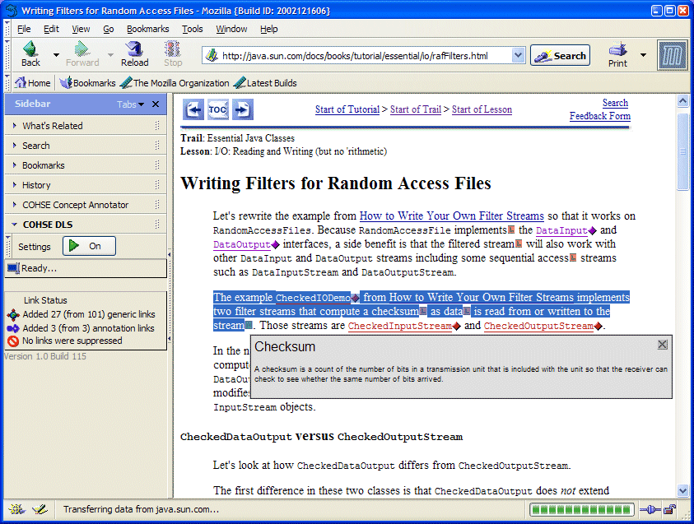
The Annotated Web
Add structure to unstructured data
  Annotate existing web pages
  Classify web pages
  Use natural language techniques to extract information from web pages
Annotations enable enhanced browsing and searching

Slide 14
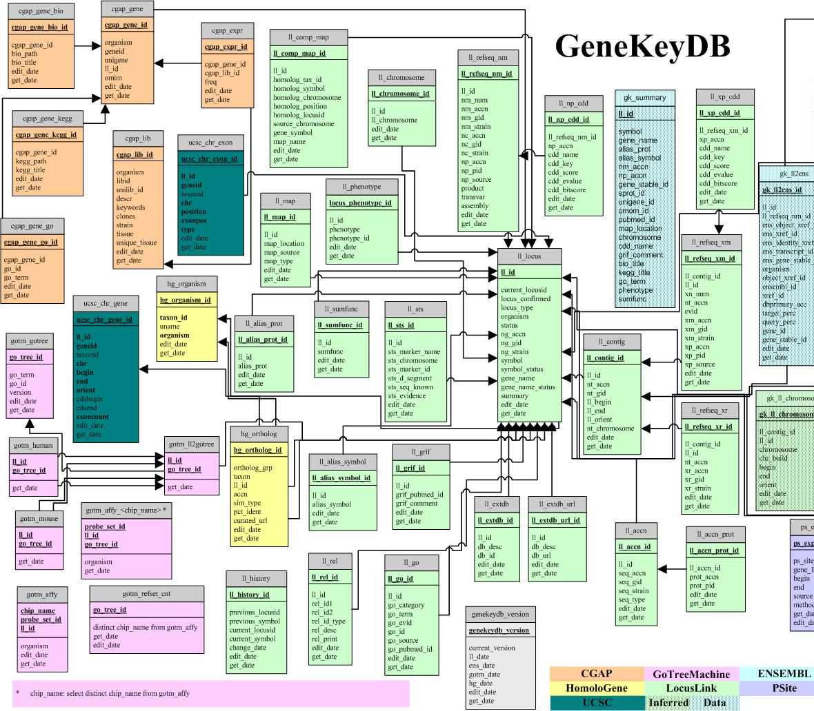
The Web of (Linked) Data
Make the most of the structure you already have
  Expose existing databases in a common format
  Express database schemas in a machine-understandable form
Common format allows the integration of data in unexpected ways
Machine-understandable schemas allow reasoning about data

Slide 15
Rocket Science (not)
Is this rocket science? Well, not really. The Semantic Web, like the World Wide Web, is just taking well established ideas, and making them work interoperably over the Internet. This is done with standards, which is what the World Wide Web Consortium is all about. We are not inventing relational models for data, or query systems or rule-based systems. We are just webizing them.
Berners-Lee, T. (2001) Business Model for the Semantic Web, http://www.w3.org/DesignIssues/Business

Slide 16
The Origins of the Semantic Web

Slide 17
Interwoven themes
Knowledge Based
Systems
Hypertext and
Hypermedia
Library and
Information
Science

Slide 18
Metadata
Metadata is data about data
  A webpage is data
  A description of the webpage is metadata
  Metadata for a webpage could include
    author
    date of publication
    file size
    …
Library cataloguing = metadata
Notes:
The origins of the Semantic Web lie in metadata
Early development of RDF (pre “Semantic Web”) heavily driven by librarians – web catalogues

Slide 19
Beyond metadata
The scope of the modern Semantic Web goes beyond bibliographic metadata for webpages
  Metadata is still just data
If we have an infrastructure for metadata, we can use it for data in general

Slide 20
Knowledge representation
Long-standing discipline within Artificial Intelligence
Knowledge representation languages should:
  Handle qualitative knowledge
  Allow new knowledge to be inferred
  Represent both the general and the specific
  Capture complex meaning
  Allow meta-level reasoning
RDF, RDF Schema and OWL are knowledge representation languages
Notes:
(the Semantic Web has a strong heritage!)

Slide 21
Knowledge representation
“Traditional” knowledge representation is formal logic
Network (graph-based) knowledge representation originated in 1960s with psychologists and linguists
action
bark
dog
brown
colour
is a
Fido
steak
eats
Notes:
Qullian – semantic networks
(also Minsky’s frames)
Nodes are objects or concepts
Edges are relations or associations

Slide 22
Vocabularies and ontologies
A knowledge representation language by itself is of little use
We need to be able to tailor the language to our application domain
  The bibliographic domain needs to be able to talk about works and authors
  The e-commerce domain needs to be able to talk about orders and prices
  …
We need domain-specific vocabularies, or ontologies
Notes:
Ontology – assume a defined vocabulary for a particular domain

Slide 23
Hypertext
Non-linear writing
  Interlinked texts
  Multiple pathways, multiple reading sequences
Essence of hypertext is connections
  Association of ideas
  Relationships in an abstract domain
  Implemented as navigable links
Many kinds of relationships:
  Author-of, homepage-of, see-also, background-info, definition, etc
  Typed links

Slide 24
Hypermedia versus Network KR
Open hypermedia makes links between different bits of knowledge
Network knowledge representation makes links that are knowledge
Are typed hypermedia links knowledge?
Is a set of hypermedia link types an ontology?
Notes:
Knowledge is expressed as text, images, etc

Slide 25
Basic Concepts

Slide 26
The World Wide Web vs. the Semantic Web
The World Wide Web is the Web for people
  Information is predominantly textual
  Technologies include URI, HTTP, XML, HTML
The Semantic Web is the Web for machines
  Information needs to be structured
  Technologies include RDF, RDFS, OWL
  (in addition to those for the Web)

Slide 27
Machine readable vs. machine understandable
On the World Wide Web, information needs humans to give it interpretation
  Information is predominantly natural language
  Difficult to mediate by software agents
On the Semantic Web, information is structured so that it can be interpreted by machines
  Humans need not interact directly with Semantic Web information – mediation through agents
Formal meaning is critical to understanding

Slide 28
Machine readable vs. machine understandable
XML is a machine readable format:
It can be parsed to give an unambiguous document structure
but
It has no formal meaning
Meanings of XML interchange formats must be explicitly agreed

Slide 29
Machine readable: XML
<foo bar=“2003386947”>
<baz qux=“19J”>502-224</baz>
<quux>2</quux>
<quuux>3998SB</quuux>
</foo>
foo
bar=2003386947
baz
quux
quuux
quz=19J
502-224
2
3998SB

Slide 30
Machine readable: XML
<order ref=“2003386947”>
<part catalogue=“19J”>502-224</part>
<quantity>2</quantity>
<customer>3998SB</customer>
</order>
order
ref=2003386947
part
quantity
customer
catalogue=19J
502-224
2
3998SB

Slide 31
Machine readable vs. machine understandable
RDF is a machine understandable format
The structures generated by an RDF parser have a formal meaning
RDF is a framework for interchange formats that provides a base level of common understanding
RDF provides basic notions of classes and properties
RDF enables simple inference (certain types of deduction may be made from existing knowledge)

Slide 32
Semantic Web Technical Architecture

Slide 33
Fundamental Principles
Anyone can make assertions about anything
Entities are referred to using Uniform Resource Identifiers
Based on XML technologies
Formal semantics

Slide 34
The Semantic Web layer cake
User Interface and Applications
Trust
Attribution
Proof
Explanation
SPARQL
(queries)
OWL
Rules
Ontologies +
Inference
Signature
Encryption
RDF Schema
RDF
Metadata
XML + Namespaces
Standard syntax
URI
Unicode
Identity

Slide 35
Resource Description Framework
Underlying model of triples used to describe the relations between entities
  Subject-Predicate-Object (compare Entity-Attribute-Value)
  Predicates are analogous to link types
RDF Semantics
edited by
Pat Hayes
subject
predicate
object
Notes:
Network knowledge representation
Labelled, directed graph
Entities as nodes, relations as edges

Slide 36
Example
Take a citation:
  Tim Berners-Lee, James Hendler and Ora Lassila. The Semantic Web. Scientific American, May 2001
We can identify a number of distinct statements in this citation:
  There is an article titled “The Semantic Web”
  One of its authors is a person named “Tim Berners-Lee” (etc)
  It appeared in a publication titled “Scientific American”
  It was published in May 2001

Slide 37
Example
We can represent these statements graphically:
date
2001-05
The Semantic Web
Tim Berners-Lee
creator
name
title
James Hendler
creator
name
publishedIn
Ora Lassila
creator
name
Scientific American
title

Slide 38
Example
There are two types of node in this graph:
Literals, which have a value but no identity
(a string, a number, a date)
Resources, which represent objects with identity
(a web page, a person, a journal)
Scientific American

Slide 39
Example
Resources are identified by URIs
Properties are resources that are used as predicates
Collection of properties constitutes a vocabulary (or ontology)
http://purl.org/dc/elements/1.1/title
http://www.scientificamericancom/
Scientific American
subject
predicate
object

Slide 40
Resource Description Framework
RDF is a framework for representing information about resources
Triple-based data model (abstract syntax)
Uses URIs to identify resources and relations
Model-theoretic semantics
Various serialisation formats (RDF/XML, Turtle, JSON-LD, RDFa, etc)

Slide 41
RDF Vocabulary Description Language
RDF lets us make assertions about resources using a given vocabulary
RDF does not let us define these domain vocabularies by itself
RDF Schema is an RDF vocabulary which we can use to define other vocabularies
Define classes of objects and their relationship with other classes
Define properties that relate objects together and their characteristics

Slide 42
Mixing Vocabularies
date
2001-05
The Semantic Web
Tim Berners-Lee
creator
name
title
James Hendler
creator
name
publishedIn
Ora Lassila
creator
name
foaf
Scientific American
title
dc
bibo
Notes:
The triple-based graph model makes it possible to mix terms from different vocabularies in the same graph

Slide 43
OWL Web Ontology Language
RDF Schema is not expressive enough for many applications
Only supports explicit class/property hierarchies
Only supports global range and domain constraints
OWL provides more expressive features:
Property restrictions (local range/cardinality/value constraints)
Equivalence and identity relations
Property characteristics (transitive/symmetric/functional)
Complex classes (set operators, enumerated classes, disjoint classes)

Slide 44
SPARQL
The SPARQL Protocol and RDF Query Language
Expressive SQL-like language for querying RDF systems
HTTP-based RESTful protocol

Slide 45
Next Lecture:
Vocabularies and Applications

