Slide 1
Web Advertising and Cookies
COMP3220/6218
Web Infrastructure/Web Architecture
Heather Packer – hp3@ecs.soton.ac.uk
27/11/18

Slide 2
Advertisers and Audience Templates
Advertisers are people who want to sell a product
They want to tell a target audience about their product
An audience template is a document describing their ideal audience:
Socio-economic grouping
Income and personal finances
Family status
Home ownership
Past purchasing behavior
Location

Slide 3
Web Advertising
It provides ways for advertisers to reach their target audience
Improves efficiency with profiling customers vs broadcast advertising methods

Slide 4
Terminology
Banner – the available space to place adverts on a web page
Impression – is an ad view
Click through – is when a person clicks on the ad
Click ratio – is the ratio of clicks vs views

Slide 5
Factors that Affect the Rates Charged
Ad size and type
Location of an ad on the page
The nature of the site
Contract length
Cost Model

Slide 6
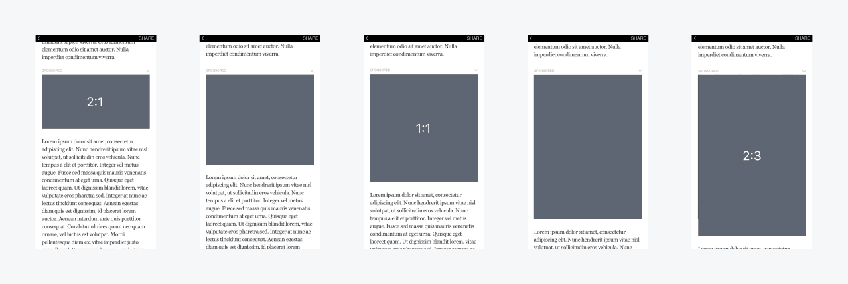
Advertisement’s Size and Type - Mobile

Slide 7
Factors that Affect the Rates Charged
Ad size and type
Location of an ad on the page
The nature of the site
Contract length
Cost Model

Slide 8
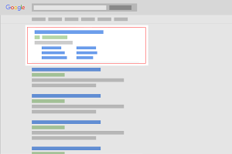
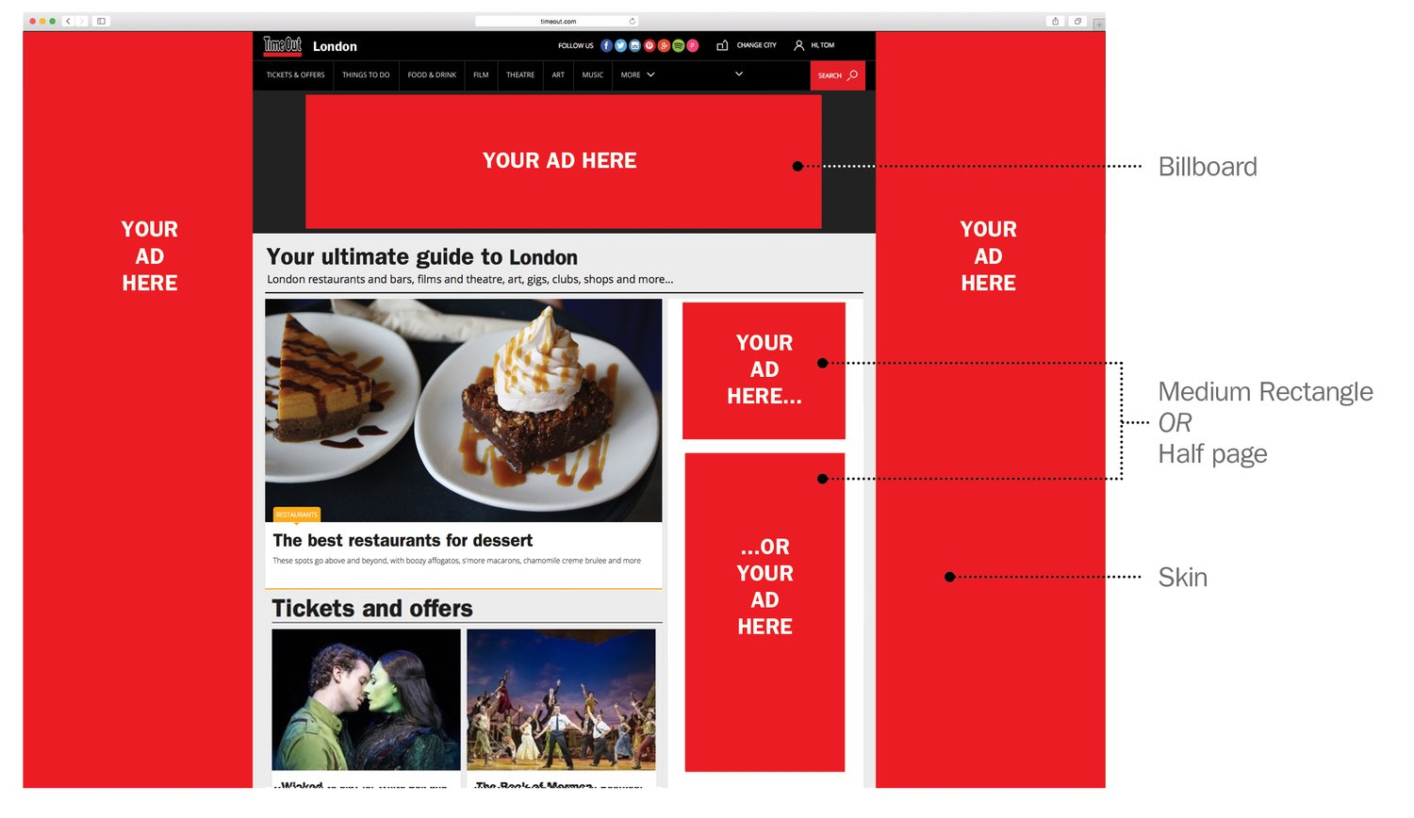
Location of Advertisements
Each page may have multiple banners so more than one impression can be sold per page view
Ads do not have a standardised placement, but larger ones and ones in better positions typically cost more

Slide 9
Facebook Ad Placement
Facebook Desktop Newsfeed
Facebook Mobile Newsfeed
The Right-hand Column
Facebook Instant Articles
Facebook In-Stream Articles
Facebook Suggested Videos
Instagram Feed
Instagram Stories
Facebook Audience Network

Slide 10
Factors that Affect the Rates Charged
Ad size and type
Location of an ad on the page
The nature of the site
Content sites vs portals
Google, Facebook
Contract length
Cost Model

Slide 11
Cost Model
CPM –Cost Per Mille (1,000 impressions)
Whether the ad is clicked is not taken into account.
Each time an ad is fetched, it is counted as one impression.
CPM = Total spending/Number of impressions
CPC/PPC – Cost per Click/Pay per Click
an advertiser pays a publisher when the ad is clicked
CPC = Total spending/Number of clicks

Slide 12
Cost Model
CPA – Cost per Action
Mailing list
Buying an item Conversions
Request quote
CPA = Total spending/Number of conversions
CTR – Click through rate
CTR = (Total clicks/Number of impressions) x 100

Slide 13
Effectiveness and Pricing of Advertisement
Advertising spend for a given audience template is agreed in advance
Metrics for return on this investment are unreliable
Exposure models (demographic)
Click through rates
Actual purchases
Cost for acquisition of a new customer
Advertising companies compete to satisfy the audience template

Slide 14
Issues
The web advertising industry is about matching audience viewing a particular site with an audience template and hence an advert
Algorithmic Implementation
Millions of impressions per second
2 key problems
Providing mappings that satisfies the audience template
Action several mappings efficiently over time

Slide 15
Delivery Methods
Search linked ads (AdWords)
Context linked ads (AdSense)
Display Advertising (Banners)

Slide 16
Search Linked Ads
Search Engines (SE) have huge audiences
Advertisers can place ads against keyword searches
SE can leverage their massive platform capabilities to action many such mappings at once
Highly effective since it reaches people when they are interested in a topic
Relevant, yet not obtrusive
October 2016: Google: 89.3%, Bing 4.36%

Slide 17
Search Linked Ads - Google Adwords

Slide 18
Auctions for AdWords
Find all ads whose keywords match the search terms
Ignore ads that are not eligible eg different country
Calculate Ad Rank
Only show ads with a sufficient Ad Rank; position also determined

Slide 19
Context Linked Ads - AdSense
Ads are related to the page they are displayed on
They use a keyword matching engine to match ads
Matching algorithm have been tweaked to deal with multiple topics on a page
Auctions mechanisms cater for ad position on page

Slide 20
AdWords vs AdSense
AdWords | AdSense
Ad keywords match search | Ad keywords match page topic/s
AdWords is on Google Search Engine Result Page (SERP) | AdSense is shown on web pages
Higher click through | Lower click through
Both use Auctions to select Ads to place on SERP or individual web page

Slide 21
Display Advertising Platform
Deliver general advertisements and brand messages to website visitors.
Standardized Ad shapes with images / video
Normally not related to content
Retargeting
Ad served to people who have already visited the advertiser’s website or are on a list of their customers

Slide 22
Display Advertising Platforms
Publisher
Content
Server
User’s
Browser

Slide 23
Display Advertising Platforms
1
Publisher
Content
Server
User’s
Browser

Slide 24
Display Advertising Platforms
1
Publisher
Content
Server
2
User’s
Browser

Slide 25
Display Advertising Platforms
1
Publisher
Content
Server
2
3
User’s
Browser
Publisher
Ad
Server

Slide 26
Display Advertising Platforms
1
Publisher
Content
Server
2
3
User’s
Browser
Publisher
Ad
Server
4

Slide 27
Display Advertising Platforms
1
Publisher
Content
Server
2
3
User’s
Browser
Publisher
Ad
Server
4
Agency
Ad
Server

Slide 28
Display Advertising Platforms
1
Publisher
Content
Server
2
3
User’s
Browser
Publisher
Ad
Server
4
5
Agency
Ad
Server

Slide 29
Display Advertising Platforms
1
Publisher
Content
Server
2
3
User’s
Browser
Publisher
Ad
Server
4
5
6
Agency
Ad
Server

Slide 30
Display Advertising Platforms - Auction
Publisher
Content
Server
User’s
Browser
Publisher
Ad
Server

Slide 31
Display Advertising Platforms - Auction
Publisher
Content
Server
Supply
Side
Platform
Ad
Exchange
User’s
Browser
Publisher
Ad
Server

Slide 32
Display Advertising Platforms - Auction
Publisher
Content
Server
Supply
Side
Platform
Ad
Exchange
User’s
Browser
Publisher
Ad
Server

Slide 33
Display Advertising Platforms - Auction
Data
Management
Platform
Publisher
Content
Server
Supply
Side
Platform
Ad
Exchange
User’s
Browser
Publisher
Ad
Server

Slide 34
Display Advertising Platforms - Auction
Data
Management
Platform
Publisher
Content
Server
Supply
Side
Platform
Ad
Exchange
User’s
Browser
Publisher
Ad
Server

Slide 35
Display Advertising Platforms - Auction
Data
Management
Platform
Publisher
Content
Server
Supply
Side
Platform
Ad
Exchange
Demand
Side
Platform
User’s
Browser
Publisher
Ad
Server
Agency
Brand

Slide 36
Display Advertising Platforms - Auction
DSP
Data
Management
Platform
Publisher
Content
Server
DSP
Supply
Side
Platform
Ad
Exchange
Demand
Side
Platform
User’s
Browser
Publisher
Ad
Server
Agency
DSP
Brand

Slide 37
Display Advertising Platforms - Auction
DSP
Data
Management
Platform
Publisher
Content
Server
DSP
Supply
Side
Platform
Ad
Exchange
Demand
Side
Platform
User’s
Browser
Publisher
Ad
Server
Agency
DSP
Brand

Slide 38
Display Advertising Platforms - Auction
DSP
Data
Management
Platform
Publisher
Content
Server
DSP
Supply
Side
Platform
Ad
Exchange
Demand
Side
Platform
User’s
Browser
Publisher
Ad
Server
Agency
DSP
Brand
Ad
Ex.

Slide 39
Display Advertising Platforms - Auction
DSP
Data
Management
Platform
Publisher
Content
Server
DSP
Supply
Side
Platform
Ad
Exchange
Demand
Side
Platform
User’s
Browser
Publisher
Ad
Server
Agency
DSP
Brand
Ad
Ex.

Slide 40
Display Advertising Platforms - Auction
DSP
Data
Management
Platform
Publisher
Content
Server
DSP
Supply
Side
Platform
Ad
Exchange
Demand
Side
Platform
User’s
Browser
Publisher
Ad
Server
Agency
DSP
Brand
Ad
Ex.

Slide 41
Display Advertising Platforms - Auction
DSP
Data
Management
Platform
Publisher
Content
Server
DSP
Supply
Side
Platform
Ad
Exchange
Demand
Side
Platform
User’s
Browser
Publisher
Ad
Server
Agency
DSP
Brand
Ad
Ex.

Slide 42
Display Advertising Platforms - Auction
DSP
Data
Management
Platform
Publisher
Content
Server
DSP
Supply
Side
Platform
Ad
Exchange
Demand
Side
Platform
User’s
Browser
Publisher
Ad
Server
Agency
DSP
Brand
Ad
Ex.

Slide 43
Display Advertising Platforms - Auction
DSP
Data
Management
Platform
Publisher
Content
Server
DSP
Supply
Side
Platform
Ad
Exchange
Demand
Side
Platform
User’s
Browser
Publisher
Ad
Server
Agency
DSP
Brand
Ad
Ex.
Agency
Ad
Server

Slide 44
Display Advertising Platforms - Auction
DSP
Data
Management
Platform
Publisher
Content
Server
DSP
Supply
Side
Platform
Ad
Exchange
Demand
Side
Platform
User’s
Browser
Publisher
Ad
Server
Agency
DSP
Brand
Ad
Ex.
Agency
Ad
Server

Slide 45
Display Advertising Platforms - Auction
DSP
Data
Management
Platform
Publisher
Content
Server
DSP
Supply
Side
Platform
Ad
Exchange
Demand
Side
Platform
User’s
Browser
Publisher
Ad
Server
Agency
DSP
Brand
Ad
Ex.
Agency
Ad
Server

Slide 46
Third Party Information
IP Address
User Agent
Cookies
IP Address
User Agent
Cookies
Referring URL
Location URL
Site specific
information
IP Address
User Agent
Cookies
Referring URL
Location URL
Site specific
information
Geo Location
Income Bracket
Recent User
Behaviour
Content Type
IP Address
User Agent
Cookies
Referring URL
Location URL
Site specific
information
Geo Location
Income Bracket
Recent User
Behaviour
Content Type
Advertiser Cookie
User’s browser Website Adds Ad server augmentation Advertiser Specific

Slide 47
Cookies

Slide 48
Browser Cookies
Cookies are small text files
Their information is set and accessed by web servers
They identify you and remember things about you
Record your browsing activities
Pages content you looked at
When you visited
What you searched
You clicked on an ad

Slide 49
HTTP Cookies
1991 - Lou Montulli developed cookies for use on Lynx
Magic cookie
“something that passed between routines or programs that enable the receiver to perform some operation, a capability ticket or opaque identifier”
1994 - Cookies were used in Netscape
“verify whether users had visited Netscape website before and enabled websites to remember your preferences”

Slide 50
HTTP Cookies
1996 - media started to report on the potential threat to privacy
1998 - US Department of Energy Computer Incident Advisory Capability released a bulletin:
“The vulnerability of systems to damage or snooping by using Web browser cookies is essentially nonexistent. Cookies can only tell a Web server if you have been there before and can pass short bits of information (such as user number) from the Web server back to itself the next time you visit... Information about where you came from and what. Web pages you visit already exists in the Web server’s log files and could also be used to track users browsing habits, cookies just make it easier.”

Slide 51
Cookies and HTTP
Scope of the cookie (Domain and Path)
HTTP Request Header – Browser sends cookies
Cookie: name1=value1; name2=value2
HTTP Response Header – Site sets cookies
Set-Cookie: name1=value1
Set-Cookie: name2=value2; Expires=Wed, 09 Jun 2021 10:18:14 GMT

Slide 52
First Party Cookies
Placed by a site when you visit it
Make your experience on the web more efficient
For example
Log-in name
Session
Preferences
Game scores
Items in your shopping cart

Slide 53
Third Party Cookies
Placed by someone other than the site you are on
Include an advertising network or a company that helps track website usage
Usually attached to images and other webpage components
eg invisible 1x1 images

Slide 54
Transient vs Persistent Cookies
Transient Cookies
help “sessionize” your experience on a website
“set” when we visit the site, it disappears when we leave

Slide 55
Transient vs Persistent Cookies
Persistent Cookies
Set the first time a website is visited
Remains there for the duration that the website determines
Help identify a unique browser to our website, closest thing to tracking a person/unique visitor
Can contain Personally Identifiable Information (PII) data
Random string of numbers or letters that only the company who set the cookie can read

Slide 56
ICO Survey - Feb 2015
Surveyed 16,555 cookies
Average website places 34 cookies your first visit
70% third-party cookies
30% first-party cookies
3 websites set cookie’s expiry date to 31st Dec 9999
The average cookie is set to expire after one to two years
86% of cookies are persistent cookies
14% of cookies were transient cookies

Slide 57
Cookie Issues
Clearly cookies have an important function
But they are a potential threat
Unfortunately, the original intent of the cookie has been subverted by some unscrupulous entities who have found a way to use this process to actually track your movements across the Web. They do this by surreptitiously planting their cookies and then retrieving them in such a way that allows them to build detailed profiles of your interests, spending habits, and lifestyle.
- Cookie Central

Slide 58
Tracking
Ad agencies and analytics companies can track you across members of their network
May reconcile across multiple tracking networks
Understand your web-browsing activity in order to better profile you
Evercookies, Device fingerprinting, Cross-device tracking

Slide 59
What makes it easier to blend into the crowd?
Use a system configuration that many others use
Don’t install other fonts and browser plugins
Clear your cache and cookie each time you close your browser
Disable JavaScript and Flash
Many websites will not function unless enabled
Control which scripts are allowed to run
Some website may not function when certain scripts are blocked

Slide 60
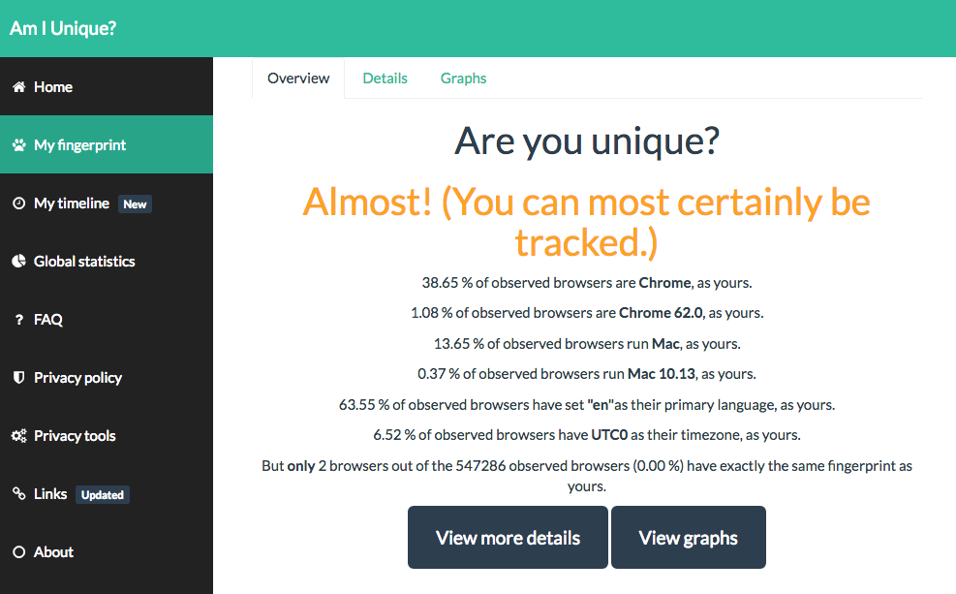
Am I Unique? amiunique.org

Slide 61
Cookie theft
Cookie store session data
Cookies are usually store as plain text
Use https
Encrypt your hard drive

Slide 62
Tracking in the USA
A handful of big companies hold a vast amount of personally identifiable information about millions of people
There have been attempts to introduce “Do Not Track” legislation
Various bills have been introduced, but withdrawn or failed
It is difficulty to establishing standards and agreeing workable legislation

Slide 63
GDPR Cookie Consent
Cookies can be personal data
online identifiers, including pseudonymous, which has the potential for an individual to be identified or singled out is personal data
Implied consent is no longer going to be compliant.
GDPR requires the user to make an ‘affirmative action’
Advice to adjust browser settings won’t be enough.
GDPR says it must be as easy to withdraw consent
Telling people to block cookies isn’t sufficient

Slide 64
GDPR Cookie Consent
‘By using this site, you accept cookies’ statements are not compliant
If there is no genuine and free choice, then there is no valid consent.
Sites will need an always available opt-out
Consent will need to be specific to different cookie purposes
Granular levels of control - separate consents for tracking and analytics cookies

Slide 65
Privacy Conclusions
Regulating cookies may not improve online privacy
There are similar technologies that most people don’t know about (like local storage), which can do the same thing
Cookies by themselves pose no threat to the average person
Information that companies store about you (with or without cookies) is always a concern, and should be protected
The real issue isn’t the technology, it’s what people choose to do with it, but that’s harder to police

Slide 66
Conclusions
Client server Web is private two-party communication
But adverts are from a third party, on behalf of a fourth party, mediated by a fifth party
Google try to occupy the whole service space themselves
Everyone else has to piece it together with different specialist services
Snooping to gain knowledge for the market to increase the value of transactions. Cookies!

