Slide 1
Content Delivery Network
COMP3220/6218
Web Infrastructure/Architecture
Heather Packer – hp3@ecs.soton.ac.uk
3/12/18

Slide 2
CDN
CDN Connection
User
Connection
User
Origin Server
Edge Server

Slide 3
CDN
CDN Connection
User
Connection
User
Origin Server
Edge Server

Slide 4
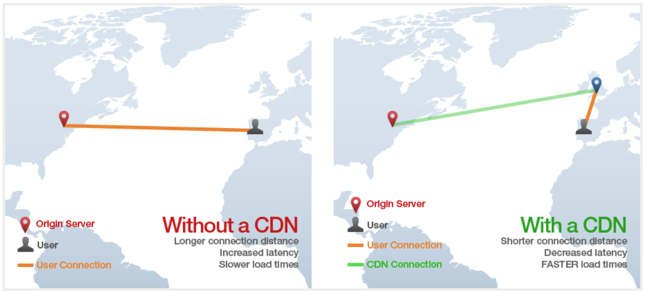
Why use CDN?

Slide 5
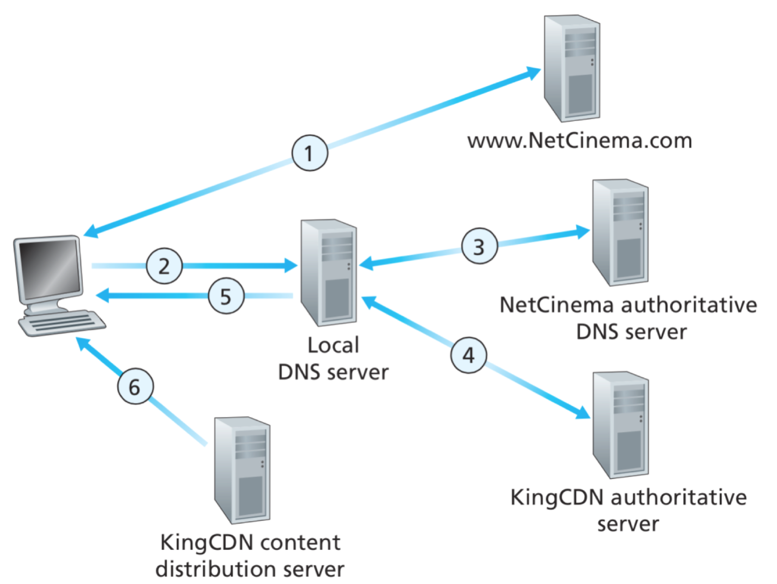
CDN: Simple Content Access Scenario
A CDN has to be able to tell clients where to find resources
A client will request a file, with one URL but retrieve it from another
http://video.netcinema.com/6Y7B23V
http://KingCDN.com/NetC6Y7B23V

Slide 6
CDN: Simple Content Access Scenario
A CDN has to be able to tell clients where to find resources
A client will request a file, with one URL but retrieve it from another
http://video.netcinema.com/6Y7B23V
http://KingCDN.com/NetC6Y7B23V

Slide 7
CDN Cluster Selection Strategy
CDN DNS decides
Pick CDN node geographically closest to client
Pick CDN node with shortest delay (min hops) to client (CDN nodes periodically ping access ISPs, report results to CDN DNS)
Or let the Client decide – give client a list of several CDN servers

Slide 8
DASH - Dynamic Adaptive Streaming over HTTP
Server
Divides video files into multiple chucks
Each chunk stored encoded at different bit rates
Manifest file: provides URLs for different chunks
Client
Periodically measures server-to-client bandwidth
Consulting manifest, requests one chunk at a time
Chooses maximum coding rate sustainable given current bandwidth
Can choose different coding rates at different points in time (depending on available bandwidth at time)

Slide 9
Commercial CDNs
Limelight Networks
Level 3 Communications
Akamai Technologies
Amazon CloudFront
CloudFlare
IBM Cloud Video
Livestream

Slide 10
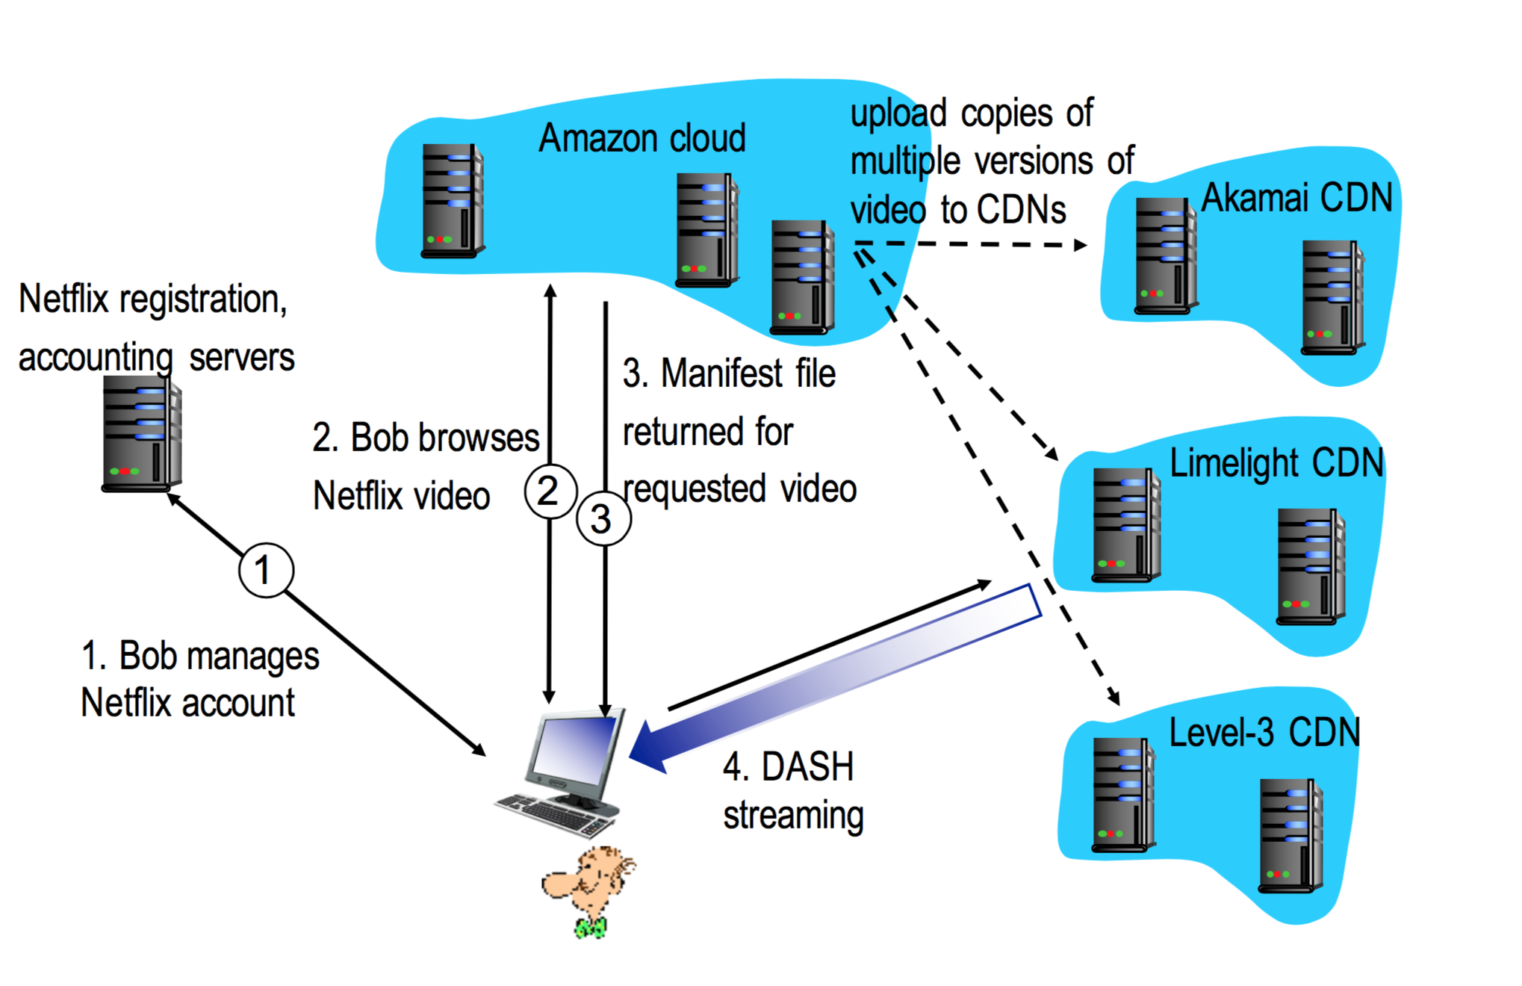
Case Study: Netflix’s First Approach

Slide 11
Netflix OpenConnect
High optimised for delivery large files
Data centers around the world
Client Intelligence
Calculates best edge server to use
Continually probes the best way of receiving content (automatically switches between different CDNs and different bitrate levels)

