Slide 1
Privacy, the Internet and the Dark Web
COMP3220/6218
Web Infrastructure/Architecture
Heather S. Packer hp3@ecs.soton.ac.uk
7/12/18

Slide 2
Should we care about privacy on the Internet?

Slide 3
Should we care about privacy on the Internet?
Sharing your personal data
Sharing fitbit data
Sharing your home plan (Roomba)

Slide 4
Internet vs World Wide Web
The Internet is a global system
Collection of interconnected computer networks
Using Internet protocols to link devices
Provides the backbone for services
World Wide Web
Email
File sharing
Darknets
Social Networking (messaging)

Slide 5
Internet vs World Wide Web
The Internet is a global system
Collection of interconnected computer networks
Using Internet protocols to link devices
Provides the backbone for services
World Wide Web (Surface and Deep Web)
Email
File sharing
Darknets (Dark Web)
Social Networking (messaging)

Slide 6
What is the Deep Web?
WWW content which is not indexed by standard search engines
Content of the deep web is hidden behind HTML forms

Slide 7
The Deep Web
Early estimates suggest it is 400-550 times larger than the surface web.
2001 - speculated it was 7.5 petabytes.
2004 - around 300,000 websites
2006 - 14,000 deep websites in the Russian WWW
Estimated that 99% of web content is hidden

Slide 8
What is the Dark Web?
WWW content existing on darknets, overlay networks which use the Internet
They require specific software, configurations and authorisation to access

Slide 9
Tor
The onion router
TOR browser
TOR network
Browse the web anonymously
Developed 1990s by US Naval Research Lab
Protect US intelligence online

Slide 10
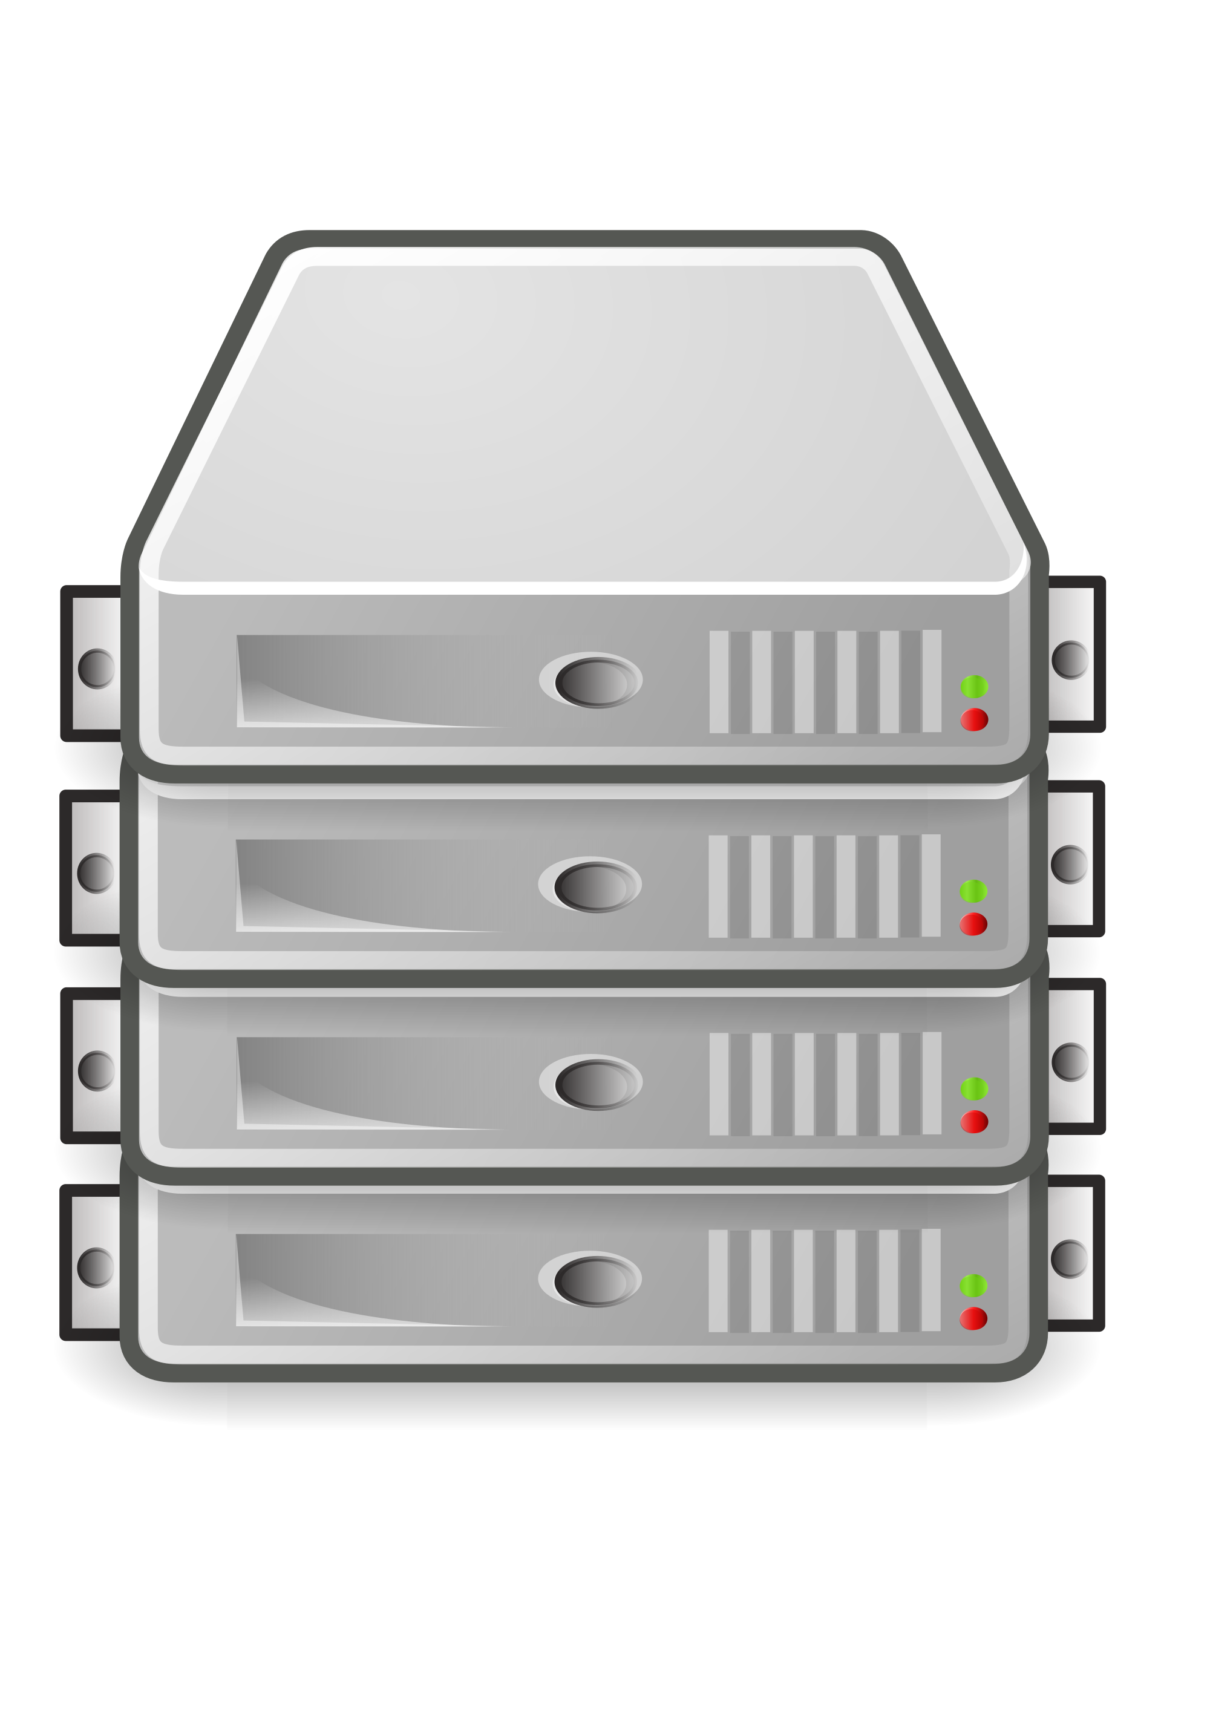
Web Browsers

Slide 11
TOR Network

Slide 12
TOR Network

Slide 13
TOR Network

Slide 14
TOR Network

Slide 15
TOR Hidden Services
Can be used to create private websites and other apps
Can only be found using the TOR browser
Content remains within the TOR network – does not use exit nodes

Slide 16
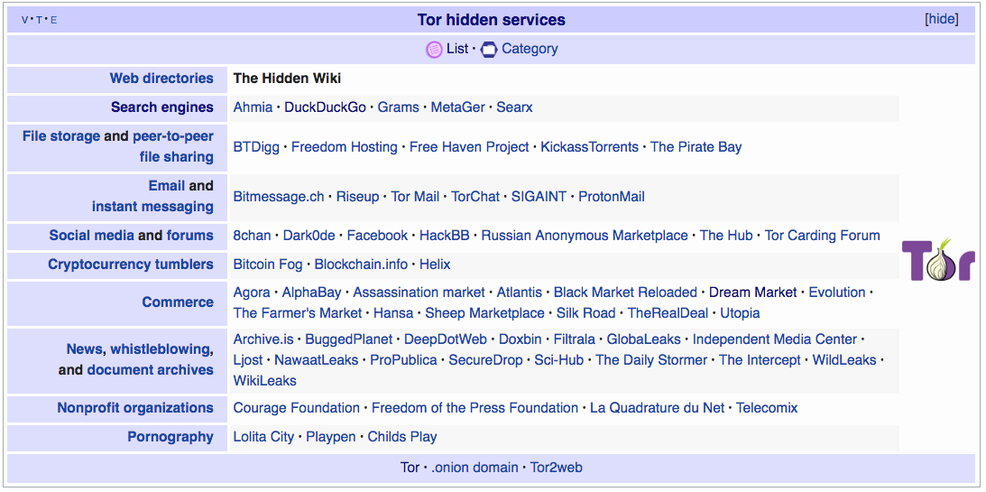
TOR Hidden Services

Slide 17
Who would want to use TOR?

Slide 18
Should we all go dark*? *(everyone using TOR and/or private networks)

Slide 19
Current Laws
Current laws are vaguely applicable to the dark web
Hacking is regulated by the Computer Misuse Act (UK) and Computer Fraud and Abuse Act (US), etc
Bans trespassing, unauthorised accessing and damaging computers
The DarkWeb enables hackers (Purchase malware, Collection of ransom from ransomware attacks)
Bars trafficking, unauthorised computer access and computer espionage

Slide 20
Silk Road Charges
Money Laundering
Computer hacking
Conspiracy to traffic narcotics
Attempting to kill people
Running a criminal enterprise
Orchestrating a conspiracy to sell fake IDs
Conspiracy to sell hacking tools

Slide 21
What role should the government play in the Dark Web?

Slide 22
What role should the government play in the Dark Web?
Should anonymity on the web be banned?
How should we handle coordinating regulations internationally?
Some content all agree is illegal, some is not

Slide 23
What are the appropriate tactics for government intervention on the Dark Web?

Slide 24
What are the appropriate tactics for government intervention on the Dark Web?
What can we do to deter people from starting nefarious hidden services
Should we make users accountable for their actions?

Slide 25
If the tracked services is one privacy extreme and Dark Web is another, is there a middle ground?

