Slide 1
Content Caches
COMP3220/6218
Web Infrastructure/Architecture
Heather Packer – hp3@ecs.soton.ac.uk
3/12/18

Slide 2
Caching
What is caching?

Slide 3

Slashdot effect

Slide 4
Web Caching
The temporary storage (caching) of frequently accessed data for rapid access
  Web documents
  HTML pages
  Images
Caches can be located at various points in a network
  Reduces access time/latency for clients
  Reduces bandwidth usage across slower links
  Reduces load on a server

Slide 5
What Can be Cached?
Cache friendly:
  Logos and brand images
  Style sheets
  Javascript files, site and library
  Downloadable content
  Media files

Slide 6
What Can be Cached?
Cache friendly:
  Logos and brand images
  Style sheets
  Javascript files, site and library
  Downloadable content
  Media files
Be careful caching:
  Data
  HTML pages
  Rotating images
  Frequently modified Javascript and CSS
  Content requested with authentication cookies
Never cache
  Sensitive data
  User-specific data that frequently changes

Slide 7
Terminology
Origin server – original location of content
Hit – response in cache
Miss – response is not in the cache
Stale content – Expired response
Cache hit ratio – hits:total requests
Validation – Check that cached response is most recent version
Invalidation – Removal of response before it expires, due to update on origin server

Slide 8
Different Web Caching Solutions
Browser Cache
Proxy Cache
Reverse Proxy Cache

Slide 9
Browser Cache
Browsers maintain a small cache
Stored locally
Cache for a single user or application
Browser sets a caching policy, deciding what data to cache
  User specific content
  Expensive content

Slide 10
Browser Cache
Local Machine
Origin Server
resource
Browser Cache

Slide 11
Browser Cache vs Cookies
Cache | Cookies
Stores files | Stores session info or tracking
Faster viewing | Preferences and targeting advertising
Stored locally | Stored locally

Slide 12
Tracking and Caches
Browser caches can also be used for tracking you
It is possible to track you cross-site and across browser restarts, even if you disable or clear cookies
Browsers cache content based on the expiration headers provided by the server
  A web application can include unique content in a page, and then use JavaScript to check if the content is cached or not in order to identify a user.
  It is difficult to defend against unless you routinely (e.g. on closing the browser) delete all content.

Slide 13
Proxy Cache
Cache located close to the clients (hosted by University or Internet Service Provider)
  Decrease bandwidth usage
  Decreases network latency
Scale provides the main advantage: many users within the ISP may all be asking for the same web pages

Slide 14
Proxy Cache
Server
Local Machine
resource
Proxy Cache

Slide 15
Reverse Proxy Cache
Cache proxy located closer to the origin web server
Usually deployed by a Web host
Decreases load on the Web service (e.g. database)
Several reverse proxy caches implemented together can for a Content Delivery Network

Slide 16
Reverse Proxy Cache
Server
Local Machine
Reverse Proxy Cache
resource

Slide 17
Caches can be controlled with HTTP: Last-Modified Header
GET Conditional GET
GET /HTTP/1
Host: comp3220.ecs.soton.ac.uk
Accept: */*
HTTP/1 200 OK
Date: Wed 15 Nov 2017 07:43:20 GMT
Connection: keep-alive
Content-Type: text/html; charset=UTF-8
Content-Length: 4003
Last-Modified: Tue 14 Nov 2017 08:00:20 GMT
GET /HTTP/1
Host: comp3220.ecs.soton.ac.uk
Accept: */*
If-Modified-Since: Tue 14 Nov 2017 08:00:20 GMT
HTTP/1 304 Not Modified
Date: Wed 15 Nov 2017 07:55:10 GMT
Connection: keep-alive
Last-Modified: Tue 14 Nov 2017 08:00:20 GMT

Slide 18
Caching Headers
Last-Modified
Cache-Control flags
  no-store - no-cache
  max-age - must-revalidate
  proxy-revalidate - no-transform
Etag – used in validation
Content-Length – can be used in caching policies

Slide 19
HTTP with Cache-Control Header
GET GET
GET /HTTP/1.1
Host: comp3220.ecs.soton.ac.uk
Accept: */*
HTTP/1.1 200 OK
Date: Wed 15 Nov 2017 07:43:20 GMT
Connection: keep-alive
Content-Type: text/html; charset=UTF-8
Content-Length: 4003
Last-Modified: Thurs 7 Dec 2017 08:00:20 GMT
Cache-Control: max-age=86400
* No request sent *

Slide 20
Content Delivery Networks

Slide 21
Motivation Scenario
Stream video content to 100,000+ simultaneous users
You could use a single large “mega-server”

Slide 22
Motivation Scenario
Stream video content to 100,000+ simultaneous users
You could use a single large “mega-server”
  Single point of failure
  Point of network congestion
  Long path to distant clients
  Multiple copies of video sent over outgoing link
This solution doesn’t work in practice

Slide 23
Content Delivery Network
CDN a geographically distributed network of proxy servers (edge nodes)
Hosts static content (such as images, CSS and JS)
Data travels to user via the shortest path (reduced latency)

Slide 24




CDN
CDN Connection
User
Connection
User
Origin Server
Edge Server

Slide 25
CDN
Origin Server
Edge Server
Local Machine
Edge Server
Edge Server
Edge Server
Local Machine
Notes:
Here is another way to visualize a CDN, in the style we used before. Where the local machines use the closest edge server.

Slide 26
Commercial CDNs
Limelight Networks
Level 3 Communications
Akamai Technologies
Amazon CloudFront
CloudFlare

Slide 27
Motivational Scenario
Streaming video to 100,000+ simultaneous users
Working Web solution: store/serve many copies of video at multiple geographically distributed sites (CDN)
Two strategies:
  Push CDN servers deep into many access networks
    Close to users
    Used by Akamai, 1700 locations
  Place larger clusters at key points in the network near internet exchanges
    Used by Limelight

Slide 28
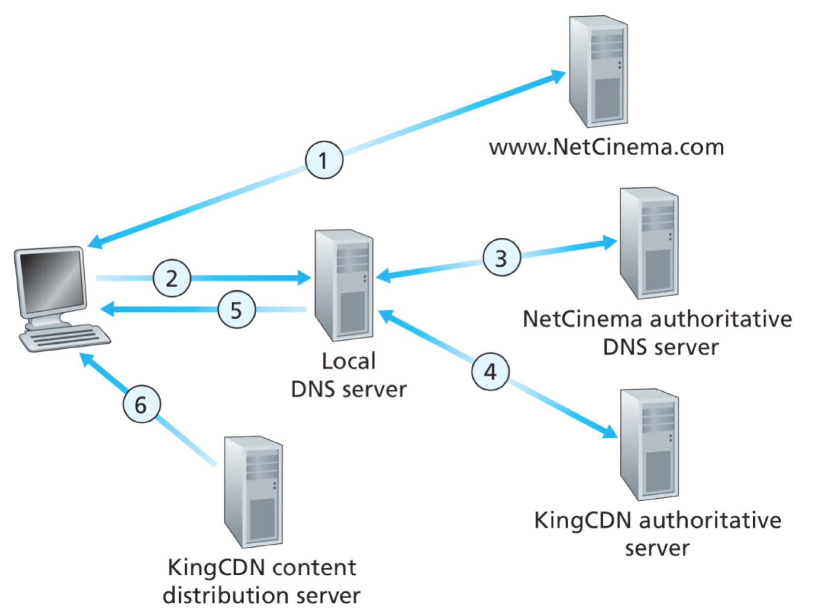
CDN: simple content access scenario
A CDN has to be able to tell clients where to find resources
A client will request a file, with one URL but retrieve it from another
http://video.netcinema.com/6Y7B23V
http://KingCDN.com/NetC6Y7B23V

Slide 29
CDN: simple content access scenario
  Requests URL for videohttp://video.netcinema.com/6Y7B23V

Slide 30
CDN: simple content access scenario
  2. Resolves Domain name via local DNS video.netcinema.com

Slide 31
CDN: simple content access scenario
  3. NetCinema DNS returns Domain name KingCDN.com

Slide 32
CDN: simple content access scenario
  4. Resolves Domain name KingCDN.com
  5. Returns IP of KingCDN

Slide 33
CDN: simple content access scenario
  6. Requests URL http://KingCDN.com/NetC6Y7B23V

Slide 34
CDN Cluster Selection Strategy
CDN DNS decides
  Pick CDN node geographically closest to client
  Pick CDN node with shortest delay (min hops) to client (CDN nodes periodically ping access ISPs, report results to CDN DNS)
Or let the Client decide – give client a list of several CDN servers

Slide 35
Case Study: Netflix’s first Approach
Owned very little infrastructure, uses 3rd party services
  Own registration, payment servers
  Amazon (3rd party) cloud services
    Netflix uploads studio master to Amazon cloud
    Create multiple version of movie (different encodings) in cloud
    Upload versions from cloud to CDNs
  Three 3rd party CDNs host/stream Netflix content: Akamai, Limelight, Level-3

Slide 36
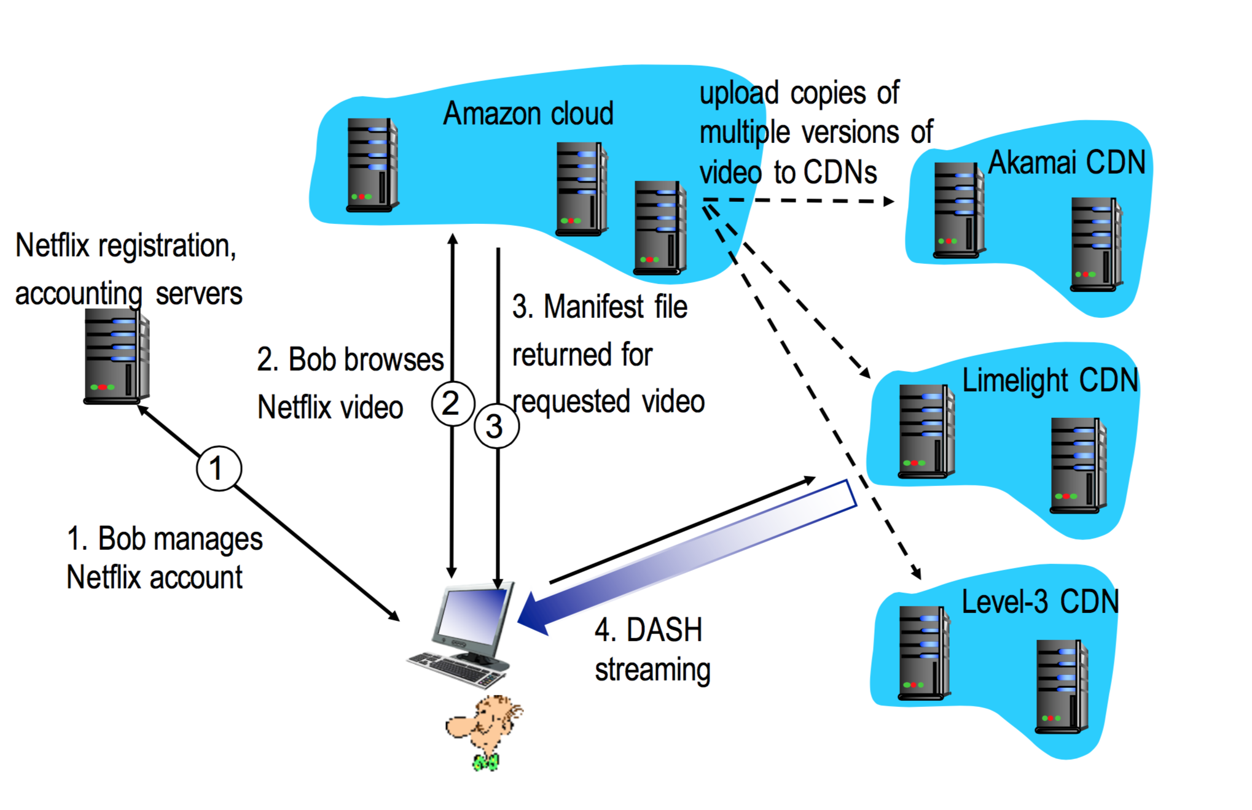
Case Study: Netflix

Slide 37
DASH - Dynamic Adaptive Streaming over HTTP
Server
  Divides video files into multiple chucks
  Each chunk stored encoded at different bit rates
  Manifest file: provides URLs for different chunks
Client
  Periodically measures server-to-client bandwidth
  Consulting manifest, requests one chunk at a time
  Chooses maximum coding rate sustainable given current bandwidth
  Can choose different coding rates at different points in time (depending on available bandwidth at time)

Slide 38
MPEG-DASH Adoption
MPEG DASH is independent, open and international standard, which has broad support from the industry
HTML5 Media Source Extensions and HbbTV are MPEG-DASH enabled
Heavy plugins like Silverlight and Flash perform poorly and cause security issues

Slide 39
Netflix OpenConnect
High optimised for delivery large files
Data centers around the world
Client Intelligence
  Calculates best edge server to use
  Continually probes the best way of receiving content (automatically switches between different CDNs and different bitrate levels)

Slide 40
Summary
Caches
  Browser
  Proxy
  Reverse Proxy
Cache Control Headers
Content Delivery Networks
CDNs in practice

