Slide 1
Academic integrity in context Preparing for a technical report
Dr Su White
Professional Development (COMP1205)
https://http://www.edshare.soton.ac.uk/17840/

Slide 2
Academic Integrity - why is it important?
“a commitment, even in the face of adversity, to five fundamental values: honesty, trust, fairness, respect, and responsibility”
[Center for Academic Integrity]
Why is it important/
We want to assess your own knowledge and understanding of the learning outcomes of a degree
Our degrees are accredited by professional bodies that maintain high quality professional standards
1

Slide 3
Read slides| read regulations | take test on blackboard.soton.ac.uk
Deadline: End of Semester
You will not pass the module if you do not pass the Academic Integrity test

Slide 4
University Regulations
Academic Integrity

Slide 5
University policy
The University has adopted policy and procedures regarding the standards we expect from our students, and what should be done in cases where students fall short of these standards
“breaches” of academic integrity
Full details in the University Calendar link on last slide
This lecture gives a summary of
ways of breaching academic integrity
the consequences of breaching academic integrity
how to avoid such breaches
University regulations (download PDF)
http://www.calendar.soton.ac.uk/sectionIV/academic-integrity-regs.html

Slide 6
Our expectations
We expect you to
take responsibility for your own work;
respect the rights of other scholars;
fully acknowledge the work of others wherever it has contributed to your own (thereby avoiding plagiarism);
follow the standards and conventions of your discipline;
avoid taking unfair advantage of others.

Slide 7
Summary of regulations - AVOID
Plagiarism: copying or paraphrasing without acknowledgement material attributable to, or the intellectual property of, someone else.
Collusion: submitting work that was produced in collaboration with others, without declaration.
Cheating: gaining unfair advantage for yourself or another, e.g., by ghosting: submitting work produced for you by someone else.
Falsification: presenting fictitious or distorted data, making false claims.
Recycling: reusing your own work without declaring you have done so.
Breaching ethical standards: failing to seek ethical approval for research/studies that involve humans or their data

Slide 8
How you see the regulations in ECS
When you submit coursework you will be asked to declare e.g. via a signature or electronic tick box that you are”
“aware of the requirements of good academic practice, and the potential penalties for any breaches”

Slide 9
Academic Integrity breaches
Minor breaches
small amount of plagiarism (due to inexperience/lack of understanding)
minor recycling
collusion leading to limited similarity
Major breaches
any repeated incident
moderate/extensive/serial plagiarism
moderate/extensive recycling
collusion leading to significant similarity
breaching ethical standards
copying/breaches of examination regulations, e.g., unauthorized use of notes in examination rooms
falsification
ghosting/impersonation/use of essay bank services.

Slide 10
Range of penalties
Written warning.
Reduction in marks for the affected work; any plagiarised material is ignored when marking.
Resubmission of the piece of work for a reduced maximum mark.
Mark of zero is returned.
Failure of the whole module.
Failure of the whole year
Reduction in degree classification
Termination of studies
Withdrawal of award

Slide 11
What is Plagiarism – how can I avoid plagiarising?
Academic integrity

Slide 12
What is plagiarism
In some countries/cultures students may expect to copy
Teachers may want students to repeat exactly what’s in books or lecture notes
Here - at the University of Southampton, all the work you submit for marking must be your own original creation
Plagiarism is using someone else’s work or ideas
without indicating that they are not your own
without crediting the original author

Slide 13
Examples of plagiarism
Including in your own work extracts from another person’s work without the use of quotation marks or without crediting the source
The use of ideas of another person without acknowledgement of the source
Paraphrasing/summarizing another person’s work without acknowledgement
Submitting a piece of work entirely as your own when it was produced in collaboration with others, and not declaring that this collaboration has taken place

Slide 14
How to avoid plagiarism
Quoting any material directly copied from elsewhere
but this should be limited to a few words, or a sentence or two !
extensive quoting is bad practice and should be avoided !
Paraphrasing other people’s work (i.e. describing it in your own words)
most of the time you should paraphrase rather than quote !
Citing: follow the quotation or paraphrased material with a citation such as [3], which clearly identifies an item in your bibliography
References: Put the references at the end of your report, giving details such as title, author, and year for each source you have cited. You must do this for all sources!

Slide 15
Examples of using quotes…
The easiest and clearest way to identify a quotation is with quotation marks “…”
“Testing shows the presence, not the absence of bugs.” [1]
An alternative is to indent, or display, the quoted material, which is usually in italics
Testing shows the presence, not the absence of bugs.[1]
But only use quotations if paraphrasing diminishes the value of the message!
For example here is a longer quote: “the other pre-eminent name in British Computing, Maurice Wilkes, arguably contributed rather more than Turing, certainly in practical terms, but is much less prominent in the popular perception” [4]

Slide 16
How to quote
It is easy and clear to identify a quotation with quote marks “…” ‘…’ as shown below
“the other pre-eminent name in British Computing, Maurice Wilkes, arguably contributed rather more than Turing, certainly in practical terms, but is much less prominent in the popular perception” [4] However, Turing’s contribution towards
An alternative is to indent, or display, the quoted material, which is usually in italics and sometimes indented. This is less clear (coloured text included for the slide only)
The other pre-eminent name in British Computing, Maurice Wilkes, arguably contributed rather more than Turing, certainly in practical terms, but is much less prominent in the popular perception [4] However, Turing’s contribution towards …

Slide 17
Really clear quotations…
Probably the clearest way is to indent the text on both sides and enclose it in quote marks, also writing explanatory/linking text before and after the quote…
When considering the key figures in the the development of computing in the UK
However, Turing’s contribution towards
“the other pre-eminent name in British Computing, Maurice Wilkes, arguably contributed rather more than Turing, certainly in practical terms, but is much less prominent in the popular perception.” [1]
Beware: A report which is mostly direct quotes will not get a good mark!

Slide 18
Turning a quote into paraphrasing
In the vast majority of cases you will paraphrase rather than quote
Copyright law only allows you to copy small amounts of text (one or two line)
Longer quotes require the author to give permission
In such cases you should paraphrase the source by putting the material in your own words
‘[…] the other pre-eminent name in British Computing, Maurice Wilkes, arguably contributed rather more than Turing, certainly in practical terms, but is much less prominent in the popular perception’ [4] However, Turing’s contribution towards […]
Can be paraphrased as
Wilkes, though not as famous as Turing, perhaps made greater practical contribution
You also paraphrase to make sure your report flows smoothly and reads well
A sequence of quotations can confuse your reader
Paraphrasing demonstrates your understanding of the material, as you comment on, evaluate, and summarize the key points of the source in your own words

Slide 19
Plagiarism vs Paraphrasing
It is plagiarism if you…
Take too much from one source,
Only replace some words with synonyms,
Simply swap words or phrases round to make the sentence look different
Instead you must
Summarise the key points from your source
Use your own words and phrases
Comment on and evaluate your source

Slide 20
How to acknowledge figures correctly
Figure 1: a UML communication diagram (Lethbridge and Laganiere [5], ch.8, p.290)
Re-printing/’quoting’
Figure 2: a UML communication diagram (based on Lethbridge and Laganiere [5], ch. 8, p.290)
Adaptation/’paraphrasing’

Slide 21
Take good notes as you research
When you take notes from sources, make sure you identify:
Identify any direct quotations you are recording
Note any paraphrasing you make
Distinguish those parts of your notes where you are recording/noting your own observations/insights based on the document you are reading
Record any sources your notes refer to
Observe how the articles you read use citations, learn from their examples
This will be particularly important if you are taking notes over an extended period and then reviewing them later.

Slide 22
In turnitin, this is what copy and past plagiarism looks like
Plagiarism is copying and pasting from electronic sources without explicit acknowledgement of the source or without explicitly marking the pasted text as a quotation is plagiarism
even if you subsequently modify the text e.g., by replacing some words with synonyms, it will still be plagiarism

Slide 23
How and where to Cite
Immediately after the quote or the paraphrased material
Use a consistent citation style
In IEEE format: Here is a piece of paraphrased text [2]
[2] is the citation tag
In Harvard format: Here is a piece of paraphrased text (<name of author(s)>, <year of publication>)
(<name of author(s)>, <year of publication>) is the citation tag
A citation tag will refer to the same source throughout the document
You can cite more than one source for the same piece of content
E.g., IEEE: Here is another piece of paraphrased text [2,3]

Slide 24
Why cite sources?
We are legally obliged to respect an author’s moral right to be acknowledged as the source
Citations support the scientific process:
new results are published (details of publication are recorded)
leading to new claims being made
these results and claims may be challenged
or they may be supported by further findings
Each step records how scientific understanding develops, and the process requires a clear audit trail

Slide 25
References
In the reference section you list the sources you have cited in your document
You should list each source just once
References need to be
Complete and in a standard format
Sufficiently detailed to enable a reader to locate the same source again
Citation standards (check out the library guidance) specify that detail
Some tools enable automatic formatting of citations
Endnote (Microsoft Word)
Bibtex (LaTeX)
Zotero
Bibliography or Further Reading
If there is text which you used for reference but did not cite, you may list a reference to it under a bibliography or further reading section

Slide 26
Is ignoring academic integrity a “victimless crime”?
If you plagiarise
You deny the true author the credit,
You undermine the scientific publication process
All breaches of academic integrity
Divert staff from more constructive activities, and
Undermine the reputation of ECS degrees

Slide 27
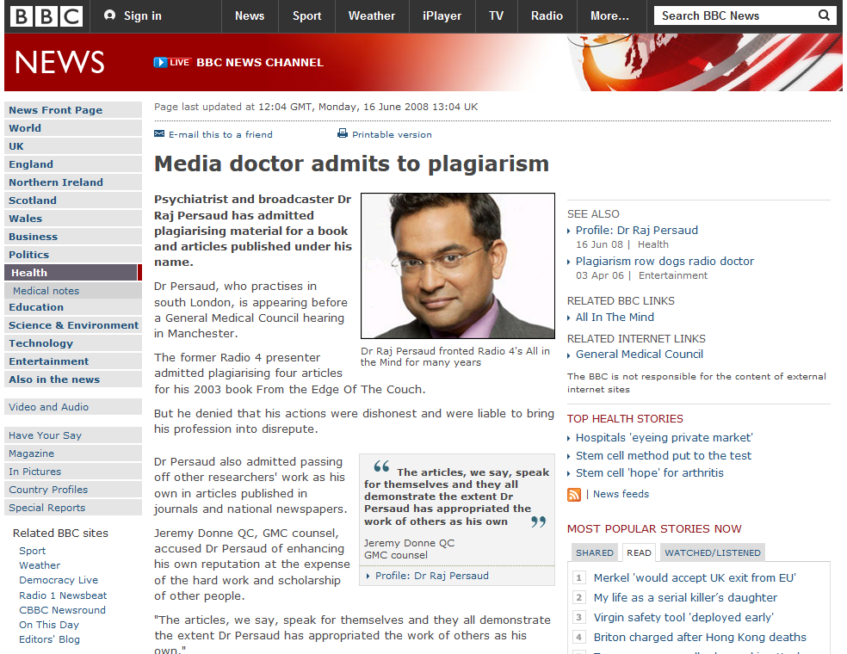
Case study of plagiarism…
BBC News, June 2008
http://news.bbc.co.uk/1/hi/health/7452877.stm, visited on November 3rd, 2014

Slide 28
.. Case study

Slide 29
Lessons learned
What can we learn from Dr Raj Persaud?
Find ways to plan your study time effectively
Be aware of deadlines / schedule your workload
Be realistic/objective/honest with yourself
Leave plenty of time for writing (little and often is best)
This will help avoid the need for ‘short-cuts’ which could lead to bad academic practice.

Slide 30
Understanding and avoiding plagiarism
The concept of plagiarism extends to all sorts of academic work: lab work, design and build, programming and written work
When you complete a handin you will be asked to confirm that the work is your own. Make sure you
Explain any collaborative work you may have done
Acknowledge the use of other people’s work such as code, design, graphs and diagrams
Acknowledge any reuse of your own previous work

Slide 31
How we detect plagiarism
Sometimes, it’s just obvious
Different writing styles
Better English
Or even different fonts
Online plagiarism tools…
We routinely use turnitin, we run code checks
We can use the internet quite well ourselves and may well investigate possible serious breaches very intensively

Slide 32
Plagiarism detection service
The University uses automated plagiarism detection systems
across student groups
across externally published work
These systems use a huge library of sources:
over 135 million previously submitted student papers
over 13.5 billion pages of web content (including wikipedia!!!)
articles from more than 90,000 subscription-based journals and periodicals
In recent years, these have detected a small number of cases where there has been a major level of plagiarism
and some students have failed their degrees as a result

Slide 33
Assessment/coursework
The purpose of assessment is to enable you to develop and demonstrate
your own knowledge and understanding of the learning outcomes of a module or programme
It is entirely appropriate that your work is informed by, and refers to
the work of others in the field,
discussions with your peers, tutor or supervisor
Such contributions must always be acknowledged in accordance with conventions appropriate to the discipline
this requires more than just a mention of a source in a reference list
make clear which are your words/ideas/artwork
acknowledge each instance of another person’s words/ideas/artworks appropriately

Slide 34
Group work
Some assignments, labs, and projects are carried out in groups
For small tasks it will be assumed that everyone contributed equally
if a member of your group is not doing their share of the work, you must tell the lecturer
For major pieces of work you will be asked to indicate your contribution and that of others
so keep a record of this in your log book

Slide 35
Collaboration (and Collusion)
When you have worked on a problem together it is difficult to know who should get the credit – this is called collaboration. You should declare this when submitting the work:
this is my own work except for <material> which <friend> and I developed together
If you don’t declare your collaboration, this is called collusion and will be treated as a breach of academic integrity

Slide 36
Collaboration (and Collusion)
It is often helpful to discuss ideas and approaches to your work with your peers. You may ask a friend to explain material to you.
However:
what you submit must be your own work!
you must be able to explain what you have done and how you have done it
any collaboration must be declared at the time of submission
this is my own work except for <material> which <friend> and I developed together

Slide 37
Collusion… rather than Collaboration
What is collusion?
Unauthorised (and undeclared) collaboration between students on an individual assignment
unauthorised (and undeclared) assistance of another student on an individual assignment
Collusion is the second most common AI breach in ECS, and often results in a mark of zero for the assignment!

Slide 38
Examples of Collusion
Examples of collusion
submitting work that was carried out in collaboration with another student or with input from another student, without declaring this
submitting work carried out by another student
showing another student your work
allowing another student to submit your work (in part or as a whole) as their own
Don’t do it!

Slide 39
How to Avoid Collusion
Carry out each assignment yourself
You must be able to explain your solution/code fully if asked to do so
if you have problems with your work
Ask the lecturer/demonstrators
If you wish to help others,
Explain principles and help improve their general understanding
Do not show or give them your solution

Slide 40
Please remember
Maintaining Academic integrity is very important.
Breaches include plagiarism, cheating, falsification, collusion and recycling.
We use automatic plagiarism detection software to help us identify breaches.
Students who have purposefully breached academic integrity guidelines have been caught, and some have failed their degree as a result.
Make sure you paraphrase, and cite all your sources in a clear and standard way.
Ignorance is NOT an excuse – every time you submit coursework, you state that you are aware of these regulations.

Slide 41
Academic Integrity links
University regulations (download PDF)
http://www.calendar.soton.ac.uk/sectionIV/academic-integrity-regs.html
How to avoid plagiarism when writing
http://www.plagiarism.org/article/preventing-plagiarism-when-writing
Library Academic Skills (Academic Integrity)
http://library.soton.ac.uk/sash/ai

Slide 42
Read slides| read regulations | take test on blackboard.soton.ac.uk
Deadline: End of Semester
You will not pass the module if you do not pass the Academic Integrity test

Slide 43
Appendices
Read these next

Slide 44
Advice:
There is a large amount of content in these slides
As well as paying attention during the lecture you are advised to:
Read the slides carefully after the lecture
Discuss with your friends anything you do not think you completely understand
Take the academic integrity test and repeat until you pass ☺

Slide 45
The technical report…
You have had the brief….
You read the brief…think…
re-read (repeat until understood)
If you want to get a good mark
Rise to the intellectual challenge

Slide 46
How we are helping you
The brief
Outlines the problem
Sets the context
You are investigating a topic
You have to answer some specific questions
You are ’working’ for a ‘client’
Interim deadlines
Structure your progress
Provide you with feedback
The purpose of the content of the report is to record your thinking and investigations

Slide 47
Academic integrity?
You demonstrate academic integrity by
Recording the steps you take
Writing your account in a way so that someone else could follow each of your steps
Structure the account to make it clear
Provide references to your sources which adhere to an agreed convention*
Explain what you did in your own words
*Harvard in this case

Slide 48
Students sometimes cut corners
When they don’t understand what they are trying to explain
When they don’t feel able to express themselves fluently
When they leave things until the last minute
All these things can cause problems with academic integrity
You need to avoid these issues, or overcome these problems
And you must work through the slides and take the AI test

Slide 49
Students sometimes cut corners
When they don’t understand what they are trying to explain
When they don’t feel able to express themselves fluently
When they leave things until the last minute
We have structured the coursework so that you avoid these problems
Which is why we have the interim deadlines
And why you are going to discuss your technical report in a few moments…
All these things are designed to help you

Slide 50
Students sometimes cut corners
When they don’t understand what they are trying to explain
When they don’t feel able to express themselves fluently
When they leave things until the last minute
Writing the draft abstract early helps you to understand and plan what you are going to do
Submitting a draft is designed to help you work on the report in good time
All these things are designed to help you

Slide 51
The resources page is important
Use the resources
You need to work on your own
You need to do preparation and practice
Question:
Talk to your neighbour
What are your strengths for CW3?
What are you weaknesses for CW3?

Slide 52
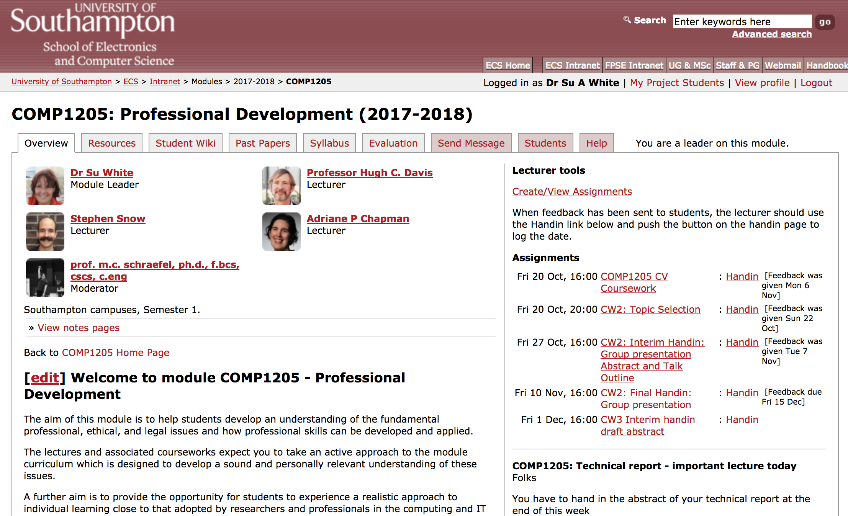
Today…
We will mentally prepare for CW3
So that you do not cut corners
We will skim AI slide set during the class
You will have to read the rest of these slides carefully before the end of the week

Slide 53
Explaining in pairs
Give an overview of the topic you have been set for the technical report
Title
Keywords
What are the challenges?

Slide 54
What is the context of your topic
The big picture
In what ways is the topic you have been allocated an issue in the wider sense?
How does it impact on society? Is it just a technical problem?
Why is it important?
This is the way the world is

Slide 55
But what about the brief?
Why is the topic important the ’client’ of your topic brief?
What will the client be interested in?
This is the problem statement

Slide 56
What are you going to have to do?
What sorts of things do you need to find out?
Where will you look for evidence?
How will you organise yourself?

Slide 57
How will you present your argument?
How will you translate your investigation into writing in the report?
Can you sketch out a structure?
Here is how I am going to investigate

Slide 58
How will you present your argument?
Are there recommendations which you will have to make?
How will you go about drawing conclusions
Here is what I found (intend to present)

Slide 59
There are some videos you can watch
https://secure.ecs.soton.ac.uk/notes/ellabs/1/l12/
Produced for our electronics labs – but relevant to the work that you are doing

Slide 60
I sent you an email
Did you read it?
Read the brief and make sure you understand it.
Get ready for your task, organise yourself

Slide 61
Stage 0 - orientation
Reference manager
install
familiarise
Plan a systematic approach
schedule your time
think about conflicting deadlines
https://pacemaker.press/ may help
Specifically schedule time for
Orientation
Research
Drafting (best done as you go)
Revising and final checking
Make sure you know when the interim and final deadlines are

Slide 62
Evaluate your references as you go
And make sure you store them in your reference manager!

Slide 65
Readings
Dunleavy, 2014, doing a quick literature review
https://medium.com/advice-and-help-in-authoring-a-phd-or-non-fiction/doing-a-quick-literature-review-f94700f947ce#.aea9ztz05
Keshav, 2007, How to read a paper
http://ccr.sigcomm.org/online/files/p83-keshavA.pdf
OU, 2007, How to read a paper - Workflow
http://www.open.edu/openlearn/ocw/pluginfile.php/420119/mod_resource/content/3/Keshav-%20How%20to%20read%20a%20paper%20workflow.pdf
Davis, 2007, How to review a paper
http://users.ecs.soton.ac.uk/hcd/reviewing.html
Mitzenmacher, n.d. How to read a research paper
http://www.eecs.harvard.edu/~michaelm/postscripts/ReadPaper.pdf

Slide 66
Videos:
Lecture from a Microsoft scientist at Cambridge about doing research - pitched at a higher level than you but still very relevant, interesting and motivation
https://www.youtube.com/watch?v=g3dkRsTqdDA

Slide 67
Stage 1 orientation
Find out more about your topic. Use all the generic research tools at your disposal.
Discuss the topic, read and re-read the brief to make sure you understand it.
Turn the brief into an abstract.
You will be able to write the whole of the abstract in a draft form,
The final section will be tentative saying what you propose to do in general terms, or even includes some speculation e.g “the report concludes with a set of xxx recommendations focussing on xxxxx” Obviously it cant say what you found out because you have not done the work yet, but it should reassure us that you know what you are going to be investigating.

Slide 68
Advice:
There is a large amount of content in these slides
As well as paying attention during the lecture you are advised to:
Read the slides carefully after the lecture
Discuss with your friends anything you do not think you completely understand
Take the academic integrity test and repeat until you pass ☺

Slide 69
Acknowledging Ownership
Professional Development (COMP1205)

Slide 70
The power of the Web
Anyone with access to a computer has an unprecedented amount of information available to them “at their fingertips”
This is good news to you when researching your essays, reports, and projects, but
with power comes responsibility to use these resources properly;
there is an increased need for reproduction literacy and academic integrity.

Slide 71
Intellectual property
You have both rights and responsibilities over digital works
You have rights as a creator of digital works to decide how your work may be used, shared or exploited; these are your Intellectual Property Rights.
As a user of digital works you have a responsibility to respect the Intellectual Property Rights of others.
Licenses help to protect the use and reproduction of digital works
Corporate licensing
Licensing of free and open source software
Other digital works e.g., Creative Commons.

Slide 72
Acknowledging Ownership (2)
Copyright icon
For protecting non-digital media too, it doesn’t imply sharing
One of the Creative Commons licenses
They have been designed for sharing digital works
71

Slide 73
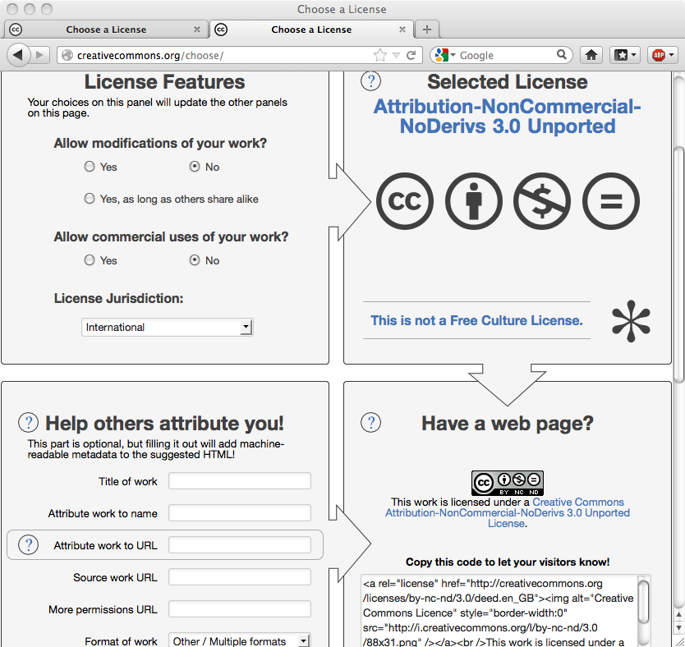
Rights
Licensing allows you to assert your Intellectual Property Rights
If someone infringes your rights you may sue or demand that the infringing work is removed
Example: Creative Commons
This is NOT a free culture license
You may not use the work for commercial purposes.
You may not make derivatives of the work.
You must give the author credit.
This is a free culture license that requires attribution of the author only.

Slide 74
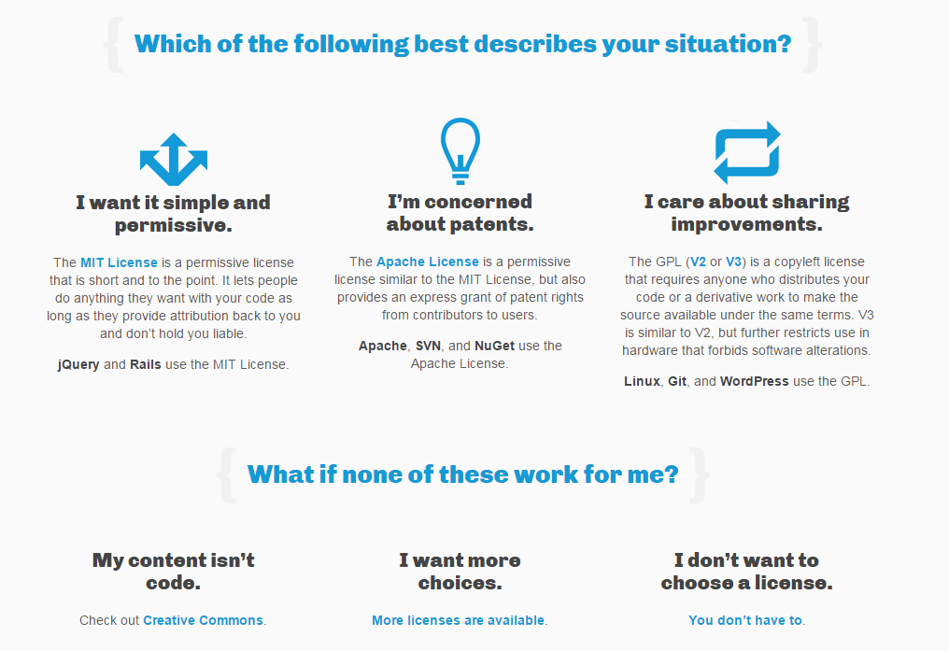
choosealicense.com
73

Slide 75
Responsibilities
Your responsibility is to follow the terms of the license that has been asserted.
If you infringe the terms of a license you may be sued.
Don’t assume that if a license is not explicit there isn’t one.
[Source: choosealicense.com]

