Slide 1
Web Search Engines
COMP3220/6218
Web Infrastructure/Architecture
Heather Packer hp3@ecs.soton.ac.uk
20/10/18

Slide 2
Introduction
Search Engines
History of Search Engines
Search Engine Issues

Slide 3
Specific Board and Vague Queries
 | Specific | Broad | Vague
I know specifically what I’m looking for | ✔ | ✖ | ✖
I know where to look for what I’m looking for | ✔ | ✔ | ✖
Example | Looking for a specific gene in the Gene Database | Looking for the manager of HR, in the company directory | Google

Slide 4
Specific Board and Vague Queries
Search Engines
 | Specific | Broad | Vague
I know specifically what I’m looking for | ✔ | ✖ | ✖
I know where to look for what I’m looking for | ✔ | ✔ | ✖
Example | Looking for a specific gene in the Gene Database | Looking for the manager of HR, in the company directory | Google

Slide 5
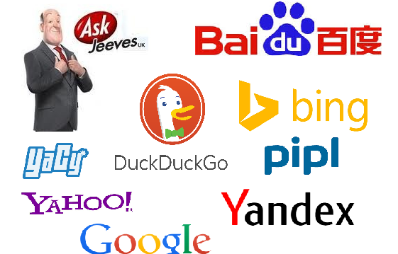

Search Engines

Slide 6
Search Engines
Search engines are a service
They allow users to search for content using keywords
They DO NOT access the web directly
They USE huge databases
A query returns a ranked set of results

Slide 7

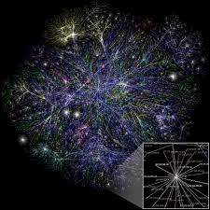
Simple Framework
Query Engine
Search
index
Interface
Web Crawler

Slide 8
Web Crawler
Web Crawler, spider or bot
An algorithm that systematically browses the web
A basic algorithm
  Start at a webpage
  Follow the hyperlinks that webpage points to
  Then follows the links those webpages point to
Each page it visits it collects metadata about it
Stores a file for each resource, with its meta data in a search index

Slide 9
Web Crawlers
Crawlers consume resources
Can visit sites without approval
Mechanisms exist for public sites not wishing to be crawled

Slide 10
robots.txt
Block all web crawlers
User-agent: *
Disallow: /
Allow all web crawlers
User-agent: *
Disallow:
Block a specific web crawler from a specific folder
User-agent: Googlebot
Disallow: /example-subfolder/
Disallow: /index.html

Slide 11
Web Crawler Policies
The behaviour of a web crawler is based on:
  Selection Policy
  Re-visit Policy
  Politeness Policy
  Parallelisation Policy

Slide 12
Selection Policy
Search engines only index part of the web
It’s important to download the most relevant pages
A selection policy states which pages to index
Strategies:
  Breadth first
  Back link count
  PageRank
Only request pages that have searchable content (HTML, PDF etc)

Slide 13
Re-visit Policy
Its worth revisiting web pages because they change over time
An ideal search engine would have the most up-to-date version of every page in its index
Strategies
  Re-visit all pages equally frequent
  Prioritise pages that change often (but not too often!)
May take page quality into account

Slide 14
Politeness Policy
Issues of schedule and load when large collections of pages are accessed
Stategies
  Do not make parallel calls to the same server
  Spread out requests
  Abide by Crawler delay in Robots.txt

Slide 15
Parellisation Policy
An efficient crawler needs to access many web servers at once
Run multiple processes in parallel
Could find the same URL on multiple pages
Strategies:
  Dynamically assign pages to crawler processes
  Static mapping eg based on a hash function

Slide 16
Crawlability
Broken links
Denied access
Outdated URLs
URL errors
Blocked
No out links
Slow load speed
Duplicated pages
Flash content
JavaScript
HTML frames

Slide 17
Ranking
Query results can be ranked using many features:
  How many times does the page contain the keywords
  Do keywords appear in the title or url
  Does it contain synonyms for your keywords
  Is it from a quality source
  What is it’s importance
  How often a page is updated
  Freshness of information
  Page load time

Slide 18
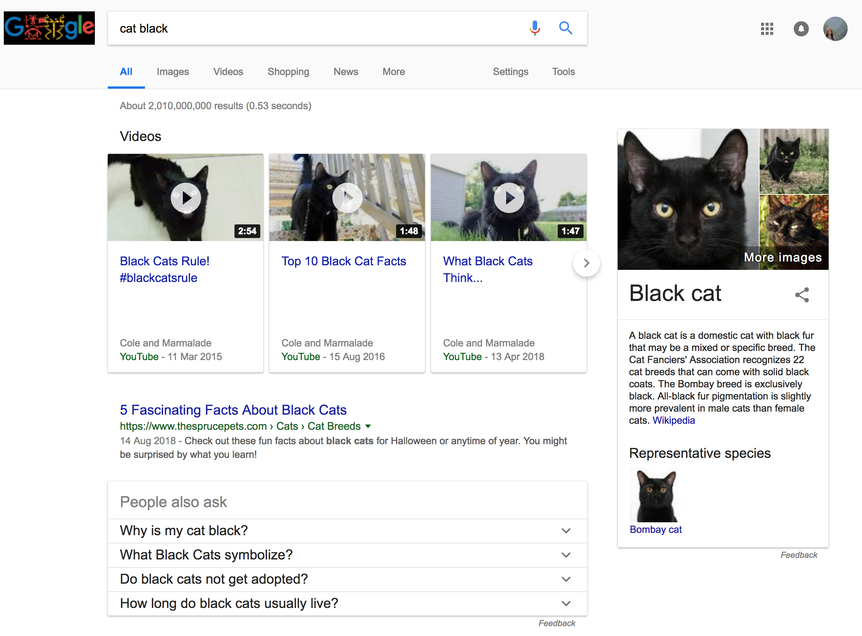
User Search Problems: Ordering of Terms

Slide 19
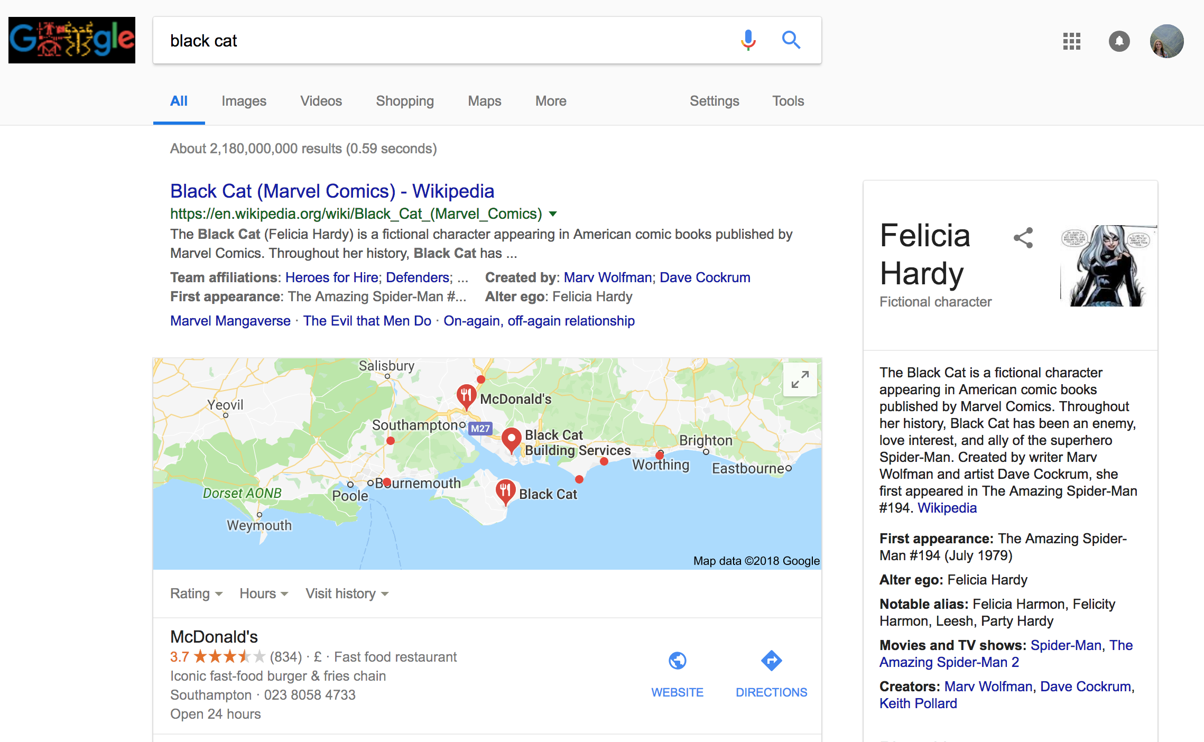
User Search Problems: Ordering of Terms

Slide 20
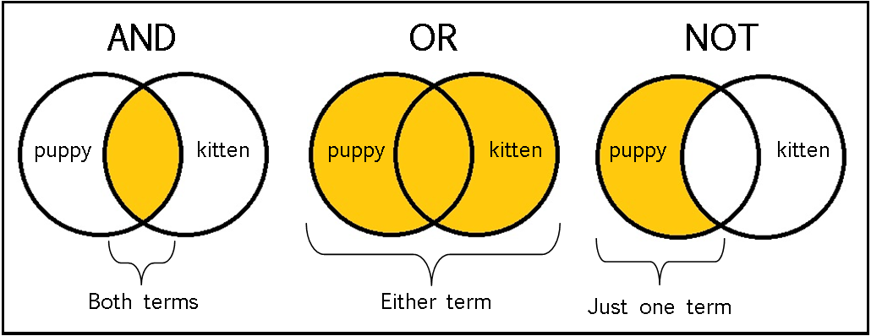
User Search Problems: Boolean Logic
“”, *, +, -, case sensitivity

Slide 21
User Search Problems
Users do not understand how to provide a sequence of words for searches
Users may get unexpected answers because they are not aware of the input requirement of the search engine.
  For example, some search engines are case sensitive.
Users have problems understanding Boolean logic
Around 85% of users only look at the first page of the result, so relevant answers might be skipped.

Slide 22
Indexing Data Issues
Distributed data
Changes over time
Large volume
Data
  Unstructured data - gifs, pdf, etc
  Redundant data - 30% pages are near duplicates
  Quality of data - False, poorly written, invalid, misspelt
  Heterogeneous data - media, formats, languages, alphabets

Slide 23
History of Search Engines

Slide 24
Before Search Engines
Exploit hyperlink structure
  Personal homepages with links
  Directories
Word of mouth
  Email, forums, Usenet

Slide 25
Timeline 90’s – Hand vs Crawler
Services to search the web started in the early 90s
The indexes were either created and edited by hand
Or, by crawlers
June 1993
1st Web Robot
Wandex
Meausres size
Marh 1996
Larry Page
BackRub
SE
1998
Google Search
SE
Jan 1994
Altavista
Crawler
Sept1993
1st Web SE
By Hand
April 1997
Ask Jeeves
SE
Jul/Sept 1998
MSN Search
1995
LookSmart
Web Directory
May 1996
HotBot
SE
April 1994
Yahoo!
Web Directory
By Hand
Oct/Nov 1993
2nd Web SE
By Hand
Dec 1993
3rd Web SE
Crawler
Jul7 1994
Lycos
Crawler
1993 1994 1995 1996 1997 1998

Slide 26
Early 90s Architectures
Query Engine
Search
index
Interface
Web Crawler
Or
Person

Slide 27
Early 90s Architectures
Query Engine
Search
index
Interface
Web Crawler
Or
Person

Slide 28
Early 90s Architectures
Query Engine
Search
index
Interface
Web Crawler
Or
Person

Slide 29

Web Crawlers
Wandex 1993 – size of the web
WebCrawler Dec 1993 - indexer
WebCrawler 1994 - indexed entire web page

Slide 30
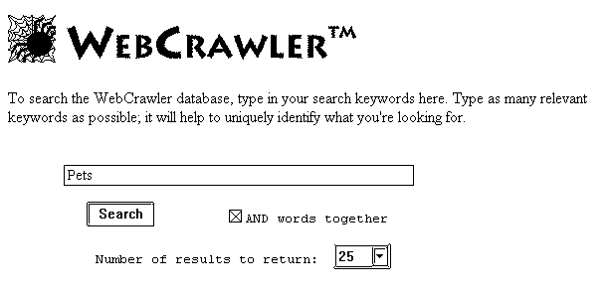

Slide 31
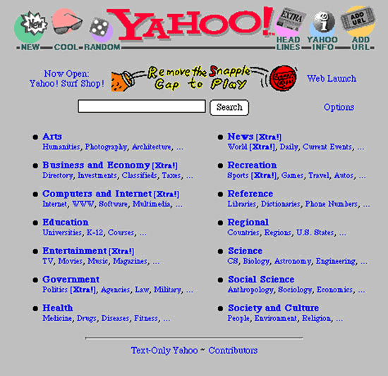
Yahoo!

Slide 32
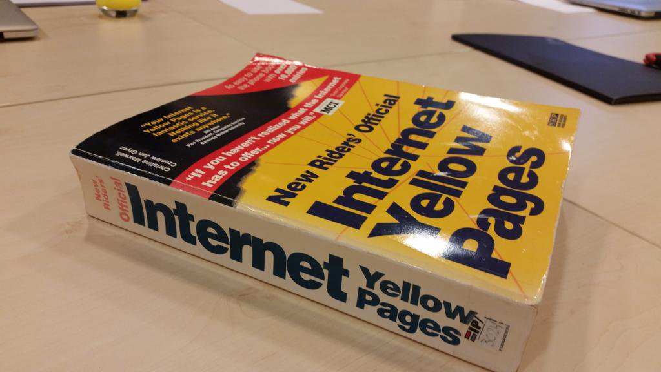
Internet Yellow Pages 1994

Slide 33
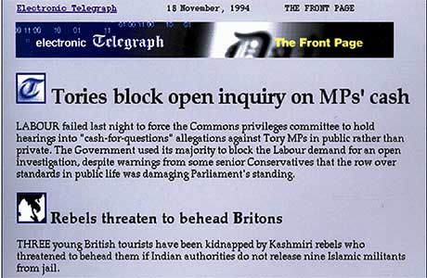
Website - Telegraph 1994

Slide 34
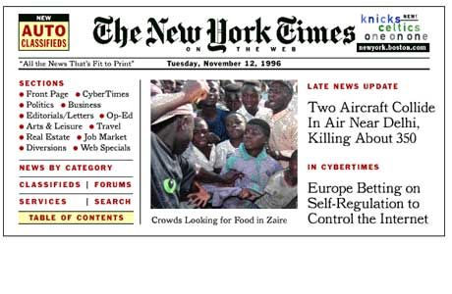
Website – New York Times 1995

Slide 35
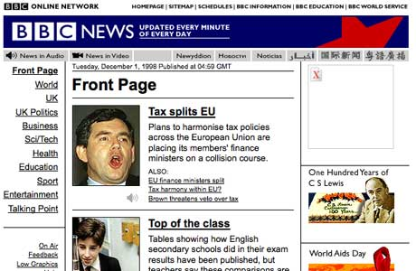
Website – BBC News 1997

Slide 36
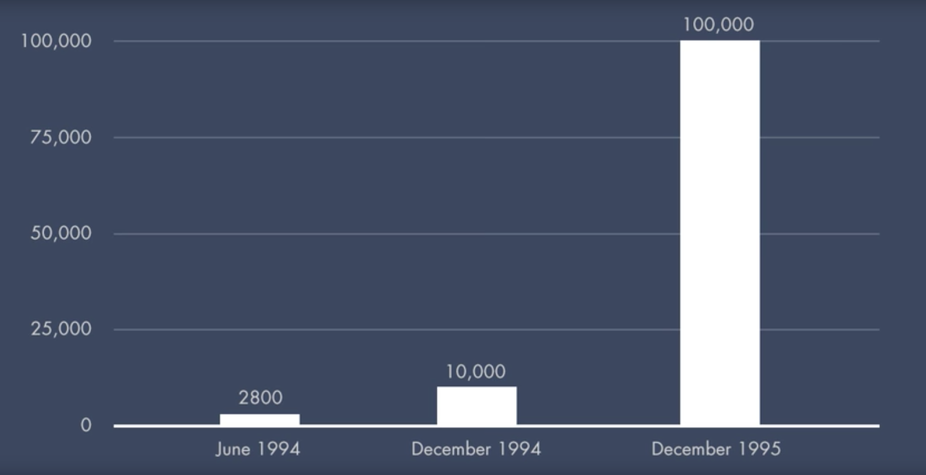
Number of Websites June 1994 - Dec 1995

Slide 37
Search Engines Issues Mid ‘90s
Scale
  How to rank pages to give the best results
Spamming
  Web searches favoured web pages with high keyword density
Keywords
  Spelling mistakes

Slide 38
Timeline 90’s
June 1993
1st Web Robot
Wandex
Meausres size
Marh 1996
Larry Page
BackRub
SE
1998
Google Search
SE
Jan 1994
Altavista
Sept1993
1st Web SE
List
April 1997
Ask Jeeves
SE
Jul/Sept 1998
MSN Search
1995
LookSmart
Web Directory
May 1996
HotBot
SE
April 1994
Yahoo!
Web Directory
Oct/Nov 1993
2nd Web SE
List
Jul7 1994
Lycos
SE
Dec 1993
3rd Web SE
Crawler
Indexer
Seraching
1993 1994 1995 1996 1997 1998

Slide 39
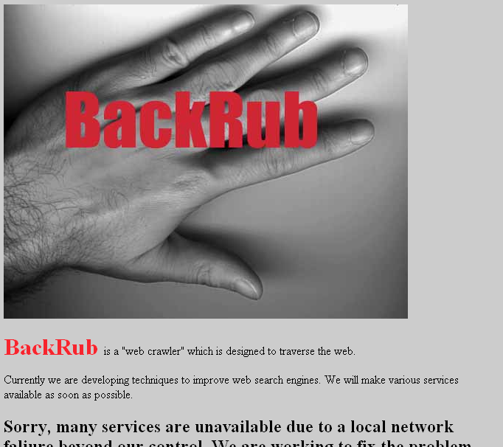
BackRub
Utilised PageRank
  More advanced than previous indexing
Used back links

Slide 40
PageRank
Assumes important websites are likely be linked to
Similar to a voting:
  where in links are votes
  the quality of a vote is determined by the number of votes (in links)
  your vote is worth more if you have a higher page rank
Factors Considered:
  Number of in links
  Quality of in links
  Web page’s context
Favoured high keyword density

Slide 41
Keyword Stuffing
Our company provides software development and consultation services. We are the best software development and consultation services. Our company staff provides software development and consultation services. We offer the best software development and consultation services. Our software development and consultation services is the right solution for your business. Satisfaction with our software development and consultation services is guaranteed. We build your business solution with out software development and consultation services. Contact us and you will receive quality software development and consultation services.

Slide 42
Keyword Stuffing
Our company provides software development and consultation services. We are the best software development and consultation services. Our company staff provides software development and consultation services. We offer the best software development and consultation services. Our software development and consultation services is the right solution for your business. Satisfaction with our software development and consultation services is guaranteed. We build your business solution with out software development and consultation services. Contact us and you will receive quality software development and consultation services.

Slide 43
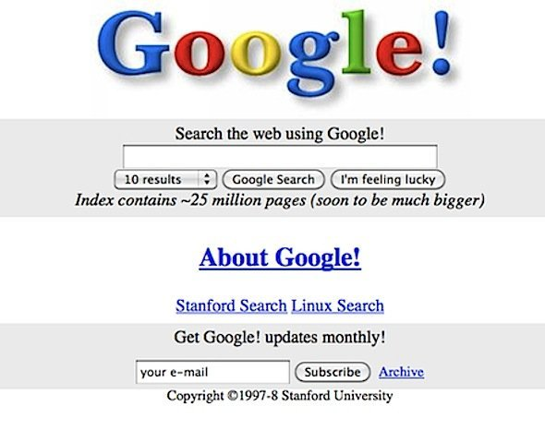
Google 1997-8

Slide 44
The Evolution of Search Engine Features
Search Engine algorithms are constantly changing
They strive to be their
  Efficiency
  How to order the results
    Freshness
    Relevancy
  How to improve user interaction
  Include real time searches
  Additional features

Slide 45
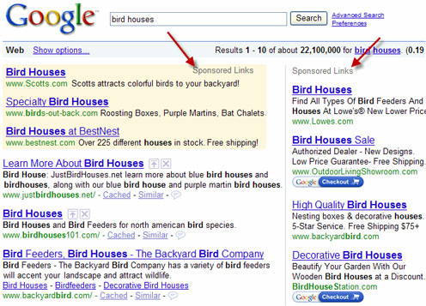
Google Adwords 2000

Slide 46
Relevancy
During 9/11 it was apparent that search engines did not cater of time-sensitive queries
This lead to Google developing Google News
The freshness of search engine’s index became more important

Slide 47
Google 2012
In 1999, it took Google one month to crawl and build an index of about 50 million pages.*
In 2012, the same task was accomplished in less than one minute.*
16% to 20% of queries that get asked every day have never been asked before.*
*Mitchell, Jon. "How Google Search Really Works." Readwrite. February 29, 2012.

Slide 48
Search Verticals
In a bid for content and market share, Search Engines develop other search verticals:
  Books
  Travel
  Finance
  Shopping
  Scholar

Slide 49
Mobile Search
By 2015 mobile accounted for more than half of all searches
Searches need to be context aware (location)
Limited screen and bandwidth means relevancy is critical
Boost mobile-friendly pages in ranking algorithm

Slide 50
More than a Search Engine
Calculator
Images
Infobox - structured information/queries
Translation
Mapping
Voice commands
Personal information eg search email, contacts, web

Slide 51
Search Engines Issues

Slide 52
Boosting web traffic
Search engines direct traffic to websites
85% of people don’t look at the second page
People try to optimise their site so that it ranks highly on Search Engines
Could be fundemental to a website’s business model

Slide 53
Search Engine Optimisation
Whole industry exists trying to boost search ranking
Ensure pages are indexed by search engines
Legitimate SEO (White Hat)
  Good Design
  Eg Valid metadata, alt tags on images
Illegitimate SEO (Black Hat)
  Often gaming search ranking algorithms
  Deception
  Leads to arms race between SEO and search engines

Slide 54
Combatting SEO
Most search engines have rules against:
  Invisible text
  Meta tag abuse
  Heavy repetition
  “domain spam”
    Overtly submission of “mirror” sites in an attempt to dominate the listings for particular terms

Slide 55
Google and other SEs are a Business
Search Engines record tracking information
  Google saves every voice search
  IP addresses
  Location
  Saves your searches
Google’s revenue is from adverts
  Improve their revenue with targeted advertising
Google has a large research department
  Improve their technology

Slide 56
Search Engines - Tracking
Oscobo – no cookies no tracking no ip address no location
Hulbee – no ip address, no browser, no cookies
MetaGer – no ip address, search info, no location no cookies, encrypted https, no sessions
Startpage – send to google, and uses its ip address, no session
Duckduckgo – no ip, search info, no location, no cookies, encrypted

Slide 57
Summary
What types of queries can be answered on the web
Search engines and their basic framework:
  Web crawler
  Search index
  Query engine
  Interface
Their history
Issues with Search Engines

