Slide 1
Web Graph
Web Infrastructure/Web Architecture
COMP 3220/6218
Heather Packer – hp3@ecs.soton.ac.uk
20/11/18

Slide 2
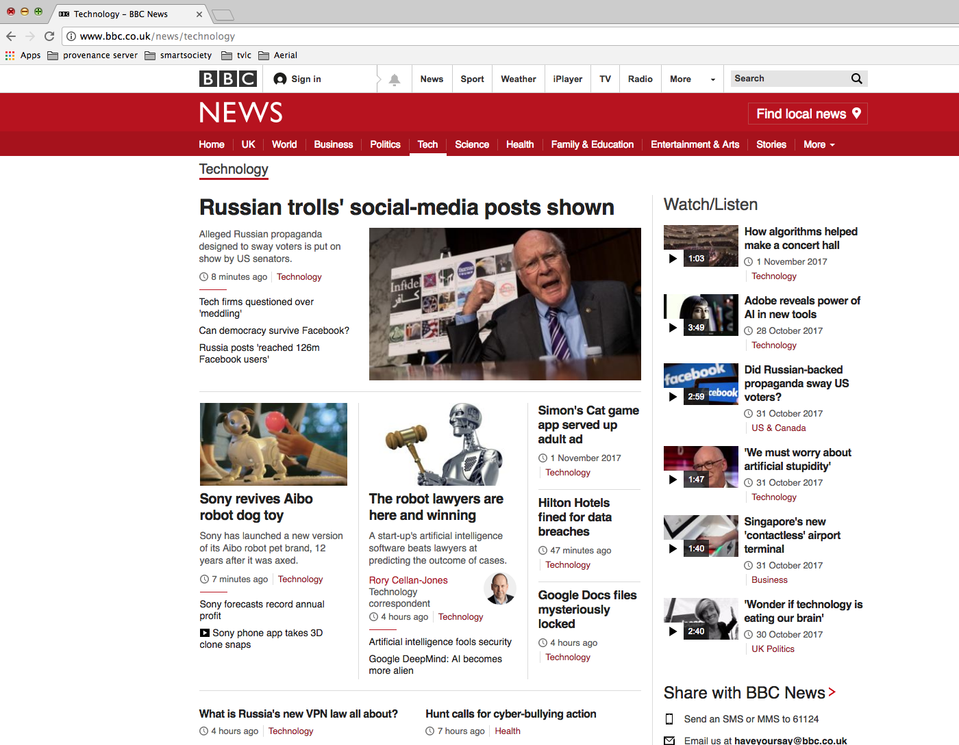
How is the Web Structured?

Slide 3
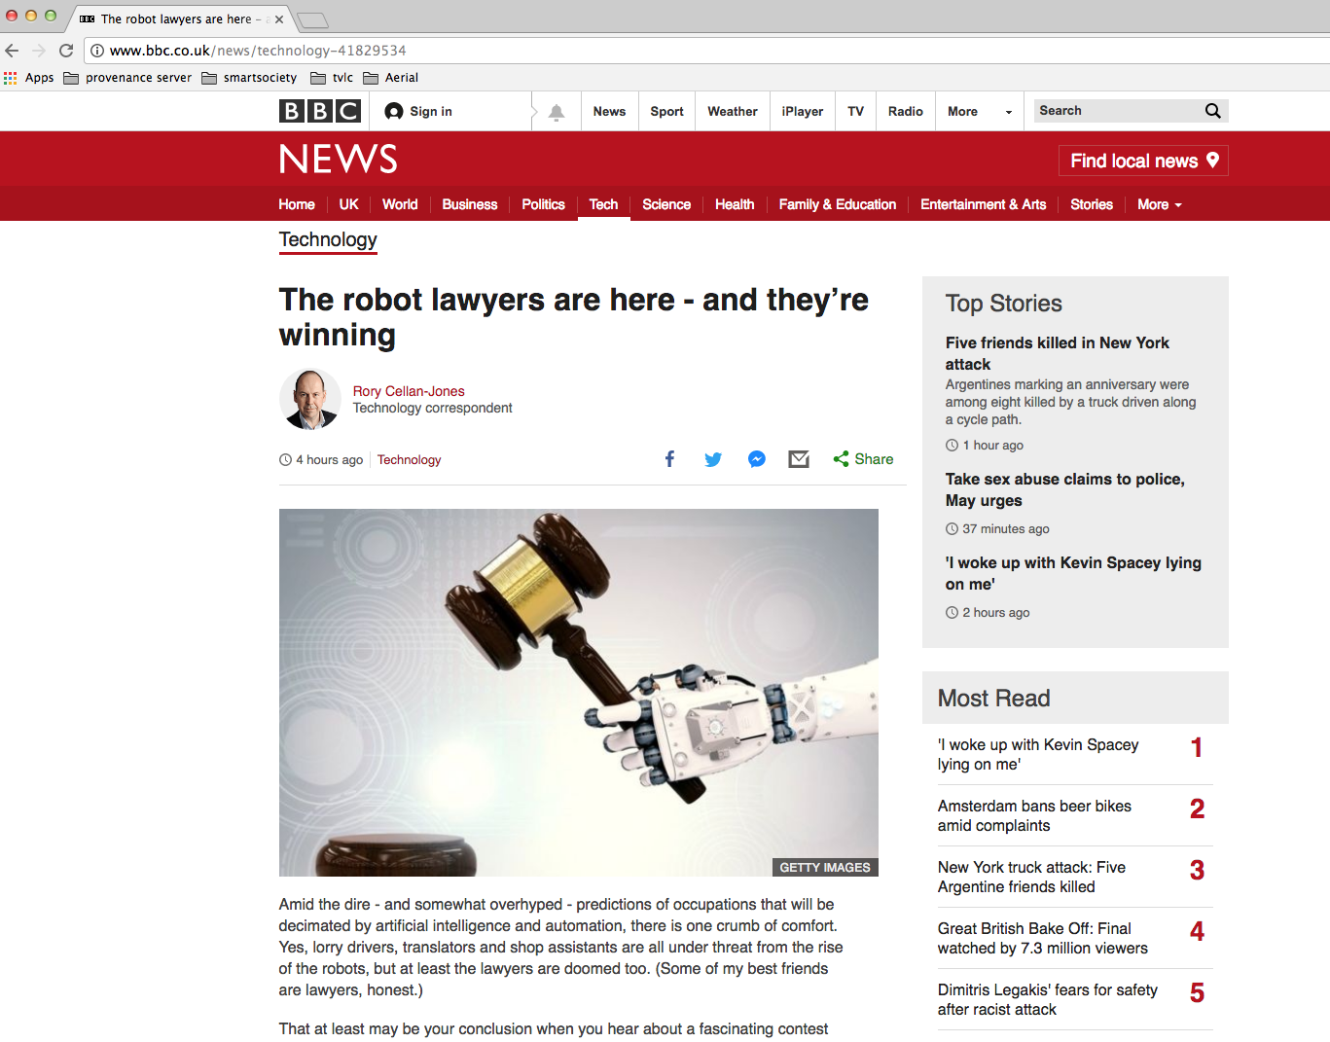
How is the Web Structured?
hyperlink

Slide 4
How is the Web Structured?
Graph Theory: Pages are nodes & links are directed edges

Slide 5
Graphs can Model
The Web
Facebook users
Tweets
Publications
Bitcoin/Block chain transactions

Slide 6
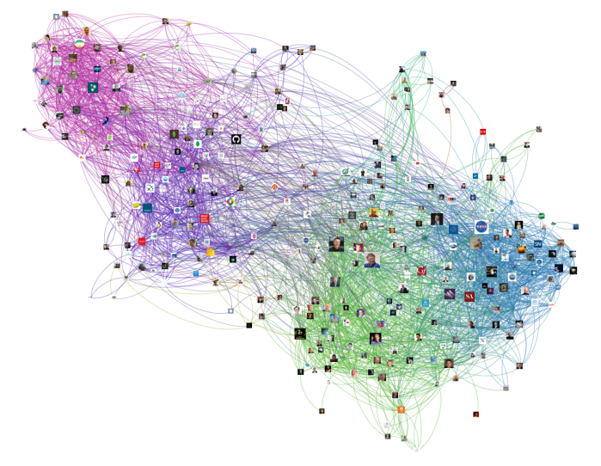

Slide 7
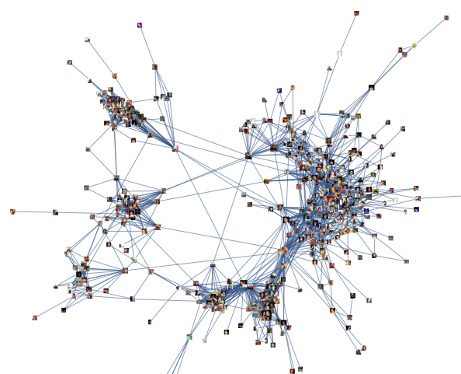

Slide 8
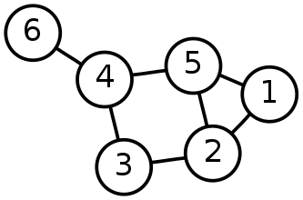
Graph Theory – Useful Measures
Distance between two vertices (v and v’)
Diameter of a graph, longest distance between any two vertices
Average-case diameter, average distance between any pair of nodes (v and v’)
Degree of a vertex, number of edges connected to it
Density of network, ratio of edges to vertices
A graph is made from Nodes or Vertices (V) and Edges (E)
G = (V, E)
Network size, total number of vertices (N)

Slide 9
Which is the Most Important Node?
P
L
Q
M
N
I
O
H
J
K
D
G
A
E
B
F
C

Slide 10
Graph Theory – Is this Node Important?
Importance measures using centrality:
Degree centrality
Betweenness centrality
Nearness centrality
Eigenvector centrality
*Central as in important, vital or `at the heart of’, not near the centre
Notes:
So we’re going to look at four different methods to determine the importance of node.
We’re going to look at four different importance measures using centrality
When I say centrality I don’t mean the center point of a graph, it refers to the importance of node meaning that it plays a vital role in the network.

Slide 11
Which is the Most Important Node?
Eigenvector
P
L
Q
M
N
Degree
I
Closeness
O
H
J
K
D
G
Betweenness
A
E
B
F
C
Notes:
Each of these methods mean something different, you can see as we thought before there is not one right answer.
Lets take a look at these approaches in more detail.

Slide 12
Degree Centrality
F
Degree centrality focuses on individual nodes – it simply counts the number of edges that a node has
Hub nodes with high degree usually play an important role in a network
B
deg(E)=5
G
C
A
E
deg(A)=4
H
D
I
J

Slide 13
Degree Centrality – In Degree
F
In degree – links to a vertex
Often used as a proxy for popularity
A web page is important if lots of things link to it
A twitter user is important if lots of other users follow it
A journal article is important if lots of other articles cite it
B
inDeg(E)=4
G
C
A
E
H
D
I
J

Slide 14
Degree Centrality – Out Degree
F
Out degree – links from this vertex
Authorities on a topic
B
inDeg(E)=4
G
C
A
E
outDeg(E)=1
H
D
I
J

Slide 15
Degree Distributions
Degree distributions p(k)
A plot showing the degree of nodes in a graph
F
1
B
1
G
1
C
1
A
E
Number of Nodes
4
5
H
D
1
1
I
Number of links
2
J
1

Slide 16
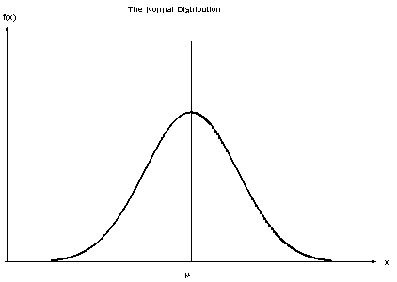
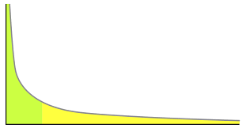
Degree Distribution Examples
Normal distribution
The average degree is most likely
Very high and very low degrees are highly unlikely
Power law distribution
No meaningful average degree
Very low degrees are likely, but very high degrees are unlikely

Slide 17
Power Law Networks
Some nodes have a tremendous number of connections to other nodes (hubs)
Most nodes have just a handful of links
Robust against accidental failures, but vulnerable to coordinated attacks
Nodes can have millions of links: The network appears to have no scale (no limit)
hubs

Slide 18
Betweenness Centrality
Number of shortest paths going through a node
A node that has high betweenness is vital to the communication of the network
Many/most messages between two nodes must travel through it.
E
B
A
D
F
C

Slide 19
Betweenness Centrality
Betweeness Centrality for A
B to D
B to E
B to F
C to D
C to E
C to F
BC(A) = 6
E
B
A
D
F
C

Slide 20
Closeness Centrality
Closeness is the average of the shortest distances to all other nodes in the graph
The farness of a vertex with respect to a graph is the sum of its distances to every other vertex in the graph
The closeness of a vertex is the inverse of its farness
E
B
1 ms
1 ms
1 ms
3 ms
A
D
2 ms
1 ms
F
C

Slide 21
Closeness Centrality
Closeness centrality of A
A to B = 1 ms
A to C = 1 ms
A to D = 1 ms
A to E = 2 ms
A to F = 3 ms
CC(A) = 1.6 ms
E
B
1 ms
1 ms
1 ms
3 ms
A
D
2 ms
1 ms
F
C

Slide 22
Eigenvector Centrality
F
Eigenvector measures the popularity by looking at the quality of links
Identifies whether a node is connected to influential nodes
PageRank is an example
B
G
C
A
E
H
D
I
J

Slide 23
What do the Measures Tell Me?
Degree: exposure to the network, opportunity to directly influence
Betweenness: informal power, gate keeping, brokering, controls flow of browsing
Closeness: estimates time to receive information, indirect influence, point of rapid diffusion
Eigenvector: connected to influential nodes of high degree, “not what you know but who you know”

Slide 24
Google’s PageRank Algorithm
Number of links
Pages with more in links rank higher, than a page fewer in links
Link Quality
A link from an important page is worth more than many links from relatively unknown sites
Link Context
The text in and around out links relates to the page they point at.
Ranking boosts on text styles

Slide 25
PageRank: Original Formula
PageRank (PR) of page u is given by the summation of the PR of all pages in the set of all pages linking to page u (v∈B_{u}), divided by the number of L(v) of links from page v
Iterative formula, starting with rank 1/n for all n pages

Slide 26
PageRank: Surfer Model
Usage simulation
Based on a model of a Web surfer who follows links and makes occasional haphazard jumps
User randomly navigates
Jumps to random page with probability p
Follows a random hyperlink with probability 1-p
Never goes back to a previously visited page

Slide 27
Google and PageRank
PageRank was the first ranking algorithm and most well known
Today PageRank is not the only algorithm used
PageRank score used to be available through the browser
PageRank can and was gamified

Slide 28
What Does the Web Look Like?

Slide 29
What Does the Web Look Like?
Experimental Observations [Barabasi, Albert (1999)]
Sparse graph
Power law
Small world network
The Shape of the Web [Broder et al (2000)]
2005 what the web looks like

Slide 30
Small World Network
Six Degrees of Separation is a theory that everyone is 6 or fewer steps away from any other person in the world
Experiment by Stanley Milgram in the 1960
300 letters
Sent to intermediary person on a first name basis
64 made it
Average hops of 5.2 intermediaries

Slide 31
Small World Network - Erdos

Slide 32
Small World Network - Erdos

Slide 33
Small World Network
Small World Network is a graph which most nodes are not neighbours but most nodes can be reached by a small number of connections
Website links
Social networks
Wikipedia
Many hubs – pages with many in links
Robust for random node deletions

Slide 34
Experimental Methodology
Intuition: Networks grow by iterative process
Simulate growing a network and then examine its properties
Experiment with different models
For example: Preferential attachment means that the more connected a node is, the more likely it is to receive new links
This can lead to the power law distribution
Eg: Links on the web or Citations to scientific papers

Slide 35
What does the Web look like?
Experimental Observations [Barabasi, Albert (1999)]
Sparse graph (n vertices, mn edges)
Small world network
Power law
The Shape of the Web [Broder et al (2000)]
The Opte Project 2003

Slide 36
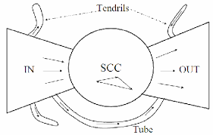
The Bow Tie
Strongly Connected Components
In links
Out links
Tendrils and Tubes

Slide 37
Web Graph Results
The diameter of the central core (SCC) is at least 28, and the diameter of the graph as a whole is over 500
The probablity of a path between randomly chosen pairs is only 24%
Average directed path length is about 16
Average undirected path length is about 6

Slide 38
What does the Web look like?
Experimental Observations [Barabasi, Albert (1999)]
Sparse graph (n vertices, mn edges)
Small world network
Power law
The Shape of the Web [Broder et al (2000)]
The Opte Project 2003

Slide 39
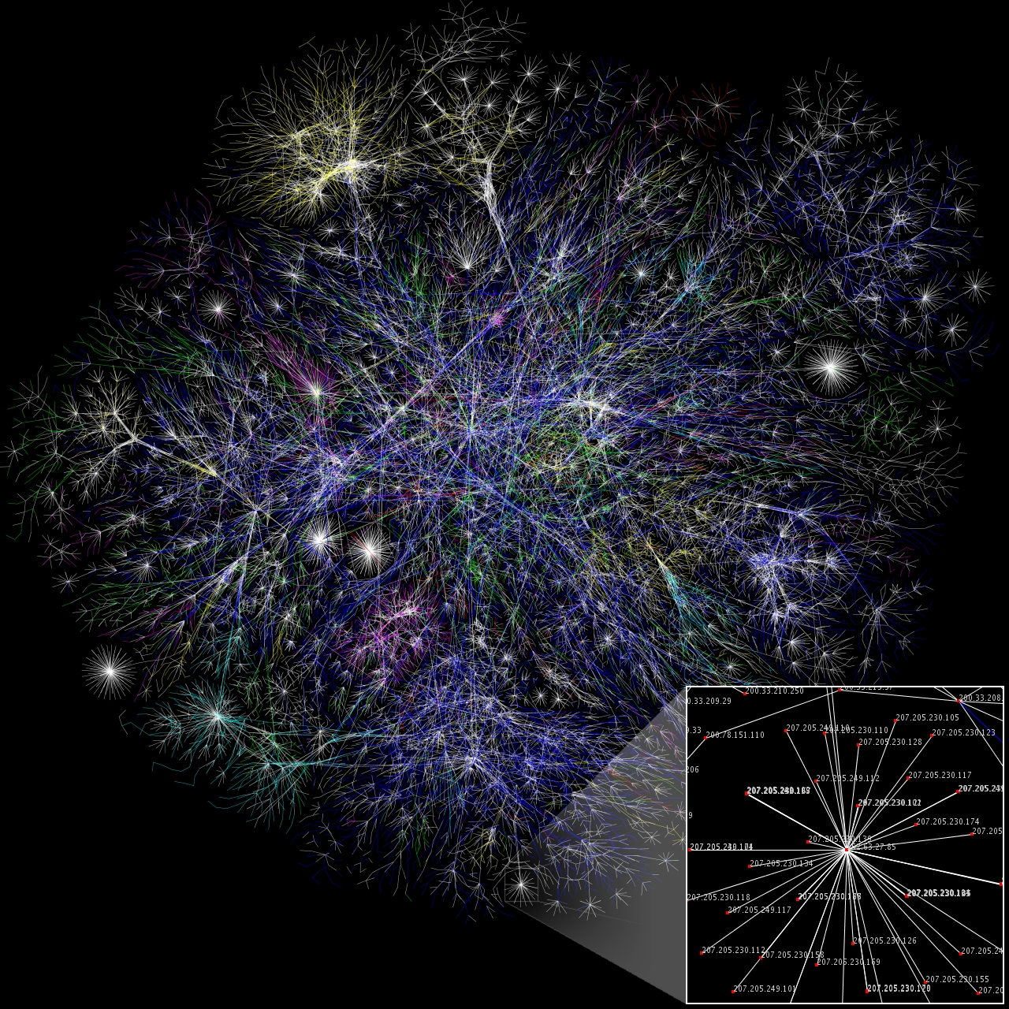
Web Graph
Notes:
Partial map of the internet based on the January 15, 2005 data. Each line drawn between two nodes representing two IP addresses. The length of the lines are indicative of the delay between those two nodes.
Map of the internet
2000 - 200 million nodes 1 billion edges (no map reduce/ hadoop)
Web is bigger, specialised systems

Slide 40
Modern Web Research
Temporal aspects – how is the Web Graph evolving over time?
Information aspects – how does new information propagate throughout the web (or blogosphere, or twitter, ...)
Finer-grained structure – how to define and compute “communities” in information and social networks

Slide 41
Summary
The Web can be modeled as graph
Importance Measures
Page Rank
What the Web looks like at scale

