Slide 1
How do I research effectively? Part 2
COMP1205
http://edshare.soton.ac.uk/19120/

Slide 2
Begin with a reminder…

Slide 3
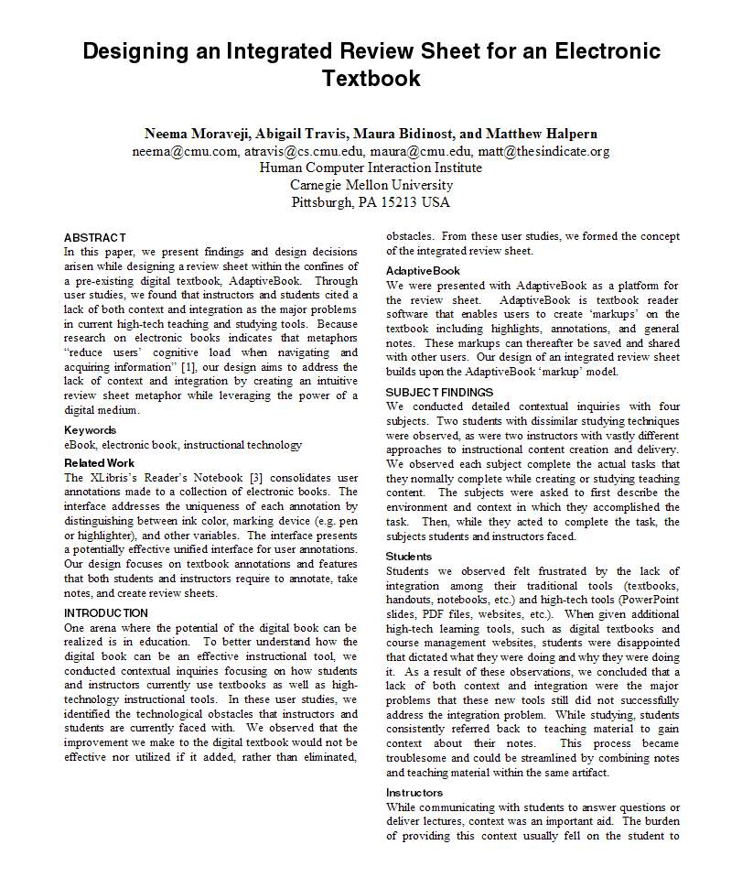
The Scholarly Trail
They cite a source which
will be “referenced” at
the end of the paper
The Blue bubbles are all “Citations”
This person said this
This person has done this
And this person said this
And this person has done this
“
And this
is my summary of this person’s work
”
And this quote came from here

Slide 4
Good source/poor source?
A Facebook Page?
Someone’s Blog?
A company website?
A Newspaper Article?
A magazine?
A trade journal?
A talk presented at a conference?
A Wikipedia page?
An open source pre-print journal paper?
A scholarly journal paper?
A book?

Slide 5
Why? What makes one source better than another?
Authoritative
We must identify information which is reliable and true
preferably written by the person who is the authority i.e. a primary source
rather than an author who is quoting the primary source i.e. a secondary source
Findable
Your reader must be able to follow your reference to find the article or book in their library or on-line.
The thing they find must not have changed since you referenced it.

Slide 6
Where do we find sources of information?
Serendipity:
references in articles, blogs, newspapers, videos stumbled across by good fortune
Systematic search
Google (or other search engine)
Google Scholar
Wikipedia (for orientation) but beware use but only to follow up the references they have found)
The Library
common student mistakes
What they do:
Student finds an article and cites it from CiteSeer
What they need to do: read the paper you find, but locate the definitive source of the information

Slide 7
Example: Somehow from citeseer…

Slide 8
1. Check out via google scholar

Slide 9
2. Confirm contents and grab citation

Slide 10
3. Try to get a copy via university
Log in to journal
Select shibboleth option
Log in via soton through shibboleth
Discover that you still can’t access the document
Find another way….
PS if you are working off campus, make sure on all your searches that you are connected via vpn – global connect

Slide 11
4 – find another way Full text via researchgate

Slide 12
Before we begin CW3…
Let’s think about our activity in the real world..
You have a task…
Prepare a technical report
What do you know already?
How can you get up to speed quickly?
How can you complete the task in the most efficient way possible?

Slide 13
Lets take a look at the topics
You don’t get to choose a topic
You have to submit
An abstract – week 9 for small group feedback 30th November
A draft for submission to the turnitin plagiarism checker – week 11 13th December
Final report 11th January
Topic List
http://edshare.soton.ac.uk/19454/
Download https://goo.gl/W2CiRQ

Slide 14
Lets look at the topics
Think about the topics
Who knows what topic they have been allocated?
How confident are you that you will be able to
do the work well
meet all the deadlines
NEXT: Suggestions on how to go about preparing
Topic List
Topic List

Slide 15
First stage orientation
Suggest some search terms or strategies :-)
http://google.co.uk/

Slide 16
Second stage focussed searching
Suggestions of search terms or strategies
http://scholar.google.co.uk/

Slide 17
But lets back up…
One touch
What tools and note taking methods?
How will we go about the writing?
How many stages to the writing?
Lets plan a timeline

Slide 18
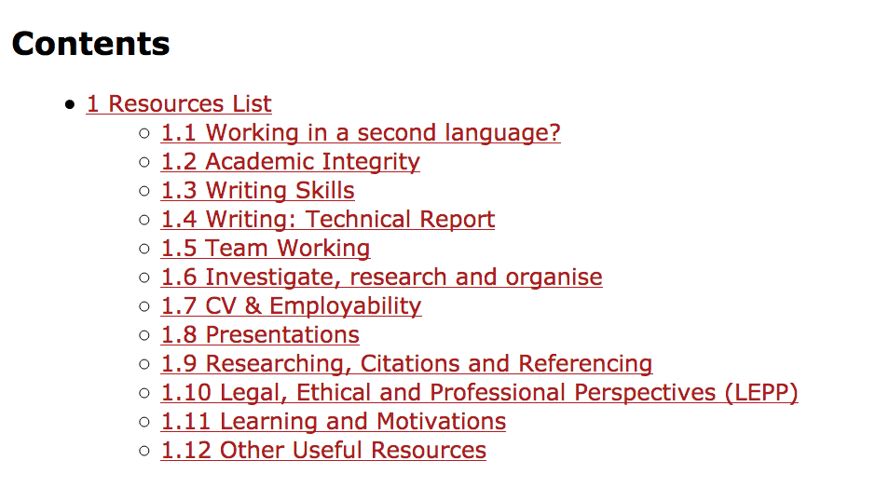
We have thought about this before

Slide 19
Probably we are running out of time
So – what are you going to do next?
Example of bullet list continuation
Rule of three

Slide 20
Search Terms
Coming up with good terms to put into a search engine is a skill
(Librarians are the people who know how to do this best)
In general thinks of
Keywords
Synonyms
Alternative Spellings
Common Abbreviations

Slide 21
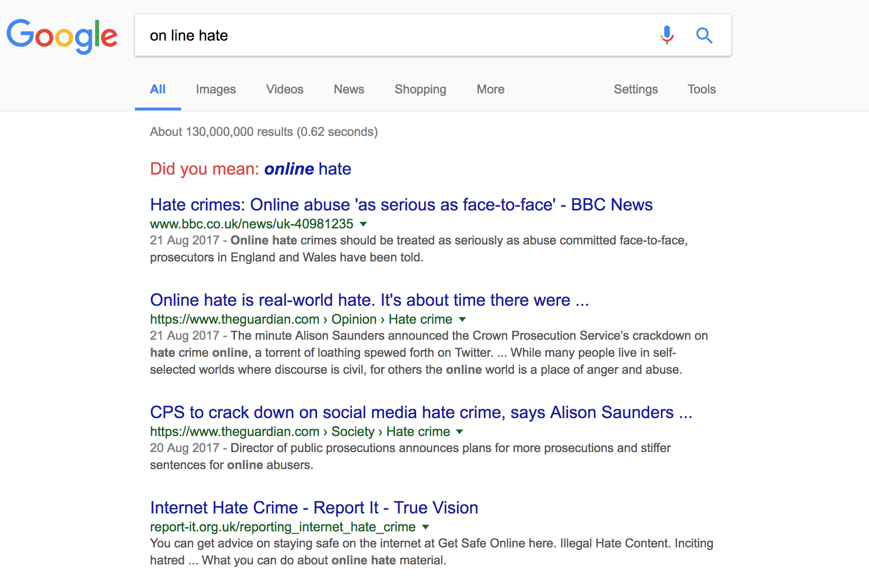
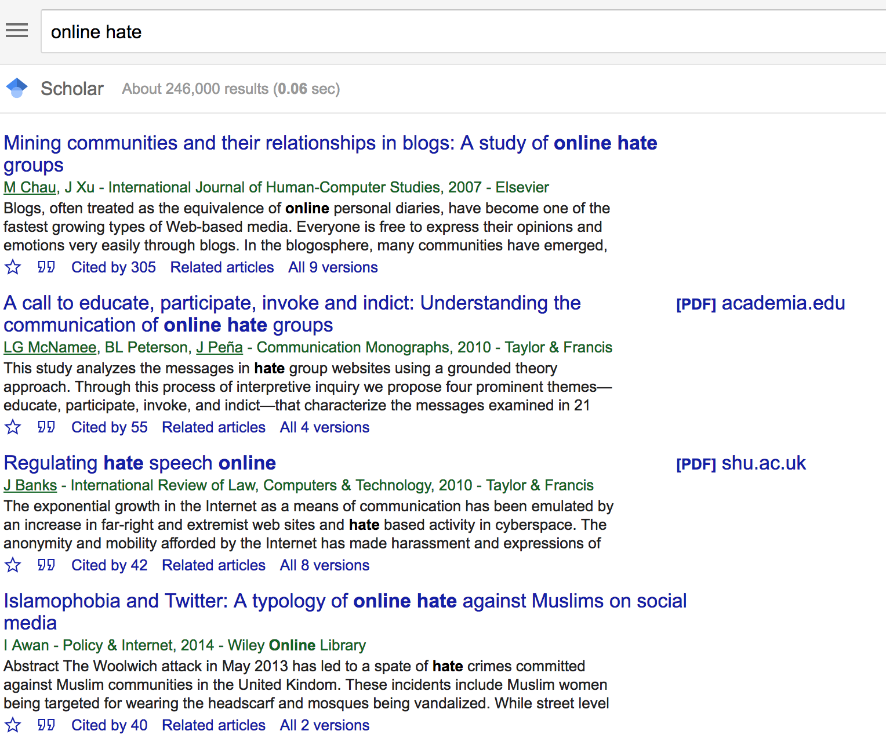
Google vs Google Scholar

Slide 22
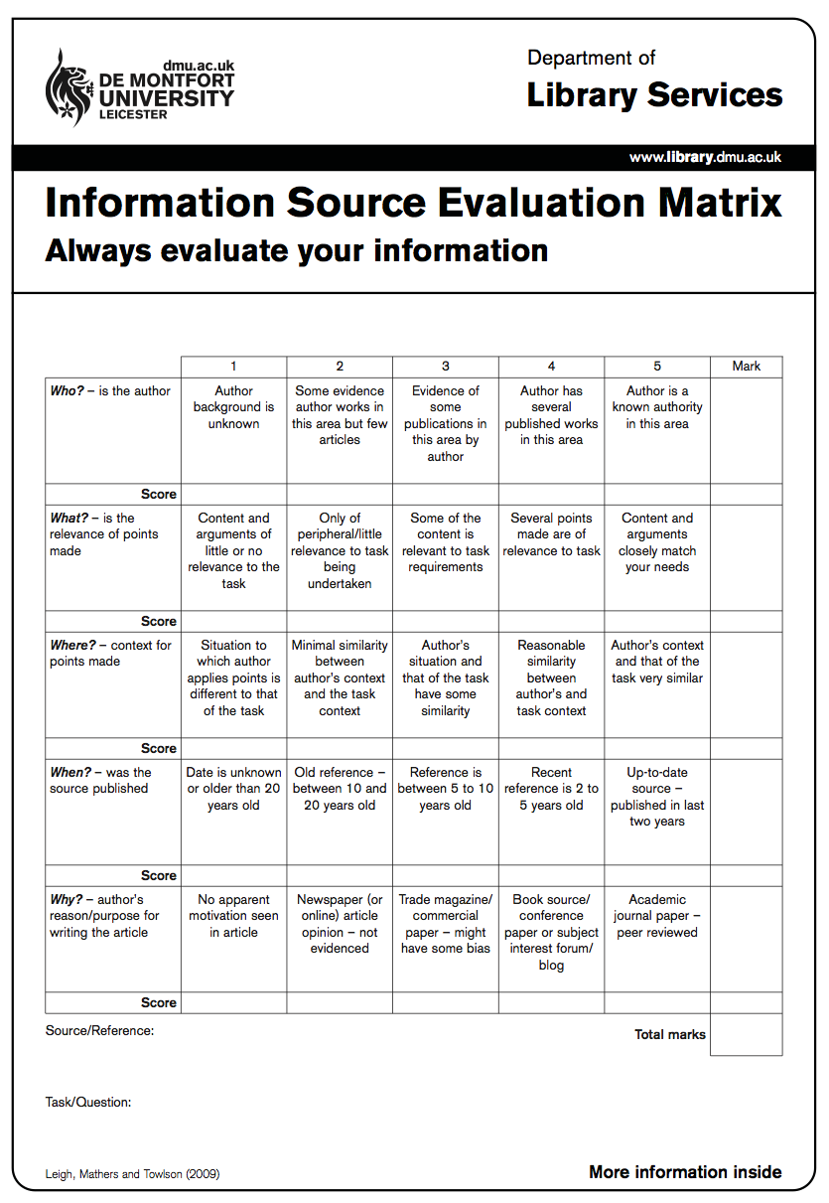
Evaluating the Sources you find
Who is the author
What is the relevance of the points made?
Is the context correct?
When was the source published?
What was the publication medium?

Slide 23
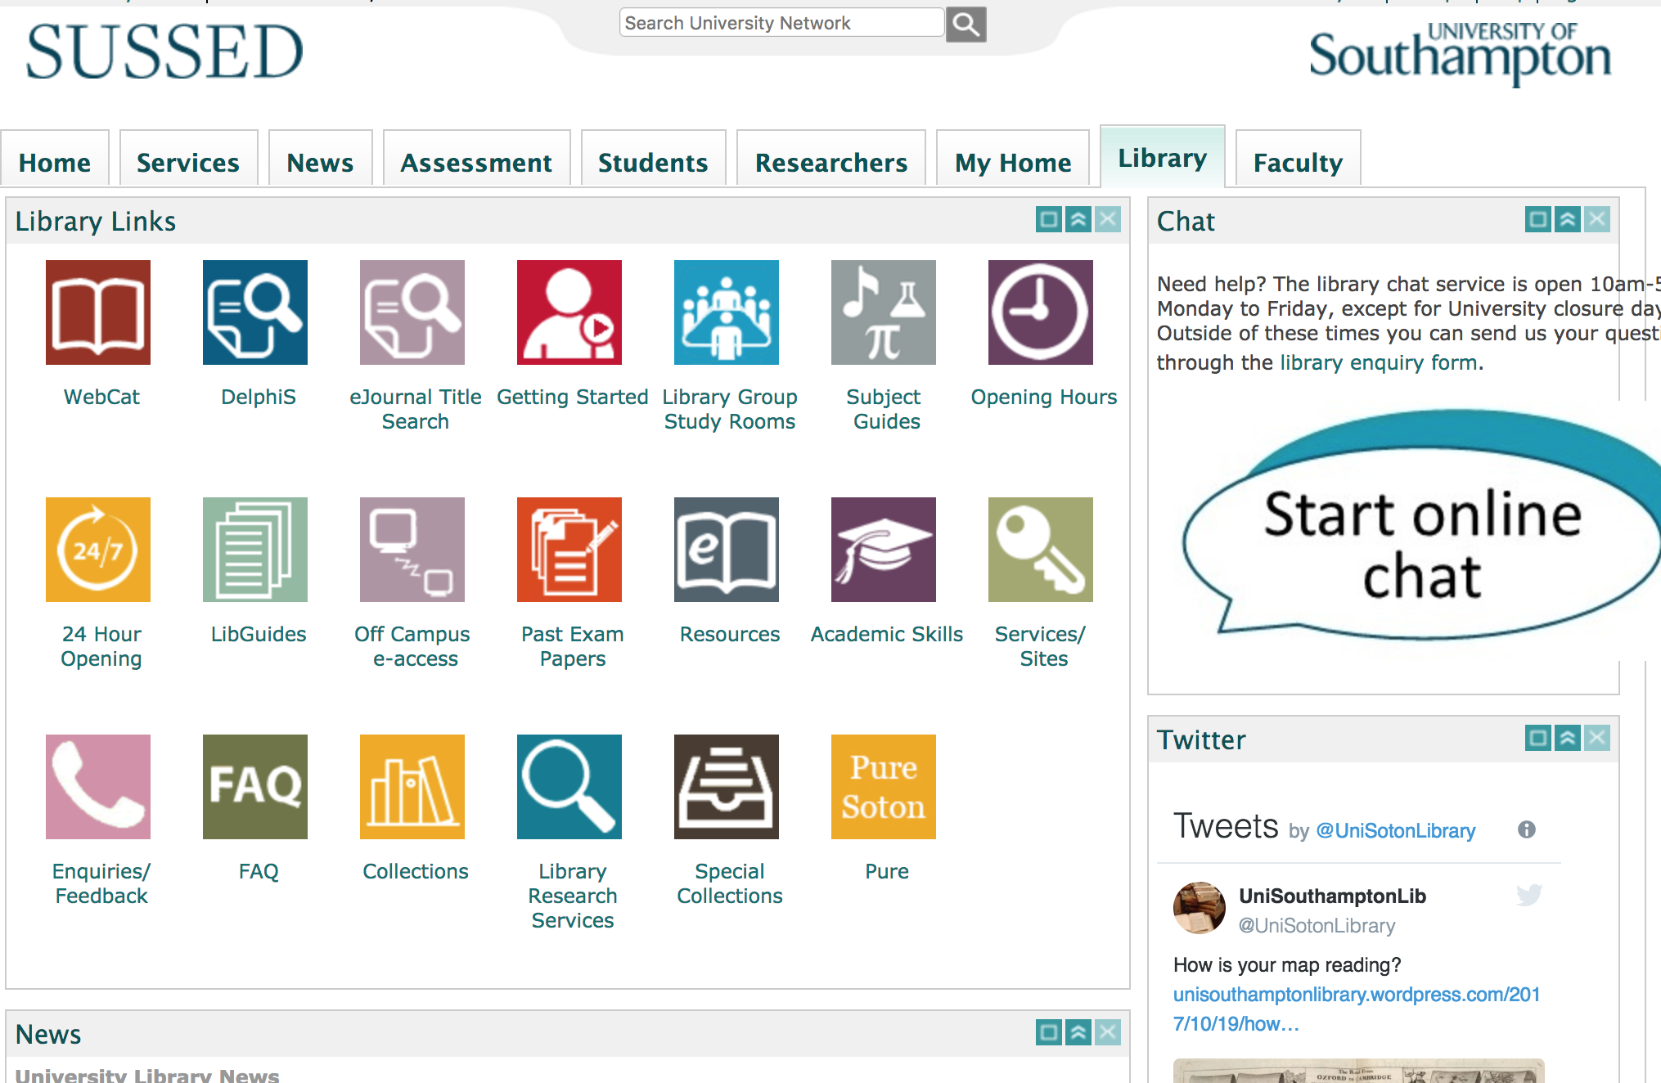
Finding Papers you have seen referenced

Slide 24
Access to on-line journals
You usually need to have accessed the journal through the university library
May need to login to say you are from University of Southampton along the way
Access to *most* quality journals is available on line.
Including all the ACM and IEEE journals and conference proceedings

Slide 25
Thank you
Any Questions?
Su White
saw@soton.ac.uk

