Slide 1
WEBS6203
Interdisciplinary Thinking
Reminders
Courseworks 2 &3

Slide 2
How this module is structured
An exercise in Interdisciplinary thinking
Developing and evolving your understanding
Rehearsing arguments
Exploring ideas
Explore and research topic areas
Identify a web science research question which can be considered from two distinct disciplinary perspectives
Decide on a comparative study

Slide 3
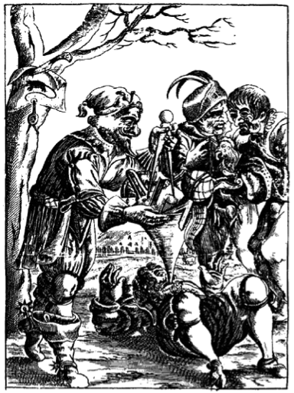
What this module is not about
We are not pouring knowledge in!
We are not telling you what to write!
We are not telling you what to research!

Slide 4

What this module is about
Learning by doing
Refining our approaches
Individual learning

Slide 5
Assessment reminder
Research and report
  CW1 annotated bibliography
  CW2 annotated abstract plus slideshow
  CW3 report
Exploring a question
Which approaches a web science topic from two individual disciplinary perspectives
  Which you have not studied in any depth before
Milestones
Title
Literature review
  Annotated bibliography
Abstract
  For the annotated bibliography
  For the final report (later)
Extended Abstract
Slideshow based on your extended abstract (assessed)
Structured draft
Peer review
Written Report (assessed)
Check the module web site for links to the handins

Slide 6
Resources
The course guide
  Coursework descriptions
  The timetable
  Reading lists
  (for early weeks)
The module web site
  Handin machine
  Links to resources online
  Links to EdShare
Your tasks
Learning to become a scholar
  LOTS of reading
  more reading
  Discussing your reading
  Thinking and reflecting
  LOTS of writing

Slide 7
What we expect you to do
1. DEFINE problems, issues, topics or questions that warrant interdisciplinary examination
2. PRESENT a clear rationale for taking interdisciplinary approach including the advantages to be gained
3. IDENTIFY relevant disciplines
4. CONDUCT a literature review (what is known on the topic from each of the disciplines)
5. DEVELOP a command of each relevant discipline set out the analytical structure central to each discipline, identify key underlying assumptions, and methods of evaluation.
6. STUDY the problem and generate insights including predictions from each of the relevant disciplines - in isolation!!
7. IDENTIFY conflicts between and/or areas of complementary between the insights offered from each discipline
8. CREATE common ground by developing a cohesive framework of analysis that incorporates insights from the relevant disciplines in a systematic manner
9. COMBINE disciplinary insights to construct new more integrated understanding of the problem
Repko & Welch 2005

Slide 8
Repko: The flow of activities
problem
Disciplinary insights
Integration
Understanding

Slide 9
How to demonstrate your learning
Extended Abstract and Slide show
Report
Provide a structured overview of your chosen areas
Communicate key points in visually compelling manner
Annotated bibliography
conduct a literature review
select and critique a set of papers
identify a topic
Revise and refine
Revise and refine
reading
discussing
reviewing
thinking
reflecting
revising

Slide 10
The abstract sequence
Context
Problem
Statement
Proposed Methods
Findings
Recommendations
what is in your following text
Or
What you plan to present

Slide 11
Examples of types of content in an abstract
Context
Why does it matter?
What is the scale and scope of your chosen area?
  How many are affected?
  What does it cost?
  …
Problem statement
Current research is faulty
The problem has changed/is evolving
Estimates of scale are not well informed
…
You will have far more information than you can fit in the absract

Slide 12
Your proposed methods or solutions will address the problem statement
Problem statement
Current research is faulty
The problem has changed/is evolving
Estimates of scale are not well informed
…
Proposed method
How you will do better research
How you will gather data to give true estimate of the problem
How your method will evolve with the problem
How you will get better data
How different methods and different disciplines can enhance our understanding

Slide 13
Findings/Recommendations
Findings: In an early abstract
You needs to suggest the likely shape of the recommendations
  Data collection methods
  You are trying to point towards a plausible way forward
Or simply explain anything remaining about the document/artefact for which you are providing an abstract

Slide 14
You cant expect to get it right first time
Its an iterative, iterative process
Pre-writing
Writing
Revising
Abstract
Extended abstract + slides
Research report

Slide 15
For each coursework you will
Work through the process
Pre-write
Write
Revise
Expect to
Understand more
Discover insights
Have to make compromises

Slide 16
Titles
Your title will change

Slide 17
Revisit the abstract sequence
Context
Problem
Statement
Proposed Methods
Findings
Recommendations
Review and revise your abstract based on reflection, discussion, feedback
Expand each section, cite key references

Slide 18
Structure your report
Abstract
Introduction
Body
Discipline 1
Discussion
References
Further reading
Discipline 2
Focus and Methods
Focus and methods
Conclusions
Web Science and Interdisciplinarity
How they relate to your report topic
Recommendations
Title
Keywords
Develop, review and revise your report based on
reflection, discussion, peer review, self evaluation

Slide 19
Peer review
In your reading group sets
Each provide a draft to each other member
Author
Ask for specific feedback
Explain any difficulties you have experienced in the writing process
If the draft is incomplete provide indicative content which the reviewer can understand
Reviewer
Provide feedback on specific questions
Look at each section against the mark scheme, make suggestions as to how the content might be improved
Identify any parts of the text you found difficult to understand and try to explain your reasoning
Be careful to remain constructive at all times in your feedback – your task is to help improve the work being reviewed

