Slide 1
Privacy and Interdisciplinarity.
How Different Disciplines Are Needed to Understand the Privacy Wars
Kieron O’Hara 05 November 2018
Notes:
Please use the dd month yyyy format for the date for example 11 January 2008. The main title can be one or two lines long.

Slide 2
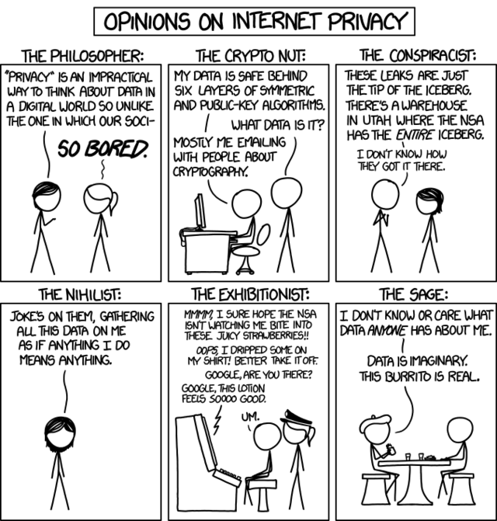
What is Privacy?

Slide 3
‘A Concept in Disarray’
Daniel Solove, Understanding Privacy
“Any attempt to locate a common denominator for all the manifold things that fall under the rubric of ‘privacy’ faces an onerous choice. A common denominator broad enough to encompass nearly everything involving privacy risks being overinclusive or too vague. A narrower common denominator risks being too restrictive.”
“Perhaps the quest for a common denominator is a search for the holy grail. What if there is no essence or core dimension of privacy?”

Slide 4
‘A Concept in Disarray’
Jeff Jarvis, Public Parts
“Do you feel any closer to a definition of privacy? I don’t. I see a confused web of worries, changing norms, varying cultural mores, complicated relationships, conflicting motives, vague feelings of danger with sporadic specific evidence of harm, and unclear laws and regulations made all the more complex by context.”

Slide 5
Its Multifarious Nature
“Thus privacy is a fundamental right, essential for freedom, democracy, psychological well-being, individuality, and creativity. It is proclaimed inviolable but decried as detrimental, antisocial, and even pathological. Some claim that privacy is nearing extinction; others argue that the threat to privacy is illusory. It seems as though everybody is talking about ‘privacy,’ but it is not clear exactly what they are talking about.” (Solove)

Slide 6
Its Multifarious Nature
“Thus taxation is a fundamental duty, a means to keep the state going, promote citizenship and inclusion, redistribute wealth and decrease inequality, promote certain types of behaviour and disincentivise others, or maintain the social contract. It is decried as state-sponsored theft, oppression and a disincentive to thrift, innovation or self-reliance. Some claim that we should tax wealth, others income, property, carbon dioxide, consumption, cigarettes, imports, luxuries, land, financial transactions or inheritances. Some want taxes to be progressive, others at a flat rate, and still others want negative income taxes. There is barely any similarity between, say, the administration of a medieval tithe and a value-added tax in a 21st century digitised economy. It seems as though everybody is talking about ‘taxation,’ but it is not clear exactly what they are talking about.”

Slide 7
What’s Going Wrong?
Example: “The freedom from unreasonable constraints on the construction of one’s own identity” (Agre & Rotenberg)
Whole theory about privacy and its value baked into the definition
What is reasonable/unreasonable?
What about activities that don’t construct an identity?
Are there ramifications about the idea that the interference with constructing an identity precedes the construction?
Why would anyone not want this?

Slide 8
Yet Isn’t It Simple Really?
OED, “being withdrawn from society or public interest … avoidance of publicity”
If we can discuss the state of (lack of) privacy independently of our claims to it, the rights associated with it, our preferences about it, our control over it, and the value of it, could we begin to make more sense?

Slide 9
A Sketch of Privacy
To do with the boundaries of the self and group
Comes into play when we entertain first person possessive adjectives
My/our
That’s my/our business
My information, my body, my personal space, our property, my image, my family, my thoughts, our intimate secret, my friends, my history, my income, our ambitions, my shame, our meeting, my bodily functions, the skeleton in my closet

Slide 10
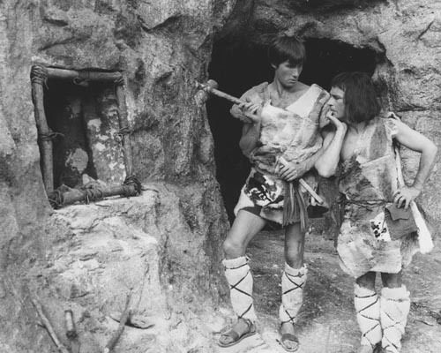
Example: The Window

Slide 11
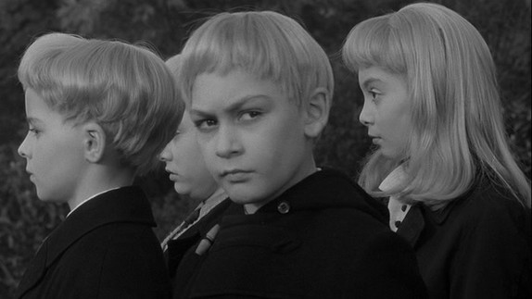
Example: Telepathy

Slide 12
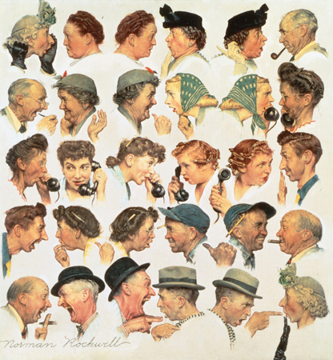
Why the Confusion?

Slide 13
Because Different Conversations Are Going On
Specifically, privacy affects us in different ways, and we need a range of disciplines to understand them all
Who is saying what, in what language?

Slide 14
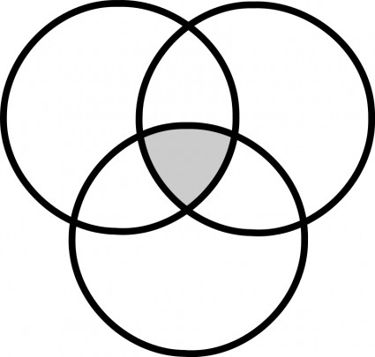
Different Perspectives
Social
Technical
Individual
http://clipart-library.com/clipart/1048447.htm

Slide 15
Level 1: Concept
What conceptions of privacy (breaches) govern the relevant space?
Different types of breach
How do new practices/technologies affect us?
Plug your own idea in here
A state
Linguistic markers
Philosophy

Slide 16
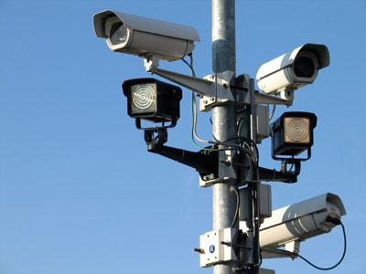
Level 2: Affordances
Is there a breach of privacy?
What intrusions does the architecture facilitate?
It does NOT mean
Have my rights been breached?
Has the law been broken?
Has harm been incurred?
Have I noticed anything untoward?
Has anything happened that I care about?
Cybersecurity, design

Slide 17
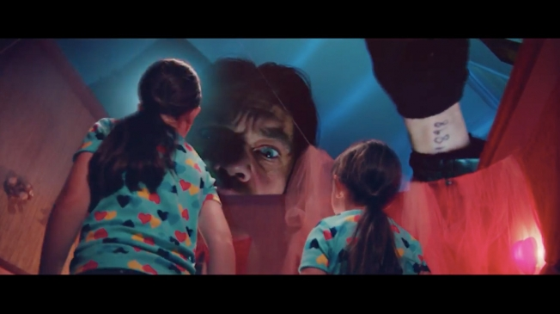
Level 3: Phenomenology
What does the breach/non-breach feel like?
Shame, outrage, creepiness, pride
Do I even notice?
Little work at this level
Creepiness literature
Facebook
Harzog, Privacy’s Blueprint

Slide 19
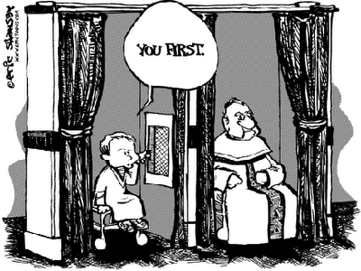
Level 4: Preferences
What do I want?
When do I want visibility to my network?
When do I want to be concealed?
What exposure to others do I want?
Cognitive psychology, microeconomics
Control, consent, privacy markets
Altman
Adjusting/negotiating boundaries
Acquisti
Privacy paradox

Slide 20
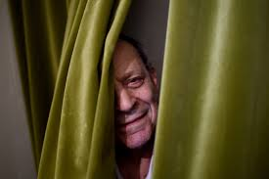
Level 5: Norms
Regularities, conventions, expectations, ethical codes
Variations across culture, classes
Reasonable expectations
Relation to other norms
Sociology, cultural psychology
Nissenbaum, contextual integrity

Slide 21
Level 6: Law
Privacy is not a legal concept!
Unlike data protection
It is regulated by law
Privacy law
Tort, contract, property
Rights
Regulation of private sector space
Solove
http://www.tellymix.co.uk/reality-tv/strictly-come-dancing/279072-judge-rinder-just-stormed-strictly-come-dancing-ballroom.html

Slide 22
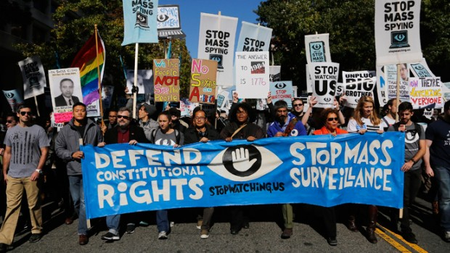
Level 7: Value
What is right/wrong?
(Nature of) privacy rights
Why do we need it?
Political effects
Democracy (Westin)
Security (Etzioni)
Autonomy of the citizen (Rössler)
Economics of big data & innovation
Asymmetrical information flow & power
Moral philosophy, political theory, macroeconomics, social theory
https://popularresistance.org/developing-a-people-centered-security-culture/

Slide 23
These Levels Interact
Privacy breach feels bad because norms are broken
My preferences may be unreasonable
Privacy law seeks to outlaw or deter harms
Cybersecurity aims to give control to data subjects or controllers
I want to share information because SNSs make it feel good
Data sharing habits are incompatible with democracy
US law supports individual preferences
EU law realises norms and political outcomes
Consent implements control in a legal framework

Slide 24
… But Remain Distinct
If my preferences are unreasonable, that does not mean they are cannot be my preferences
If EU law supports social norms, that does not mean that norms are the law, or that we can determine the norms by looking at the law
If a PDS allows control within an economic framework, that does not mean that whatever I achieve is my preference
If an effective cybersecurity programme is in place, that does not mean that people feel safe
If privacy law legitimises a set of practices, that does not mean that those practices do not breach privacy
SO WE NEED TO WORK AT THE INTERFACE BETWEEN DISCIPLINES

Slide 25
The Landscape of Discourses
1: Conception
Technical
2: Affordances
3: Phenomenology
Individual
Descriptive
4: Preferences
5: Norms
Normative
6: Law
Social
7: Value
Political

Slide 26
Disclaimer
Texts, marks, logos, names, graphics, images, photographs, illustrations, artwork, audio clips, video clips, and software copyrighted by their respective owners are used on these slides for non-commercial, educational and personal purposes only. Use of any copyrighted material is not authorized without the written consent of the copyright holder. Every effort has been made to respect the copyrights of other parties. If you believe that your copyright has been misused, please direct your correspondence to: kmo@ecs.soton.ac.uk stating your position and I shall endeavour to correct any misuse as early as possible.

