Slide 2
Documenting REST
COMP3220 Web Infrastructure COMP6218 Web Architecture
Dr Nicholas Gibbins – nmg@ecs.soton.ac.uk

Slide 3
Exercise
Five-minute discussion in pairs:
What are the key aspects of a RESTful interface?
How could you document each of these?
(remind yourselves of the three parts of the Web architecture)

Slide 4
Identification

Slide 5
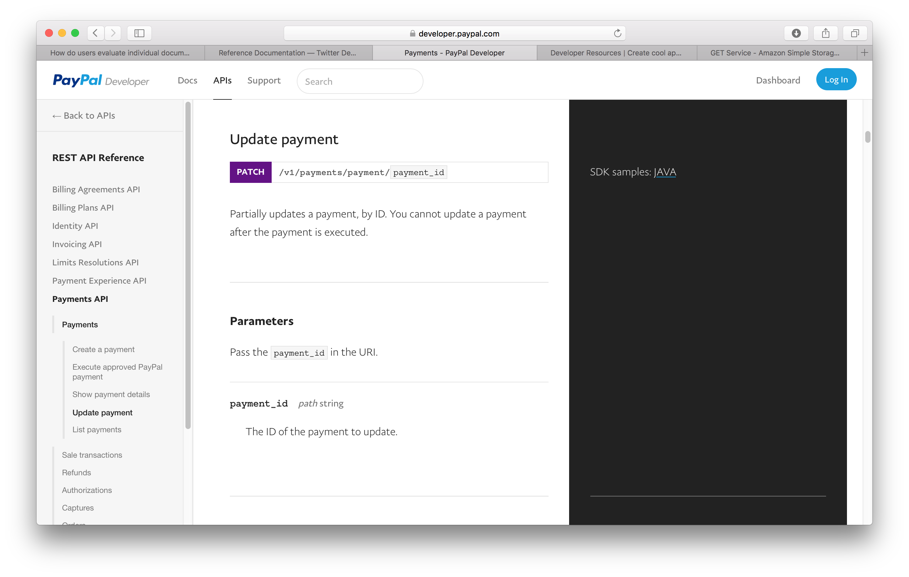
URIs

Slide 6
URI Parameters

Slide 7
Interaction

Slide 8
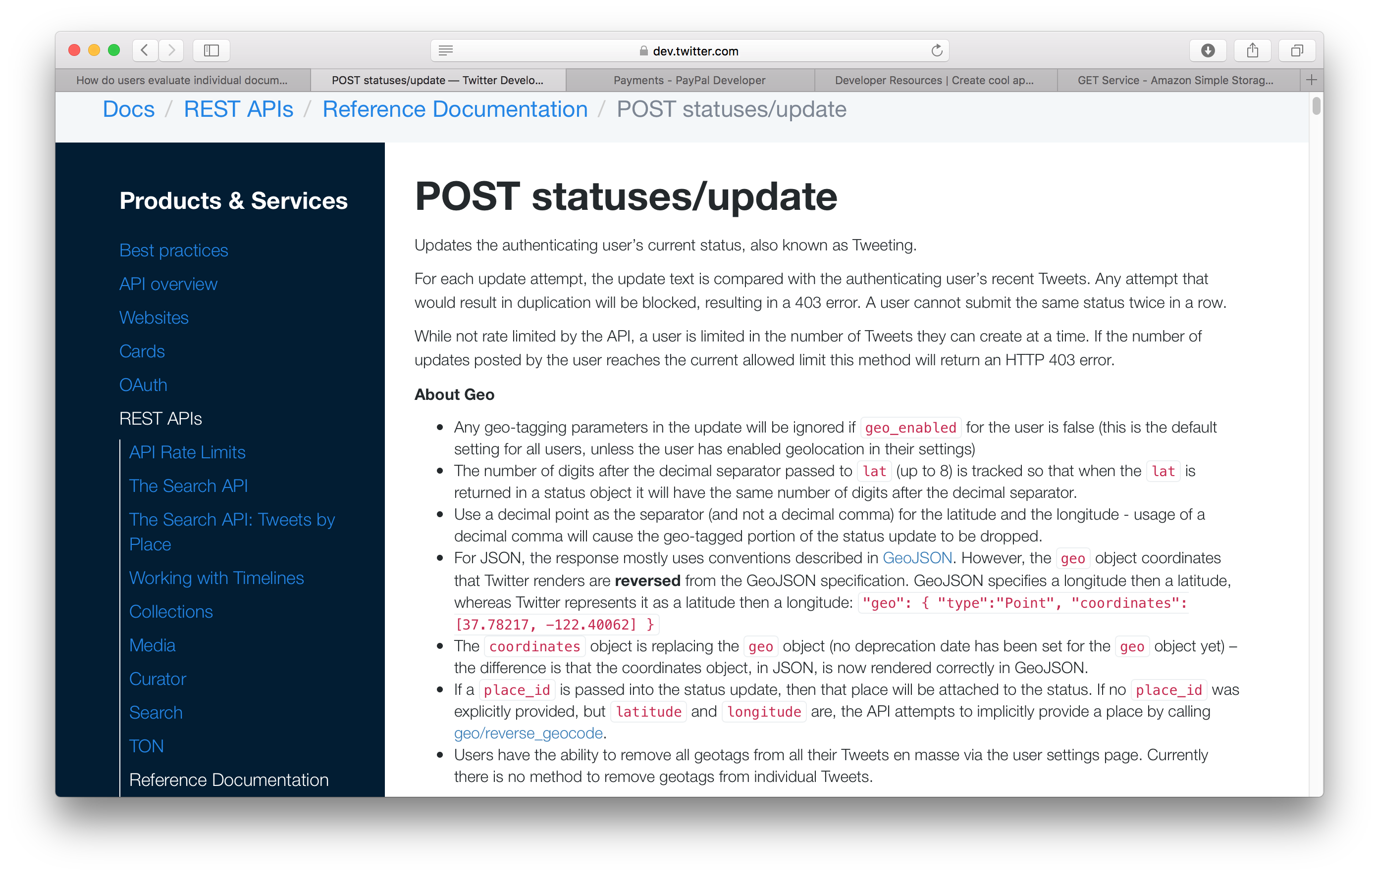
Methods

Slide 9
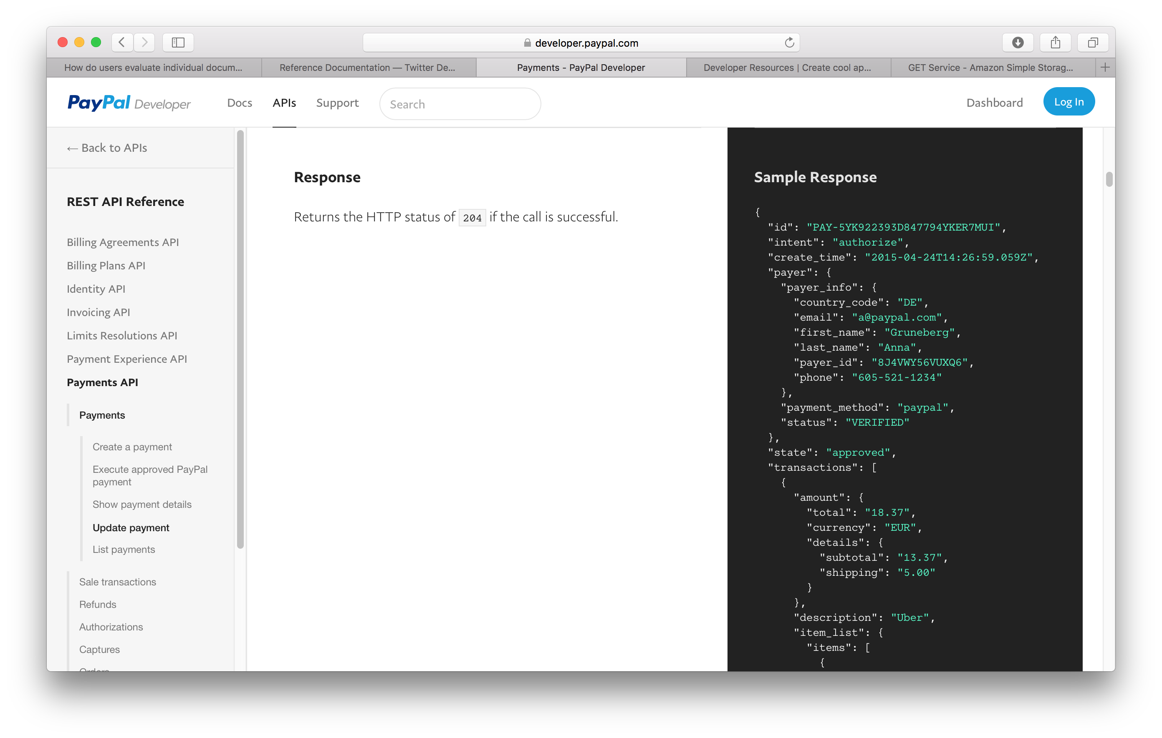
Status Codes

Slide 10
Headers
Mostly for Authorization
OAuth 2.0, etc
Consider how the various Accept-* headers might be used.

Slide 11
Representation

Slide 12
Representation

Slide 13
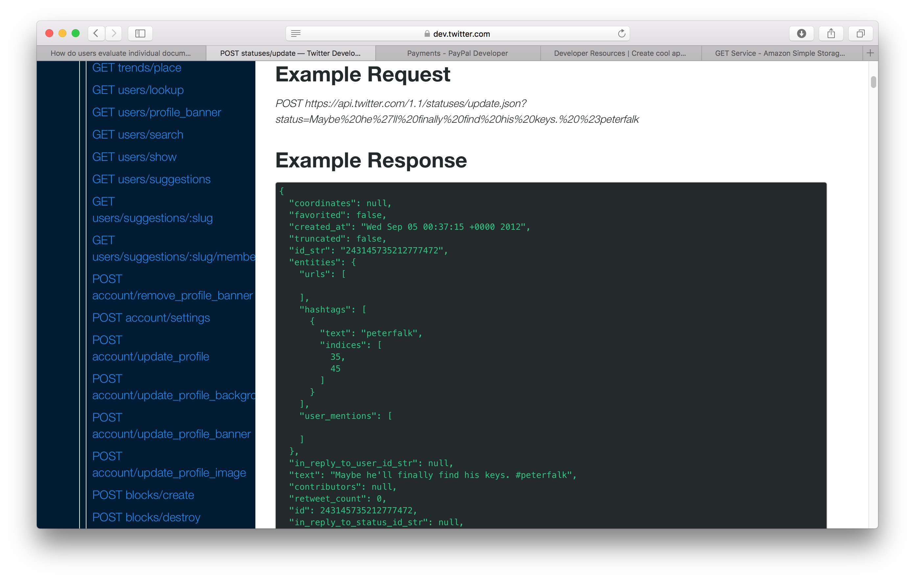
Examples

Slide 14
HATEOAS

Slide 15
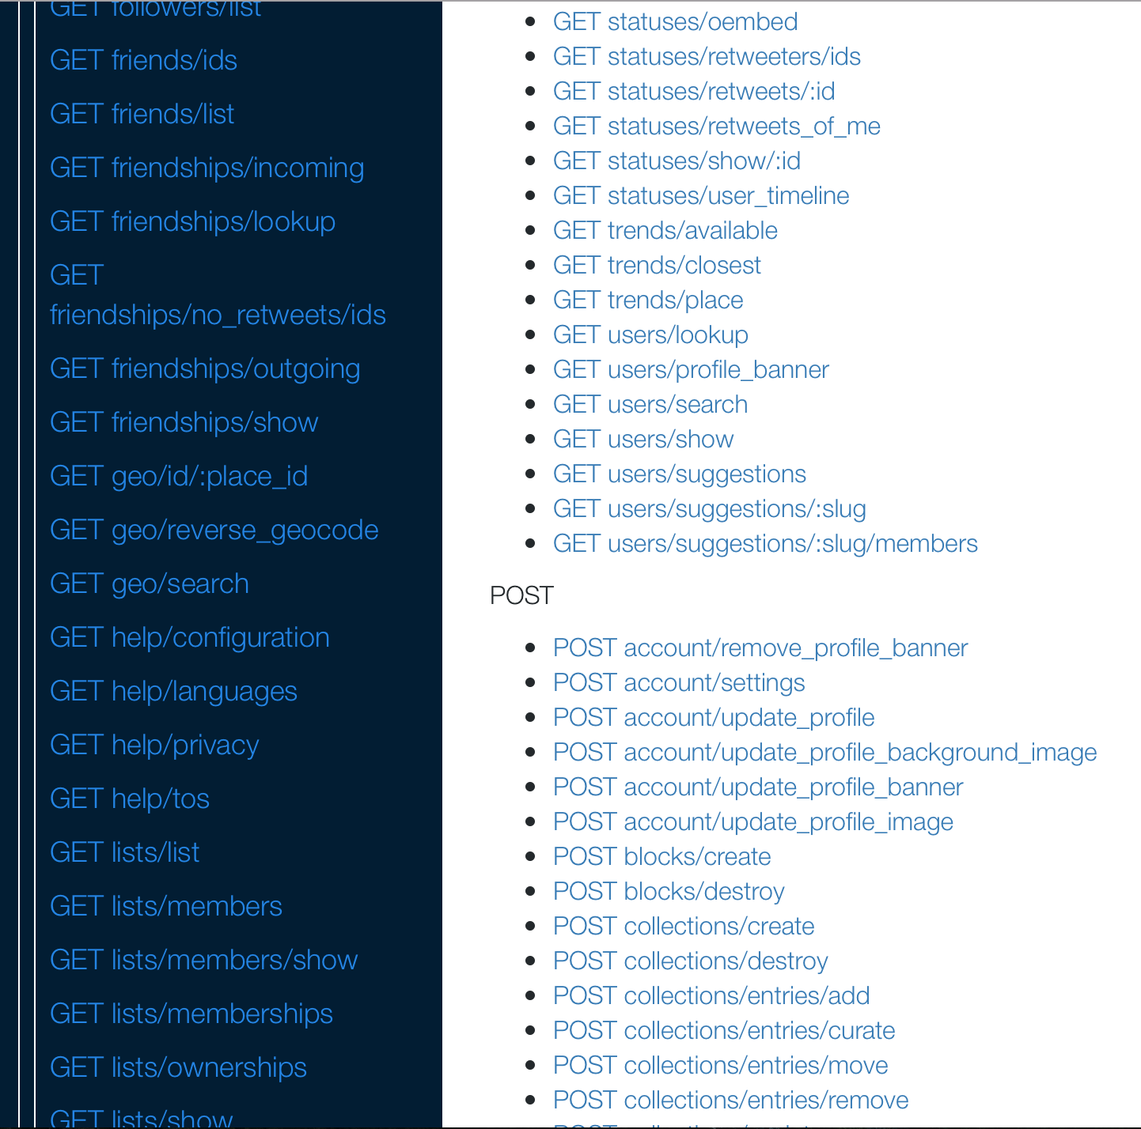
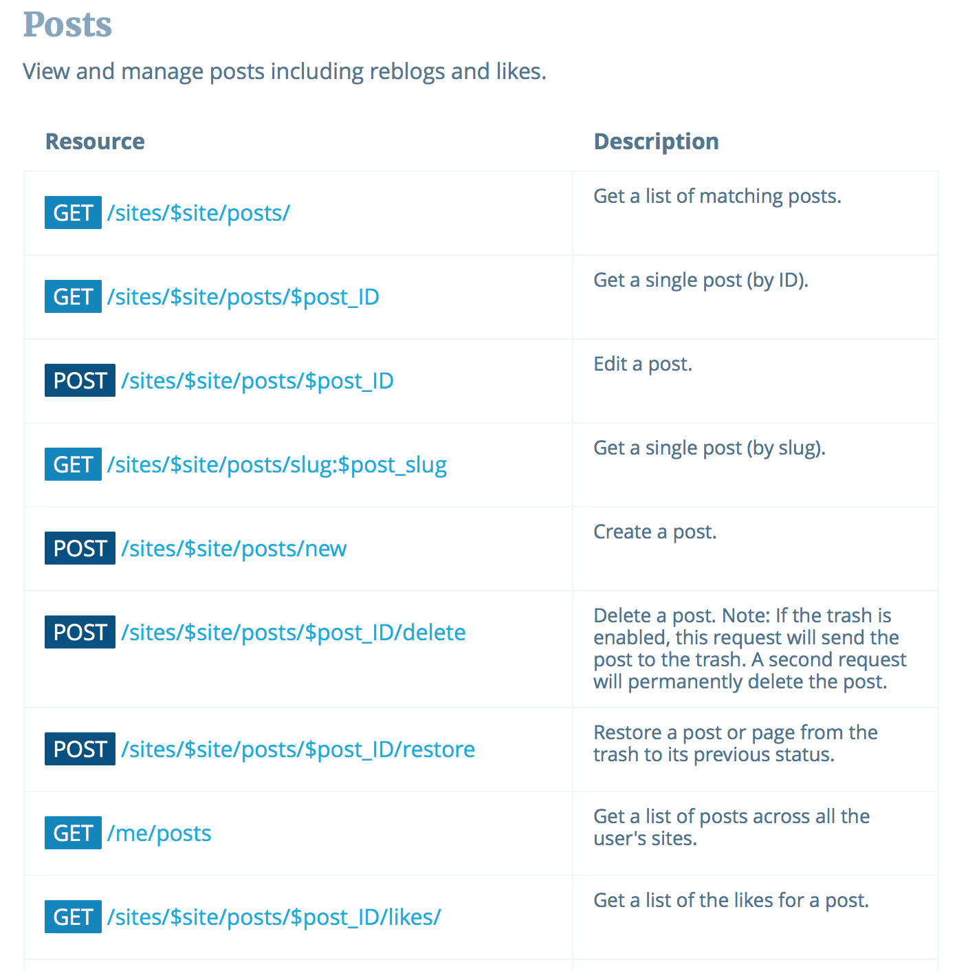
Listings

Slide 16
Summary
Documentation should cover all the bases of the web architecture
Identification – parameterised URIs
Interaction – HTTP methods, status codes and headers
Representation – formats for request and response, with examples
Listings of all of the above

Slide 17
RESTful API Examples
Twitter
https://developer.twitter.com/en/docs/api-reference-index
Paypal
https://developer.paypal.com/docs/api/payments/
Imgur
https://developer.wordpress.org/rest-api/
Wordpress
https://developer.wordpress.org/rest-api/

Slide 18
Next Lecture: Telling Tales

