Slide 1
Thinking about images
Visual Literacy

Slide 2
Think about your visual literacy
The purpose of this session is to prompt you to
review your visual literacy
As a result you may:
Identify how you might communicate using visual methods
Develop a wider understanding of the power and use of visualisations

Slide 3
Question
How many different visualisation methods can you name?
Think, pair, share
Start you list individually
Then pair and discuss
Then feedback to class

Slide 4
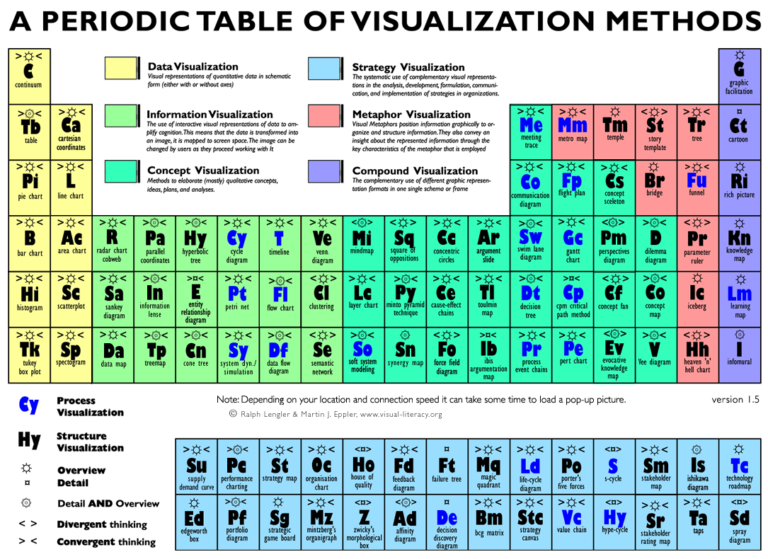

Slide 5
Visual-literacy.org
Q
Look though the periodic table, which methods would you like to see?
Follow work in progress
Use the periodic table in an interactive method to learn about the different methods
http://www.visual-literacy.org/pages/documents.htm

Slide 6
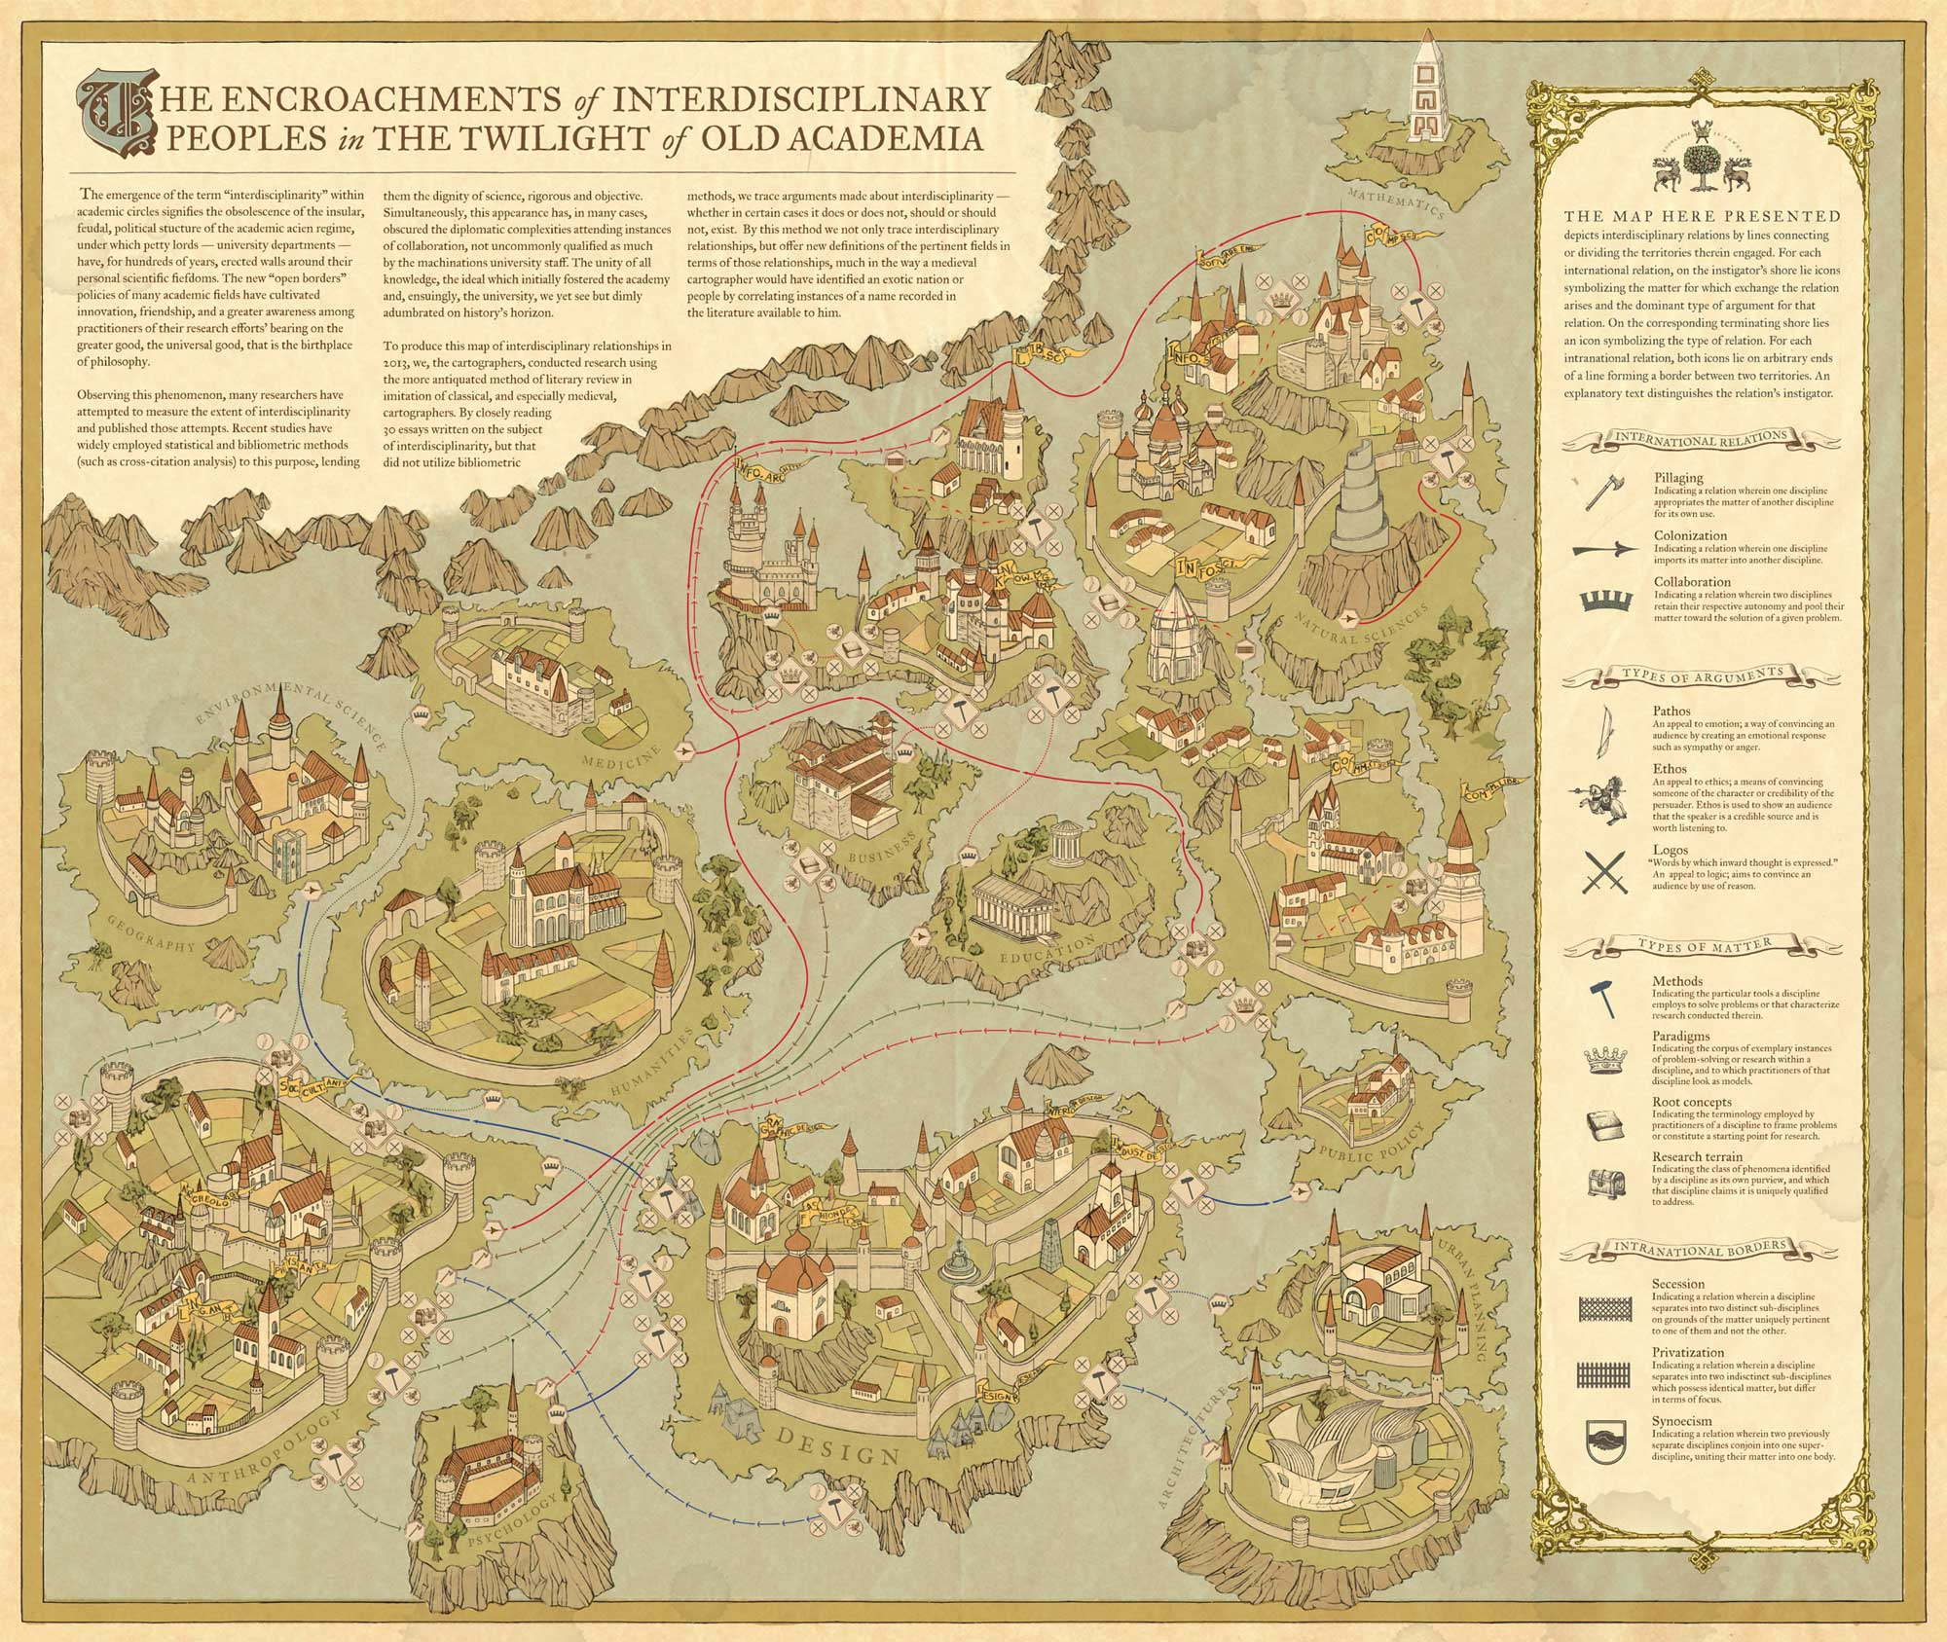

Slide 7
Classic Diagrams from Web SCIENCE
Images you might know

Slide 8
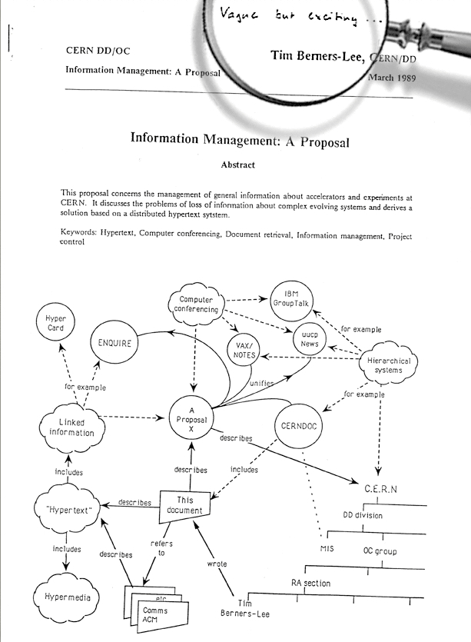

Slide 9
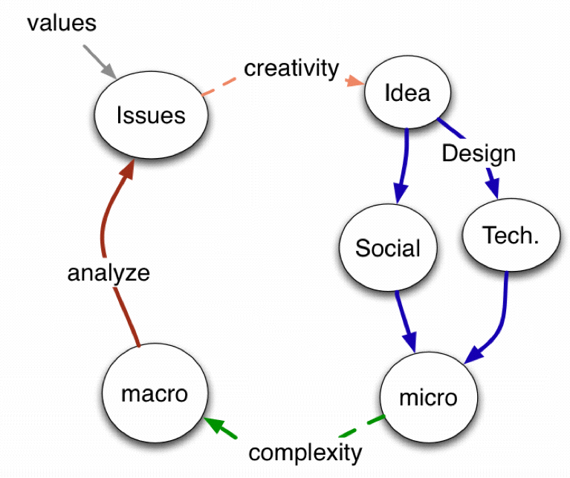
Berners-Lee, T. 2007 The Process of Designing Things in a Very Large Space
TBL’s: Two magic’s

Slide 10
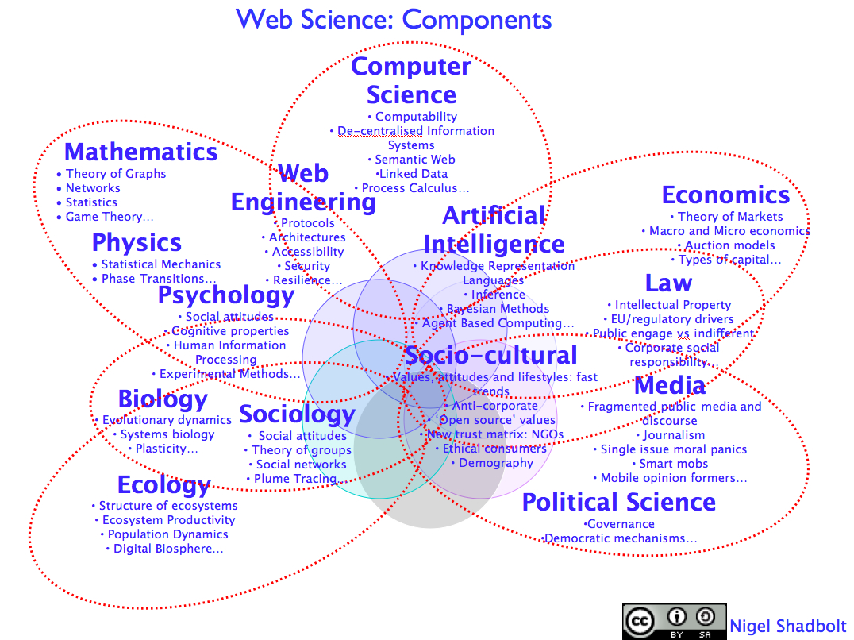
Web Science and additionality
Not the union of the disciplines
But more than their intersection
Applicable in many contexts
Inference
Openness of the web
Dynamics of the Web
Collective intelligence
Security, Privacy and Trust

Slide 12
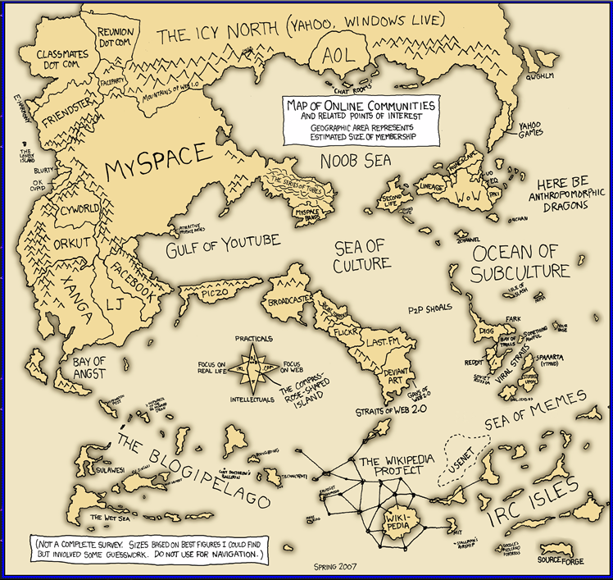
We Need A Web Science Road Map
http://imgs.xkcd.com/comics/online_communities_small.png

Slide 13
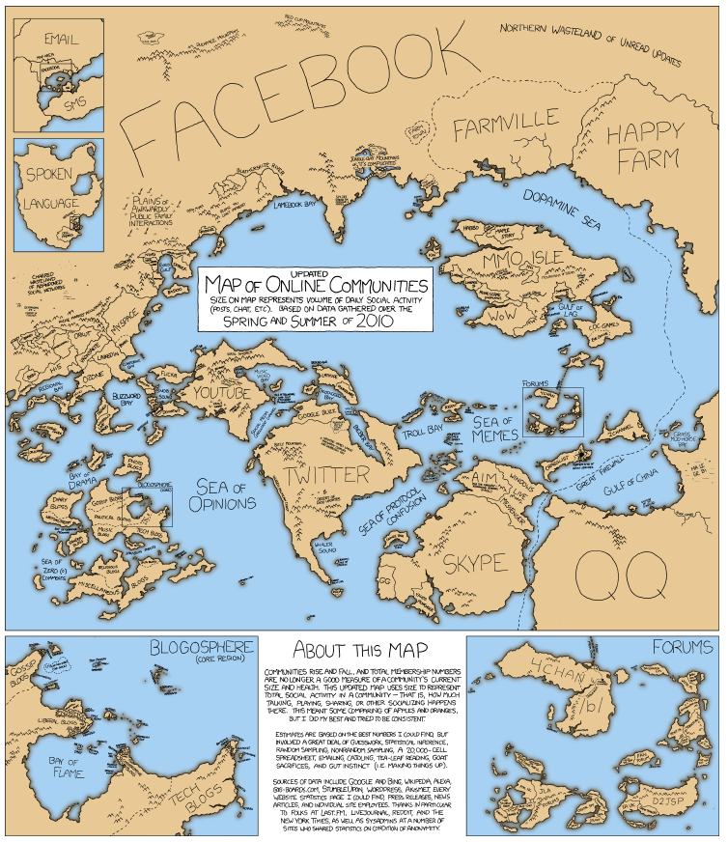
And remember the Map is not the territory
http://imgs.xkcd.com/comics/online_communities_small.png

Slide 14
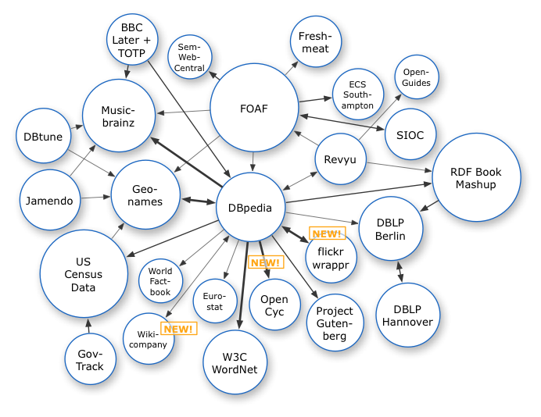
The Web emergent networks of linked data
Richard Cyganiak
Notes:
In 2007 we see the first stirrings of a new kind of network – a network of Linked Open Data

Slide 15
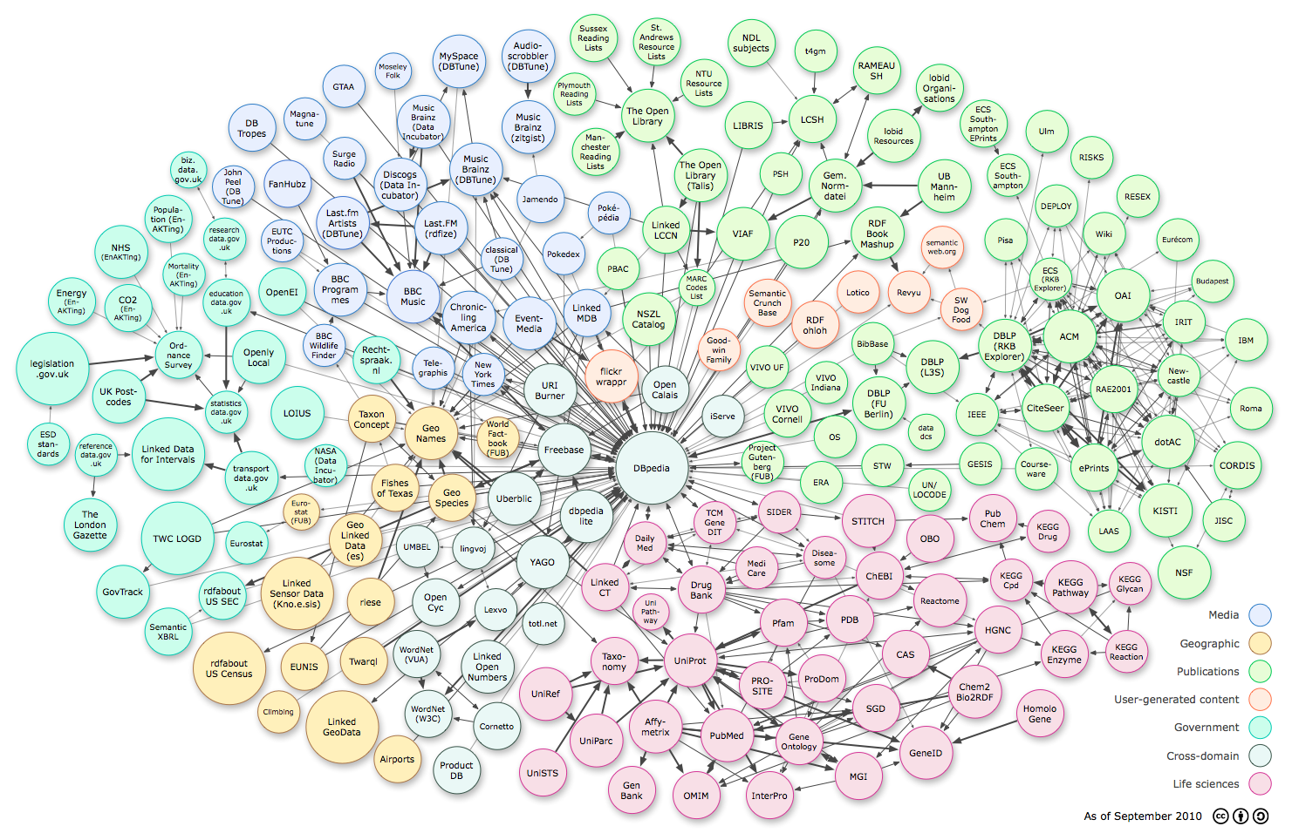
The Web an emergent networks of linked data

Slide 16
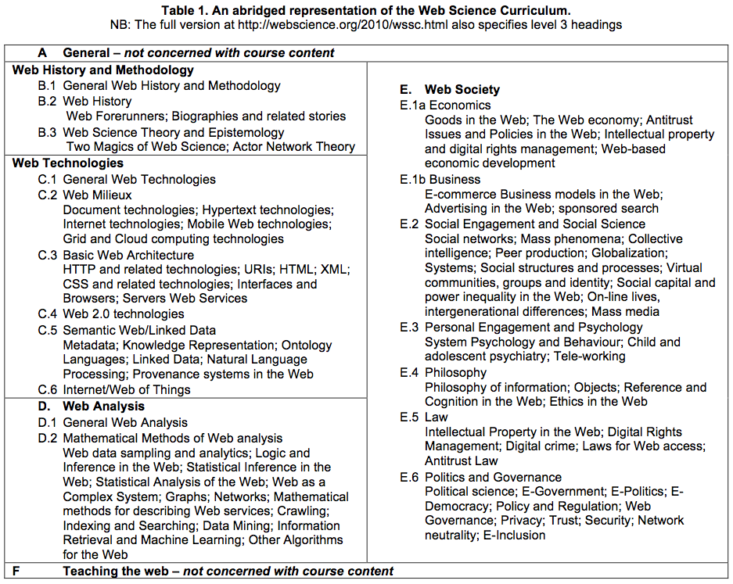
http://webscience.org/2010/wssc.html
Notes:
Here is one example of an instantiation of the curriculum – the result of discussions across the community
This major piece of work was led by Michalis Vafapoulos

Slide 17
Visualising the data – social science impact
Look at examples

Slide 18
Explore tools

Slide 19
Protocols
Citing or adapting

Slide 20
Using other people’s diagrams
Identify the source
Acknowledge in the figure title

Slide 21
Tools for creativity
Thinking and recording

Slide 24
Production Pragmatics
What to use?

Slide 25
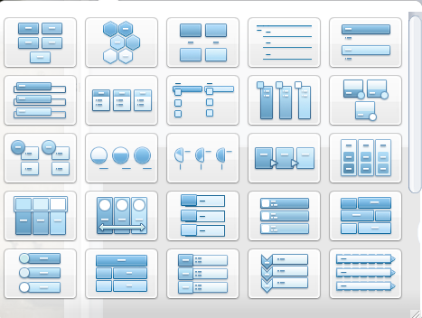
Office tools
How much do you know about the tools you use?
DEMO?

Slide 26
Templates and objects
Not all will be useful or relevant!

Slide 27
Simple (free) tools

Slide 28
Remember…
Visualisations can make order and save words
Visualisation can help creativity
It can be good to get away from the computer
You can always photograph a sketch or set of post-its

Slide 29
Why and how visuals can be useful?
A tool for thinking
Create a table or draw a diagram
You can then systematically explain the diagram in the text
Use a series of diagrams to explain building ideas or evolving understandings/designs

Slide 30
Over to you
What might you use?
What tools?
How might you use them?

Slide 31
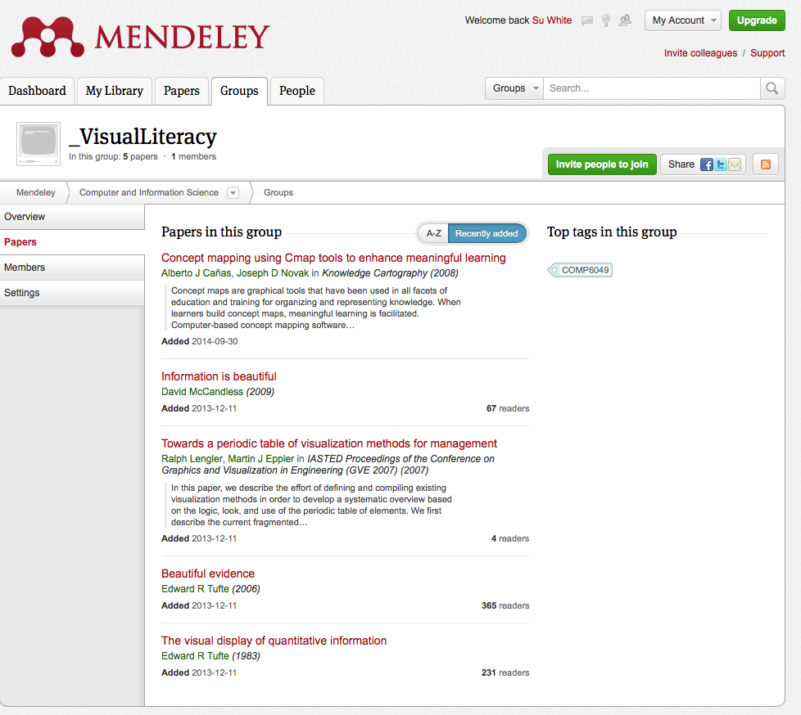
references
Visual Literacy Mendeley Group
http://www.mendeley.com/groups/3963921/visualliteracy/papers/

Slide 32
Further Browsing
GapMinder: http://www.gapminder.org
Guardian Data Store Flickr Group http://www.flickr.com/groups/1115946@N24/
Information Is Beautiful http://www.informationisbeautiful.net
Many Eyes: http://www-958.ibm.com/‎
Visual-Literacy: http://www.visual-literacy.org/

