Slide 1
Finding and Evaluation Information
COMP1205
Hugh Davis @HughDavis hcd@soton.ac.uk
Professor of Learning Technologies
ECS, University of Southampton, UK
http://users.ecs.soton.ac.uk/hcd
Date

Slide 2
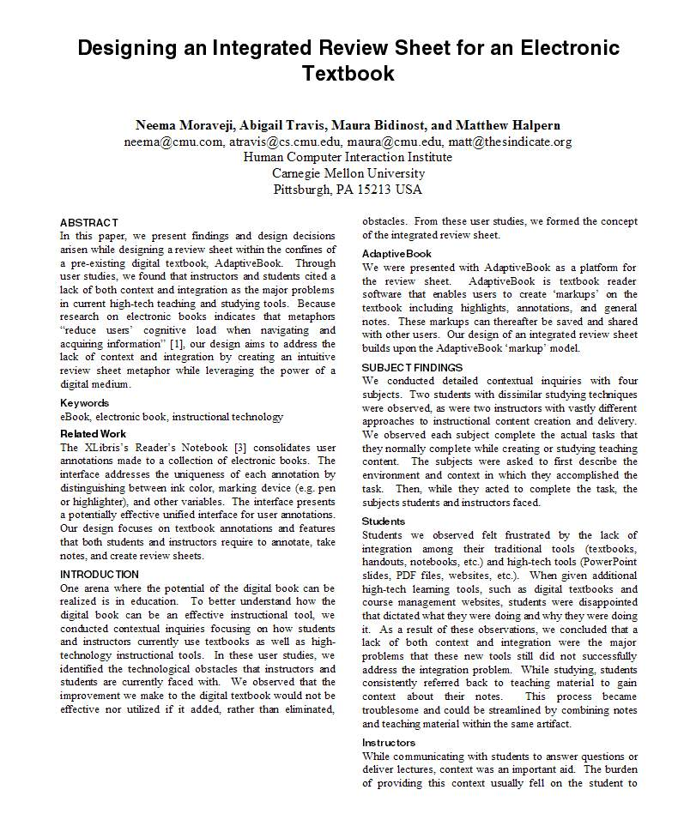
The Scholarly Trail
They cite a source which
will be “referenced” at
the end of the paper
The Blue bubbles are all “Citations”
This person said this
This person has done this
And this person said this
And this person has done this
“
And this
is my summary of this person’s work
”
And this quote came from here

Slide 3

What would make a good source?
A Facebook Page?
Someone’s Blog?
A company website?
A Newspaper Article?
A magazine?
A trade journal?
A talk presented at a conference?
A wikipedia page?
An open source pre-print journal paper?
A scholarly journal paper?
A book?

Slide 4
Why? What makes one
source better than another?
We need sources to be
Authoritative
We must believe that the information is reliable and true
(and preferably written by the person who is the authority and not someone quoting them) (Primary Vs Secondary sources)
Findable
Your reader must be able to follow your reference to find the article or book in their library or on-line.
The thing they find must not have changed since you referenced it.

Slide 5

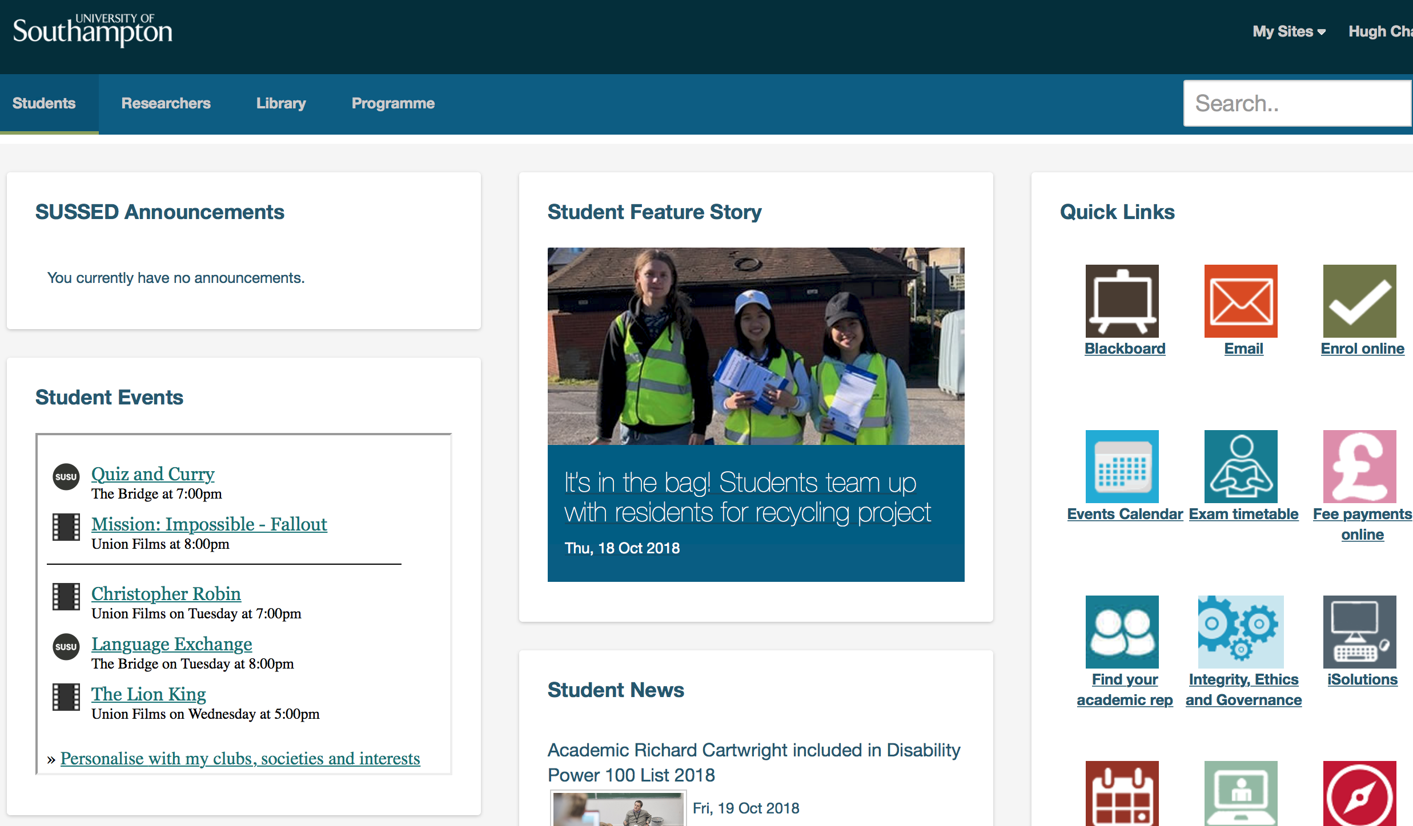


Where do we find sources of information?
We may find useful references in articles and blogs that we have stumbled across by good fortune
More often we must conduct a search
    Google
    Google Scholar
    Wikipedia (but only to follow up the references they have found)
    The Library

Slide 6
Search Terms
Coming up with good terms to put into a search engine is a skill
(Librarians are the people who know how to do this best)
In general thinks of
Keywords
Synonyms
Alternative Spellings
Common Abbreviations

Slide 7
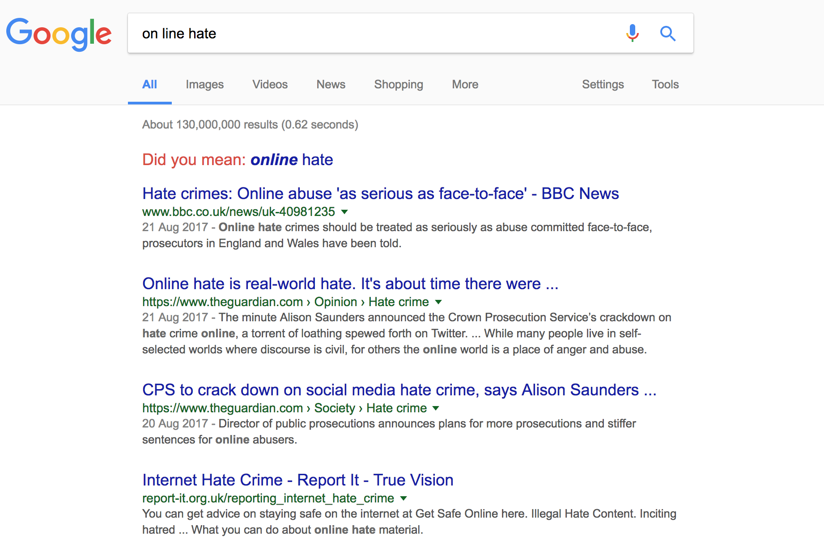
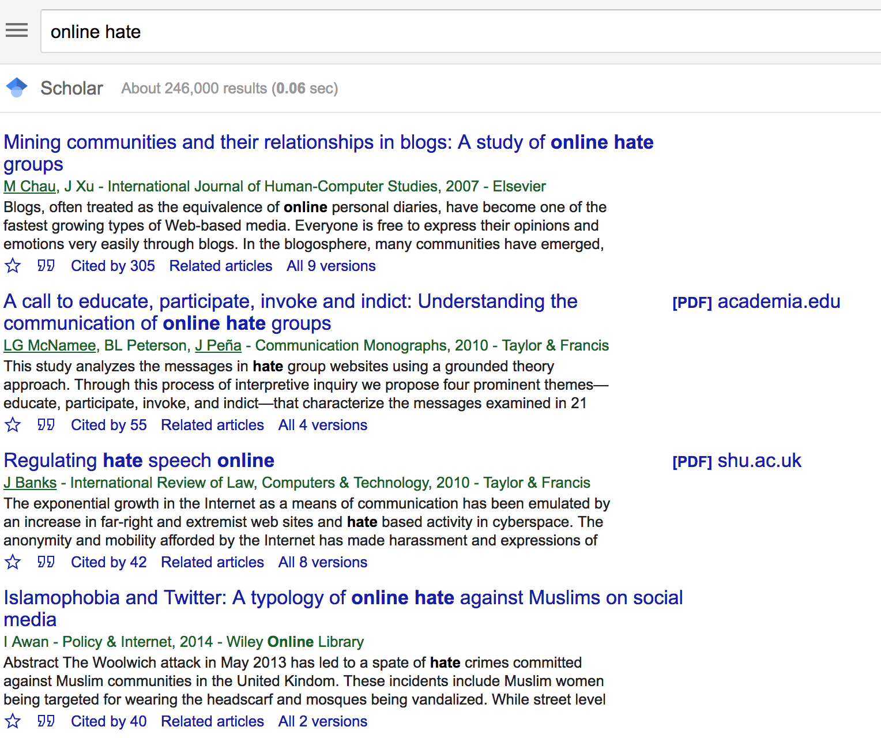
Google vs Google Scholar

Slide 8
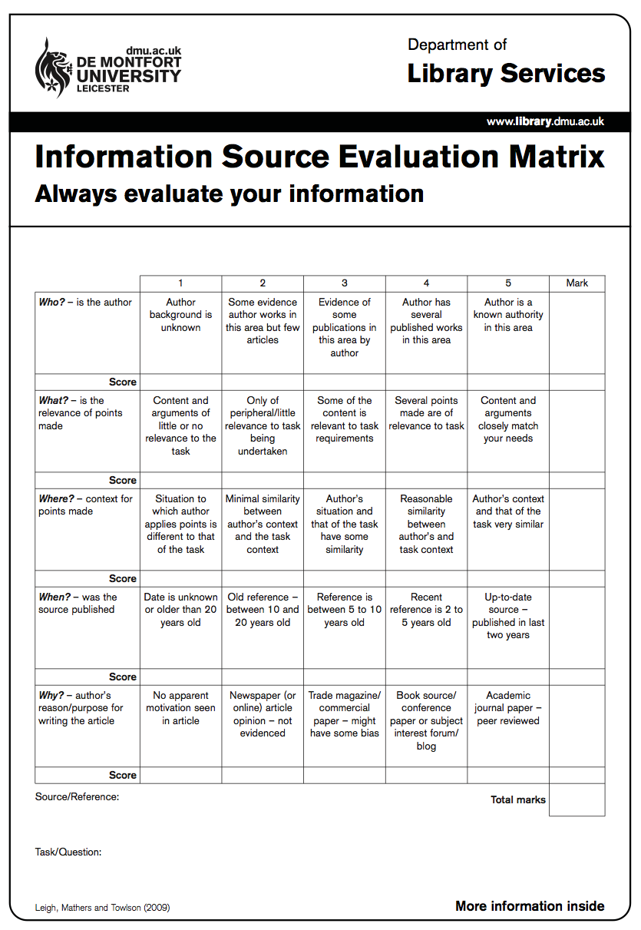
Evaluating the Sources you find
Who is the author
What is the relevance of the points made?
Is the context correct?
When was the source published?
What was the publication medium?

Slide 9
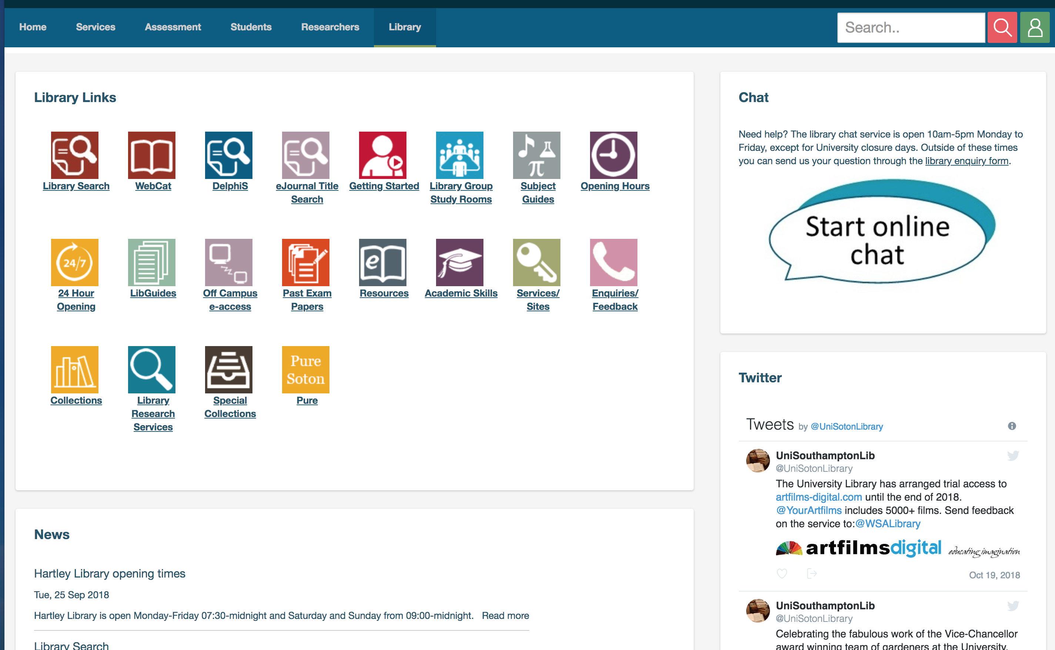
Finding Papers you have seen referenced

Slide 10
Access to on-line journals
You usually need to have accessed the journal through the university library
May need to login to say you are from University of Southampton along the way
Access to *most* quality journals is available on line.
Including all the ACM and IEEE journals and conference proceedings

Slide 11
Thank you
Any Questions?
Hugh Davis
@HughDavis
http://users.ecs.soton.ac.uk/hcd
hcd@soton.ac.uk

