Slide 2
Hypertext Markup Language
COMP3220 Web Infrastructure
COMP6218 Web Architecture
Dr Nicholas Gibbins – nmg@ecs.soton.ac.uk

Slide 3
Representation
URI
identifies
http://www.bbc.co.uk/weather/2637487
Resource
yields on dereference
today’s BBC weather forecast for Southampton
Representation
represents
Metadata:
Content-Type: text/html
Data:
<html>
<head>
<title>BBC Weather – Southampton</title>
...
</html>

Slide 4
What is HTML?
The data format for Web pages
A markup language for structured documents
A platform for Web application development
All of the above
Notes:
In this lecture, we’ll concentrate on #2

Slide 5
Which HTML?
HTML Tags
HTML+
HTML 2.0
HTML 3.0
HTML 3.2
HTML 4
HTML 4.01
XHTML
XHTML 2
HTML 5
HTML 5.1
HTML 5.1 2nd ed.
HTML 5.2
...
Notes:
Evolution of features – overview of HTML 5 in next lecture

Slide 6
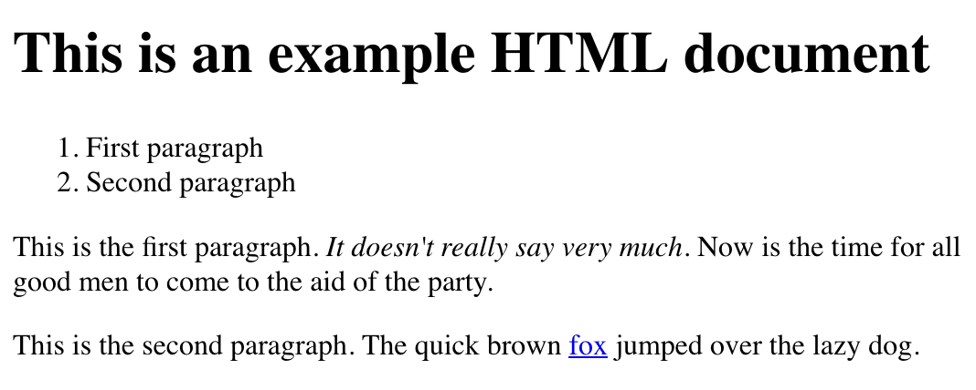

Slide 7
HTML source
<!DOCTYPE html>
<html>
<head>
<title>My Document</title>
</head>
<body>
<h1>This is an example HTML document</h1>
<ol>
<li>First paragraph</li>
<li>Second paragraph</li>
</ol>
<p>This is the first paragraph. <em>It doesn't really say
very much.</em> Now is the time for all good men to come
to the aid of the party.</p>
<p>This is the second paragraph. The quick brown
<a href="http://example.org/">fox</a> jumped over the
lazy dog.</p>
</body>
</html>

Slide 8
HTML markup basics
Tags that structure a document as a hierarchy of elements
  <p> ... </p>
Attributes that modify elements
  <a href=“...”>...</a>
Entity references that represent character sequences
  R&amp;D

Slide 9
Element structure
html
head
title
body
ol
li
li
p
i
p
h1
a

Slide 10
Evolution of HTML
Initially a language for encoding simple document semantics
<h1>Things to See in London</h1>
<p>The <i>Millennium Dome</i> is great.</p>

Slide 11
Evolution of HTML
Subsequently extended to allow more design precision and visual effects
<h1><center>Things to See in London</center></h1>
<p><font size=“3” text=“#FF0000”>The <i>Millennium Dome</i> is <blink>great</blink>.</font></p>

Slide 12
Evolution of HTML
Separation of semantics from presentation using stylesheets
Large font, bold, red
<h1>Things to See in London</h1>
<p>The <em>Millennium Dome</em> is great.</p>
Normal font, 1cm indent
Italic font

Slide 13

What is HTML5?
A major revision of HTML
  Started in 2004 by WHATWG
  Adopted by W3C in 2007
  W3C Recommendation in 2014
  Largely driven by browser manufacturers

Slide 14
Why HTML5?
Usage of HTML in the wild had changed
  Greater emphasis on JavaScript-based web applications
  (AJAX, XMLHttpRequest, etc)
  Concerns about widespread use of Adobe Flash for interactivity
  (openness, reliability, security, performance)
  Concerns about consistency of handling invalid markup
  (browser “quirks modes”)
  Overuse of generic semantics-light markup
  (div and span for everything)
W3C efforts lay in a different direction (XHTML 2.0)
Notes:
HTML 4.01 released in 1999
Steve Jobs’ “Thoughts on Flash” open letter in 2010

Slide 15
HTML5 Design Principles
Compatibility
  Support existing content (HTML 4 and earlier, broken markup)
  Degrade gracefully (work well in older browsers)
Utility
  Separation of concerns (content versus presentation)
  Priority of constituencies (users > authors > implementers)
Interoperability
  Well-defined behaviour
  Graceful error handling
Universal access
  Work on all platforms
  Work for all users

Slide 16
HTML5 Design Principles in practice
Define what should happen when a browser gets bad markup
(cannot assume well-formed or valid HTML)
Define APIs that improve programmatic access to document and browser
(HTML5 as Flash-killer)
Define markup that better captures document semantics
(better alternatives to span and div)

Slide 17
Notes on HTML5 parsing
HTML 4.01 (and earlier) and XHTML define a document grammar
  Declarative definition
  Describes the structure, but not how the structure should be processed
  Behaviour with ill-formed or invalid documents is undefined
HTML 5 also defines document grammar
  Procedural definition
  Describes the process by which a compliant implementation should parse an HTML5 document (i.e. state machine)
  Defines behaviour with ill-formed or invalid documents

Slide 18
HTML5 top-level structure
<!DOCTYPE html>
<html>
<head>
<title>...</title>
</head>
<body>
...
</body>
</html>
document type declaration
document metadata
document content
root element

Slide 19
Document-level metadata
Document title <title>
Base URI <base>
Document-level links <link>
Presentation information <style>
Other metadata <meta>

Slide 20
Flow content
Things that behave like paragraphs...
Paragraphs <p>
Lists <ol> <ul> <li> <dl> <dt> <dd>
Figures <figure> <figcaption>
Quotations <blockquote> <pre>
Miscellaneous <hr> <main> <div>
Headings <h1> <h2> <h3> <h4> <h5> <h6>

Slide 21
Flow example
<!DOCTYPE html>
<html>
<head>
<title>My Document</title>
</head>
<body>
<h1>This is an example HTML document</h1>
<ol>
<li>First paragraph</li>
<li>Second paragraph</li>
</ol>
<p>This is the first paragraph. <em>It doesn't really say
very much.</em> Now is the time for all good men to come
to the aid of the party.</p>
<p>This is the second paragraph. The quick brown
<a href="http://example.org/">fox</a> jumped over the
lazy dog.</p>
</body>
</html>
a top-level heading
an ordered list
a paragraph
the items in the list
another paragraph

Slide 22
Phrasing content
Things that behave like the contents of paragraphs...
30+ elements for structuring text within paragraphs
  Links <a>
  Emphasis <em> <strong> <i> <b>
  Abbreviations <abbr> <dfn>
  Quotes and citations <q> <cite>
  Dates, times <time>
  Bidirectional text <bdi>
  Ruby annotations (pronunciation guides for East Asian typography – furigana, etc)

Slide 23
Phrasing example
<!DOCTYPE html>
<html>
<head>
<title>My Document</title>
</head>
<body>
<h1>This is an example HTML document</h1>
<ol>
<li>First paragraph</li>
<li>Second paragraph</li>
</ol>
<p>This is the first paragraph. <em>It doesn't really say
very much.</em> Now is the time for all good men to come
to the aid of the party.</p>
<p>This is the second paragraph. The quick brown
<a href="http://example.org/">fox</a> jumped over the
lazy dog.</p>
</body>
</html>
some emphasised text
a link

Slide 24
Sectioning content
Elements that can be used to group together paragraph-like things:
  Navigation
  Headers and footers
  Articles
  Asides
  Sections
  Addresses

Slide 25
Navigation
<nav>
  Represents a navigation block that groups links to other pages or to parts of the current page whose role is purely navigation
<nav>
<ul>
<li><a href=“/”>Home</a></li>
<li><a href=”/events”>Events</a></li>
<li><a href=“/contact”>Contact us</a></li>
</ul>
</nav>

Slide 26
Headers and Footers
<header>
  Represents introductory content for its nearest ancestor, typically contains a group of introductory or navigational aids.
  When the nearest ancestor the body element, then it applies to the whole page
<header>
<h1>Scalable Vector Graphics (SVG) 1.2</h1>
<p>W3C Working Draft 27 October 2004</p>
<ul>
<li><a href="http://www.w3.org/TR/2004/WD-SVG12-20041027/">This version</a></li>
<li><a href="http://www.w3.org/TR/2004/WD-SVG12-20040510/"> Previous version</a></li>
</ul>
<p>Editor: <a href=“mailto:dean@w3.org”>Dean Jackson, W3C</a></p>
</header>

Slide 27
Headers and Footers
<footer>
  represents a footer for its nearest ancestor, and typically contains information about its section (who wrote it, links to related documents, copyright data, etc)
  May contain entire sections: appendices, indexes, colophons
<footer>
<nav>
<ul>
<li><a href="/credits.html">Credits</a></li>
<li><a href="/tos.html">Terms of Service</a></li>
<li><a href="/index.html">Blog Index</a></li>
</nav>
<p>Copyright © 2009 Gordon Freeman</p>
</footer>

Slide 28
Articles
<article>
  Represents a complete, or self-contained, composition in a document, page, application, or site and that is, in principle, independently distributable or reusable
  A forum post, newspaper article, a blog entry, comment, etc
<article>
<header>
<h1>The Very First Rule of Life</h1>
<p><time>3 days ago</time></p>
</header>
<p>If there's a microphone anywhere near you, assume it's hot and
sending whatever you're saying to the world. Seriously.</p>
<footer><a href=“?comments=1>Show comments</a></footer>
</article>
Notes:
Can contain header, footer

Slide 29
Asides
<aside>
  Represents a section of a page that consists of content that is tangentially related to the content around the aside element, and which could be considered separate from that content
  Pull quotes, sidebars, etc
<aside>
<h1>Switzerland</h1>
<p>Switzerland, a land-locked country in the middle of geographic
Europe, has not joined the geopolitical European Union, though
it is a signatory to a number of European treaties.</p>
</aside>
Notes:
Can contain header, footer

Slide 30
Sections
<section>
  Represents a generic section of a document or application, a thematic grouping of content
  Part of something else (unlike an article, which is a thing in its own right)
<article>
<header><h2>Apples</h2></header>
<p>The apple is the pomaceous fruit of the apple tree.</p>
<section><h3>Red Delicious</h3><p>These bright red apples are the
most common found in many supermarkets.</p></section>
<section><h3>Granny Smith</h3><p>These juicy, green apples make a
great filling for apple pies.</p></section>
</article>
Notes:
Can contain header, footer

Slide 31
Addresses
<address>
  Represents the contact information for its nearest article or body ancestor
<address>
<a href="../People/Raggett/">Dave Raggett</a>,
<a href="../People/Arnaud/">Arnaud Le Hors</a>,
contact persons for the
<a href="Activity">W3C HTML Activity</a>
</address>
Notes:
Can contain header, footer

Slide 32
Tables
Expressive data model for tables
Table header, body, footer <thead> <tbody> <tfoot>
Row-by-row data <tr> <th> <td>
Grouping of columns <colgroup>

Slide 33
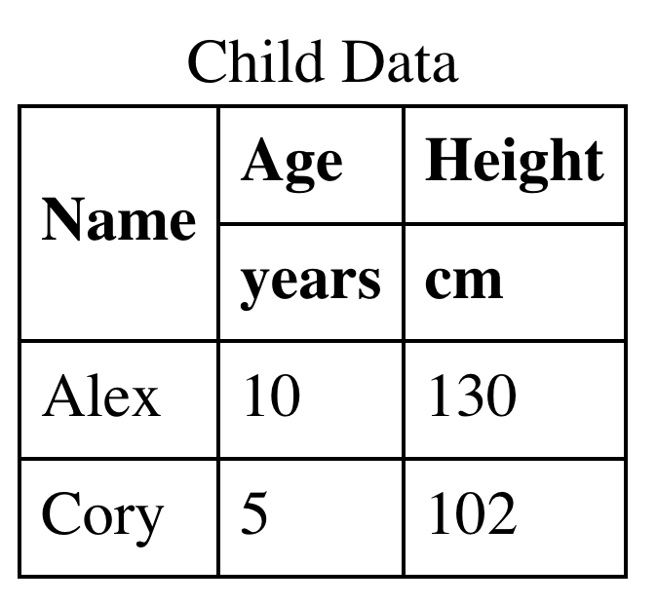
Table example
<table>
<caption>Child Data</caption>
<thead>
<tr>
<th rowspan="2">Name</th>
<th>Age</th><th>Height</th>
</tr>
<tr>
<th>years</th><th>cm</th>
</tr>
</thead>
<tbody>
<tr>
<td>Alex</td><td>10</td><td>130</td>
</tr>
<tr>
<td>Cory</td><td>5</td><td>102</td>
</tr>
</tbody>
</table>

Slide 34
Forms
Structured data entry widgets
  Text fields
  Buttons (including checkboxes and radio buttons)
  Date/time pickers
  Colour pickers
  File upload
  Sliders
  Single/multiple selections
  Progress indicators and meters

Slide 35
Embedded content
Images <img> <map> <area>
Multimedia <video> <audio> <track> <source>
Nested documents <iframe>
Miscellaneous <object> <embed>
Notes:
Source – alternative media resources
Track – timed text tracks (subtitles, captions, etc)

Slide 36
Further Reading
HTML5.2 Spec
  https://www.w3.org/TR/html52/
  (not for the faint-hearted)
WHATWG HTML Living Standard
  https://html.spec.whatwg.org/
  (over 1200 pages!)
W3Schools HTML5 Tutorial
  https://www.w3schools.com/html/
  (approachable text-based tutorials)
Lynda.com
  Large number of HTML video tutorials, aimed at a wide range of prior knowledge

Slide 37
Next Lecture:
Other Web Formats

