Slide 2
The Architecture of the World Wide Web
COMP3220 Web Infrastructure COMP6218 Web Architecture
Dr Nicholas Gibbins – nmg@ecs.soton.ac.uk

Slide 3
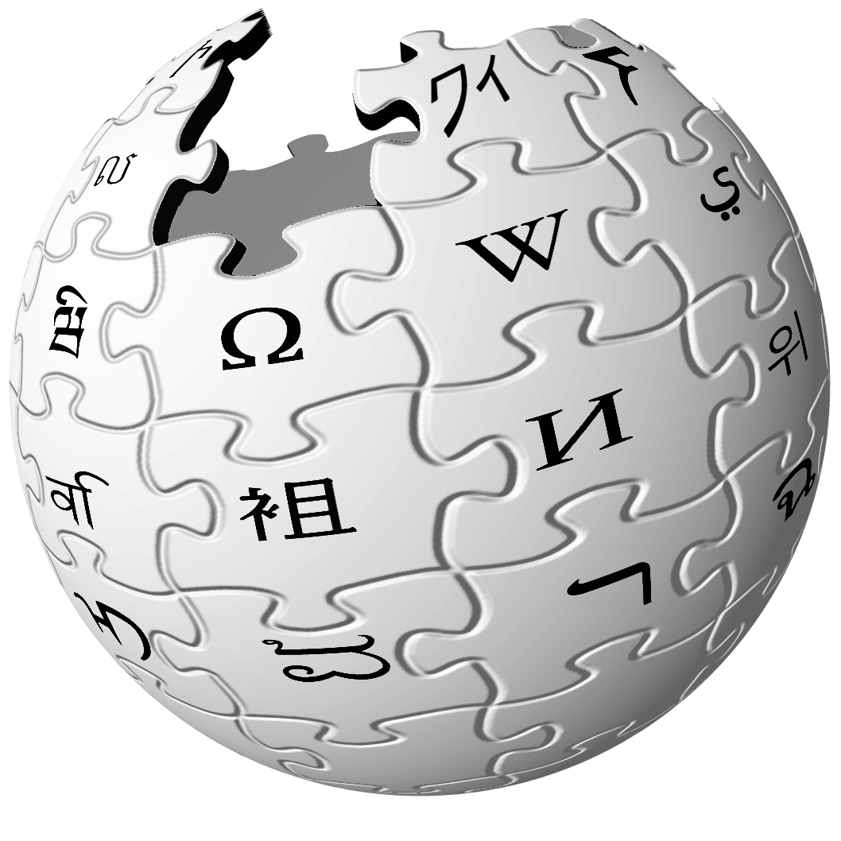
What is the Web?
The Web is a distributed information system that provides access to hypertext documents and other objects of interest
We have a general name for these objects of interest:
resources

Slide 4
What is a resource?
“Familiar examples [of resources] include an electronic document, an image, a source of information with a consistent purpose (e.g., ‘today's weather report for Los Angeles’), a service (e.g., an HTTP-to-SMS gateway), and a collection of other resources. A resource is not necessarily accessible via the Internet; e.g., human beings, corporations, and bound books in a library can also be resources. Likewise, abstract concepts can be resources, such as the operators and operands of a mathematical equation, the types of a relationship (e.g., ‘parent’ or ‘employee’), or numeric values (e.g., zero, one, and infinity).”
Berners-Lee, T. et al (2005) Uniform Resource Identifier (URI): Generic Syntax. RFC3986.

Slide 5
Example
Resource
today’s BBC weather forecast for Southampton

Slide 6
Architectural Bases of the Web
The notion of a resource is central to the architecture of the Web
We need to be able to:
identify them
represent them
interact with them

Slide 7
Identification

Slide 8
Uniform Resource Identifiers
A “compact string of characters for identifying an abstract or physical resource”
Example:
http://www.ecs.soton.ac.uk/
General syntax:
<scheme>:<hierarchical part>?<query>#<fragment>

Slide 9
Example
URI
identifies
http://www.bbc.co.uk/weather/2637487
Resource
today’s BBC weather forecast for Southampton

Slide 10
URI Schemes and Examples
http://www.example.org/aboutus#staff
https://www.example.org/login
mailto:joe@example.org
ftp://example.org/aDirectory/aFile
news:comp.infosystems.www
tel:+1-816-555-1212
ldap://ldap.example.org/c=GB?objectClass?one
urn:oasis:names:tc:entity:xmlns:xml:catalog

Slide 11
Identification Principles
Identifiers should be global
Global naming leads to global network effects.
We want to avoid creating walled gardens.

Slide 12
Every object should be addressable
In principle, every object that someone might validly want/need to cite should have an unambiguous address (capable of being portrayed in a manner as to be human readable and interpretable). (e.g., not acceptable to be unable to link to an object within a ‘frame’ or ‘card.’)
Englebart, D.C. (1990) Knowledge-Domain Interoperability and an Open Hyperdocument System. Proceedings of the Conference on
Computer-Supported Collaborative Work.

Slide 13
Identification Principles
Identifiers should be global
Assign distinct identifiers to distinct resources
Using the same URI to directly identify different resources produces a URI collision.
Example: using http://www.ecs.soton.ac.uk/ to refer to both a university department and a web page about that department
Collision often imposes a cost in communication due to the effort required to resolve ambiguities.

Slide 14
Identification Principles
Identifiers should be global
Assign distinct identifiers to distinct resources
Avoid aliases
A URI owner SHOULD NOT associate arbitrarily different URIs with the same resource.
Example: http://www.soton.ac.uk/ and http://www.southampton.ac.uk/ both refer to the same resource – but we can’t tell that just by looking at the identifiers (URIs are opaque)
The value of a given resource can be measured by the number and value of the resources that link to it

Slide 15
The Early Web
Early (pre-1991) documents refer to document naming
“As many protocols are currently used for information retrieval, the address must be capable of encompassing many protocols, access methods or, indeed, naming schemes”
“A hypertext link to a document ought to be specified using the most logical name as opposed to a physical address. This is (almost) the only way of getting over the problem of documents being physically moved. As the naming scheme becomes more abstract, resolving the name becomes less of a simple look-up and more of a search.”
http://www.w3.org/DesignIssues/Naming
Notes:
naming and addressing treated as near-synonyms

Slide 16
The Classical View
Uniform Resource Identifiers
Uniform Resource Locators
Uniform Resource Names
Explicitly associated with
network protocols (e.g. http, ftp, etc)
Independent of location
or protocol (e.g. isbn)

Slide 17
The Classical View
URL resolution is (usually) well-defined
URNs don’t necessarily have well-defined resolution semantics
Resolving names depends on context
What does resolution mean for URIs which do not refer to network resources?

Slide 18
The Modern View
Formal URL/URN distinction is unhelpful, but...
URL is a useful informal concept
“a URL is a type of URI that identifies a resource via a representation of its primary access mechanism”
http://www.w3.org/TR/uri-clarification/

Slide 19
Representation

Slide 20
Defining Representation
A representation is data that encodes information about resource state. Representations do not necessarily describe the resource, or portray a likeness of the resource, or represent the resource in other senses of the word "represent".
Representations of a resource may be sent or received using interaction protocols.
Notes:
resource – an interview
representations – a text transcript, an audio recording, a video recording

Slide 21
Example
Resource
today’s BBC weather forecast for Southampton
Representation
represents
Metadata:
Content-Type: text/html
Data:
<html>
<head>
<title>BBC Weather – Southampton</title>
...
</html>

Slide 22
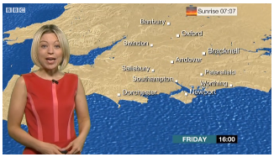
Example
Representation
Metadata:
Content-Type: video/mp4
Data:
represents
Resource
today’s BBC weather forecast for Southampton
Representation
represents
Metadata:
Content-Type: text/html
Data:
<html>
<head>
<title>BBC Weather – Southampton</title>
...
</html>

Slide 23
Internet Media Types
Hierarchical descriptions of data types (used originally in email - MIME)
Top-level types: text, image, audio, video, application (also multipart and message)
Refinements of these top-level types:
text/plain, text/html, text/xml, text/csv, …
image/jpeg, image/gif, image/png, image/tiff, …
audio/mpeg, audio/ogg, …
video/mp4, video/quicktime, …
application/ecmascript, application/pdf, application/rdf+xml, …
Notes:
encoding may be in a number of formats – need to identify formats

Slide 24
Representation Principles
Separate content, presentation and interaction
A representation format should allow authors to separate content from both presentation and interaction concerns.
How a resource is presented to a user (e.g. mobile versus desktop), and how the user interacts with that resource, are independent of the informational content of the resource.

Slide 25
Content, Behaviour, Presentation
ECMAScript
HTML
DOM
CSS
XML
Behaviour
Data Content
Visual Style
XSLT
SVG
PNG
MathML
Web Resource

Slide 26
Representation Principles
Separate content, presentation and interaction
Identify links
A representation format should provide ways to identify links to other resources, including to secondary resources (via fragment identifiers).

Slide 27
Representation Principles
Separate content, presentation and interaction
Identify links
Links should be web-wide
A representation format should allow Web-wide linking, not just internal document linking.
(a corollary of global identifiers)

Slide 28
Representation Principles
Separate content, presentation and interaction
Identify links
Links should be web-wide
Links should use generic identifiers
A representation format should allow content authors to use URIs without constraining them to a limited set of URI schemes.
Formats should be future-proof; we don’t know what identifier types or protocols we’ll be using in the future.

Slide 29
Representation Principles
Separate content, presentation and interaction
Identify links
Links should be web-wide
Links should use generic identifiers
Links should be navigable
A representation format should incorporate hypertext links if hypertext is the expected user interface paradigm.
We would like links between resources to be able to behave like any other hypertext links.

Slide 30
Interaction

Slide 31
Interaction
The interactions between Web agents and resources are defined in terms of protocols that control the exchange of messages
HTTP, FTP, SOAP, NNTP, SMTP, ...
Messages include both data and metadata
Data: the informational content of the message
Metadata: a description of the message and its content

Slide 32
Dereferencing URIs
The schemes in URIs used to identify resources may indicate protocols that can be used to access those resources
Though not always: caches, proxies, name resolution services (DNS)
Many URI schemes define a default interaction protocol
Resource access takes several forms:
Retrieving a representation of the resource
Adding or modifying a representation of the resource
Deleting some or all representations of the resource

Slide 33
Example
URI
identifies
http://www.bbc.co.uk/weather/2637487
Resource
yields on dereference
today’s BBC weather forecast for Southampton
Representation
represents
Metadata:
Content-Type: text/html
Data:
<html>
<head>
<title>BBC Weather – Southampton</title>
...
</html>

Slide 34
Interaction Principles
Reuse representation formats
New protocols created for the Web should transmit representations as octet streams typed by Internet media types.

Slide 35
Interaction Principles
Reuse representation formats
Provide representations
A URI owner should provide representations of the resource it identifies.
There is a general expectation that it should be possible to retrieve a representation of any resource.

Slide 36
Interaction Principles
Reuse representation formats
Provide representations
Retrieval should be safe
Agents do not incur obligations by retrieving a representation.
Put another way, the act of retrieving a representation of a resource should not have any significant side-effects (for example, deleting the resource or changing its state).

Slide 37
Interaction Principles
Reuse representation formats
Provide representations
Retrieval should be safe
Reference does not imply dereference
An application developer or specification author should not require networked retrieval of representations each time they are referenced.
Just because you can retrieve a representation of a resource, doesn’t mean that you must.
Example: URIs used to identify document schemas: http://www.w3.org/TR/html4/strict.dtd

Slide 38
Interaction Principles
Reuse representation formats
Provide representations
Retrieval should be safe
Reference does not imply dereference
Representations should be consistent
A URI owner should provide representations of the identified resource consistently and predictably.
We want our identifiers to be persistent: once an identifier has been associated with that resource, it should continue to refer to that resource indefinitely.
(a matter of policy, not technology)

Slide 39
Conclusion
URI
identifies
http://www.bbc.co.uk/weather/2637487
Resource
yields on dereference
today’s BBC weather forecast for Southampton
Representation
represents
Metadata:
Content-Type: text/html
Data:
<html>
<head>
<title>BBC Weather – Southampton</title>
...
</html>

Slide 40
Summary
The Web Architecture has three parts:
Identification (URIs)
Representation (formats: HTML, XML, PNG, etc)
Interaction (protocols: HTTP)

Slide 41
Further Reading
Architecture of the World Wide Web, Volume One
http://www.w3.org/TR/webarch/
Architectural Styles and the Design of Network-based Software Architectures, Chapter 4
http://www.ics.uci.edu/~fielding/pubs/dissertation/top.htm

Slide 42
Next Lecture: HTTP

