Slide 2
COMP3220 Web Infrastructure
COMP6218 Web Architecture
Dr Nicholas Gibbins – nmg@ecs.soton.ac.uk

Slide 3
What’s this module about?
What is the Web?
What makes it so “Webby”?
What came before the Web?
What was new about the Web that we didn’t have before?
What is the Unique Selling Point of the Web?

Slide 4

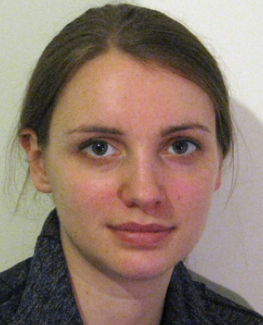

Lecturers
Dr Nick Gibbins
Dr Heather Packer
Prof Les Carr

Slide 5
Course Structure
Three lectures per week:
  Tuesday 1000 in 02/1039
  Tuesday 1600 in 35/1005
  Friday 0900 in 46/2003
One lab per week for COMP3220 only
  Thursday 1500 in 58/1043
  Starting from Week 2

Slide 6
Assessment: COMP3220
Examination: 50% (120 minutes, 3 questions from 5)
REST architecture coursework: 50%
  Specification published by week 6
  Submission due week 11
  Feedback due week 15

Slide 7
Assessment: COMP6218
Examination: 50% (120 minutes, 3 questions from 5)
Technical Report: 50%
  Specification published by week 6
  Submission due week 11
  Feedback due week 15

Slide 8
Teaching Schedule
Week 1: Hypertext and the Architecture of the Web
Week 2: Web Protocols and Formats
Week 3: Hypertext History
Week 4: Styling the Web
Week 5: Representational State Transfer
Week 6: Narrative Hypertext
Week 7: The Future of Hypertext
Week 8: Web Graph and Search Engines

Slide 9
Teaching Schedule
Week 9: Advertising, Cookies, Content Delivery
Week 10: Net Neutrality, Open Access, Open Data
Week 11: tbd
Week 15: Review

Slide 10
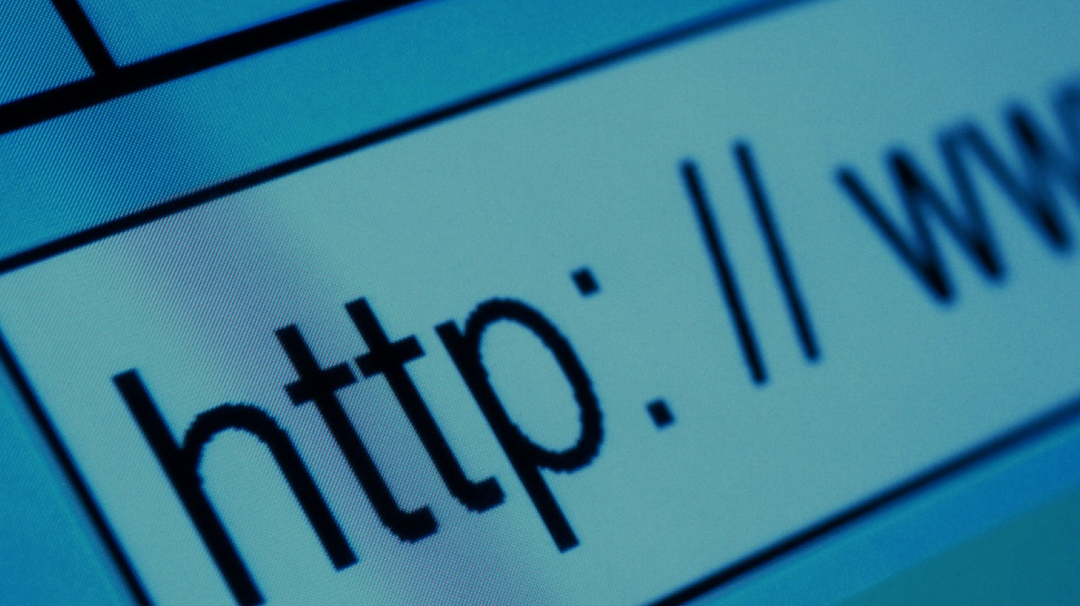
The World Wide Web

Slide 11
Before the Web
A user typed a host address into a client
The client communicated with a file server using FTP
The user typed commands into the client:
  To navigate to the right directory
  To specify whether the file being transferred was binary or ASCII
  To GET the right file
The server sent a file (in plain text or PostScript) back
The client stored the file on the hard disk
The user printed the file, or used a special viewer
Notes:
Interaction characterised as downloading

Slide 12
The Web Experience
A user clicks on a link in a browser
The browser talks to a web server
The server sends a document back
The browser displays the document
The user clicks on another link (etc)
Notes:
Interaction characterised as browsing

Slide 13
Web Growth 1991-2015
Netcraft (2015) Web Server Survey.

Slide 14

How does the Web work?
This woman is reading a newspaper on the Web
What technologies underpin her activity?
EXERCISE: Brainstorm all the programs, protocols, data formats and standards you can think of that contribute to the Web as you use it.

Slide 15
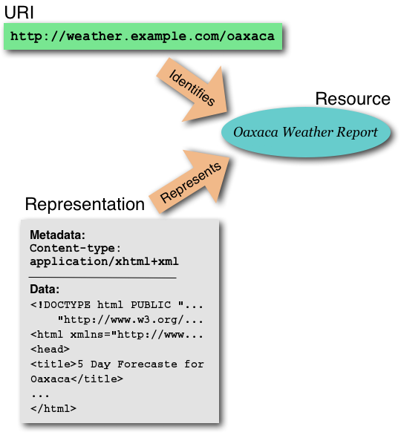
Web Architecture
Resources are identified by URIs
(Uniform Resource Identifiers)
Resources have different representations in different formats (HTML, text, PDF)
Resources can be obtained by asking the Internet for them (using HTTP)
Key components:
  Identification
  Interaction
  Formats

Slide 16
Web Principles
All entities of interest (information resources, real-world objects, and vocabulary terms) should be identified by URIs
URIs should be dereferenceable
An application can look up a URI (using HTTP or some other protocol) and retrieve data about the identified resource (a representation)
Data should be provided using a standard format
Data should be linked with other data

Slide 17
5 Stars of Linked Data (2010)
★ Available on the Web (in whatever format) under an open licence
★★ As above, but as machine-readable structured data
(e.g. Excel instead of an image of a table)
★★★ As above, but in a non-proprietary format
(e.g. CSV instead of Excel)
★★★★ As above, but using W3C standards (RDF, SPARQL) to identify things,
so that others can point at your data
★★★★★ As above, but linked to other people’s data to provide context

Slide 18
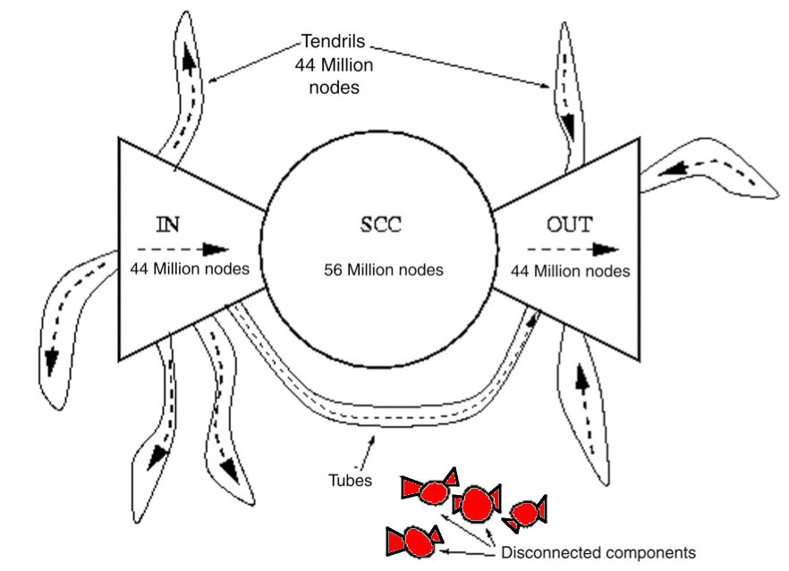
The Shape of the Web

Slide 19
Something to think about…
If we agree that everything that exists or that we can imagine should have:
an identifier and
a way to look up it up and get hold of it
…what happens to privacy?
…what happens to security?

Slide 20
Next Lecture:
The Fundamentals of Hypertext

