Slide 1
WEBS6203 Interdisciplinary Thinking
Clarifications and beginnings

Slide 2
1.1

Slide 3
How this module is structured
An exercise in Interdisciplinary thinking
Developing and evolving your understanding
Rehearsing arguments
Exploring ideas
Explore and research topic areas
Identify a web science research question which can be considered from two distinct disciplinary perspectives
Decide on a comparative study

Slide 4
Assessment
Research and report
CW1 annotated bibliography
CW2 extended abstract
CW3 report
Exploring a question
Which approaches a web science topic from two individual disciplinary perspectives
Which you have not studied in any depth before
Milestones
Title
Literature review
Annotated bibliography
Abstract(s)
For the annotated bibliography
For the final report (later)
Extended Abstract
Slideshow based on your extended abstract (assessed)
Structured draft
Peer review
Written Report (assessed)
Check the module web site for details of assessments

Slide 5
Resources
The course guide
Coursework descriptions
The timetable
Reading lists (for early weeks)
The module web site
Handin machine
Links to resources online
Links to EdShare
Your tasks
Learning to become a scholar
LOTS of reading
more reading
Discussing your reading
Thinking and reflecting
LOTS of writing
Check the module front page and the resources page for more details
https://secure.ecs.soton.ac.uk/module/1819/WEBS6203/

Slide 6
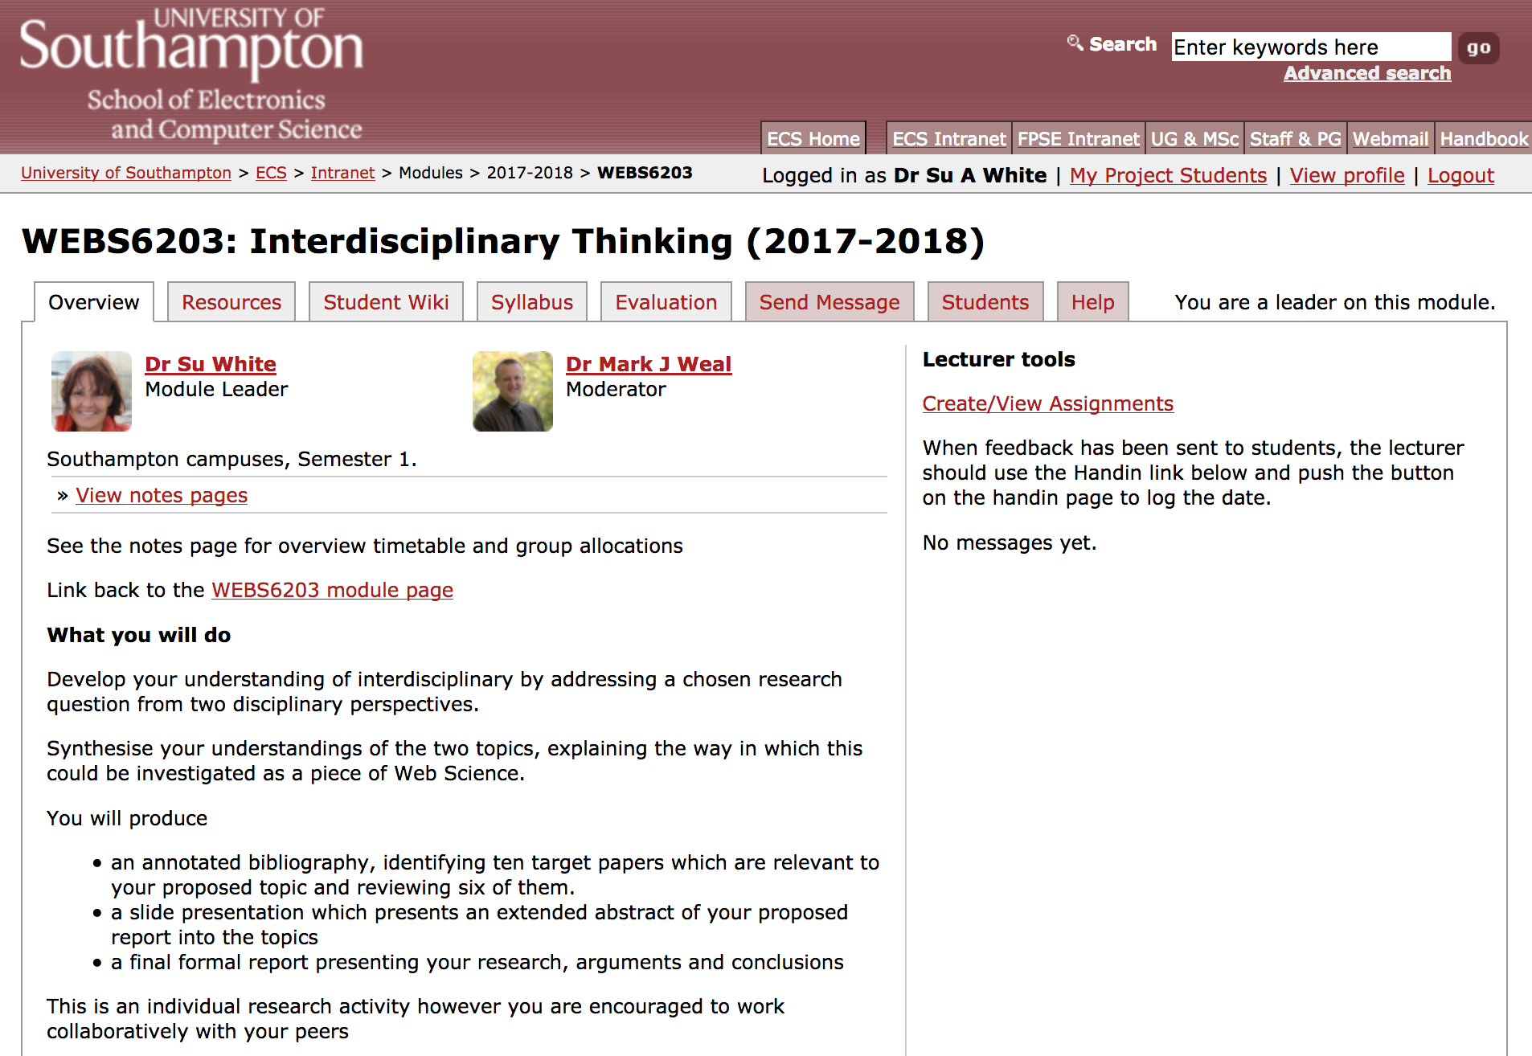
https://secure.ecs.soton.ac.uk/module/1819/WEBS6203/

Slide 7
Resources
The course guide
Coursework descriptions
The timetable
Reading lists (for early weeks)
The module web site
Handin machine
Links to resources online
Links to EdShare
Your tasks
Learning to become a scholar
LOTS of reading
more reading
Discussing your reading
Thinking and reflecting
LOTS of writing
Check the module front page and the resources page for more details
https://secure.ecs.soton.ac.uk/module/1819/WEBS6203/

Slide 8
In the first week you are split into groups
You will work in your group to
Complete small group exercises
Hold a reading discussion
Conduct peer reviews
Group/individual task
Meet as a reading group
Establish a tentative programme for your reading group
Timing - weekly
Areas of interest

Slide 9
Reminder
At masters level we expect you to work hard and to work independently
This module aims to introduce you to ideas but…
You have to then use your readings to make sense of the ideas
There are practical aspects
Learn to use scholarly tools
Plan to do a lot of reading

Slide 10
What we expect you to do
1. DEFINE problems, issues, topics or questions that warrant interdisciplinary examination
2. PRESENT a clear rationale for taking interdisciplinary approach including the advantages to be gained
3. IDENTIFY relevant disciplines
4. CONDUCT a literature review (what is known on the topic from each of the disciplines)
5. DEVELOP a command of each relevant discipline set out the analytical structure central to each discipline, identify key underlying assumptions, and methods of evaluation.
6. STUDY the problem and generate insights including predictions from each of the relevant disciplines - in isolation!!
7. IDENTIFY conflicts between and/or areas of complementary between the insights offered from each discipline
8. CREATE common ground by developing a cohesive framework of analysis that incorporates insights from the relevant disciplines in a systematic manner
9. COMBINE disciplinary insights to construct new more integrated understanding of the problem
Repko & Welch 2005

Slide 11
Repko: The flow of activities
problem
Disciplinary insights
Integration
Understanding

Slide 12
How to demonstrate your learning
Slide show
Report
Provide a structured overview of your chosen areas
Communicate key points in visually compelling manner
Annotated bibliography
conduct a literature review
select and critique a set of papers
identify a topic
reading
discussing
reviewing
thinking
reflecting
revising

Slide 13
Sources and examples?
What are your interests?
Where is your expertise?
Learn from
Previous Web Science conference proceedings
Previous Web Science Masters students
Talk with them ☺
Previous topics
see appendix

Slide 14
Lets get down to inter-disciplinarity
https://imgs.xkcd.com/comics/impostor.png

Slide 15
inter-disciplinarity
https://imgs.xkcd.com/comics/purity.png

Slide 16
inter-disciplinarity
https://imgs.xkcd.com/comics/interdisciplinary.png

Slide 17
Class exercise: apologies for yet another introductory round
Small groups
Ask about disciplinary stories
Tell the class what you learnt
“This is my friend <xxxx>
They have a background in <xxxx>
They explained that the values and principles of their predominant field of study are …..
think
share
pair
Notes:
There is a handout, make notes during the feedback

Slide 18
What is our interdisciplinarity?
For the people in this room today
What academic perspectives shape each of our understandings of the world?
What do we each consider to be our ‘home’ discipline (s)?
What are the values, beliefs and working methods to which we each cleave?
Academic disciplines
Fields of study
Think
Then break into groups for activity

Slide 19
Feedback round
“This is my friend <xxxx>
They have a background in <xxxx>
They explained that the values and principles of their predominant field of study are …..

Slide 20
1.2

Slide 21
An idea of web science you may have seen…

Slide 22
Another…

Slide 23
Hooper, Clare J., Georgeta Bordea, and Paul Buitelaar. "Web Science and the Two (Hundred) Cultures: Representation of Disciplines Publishing in Web Science." (2013).
Kinder-Kurlanda, K. and Weller, K., 2014, June. I always feel it must be great to be a hacker!: the role of interdisciplinary work in social media research. In Proceedings of the 2014 ACM conference on Web science (pp. 91-98). ACM.
Hooper, C.J., Neves, B. and Bordea, G., 2015, May. A Disciplinary Analysis of Internet Science. In International Conference on Internet Science (pp. 63-77). Springer, Cham.

Slide 24
Where will you find information?
Since you have to work with disciplines with which you are not yet familiar, what sources might be useful to you?

Slide 25
Where will you find information?
Since you have to work with disciplines with which you are not yet familiar, what sources might be useful to you?
Library
Online videos
Open courseware
MOOCs
If you choose to use online searches be aware that they may be tricky and sources are not always authoritative

Slide 26
Support materials
Slides
HESA disciplines
Example posters and reports
Previous posters, reporta
Existing research
Work plan
Hand in (fixed dates)
Module page
Overview
Processes
In the wild
WAIS/DTC
Supplementary
Visual literacies
Slide guides
Research
Creation
Mendeley
Reflection
Blogs,dicussion

Slide 27
Building skills
Thinking about handins

Slide 28
Find out how to read a paper
If you already know how to
Tell others about what you do
streamline the process
Possible tools?
How many of you use a reference manager?
Other tips?

Slide 29
1.3

Slide 30
The Library is your friend

Slide 31
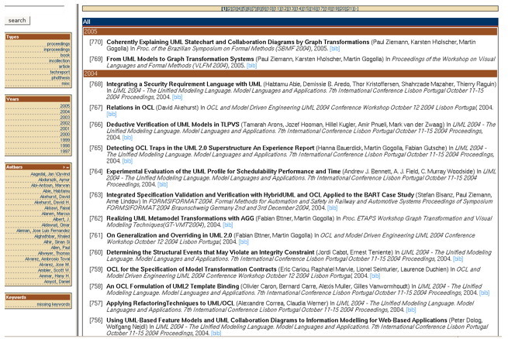
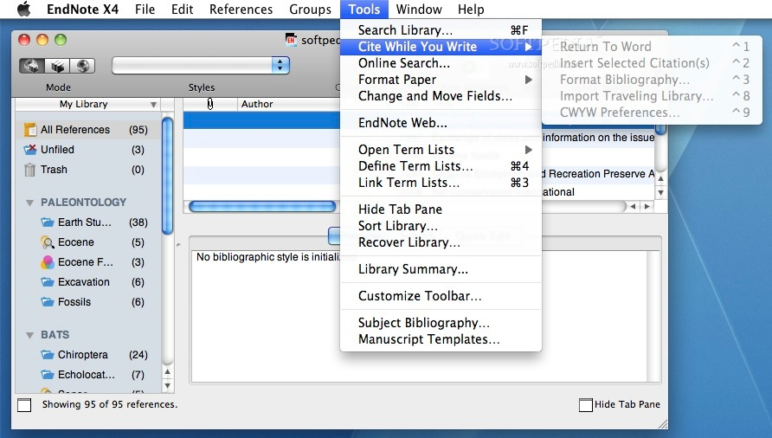
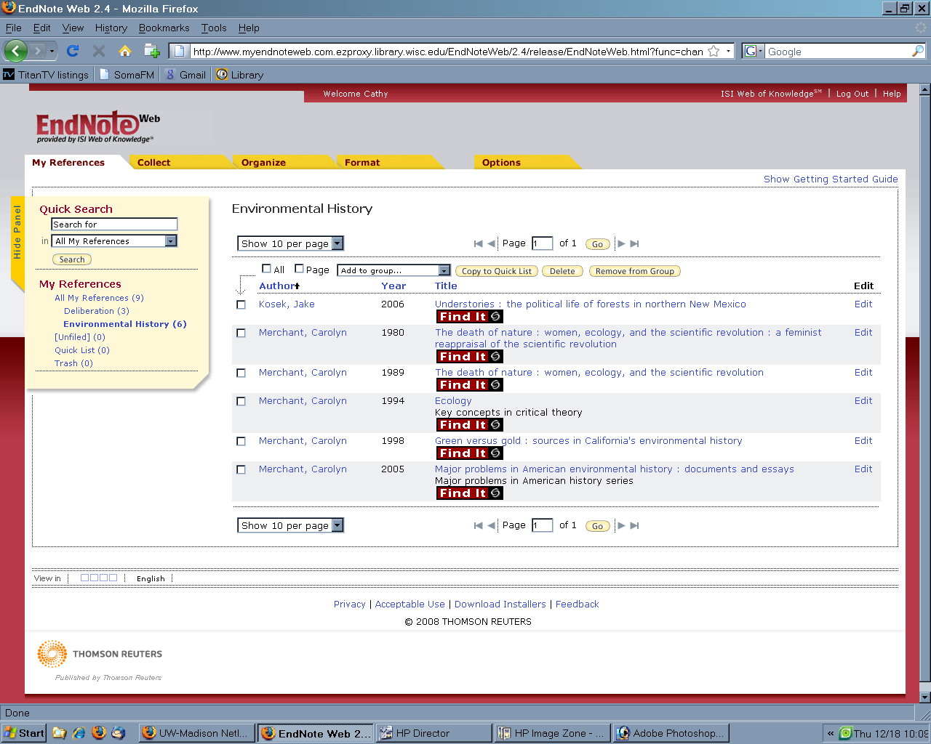
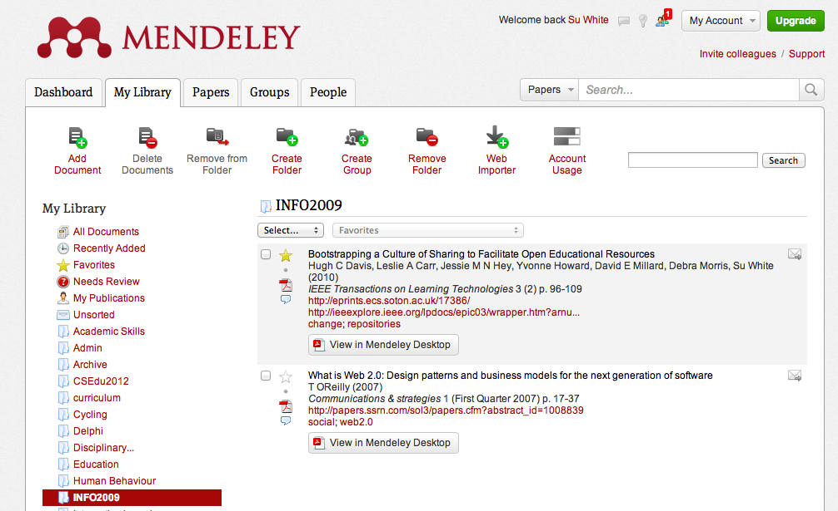
Generations and affordances
0 x
1 x
2 x
x x
3
Card index – manual, systematic
Bibtex– simple software
EndNote WYSIWYG, integration, then web enabled
Mendeley social, semantic; online & app

Slide 32
In the first week
I need to explain how I expect the tutorial groups to work, and how the reading groups will work
You need to
get to know your fellow group members and exchange contact details
Put details on your group onto the student wiki
https://secure.ecs.soton.ac.uk/student/wiki/w/WEBS6203

Slide 33
In the first week
Tutorial groups:
Group discussions – general understanding
Exploring interdisciplinariy
Sharing knowledge and understanding
E.g. Web Science theory and background
Specialist disciplinary knowledge
Reading groups
Agree a programme of readings
Meet to discuss a specific piece of literature
Find a room – and maybe an alternative time for the meeting
Book rooms
via library and sussed

Slide 34
Group tutorial tasks W1 or W2
Ideas swap
identify three possible areas for investigation
For each:
Identify all possible target disciplines/sub disciplines
Identify two prime perspectives
In your groups
Take turns to talk through each option
Why have you chosen the area?
Three rounds
Three readings:
Tiropannis et al (2014)
A model for an interdisciplinary discussion
Compare with Chynoweth (2009) from last week’s set
Trowler (2012) and Hughs (2013) offer two perspectives onto disciplinary cultures
All references are in our shared Mendeley group
Copies of the papers are in EdShare
http://www.edshare.soton.ac.uk/15032/

Slide 35
Reading groups 1
Look through the lists of suggested reading
Individually identify a few papers you would like to read
Discuss your selection with other members of the group
Come up with a list of papers you are might like to discuss as a group
Schedule to discuss one per week for the next six or seven weeks
Agree where and when you will meet

Slide 36
Reading groups 2
You may like to nominate a convenor for each meeting
Booking a tutor room in advance is a good idea
Turn up prepared with notes
Think of this as rehearsing the ideas you might put in the annotated bibliography
Agree a time schedule
Nominate a time keeper (and use an alarm)
For example:
Three minutes per person (round robin)
Ten minutes open discussion
One minute each round up
Each revise your notes after the meeting

Slide 37
The scope of interdisciplinarity

Slide 38
How to demonstrate your learning
Slide show
Report
Provide a structured overview of your chosen areas
Communicate key points in visually compelling manner
Annotated bibliography
conduct a literature review
select and critique a set of papers
identify a topic
reading
discussing
reviewing
thinking
reflecting
revising

Slide 39
Selecting your topic: What to do next
Think about your target contributory topics
Look into their foundational concepts
Consult textbooks (university library)
Look at programme specification (online, this university and others)
Watch a few video lectures –e.g. YouTube, ITunesU
Talk to your fellow students
Reflect on your other lecture content
Look at proceedings from previous web science conferences
Establish some shared working methods

Slide 40
Look at the posters & reports
Individually or in groups
Use these as guidelines and a means to generate ideas

Slide 42
Thinking about images
Visual Literacy

Slide 43
Slides preparation
Teach yourself some visual literacy
See the course notes
Read the papers
Discuss in your group tutorials

Slide 44
Slide Tips
Put your references into an open Mendeley collection and have a shortcut to them which is a QR code
Copy logos from an existing resource even if you are using a different template
They will be the correct resolution
If you are sponsored, acknowledge your patron
If you are on the web science iPhD you will need to find that logo too
Work as a team across the class, share tasks and pool your resources online
Help each other with constructive criticism
Enjoy the creativity of the task

Slide 45
Slide ideas
Find a template
Create a storyboard for your design
Creativity exercises
Use the pecha kucha discipline to create a set of visuals to explain the concepts in your report

Slide 46
Slides: Independent study activities
Requirements review
Skills update
Read through the final version of the assessment criteria
Do you understand
what you have to do?
What you have to hand in?
Decide on the tools you will use
What system
How to add an audio track
How to insert the notes
How to create a pdf
Notes:
Using the two handouts

Slide 47
Opportunities to improve
From now on
Informally asking fellow students to feedback
During the scheduled peer review sessions

Slide 48
The flow of activites
problem
Disciplinary insights
Integration
Understanding

Slide 49
Think about your visual literacy
The purpose of this session is to prompt you to
review your visual literacy
As a result you may:
Identify how you might communicate using visual methods
Develop a wider understanding of the power and use of visualisations

Slide 50
Question
How many different visualisation methods can you name?
Think, pair, share
Start you list individually
Then pair and discuss
Then feedback to class

Slide 51
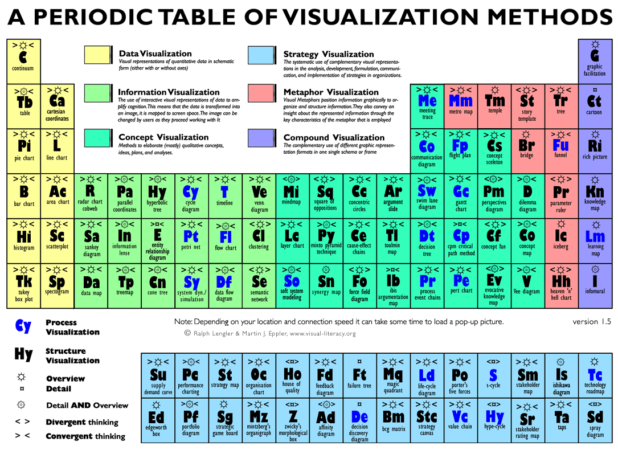

Slide 52
Visual-literacy.org
Q
Look though the periodic table, which methods would you like to see?
Follow work in progress
Use the periodic table in an interactive method to learn about the different methods
http://www.visual-literacy.org/pages/documents.htm

Slide 53
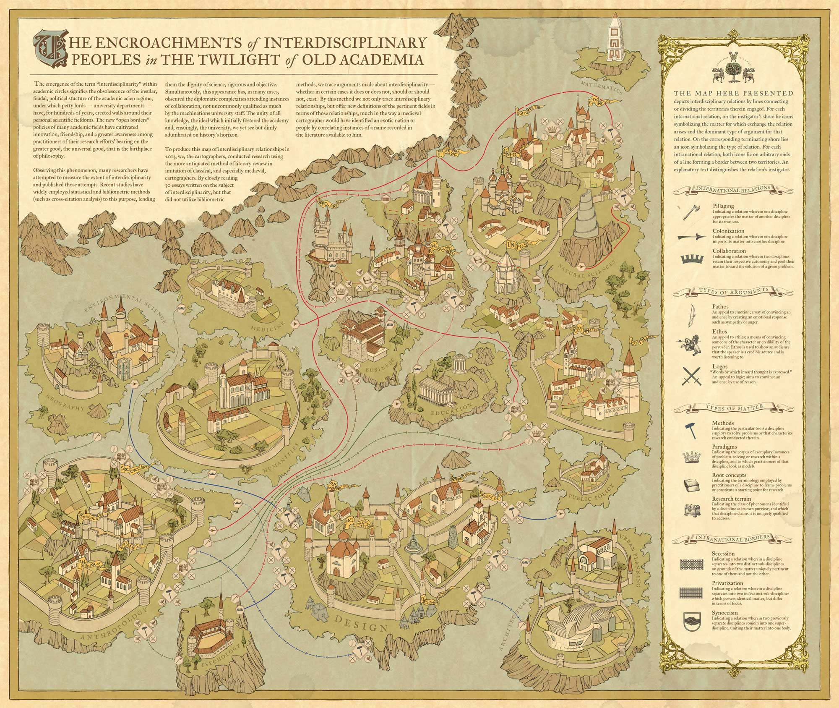

Slide 54
Classic Diagrams from Web SCIENCE
Images you might know

Slide 55
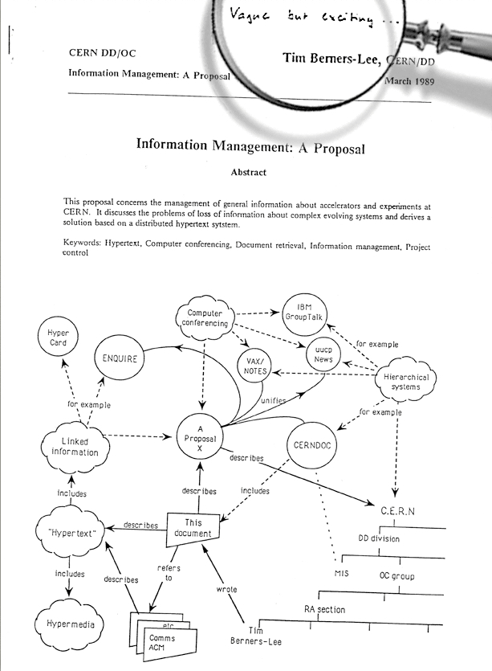

Slide 56
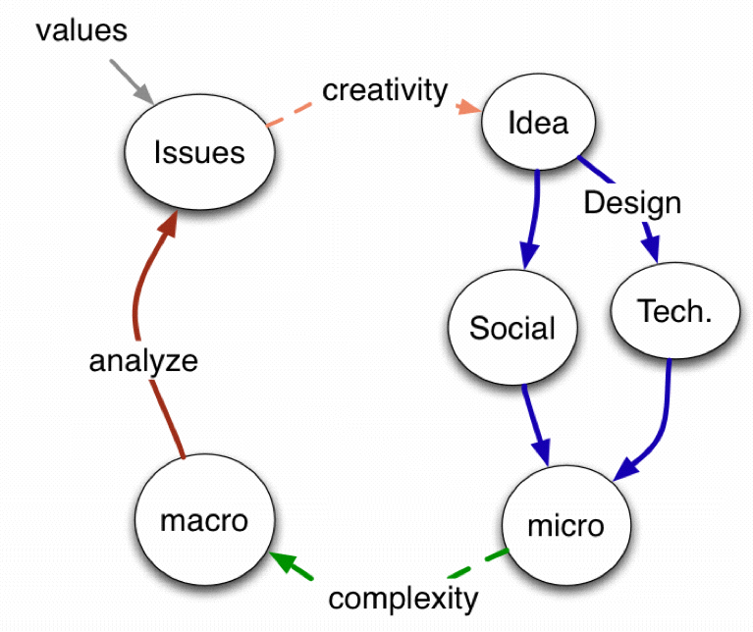
Berners-Lee, T. 2007 The Process of Designing Things in a Very Large Space
TBL’s: Two magic’s

Slide 57
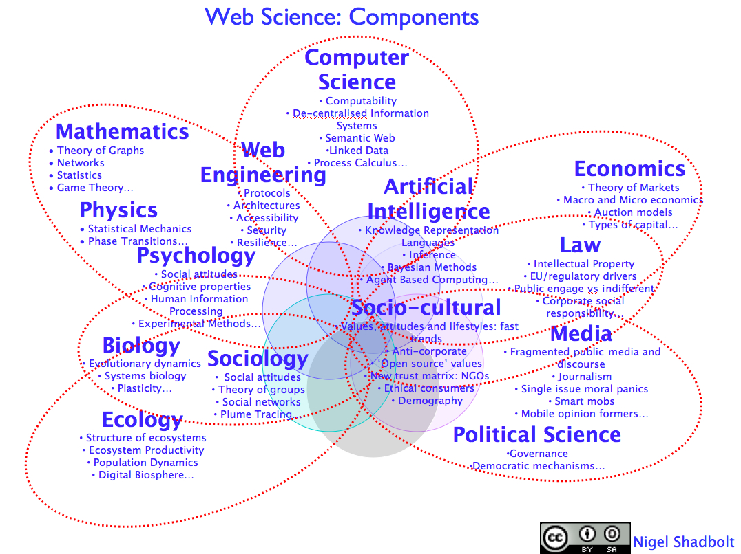
Web Science and additionality
Not the union of the disciplines
But more than their intersection
Applicable in many contexts
Inference
Openness of the web
Dynamics of the Web
Collective intelligence
Security, Privacy and Trust

Slide 59
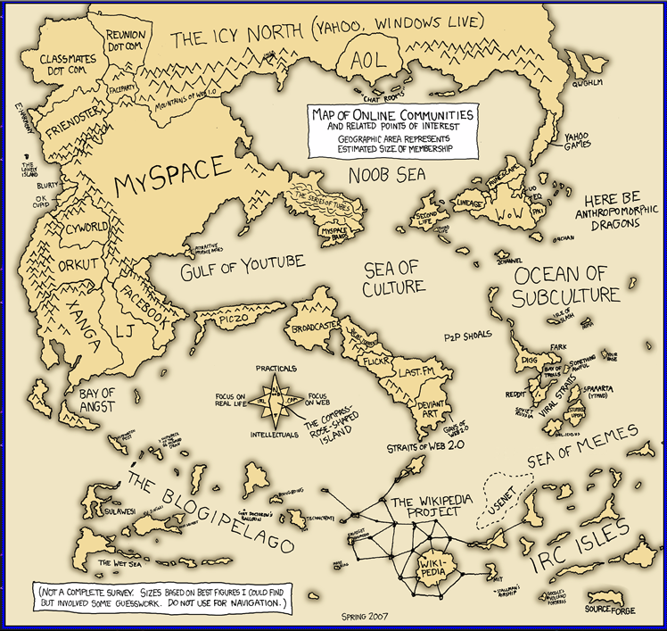
We Need A Web Science Road Map
http://imgs.xkcd.com/comics/online_communities_small.png

Slide 60
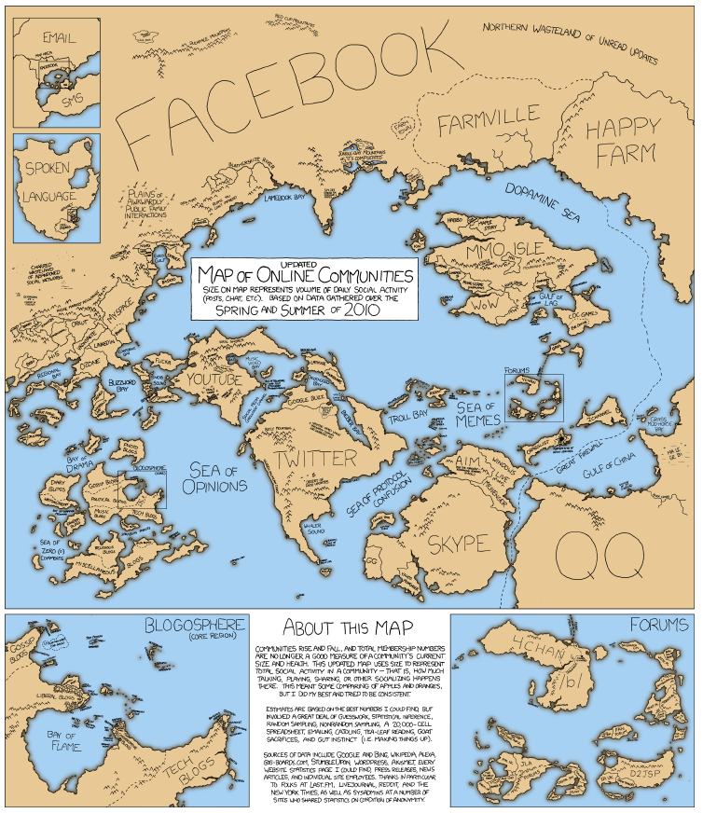
And remember the Map is not the territory
http://imgs.xkcd.com/comics/online_communities_small.png

Slide 61
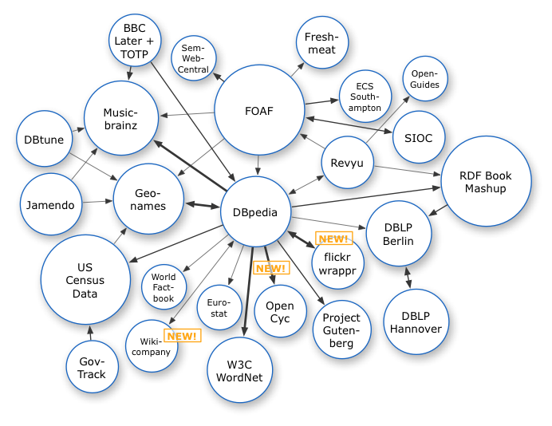
The Web emergent networks of linked data
Richard Cyganiak
Notes:
In 2007 we see the first stirrings of a new kind of network – a network of Linked Open Data

Slide 62
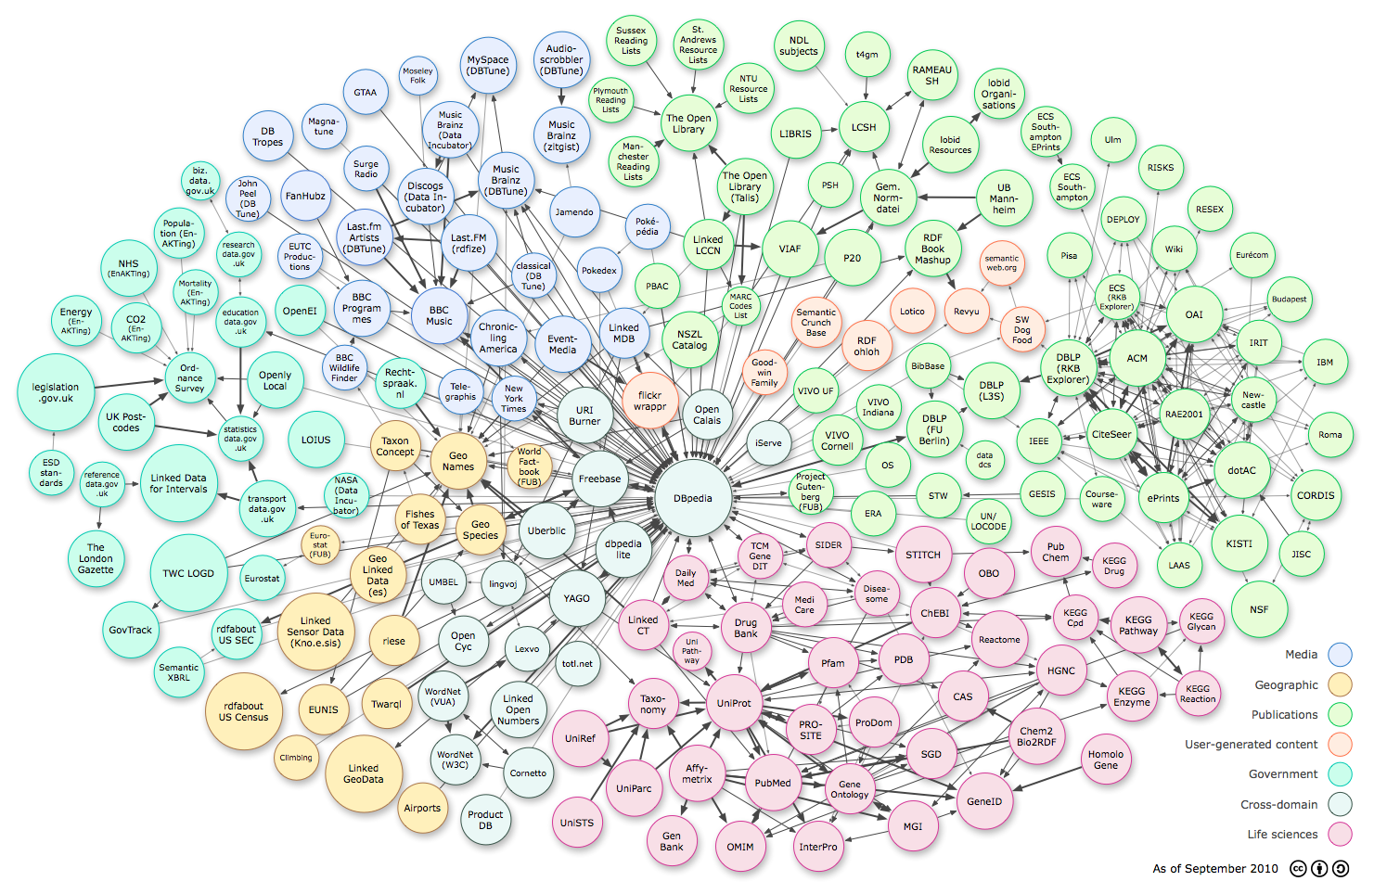
The Web an emergent networks of linked data

Slide 63
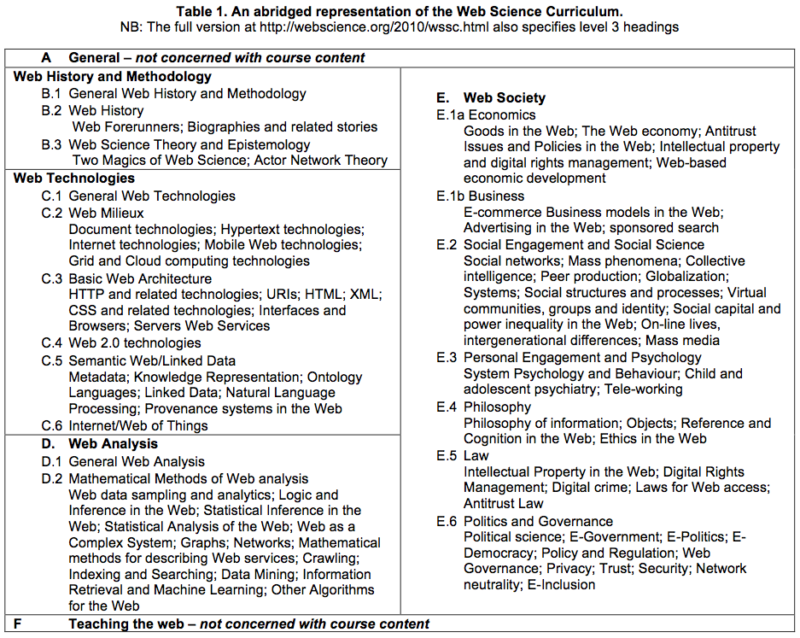
http://webscience.org/2010/wssc.html
Notes:
Here is one example of an instantiation of the curriculum – the result of discussions across the community
This major piece of work was led by Michalis Vafapoulos

Slide 64
Protocols
Citing or adapting

Slide 65
Using other people’s diagrams
Identify the source
Acknowledge in the figure title

Slide 66
Tools for creativity
Thinking and recording

Slide 69
Production Pragmatics
What to use?

Slide 70
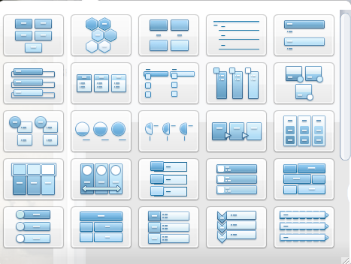
Office tools
How much do you know about the tools you use?
DEMO?

Slide 71
Templates and objects
Not all will be useful or relevant!

Slide 72
Simple (free) tools

Slide 73
Remember…
Visualisations can make order and save words
Visualisation can help creativity
It can be good to get away from the computer
You can always photograph a sketch or set of post-its

Slide 74
Why and how visuals can be useful?
A tool for thinking
Create a table or draw a diagram
You can then systematically explain the diagram in the text
Use a series of diagrams to explain building ideas or evolving understandings/designs

Slide 75
Over to you
What might you use?
What tools?
How might you use them?

Slide 76
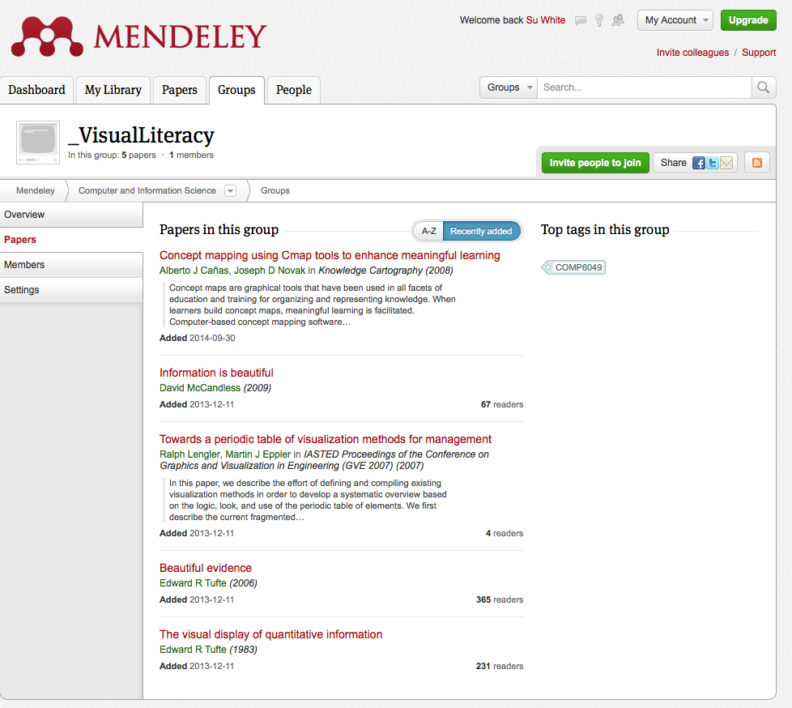
references
Visual Literacy Mendeley Group
http://www.mendeley.com/groups/3963921/visualliteracy/papers/

Slide 77
Further Browsing
GapMinder: http://www.gapminder.org
Guardian Data Store Flickr Group http://www.flickr.com/groups/1115946@N24/
Information Is Beautiful http://www.informationisbeautiful.net
Many Eyes: http://www-958.ibm.com/‎
Visual-Literacy: http://www.visual-literacy.org/

Slide 78
Learning from Posters
Planning your topics and understanding interdisciplinarity

Slide 79
Group exercise:
Individually
Look at the posters (via slideshow)
Identify the (possible) contributory disciplines
In Pairs
Discuss your analysis
Expand the list of contributory views
Share
In a round
Tell the class what you learnt
Comment on the titles
are they useful?
did you understand them?
think
share
pair
Notes:
There is a handout, make notes during the feedback

Slide 80
Quick preview
While you are looking at the posters
Think about the topics
What disciplines?
What variations on a theme
Posters are follow at the end of this slide set.
Or you can look at them on the web site pdf downloads available http://dtc.webscience.ecs.soton.ac.uk/people-and-partners/list-of-students/student-research-interests/web-science-posters/
Notes:
Then swap over to the posters slideset in common core

Slide 81
Scan through papers from previous Web science conferences
Available from web science trust
http://journal.webscience.org/
Available from the ACM digital library
Links from DL are dynamic so….
Search for web science and year (2011 – 2016)
2011 was the 4th conferenece

Slide 93
Possible activities
Posters

Slide 94
Quick preview: group projects
While you are looking at the posters go by
Use them to help you think your own groups’ ideas
Reflect on them
Posters are available in a slide set http://www.edshare.soton.ac.uk/13359/ Or you can look at them on the web site pdf downloads available http://dtc.webscience.ecs.soton.ac.uk/people-and-partners/list-of-students/student-research-interests/web-science-posters/

Slide 95
Quick preview: individual reports
While you are looking at the posters go by
Use them to help you think your own ideas
Reflect on them
Posters are available in a slide set http://www.edshare.soton.ac.uk/13359/ Or you can look at them on the web site pdf downloads available http://dtc.webscience.ecs.soton.ac.uk/people-and-partners/list-of-students/student-research-interests/web-science-posters/

Slide 96
Class exercise: thinking about interdisciplinarity
Individually
Look at the posters
Identify the (possible) contributory disciplines
In Pairs
Discuss your analysis
Expand the list of contributory views
Share
In a round
Tell the class what you learnt
How useful are the titles?
think
share
pair
Notes:
There is a handout, make notes during the feedback

Slide 97
Quick preview: poster preparation
While you are looking at the posters go by
Which ones are most visually appealing?
Which ones can you actually read?
How useful are the titles?
Posters are available in a slide set http://www.edshare.soton.ac.uk/13359/ Or you can look at them on the web site pdf downloads available http://dtc.webscience.ecs.soton.ac.uk/people-and-partners/list-of-students/student-research-interests/web-science-posters/

Slide 98
Appendix
Previous topics

Slide 99
1.1
Neil Amos
The New You? People, Machines and Identity
Psychology
Computer Science

Slide 100
1.2
Nick Bennett
How much does an avatar cost? Self-representation through avatars in online gaming
Economics
Psychology

Slide 101
1.3
Briony Gray
Virtual Environments: the future for City Metrics and Big Data
Economic Geography
Computer Science

Slide 102
1.4
Dola Majekodunmi
Banking on the Web
Psychology
Computer Science

Slide 103
1.5
Colin Pattinson
State-sponsored Cybercrime
Criminology
International Relations

Slide 104
1.6
Gefion Thuermer
Can there be a European public?
Political Science
Media Studies

Slide 105
1.7
Jack Webster
Migrant Communities and Social Media
Human Geography
Social Anthropology

Slide 106
1.8
Nic Fair
The Ideology and Architecture of the Founding Principles of the Web : an Interdisciplinary Approach
Political Science Computer Science

Slide 107
1.9
Sarah Hewitt
Feminist Psychology and Networks
Psychology
Computer Science

Slide 108
2.1
Edmund Baird
LGBT Identity and the Web
Psychology
Sociology

Slide 109
2.2
Flavia Dinca Spreading (mis)information online: the case of anti-vaccination campaigns Public Health Computer Science

Slide 110
2.3
taekyun kim
why people show different behaviour between online and offline
computer science
psychology

Slide 111
2.4
Rafael Melgarejo Heredia
GOLEM & HUMAN BEING: FREE WILL AUTOMATA?
Computer Science
Theory of Complexity

Slide 112
2.5
Keisha Taylor
The Growth Of The ‘Sharing Economy’: How Does Sociology & Economics Help Us Understand?
Sociology & Economics

Slide 113
2.6
Niko Tsakalakis
Self-disclosure online: Perspectives from Computer Science and Social Social Psychology
Psychology
Computer Science

Slide 114
2.8
Paul Gilbert
Will the new GCSE Computer Science curriculum change society’s understanding of open software & systems
Computer Science
Social Sciences

