Slide 1
A Brief history of the web
Social
David Millard
dem@ecs.soton.ac.uk

Slide 2

I remembered the line from the Hindu scripture, the Bhagavad-Gita... "Now, I am become Death, the destroyer of worlds.”
- Robert Oppenheimer (Director of the Manhattan Project)

Slide 3
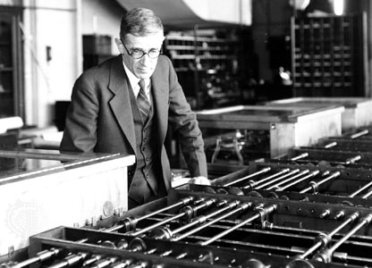
2000
1990
1980
1970
1960
1945: Vannevar Bush – The memex
1950
1940

Slide 4
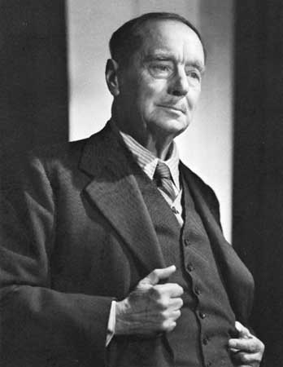
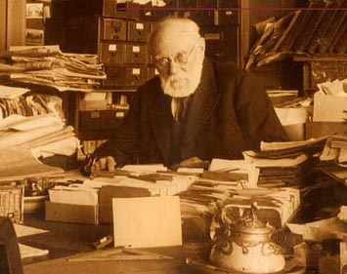
2000
1990
H.G Wells
The World Brain (1938)
1980
1970
Paul Otlet The Mundaneum (1910)
1960
1950
Hypertext Prehistory
1940

Slide 5
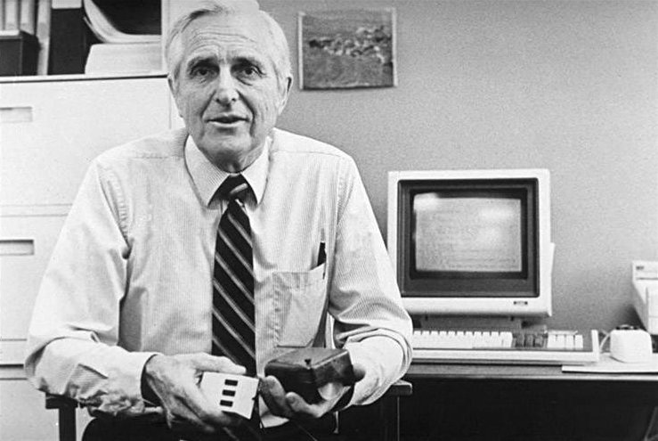
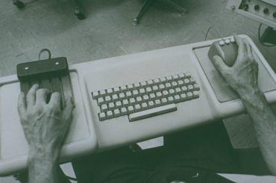
2000
1990
1980
1970
1960
1960s: Doug Engelbart – NLS Augment and the mouse
1950
1940

Slide 6
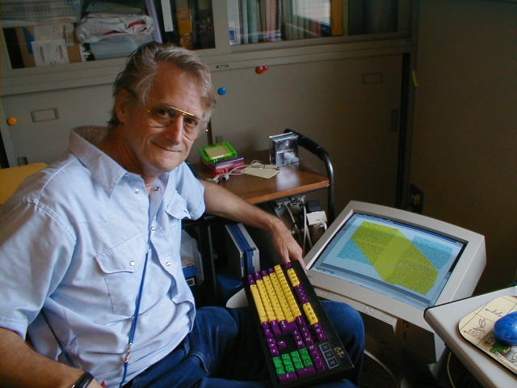
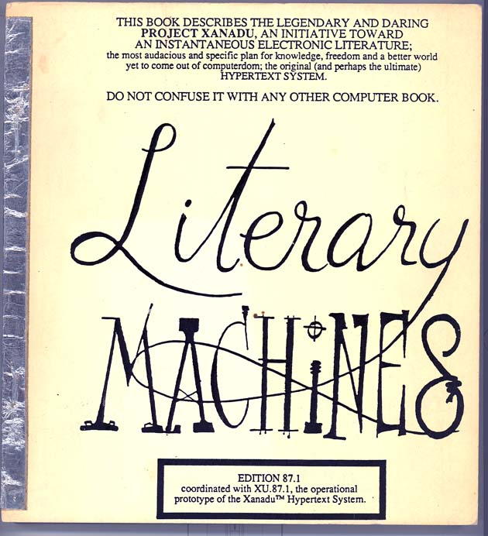
2000
1990
1980
1970
1960
1950
1960-80: Ted Nelson – Project Xanadu
1940

Slide 7
2000
1990
1980
1970
1960
Hypertext Pioneers
1950
1940

Slide 8
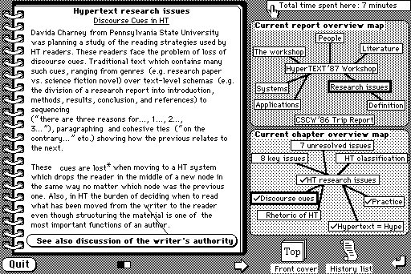
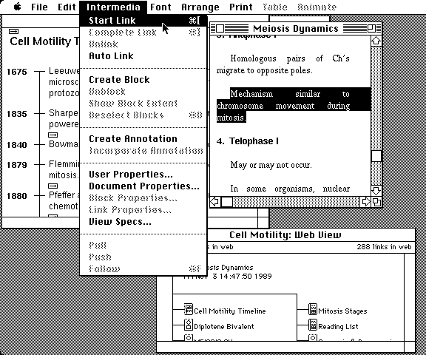
2000
1990
1987: Hypercard (Apple)
1980
1970
1960
Hypertext Pioneers
1950
1985: Intermedia
(Brown University)
1940

Slide 9
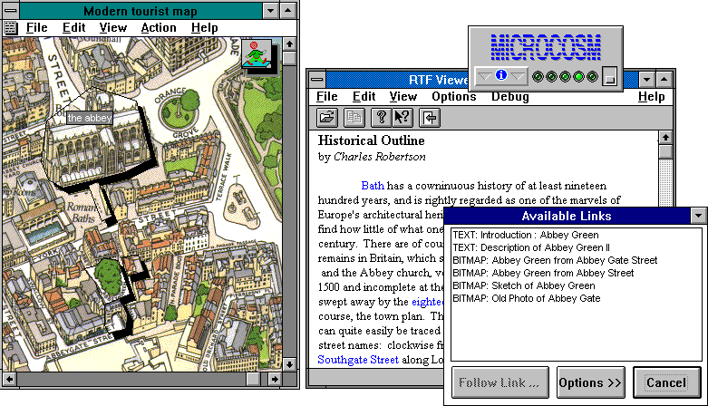
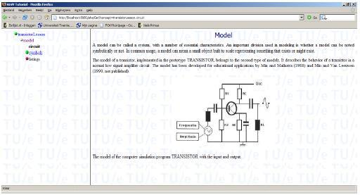
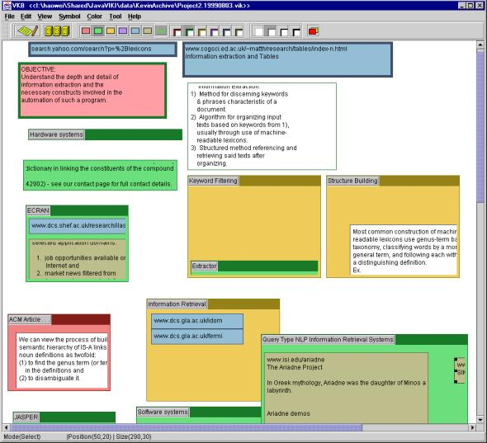
2000
1990
1992: Open Hypermedia - Microcosm
(Southampton University)
1980
1970
1960
1999: Adaptive Hypermedia - AHA!
(Eindhoven University)
Hypertext Pioneers
1950
1994: VIKI/VKB
(Texas A&M University)
1940

Slide 10
2000
1990
Hypertext
1980
1970
1960
Hypertext Pioneers
1950
1940

Slide 11
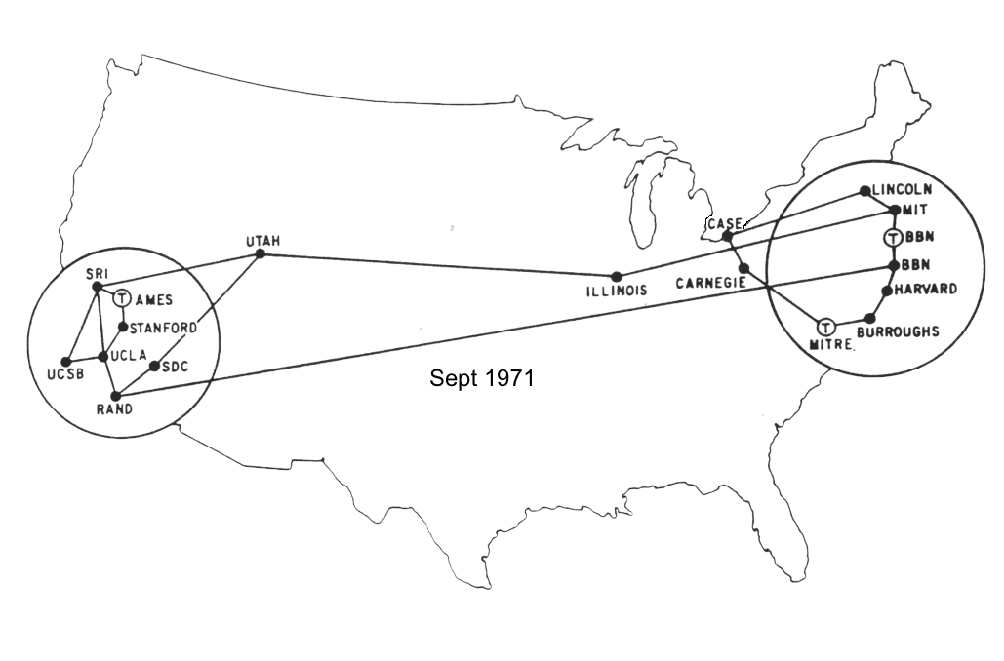
2000
1990
Hypertext
1980
1970
1960
1969: ARPANET
1974: TCP/IP
1982: ARPANET adopts TCP/IP
Hypertext Pioneers
1950
1940

Slide 12
2000
1990
Hypertext
Internet
1980
1970
1960
Hypertext Pioneers
1950
1940

Slide 13
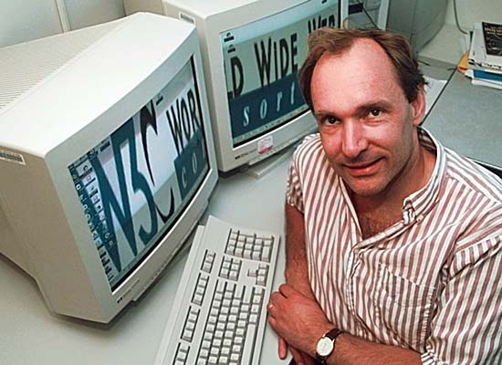
2000
1990
Hypertext
Internet
1980
1970
1991: Tim-Berners Lee invents WWW
1960
Hypertext Pioneers
1950
1940

Slide 14
2015: 30 trillion pages*
2013: 50 billion pages
2005: 11.5 billion pages
2001: Wikipedia launched
2000: 7 million pages
1998: Google is founded
1995: Amazon is founded
1995: Internet Explorer packaged with Windows
1993: Mosaic First Multimedia Web Browser
1991: First Commercial ISP
* as indexed by Google
2000
1990
Hypertext
Internet
1980
1970
1960
Hypertext Pioneers
1950
1940

Slide 15
2000
Web 1.0
1990
Hypertext
Internet
1980
1970
1960
Hypertext Pioneers
1950
1940

Slide 16
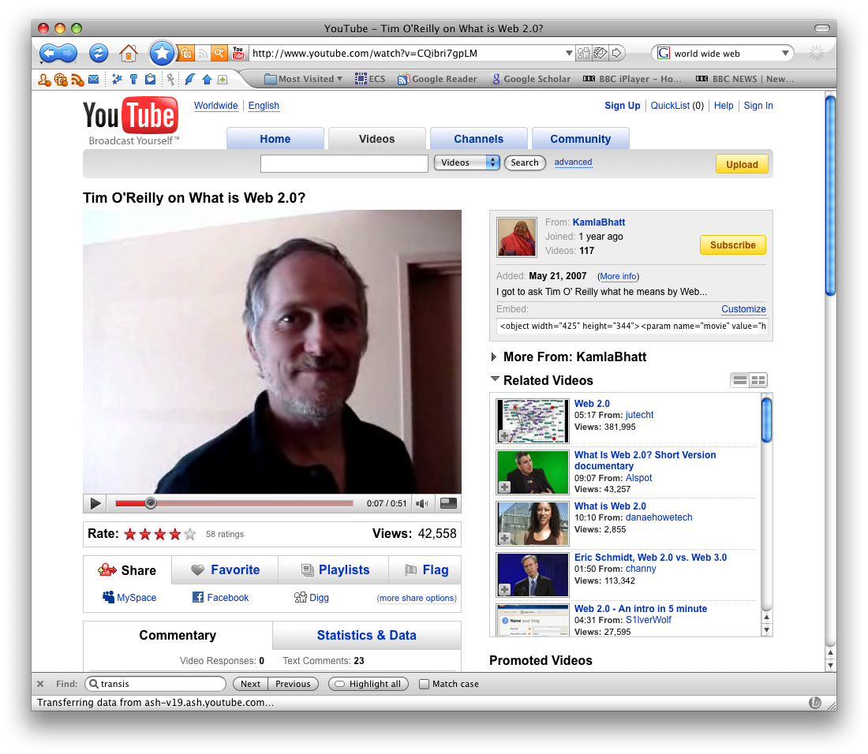
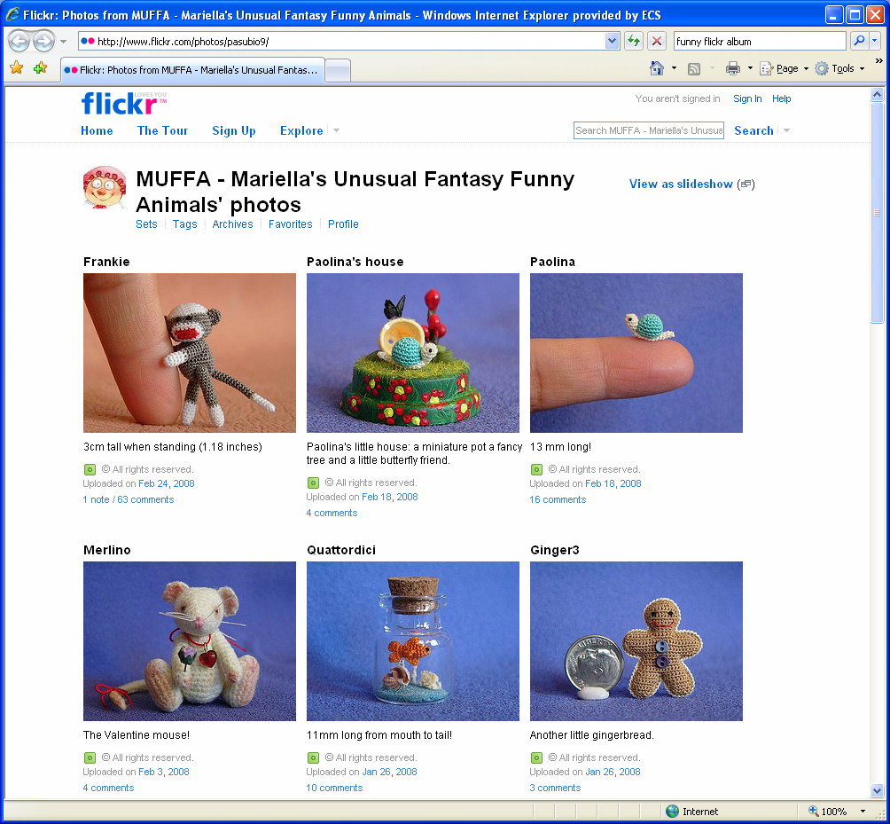
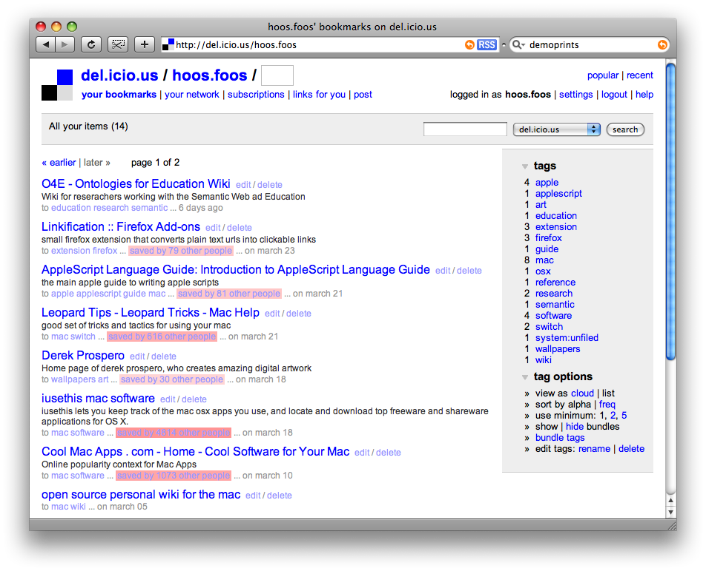
2000
2005: Youtube
Web 1.0
1990
Hypertext
Internet
1980
2004: Flickr
1970
1960
Hypertext Pioneers
2003: del.icio.us
1950
1940

Slide 17
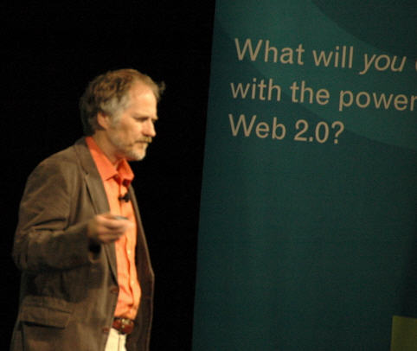
2000
Web 1.0
1990
Hypertext
Internet
1980
1970
1960
2005: Tim O’Reilly, ‘What is Web 2.0’
Hypertext Pioneers
1950
1940

Slide 18
Web 2.0
2000
Web 1.0
1990
Hypertext
Internet
1980
1970
1960
Hypertext Pioneers
1950
1940

Slide 19
Web 2.0
2000
Web 1.0
1990
Hypertext
Internet
1980
1970
1960
Hypertext Pioneers
What about Social Networks?
1950
1940

Slide 20
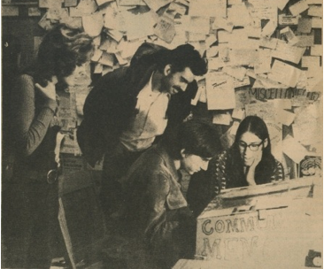
Web 2.0
2000
Web 1.0
1990
Hypertext
Internet
1980
Community
Memory
1973
1970
1960
Hypertext Pioneers
What about Social Networks?
1950
1940

Slide 21
Web 2.0
2000
Web 1.0
1990
Hypertext
Internet
1980
Usenet 1980
BBS 1978
Community
Memory
1973
1970
1960
Hypertext Pioneers
What about Social Networks?
1950
1940

Slide 22
Web 2.0
2000
Web 1.0
BuddyLists and Blogrolls
1990
Hypertext
Internet
1980
Usenet 1980
BBS 1978
Community
Memory
1973
1970
1960
Hypertext Pioneers
What about Social Networks?
1950
1940

Slide 23
Web 2.0
2000
Sixdegrees 1997
Web 1.0
BuddyLists and Blogrolls
1990
Hypertext
Internet
1980
Usenet 1980
BBS 1978
Community
Memory
1973
1970
1960
Hypertext Pioneers
What about Social Networks?
1950
1940

Slide 24
Web 2.0
2000
MySpace, Del.icio.us 2003
Friendster 2002
Sixdegrees 1997
Web 1.0
BuddyLists and Blogrolls
1990
Hypertext
Internet
1980
Usenet 1980
BBS 1978
Community
Memory
1973
1970
1960
Hypertext Pioneers
What about Social Networks?
1950
1940

Slide 25
Web 2.0
Facebook, Orkut, Digg 2004
2000
MySpace, Del.icio.us 2003
Friendster 2002
Sixdegrees 1997
Web 1.0
BuddyLists and Blogrolls
1990
Hypertext
Internet
1980
Usenet 1980
BBS 1978
Community
Memory
1973
1970
1960
Hypertext Pioneers
What about Social Networks?
1950
1940

Slide 26
Web 2.0
YouTube 2005, Twitter 2006, Tumblr 2007
Facebook, Orkut, Digg 2004
2000
MySpace, Del.icio.us 2003
Friendster 2002
Sixdegrees 1997
Web 1.0
BuddyLists and Blogrolls
1990
Hypertext
Internet
1980
Usenet 1980
BBS 1978
Community
Memory
1973
1970
1960
Hypertext Pioneers
What about Social Networks?
1950
1940

Slide 27
FourSquare, Gowalla , Renren, Sina Weibo 2009
Web 2.0
YouTube 2005, Twitter 2006, Tumblr 2007
Facebook, Orkut, Digg 2004
2000
MySpace, Del.icio.us 2003
Friendster 2002
Sixdegrees 1997
Web 1.0
BuddyLists and Blogrolls
1990
Hypertext
Internet
1980
Usenet 1980
BBS 1978
Community
Memory
1973
1970
1960
Hypertext Pioneers
What about Social Networks?
1950
1940

Slide 28
SnapChat, WeChat, Google+ 2011, Vine 2013
WhatsApp 2009, Pinterest, Instagram 2010
FourSquare, Gowalla , Renren, Sina Weibo 2009
Web 2.0
YouTube 2005, Twitter 2006, Tumblr 2007
Facebook, Orkut, Digg 2004
2000
MySpace, Del.icio.us 2003
Friendster 2002
Sixdegrees 1997
Web 1.0
BuddyLists and Blogrolls
1990
Hypertext
Internet
1980
Usenet 1980
BBS 1978
Community
Memory
1973
1970
1960
Hypertext Pioneers
What about Social Networks?
1950
1940

Slide 29
Periscope, Facebook Live 2015
SnapChat, WeChat, Google+ 2011, Vine 2013
WhatsApp 2009, Pinterest, Instagram 2010
FourSquare, Gowalla , Renren, Sina Weibo 2009
Web 2.0
YouTube 2005, Twitter 2006, Tumblr 2007
Facebook, Orkut, Digg 2004
2000
MySpace, Del.icio.us 2003
Friendster 2002
Sixdegrees 1997
Web 1.0
BuddyLists and Blogrolls
1990
Hypertext
Internet
1980
Usenet 1980
BBS 1978
Community
Memory
1973
1970
1960
Hypertext Pioneers
What about Social Networks?
1950
1940

Slide 30
Web 3.0?
Periscope, Facebook Live 2015
SnapChat, WeChat, Google+ 2011, Vine 2013
WhatsApp 2009, Pinterest, Instagram 2010
FourSquare, Gowalla , Renren, Sina Weibo 2009
Web 2.0
YouTube 2005, Twitter 2006, Tumblr 2007
Facebook, Orkut, Digg 2004
2000
MySpace, Del.icio.us 2003
Friendster 2002
Sixdegrees 1997
Web 1.0
BuddyLists and Blogrolls
1990
Hypertext
Internet
1980
Usenet 1980
BBS 1978
Community
Memory
1973
1970
1960
Hypertext Pioneers
What about Social Networks?
1950
1940

Slide 31
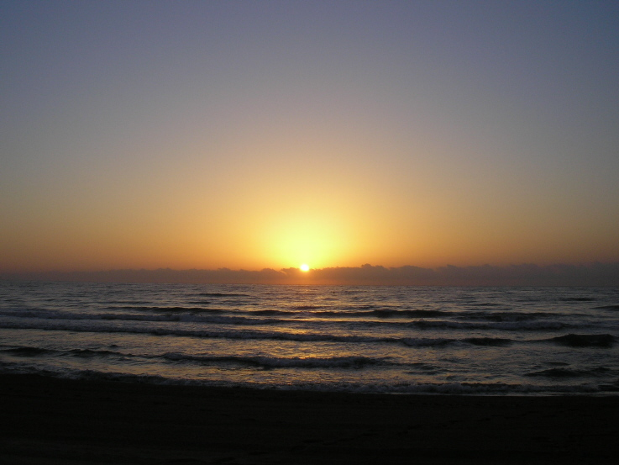
Questions?
“the objective of hypertext research is to save the planet”
- Ted Nelson (Project Xanadu)

