Slide 1
Power: Part ii
David Millard
dem@ecs.soton.ac.uk

Slide 2
Does Power in Social Media Translate to the Real World?

Slide 3
What do we mean by Real World Power?
Power as Action
If Influence is a form of Power as Action
Then is Influence in Social Media a form of Power as Action?
Power as Influence
And Connection/Propagation/Interaction on Social Media is a form of Influence
Power as Connection
Power as Propagation
Power as Interaction
URI
Concept

Slide 4
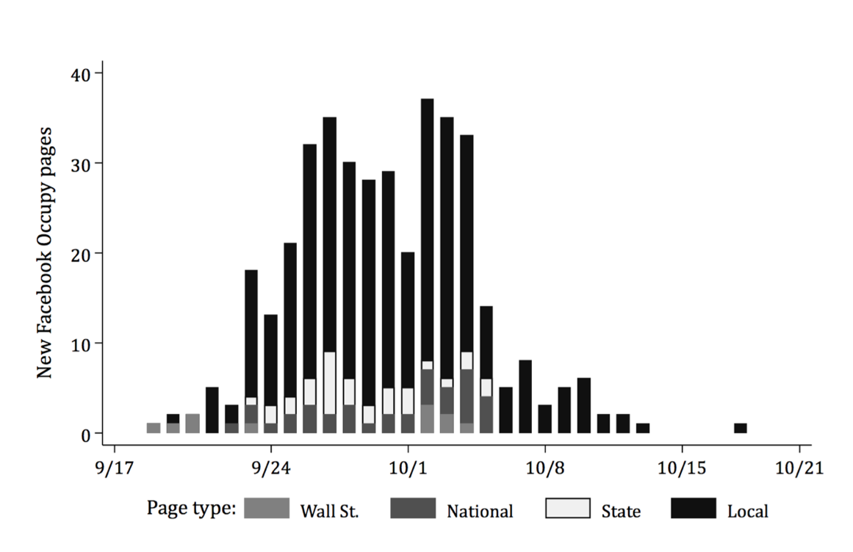
Occupy Movement
Caren, N., & Gaby, S. (2011). Occupy Online: Facebook and the Spread of Occupy Wall Street. SSRN Electronic Journal.

Slide 5
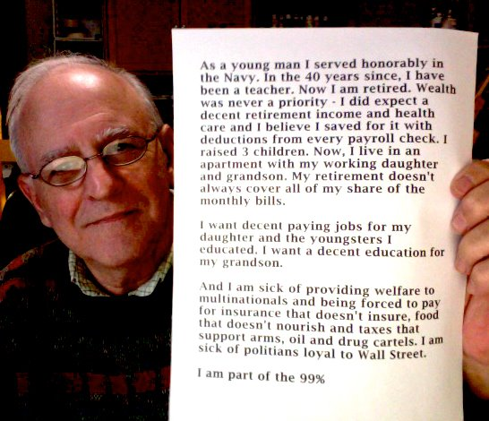
How Occupy Uses Facebook
170,000 participants across more than 400 pages
Facebook is a recruiting tool for bringing in new supporters and getting people to events
Facebook is a medium for compiling and sharing relevant news stories
Requests for resources can reach a large range of members when posted on Facebook. E.g. “Urgent: We really need tarps, tents, and sleeping bags. It's going to rain soon and we're low. Thank you!”
Facebook is a space used for telling narratives or retelling the experiences of other movement participants.
Facebook provides a medium for instant communication between geographically separated groups within the movement
Caren, N., & Gaby, S. (2011). Occupy Online: Facebook and the Spread of Occupy Wall Street. SSRN Electronic Journal.

Slide 6
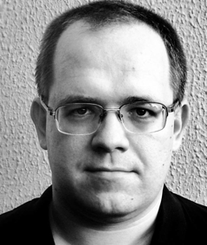
Slacktavism
Where online activity (like clicking a petition, or liking a Facebook page) takes the place of real world activism
Morozov E. The Net Delusion: How not to liberate the world. Penguin (5 April 2012)

Slide 7
Slacktavism
Where online activity (like clicking a petition, or liking a Facebook page) takes the place of real world activism
Facebook Group
Save the Children of Africa
1.7 million members
$12,000
Morozov E. The Net Delusion: How not to liberate the world. Penguin (5 April 2012)

Slide 8
Revolutionising Revolution?

Slide 9
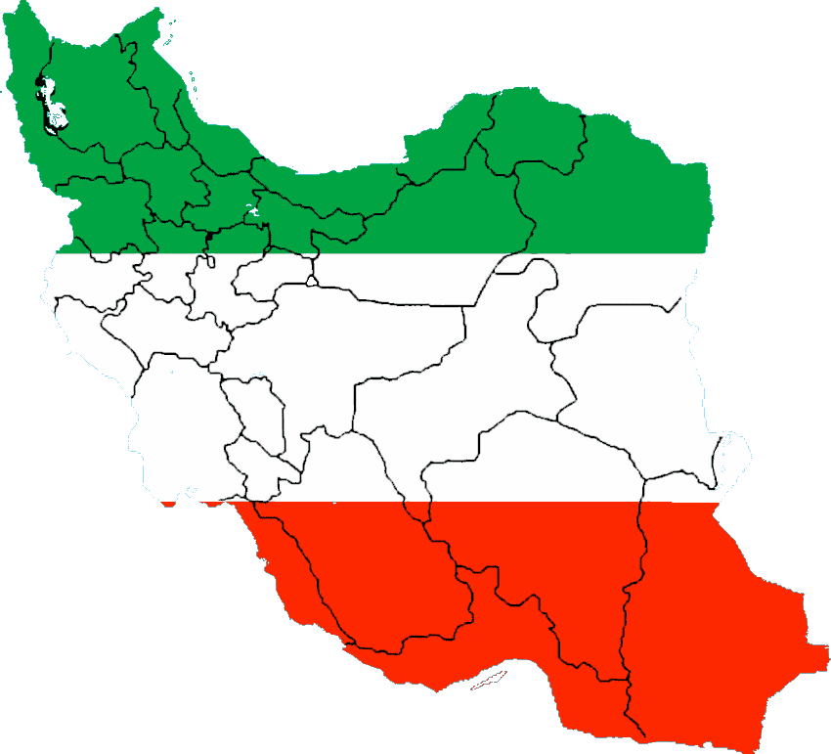
“[Iran’s] is the first revolution that has been catapulted onto a global stage and transformed by social media.” - Clay Shirky

Slide 10
BBC Virtual Revolution: Enemy of the State

Slide 11
Discussion

Slide 12
Discussion - The Protesters
Scenario:
You are tech-savvy supporters of democratic change in the Republic of Fakeland. The Dictator has been promising change for many years, but it has become clear that he has no real intentions of this. It is clear that a recent election was rigged, people are angry, and there is an opportunity for protest to force change to happen!
You have been tasked with looking at how Social Media could help your cause!
Questions:
What types of power might you be able to wield through Social Media?
How could you analyze what is happening during the protest to help identify and support key individuals?
How might you reflect after the protest to see how effective this strategy was?

Slide 13
Discussion - The Government
Scenario:
You are a member of the technology branch of Fakeland Police. Your country’s President has led a legitimate government through many tough years, and now the country is recovering he is trying to introduce difficult political and religious reforms. Now, after a recent election went badly for them, a small number of religious extremists are trying to spark riots and unrest that threatens all the progress that has been made!
You have been tasked with looking at how Social Media could help track down and stop the extremists!
Questions:
What types of power might the extremists be able to wield through social media?
How could you use social media during the protest to interfere with the extremists plans.
How might you analyse what happened afterwards in order to identify and arrest key extremists.

Slide 14
Discussion - The Government
Questions for Protesters:
What types of power might you be able to wield through Social Media?
How could you analyze what is happening during the protest to help identify and support key individuals?
How might you reflect after the protest to see how effective this strategy was?
Questions for Government:
What types of power might the extremists be able to wield through social media?
How could you use social media during the protest to interfere with the extremists plans.
How might you analyse what happened afterwards in order to identify and arrest key extremists.

Slide 15
The Tweets that Cut Both Ways
“both Twitter and Facebook give Iran’s secret services superb platforms for gathering open source intelligence about the future revolutionaries, revealing how they are connected to each other”
“foreign supporters of the Twitter Revolution managed to do what the Iranian government couldn’t: make the Internet unusable for activists”
“Twitter accounts that looked “suspicious”—that is, appeared to be spreading “misinformation” about the venues and times of the protests”
Morozov. Iran: Downside to the "Twitter Revolution". Dissent (9) vol. 56 (4) pp. 10-14

Slide 16
A Western Lens?
Approx 9000 Twitter users in Iran
Homophily in Action (young, educated, technology literate)
Less than 1% of Iranian Internet users
A multitude of technologies used for communication
SMS and Word-of-mouth more important that Social Media
Western reporters lack access to Iran
Many tweets with #iranelection are retweets (approximately 3:1 ratio)
Most tweets with #iranelection are not from Iran (40% outside, 35% unknown)
Creates a whisper effect that distorts information
Argument: All this generates a disproportionate sense of Twitters importance to Western viewers!
Burns and Eltham. Twitter Free Iran: An Evaluation of Twitter's Role in Public Diplomacy and Information Operations in Iran's 2009 Election Crisis. Communications Policy & Research Forum 2009 (2009)
Schectman, J. Iran's Twitter Revolution? Maybe Not Yet. Bloomberg Businessweek, June 17, 2009. Available As: http://www.businessweek.com/technology/content/jun2009/tc20090617_803990.htm

Slide 17
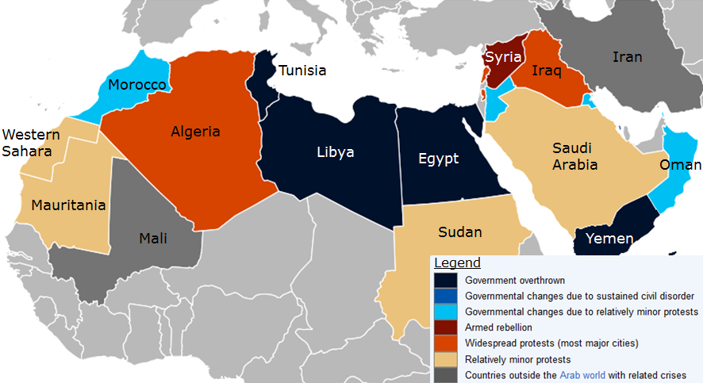
What About the Arab Spring?
A wave of demonstrations, protests, and wars occurring in the Arab world that began in December 2010.

Slide 18
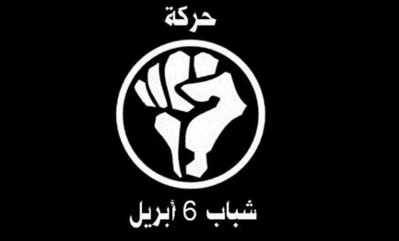
In Egypt…
“The protests were kickstarted by a Facebook campaign run by the opposition “April 6 Youth Movement,” which generated tens of thousands of positive responses to the call to rally against government policies”
- Stepanova, E. (2011). The Role of Information Communication Technologies in the “Arab Spring.” PONARS Eurasia Policy Memo No. 159, May 2011

Slide 19
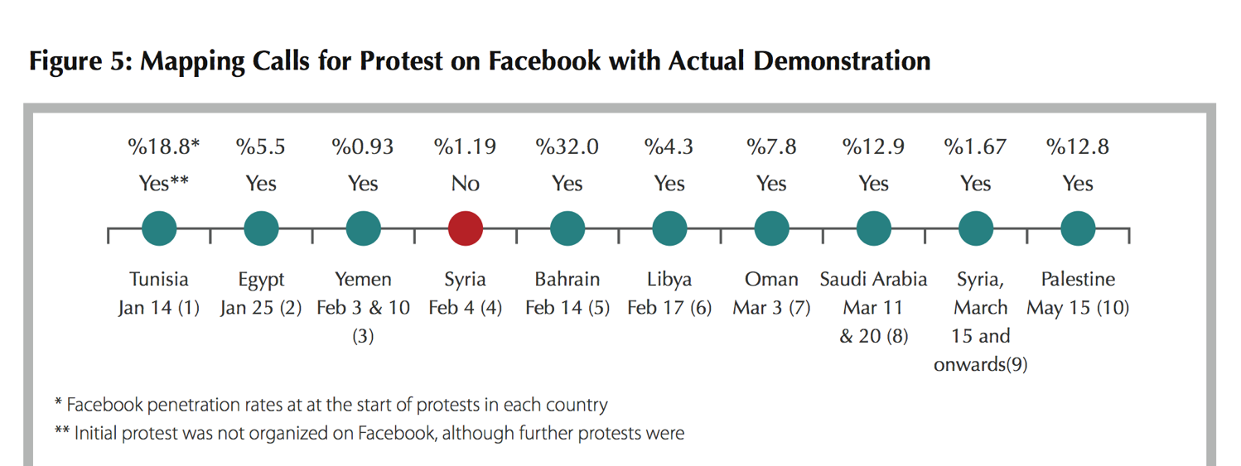
Did Facebook Calls Precede ‘Real’ Protests?
The Arab Social Media Report, Dubai School of Government, Vol 1, No. 2, May 2011

Slide 20
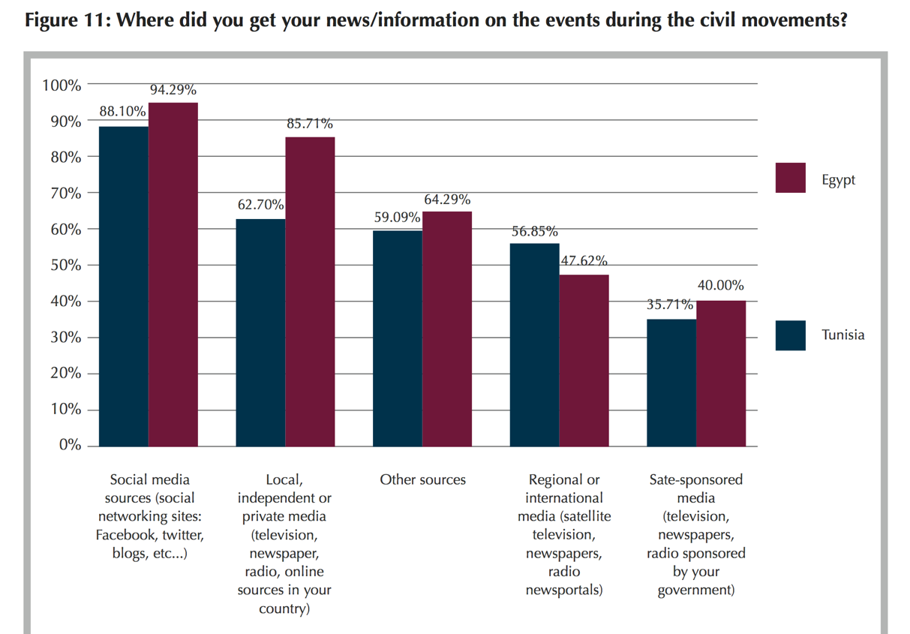
Where did Facebook Users get their news?
The Arab Social Media Report, Dubai School of Government, Vol 1, No. 2, May 2011

Slide 21
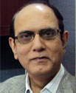
Social Media as a Catalyst for Revolution?
“There is no question that social media played a significant role in the political movements in Tunisia and Egypt, but one should not overstate the role. The role of conventional media, especially television (e.g. Al Jazeera), was crucial. However, the most important underlying factor was the presence of revolutionary conditions and the inability of the state apparatus to contain the revolutionary upsurge. In this schema, social media was a vital tool—a necessary condition—especially in the face of a muzzled conventional local media, but a tool nevertheless. It was not a sufficient condition.”
^{HABIBUL HAQUE KHONDKER}
Zayed University, Abu Dhabi, United Arab Emirates
Khondker, H. H. (2011). Role of the New Media in the Arab Spring. Globalizations, 8(5), 675–679

Slide 22
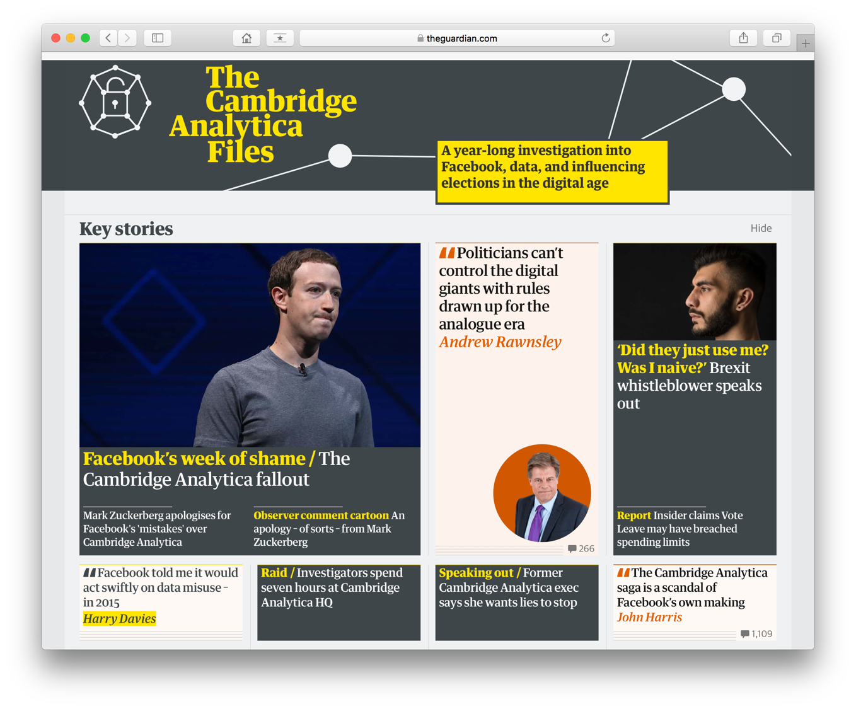
What About Western Democracy?
Notes:
87 million profiles harvested
App that gathered info on you, and friends of friends
Psychologically profiled, and sold for election marketing

Slide 23
What About Western Democracy?
Micro-Segmentation
Divide the audience
Identify valuable groups
Spent effort (money) on targeting those groups
With specific messages designed for them

Slide 24
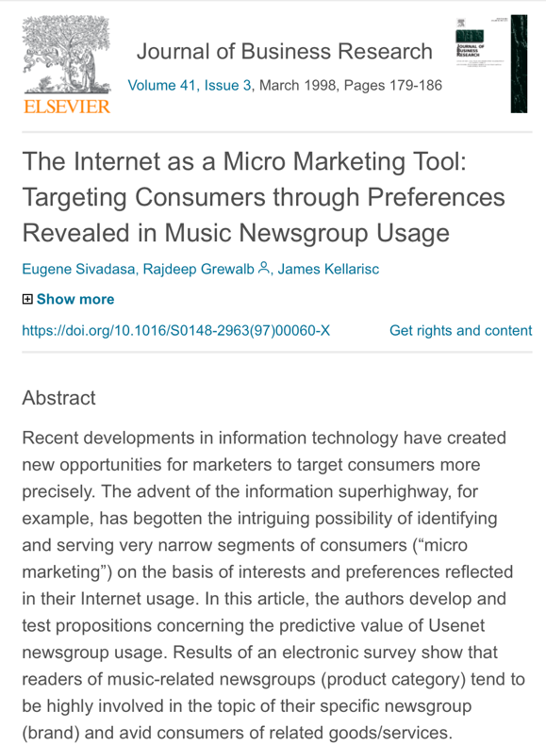
What About Western Democracy?
Micro-Segmentation
Divide the audience
Identify valuable groups
Spent effort (money) on targeting those groups
With specific messages designed for them

Slide 25
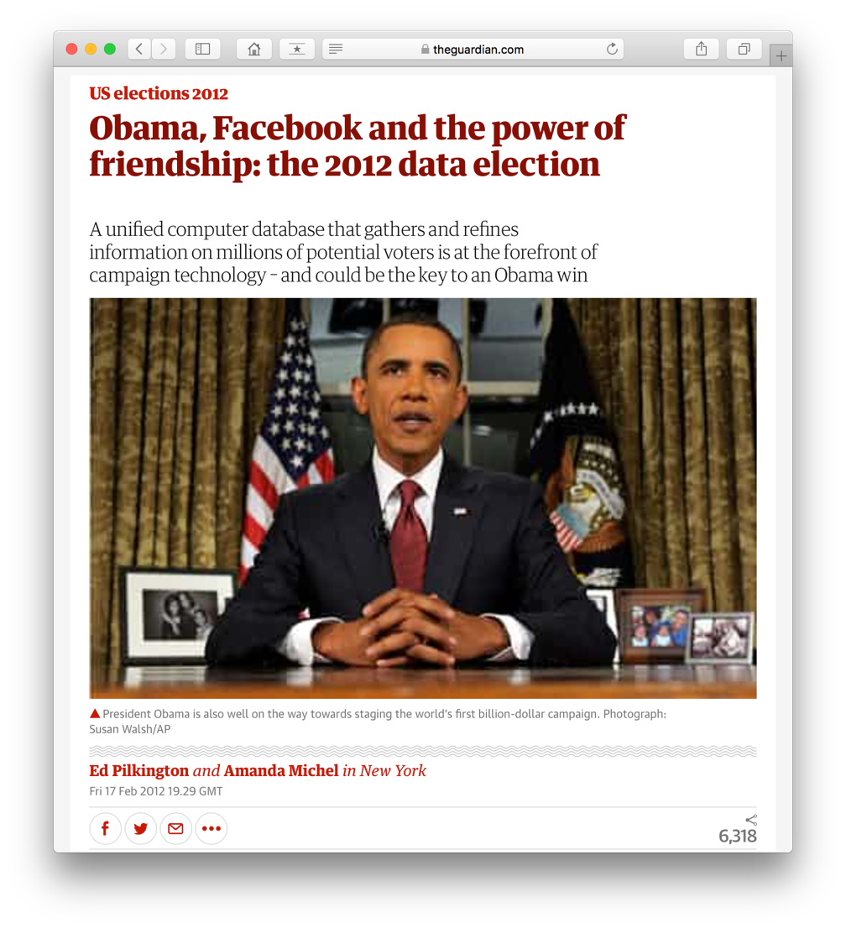
Obama 2012
The Norm:
Conservatives 2015
able to serve ads to 80% of Facebook users in key marginal seats
Trump 2016
Project Alamo – purchased profiles of 220 million US voters
Ran both conversion and suppression ads
Vote Leave
2016 Brexit Referendum
98% of budget on digital media

Slide 26
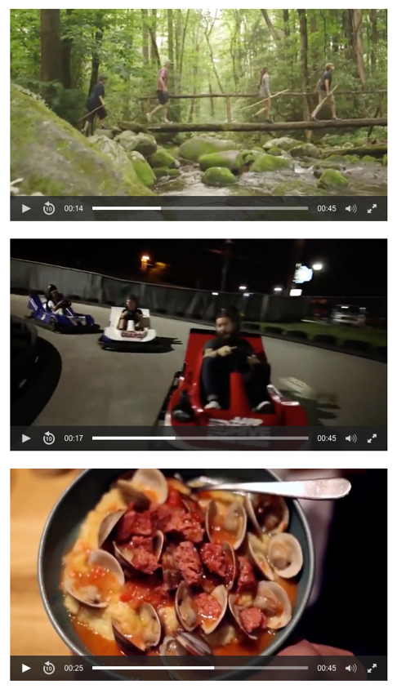
The Future
What if 1 million customers need 1 million adverts?
Tennessee Tourism template based video ad, 2016
A video mix of different activities and environments
Over 2000 combinations – with shared titles and music
Delivered according to location, interests, hobbies
Nano-Segmentation?

Slide 27
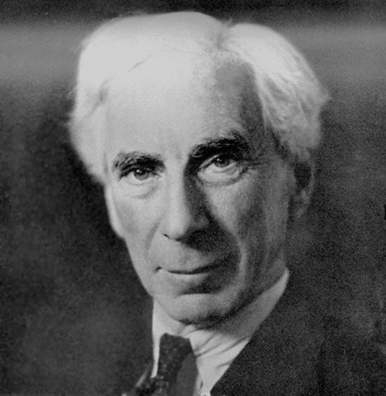
Who has the Power?
Work on Social Media and Power has focused on which social media participants are powerful
But the real power lies with the people who are doing the analysis
And the people selling the data
“Power is the production of intended effects”
- Bertrand Russell

Slide 28
Lessons Learned
Claims over the revolutionary power of social media may be exaggerated
Slacktavism – where online action replaces real world action
Empowers people but can also empower governments and security forces
A Western Lens – we get an exaggerated view of its importance
But there is evidence that it has played a role in real change
An important organisational tool
An important (but not unique) source of information
Perhaps we are asking the wrong question
Election Marketing shows that power lies not within the network
But with the owners of the network
And those they sell to

Slide 29
Questions…
?
Dave Millard (dem@ecs.soton.ac.uk)

