Slide 1
Power: Part I
David Millard
dem@ecs.soton.ac.uk
With additional material from:
Norhidayah Azman
nba08r@ecs.soton.ac.uk

Slide 2
What are Power and Influence?

Slide 3
Who has What Power?
Video available separately

Slide 4
Types of Power
Power
French, J.R.P., & Raven, B. (1959). 'The bases of social power,' in D. Cartwright (ed.) Studies in Social Power. Ann Arbor, MI: University of Michigan Press.

Slide 5
Types of Power
Power
Reward
Positive: The granting of a good
Negative: The removal of a bad
French, J.R.P., & Raven, B. (1959). 'The bases of social power,' in D. Cartwright (ed.) Studies in Social Power. Ann Arbor, MI: University of Michigan Press.

Slide 6
Types of Power
Power
Reward
Coercive
The threat of something negative
Is the withdrawal of punishment a reward?
French, J.R.P., & Raven, B. (1959). 'The bases of social power,' in D. Cartwright (ed.) Studies in Social Power. Ann Arbor, MI: University of Michigan Press.

Slide 7
Types of Power
Power
Reward
Coercive
Legitimate
Power from position in culture/society/group.
Stems from authority but also norms and values
French, J.R.P., & Raven, B. (1959). 'The bases of social power,' in D. Cartwright (ed.) Studies in Social Power. Ann Arbor, MI: University of Michigan Press.

Slide 8
Types of Power
Power
Reward
Coercive
Legitimate
Referent
Power from charisma, attraction and a sense of ‘oneness’
Referent Power is not mediated by the powerful
French, J.R.P., & Raven, B. (1959). 'The bases of social power,' in D. Cartwright (ed.) Studies in Social Power. Ann Arbor, MI: University of Michigan Press.

Slide 9
Types of Power
Power
Reward
Coercive
Legitimate
Referent
Expert
Power based on the perception of knowledge.
Credibility vs. Self-evident facts
French, J.R.P., & Raven, B. (1959). 'The bases of social power,' in D. Cartwright (ed.) Studies in Social Power. Ann Arbor, MI: University of Michigan Press.

Slide 10
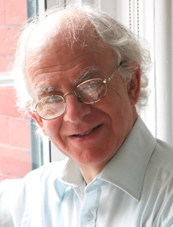
Deeper Dimensions of Power
Prof. Steven Lukes
New York University
The Radical View of Power.
Lukes, S., 2005. Power: A Radical View 2nd ed., Palgrave Macmillan

Slide 11
Deeper Dimensions of Power
1st Dimension:
Overt and Observable
Prof. Steven Lukes
New York University
The Radical View of Power.
Lukes, S., 2005. Power: A Radical View 2nd ed., Palgrave Macmillan

Slide 12
Deeper Dimensions of Power
1st Dimension:
Overt and Observable
Prof. Steven Lukes
New York University
The Radical View of Power.
2nd Dimension:
Covert, Controlling Agendas
Lukes, S., 2005. Power: A Radical View 2nd ed., Palgrave Macmillan

Slide 13
Deeper Dimensions of Power
1st Dimension:
Overt and Observable
Prof. Steven Lukes
New York University
The Radical View of Power.
2nd Dimension:
Covert, Controlling Agendas
3rd Dimension:
Shape Desires and Beliefs
Lukes, S., 2005. Power: A Radical View 2nd ed., Palgrave Macmillan

Slide 14
Measuring Power and Influence

Slide 15
Working Definitions of Power
In Political Philosophy:
Power is “the production of intended effects”
Russell, B., 1948. Power - A New Social Analysis Sixth., London: Unwin Brothers
Power as Action

Slide 16
Working Definitions of Power
In Communication Theory:
Power is "relational capacity that enables a social actor to influence asymmetrically the decisions of other social actor(s) in ways that favor the empowered actor's will, interests, and values.”
Castells, M., 2009. Communication Power, OUP Oxford
Critical people: Connectors, Mavens and Salesmen
Gladwell, M. 2002. The Tipping Point: How Little Things Can Make a Big Difference. Back Bay Books.
Power as Action
Power as Influence

Slide 17
Working Definitions of Power
In Social Networking?
How might we characterise Power in a Social Media Context?
Power as Action
Power as Influence
?

Slide 18
Working Definitions of Power
In Social Networks we might interpret power as connection
We can use network characteristics like Betweenness, Centrality and Hops to analyse a persons ability or potential to influence
Power as Action
Power as Influence
Power as Connection

Slide 19
Working Definitions of Power
Or we might interpret power as propagation
Propagation of Content (URIs) – we can trace a URI through Social Media and identify sources (originating posts)
Power as Action
Power as Influence
Power as Connection
Power as Propagation
URI

Slide 20
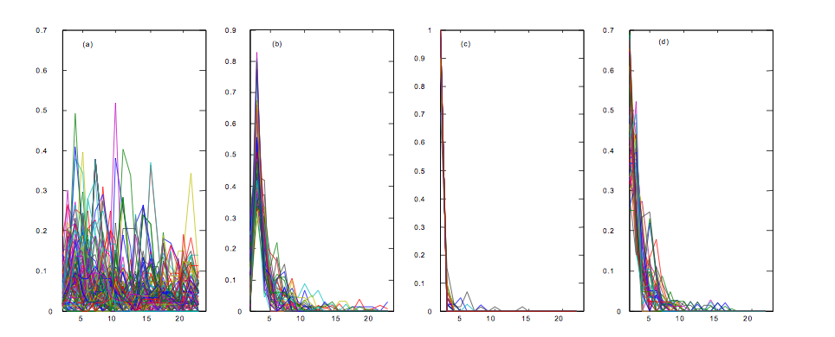
Information Epidemics
The Spread of URIs (through Blogs)
124/259
Sustained Interest
(e.g. iTunes homepage)
51/259
Day 2 peak + slow decay
(e.g. Serious news)
38/259
Day 1 peak + fast decay
(e.g. Slashdot articles)
51/259
Day 1 peak + slow decay
(e.g. media news)
Adar et al. Implicit Structure and the Dynamics of Blogspace. Workshop on the Weblogging Ecosystem New York, NY, USA (2004)

Slide 21
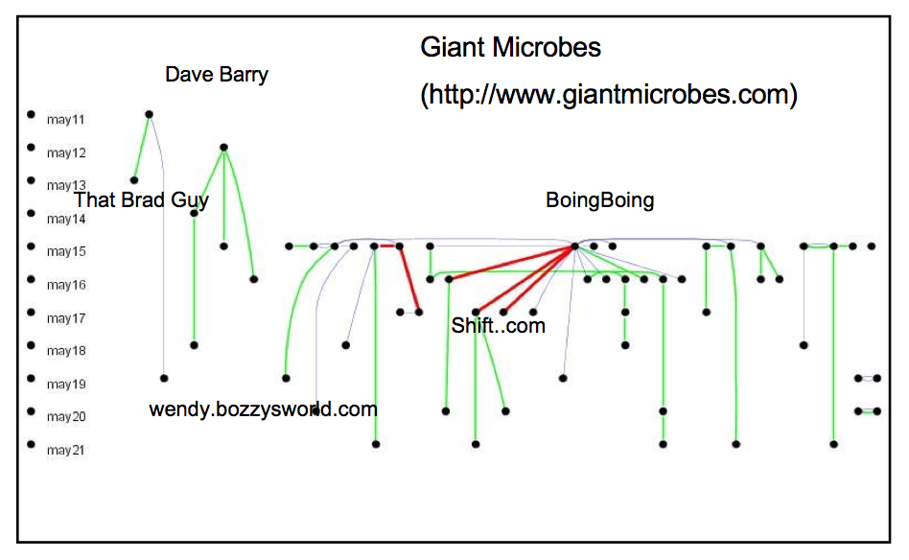
Information Epidemics
Blue = Explicit
Red = Via
Green = Inferred
Adamic. Tracking information epidemics in blogspace. In Proceedings of the 2005 IEEE/WIC/ACM International Conference on Web Intelligence (28) vol. pp. 207- 214

Slide 22
Working Definitions of Power
Or we might interpret power as propagation
Propagation of Content (URIs) – we can trace a URI through Social Media and identify sources (originating posts)
Propagation of Content (Concepts) – we can trace concepts (terms) through Social Media and identify key sources whose concepts survive and are passed on the most
Power as Action
Power as Influence
Power as Connection
Power as Propagation
URI
Concept

Slide 23
Information Diffusion
Tracking concepts (terms) through the blogosphere
Post 1
“AB”
Post 2
“AC”
Post 3
“AC”
Post 4
“BC”
Matsumura, N., Yamamoto, H. & Tomozawa, D., 2010. Finding Influencers and Consumer Insights in the Blogosphere. In International AAAI Conference on Weblogs and Social Media

Slide 24
Information Diffusion
Tracking concepts (terms) through the blogosphere
Post 1
“AB”
A
Post 2
“AC”
AC
Post 3
“AC”
B
Post 4
“BC”
Matsumura, N., Yamamoto, H. & Tomozawa, D., 2010. Finding Influencers and Consumer Insights in the Blogosphere. In International AAAI Conference on Weblogs and Social Media

Slide 25
Information Diffusion
The Influence Diffusion Model (IDM)
Post 1
“AB”
A
Post 2
“AC”
AC
Post 3
“AC”
B
Post 4
“BC”
 | P1 | P2 | P3 | P4 | Inf(out)
P1 | 0 | 1 | 1 | 1 | 3
P2 | 0 | 0 | 2 | 0 | 2
P3 | 0 | 0 | 0 | 0 | 0
P4 | 0 | 0 | 0 | 0 | 0
Most Influential
Matsumura, N., Yamamoto, H. & Tomozawa, D., 2010. Finding Influencers and Consumer Insights in the Blogosphere. In International AAAI Conference on Weblogs and Social Media

Slide 26
Information Diffusion
The Influence Diffusion Model (IDM)
Post 1
“AB”
A
Post 2
“AC”
AC
Post 3
“AC”
B
Post 4
“BC”
Most Influenced
 | P1 | P2 | P3 | P4 | Inf(out)
P1 | 0 | 1 | 1 | 1 | 3
P2 | 0 | 0 | 2 | 0 | 2
P3 | 0 | 0 | 0 | 0 | 0
P4 | 0 | 0 | 0 | 0 | 0
Inf(in) | 0 | 1 | 3 | 1
Most Influential
Matsumura, N., Yamamoto, H. & Tomozawa, D., 2010. Finding Influencers and Consumer Insights in the Blogosphere. In International AAAI Conference on Weblogs and Social Media

Slide 27
Information Diffusion
Which of the Bloggers (x,y,z) is most influential?
x
y
z
Post 1
“AB”
A
Post 2
“AC”
AC
Post 3
“AC”
B
z
Post 4
“BC”
 | P1 | P2 | P3 | P4 | Inf(out)
P1 | 0 | 1 | 1 | 1 | 3
P2 | 0 | 0 | 2 | 0 | 2
P3 | 0 | 0 | 0 | 0 | 0
P4 | 0 | 0 | 0 | 0 | 0
Inf(in) | 0 | 1 | 3 | 1
Matsumura, N., Yamamoto, H. & Tomozawa, D., 2010. Finding Influencers and Consumer Insights in the Blogosphere. In International AAAI Conference on Weblogs and Social Media

Slide 28
Information Diffusion
Which of the Bloggers (x,y,z) is most influential?
x
y
z
Post 1
“AB”
A
Post 2
“AC”
AC
Post 3
“AC”
B
z
Post 4
“BC”
 | P1 | P2 | P3 | P4 | Inf(out)
P1 | 0 | 1 | 1 | 1 | 3
P2 | 0 | 0 | 2 | 0 | 2
P3 | 0 | 0 | 0 | 0 | 0
P4 | 0 | 0 | 0 | 0 | 0
Inf(in) | 0 | 1 | 3 | 1
 | Inf(out) | Inf(in)
x | 3 | 0
y | 2 | 1
z | 0 | 4
Most Influential
Most Influenced
Matsumura, N., Yamamoto, H. & Tomozawa, D., 2010. Finding Influencers and Consumer Insights in the Blogosphere. In International AAAI Conference on Weblogs and Social Media

Slide 29
Working Definitions of Power
In Social Networks we might interpret power as interaction
we can look at audience reaction and can discover who engages most with others
replies, messages, sharing, joint activities, etc…
Power as Action
Power as Influence
Power as Connection
Power as Propagation
Power as Interaction
URI
Concept

Slide 30
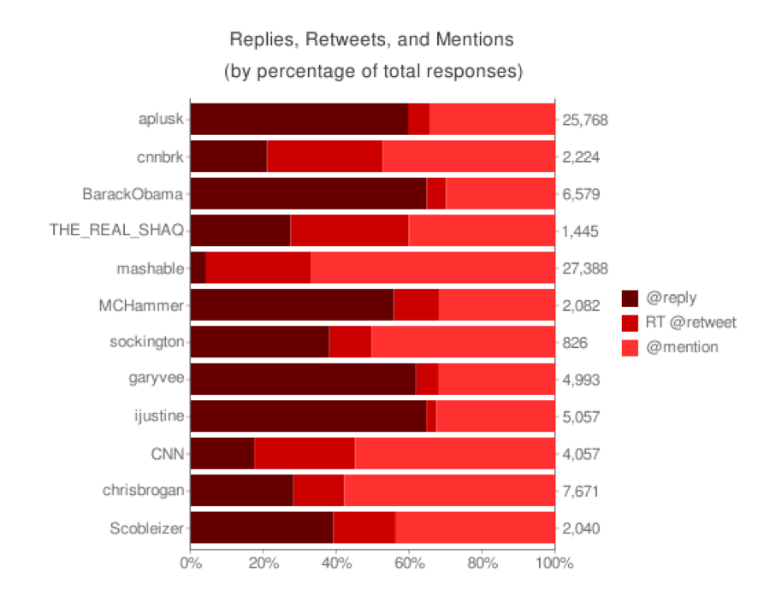
Audience Response
Social Networks give us new ways to measure influence…
Conversation vs. Content
Leavitt et al. The Influentials: New Approaches for Analyzing Influence on Twitter. a Publication of the Web Ecology Project (2009)

Slide 31
Audience Response
Public Figures and News Sources
Indegree influence, the number of followers of a user
Directly indicates the size of the audience for that user.
Retweet influence, the number of retweets containing one’s name
Indicates the ability of that user to generate content with pass-along value
Mention influence, the number of mentions containing one’s name
Indicates the ability of that user to engage others in a conversation.
Indegree
27.4%
Retweets
Mentions
3%
5.6%
7.1%
26.4%
23.8%
6.7%
Content Aggregators
Celebrities
Cha et al. Measuring user influence in twitter: The million follower fallacy. Proceedings of the Fourth International AAAI Conference on Weblogs and Social Media (2010) pp. 10-17

Slide 32
Properties of Power and Influence

Slide 33
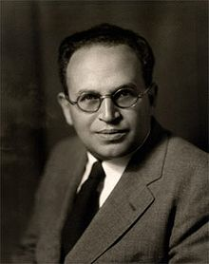
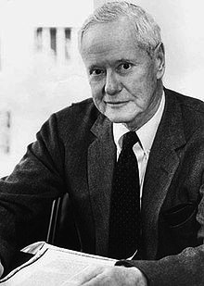
Homophily (love of the same)
The degree to which pairs (or groups) of individuals are alike
Similarity (dissimilarity)
Segregation
Social Closeness (Distance)
Complementarity
Lazarfeld and Merton coined the term Homophily in 1954
Status Homophily
Value Homophily
Paul Lazarsfeld
Robert K. Merton
Lazarsfeld and Merton. Friendship as a social process: A substantive and methodological analysis. Freedom and control in modern society (1954)

Slide 34
Homophily (love of the same)
Mcpherson et al. detail over 100 sociological studies observing the phenomenon, for example:
Race and Ethnicity
8% of people have a close friend from another ethnic group, whereas probability says it should be over 54% (Marsden, 1987)
Sex and Gender
Youths are more likely to delete a same-sex friendship than to resolve an intransitivity by adding a cross-sex one (Tuma and Hallinan 1979)
Age
38% of all Detroit men’s close friends were within two years of their age; 72% were within eight years (Fischer, 1977)
Religion
80% of all Jewish marriages are to Jews, although Jewish people make up less than 2% of the population (Kalmijn 1998)
Andy
Bob
Chloe
Mcpherson et al. Birds of a Feather: Homophily in Social Networks. Annual Review of Sociology (2001) vol. 27 pp. 415-444

Slide 35
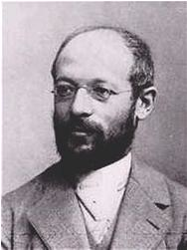
Heterophily and the Stranger
Heterophily (love of the different) is one way to talk about the opposite of Homophily
For example, in order to explore success factors in Heterophilous groups
But can also be significant in its own right
Simmel’s notion of the Stranger
A person “near and far at the same time”
Strangers are valuable to groups
Add new skills, perspectives and objectivity
Can bridge between otherwise homophilous groups
Are trusted because of their lack of connection
Georg Simmel
Rogers and Bhowmik. Homophily-heterophily: Relational concepts for communication research. Public Opinion Quarterly (1970) vol. 34 (4) pp. 523-538
Simmel. The Stranger. Reprinted in The Sociology of Georg Simmel, 1950 (1908)

Slide 36
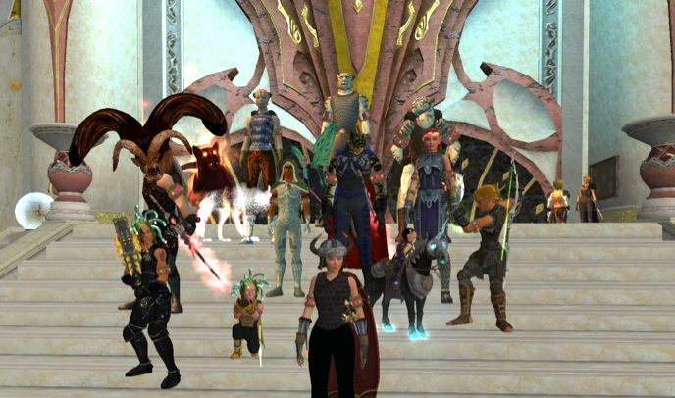
Does Homophily apply in the Virtual World?
3140 players of Everquest II
From US + Canada
4 Relations Tested
Partnerships (Group of 2)
Instant Messaging (in-game Chat)
Player Trade (face-to-face exchange)
Mail (in-game mail)
Huang et al. Virtually there: Exploring proximity and homophily in a virtual world. Computational Science and Engineering, 2009. CSE'09. International Conference on (2009) vol. 4 pp. 354-359

Slide 37
Does Homophily apply in the Virtual World?
3140 players of Everquest II
From US + Canada
4 Relations Tested
Partnerships (Group of 2)
Instant Messaging (in-game Chat)
Player Trade (face-to-face exchange)
Mail (in-game mail)
Hypothesis | Partner | IM | Trade | Mail
Spatial Proximity | Yes | Yes | Yes | Yes
Gender Homophily | No | No | No | No
Age Homophily | Yes | Yes | Yes | Yes
Experience Homophily | Yes | Yes | Yes | Yes
Few female-female
Huang et al. Virtually there: Exploring proximity and homophily in a virtual world. Computational Science and Engineering, 2009. CSE'09. International Conference on (2009) vol. 4 pp. 354-359

Slide 38
Homophily in Action
Nathaniel Buckley and Brynjolfsson. Global Village or CyberBalkans: Modeling and Measuring the Integration of Electronic Communities . Journal Management Science (2005) vol. 51 (6)

Slide 39
Homophily in Action: Local Networks
Nathaniel Buckley and Brynjolfsson. Global Village or CyberBalkans: Modeling and Measuring the Integration of Electronic Communities . Journal Management Science (2005) vol. 51 (6)

Slide 40
Homophily in Action: Local Networks
Nathaniel Buckley and Brynjolfsson. Global Village or CyberBalkans: Modeling and Measuring the Integration of Electronic Communities . Journal Management Science (2005) vol. 51 (6)

Slide 41
Homophily in Action: The Global Village
Nathaniel Buckley and Brynjolfsson. Global Village or CyberBalkans: Modeling and Measuring the Integration of Electronic Communities . Journal Management Science (2005) vol. 51 (6)

Slide 42
Homophily in Action: The Global Village
Nathaniel Buckley and Brynjolfsson. Global Village or CyberBalkans: Modeling and Measuring the Integration of Electronic Communities . Journal Management Science (2005) vol. 51 (6)

Slide 43
Homophily in Action: CyberBalkanization
The Echo Chamber
Nathaniel Buckley and Brynjolfsson. Global Village or CyberBalkans: Modeling and Measuring the Integration of Electronic Communities . Journal Management Science (2005) vol. 51 (6)

Slide 44
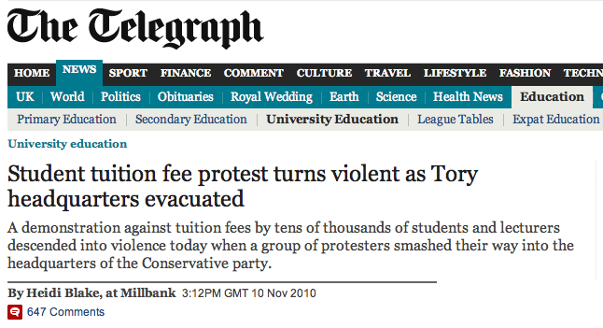
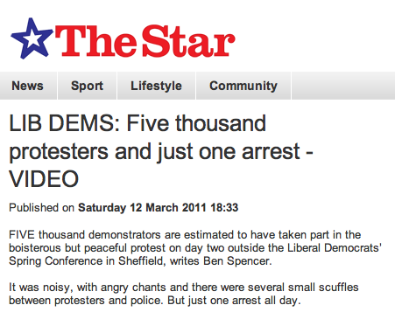
But how do groups decide to act?
Why are these outcomes different?

Slide 45
Thresholds of Collective Action
Assume a binary positive/negative choice
E.g. to riot or not to riot
Assume that cost/benefit of the choice is effected by others
E.g. if there are lots of people already rioting then the risk to me is lower
A Person’s threshold is the proportion of the group that they would need to see make a decision before they made the same decision
E.g. I will not riot until 75% of the group are already rioting
Granovetter. Threshold Models of Collective Behavior. The American Journal of Sociology (1978) vol. 83 (6) pp. 1420-1443

Slide 46
Thresholds of Collective Action
Assume a binary positive/negative choice
E.g. to riot or not to riot
Assume that cost/benefit of the choice is effected by others
E.g. if there are lots of people already rioting then the risk to me is lower
A Person’s threshold is the proportion of the group that they would need to see make a decision before they made the same decision
E.g. I will not riot until 75% of the group are already rioting
Q: What is the Equilibrium?
Granovetter. Threshold Models of Collective Behavior. The American Journal of Sociology (1978) vol. 83 (6) pp. 1420-1443

Slide 47
Thresholds of Collective Action
Assume a binary positive/negative choice
E.g. to riot or not to riot
Assume that cost/benefit of the choice is effected by others
E.g. if there are lots of people already rioting then the risk to me is lower
A Person’s threshold is the proportion of the group that they would need to see make a decision before they made the same decision
E.g. I will not riot until 75% of the group are already rioting
Q: What is the Equilibrium?
A: 100% - they all riot!
Granovetter. Threshold Models of Collective Behavior. The American Journal of Sociology (1978) vol. 83 (6) pp. 1420-1443

Slide 48
Thresholds of Collective Action
Assume a binary positive/negative choice
E.g. to riot or not to riot
Assume that cost/benefit of the choice is effected by others
E.g. if there are lots of people already rioting then the risk to me is lower
A Person’s threshold is the proportion of the group that they would need to see make a decision before they made the same decision
E.g. I will not riot until 75% of the group are already rioting
Q: What is the Equilibrium Now?
Granovetter. Threshold Models of Collective Behavior. The American Journal of Sociology (1978) vol. 83 (6) pp. 1420-1443

Slide 49
Thresholds of Collective Action
Assume a binary positive/negative choice
E.g. to riot or not to riot
Assume that cost/benefit of the choice is effected by others
E.g. if there are lots of people already rioting then the risk to me is lower
A Person’s threshold is the proportion of the group that they would need to see make a decision before they made the same decision
E.g. I will not riot until 75% of the group are already rioting
Q: What is the Equilibrium Now?
A: 10% - 1 person riots
Granovetter. Threshold Models of Collective Behavior. The American Journal of Sociology (1978) vol. 83 (6) pp. 1420-1443

Slide 50
Thresholds of Collective Action
Threshold models of collective action show us that crowds with very similar norms and values can behave radically differently
And that the power that individuals hold within groups is dependent on the distribution of thresholds
So power is highly contextual
Granovetter. Threshold Models of Collective Behavior. The American Journal of Sociology (1978) vol. 83 (6) pp. 1420-1443

Slide 51
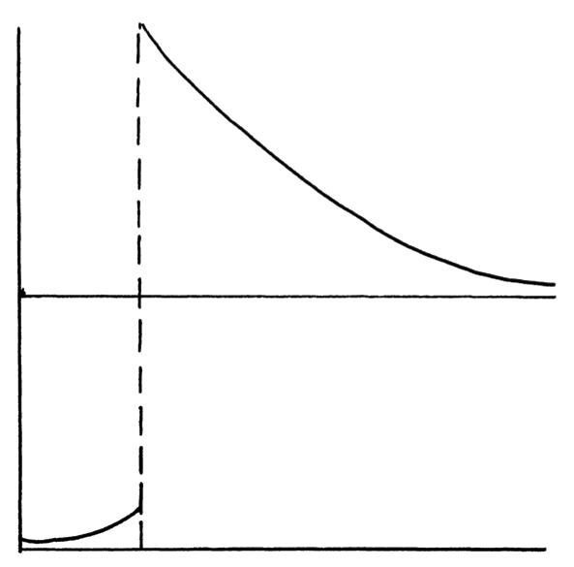
Thresholds of Collective Action
Threshold models of collective action show us that crowds with very similar norms and values can behave radically differently
And that the power that individuals hold within groups is dependent on the distribution of thresholds
So power is highly contextual
Equilibrium number of rioters, assuming normal distribution of thresholds (mean = 25, N = 100)
100
Equilibrium
50
SD = 12.2
0
Standard Deviation
Granovetter. Threshold Models of Collective Behavior. The American Journal of Sociology (1978) vol. 83 (6) pp. 1420-1443

Slide 52
Lessons Learned
Power in Social Networks primary draws on notions of Power from Communication Theory
Influence rather than Action
Influence is normally translated into characteristics of propagation
Structure: Examining network structure
Propagation: of Content (URIs, Concepts)
Interaction: Audience Reaction and Conversation
Is effected by:
The Echo Chamber
Homophily and Heterophily
CyberBalkanization
Contextual factors
Thresholds of Collective Behaviour

Slide 53
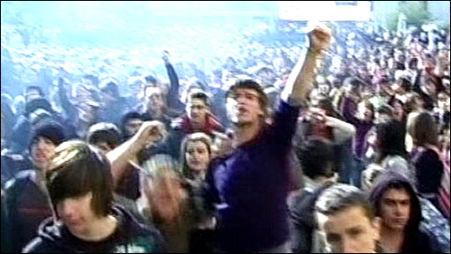
But does it matter?
Is Social Media Power Real Power?

