Slide 1
TRUST: Part 2
David Millard
dem@ecs.soton.ac.uk

Slide 2
Echo Chambers and Filter Bubbles

Slide 3
Fake News
Homophily+
Recommender
Tendency to create connections to similar people (gender, age, class, politics, religion, etc.)

Slide 4
Fake News
Homophily+
Recommender
Filter Bubbles
Tendency to create connections to similar people (gender, age, class, politics, religion, etc.)
Algorithms designed to please, will learn from this network and reflect your views back to you

Slide 5
Fake News
Homophily+
Recommender
Filter Bubbles
Echo Chambers
Tendency to create connections to similar people (gender, age, class, politics, religion, etc.)
Algorithms designed to please, will learn from this network and reflect your views back to you
Reflected views reinforce existing beliefs and normalise extreme views

Slide 6
Fake News
Homophily+
Recommender
Filter Bubbles
Echo Chambers
Fake News
Tendency to create connections to similar people (gender, age, class, politics, religion, etc.)
Algorithms designed to please, will learn from this network and reflect your views back to you
Reflected views reinforce existing beliefs and normalise extreme views
Articles designed to propagate in this environment (clickbait) – with monetary or political aims

Slide 7
The Post-Truth World
Homophily+
Recommender
Filter Bubbles
Echo Chambers
Fake News
Tendency to create connections to similar people (gender, age, class, politics, religion, etc.)
Algorithms designed to please, will learn from this network and reflect your views back to you
Reflected views reinforce existing beliefs and normalise extreme views
Articles designed to propagate in this environment (clickbait) – with monetary or political aims
Public narrative is disconnected from science or policy, and instead framed emotionally or ideologically

Slide 8
Filter bubbles – The Evidence
Notes:
2011 book

Slide 9
Filter bubbles?
Bakshy et al. 2015 study into exposure to diverse views on Facebook
10.1 million active US users with self-declared affiliation
7 million links shared over a 6 month period
Eytan Bakkshy, Solomon Messing, Lada Adamic (2015). Exposure to ideologically diverse news and opinion on Facebook. Science. May 2015

Slide 10
Filter bubbles?
This is a study by Facebook
Bakshy et al. 2015 study into exposure to diverse views on Facebook
10.1 million active US users with self-declared affiliation
7 million links shared over a 6 month period
Eytan Bakkshy, Solomon Messing, Lada Adamic (2015). Exposure to ideologically diverse news and opinion on Facebook. Science. May 2015

Slide 11
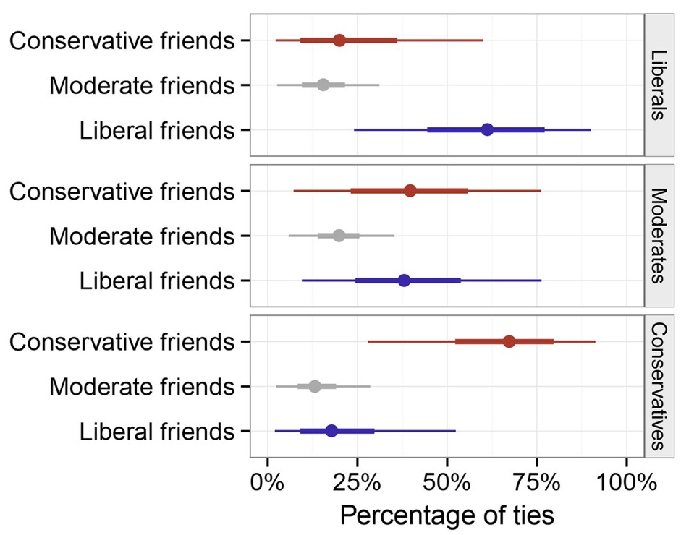
Filter bubbles?
Bakshy et al. 2015 study into exposure to diverse views on Facebook
10.1 million active US users with self-declared affiliation
7 million links shared over a 6 month period
Eytan Bakkshy, Solomon Messing, Lada Adamic (2015). Exposure to ideologically diverse news and opinion on Facebook. Science. May 2015

Slide 12
Filter bubbles?
Bakshy et al. 2015 study into exposure to diverse views on Facebook
10.1 million active US users with self-declared affiliation
7 million links shared over a 6 month period
Clear evidence of political homophily
Eytan Bakkshy, Solomon Messing, Lada Adamic (2015). Exposure to ideologically diverse news and opinion on Facebook. Science. May 2015

Slide 13
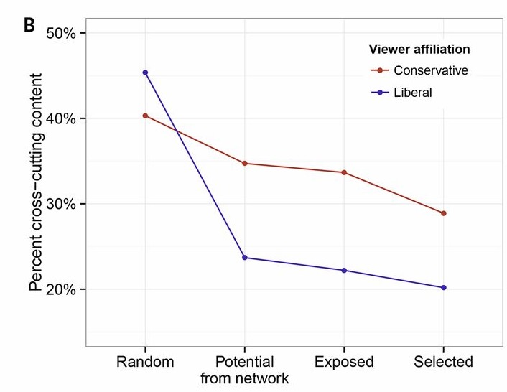
Filter bubbles?
Bakshy et al. 2015 study into exposure to diverse views on Facebook
10.1 million active US users with self-declared affiliation
7 million links shared over a 6 month period
Eytan Bakkshy, Solomon Messing, Lada Adamic (2015). Exposure to ideologically diverse news and opinion on Facebook. Science. May 2015
Notes:
Random – based on volume of content
Potential – based on their friend network
Exposed – based on the algorithm
Selected – what they engaged with (clicked)
Impact of the network is biggest effect

Slide 14
Filter bubbles?
Filter Bubble
Bakshy et al. 2015 study into exposure to diverse views on Facebook
10.1 million active US users with self-declared affiliation
7 million links shared over a 6 month period
Clear evidence of filter bubble – but filter bubble is smallest effect
Eytan Bakkshy, Solomon Messing, Lada Adamic (2015). Exposure to ideologically diverse news and opinion on Facebook. Science. May 2015
Notes:
Random – based on volume of content
Potential – based on their friend network
Exposed – based on the algorithm
Selected – what they engaged with (clicked)

Slide 15
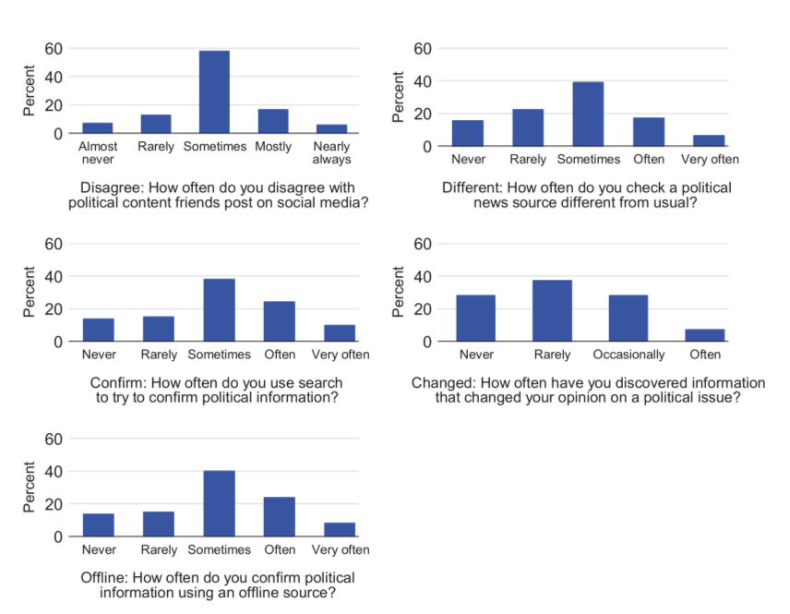
Echo Chambers?
Dubois & Blank (2018) a study of exposure to different opinions, based on a 2000 person UK sample.
Disagree
Different
Confirm
Offline
Change
Elizabeth Dubois & Grant Blank (2018) The echo chamber is overstated: the moderating effect of political interest and diverse media, Information, Communication & Society, 21:5, 729-745
Notes:
https://www.tandfonline.com/doi/abs/10.1080/1369118X.2018.1428656

Slide 16
Echo Chambers?
Dubois & Blank (2018) a study of exposure to different opinions, based on a 2000 person UK sample.
Disagree
Different
Confirm
Offline
Change
Significant numbers report exposure to multiple opinions
Elizabeth Dubois & Grant Blank (2018) The echo chamber is overstated: the moderating effect of political interest and diverse media, Information, Communication & Society, 21:5, 729-745
Notes:
https://www.tandfonline.com/doi/abs/10.1080/1369118X.2018.1428656
(1) Read something you DISAGREE with?’ (which we call ‘Disagree’);
(2) ‘Check a news source that’s different from what you normally read?’ (which we call
‘Different’);
(3) ‘Try to confirm political information you found by searching online for another
source?’ (which we call ‘Confirm’).
(4) ‘Try to confirm political information by checking a major offline news medium?’
(which we call ‘Offline’)
The fifth dependent variable, which we call ‘Changed’, is about opinion change:
(5) ‘Thinking about recent searches you have done online using a search engine, how often have you discovered something that CHANGED your opinion on a political issue?’

Slide 17
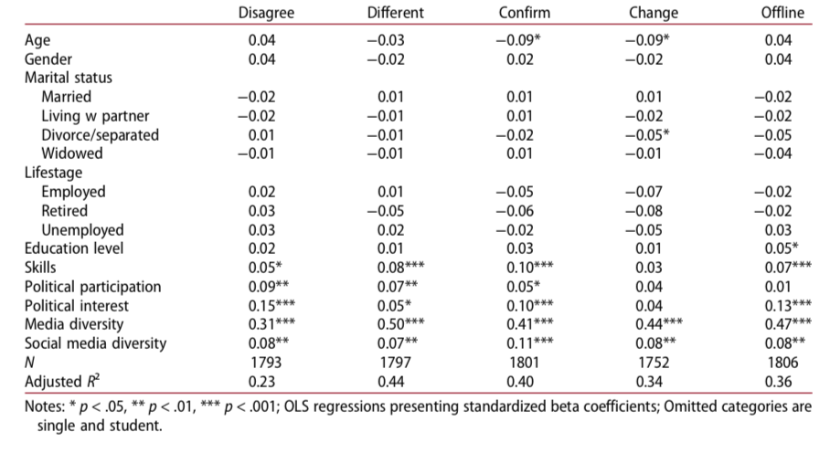
Echo Chambers?
Dubois & Blank (2018) a study of exposure to different opinions, based on a 2000 person UK sample.
Disagree
Different
Confirm
Offline
Change
Elizabeth Dubois & Grant Blank (2018) The echo chamber is overstated: the moderating effect of political interest and diverse media, Information, Communication & Society, 21:5, 729-745
Notes:
https://www.tandfonline.com/doi/abs/10.1080/1369118X.2018.1428656

Slide 18
Echo Chambers?
Dubois & Blank (2018) a study of exposure to different opinions, based on a 2000 person UK sample.
Disagree
Different
Confirm
Offline
Change
Political Interest and Media Diversity correlate strongly with high exposure
Elizabeth Dubois & Grant Blank (2018) The echo chamber is overstated: the moderating effect of political interest and diverse media, Information, Communication & Society, 21:5, 729-745
Notes:
In other words, looking at social media alone does not tell the whole story
https://www.tandfonline.com/doi/abs/10.1080/1369118X.2018.1428656
All dependent variables are coded so that lower values mean the respondent is more likely to be in an echo chamber. This coding implies that, in the regressions, negative coef- ficients of the independent variables mean a respondent is more likely to be in an echo chamber; positive coefficients mean they are less likely.

Slide 19
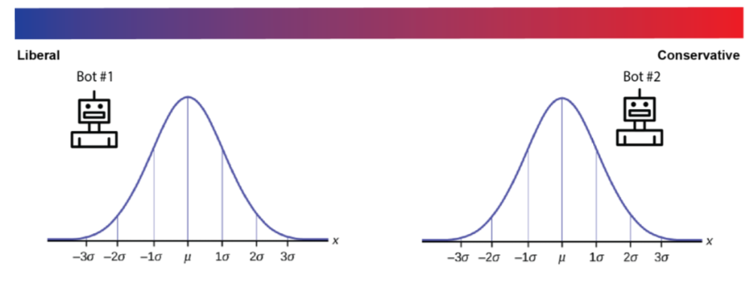
Echo Chambers?
Bail et al. (2018) paid a sample of 697 Democrats and 542 Republicans to follow a political bot that counter retweeted political messages into their Twitter feeds – and measure the impact on their views
Bail et al. (2018) Exposure to Opposing Views can Increase Political Polarization: Evidence from a Large-Scale Field Experiment on Social Media, SocARXiv
Notes:
https://osf.io/preprints/socarxiv/4ygux/
Create bots that tweet a random sample of tweets from the 1-3 liberal and 5-8 conservative quantiles of the distribution

Slide 20
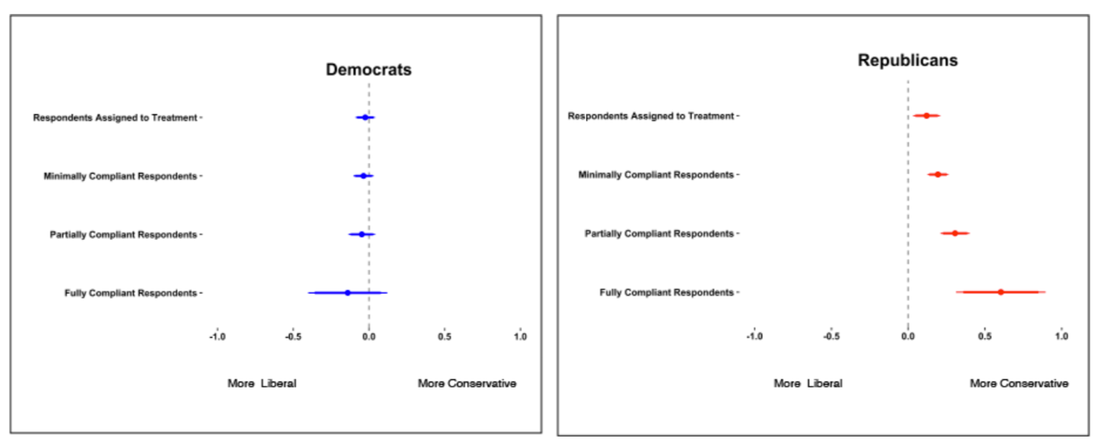
The Backfire Effect
Bail et al. (2018) paid a sample of 697 Democrats and 542 Republicans to follow a political bot that counter retweeted political messages into their Twitter feeds – and measure the impact on their views
(ITT= -.02, t= -.76, p=.48)
(ITT=.12, t=2.68, p=.007)
(CACE= -.04, t= -1.07, p=.28)
(CACE=.19, t=5.6, p <.001)
(CACE=-.05, t= -1.05, p=.29)
(CACE=.31, t=6.30, p <.001)
(CACE=-.14, t= -1.05, p=.29)
(CACE =.60, t=4.06, p <.001)
Bail et al. (2018) Exposure to Opposing Views can Increase Political Polarization: Evidence from a Large-Scale Field Experiment on Social Media, SocARXiv
Notes:
https://osf.io/preprints/socarxiv/4ygux/
Intent-to-Treat (ITT) ef- fect
Complier Average Causal Effect (CACE)

Slide 21
The Backfire Effect
Bail et al. (2018) paid a sample of 697 Democrats and 542 Republicans to follow a political bot that counter retweeted political messages into their Twitter feeds – and measure the impact on their views
“our study indicates that well- intentioned attempts to introduce people to opposing political views on social media might not only be ineffective, but counter-productive—particularly if they are initiated by Democrats.”
(ITT= -.02, t= -.76, p=.48)
(ITT=.12, t=2.68, p=.007)
(CACE= -.04, t= -1.07, p=.28)
(CACE=.19, t=5.6, p <.001)
(CACE=-.05, t= -1.05, p=.29)
(CACE=.31, t=6.30, p <.001)
(CACE=-.14, t= -1.05, p=.29)
(CACE =.60, t=4.06, p <.001)
Bail et al. (2018) Exposure to Opposing Views can Increase Political Polarization: Evidence from a Large-Scale Field Experiment on Social Media, SocARXiv
Notes:
https://osf.io/preprints/socarxiv/4ygux/
Intent-to-Treat (ITT) ef- fect
Complier Average Causal Effect (CACE)

Slide 22
What Does this Tell Us?
Echo chambers exist on social media
They are driven primary by homophilous networks
Filter algorithms have a modest exacerbating effect
Echo chambers become weaker when considering social media as part of a larger media landscape
Exposure to strong counter-opinion can also reinforce existing beliefs (the backfire effect)
Fake News will occur, so how do we help people identify it?

Slide 23
Determining Credibility

Slide 24
Source, Message, and Media
Hellmueller, L. and Trilling, D. (2012). The credibility of credibility measures: A meta- analysis in leading communication journals, 1951 to 2011.
In WAPOR 65th Annual Conference in Hong Kong.
Metzger, M. J., Flanagin, A. J., Eyal, K., Lemus, D. R., & McCann, R. M. (2003). Credibility for the 21st century: integrating perspectives on source, message, and media credibility in the contemporary media environment. In P. J. Kalbfleisch (Ed.), Communication Yearbook 27

Slide 25
Source, Message, and Media
Source Credibility, where it comes from. Influenced by:
Perceived competence
Trustworthiness
Goodwill
Hellmueller, L. and Trilling, D. (2012). The credibility of credibility measures: A meta- analysis in leading communication journals, 1951 to 2011.
In WAPOR 65th Annual Conference in Hong Kong.
Metzger, M. J., Flanagin, A. J., Eyal, K., Lemus, D. R., & McCann, R. M. (2003). Credibility for the 21st century: integrating perspectives on source, message, and media credibility in the contemporary media environment. In P. J. Kalbfleisch (Ed.), Communication Yearbook 27

Slide 26
Source, Message, and Media
Source Credibility, where it comes from. Influenced by:
Perceived competence
Trustworthiness
Goodwill
Message Credibility, the quality. Influenced by:
Information quality
Language intensity
Message discrepancy
Hellmueller, L. and Trilling, D. (2012). The credibility of credibility measures: A meta- analysis in leading communication journals, 1951 to 2011.
In WAPOR 65th Annual Conference in Hong Kong.
Metzger, M. J., Flanagin, A. J., Eyal, K., Lemus, D. R., & McCann, R. M. (2003). Credibility for the 21st century: integrating perspectives on source, message, and media credibility in the contemporary media environment. In P. J. Kalbfleisch (Ed.), Communication Yearbook 27

Slide 27
Source, Message, and Media
Source Credibility, where it comes from. Influenced by:
Perceived competence
Trustworthiness
Goodwill
Message Credibility, the quality. Influenced by:
Information quality
Language intensity
Message discrepancy
Media Credibility, the media type
Influenced by perception of media type
Assumes difference between types if greater than differences within
within type
Online
Offline
Guardian Online
Guardian Paper
Broadsheet
between type
The Sun
Online
The Sun
Paper
Tabloid
Hellmueller, L. and Trilling, D. (2012). The credibility of credibility measures: A meta- analysis in leading communication journals, 1951 to 2011.
In WAPOR 65th Annual Conference in Hong Kong.
Metzger, M. J., Flanagin, A. J., Eyal, K., Lemus, D. R., & McCann, R. M. (2003). Credibility for the 21st century: integrating perspectives on source, message, and media credibility in the contemporary media environment. In P. J. Kalbfleisch (Ed.), Communication Yearbook 27

Slide 28
A Case Study: Consider Wikipedia

Slide 29
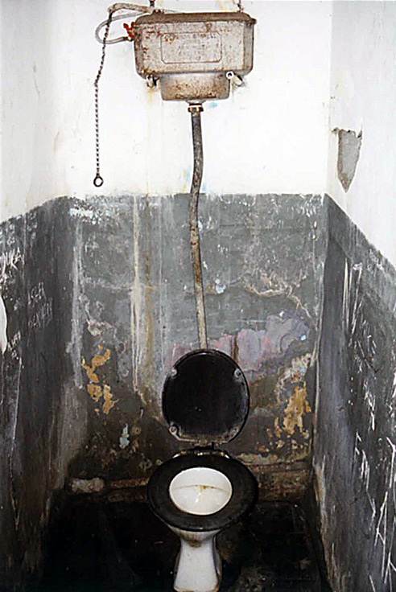
Is Wikipedia a Toilet?
Somebody who reads Wikipedia is “rather in the position of a visitor to a public restroom,” says Mr. McHenry, Britannica’s former editor. “It may be obviously dirty, so that he knows to exercise great care, or it may seem fairly clean, so that he may be lulled into a false sense of security. What he certainly does not know is who has used the facilities before him.”
The Economist (Vol. 379, April 22, 2006, pp. 14–15)

Slide 30
Can we Trust Wikipedia?
Fallis. Toward an epistemology of Wikipedia. Journal of the American Society for Information Science and Technology (2008) vol. 59 (10) pp. 1662-1674

Slide 31
Can we Trust Wikipedia?
The Case for the Prosecution
Reliable?
Inaccurate information persists
Allows non expert contribution
Deters those with expertise from contributing
No credit for work
Experts lack the time or inclination to fight
Is a target for intentional deception
Is full of bullshit
Verifiable?
Bad presentation is a marker of Bad information but in Wikipedia good presenters correct mistakes regardless of info quality
Difficult to link information to individuals
Because of collaborative editing
And anonymous contributions
Fallis. Toward an epistemology of Wikipedia. Journal of the American Society for Information Science and Technology (2008) vol. 59 (10) pp. 1662-1674

Slide 32
Can we Trust Wikipedia?
The Case for the Prosecution
Source Credibility
Perceived competence
Trustworthiness
Goodwill
Reliable?
Inaccurate information persists
Allows non expert contribution
Deters those with expertise from contributing
No credit for work
Experts lack the time or inclination to fight
Is a target for intentional deception
Is full of bullshit
Verifiable?
Bad presentation is a marker of Bad information but in Wikipedia good presenters correct mistakes regardless of info quality
Difficult to link information to individuals
Because of collaborative editing
And anonymous contributions
Message Credibility
Information quality
Language intensity
Message discrepancy
Media Credibility
Influenced by perception of media type
Fallis. Toward an epistemology of Wikipedia. Journal of the American Society for Information Science and Technology (2008) vol. 59 (10) pp. 1662-1674

Slide 33
Can we Trust Wikipedia?
The Case for the Prosecution
Source Credibility
Perceived competence
Trustworthiness
Goodwill
Reliable?
Inaccurate information persists
Allows non expert contribution
Deters those with expertise from contributing
No credit for work
Experts lack the time or inclination to fight
Is a target for intentional deception
Is full of bullshit
Verifiable?
Bad presentation is a marker of Bad information but in Wikipedia good presenters correct mistakes regardless of info quality
Difficult to link information to individuals
Because of collaborative editing
And anonymous contributions
PC
Message Credibility
Information quality
Language intensity
Message discrepancy
PC
G
T
Media Credibility
Influenced by perception of media type
Fallis. Toward an epistemology of Wikipedia. Journal of the American Society for Information Science and Technology (2008) vol. 59 (10) pp. 1662-1674

Slide 34
Can we Trust Wikipedia?
The Case for the Prosecution
Source Credibility
Perceived competence
Trustworthiness
Goodwill
Reliable?
Inaccurate information persists
Allows non expert contribution
Deters those with expertise from contributing
No credit for work
Experts lack the time or inclination to fight
Is a target for intentional deception
Is full of bullshit
Verifiable?
Bad presentation is a marker of Bad information but in Wikipedia good presenters correct mistakes regardless of info quality
Difficult to link information to individuals
Because of collaborative editing
And anonymous contributions
MD
PC
Message Credibility
Information quality
Language intensity
Message discrepancy
PC
G
T
Media Credibility
Influenced by perception of media type
IQ
Fallis. Toward an epistemology of Wikipedia. Journal of the American Society for Information Science and Technology (2008) vol. 59 (10) pp. 1662-1674

Slide 35
Can we Trust Wikipedia?
The Case for the Prosecution
Source Credibility
Perceived competence
Trustworthiness
Goodwill
Reliable?
Inaccurate information persists
Allows non expert contribution
Deters those with expertise from contributing
No credit for work
Experts lack the time or inclination to fight
Is a target for intentional deception
Is full of bullshit
Verifiable?
Bad presentation is a marker of Bad information but in Wikipedia good presenters correct mistakes regardless of info quality
Difficult to link information to individuals
Because of collaborative editing
And anonymous contributions
MD
PC
Message Credibility
Information quality
Language intensity
Message discrepancy
PC
G
T
Media Credibility
Influenced by perception of media type
IQ
MC
Fallis. Toward an epistemology of Wikipedia. Journal of the American Society for Information Science and Technology (2008) vol. 59 (10) pp. 1662-1674

Slide 36
Can we Trust Wikipedia?
The Case for the Prosecution
The Case for the Defense
Reliable?
Inaccurate information persists
Allows non expert contribution
Deters those with expertise from contributing
No credit for work
Experts lack the time or inclination to fight
Is a target for intentional deception
Is full of bullshit
Verifiable?
Bad presentation is a marker of Bad information but in Wikipedia good presenters correct mistakes regardless of info quality
Difficult to link information to individuals
Because of collaborative editing
And anonymous contributions
Reliable?
Experiments show Wikipedia is comparable in accuracy to encyclopedias like Britannica
Although articles vary in quality
Fewer major errors, more minor ones
Most problems are through omission
Should we be comparing to encyclopedias or other info sources?
Another example of Yhprum’s law?
Verifiable?
Studies show that spelling and grammar mistakes to not correlate with bad info
It is hard to identify an individual author in any encyclopedia
The principle of group testimony – we trust the process by which info is produced, rather than individuals
Article history and discussion are transparent
Fallis. Toward an epistemology of Wikipedia. Journal of the American Society for Information Science and Technology (2008) vol. 59 (10) pp. 1662-1674

Slide 37
People Struggle to Make Credibility Judgments
Lucassen and Schraagen. Small study of 12 students, each looking at 6 articles (one from each Wikipedia class):
Featured status
Good
B-class
C-class
Start
Participants asked to rate trustfulness and talk through their approach – recording was then coded and analysed…
Lucassen and Schraagen. Trust in wikipedia: how users trust information from an unknown source. WICOW '10 Proceedings of the 4th workshop on Information credibility (2010)

Slide 38
People Struggle to Make Credibility Judgments
Lucassen and Schraagen. Trust in wikipedia: how users trust information from an unknown source. WICOW '10 Proceedings of the 4th workshop on Information credibility (2010)

Slide 39
People Struggle to Make Credibility Judgments
Lucassen and Schraagen. Trust in wikipedia: how users trust information from an unknown source. WICOW '10 Proceedings of the 4th workshop on Information credibility (2010)

Slide 40
People Struggle to Make Credibility Judgments
Lucassen and Schraagen. Trust in wikipedia: how users trust information from an unknown source. WICOW '10 Proceedings of the 4th workshop on Information credibility (2010)

Slide 41
People Struggle to Make Credibility Judgments
It is hard to do
Source credibility requires central cues (high effort)
Message credibility requires peripheral cues (low effort)
They may lack the skills to do it (digital literacy)
Or the will to challenge their own viewpoint (confirmation bias)
Takes us back to automatic trust mechanisms as an imperfect way to tackle the problem

Slide 42
Tackling Fake News

Slide 43
Combatting Fake News
Google
Modified their algorithm to foreground more reliable sources
New tools for users to report problems with infoboxes and autocomplete
Emine Saner, From Wikitribune to StopFake: the battle against fake news, The Guardian, 25 Apr 2017
https://www.theguardian.com/technology/shortcuts/2017/apr/25/wikitribune-google-wikipedia-battle-against-fake-news

Slide 44
Combatting Fake News
Google
Modified their algorithm to foreground more reliable sources
New tools for users to report problems with infoboxes and autocomplete
Facebook
Users can tag stories as ‘disputed’
Sent to independent fact checkers (e.g. Snopes)
Other users are warned if they try to share a disputed story
Emine Saner, From Wikitribune to StopFake: the battle against fake news, The Guardian, 25 Apr 2017
https://www.theguardian.com/technology/shortcuts/2017/apr/25/wikitribune-google-wikipedia-battle-against-fake-news

Slide 45
Combatting Fake News
Google
Modified their algorithm to foreground more reliable sources
New tools for users to report problems with infoboxes and autocomplete
Facebook
Users can tag stories as ‘disputed’
Sent to independent fact checkers (e.g. Snopes)
Other users are warned if they try to share a disputed story
WikiTribune
Professional Journalists producing transparent stories (with sources)
Augmented by community members
Emine Saner, From Wikitribune to StopFake: the battle against fake news, The Guardian, 25 Apr 2017
https://www.theguardian.com/technology/shortcuts/2017/apr/25/wikitribune-google-wikipedia-battle-against-fake-news

Slide 46
Combatting Fake News
Google
Modified their algorithm to foreground more reliable sources
New tools for users to report problems with infoboxes and autocomplete
Facebook
Users can tag stories as ‘disputed’
Sent to independent fact checkers (e.g. Snopes)
Other users are warned if they try to share a disputed story
WikiTribune
Professional Journalists producing transparent stories (with sources)
Augmented by community members
Reputation
Policy
Provenance
Emine Saner, From Wikitribune to StopFake: the battle against fake news, The Guardian, 25 Apr 2017
https://www.theguardian.com/technology/shortcuts/2017/apr/25/wikitribune-google-wikipedia-battle-against-fake-news

Slide 47
Lessons Learned
Echo Chambers exist on Social Media
Driven by homophilous networks
Filter bubbles exacerbate the problem
Less significant when seen within broader media landscape
There is also a backfire effect if this process is reversed to firmly
Credibility
Source – where does it come from? (high effort – central cues)
Message – what is the quality of the content? (low effort – peripheral cues)
Media – what are our expectations of this media type? (biased or inaccurate)
Combatting Fake News using Trust Systems
Promoting Quality Sources – reputation trust
Deferring to an authoritative source – policy trust
Transparency of the news process – provenance trust

Slide 48
Questions…
?
Dave Millard (dem@ecs.soton.ac.uk)

