Slide 1
TRUST: Part 1
David Millard
dem@ecs.soton.ac.uk

Slide 2
What is Trust?

Slide 3
This country has a dark future unless we can attract better people into politics

Slide 4
It is safe to believe that in spite of what people say most people are primarily interested in their own welfare

Slide 5
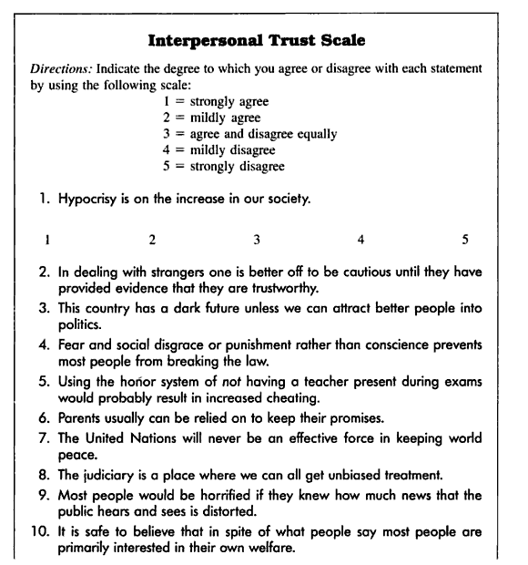
Generalized Trust
Rotter’s Interpersonal Trust Scale (ITS)
  The ITS measures an individual’s general tendency to trust different groups of people
  E.g. teachers, parents, politicians, physicians, classmates, and friends
The survey measures the individual’s “general optimism regarding the society”
Rotter, J. B. 1967. A new scale for the measurement of inter- personal trust. Journal of Personality. 35; 615-665

Slide 6
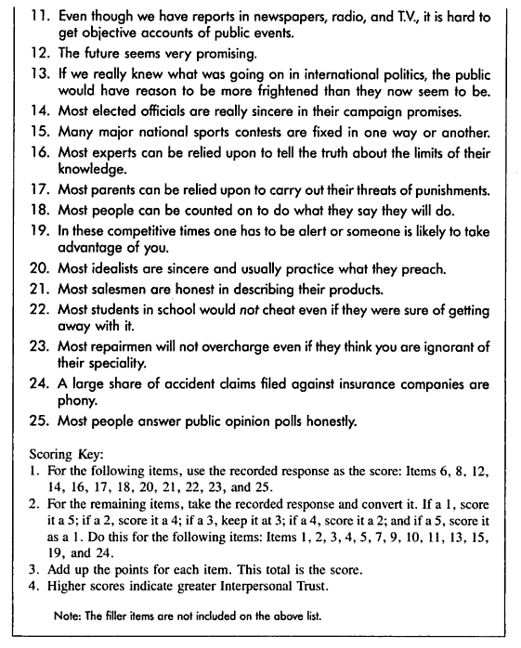
Generalized Trust
Rotter summarised his 13 years of findings in 1980
Subjects that are high in interpersonal trust tend to be:
  more trustworthy
  better liked
  happier
Subjects low in interpersonal trust tend to exhibit untrustworthy behavior (self-reported cheating and lying)
Rotter, J. B. (1980). Interpersonal trust, trustworthiness, and gullibility. American Psychologist, 35(1), 1-7

Slide 7
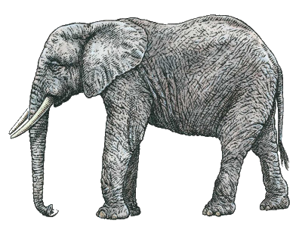
Psychology
Trust is a Personal Trait

Slide 8
Trust as Social Reality
Cognitive
A Unitary Social Experience
“individuals have no occasion or need to trust apart from social relationships”
Emotional
Behavioral
Lewis and Weigert. Trust as a social reality. Social Forces (1984) vol. 63 pp. 967-985

Slide 9
Trust as Social Reality
Emotionality
High Low Absent
Ideological Trust | Cognitive Trust | Rational Predication
Emotional Trust | Mundane, Routine Trust | Probably Anticipation
Faith | Fate | Uncertainty, Panic
Rationality
Absent Low High
Lewis and Weigert. Trust as a social reality. Social Forces (1984) vol. 63 pp. 967-985

Slide 10
Trust as Social Reality
Emotionality
High Low Absent
Primary Groups (Families, Friendship Groups, Small Communities)
Ideological Trust | Cognitive Trust | Rational Predication
Emotional Trust | Mundane, Routine Trust | Probably Anticipation
Faith | Fate | Uncertainty, Panic
Rationality
Absent Low High
Lewis and Weigert. Trust as a social reality. Social Forces (1984) vol. 63 pp. 967-985

Slide 11
Trust as Social Reality
Emotionality
High Low Absent
Primary Groups (Families, Friendship Groups, Small Communities)
Secondary Groups
(Prof’ Relationships,
Government,
Broader Society)
Ideological Trust | Cognitive Trust | Rational Predication
Emotional Trust | Mundane, Routine Trust | Probably Anticipation
Faith | Fate | Uncertainty, Panic
Rationality
Absent Low High
Lewis and Weigert. Trust as a social reality. Social Forces (1984) vol. 63 pp. 967-985

Slide 12
Trust as Social Reality
Emotionality
High Low Absent
Primary Groups (Families, Friendship Groups, Small Communities)
Secondary Groups
(Prof’ Relationships,
Government,
Broader Society)
Ideological Trust | Cognitive Trust | Rational Predication
Emotional Trust | Mundane, Routine Trust | Probably Anticipation
Faith | Fate | Uncertainty, Panic
Rationality
Absent Low High
Modern Societies: moving from Interpersonal Trust to System Trust (Niklas Luhmann, Trust and Power, 1979)
Lewis and Weigert. Trust as a social reality. Social Forces (1984) vol. 63 pp. 967-985

Slide 13
Sociology
Trust is Social Structure
Psychology
Trust is a Personal Trait

Slide 14
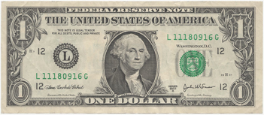
Trust, Reciprocity and Economics
The Investment Game
10 x
Person A
Person B
Berg and Dickhaut. Trust, reciprocity, and social history. Games and Economic Behavior (1995) vol. 10 (1) pp. 122-142

Slide 15
Trust, Reciprocity and Economics
The Investment Game
6 x
4 x
Person A
Person B
Berg and Dickhaut. Trust, reciprocity, and social history. Games and Economic Behavior (1995) vol. 10 (1) pp. 122-142

Slide 16
Trust, Reciprocity and Economics
The Investment Game
4 x
4 x
6 x
4 x
Person A
Person B
Berg and Dickhaut. Trust, reciprocity, and social history. Games and Economic Behavior (1995) vol. 10 (1) pp. 122-142

Slide 17
Trust, Reciprocity and Economics
The Investment Game
6 x
Person A
Person B
12 x
Berg and Dickhaut. Trust, reciprocity, and social history. Games and Economic Behavior (1995) vol. 10 (1) pp. 122-142

Slide 18
Trust, Reciprocity and Economics
The Investment Game
6 x
Person A
Person B
6 x
6 x
Berg and Dickhaut. Trust, reciprocity, and social history. Games and Economic Behavior (1995) vol. 10 (1) pp. 122-142

Slide 19
Trust, Reciprocity and Economics
The Investment Game
Person A
Person B
6 x
12 x
Berg and Dickhaut. Trust, reciprocity, and social history. Games and Economic Behavior (1995) vol. 10 (1) pp. 122-142

Slide 20
Trust, Reciprocity and Economics
The Investment Game
10 x
?
Person A
Person B
So how much would you send?
Berg and Dickhaut. Trust, reciprocity, and social history. Games and Economic Behavior (1995) vol. 10 (1) pp. 122-142

Slide 21
Trust, Reciprocity and Economics
The Investment Game
Person B
 | $0 | $1 | $2 | $3 | $4 | $5 | $6 | $7 | $8 | $9 | $10 | $11 | $12 | $13 | $14 | $15
$0 | 5,0
$1 | 4,3 | 5,2 | 6,1 | 7,0
$2 | 3,6 | 4,5 | 5,4 | 6,3 | 7,2 | 8,1 | 9,0
$3 | 2,9 | 3,8 | 4,7 | 5,6 | 6,5 | 7,4 | 8,3 | 9,2 | 10,1 | 11,0
$4 | 1,12 | 2,11 | 3,10 | 4,9 | 5,9 | 6,7 | 7,6 | 8,5 | 9,4 | 10,3 | 11,2 | 12,1 | 13,0
$5 | 0,15 | 1,14 | 2,13 | 3,12 | 4,11 | 5,10 | 6,9 | 7,8 | 8,7 | 9,6 | 10,5 | 11,4 | 12,3 | 13,2 | 14,1 | 15,0
Person A
Berg and Dickhaut. Trust, reciprocity, and social history. Games and Economic Behavior (1995) vol. 10 (1) pp. 122-142

Slide 22
Trust, Reciprocity and Economics
The Investment Game
Nash Equilibrium
Person B
 | $0 | $1 | $2 | $3 | $4 | $5 | $6 | $7 | $8 | $9 | $10 | $11 | $12 | $13 | $14 | $15
$0 | 5,0
$1 | 4,3 | 5,2 | 6,1 | 7,0
$2 | 3,6 | 4,5 | 5,4 | 6,3 | 7,2 | 8,1 | 9,0
$3 | 2,9 | 3,8 | 4,7 | 5,6 | 6,5 | 7,4 | 8,3 | 9,2 | 10,1 | 11,0
$4 | 1,12 | 2,11 | 3,10 | 4,9 | 5,9 | 6,7 | 7,6 | 8,5 | 9,4 | 10,3 | 11,2 | 12,1 | 13,0
$5 | 0,15 | 1,14 | 2,13 | 3,12 | 4,11 | 5,10 | 6,9 | 7,8 | 8,7 | 9,6 | 10,5 | 11,4 | 12,3 | 13,2 | 14,1 | 15,0
Person A
Berg and Dickhaut. Trust, reciprocity, and social history. Games and Economic Behavior (1995) vol. 10 (1) pp. 122-142

Slide 23
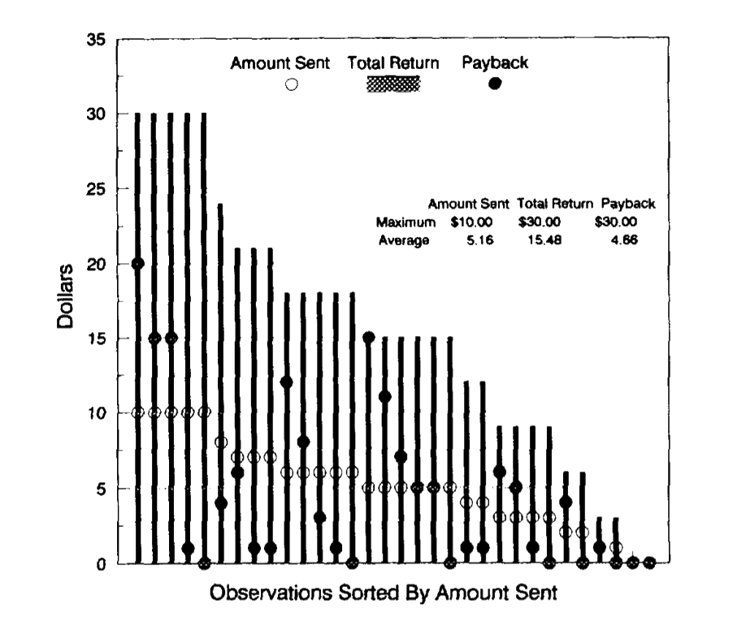
Trust, Reciprocity and Economics
The Investment Game
Berg and Dickaut study with 32 pairs shows significant deviation from the Nash equilibrium
Q: How do we account for irrational behaviour?
A: ?
On Average
Person A
lost $0.50
Berg and Dickhaut. Trust, reciprocity, and social history. Games and Economic Behavior (1995) vol. 10 (1) pp. 122-142

Slide 24
Trust, Reciprocity and Economics
The Investment Game
Berg and Dickaut study with 32 pairs shows significant deviation from the Nash equilibrium
Q: How do we account for irrational behaviour?
A: Trust in Reciprocity
On Average
Person A
lost $0.50
Berg and Dickhaut. Trust, reciprocity, and social history. Games and Economic Behavior (1995) vol. 10 (1) pp. 122-142

Slide 25
Sociology
Trust is Social Structure
Psychology
Trust is a Personal Trait
Economics
Trust is an Economic Choice Mechanism

Slide 26
The Elephant of Trust
Like the blind men and the elephant.
Trust looks different according to the discipline through which you encounter it.
Lewicki, R. J. & Bunker, B. B. “Trust in Relationships: A Model of Trust Development and Decline.” In B. B. Bunker & J. Z. Rubin (Eds.), Conflict, cooperation and justice, Jossey-Bass, San Francisco, 1995, pp. 133-173

Slide 27
Erm… So What is Trust?

Slide 28
What is Trust: Commonality?
Conditions for Trust (Rousseau)
  Risk: "Risk is the perceived probability of loss, as interpreted by a decision maker "
  Interdependence: "where the interests of one party cannot be achieved without reliance upon an- other.”
A Common Definition?
  “Trust is a psychological state comprising the intention to accept vulnerability based upon positive expectations of the intentions or behavior of another.”
Rousseau et al. Not so different after all: a cross-discipline view of trust. Academy of Management Review (1998) vol. 23 pp. 393-404

Slide 29
Trust and the Social Web

Slide 30
How Might we Calculate Trust?
Policy-Based Trust
Provenance-Based Trust
Reputation-Based Trust

Slide 31
How Might we Calculate Trust?
Dan
Bob
Clare
Alice
Artz and Gil. A survey of trust in computer science and the semantic web. Web Semantics: Science, Services and Agents on the World Wide Web (2007) vol. 5 (2) pp. 58-71

Slide 32
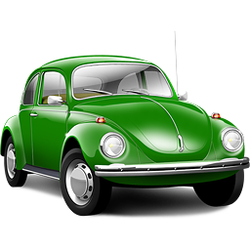
How Might we Calculate Trust?
Bob is selling Clare a car that used to belong to Alice
Dan has bought stuff from Bob before
Can Clare trust the info Bob gives her about the car?
Dan
Bob
Registration Info
…………
…………
Clare
Alice
Artz and Gil. A survey of trust in computer science and the semantic web. Web Semantics: Science, Services and Agents on the World Wide Web (2007) vol. 5 (2) pp. 58-71

Slide 33
How Might we Calculate Trust?
Policy-Based Trust
Provenance-Based Trust
Reputation-Based Trust

Slide 34

Policy-Based Trust
Commute responsibility to a trusted 3rd party
Use security protocols to verify credentials
Registration Info
…………
…………
Dan
Bob
Registration Info
…………
…………
Clare
Alice
Artz and Gil. A survey of trust in computer science and the semantic web. Web Semantics: Science, Services and Agents on the World Wide Web (2007) vol. 5 (2) pp. 58-71

Slide 35
Policy-Based Trust
Commute responsibility to a trusted 3rd party
Use security protocols to verify credentials
Registration Info
…………
…………
Dan
Token
Bob
Registration Info
…………
…………
Clare
Alice
Artz and Gil. A survey of trust in computer science and the semantic web. Web Semantics: Science, Services and Agents on the World Wide Web (2007) vol. 5 (2) pp. 58-71

Slide 36
Policy-Based Trust
Commute responsibility to a trusted 3rd party
Use security protocols to verify credentials
Registration Info
…………
…………
Dan
Token
Bob
Registration Info
…………
…………
Clare
Alice
Artz and Gil. A survey of trust in computer science and the semantic web. Web Semantics: Science, Services and Agents on the World Wide Web (2007) vol. 5 (2) pp. 58-71

Slide 37
Policy-Based Trust
Commute responsibility to a trusted 3rd party
Use security protocols to verify credentials
Registration Info
…………
…………
Dan
Token
?
Bob
Registration Info
…………
…………
Clare
Alice
Artz and Gil. A survey of trust in computer science and the semantic web. Web Semantics: Science, Services and Agents on the World Wide Web (2007) vol. 5 (2) pp. 58-71

Slide 38
How Might we Calculate Trust?
Policy-Based Trust
Provenance-Based Trust
Reputation-Based Trust

Slide 39
Provenance-Based Trust
The provenance of a piece of data is the process that led to that piece of data.
Dan
Bob
Registration Info
…………
…………
Clare
Alice
Moreau. The foundations for provenance on the web. Foundations and Trends in Web Science (2009)

Slide 40
Provenance-Based Trust
The provenance of a piece of data is the process that led to that piece of data.
Dan
Bob
Registration Info
…………
…………
Clare
Sold to Bob
2010
…………
………
Alice
Moreau. The foundations for provenance on the web. Foundations and Trends in Web Science (2009)

Slide 41

Provenance-Based Trust
The provenance of a piece of data is the process that led to that piece of data.
Sold to Alice
2008
…………
………
Dan
Bob
Registration Info
…………
…………
Clare
Sold to Bob
2010
…………
………
Alice
Moreau. The foundations for provenance on the web. Foundations and Trends in Web Science (2009)

Slide 42
Provenance-Based Trust
The provenance of a piece of data is the process that led to that piece of data.
Sold to Alice
2008
…………
………
Imported and Registered
2007
Dan
Bob
Registration Info
…………
…………
Clare
Sold to Bob
2010
…………
………
Alice
Moreau. The foundations for provenance on the web. Foundations and Trends in Web Science (2009)

Slide 43
Provenance-Based Trust
The provenance of a piece of data is the process that led to that piece of data.
Because provenance data is transparent, Clare is free to check with anyone named in the process.
Dan
Imported and Registered
2007
Sold to Alice
2008
…………
………
Sold to Bob
2010
…………
………
Bob
Registration Info
…………
…………
Clare
Alice
Moreau. The foundations for provenance on the web. Foundations and Trends in Web Science (2009)

Slide 44
How Might we Calculate Trust?
Policy-Based Trust
Provenance-Based Trust
Reputation-Based Trust

Slide 45
Reputation-Based Trust
Trust based on personal experience or the experiences of others
Dan
Bob
Registration Info
…………
…………
Clare
Alice
Moreau. The foundations for provenance on the web. Foundations and Trends in Web Science (2009)

Slide 46
Reputation-Based Trust
Trust based on personal experience or the experiences of others
Bob is 100% trustworthy
Dan
Bob is 90% trustworthy
Bob is 50% trustworthy
Bob
Registration Info
…………
…………
Clare
Alice
Moreau. The foundations for provenance on the web. Foundations and Trends in Web Science (2009)

Slide 47
Reputation-Based Trust
Trust based on personal experience or the experiences of others
Bob is 100% trustworthy
Dan
Bob is 90% trustworthy
Weight = 5
Bob is 50% trustworthy
Bob
Registration Info
…………
…………
Weight = 10
Clare
Alice
Weight = 2
Moreau. The foundations for provenance on the web. Foundations and Trends in Web Science (2009)

Slide 48
Reputation-Based Trust
Trust based on personal experience or the experiences of others
Alice is 80% trustworthy
Bob is 100% trustworthy
Dan is 60% trustworthy
Dan
Bob is 90% trustworthy
Weight = 5
Bob is 50% trustworthy
Bob
Registration Info
…………
…………
Weight = 10
Clare
Alice
Weight = 2
Moreau. The foundations for provenance on the web. Foundations and Trends in Web Science (2009)

Slide 49
Reputation-Based Trust
Trust based on personal experience or the experiences of others
Alice is 80% trustworthy
Bob is 100% trustworthy
Dan is 60% trustworthy
So how do we combine these in a meaningful way?!
Dan
Bob is 90% trustworthy
Weight = 5
Bob is 50% trustworthy
Bob
Registration Info
…………
…………
Weight = 10
Clare
Alice
Weight = 2
Moreau. The foundations for provenance on the web. Foundations and Trends in Web Science (2009)

Slide 50
Approaches to Reputation-Based Trust:
Global Trust

Slide 51
Global Trust: The Ebay Example
B
C
A
D
F
E
Resnick et al. The value of reputation on eBay: A controlled experiment. Experimental Economics (2006) vol. 9 (2) pp. 79-101

Slide 52
Global Trust: The Ebay Example
B
- 1
C
+3
A
+2
+3
+6
-1
D
F
- 2
E
Resnick et al. The value of reputation on eBay: A controlled experiment. Experimental Economics (2006) vol. 9 (2) pp. 79-101

Slide 53
Global Trust: The Ebay Example
Global means the whole network is used to calculate a single trust value for each node
Resnick et al. show buyers will pay a STRONG-reputation seller 8.1% more on average than a NEW seller
A Pretty Poor system that is easy to exploit - Example of Yhprum’s Law?
+8, -2 = 80%
B
- 1
C
+3
A
+2
+3
+6
-1
D
F
- 2
E
+6, -2 = 75%
Resnick et al. The value of reputation on eBay: A controlled experiment. Experimental Economics (2006) vol. 9 (2) pp. 79-101

Slide 54
Approaches to Reputation-Based Trust:
Local Trust

Slide 55

Local Trust: The Filmtrust Example
Imagine a Network of People and Films where people trust people and people rate films
Q: How much should Alice like Jaws?
B
4*
9
Jaws
A
2*
3
C
Golbeck. Filmtrust: movie recommendations from semantic web-based social networks. Consumer Communications and Networking Conference (2006) pp. 282-268

Slide 56
Local Trust: The Filmtrust Example
Imagine a Network of People and Films where people trust people and people rate films
Q: How much should Alice like Jaws?
B
4*
9
Jaws
A
2*
t(A->B) * r(B->Jaws) + t(A->C) * r(C->Jaws)
3
t(A->B) + t(A->C)
C
9 * 4 + 3 *2
9 + 3
3.5*
Golbeck. Filmtrust: movie recommendations from semantic web-based social networks. Consumer Communications and Networking Conference (2006) pp. 282-268

Slide 57
Local Trust: The Filmtrust Example
Alice’s view is 3.5* but what about Dan?
B
4*
9
5*
Jaws
E
A
2*
3
C
4
7
D
Golbeck. Filmtrust: movie recommendations from semantic web-based social networks. Consumer Communications and Networking Conference (2006) pp. 282-268

Slide 58
Local Trust: The Filmtrust Example
Alice’s view is 3.5* but what about Dan?
B
4*
t(D->C) * r(C->Jaws) + t(D->E) * r(E->Jaws)
t(D->C) + t(D->E)
9
5*
Jaws
7 * 2 + 4 *5
7 + 4
E
A
2*
3.1*
3
C
4
7
D
Golbeck. Filmtrust: movie recommendations from semantic web-based social networks. Consumer Communications and Networking Conference (2006) pp. 282-268

Slide 59
Local Trust: The Filmtrust Example
The Filmtrust example uses three properties of trust in social networks:
Transitivity
  If A trusts B and B trusts J then A will also trust J
Asymmetry
  If A trusts B it doesn’t follow that B trusts A
Personalization
  Trust is held from the view of a node – it is therefore local trust
B
4*
9
5*
Jaws
E
A
2*
3
C
4
7
D
Golbeck. Filmtrust: movie recommendations from semantic web-based social networks. Consumer Communications and Networking Conference (2006) pp. 282-268

Slide 60
Credibility

Slide 61
Trust vs. Credibility
Trust is typically framed as a quality between individuals
Credibility is a measure of how “believable” a piece of information is (Fogg and Tseng, 1999)
Elaboration Likelihood Model (ELM) (Petty and Cacioppo, 1986):
  Central cues – careful and thoughtful consideration of the content of the message (high effort)
  Peripheral cues –surface-level features such as design and usability (low effort)
Examining central cues results in stable, long-term changes to attitude.
In cases where users interact with topics where they lack the requisite interest or knowledge, they are more likely to rely on peripheral cues.
Fogg, B. J. and Tseng, H. (1999). The elements of computer credibility. In ACM CHI ’99, pg 80–87, New York, NY, USA.
Petty, R. E. and Cacioppo, J. T. (1986). The elaboration likelihood model of persuasion. Adv in Experimental Social Psychology, 19(C):123–205.

Slide 62
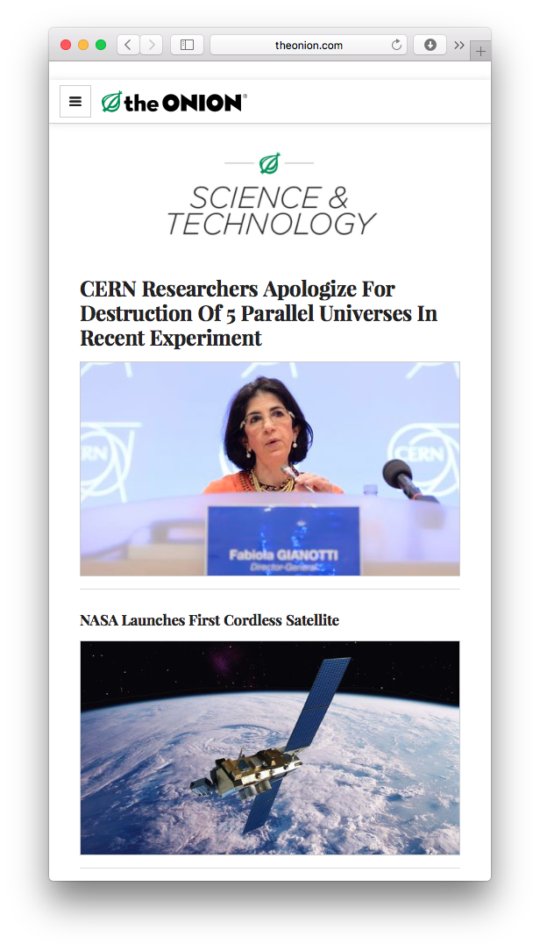
Fake News
First applied to satire
  Jon Stewart
  Stephen Colbert
  The Onion
Now internet news (typical spread on social media) that is deliberately fictional
  Fake news as political persuasion (controlling agendas)
  Fake news as economic phenomenon (driven by advertising revenue) – clickbait!
Increasingly used as a slur to undermine any news that is not sympathetic or on-message

Slide 63
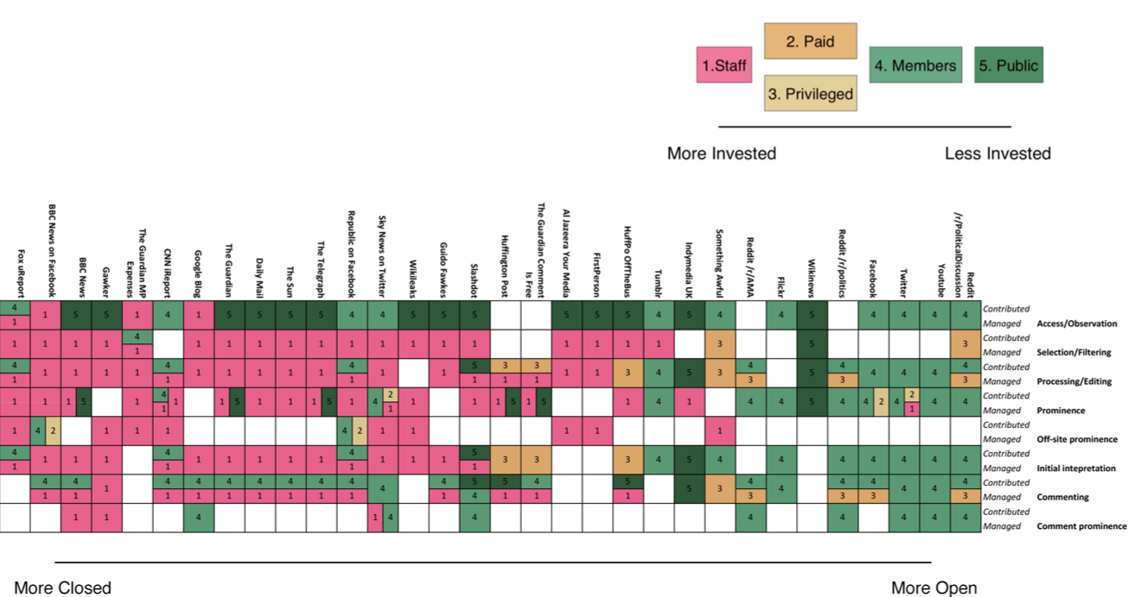
Social News
Scott, Jonathan, Millard, David and Leonard, Pauline (2014) Citizen participation in news Digital Journalism, pp. 1-22.

Slide 64
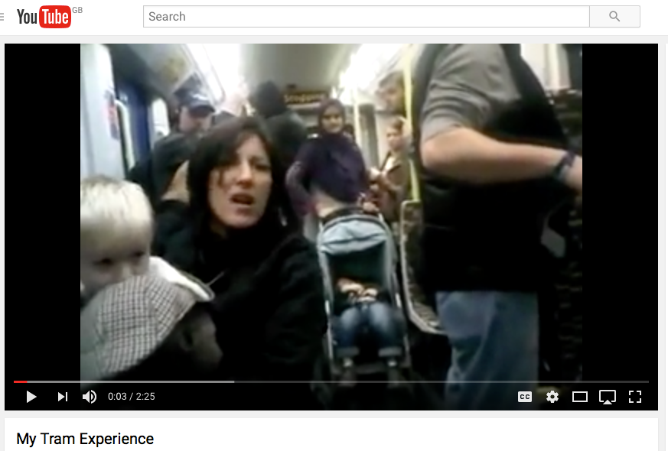
Social News
November 27th, 2011, Youtube user ladyk89 uploaded a video which showed a woman racially abusing passengers on a London tram. At 2:44am, the video was posted to Reddit under the title "I feel sorry for the kid - Racist woman on UK tram".
The Telegraph published a story about the video at 3:21pm. The Huffington post also wrote a piece on the video at 3:44pm quoting Youtube users and linking to the video. After the woman’s arrest was announced by the British Transport Police many more outlets picked up the story, including the Guardian, the Daily Mail, and the BBC.
Scott, Jonathan, Millard, David and Leonard, Pauline (2014) Citizen participation in news Digital Journalism, pp. 1-22.

Slide 65
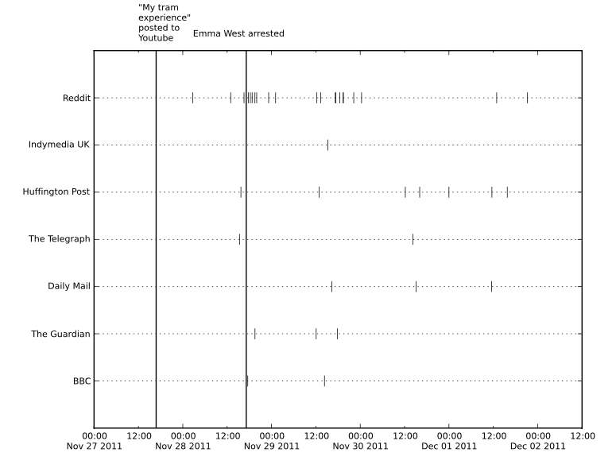
Social News
Shows how social news (in the open systems) can move into mainstream media (closed systems)
And then back again as the story develops
Thus we can see social news as part of the news ecosystem, in a cycle with traditional news sources
This is the context in which fake news spreads
Scott, Jonathan, Millard, David and Leonard, Pauline (2014) Citizen participation in news Digital Journalism, pp. 1-22.

Slide 66
Lessons Learned
The Elephant of Trust
  Psychology – Trust is a personal trait
  Sociology – Trust is social structure
  Economics – Trust is an economic choice structure
Three computational approaches to trust
  Policy-based
  Provenance-based
  Reputation-based
    Can be Global or Local (personalized)
    Exploits properties of transitivity and symmetry
Credibility - Trust in Information
  Fake News and Social News
  An open problem

Slide 67
Questions…
?
Dave Millard (dem@ecs.soton.ac.uk)

