Slide 1
D3.js
Data Driven Documents
Dr Heather Packer
16/01/18

Slide 2
Data-Driven Documents
“D3.js is a JavaScript library for manipulating documents based on data. D3 helps you bring data to life using HTML, SVG, and CSS. D3’s emphasis on web standards gives you the full capabilities of modern browsers without tying yourself to a proprietary framework, combining powerful visualization components and a data-driven approach to DOM manipulation.”

Slide 3
D3
Loads data into browser’s memory
Binds data to elements within the document
Transforms elements by interpreting each element’s bound datum and setting its visual properties
Transitions elements between states in response to user input
var data = [4,8,15];

Slide 4
D3 caveats
D3 doesn’t generate predefined visualisations
D3 doesn’t not support older browsers
D3 doesn’t hide your original data

Slide 5
D3.js technologies
HTML, SVG, CSS, and JavaScript

Slide 6
HTML
HTML is the main markup language for displaying web pages
A web page consists of HTML elements
An element is a pair of tags, and may have content
<p> Hello world!</p>
Inside a tag can have attributes
<p attribute1=“value1” attribute2=“value2”> Hello world!</p>

Slide 7
HTML DOM
Document Object Model
Describes the hierarchical structure of HTML
Each element has relationships:
parent, child, sibling,
ancestor and descendant
html is the parent of head
and body
head and body are
siblings
<html>
<head>
</head>
<body>
<script>
alert("Hello world.");
</script>
</body>
</html>

Slide 8
Basic HTML5 page
<!DOCTYPE html>
<html>
<head>
<meta http-equiv="Content-Type" content="text/html;charset=utf-8">
<title>My project</title>
<link href="style.css" rel="stylesheet">
</head>
<body>
<div id="chart”></div>
</body>
</html>

Slide 9
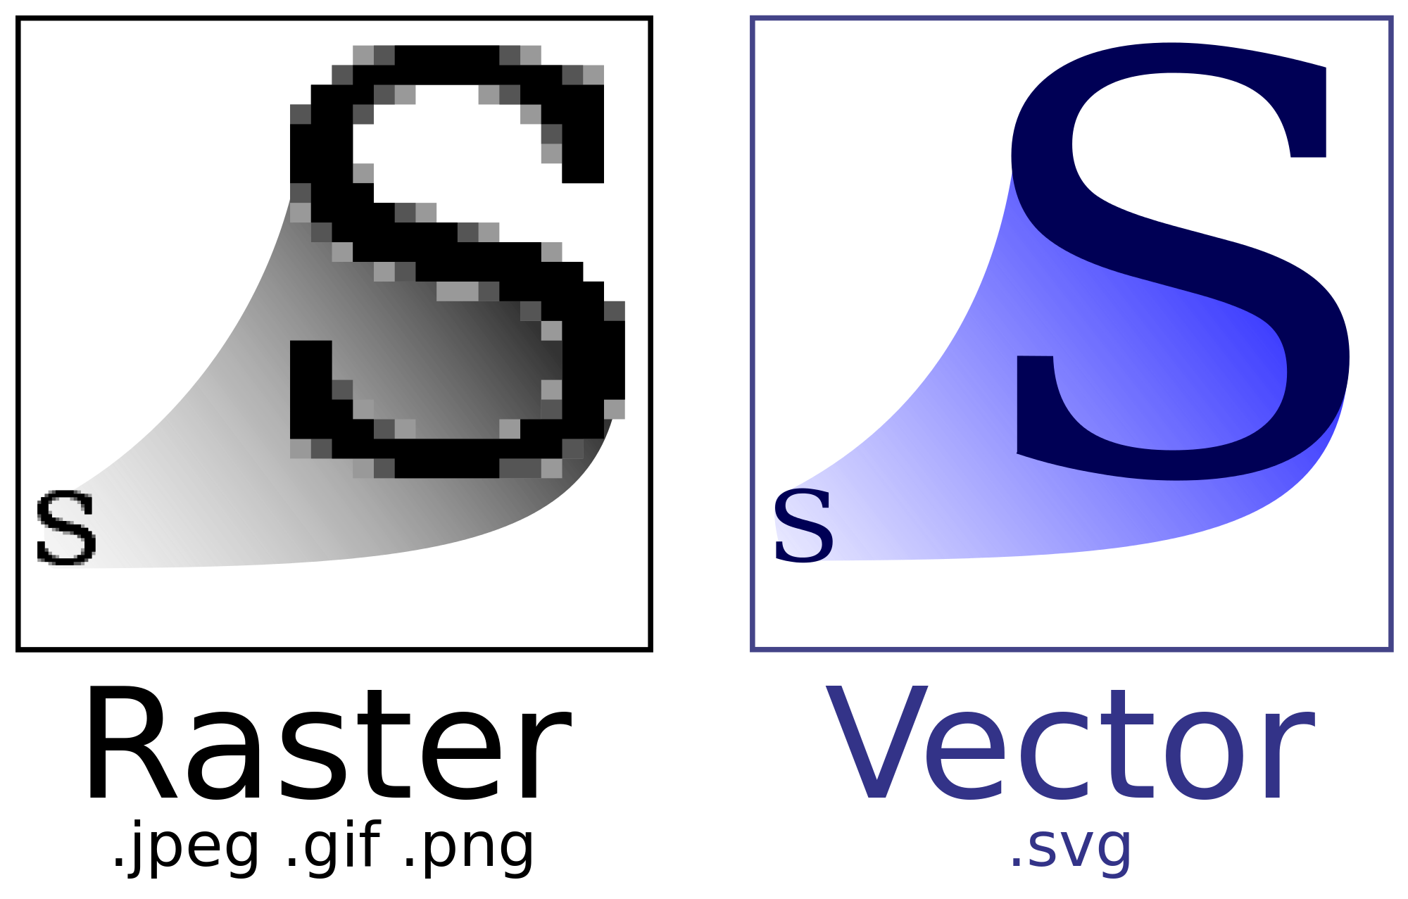
SVG
Scalable Vector Graphics
XML format
Describes pictures in terms of geometric shapes
<rect>
<circle>
<path>

Slide 10
CSS
Cascading Style Sheet CSS
Describes presentation (style) information
Eg background-color, border, margin, font-size, stroke-width
Applies to HTML and SVG DOM elements
Selectors indicate where the style applies:
eg: id, class, tagname, parents

Slide 11
CSS
<!DOCTYPE html>
<html>
<head>
<meta http-equiv="Content-Type”
content="text/html;charset=utf-8">
<title>My project</title>
<link href="style.css" rel="stylesheet">
</head>
<body>
<div id="chart"></div>
<script></script>
</body>
</html>

Slide 12
JavaScript
A programming language
Used on webpages to make them dynamic
All modern browsers understand it:
<html>
<body>
<script>
alert("Hello world.");
</script>
</body>
</html>

Slide 13
JavaScript
Variables – dynamic typing
var number = 5; var active = true; var text = “hello”;
Arrays
var myArray = [ 1, 3, 4, “hello” ];
Objects
var iceland = { name: “Iceland”, population: 334252, capital: “Reykjavik”}
Objects and Arrays
var nordic = [ iceland, norway, sweden, finland, denmark ];

Slide 14
SVG Resources
HTML Resources
https://developer.mozilla.org/en-US/docs/Learn/HTML
http://www.htmldog.com/guides/html/
https://www.lynda.com/Web-Development-tutorials/HTML-Essential-Training/170427-2.html
https://developer.mozilla.org/en-US/docs/Web/SVG/Tutorial
https://www.lynda.com/SVG-tutorials/Learning-SVG/622089-2.html

Slide 15
JavaScript Resources
CSS Resources
https://developer.mozilla.org/en-US/docs/Learn/JavaScript
http://www.htmldog.com/guides/css/beginner/
https://www.lynda.com/CSS-tutorials/CSS-Essential-Training-1/569190-2.html
https://developer.mozilla.org/en-US/docs/Learn/JavaScript
http://eloquentjavascript.net/1st_edition/contents.html
https://www.lynda.com/JavaScript-tutorials/JavaScript-Essential-Training/574716-2.html

Slide 16
Setting up D3
Create a project folder
Write an html file and include in the head element:
<script src="https://d3js.org/d3.v4.min.js"></script>

Slide 17
Version 3 and 4
D3 version 4 is the latest
Significant differences
Beware when you see code examples on the web that it might be version 3.
ALL of the following examples are version 4

Slide 18
Loading External Data

Slide 19
Loading CSV Data
dataset = d3.csv(csv_file, callback_function);
dataset = d3.csv(csv_file, data_function, callback_function);
csv_file - csv file path
callback_function - d3 code
data_function - OPTIONAL defines data structure used in callback_function

Slide 20
Loading TSV and JSON
dataset = d3.tsv(tsv_file, callback_function);
dataset = d3.tsv(tsv_file, data_function, callback_function);
dataset = d3.json(json_file,callback_function);

Slide 21
Loading More than Dataset
d3.queue()
.defer(d3.csv, "/data/chocolate.csv")
.defer(d3.json, "/data/world.geo.json")
.await(analyze);
function analyze(error, chocolate, world) {
if(error) {
console.log(error);
return;
}
console.log(chocolate[0]);
console.log(world[0]);
}

Slide 22
OPTIONAL Data Cleaning and Structuring
d3.queue()
.defer(d3.csv, "/data/chocolate.csv”,
function(data, i) {
return {
id: i,
company: data["Company"],
name: data["Name"],
rating: +data["Rating"],
choconame: data["Company"]+"-"+data["Name”]
};
});
.defer(d3.json, "/data/world.geo.json")
.await(analyze);

Slide 23
Bar Chart

Slide 24
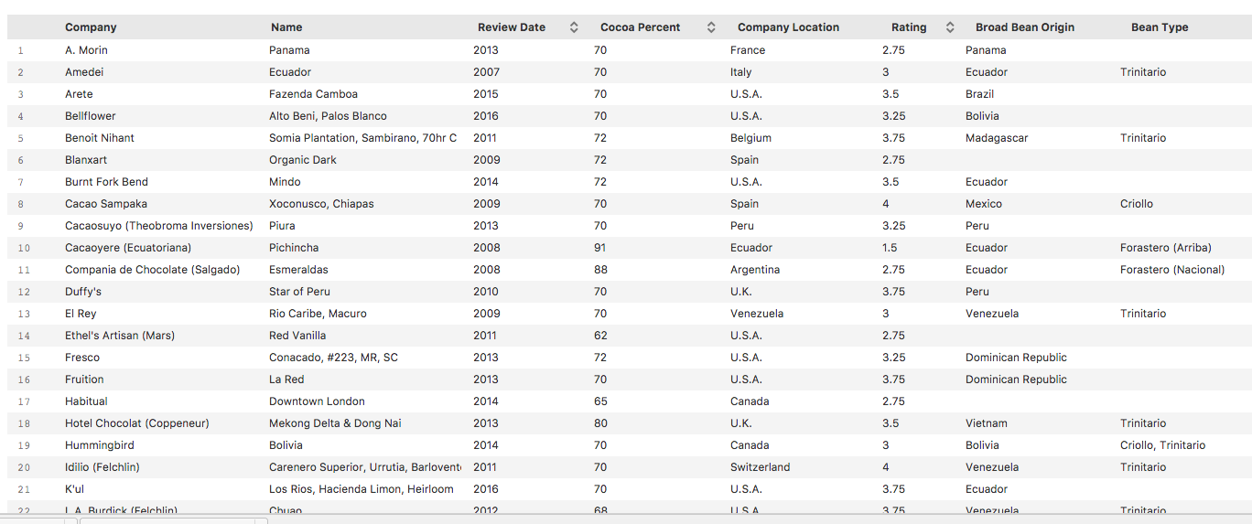
Chocolate Bar Dataset
https://public.opendatasoft.com/explore/dataset/chocolate-bars/export/

Slide 25
Chocolate Bar Dataset - Cleaning
Cleaned using Open Refine
Clustered and Text Facet
Company name
Company location
Broad Bean Origin
Bean Types
Deleted one duplicate entry

Slide 26
Selecting a Chart
Decide on the audience: Chocolate buyers, they want to know what the worst chocolate is to avoid and best to buy
Decide on purpose of chart: Compare ratings of different chocolate
Select the type of chart: horizontal bar chart
Y axis choconame long text file
X axis rating 1-5

Slide 27
Loading Data
d3.queue()
.defer(d3.csv, "/data/chocolate.csv”,
function(data, i) {
return {
id: i,
company: data["Company"],
name: data["Name"],
ref: data["Ref"],
percent: data["Cocoa Percent"],
loc: data["Company Location"],
origin: data["Broad Bean Origin"],
type: data["Bean Type"],
rating: +data["Rating"],
date: +data["Review Date"],
choconame: data["Company"]+"-"+data["Name”]
};
});
.await(anaylse);

Slide 28
Bar Chart
function analyze(error, dataset) {
if (error) {
console.log(error);
return;
}
//add more code
}

Slide 29
Bar Chart – setting up the svg container
function analyze(error, dataset) {
//error code here see previous slide
dataset = dataset.slice(0,10);
var margin = { top: 30, right: 30, bottom: 30, left: 30 };
var width = 800;
var height = dataset.length*30;
var svg = d3.select('body')
.append('svg')
.attr('width', width + margin.left + margin.right)
.attr('height', height + margin.top + margin.bottom)
.append('g')
.attr('transform', 'translate(' + margin.left + ',' +
margin.top + ")");
}

Slide 30
DOM
<body>
<svg width="830" height="330" >
<g transform="translate(30, 30)"></g>
</svg>
</body>

Slide 31
Bar Chart
function analyze(error, dataset) {
//error code here see slide
//setting up svg container, see previous slide
var bars = svg.selectAll(".bar")
.data(dataset)
.enter()
.append("rect")
.attr("class", "bar")
.attr("height", 10)
.attr("width", function(d) { return 100 * d.rating; })
.attr("x", 0)
.attr("y", function(d, i) { return i*12; })
;
}

Slide 32
Bar Chart
svg.selectAll("bar")
Selects all bar divs DOM. Because none exist yet, this returns an empty selection. This empty selection represents bars that will soon exist.
.data(dataset)
Counts and parses our data values. There are 10 values in our array called dataset, everything past this point is executed 10 times, once for each value.
.enter()
To create new, data-bound elements, you must use enter(). This method looks at the current DOM selection, and then at the data being handed to it. If there are more data values than corresponding DOM elements, then enter() creates a new placeholder element. It then hands off a reference to this new placeholder to the next step in the chain.

Slide 33
Bar Chart
.append("rect")
Adds a svg rectangle shape
.attr("class", "bar")
Adds the class bar to the rectangle
.attr("height", 10) .attr(width, function(d){return 100*d.rating})
Adds the height and width of the bar, increasing the scale by 100
.attr(x, 0).attr(y, function(d,i){return i*12})
Sets the x and y coordinates to place the bar in the svg

Slide 34
Bar Chart

Slide 35
Preparing for Axes
var y = d3.scaleBand()
.domain(dataset.map(function(d) { return d.id;}))
.range([0, height])
.padding(0.1);
var x = d3.scaleLinear()
.domain([0, d3.max(dataset, function(d){return d.rating; })])
.range([0, width]);
var bars = svg.selectAll(".bar")
.data(dataset)
.enter()
.append("rect")
.attr("class", "bar")
.attr("height", y.bandwidth())
.attr("width", function(d) { return x(d.rating); })
.attr("x", 0)
.attr("y", function(d) { return y(d.id); });
}

Slide 36
Adding Axes
// add the x Axis
svg.append("g")
.attr("transform", "translate(0," + height + ")")
.call(d3.axisBottom(x));
// add the y Axis
svg.append("g")
.call(d3.axisLeft(y).tickSize(0)
.tickFormat(function(d, i) {
return dataset[i].choconame;
})
);

Slide 37
Bar Chart with Axes

Slide 38
Adding Another Dimension: Cocoa Percentage
var colour = d3.scaleLinear()
.domain([0, 50, 100])
.range([d3.rgb("#d1a665"),d3.rgb("#7d4e29"),d3.rgb("#382001")])
var bars = svg.selectAll(".bar")
.data(dataset)
.enter()
.append("rect")
.attr("class", "bar")
.attr("height", y.bandwidth())
.attr("width", function(d) { return x(d.rating); })
.attr("x", 0)
.attr("y", function(d) { return y(d.id); })
.attr("fill", function(d) { return colour(d.percent); })
;

Slide 39
Cocoa Percentage

Slide 40
Making the Rating Clearer
bars.append("text")
.attr("class", "label")
.attr("y", function(d) {
return y(d.id) + y.bandwidth() / 2 + 4;
})
.attr("x", function(d) {
return x(d.rating) + 3;
})
.text(function(d) { return d.rating; })
;

Slide 41
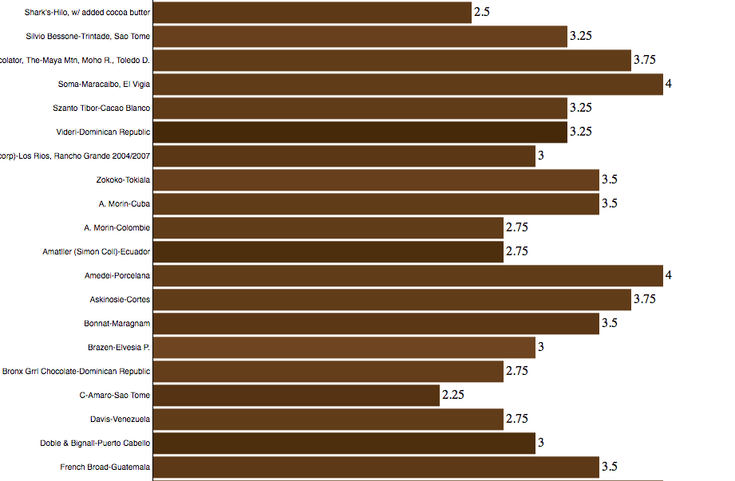
Bar Chart with Ratings

Slide 42
Scatter Chart

Slide 43
Scatter Chart – X/Y Scales
var x = d3.scaleLinear()
.domain([0, 100])
.range([0, width]);
var y = d3.scaleLinear()
.domain([0, 5])
.range([height, 0]);

Slide 44
Scatter Chart – adding points
var points = svg.selectAll(".point")
.data(dataset)
.enter()
.append("circle")
.attr("class", "point")
.attr("cy", function(d){ return y(d.rating); })
.attr("cx", function(d){ return x(d.percent); })
.attr("r", 5)
.attr("stroke", function(d){ return colour(d.percent); })
.attr("fill", "none")
.attr("opacity", 0.8)
;

Slide 45
Scatter Chart – add axes
// add the x Axis
svg.append("g")
.attr("transform", "translate(0," + height + ")")
.call(d3.axisBottom(x));
// add the y Axis
svg.append("g")
.call(d3.axisLeft(y));

Slide 46
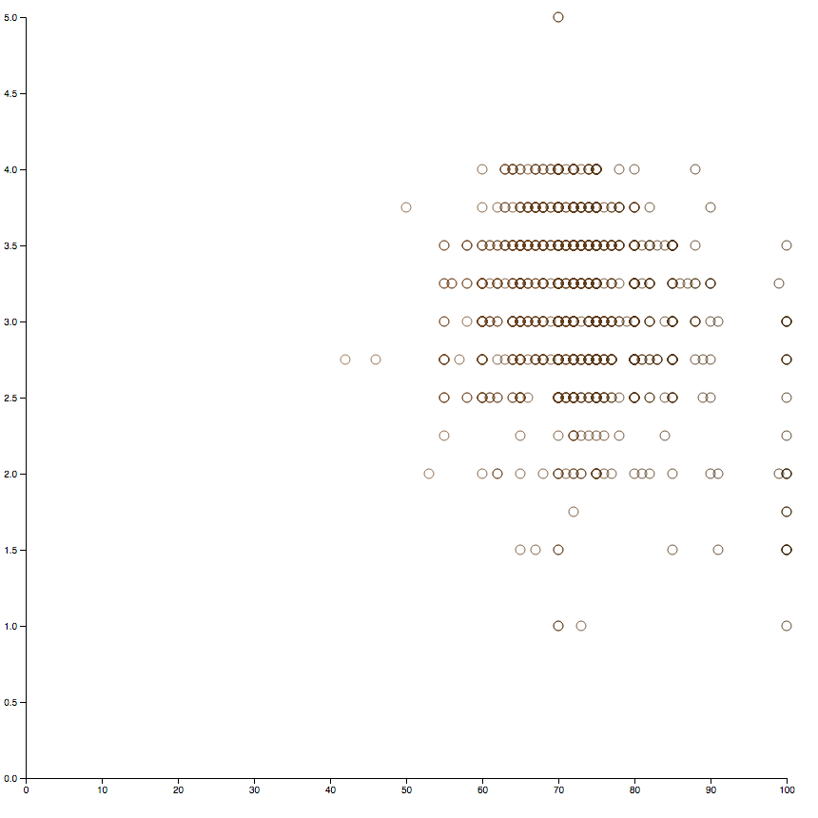
Scatter Chart

Slide 47
Scatter Chart – Adding Jitter
function jitter(v, vmin, vmax) {
var r = v + 0.01 * (vmax - vmin) * (Math.random() - 0.5);
return Math.min(vmax, Math.max(vmin, r));
}
var points = svg.selectAll(".point")
.data(dataset)
.enter()
.append("circle")
.attr("class", "point")
.attr("cy", function(d) {
return y(jitter(d.rating, 0, 5.0));
})
.attr("cx", function(d) {
return x(jitter(d.percent, 0, 100.0));
})
.attr("r", 5)
.attr("stroke", function(d) { return colour(d.percent); })
.attr("fill", "none")
.attr("opacity", 0.8)
;

Slide 48
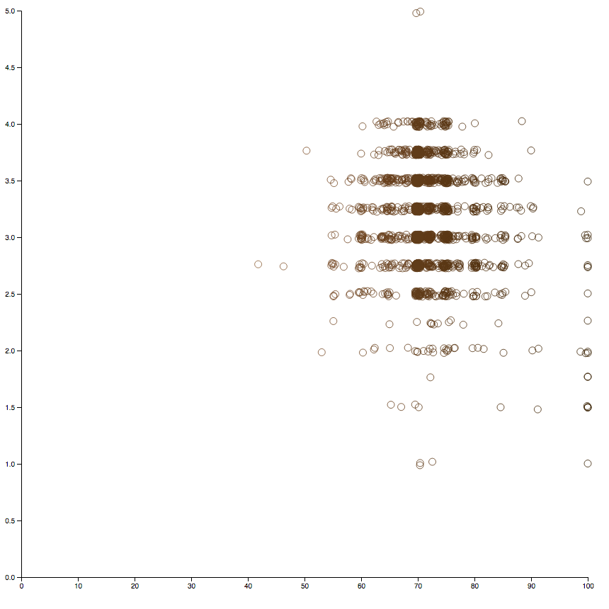
Scatter Chart with jitter

Slide 49
Maps

Slide 50
Loading CSS and Styling
<!DOCTYPE html>
<html>
<head>
<title>Leaflet GeoJSON Example</title>
<meta charset="utf-8" />
<link rel="stylesheet" href="http://cdn.leafletjs.com/leaflet-0.7.1/leaflet.css" />
<script src="https://d3js.org/d3.v4.min.js"></script>
<script src="https://d3js.org/d3-scale-chromatic.v1.min.js"></script>
<style type="text/css">
.leaflet-container{background-color:#c5e8ff;}
#map svg { background-color: cornflowerblue}
path.country{stroke:white; stroke-width: 1; fill: rgb(0,0,0)}
path.active{stroke-width: 5}
</style>
</head>
....
</html>

Slide 51
Map: Setting up map size, scale and projection
<body>
<div id="map" style="width: 1227px; height: 860px"></div>
<script>
var width = 1227;
var height = 860;
var map = d3.select("div#map").append("svg")
.attr("width", width)
.attr("height", height);
var scale = 200
var projection = d3.geoMercator()
.translate([600,500])
.scale(scale);
var path = d3.geoPath().projection(projection);

Slide 52
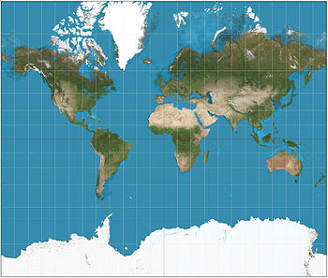
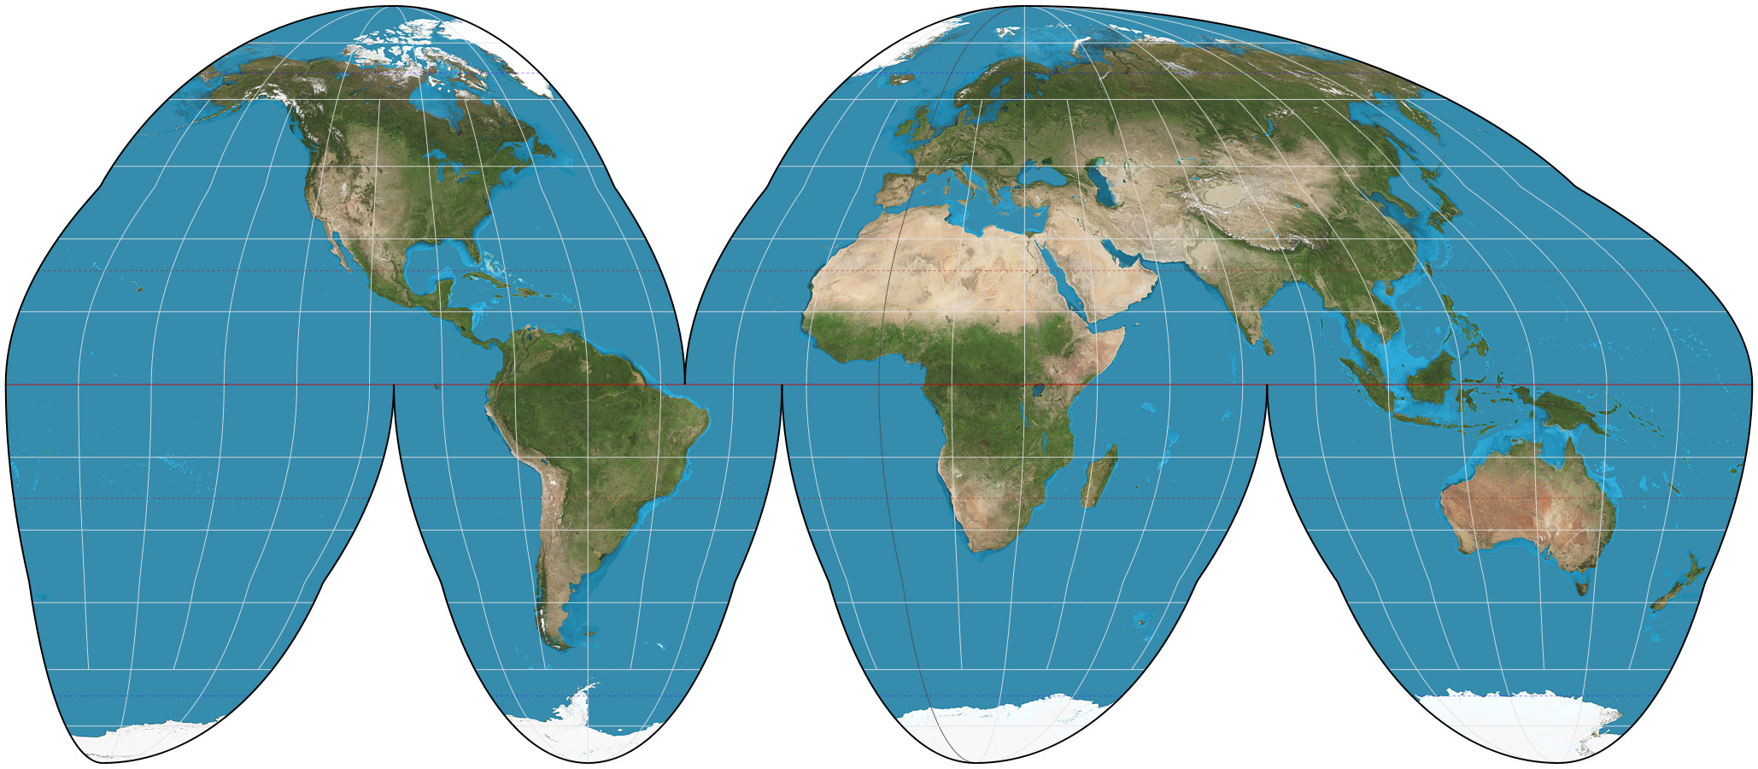
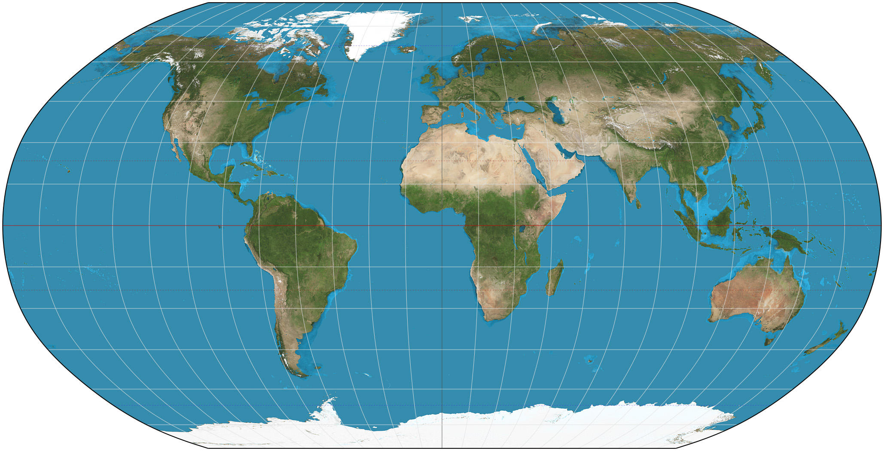
Map Projections
Mercator
Homolosine
Robinson
Etc..

Slide 53
Map: Load Data
d3.queue()
.defer(d3.csv, "/data/chocolate.csv”,
function(data, i) {
return {
id: i,
company: data["Company"],
name: data["Name"],
ref: data["Ref"],
percent: data["Cocoa Percent"],
loc: data["Company Location"],
origin: data["Broad Bean Origin"],
type: data["Bean Type"],
};
});
.defer(d3.json, "custom.geo.json”)
.await(anaylse);

Slide 54
Map: Transforming the Dataset
function analyse(error, dataset, world_map) {
map.selectAll("path")
.data(world_map.features)
.enter()
.append("path")
.attr("d", path)
.classed("country", true);
all_countries = [];
dataset.forEach(function(element) {
var bin_name = element["loc"];
if(all_countries[bin_name]){
all_countries[bin_name] = all_countries[bin_name]+1;
}else{
all_countries[bin_name] = 1;
};
});
countries = Object.keys(all_countries);

Slide 55
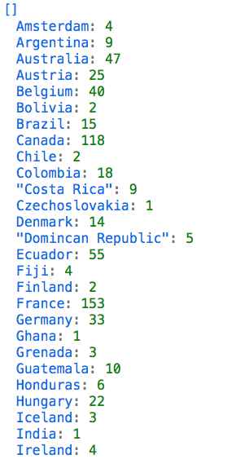
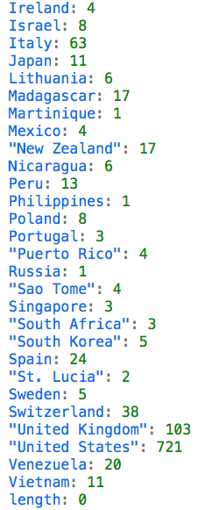
Map: Transforming the Dataset

Slide 56
Map: Colouring the map
var max_data =
d3.max(countries, function(d){return all_countries[d];})
var color = d3.scaleQuantize()
.domain([0, max_data])
.range(d3.schemeReds[9]);
map.selectAll("path")
.style("fill", function(d) {
var val = all_countries[d.properties.name];
d.visVal = val;
if (val) {
return color(val);
}
});
}
</script>
</body>

Slide 57
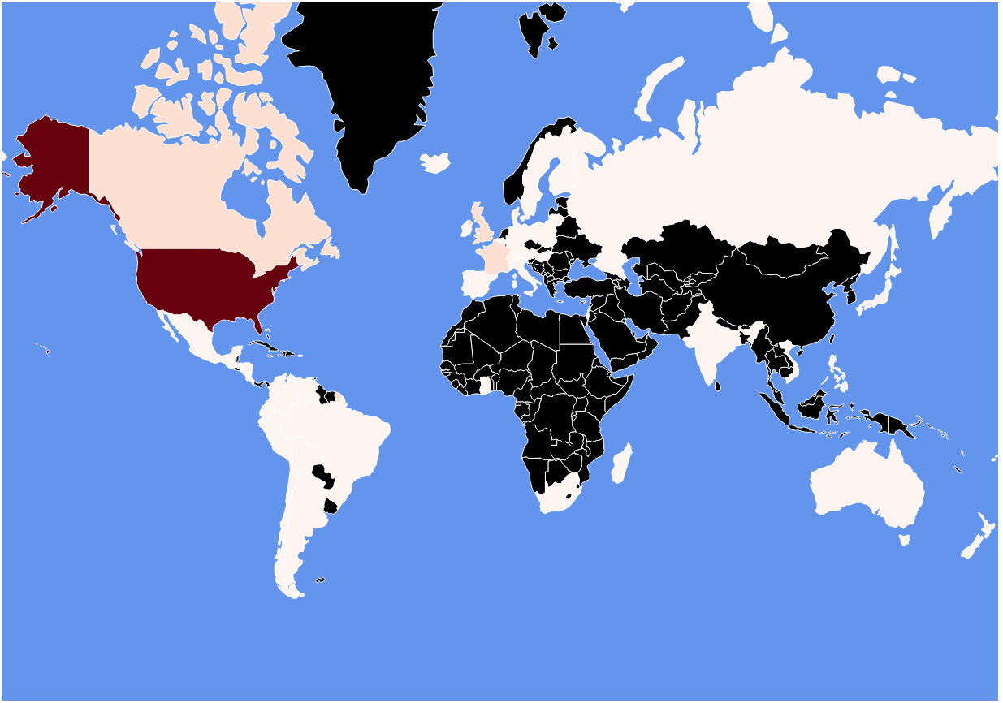

Slide 58
Map: Adding Scale
var x = d3.scaleLinear()
.domain([0,max_data])
.rangeRound([600, 860]);
var key = map.append("g")
.attr("class", "key")
.attr("transform", "translate(0,40)");
key.selectAll("rect")
.data(color.range().map(function(d) {
d = color.invertExtent(d);
if (d[0] == null) d[0] = x.domain()[0];
if (d[1] == null) d[1] = x.domain()[1];
return d;
}))
.enter().append("rect")
.attr("height", 8)
.attr("x", function(d) { return x(d[0]); })
.attr("width", function(d) { return x(d[1]) - x(d[0]); })
.attr("fill", function(d) { return color(d[0]); });

Slide 59
Map: Adding Scale
key.append("text")
.attr("class", "caption")
.attr("x", x.range()[0])
.attr("y", -6)
.attr("fill", "#000")
.attr("text-anchor", "start")
.attr("font-weight", "bold")
.text("loc");
key.call(d3.axisBottom(x)
.tickSize(13)
.tickFormat(function(x, i) { return x; })
.tickValues(color.domain()))
.select(".domain")
.remove();

Slide 60
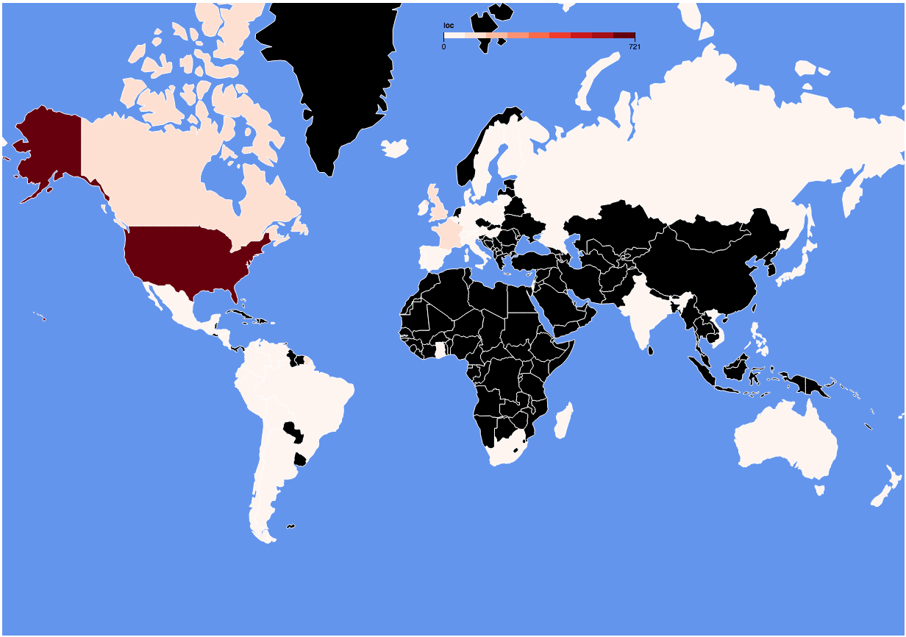
screenshot

Slide 61
Map: Tooltip Style
<style type="text/css">
.leaflet-container{background-color:#c5e8ff;}
#map svg { background-color: cornflowerblue}
path.country{stroke:white; stroke-width: 1; fill: rgb(0,0,0)}
path.active{stroke-width: 5}
div.tooltip {
position: absolute;
text-align: center;
width: 60px;
padding: 2px;
font: 12px sans-serif;
background: lightsteelblue;
border: 0px;
border-radius: 8px;
pointer-events: none;
opacity: 0;
}
div.tooltip.active {
opacity: 0.9;
}
</style>

Slide 62
Map: Adding a tooltip
<body>
<div id="map" style="width: 1227px; height: 860px"></div>
<div id="map_tooltip" class="tooltip" ></div>

Slide 63
Map: Adding Interactivity to a Path
map.selectAll("path")
.data(world_map.features)
.enter()
.append("path")
.attr("d", path)
.classed("country", true)
.on("click", function(d) {
updateSelected(this, d);
});

Slide 64
Map: Updating Tooltip
function updateSelected(el, data)
{
if(d3.select(el).classed("active")){
d3.select(el).classed("active", false);
d3.select("#map_tooltip").classed("active",false);
return;
}
map.selectAll("path.active").classed("active", false);
d3.select(el).classed("active", true);
var msg = data.properties.name;
if (data.visVal) { msg += "<br/>"+data.visVal; }
d3.select("#map_tooltip").html(msg)
.style("left", (d3.event.pageX) + "px")
.style("top", (d3.event.pageY - 28) + "px");
d3.select("#map_tooltip").classed("active",true);
}

Slide 65
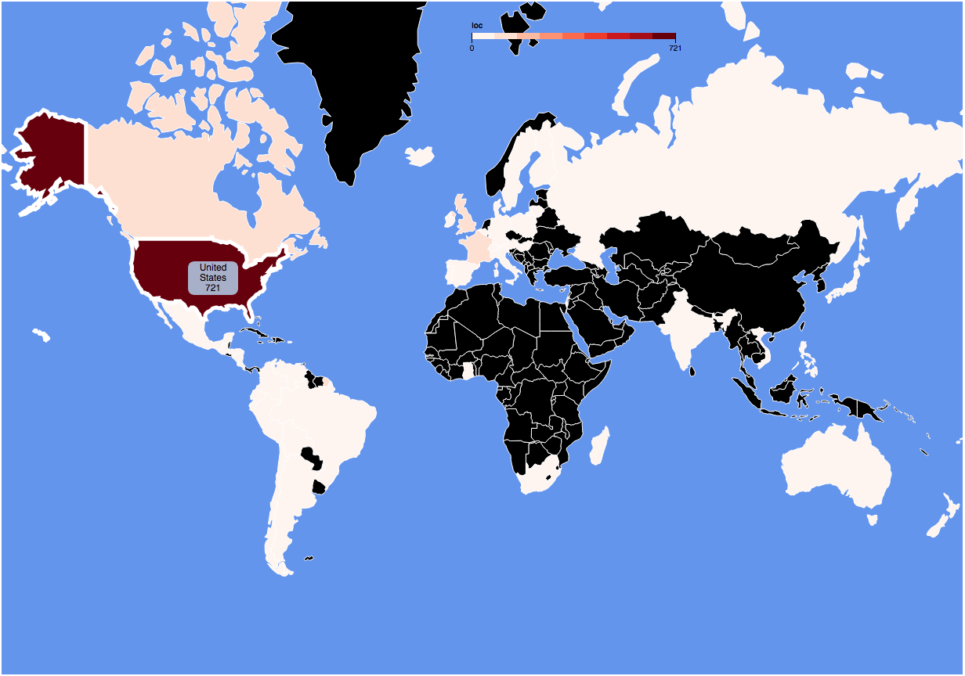
Screen shot

Slide 66
Map: Adding Radio Button
<body>
<div id="map" style="width: 1227px; height: 860px"></div>
<div id="map_tooltip" class="tooltip" ></div>
<div id="radio_button" class="radio">
<form>
<input type="radio" name="choco" checked value="loc">Company Location
<input type="radio" name="choco" value="origin" >Bean Origin
</form>
</div>

Slide 67
Map: Updating Map Colours
updateChoroplethColours();
d3.select("#radio_button form").on("change", updateChoroplethColours);
function updateChoroplethColours() {
all_countries = [];
var column_name = d3.select('input[name="choco"]:checked')
.node().value;
dataset.forEach(function(element) {
var bin_name = element[column_name];
if(all_countries[bin_name]){
all_countries[bin_name] = all_countries[bin_name]+1;
}else{
all_countries[bin_name] = 1;
};
});

Slide 68
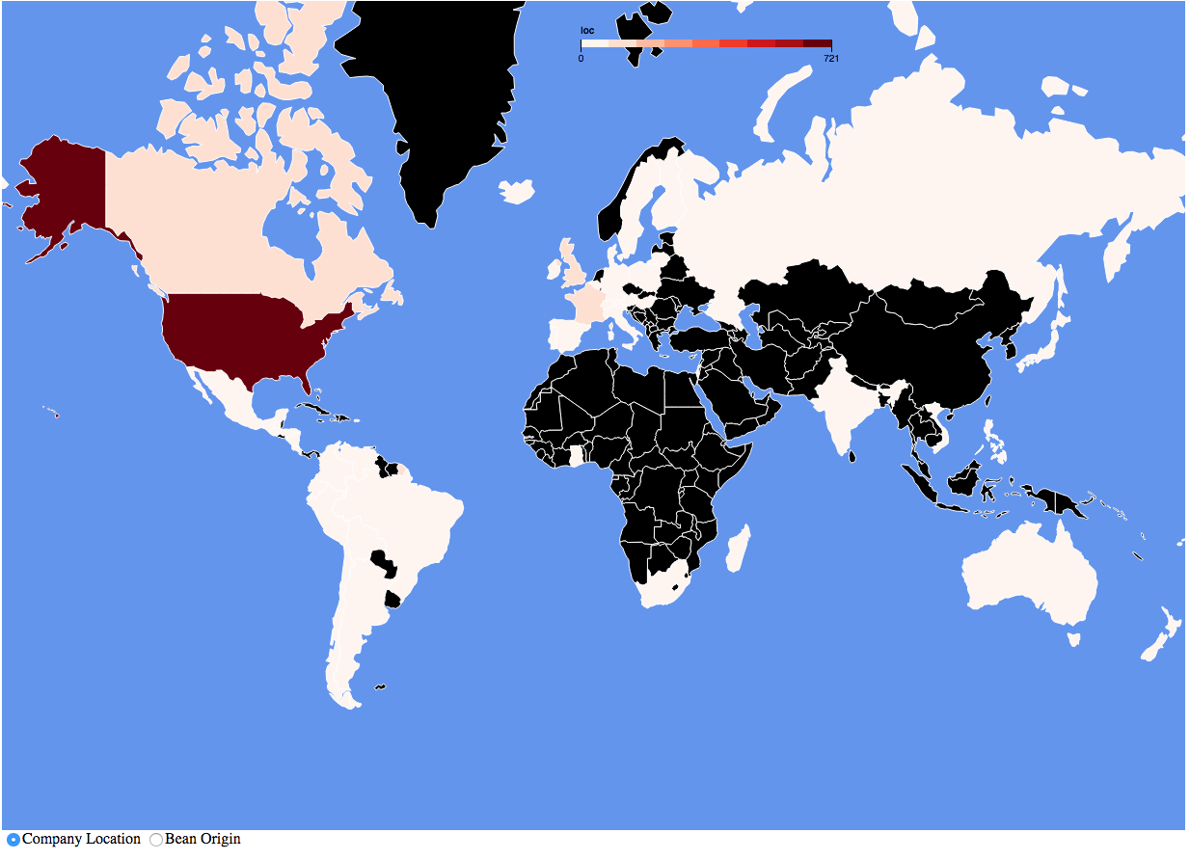

Slide 69
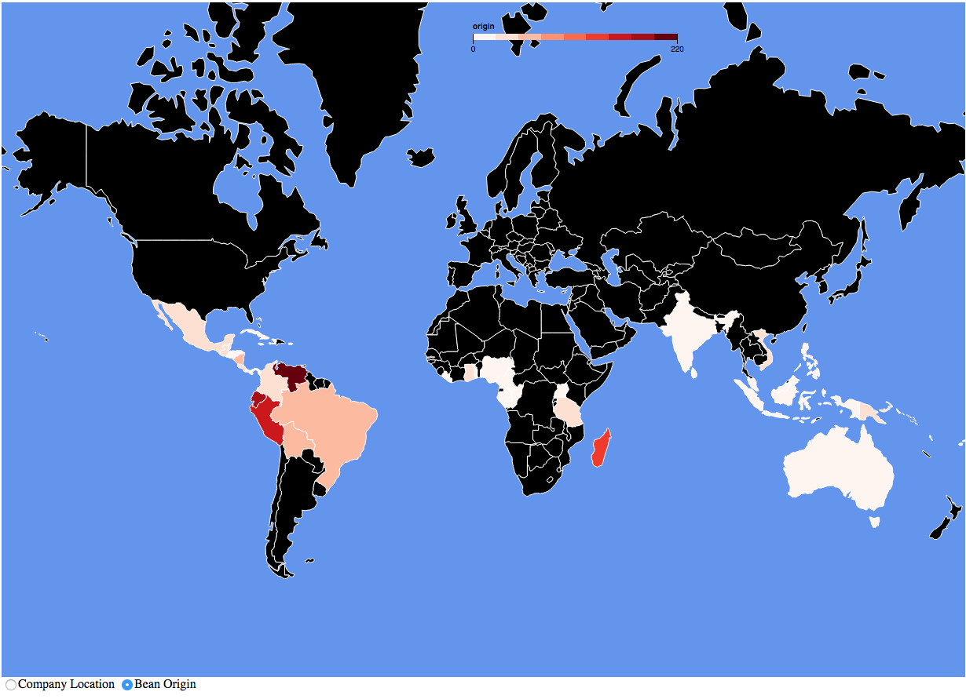

Slide 70
D3 Resources
https://d3js.org/
https://www.gitbook.com/@comp6234
https://square.github.io/intro-to-d3/
https://www.lynda.com/search?q=d3

Slide 71
Other D3

Slide 72
D3 layouts
D3 layouts take data and transform it for a specific visual task
Main layouts
Bundle
Chord
Cluster
Force
Histogram
Pack
Partition
Pie
Stack
Tree
Treemap
Other more specific layouts are available

Slide 73
Pie Chart

Slide 74
Pie Chart
var pie = d3.pie();
var arc = d3.arc()
.innerRadius(innerRad)
.outerRadius(outerRad);
var dataset = [ 5, 10, 20, 45, 6, 25 ];
var arcs = svg.selectAll("path.arc")
.data(pie(dataset))
.enter()
.append("path")
.attr("class", "arc")
.attr("transform", "translate("+outerRad+','+outerRad+")")
.attr("fill", function(d) { return colour(d.index);})
.attr("d", arc);

Slide 75
Pie Chart - layout

Slide 76
Pie Chart - layout

Slide 77
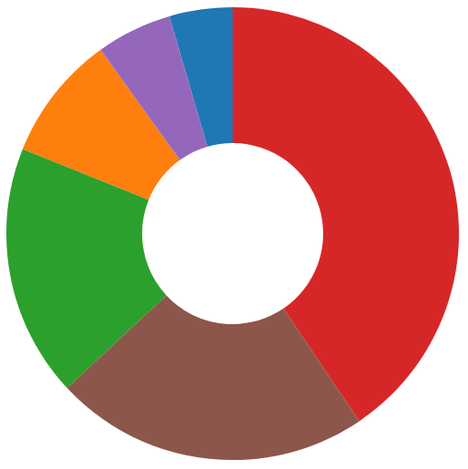
Pie Chart - arc
arc generates SVG path instructions
M move, A arc, L Line

Slide 78
Bubble Chart

Slide 79
Force-Directed Graph
https://bl.ocks.org/mbostock/4062045

Slide 80
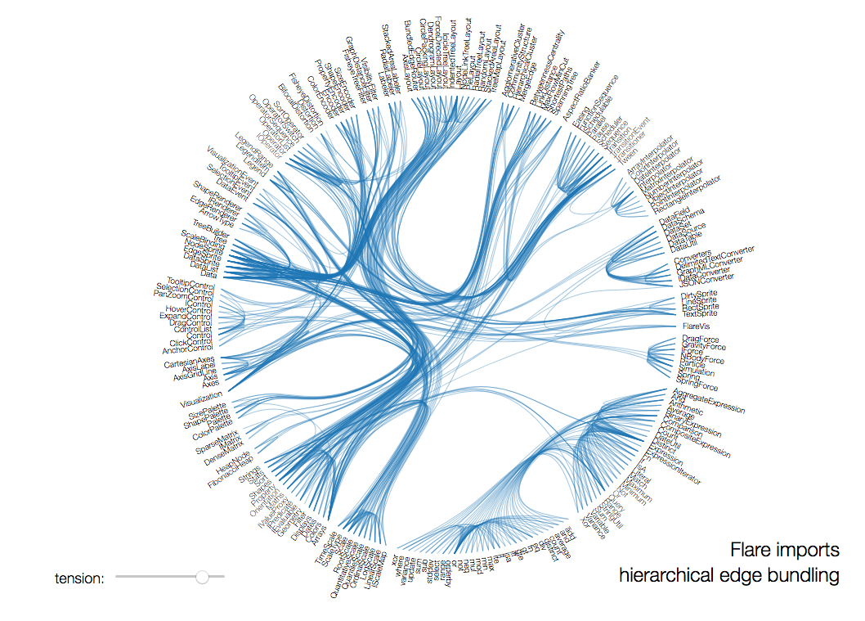
Chord Chart
http://mbostock.github.io/d3/talk/20111116/bundle.html

Slide 81
D3 Conclusions
Powerful visualisation library
Many types of visualisation
Plenty of tools and supporting libraries
Examples to borrow from

Slide 82
D3 Dev

Slide 83
Setup
Firefox
Create a local directory
Chrome
Create a local directory
Needs a local server
Using Node:
npm install –g http-server
http-server
- Using Python:
python -m SimpleHTTPServer 8000

Slide 84
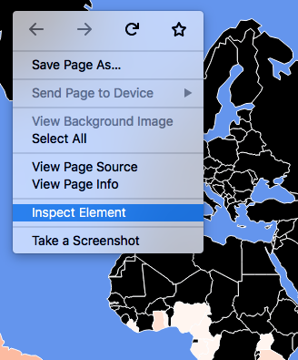
Dev Tools
Chrome: Browser menu -> More Tools -> Developer Tools
Firefox: Browser menu -> Web Developer -> Toggle Tools
Right click menu -> Inspect / Inspect Element

Slide 85
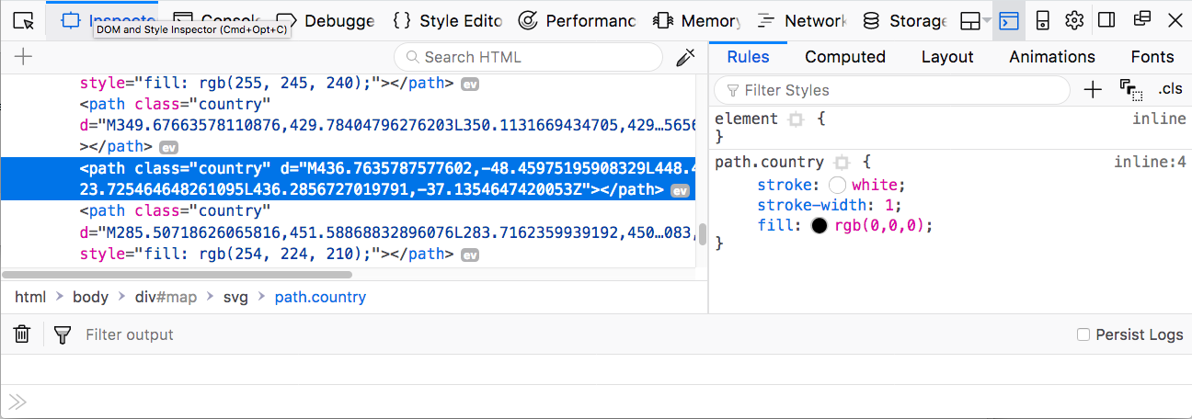
Dev Tools
Inspector
Console
Debugger

Slide 86
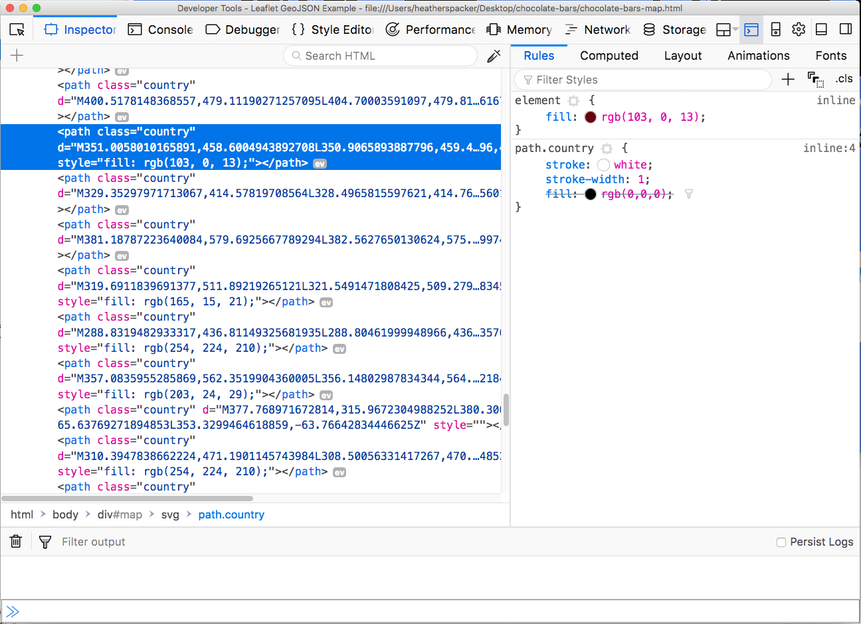
Dev Tools - Inspector

Slide 87
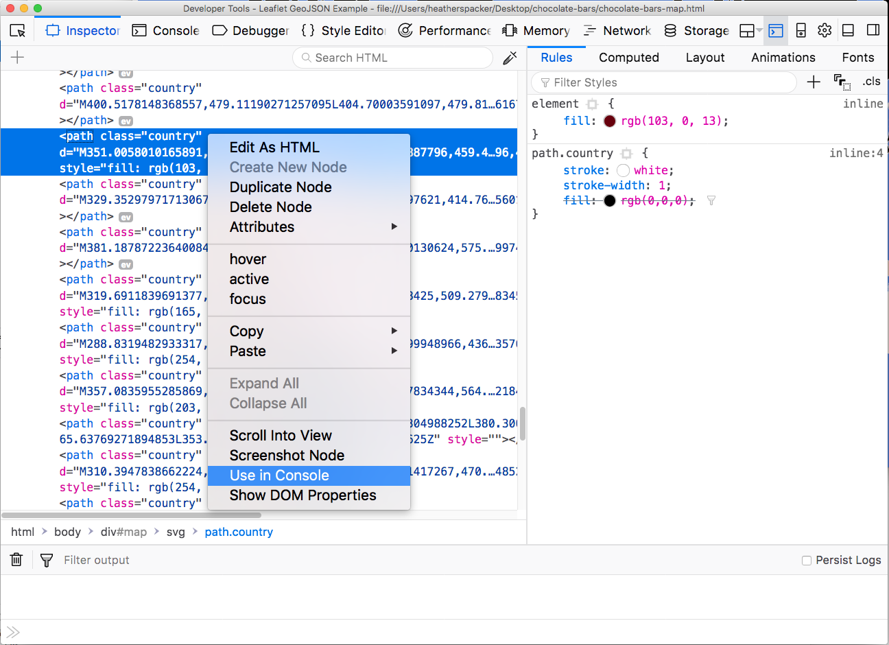
Dev Tools - Inspector

Slide 88
Dev Tools - Inspector

Slide 89
Console output
console.log("hello")
console.log(graph.nodes);

Slide 90
Console output
console.table(graph.nodes);

Slide 91
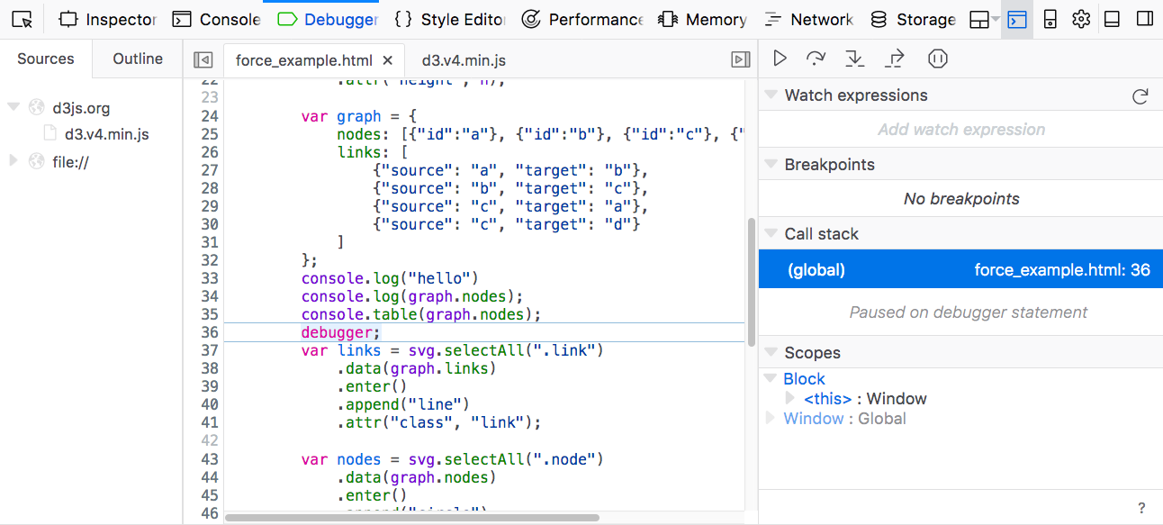
Debugging at a specific line
debugger;

Slide 92
SVG Paint order
<circle cx="75” cy="250" r="70" fill="red"/>
<circle cx="175" cy="250" r="70" fill="blue"/>
<circle cx="325" cy="250" r="70" fill="blue"/>
<circle cx="425" cy="250" r="70" fill="red"/>

Slide 93
CSS Order
<style>
div.box {
width:100px; height:100px;
background-color: blue; margin:10px
}
</style>
<div class="box"></div>
<div class="box”
style="background-color: red"></div>

Slide 94
CSS Order – inspect element

Slide 95
Open Data Visualisation & Innovation
COMP 6214
Heather Packer
16/01/18

Slide 96
Carbon Culture
A community platform designed to help people use resources more efficiently
They work out how to help companies, charities and NGO can reduce their carbon footprints
Cabinet office
10 Downing Street
Tate Modern
They use open data to promote awareness
Notes:
Exploring a single dataset
Merging more than one dataset
Real time dynamics
Supporting analytics reasoning

Slide 97
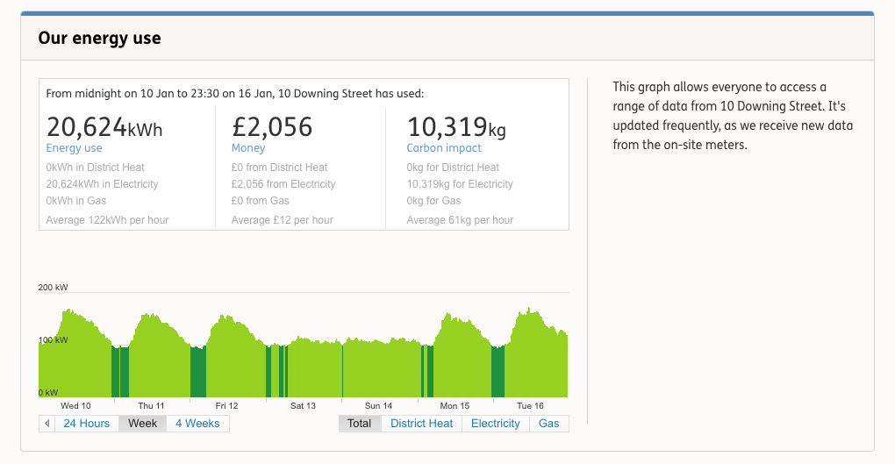
Carbon Culture - Visualisation
https://platform.carbonculture.net/places/10-downing-street/9/

Slide 98
The Guardian
https://www.theguardian.com/cities/2017/oct/04/hypnotic-beauty-public-transport-mapped
https://www.theguardian.com/global-development-professionals-network/2017/jan/03/using-data-visualisations-to-help-explain-the-global-obesity-explosion

Slide 99
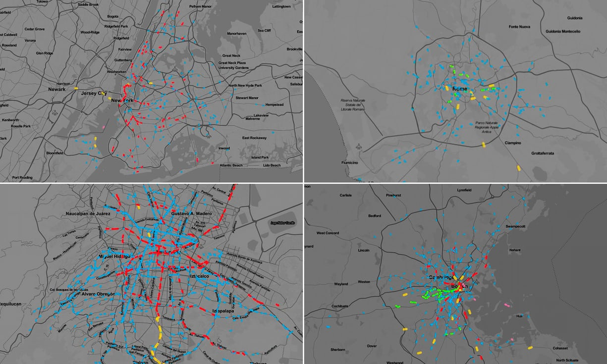
Notes:
https://www.theguardian.com/news/datablog/interactive/2013/oct/27/interactive-safest-time-to-drive

Slide 100
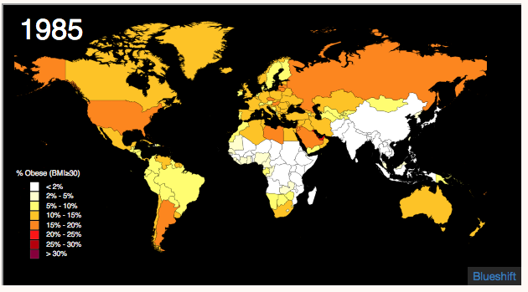
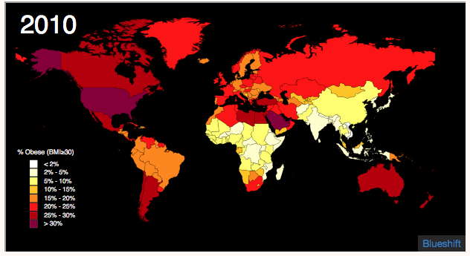
Notes:
https://www.theguardian.com/global-development-professionals-network/2017/jan/03/using-data-visualisations-to-help-explain-the-global-obesity-explosion

Slide 102
ARUP
UK based global engineering consultancy
Uses open data as a vital part of its work with smart cities
Uses public data about traffic, planning, and natural hazards

Slide 103
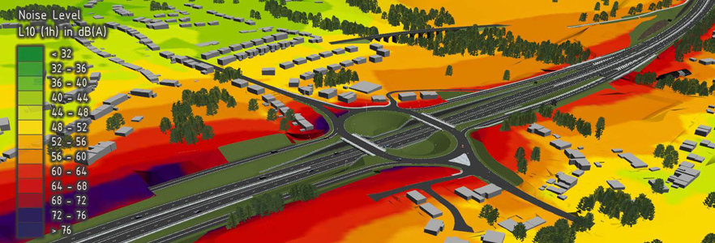
ARUP

Slide 104
Adzuma
A search engine that aggregates job adverts
Uses open data
Labour market statistics for itsJob index
https://www.adzuna.co.uk/jobs/salaries/software-developer#average_vs_vacancies

Slide 105
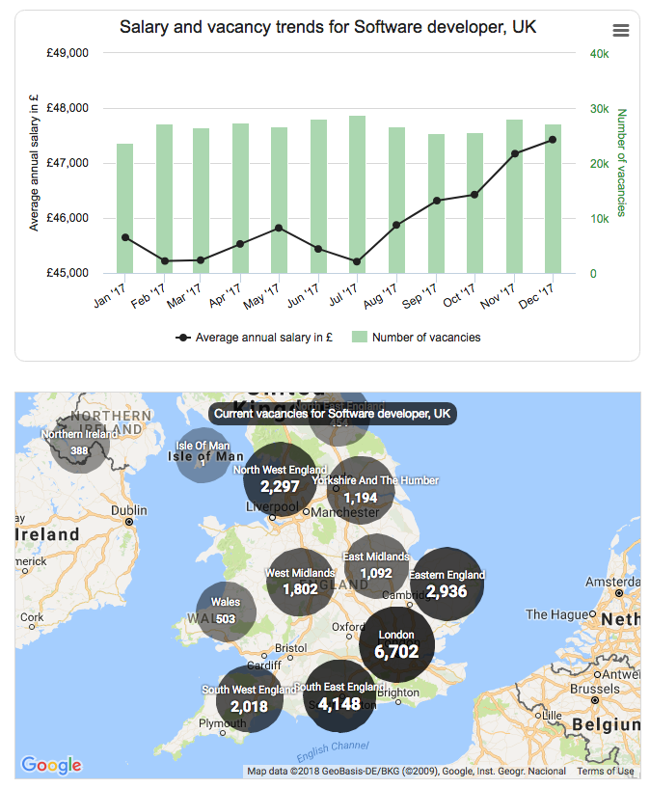
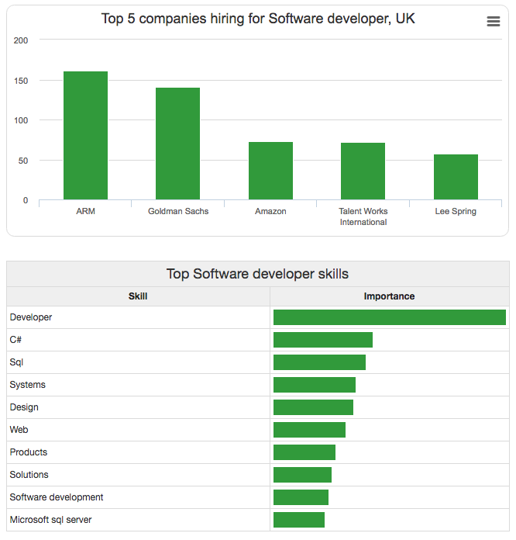
Adzuma

Slide 106
Doorda
Uses government datasets on a single map
Consultancy

Slide 107
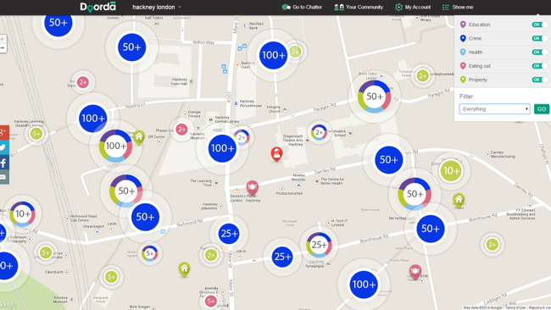
Doorda

