Slide 1
Semantic Web in Depth
Web Ontology Language (OWL)
Dr Nicholas Gibbins - nmg@ecs.soton.ac.uk
2017-2018

Slide 2
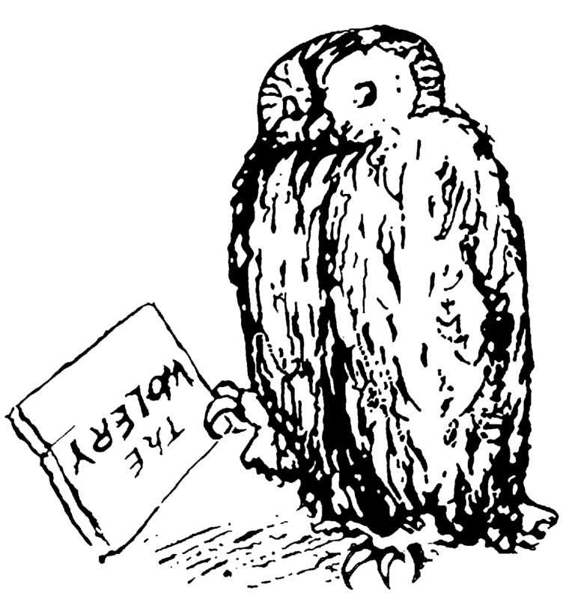
Introducing OWL
For many, RDF Schema is a sufficiently expressive ontology language
However, there are use cases which require a more expressive formalism:
Instance classification
Consistency checking
Subsumption reasoning

Slide 3
Introducing OWL
OWL is a description logic-based language
It has a syntax that expresses DL axioms in RDF triples
Designed so that the triples used to express OWL axioms are (fairly) meaningful when interpreted as RDF
Other syntaxes exist: functional, XML, Manchester
It has two complementary semantics
Direct semantics (similar to that introduced last lecture)
RDF-based semantics (compatible with RDF’s less orthodox approach)
Correspondence theorem proving the equivalence of the above

Slide 4
OWL versions
Two versions of OWL:
OWL (became a W3C Recommendation on 10 Feb 2004)
OWL 2 (became a W3C Recommendation on 29 Oct 2009)
OWL 2 is more expressive than OWL
Takes advantage of improvements in DL reasoning techniques between 2004 and 2007
We will initially concentrate on OWL

Slide 5
Languages of the Semantic Web
1995
PICS
MCF
SHOE
RDF(S)
2000
OIL
DAML
RDF Core WG
WEBONT WG
DAML+OIL
RDF(S)
OWL
2005
Notes:
Oct 1991 HTML Tags
Jun 1992 HTML DTD first draft, 1.1 in Nov
Jan 1993 Mosaic released
Jun 1993 Hypertext Markup Language (Internet Draft)
Nov 1993 HTML+ (Internet Draft)
Sep 1994 IETF HTML WG founded
Oct 1994 W3C founded
Oct 1994 Netscape 0.9 released
Apr 1995 HTML 3.0 (Internet Draft)
Aug 1995 IE released
Nov 1995 HTML 2.0 (RFC1866)
Nov 1995 HTML Forms (RFC1867)
Dec 1995 IETF HTML WG disbanded
Feb 1996 HTML ERB/WG formed
May 1996 HTML Tables (RFC1942)
Aug 1996 HTML Client-side Image Maps (RFC1980)
Nov 1996 XML WD
Jan 1997 HTML I18N (RFC2070)
Jan 1997 HTML 3.2 (W3C REC)
Dec 1997 HTML 4.0 (W3C REC)
Feb 1998 XML 1.0 W3C REC
Dec 1998 Reformulating HTML in XML
Dec 1999 HTML 4.01 (W3C REC)
Jan 2000 XHTML 1.0
May 2000 ISO HTML (ISO/IEC 15445:2000)

Slide 6
Languages of the Semantic Web
2005
First OWLED Workshop
OWL WG
OWL 1.1
OWL 2
2010
RDF WG
OWL 2
RDF 1.1
2015
Notes:
Oct 1991 HTML Tags
Jun 1992 HTML DTD first draft, 1.1 in Nov
Jan 1993 Mosaic released
Jun 1993 Hypertext Markup Language (Internet Draft)
Nov 1993 HTML+ (Internet Draft)
Sep 1994 IETF HTML WG founded
Oct 1994 W3C founded
Oct 1994 Netscape 0.9 released
Apr 1995 HTML 3.0 (Internet Draft)
Aug 1995 IE released
Nov 1995 HTML 2.0 (RFC1866)
Nov 1995 HTML Forms (RFC1867)
Dec 1995 IETF HTML WG disbanded
Feb 1996 HTML ERB/WG formed
May 1996 HTML Tables (RFC1942)
Aug 1996 HTML Client-side Image Maps (RFC1980)
Nov 1996 XML WD
Jan 1997 HTML I18N (RFC2070)
Jan 1997 HTML 3.2 (W3C REC)
Dec 1997 HTML 4.0 (W3C REC)
Feb 1998 XML 1.0 W3C REC
Dec 1998 Reformulating HTML in XML
Dec 1999 HTML 4.01 (W3C REC)
Jan 2000 XHTML 1.0
May 2000 ISO HTML (ISO/IEC 15445:2000)

Slide 7
OWL

Slide 8
OWL feature summary
Necessary and sufficient conditions for class membership
Property restrictions
Local range, cardinality, value constraints
Complex classes
Set operators, enumerated classes, disjoint classes
Equivalence and identity relations
Property characteristics
Transitive, symmetric, functional

Slide 9
OWL species
Different subsets of OWL features give rise to the following sublanguages (colloquially known as species):
OWL Lite
OWL DL
OWL Full
“There is a tradeoff between the expressiveness of a representation language and the difficulty of reasoning over the representations built using that language.”
Brachman, R. J., and H. J. Levesque. (1984). The tractability of subsumption in frame-based description languages. In Proceedings of the 4th National Conference of the American Association for Artificial Intelligence (AAAI-84). Austin, TX, pp. 34-37.

Slide 10
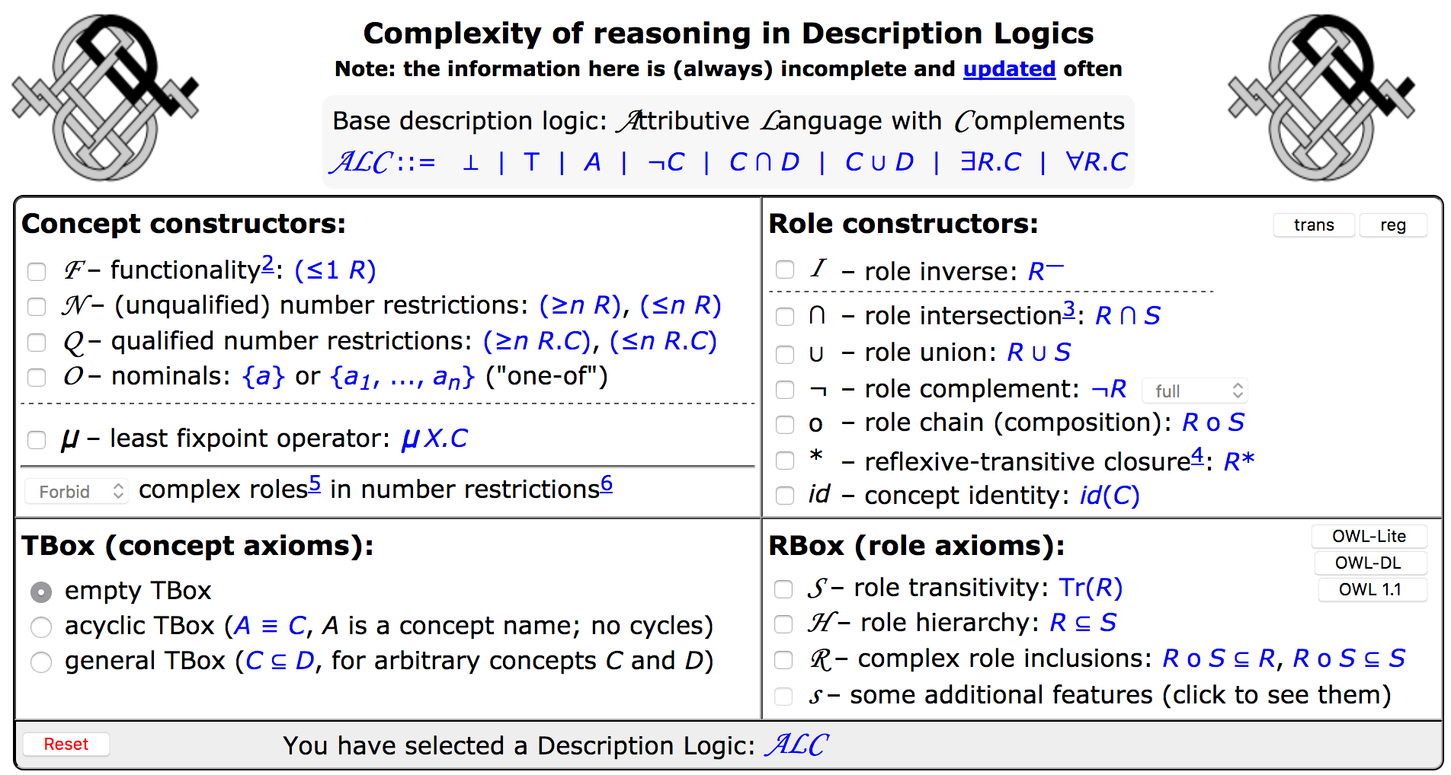
Description Logic Navigator
http://www.cs.man.ac.uk/~ezolin/dl/

Slide 11
OWL species
OWL Full
Increasing
expressivity
OWL DL
Increasing
complexity
OWL Lite
RDF(S)

Slide 12
OWL Lite
Based on the description logic $𝒮ℋℐℱ(D)$
Less complex reasoning at the expense of less expressive language
Concept satisfiability is EXPTIME-complete
Features:
No enumerated classes, boolean constructors, or disjoint classes
Restricted cardinality restrictions (values of 0 or 1 – required, permitted and excluded)
No value restrictions
equivalentClass/subClassOf cannot be applied to class expressions

Slide 13
OWL DL
Based on the description logic $𝒮ℋ𝒪ℐ𝒩 (D)$
Higher worst-case complexity than OWL Lite
Concept satisfiability is NEXPTIME-complete
Supports all OWL constructs, with some restrictions:
Properties that take datatype values cannot be marked as inverse functional
Classes, properties, individuals and datatype values are disjoint

Slide 14
OWL Full
No restrictions on use of language constructs
All OWL DL and RDFS constructs
Potentially undecidable

Slide 15
OWL class types
owl:Class
Distinct from rdfs:Class
Needed for OWL Lite/DL due to reflexive definition of RDFS
owl:Thing $⊤$
The class that includes everything
owl:Nothing $⊥$
The empty class

Slide 16
OWL property types
owl:ObjectProperty
The class of resource-valued properties
owl:DatatypeProperty
The class of literal-valued properties
owl:AnnotationProperty
Used to type properties which annotate classes and properties (needed for OWL Lite/DL)

Slide 17
OWL versus RDF Schema
Recall that the semantics of a description logic is specified by interpretation functions which map:
Individuals to members of $Δ$
Concepts to subsets of $Δ$
Roles to sets of pairs drawn from $Δ×Δ$
Reflexive definitions of RDF Schema means that some resources are treated as both classes and instances, or instances and properties

Slide 18
OWL versus RDF Schema
Ambiguous semantics for these resources
Can’t tell from context whether they’re instances or classes
Can’t select the appropriate interpretation function
The introduction of owl:Class, owl:ObjectProperty and owl:DatatypeProperty eliminates this ambiguity

Slide 19
OWL’s Dirty Secret
OWL Full
OWL DL
OWL Lite
RDF(S)

Slide 20
OWL’s Dirty Secret Uncovered
OWL Full
OWL DL
OWL Lite
RDF(S)
RDF(S)’

Slide 21
Necessary Class Definitions
Primitive/partial classes ($⊑$)
“If something belongs to this class, then it fulfils these conditions...”
Defined using rdfs:subClassOf

Slide 22
Sufficient Class Definitions
Describes a subset of the class (⊒)
“If something fulfils these conditions, then it belongs to this class...”
Defined using rdfs:subClassOf – in the other direction
Example:
$$Person⊒∃hasNationalInsuranceNumber$$

Slide 23
Necessary and Sufficient Class Definitions
Defined/complete classes (≡)
“If something belongs to this class, then it fulfils these conditions...”
“If something fulfils these conditions, then it belongs to this class...”
Defined using owl:equivalentClass
Example:
$$Student≡Person⊓∃isEnrolledAt.University$$
Note: It will be rather difficult, if not impossible, to give conditions that are both sufficient and necessary for a class that is as complex as $Person$

Slide 24
Boolean Concept Constructors
owl:intersectionOf $C⊓D$
owl:unionOf $C⊔D$
owl:complementOf $¬C$
Restrictions on use with OWL Lite
owl:unionOf and owl:complementOf cannot be used
owl:intersectionOf can be used with named classes (not bNodes) and OWL restrictions only

Slide 25
Example
$$GreenApple⊑Apple⊓GreenThing$$
<owl:Class rdf:about=“#GreenApple”> <rdfs:subClassOf> <owl:Class> <owl:intersectionOf rdf:parseType=“Collection”> <owl:Class rdf:about=“#Apple”/> <owl:Class rdf:about=“#GreenThing”/> </owl:intersectionOf> </owl:Class> </rdfs:subClassOf> </owl:Class>

Slide 26
Restrictions
Number restrictions (local cardinality constraints)
$≤n R$, $≥n R$, $=n R$
Existential/universal restrictions (local range constraints)
$∃R.C$, $∀R.C$
Value restrictions (local value constraints)
$$∃R.\{x\}$$

Slide 27
OWL Restriction Syntax
<owl:Restriction> <owl:onProperty rdf:resource=“property”/> constraint expression </owl:Restriction>

Slide 28
OWL Number Restrictions
owl:minCardinality $≥n R$
“the class of things for which property R has at least n values”
owl:maxCardinality $≤n R$
“the class of things for which property R has at most n values”
owl:cardinality $=n R$
“the class of things for which property R has exactly n values”
OWL Lite has restricted cardinalities

Slide 29
Example
$$SingleMaltWhisky≡Whisky⊓ =1 distilledBy$$
<owl:Class rdf:about=“#SingleMaltWhisky”> <owl:equivalentClass> <owl:Class> <owl:intersectionOf rdf:parseType="Collection"> <owl:Class rdf:about=“#Whisky”/> <owl:Restriction> <owl:onProperty rdf:resource=“#distilledBy”/> <owl:cardinality>1</owl:cardinality> </owl:Restriction> </owl:intersectionOf> <owl:Class> </owl:equivalentClass> </owl:Class>

Slide 30
OWL Existential/Universal Restrictions
owl:someValuesFrom $∃R.C$
“the class of things that have some value for property R of class C”
owl:allValuesFrom $∀R.C$
“the class of things that only have values for property R of class C”
Can only be used with named classes or datatypes in OWL Lite

Slide 31
Example
$$\text{Carnivores} \text{are} \text{things} \text{that} \text{eat} \text{some} \text{animals}$$
$$Carnivore≡∃eats.Animal$$
<owl:Class rdf:about=“#Carnivore”> <owl:equivalentClass> <owl:Restriction> <owl:onProperty rdf:resource=“#eats”/> <owl:someValuesFrom rdf:resource=“#Animal”/> </owl:Restriction> </owl:equivalentClass> </owl:Class>

Slide 32
Example
$$\text{Vegetarians} \text{are} \text{things} \text{that} \text{eat} \text{only} \text{plants}$$
$$Vegetarian≡∀eats.Plant$$
<owl:Class rdf:about=“#Vegetarian”> <owl:equivalentClass> <owl:Restriction> <owl:onProperty rdf:resource=“#eats”/> <owl:allValuesFrom rdf:resource=“#Plant”/> </owl:Restriction> </owl:equivalentClass> </owl:Class>

Slide 33
RDFS range/domain as OWL restrictions
RDFS defines global domains and ranges for properties
rdfs:domain, rdfs:range
In DL notation:
R rdfs:domain C . is equivalent to $∃R.⊤⊑C$
R rdfs:range C . is equivalent to $∃R^{−}.⊤⊑C$

Slide 34
Local value constraints
Defines a class based on a particular property value
owl:hasValue $∃R.\{x\}$
“the class of things that have a value for property R which is x”
Effectively the combination of an existential restriction with an enumerated singleton class
Cannot be used in OWL Lite (no enumerated classes)

Slide 35
Example
$$GreenThing≡∃hasColour.\{green\}$$
<owl:Class rdf:about=“#GreenThing”> <owl:equivalentClass> <owl:Restriction> <owl:onProperty rdf:resource=“#hasColour”/> <owl:hasValue rdf:resource=“#Green”/> </owl:Restriction> </owl:equivalentClass> </owl:Class>

Slide 36
Enumerated classes
owl:oneOf
Defines a class as a direct enumeration of its members
In DL notation:
$$C≡\{x, y, z,…\}$$
Cannot be extended (closed set – uses RDF Collections)
Cannot be used in OWL Lite (no enumerated classes)

Slide 37
Example
$$Beatles≡\{john, paul, george, ringo\}$$
<owl:Class rdf:about=“#Beatles”> <owl:oneOf rdf:parseType=“Collection”> <owl:Thing rdf:about=“#JohnLennon”/> <owl:Thing rdf:about=“#PaulMcCartney”/> <owl:Thing rdf:about=“#GeorgeHarrison”/> <owl:Thing rdf:about=“#RingoStarr”/> </owl:oneOf> </owl:Class>

Slide 38
Equivalence and identity relations
Useful for ontology mapping
owl:sameAs $x=y$ (for individuals)
owl:equivalentClass $C≡D$
owl:equivalentProperty $R≡S$
<owl:Thing rdf:about=“#MorningStar”> <owl:sameAs rdf:resource=“#EveningStar”/> </owl:Thing>

Slide 39
Identity
Are the following the same?
https://twitter.com/SteffenStaab
https://www.facebook.com/steffen.staab.1
https://www.linkedin.com/in/steffen-staab-35809414/
https://plus.google.com/100610036735969444694?hl=de

Slide 40
Identity
Are the following the same?
Norma Jeane Baker
Norma Jeane Mortenson
Stefani Joanne Angelina Germanotta
Marilyn Monroe
Lady Gaga

Slide 41
Non-equivalence relations
owl:differentFrom
Used to specify that two individuals are different from each other
A limited unique name assumption
In DL notation:
$$a≠b$$
OWL (and DLs in general) make the Open World Assumption
Knowledge of world is incomplete
If something cannot be proven true, then it isn’t assumed to be false
If we don’t tell a reasoner that two individuals are different from each other, it may assume that they’re a single individual

Slide 42
Example
$$harrycorbett≠harryhcorbett$$
<rdf:Description rdf:about=“#HarryCorbett”> <owl:differentFrom rdf:resource=“#HarryHCorbett”/> </rdf:Description>

Slide 44
Non-equivalence relations
owl:AllDifferent and owl:distinctMembers
Used to specify a group of mutually distinct individuals
Syntactic sugar for owl:differentFrom
In DL notation (assuming individuals $a, b, c$):
$$a≠b, a≠c, b≠c$$

Slide 45
Example
$$john≠paul, john≠george, john≠ringo \\ paul≠george, paul≠ringo, george≠ringo$$
<owl:AllDifferent> <owl:distinctMembers rdf:parseType=“Collection”> <rdf:Description rdf:about=“#John”/> <rdf:Description rdf:about=“#Paul”/> <rdf:Description rdf:about=“#George”/> <rdf:Description rdf:about=“#Ringo”/> </owl:distinctMembers> </owl:AllDifferent>

Slide 46
Implications (1)
<owl:Class rdf:ID=“Wine">
<rdfs:subClassOf>
<owl:Restriction> <owl:onProperty rdf:resource=“#hasWineSugar”/> <owl:cardinality>1</owl:cardinality> </owl:Restriction>
</rdfs:subClassOf>
</owl:Class>
<WineSugar
rdf:ID="OffDry"> <owl:differentFrom rdf:resource="#Dry"/> <owl:differentFrom rdf:resource="#Sweet"/>
</WineSugar>
<exp:Wine rdf:about=“#myWine”>
<exp:hasWineSugar rdf:resource=“#Dry”/>
<exp:hasWineSugar rdf:resource=“#Sweet”/>
</rdf:Description>

Slide 47
Implications (2)
<owl:Class rdf:ID=“Wine">
<rdfs:subClassOf>
<owl:Restriction> <owl:onProperty rdf:resource=“#hasWineSugar”/> <owl:cardinality>1</owl:cardinality> </owl:Restriction>
</rdfs:subClassOf>
</owl:Class>
<owl:AllDifferent>
<owl:distinctMembers rdf:parseType=“Collection”>
<rdf:Description rdf:about=“#OffDry”/>
<rdf:Description rdf:about=“#Dry”/>
<rdf:Description rdf:about=“#Sweet”/>
</owl:distinctMembers> </owl:AllDifferent>
<exp:Wine rdf:about=“#myWine”>
<exp:hasWineSugar rdf:resource=“#Dry”/>
<exp:hasWineSugar rdf:resource=“#Sweet”/>
</rdf:Description>

Slide 48
Inverse Properties
Allows us to define a property as the inverse of another property
In DL notation:
$$R≡S^{−}$$
<owl:ObjectProperty rdf:about=“#hasAuthor”> <owl:inverseOf rdf:resource=“#wrote”/> </owl:ObjectProperty>

Slide 49
Disjoint classes
owl:disjointWith
members of one class cannot also be members of some other class
In DL notation:
$$C⊓D≡⊥$$
Cannot be used in OWL Lite (no boolean constructors)

Slide 50
Example
$$MaleHuman⊓FemaleHuman≡⊥ \\ MaleHuman⊑Human$$
<owl:Class rdf:about=“#MaleHuman”> <rdfs:subClassOf rdf:resource=“#Human”/> <owl:disjointWith rdf:resource=“#FemaleHuman”/> </owl:Class>

Slide 51
Property Characteristics: Symmetric
Symmetric properties satisfy the axiom
$$R\left(x, y\right)⇔R(y,x)$$
In DL notation:
$$R≡R^{−}$$
<owl:SymmetricProperty rdf:about=“#hasSibling”/>

Slide 52
Property Characteristics: Transitive
Transitive properties satisfy the axiom
$$R\left(x,y\right)∧R\left(y,z\right)⇒R(x,z)$$
In DL notation:
$$R^{+}⊑R$$
<owl:TransitiveProperty rdf:about=“#hasAncestor”/>

Slide 53
Property Characteristics: Functional
Functional properties satisfy the axiom
$$R\left(x,y\right)∧R\left(x,z\right)⇒y=z$$
<owl:FunctionalProperty rdf:about=“#hasNINumber”/>
(everyone has only one NI number) (everyone has only one birthdate) (but: people may have several means of identification)

Slide 54
Property Characteristics: Inverse Functional
Inverse functional properties satisfy the axiom
$$R\left(y,x\right)∧R\left(z,x\right)⇒y=z$$
<owl:InverseFunctionalProperty rdf:about=“#hasNINumber”/>
(people with the same NI number are the same person) (each identification points to only one person) (but: many people have the same birthdate)
Cannot be used with owl:DatatypeProperty in OWL Lite/DL
Notes:
National Insurance Number

Slide 55
Ontology header
Ontology header for metadata about an ontology
<owl:Ontology rdf:about=“”> <owl:versionInfo>1.4</owl:versionInfo> <rdfs:comment>An example ontology</rdfs:comment> <owl:imports rdf:resource="http://www.example.org/base"/> </owl:Ontology>

Slide 56
Versioning support
owl:versionInfo
Version number, etc
owl:priorVersion
Indicates that an ontology is a previous version of this ontology
owl:backwardCompatibleWith
Indicates that an ontology is a previous version of this ontology, and that this is compatible with it
owl:incompatibleWith
Indicates that an ontology is a previous version of this ontology, but that this is incompatible with it

Slide 57
Versioning support
Classes and properties may be marked as deprecated:
owl:DeprecatedClass
owl:DeprecatedProperty
In practice, OWL versioning support is rarely used
Purely informative
Doesn’t affect the behaviour of reasoners

Slide 58
Ontology modularisation
owl:imports
This ontology includes the definitions contained in another ontology
Also possible to use terms from other ontologies without explicitly importing them
Importing another ontology requires certain entailments
Simple use of a term from another ontology does not require (but also does not prevent) those entailments

Slide 59
Example
Ontology 1 (ont1) contains: BBB rdfs:subClassOf AAA
Ontology-2 (ont2) contains: ont2 owl:imports ont1 CCC rdfs:subClassOf BBB
Ontology-2 must entail CCC rdfs:subClassOf AAA

Slide 60
Example
Ontology 1 (ont1) contains: BBB rdfs:subClassOf AAA
Ontology-3 (ont3) contains: CCC rdfs:subClassOf ont1:BBB
Ontology-3 may entail CCC rdfs:subClassOf ont1:AAA

Slide 61
OWL Status
WebOnt working group formed Nov 2001
W3C Recommendations published in Feb 2004
OWL Experiences and Directions workshops started in 2005...

Slide 62
OWL References
Web Ontology Working Group homepage
http://www.w3.org/2001/sw/WebOnt/

Slide 63
OWL 2

Slide 64
From OWL to OWL 2
OWL design based on contemporary understanding of techniques for decidable, sound and complete reasoning in description logics
Our understanding has improved since 2004
Some things that looked intractable have been shown to be possible

Slide 65
From OWL to OWL 2
Changes fall into the following categories:
Syntactic sugar (making it easier to say things we could already say)
Constructs for increased expressivity
Datatype support
Metamodelling
Annotation

Slide 66
Syntactic Sugar: Disjoint Classes
OWL lets us state that two classes are disjoint
$$C⊓D≡⊥$$
OWL 2 lets us state that a set of classes are pairwise disjoint

Slide 67
Example
$$Bacteria⊓Archaea≡⊥ \\ Bacteria⊓Eukaryota≡⊥ \\ Archaea⊓Eukaryota≡⊥$$
<owl:AllDisjointClasses> <owl:members rdf:parseType="Collection"> <rdf:Description rdf:about=”#Bacteria"/> <rdf:Description rdf:about="#Archaea"/> <rdf:Description rdf:about="#Eukaryota"/> </owl:members> </owl:AllDistinctClasses>

Slide 68
Syntactic Sugar: Disjoint Union
Allows us to define a class as the union of a number of other classes, all of which are pairwise disjoint
In DL notation:
$$C≡C_{1}⊔C_{2}⊔…⊔C_{n} \\ C_{1}⊓C_{2}≡⊥ \\ C_{1}⊓C_{3}≡⊥ \\ …$$
We’ll look at this modelling pattern more in later lectures

Slide 69
Example
$$Domain≡Bacteria⊔Archaea⊔Eukaryota \\ Bacteria⊓Archaea≡⊥ \\ Bacteria⊓Eukaryota≡⊥ \\ Archaea⊓Eukaryota≡⊥$$
<owl:Class rdf:about=“#Domain”> <owl:disjointUnionOf rdf:parseType="Collection"> <rdf:Description rdf:about=”#Bacteria"/> <rdf:Description rdf:about="#Archaea"/> <rdf:Description rdf:about="#Eukaryota"/> </owl:disjointUnionOf> </owl:Class>

Slide 70
Syntactic Sugar: Negative Property Assertions
OWL lets us assert property values for an individual
OWL 2 also lets us assert that an individual does not have a particular property value
<owl:NegativePropertyAssertion> <owl:sourceIndividual rdf:resource=“#john”/> <owl:assertionProperty rdf:resource=“#hasChild”/> <owl:targetIndividual rdf:resource=“#susan”/> </owl:NegativePropertyAssertion>

Slide 71
New Constructs: Self Restriction
Define a class of individuals which are related to to themselves by a given property (self reflexivity)
In DL Notation:
$$∃R.Self$$
<owl:Restriction> <owl:onProperty rdf:resource=“...”/> <owl:hasSelf rdf:datatype=“&xsd;boolean”>true</owl:hasSelf> </owl:Restriction>

Slide 72
Example
A narcissist is a person who loves themselves
$$Narcissist≡Person⊓∃loves.Self$$
<owl:Class rdf:about=“#Narcissist”> <owl:equivalentClass> <owl:Class> <owl:intersectionOf rdf:parseType="Collection"> <owl:Class rdf:about=“#Person”/> <owl:Restriction> <owl:onProperty rdf:resource=“#loves”/> <owl:hasSelf rdf:datatype=“&xsd;boolean”>true</owl:hasSelf> </owl:Restriction> </owl:intersectionOf> <owl:Class> </owl:equivalentClass> </owl:Class>

Slide 73
New Constructs: Qualified Cardinality
OWL lets us either specify the local range of a property, or the number of values taken by the property
OWL 2 lets us specify both together
In DL notation:
$$=n R.C \\ ≤n R.C \\ ≥n R.C$$

Slide 74
Example
“the class of things with exactly four parts that are wheels”
$$=4 hasPart.Wheel$$
<owl:Restriction> <owl:onProperty rdf:resource=“#hasPart”/> <owl:onClass rdf:resource=“#Wheel”/> <owl:cardinality rdf:datatype=“&xsd;integer”>4</owl:cardinality> </owl:Restriction>

Slide 75
New Constructs: Reflexive Properties
Allows us to assert that a property is globally reflexive (relates every object to itself)
<owl:ReflexiveProperty rdf:about=“sameAgeAs”/>

Slide 76
New Constructs: Irreflexive Properties
Allows us to assert that a property relates no object to itself
<owl:IrreflexiveProperty rdf:about=“#strictlyTallerThan”/>
<owl:IrreflexiveProperty rdf:about=“#marriedTo”/>

Slide 77
New Constructs: Asymmetric Properties
Allows us to assert that a property is asymmetric:
$$R\left(x,y\right)⇒¬R(y,x)$$
<owl:AsymmetricProperty rdf:about=“#strictlyTallerThan”/>
But:
<owl:SymmetricProperty rdf:about=“#marriedTo”/>

Slide 78
New Constructs: Disjoint Properties
Allows us to state that two individuals cannot be related to each other by two different properties that have been declared disjoint
$$R^{ℐ}∩S^{ℐ}=∅$$
<owl:ObjectProperty rdf:about=“#separatedFrom”> <owl:propertyDisjointWithrdf:resource=“#contiguousWith”/> </owl:ObjectProperty>
Typical examples include antonymic relationships:
closeTo – farFrom
loves – hates (?)
Notes:
Love – hates

Slide 79
New Constructs: Property Chain Inclusion
OWL 1 does not let us define a property as a composition (chain) of other properties
OWL 2 lets us define such property compositions
In DL notation:
$$R⊑S_{1}∘S_{2}∘…∘S_{n}$$
Notes:
locatedIn ≡ part of o locatedIn

Slide 80
Example
$$hasUncle⊑hasParent∘hasBrother$$
<owl:ObjectProperty rdf:about=“hasUncle”> <owl:propertyChainAxiom rdf:parseType=“Collection”> <owl:ObjectProperty rdf:about=“hasParent”/> <owl:ObjectProperty rdf:about=“hasBrother”/> </owl:propertyChainAxiom> </owl:ObjectProperty>

Slide 81
New Constructs: Keys
OWL 1 lets us define a property to be functional, so that individuals can be uniquely identified by values of that property
OWL 2 lets us define uniquely identifying keys that comprise several properties
<owl:Class rdf:about=“Person”> <owl:hasKey rdf:parseType=“Collection”> <owl:DatatypeProperty rdf:about=“hasSSN”/> <owl:DatatypeProperty rdf:about=“birthDate”/> </owl:hasKey> </owl:Class>

Slide 82
New Constructs: Datatype Restrictions
Allows us to define subsets of datatypes that constrain the range of values allowed by a datatype
For example, the datatype of integers $≥5$:
<owl:Datatype> <owl:onDatatype rdf:resource=“&xsd;integer”/> <owl:withRestrictions rdf:parseType=“Collection”> <xsd:minInclusive rdf:datatype=“&xsd;integer”>5</xsd:minInclusive> </owl:withRestrictions> </owl:Datatype>

Slide 83
Metamodelling: Punning
OWL 1 required the names used to identify classes, properties, individuals and datatypes to be disjoint
OWL 2 relaxes this
The same name (URI) can be used for both a class and an individual
However:
A name cannot be used for both a class and a datatype
A name cannot be used for more than one type of property (DataProperty vs ObjectProperty)

Slide 84
Example
a:Harry rdf:type a:Eagle a:Eagle rdf:type a:EndangeredSpecies
a:EndangeredSpecies rdfs:subclassOf a:Species
T-Box
a:Raptor rdfs:subclassOf a:Bird
a:Eagle rdfs:subclassOf a:Raptor
a:Eagle rdf:type a:EndangeredSpecies
T-Box
A-Box
a:Harry rdf:type a:Eagle
A-Box

Slide 85
Language Profiles
OWL has three dialects: OWL Lite, OWL DL and OWL Full
OWL 2 introduces three profiles with useful computational properties (reasoning, conjunctive queries):
OWL 2 EL (PTIME-complete, PSPACE-complete)
OWL 2 QL (NLOGSPACE-complete, NP-complete)
OWL 2 RL (PTIME-complete, NP-complete)
OWL DL (NEXPTIME-complete, decidability open)

Slide 86
OWL2 references
OWL 2 New Features and Rationale
http://www.w3.org/TR/owl2-new-features/
OWL2 Primer
http://www.w3.org/TR/owl2-primer/

Slide 87
Manchester DL Syntax

Slide 88
A Plethora of Syntaxes
The DL syntax we’ve used so far is a ‘traditional’ syntax for logical expressions
Clear relationship with FOPL
Not well understood by non-logicians
Lots of symbols that don’t appear on keyboards!
The Manchester DL syntax was introduced as a more user-friendly syntax for use in tools
Used in Protégé – the subject of our next lecture

Slide 89
Manchester Syntax Summary
Traditional DL Syntax | Manchester Syntax
 | C and D
 | C or D
 | not C
 | R some C
 | R only C
 | R min n
 | R max n
 | R exactly n
 | R value x
 | R min n C
Reflexive property | R Self
Datatype restrictions | int[>=2, <=15]

Slide 90
Further Reading
OWL2 Manchester Syntax
http://www.w3.org/TR/owl2-manchester-syntax/

Slide 91
The Protégé Ontology Editor

Slide 92
Protégé
Leading open source OWL ontology editor
Download from http://protege.stanford.edu/
Early implementer of OWL (but was around before OWL)
Thriving user community
Annual user conference
Many third party plugins for visualisation, etc
Version 5.2 strongly recommended for coursework

Slide 93
Protégé and DL Reasoners
Protégé integrates reasoning into the ontology design process
Checks your ontology for consistency, subsumption, etc
Variety of available reasoners
HermiT
http://www.hermit-reasoner.com/
Pellet
http://pellet.owldl.com/
FaCT++
http://owl.man.ac.uk/factplusplus/

Slide 94
ESSENTIAL READING!
Horridge et al, A Practical Guide to Building OWL Ontologies using the Protégé 4 and CO-ODE Tools, 2011
http://owl.cs.manchester.ac.uk/publications/talks-and-tutorials/protg-owl-tutorial/

Slide 95
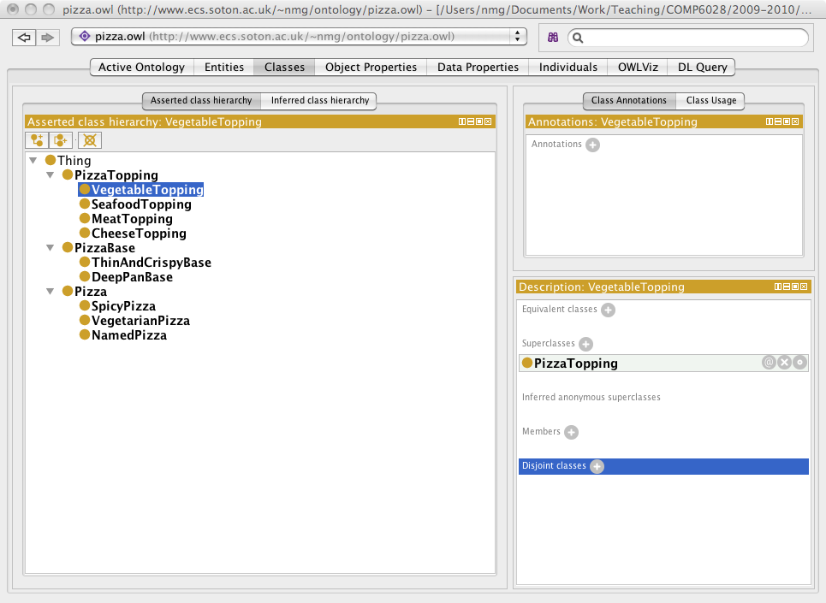

Slide 96
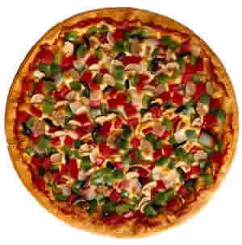
Example ontology: OWL Pizzas
Build an ontology for describing pizzas and their ingredients
Must be able to determine whether pizzas are vegetarian, spicy, etc

