Slide 1
Vocabularies and Applications
COMP6215 Semantic Web Technologies
Dr Nicholas Gibbins - nmg@ecs.soton.ac.uk
2017-2018

Slide 2
Overview
Social Networking
Bibliographic Metadata
Cultural Heritage
Knowledge Organisation
Provenance
Web Annotation
Public Sector Information
Geographic Information

Slide 3
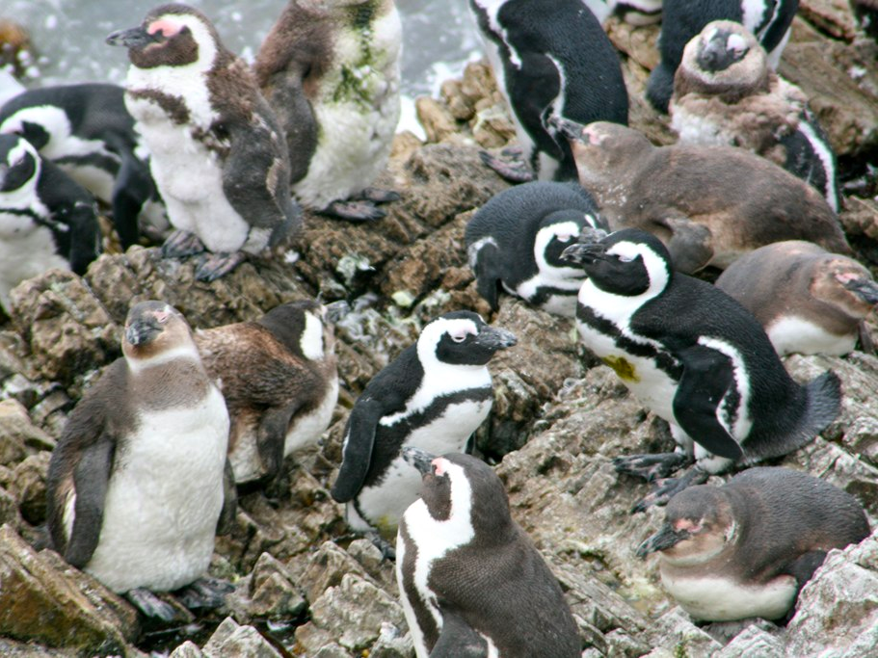


Social Networking
?
?
http://www.flickr.com/photos/bigblackbox/4269397346/

Slide 4

Friend of a Friend (FOAF)
Semantic Web realisation of “six degrees of separation”
Fully distributed system
  Each user writes an RDF file describing themselves and who they know (using the FOAF schema)
  Files are harvested and aggregated
  Data is presented in a variety of interfaces
Avoids siloing of existing social networking systems
Data from many providers
http://www.foaf-project.org/

Slide 5
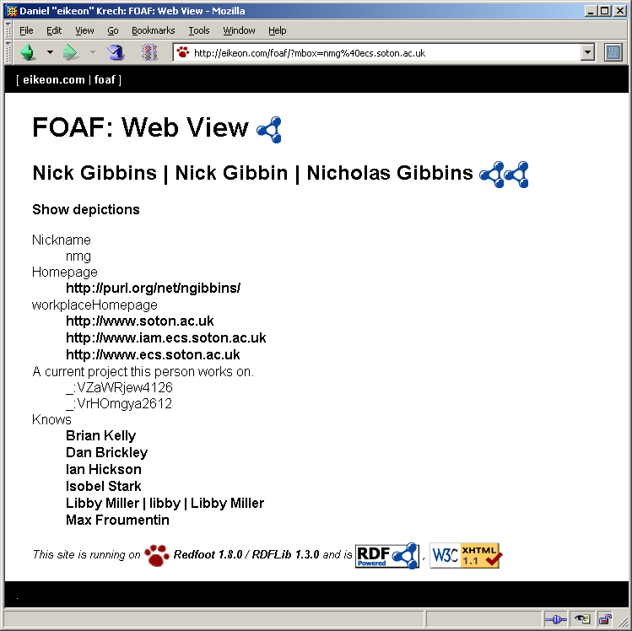
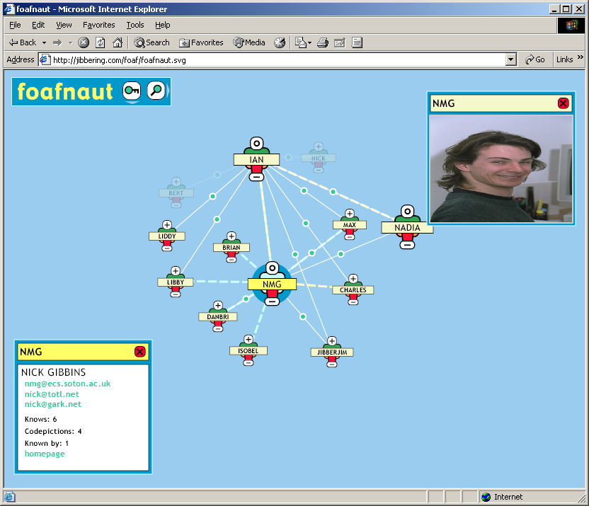
Multiple Interfaces

Slide 6
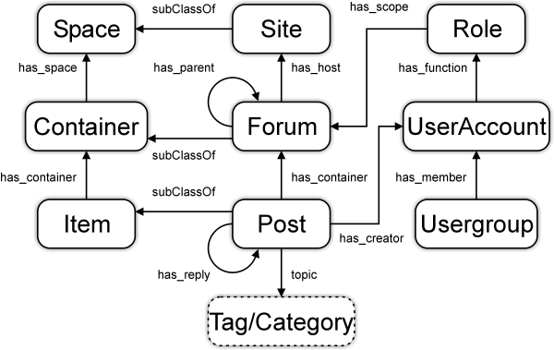

Semantically-Interlinked Online Communities
Ontology for describing wikis, bulletin boards, blogs, etc
Designed to interoperate with FOAF
http://rdfs.org/sioc/spec/
Notes:
SIOC – Semantically-Interlinked Online Communities

Slide 8

Bibliographic Metadata
http://www.flickr.com/photos/celesterc/1069893367/

Slide 9

Dublin Core
A standard set of 15 metadata elements for cross-domain information resource description
Formally endorsed by ISO, NISO and CEN
Representation language-neutral
  Plain XML serialisations in addition to RDF/XML
  Predates RDF
  (started in 1995)
Possibly the most widely used Semantic Web vocabulary
  Libraries (electronic and physical)
  Museums
  Web archives
    Open Directory Project
    UK Mirror Service
    MusicBrainz
  …
http://dublincore.org/

Slide 10
Dublin Core Element Set
Title
Creator
Subject
Description
Publisher
Contributor
Date
Type
Format
Identifier
Source
Language
Relation
Coverage
Rights

Slide 11

Bibliographic Ontology
More detailed bibliographic ontology
Describes types of publication
  Conference paper
  Journal article
  …
Builds on Dublin Core
http://bibliontology.com/

Slide 12
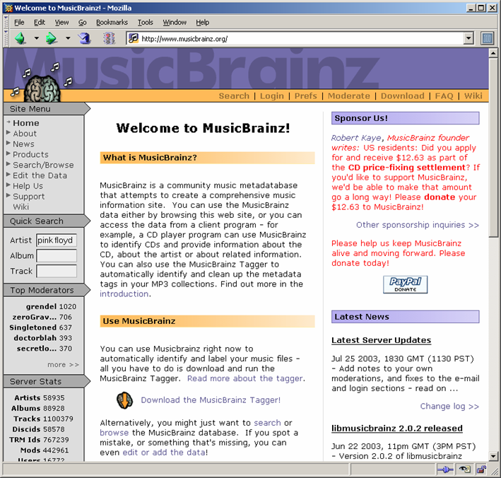
MusicBrainz
An open replacement for the Gracenote CD database
Community-maintained service
  Submissions and moderations
Vocabularies used:
  Dublin Core
  Custom ontology for metadata specifically relating to audio recordings
http://www.musicbrainz.org/

Slide 13
Publishing Standards for Industry Standard Metadata
Set of metadata vocabularies for automating publishing production processes and content exchange
Simplified profile of RDF/XML
  Lower hurdle to adoption
Commercial users include Time, Inc., Lexis-Nexis and McGraw-Hill
Vocabularies used:
  Dublin Core
  Custom ontologies for
    Controlled vocabularies
    Relational information
    Resource types
    Rights management
http://www.idealliance.org/

Slide 14

BBC Programmes
Simple ontology for describing programmes
  Brands
  Series (seasons)
  Episodes
  Broadcast events
  Broadcast services
Data describing all BBC programmes
http://purl.org/ontology/po/
http://www.flickr.com/photos/nicecupoftea/4104234460/
http://www.bbc.co.uk/programmes/developers

Slide 15

Cultural Heritage
http://www.flickr.com/photos/juanillooo/476627356/

Slide 16
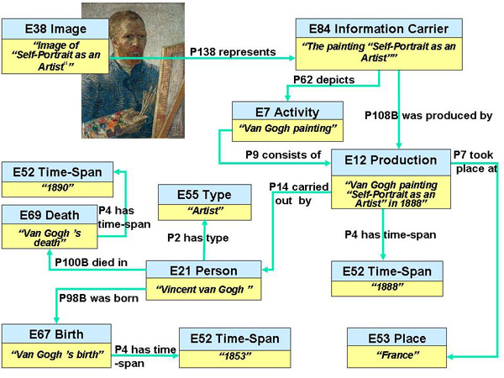
CIDOC CRM
Ontology for heterogeneous cultural heritage information
Represents more than just bibliographic information
Event-based model
(compare with Dublin Core’s attribute-based approach)
http://www.cidoc-crm.org/

Slide 17
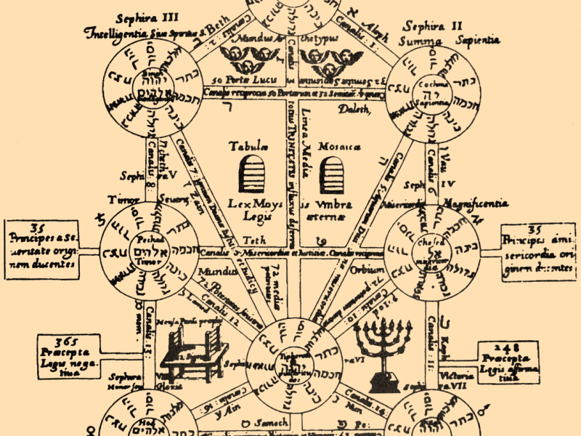
Knowledge Organisation

Slide 18
Simple Knowledge Organisation System
Standard vocabulary to support thesauri, classification schemes, subject heading lists, taxonomies, and other types of controlled vocabulary
Semantic relationships: broader, narrower, related terms
Labels, preferred labels, alternative labels
Notes, documentation, scope notes
Mappings between vocabularies
http://www.w3.org/TR/skos-reference/

Slide 19
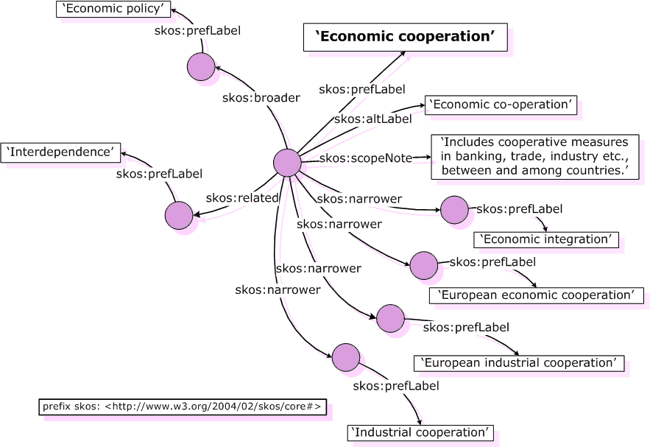
SKOS Example

Slide 20
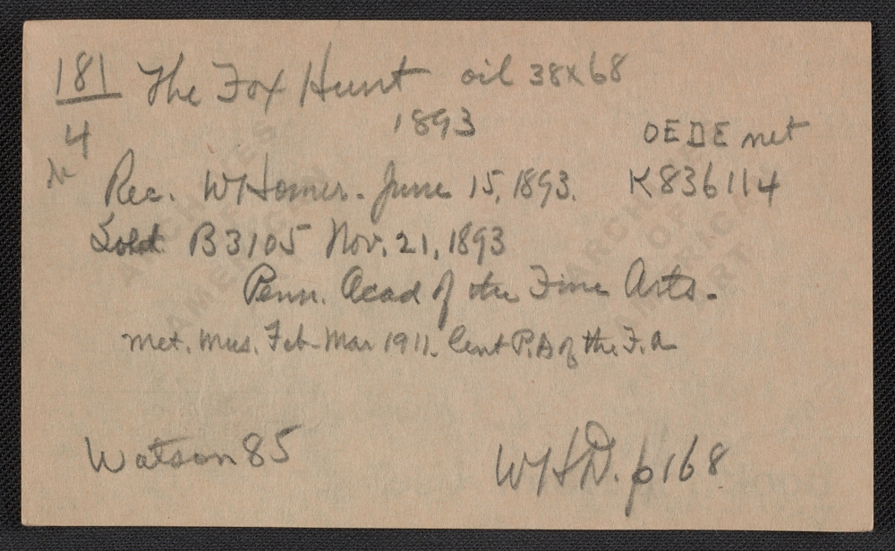
Provenance

Slide 21
Provenance
The provenance of a digital object represents its origin
Provenance facilitates:
  understanding how data was collected so it can be meaningfully used
  determining ownership and rights over an object
  making judgements about information to determine whether to trust it
  verifying that the process and steps used to obtain a result complies with given requirements
  reproducing how something was generated.

Slide 22
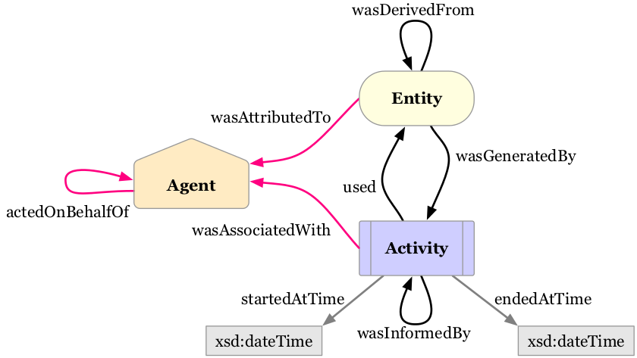
PROV-O
A specification and ontology for expressing provenance records
Records contain descriptions of the entities and activities involved in producing and delivering or otherwise influencing a given object
Became a W3C Recommendation in April 2013
http://www.w3.org/TR/prov-primer/

Slide 23
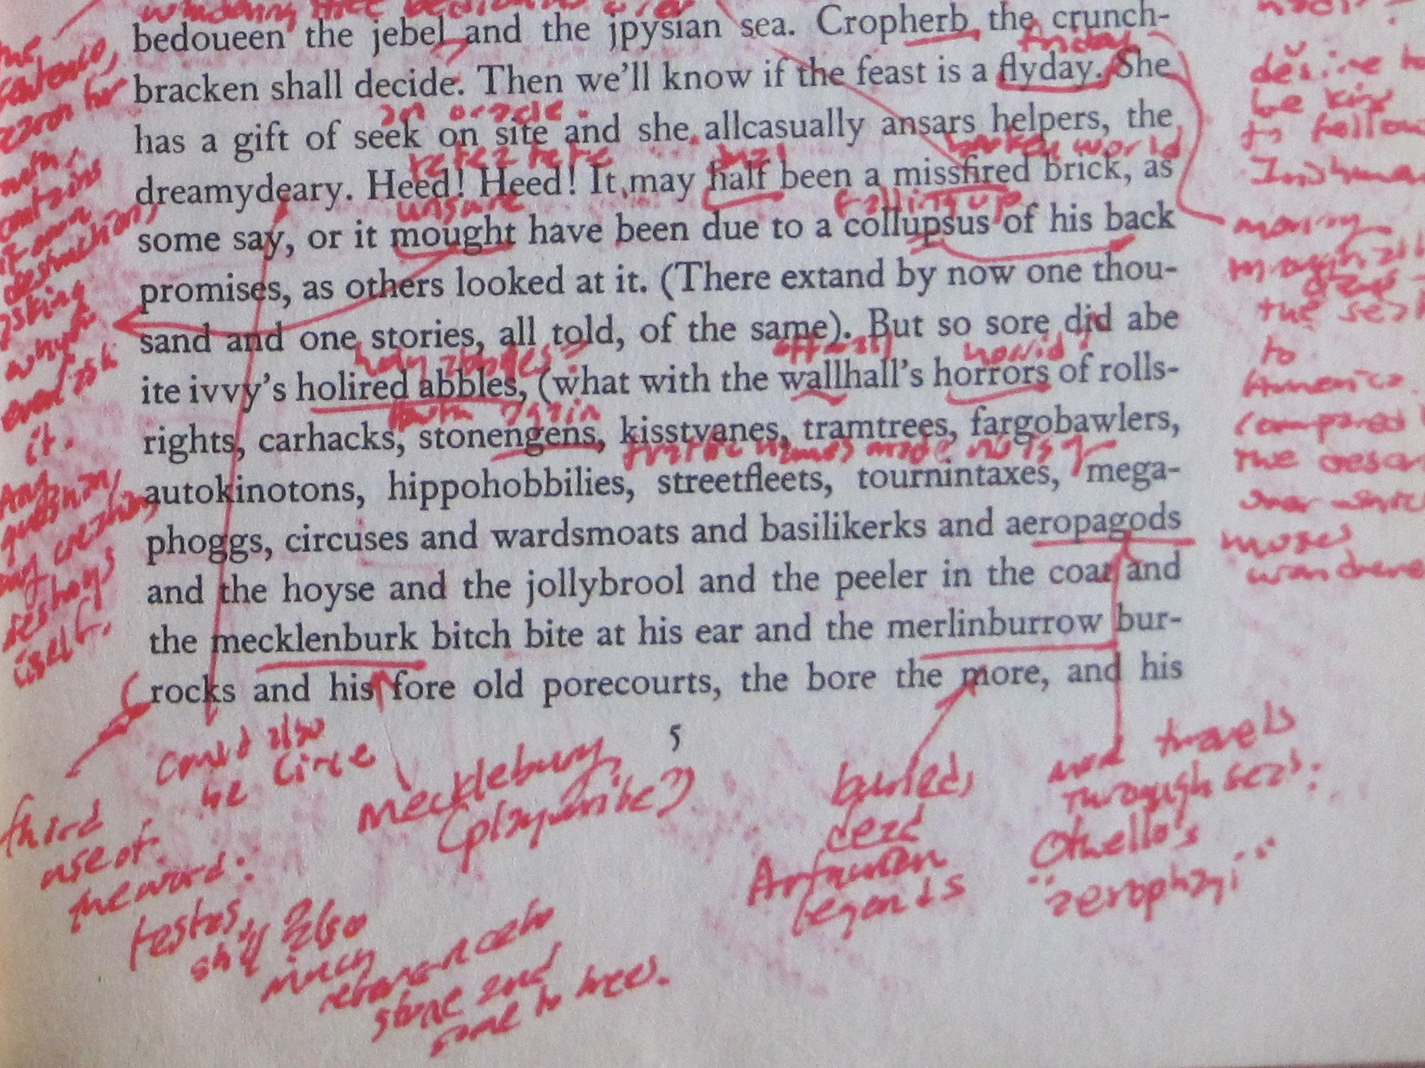
Web Annotation
http://www.flickr.com/photos/medievalkarl/4473939932/

Slide 24
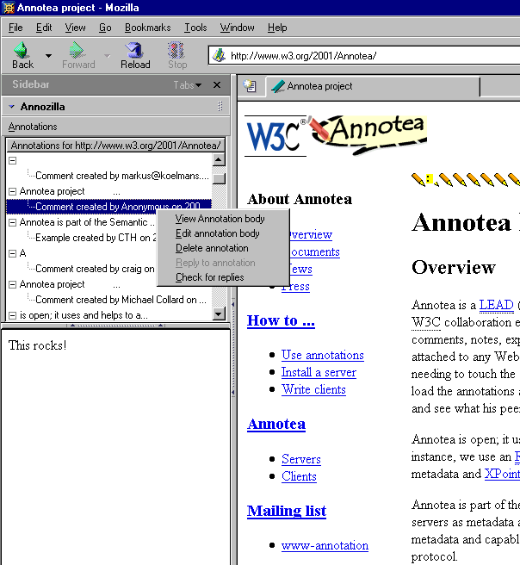
Annotea
Shared annotations for the Web
Vocabularies used:
  Dublin Core for bibliographic metadata about the annotation
  Custom schema for relating annotation to annotated document
  XPath and XPointer used to identify region of document to be annotated
http://www.w3.org/2001/Annotea/
Notes:
User wishes to annotate a document
Browsers create RDF that associates a region in the document with the annotation
RDF published to a server
(cf. link server)
Browsers can query server to obtain annotations for pages

Slide 25
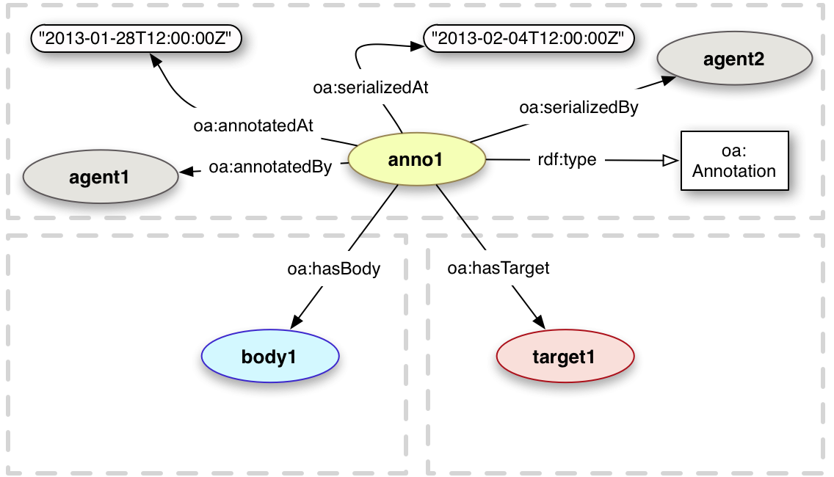
Open Annotation Data Model
W3C Proposed Recommendation (17 Jan 2017)
  Ongoing work on annotation within W3C (Web Annotation Working Group)
Vocabularies used:
  FOAF
  Dublin Core
  Provenance
  SKOS
http://www.openannotation.org/spec/core/

Slide 27

Commerce
https://www.flickr.com/photos/polycart/5786374464

Slide 28

Good Relations
Standardised vocabulary for product, price, and company data
Represents:
  Prices
  Accepted payment methods
  Opening times
  Delivery methods and charges
  Warranty promises and scope
Integrates with:
  UNSPSC vocabulary for offerings
  SIC codes for company type
http://purl.org/goodrelations/

Slide 29
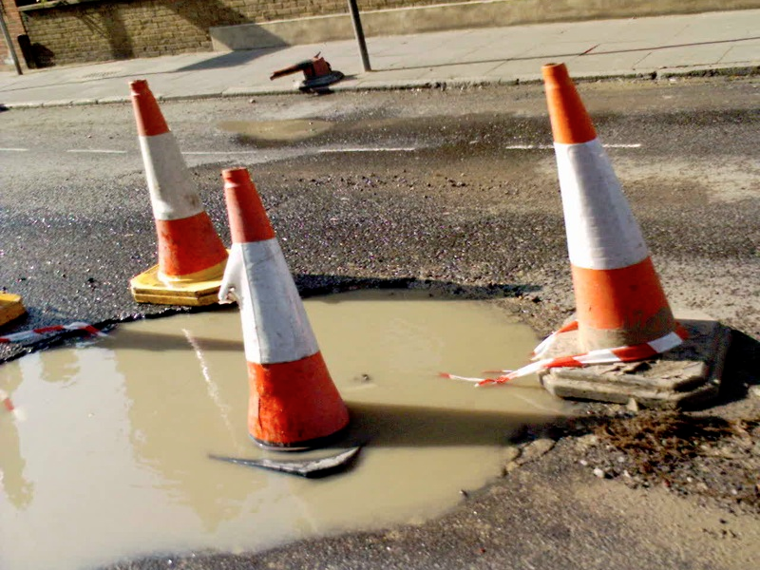
Public Sector Information
http://www.flickr.com/photos/emsef/1398072554/

Slide 30









AKTive PSI (2005)
Use advanced knowledge management technology to improve the delivery of policy and public services across Government
Build up a detailed picture of life in two London Boroughs, using as broad a collection of Public Sector Information as possible

Slide 31
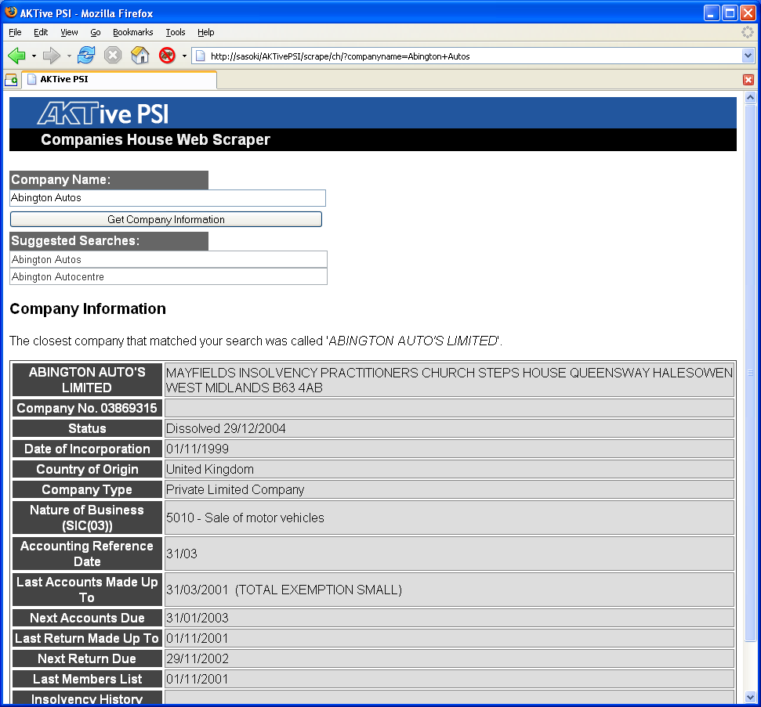
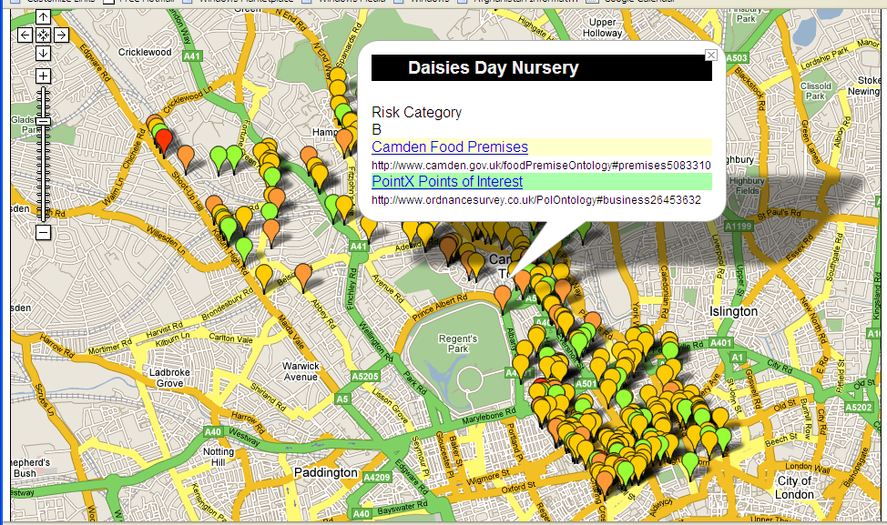
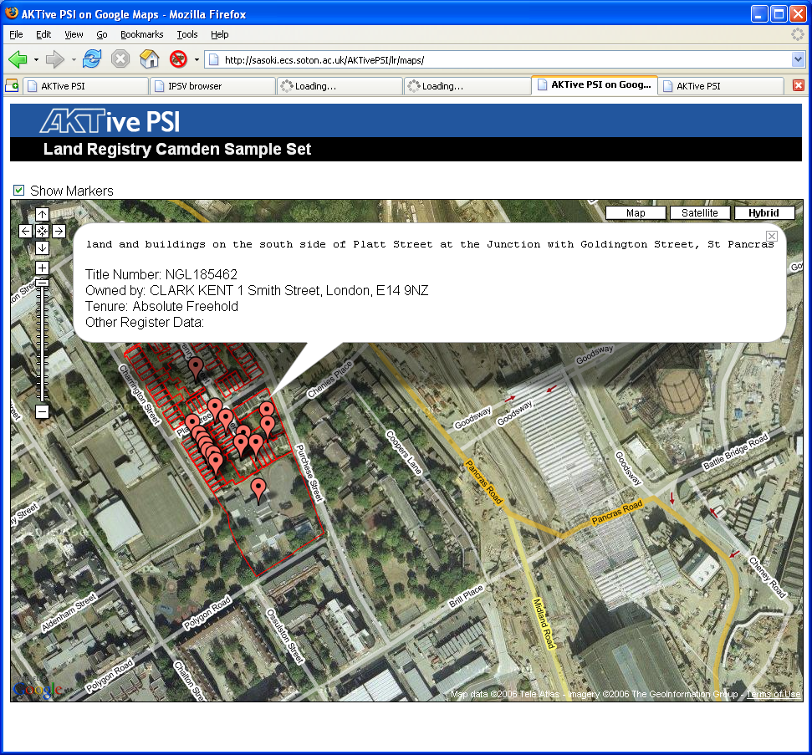
Visualisations and Mashups

Slide 32
Integrated Public Sector Vocabulary
Taxonomy for classifying public sector information resources
Developed with the backing of the ODPM and the Cabinet Office e-Government Unit
Available in a variety of formats, but RDF/XML is the definitive format
Uses Dublin Core and SKOS
http://www.esd.org.uk/standards/ipsv/

Slide 33
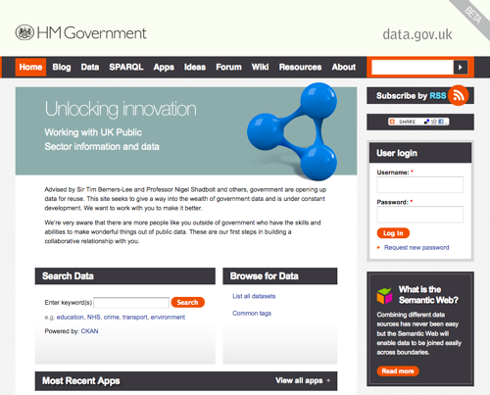
data.gov.uk (2010)
In 2009, Tim Berners-Lee and Nigel Shadbolt appointed as advisors to HMG on opening up public data
data.gov.uk website went public on 21 Jan 2010
  2890 datasets from central and local government
  Uses SW technologies to represent data

Slide 34
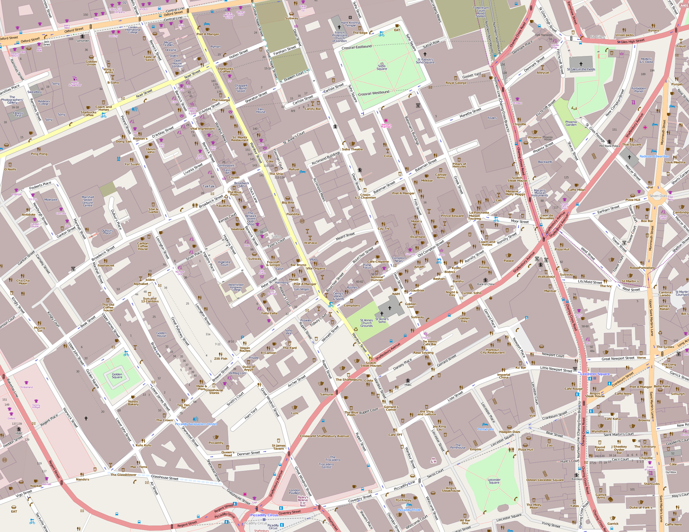
Geographic Information

Slide 35
Ordnance Survey Linked Data
Opened up datasets as part of UK public sector data initiative:
  1:50,000 Gazetteer
  250,000 place names
  Code-Point
  1,700,000 postcode units
  Boundary Line
  Electoral and administrative boundaries
Output formats:
  JSON
  RDF
SPARQL query
http://data.ordnancesurvey.co.uk/

Slide 36
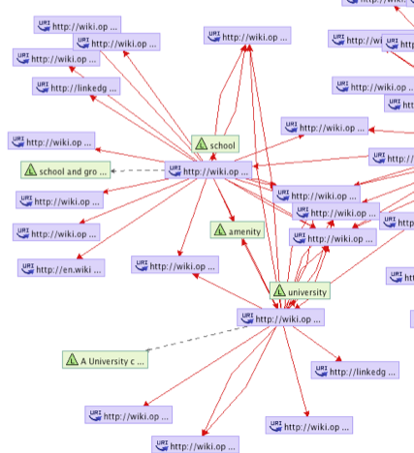
Open Streetmap Linked Data
OSM Semantic Network
  SKOS vocabulary built from map feature tags
LinkedGeoData.org
  Interlinks OSM data with other linked open data

