Slide 1
Open Data Visualisation
COMP 6214
Heather Packer
16/01/18

Slide 2
Data Visualisation
Ability to convey a story or an idea as efficiently as possible
Makes it easy to identify certain patterns or disruptions in data

Slide 3
Column Chart
A column chart is used to show a comparison among different items
Design Best Practices:
Use consistent colours throughout the chart,
Select accent colours to highlight meaningful data points or changes over time.
Use horizontal labels to improve readability.
Start the y-axis at 0 to appropriately reflect the values in your graph.

Slide 4
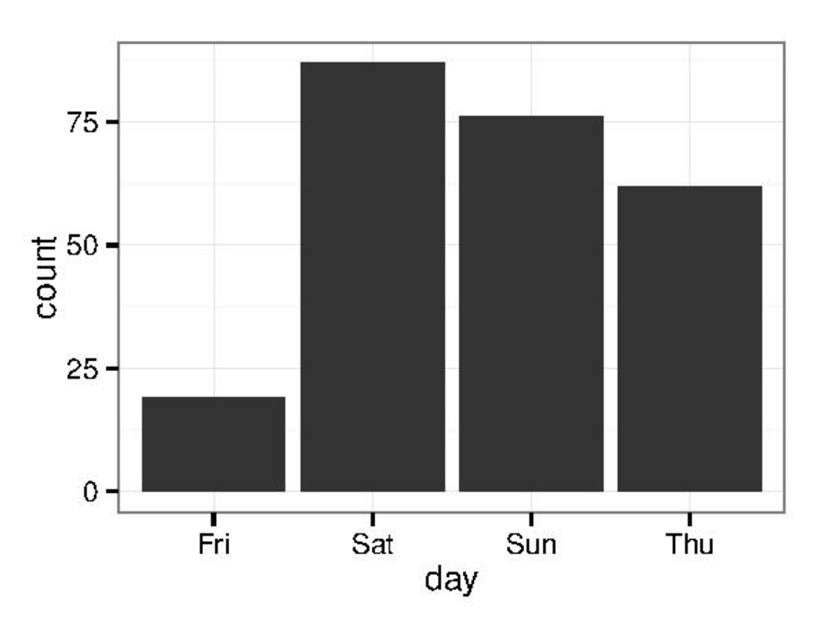
Column Chart

Slide 5
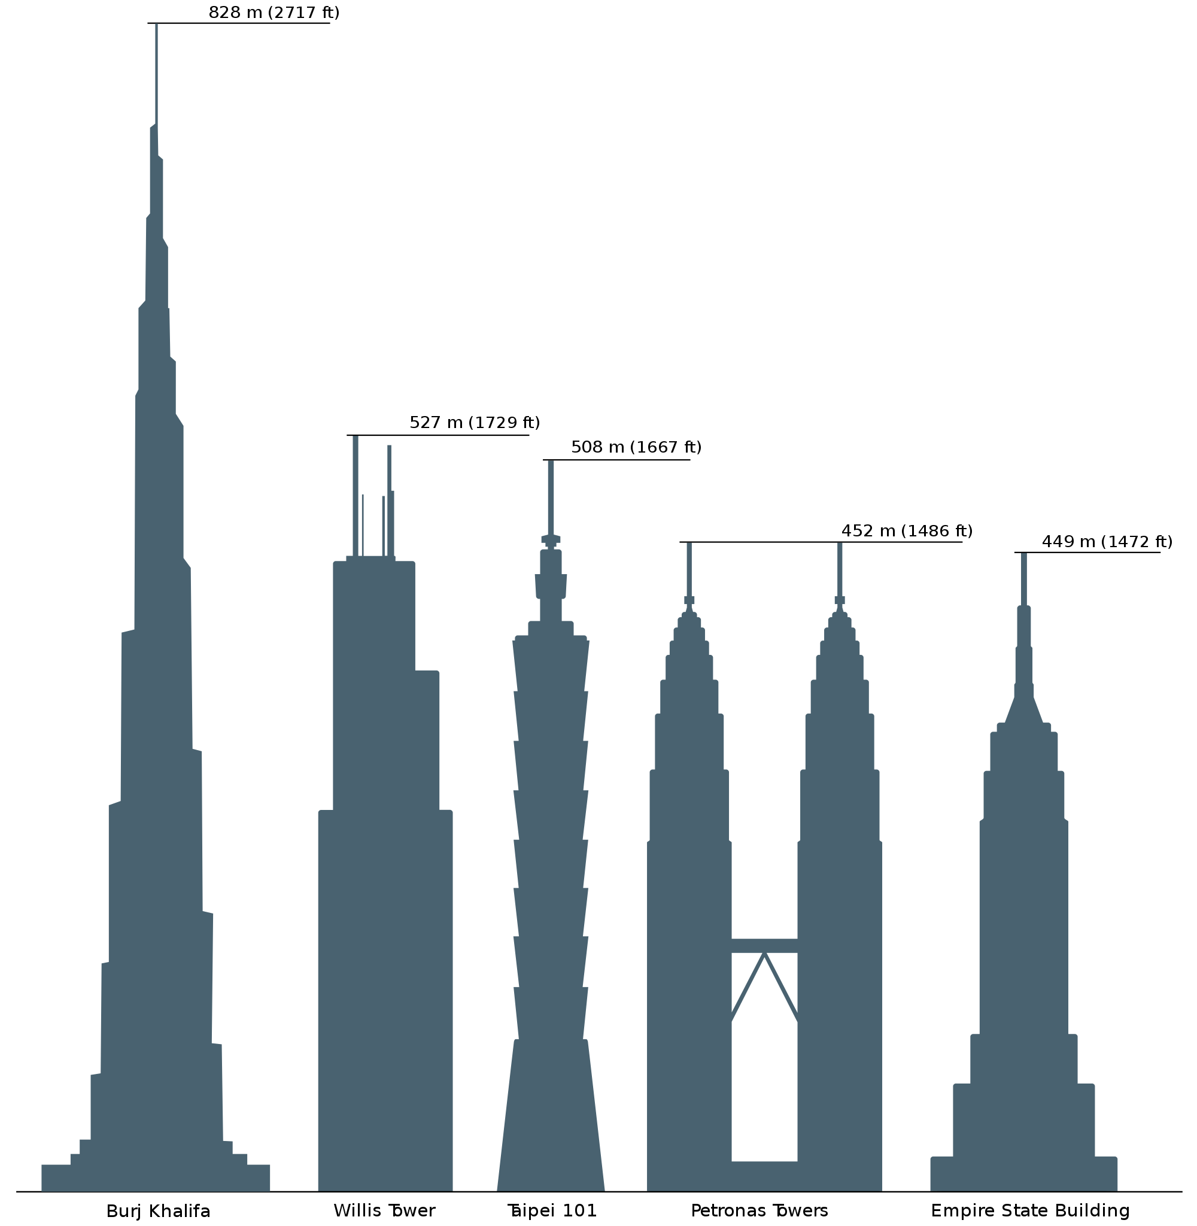
Column Chart

Slide 6
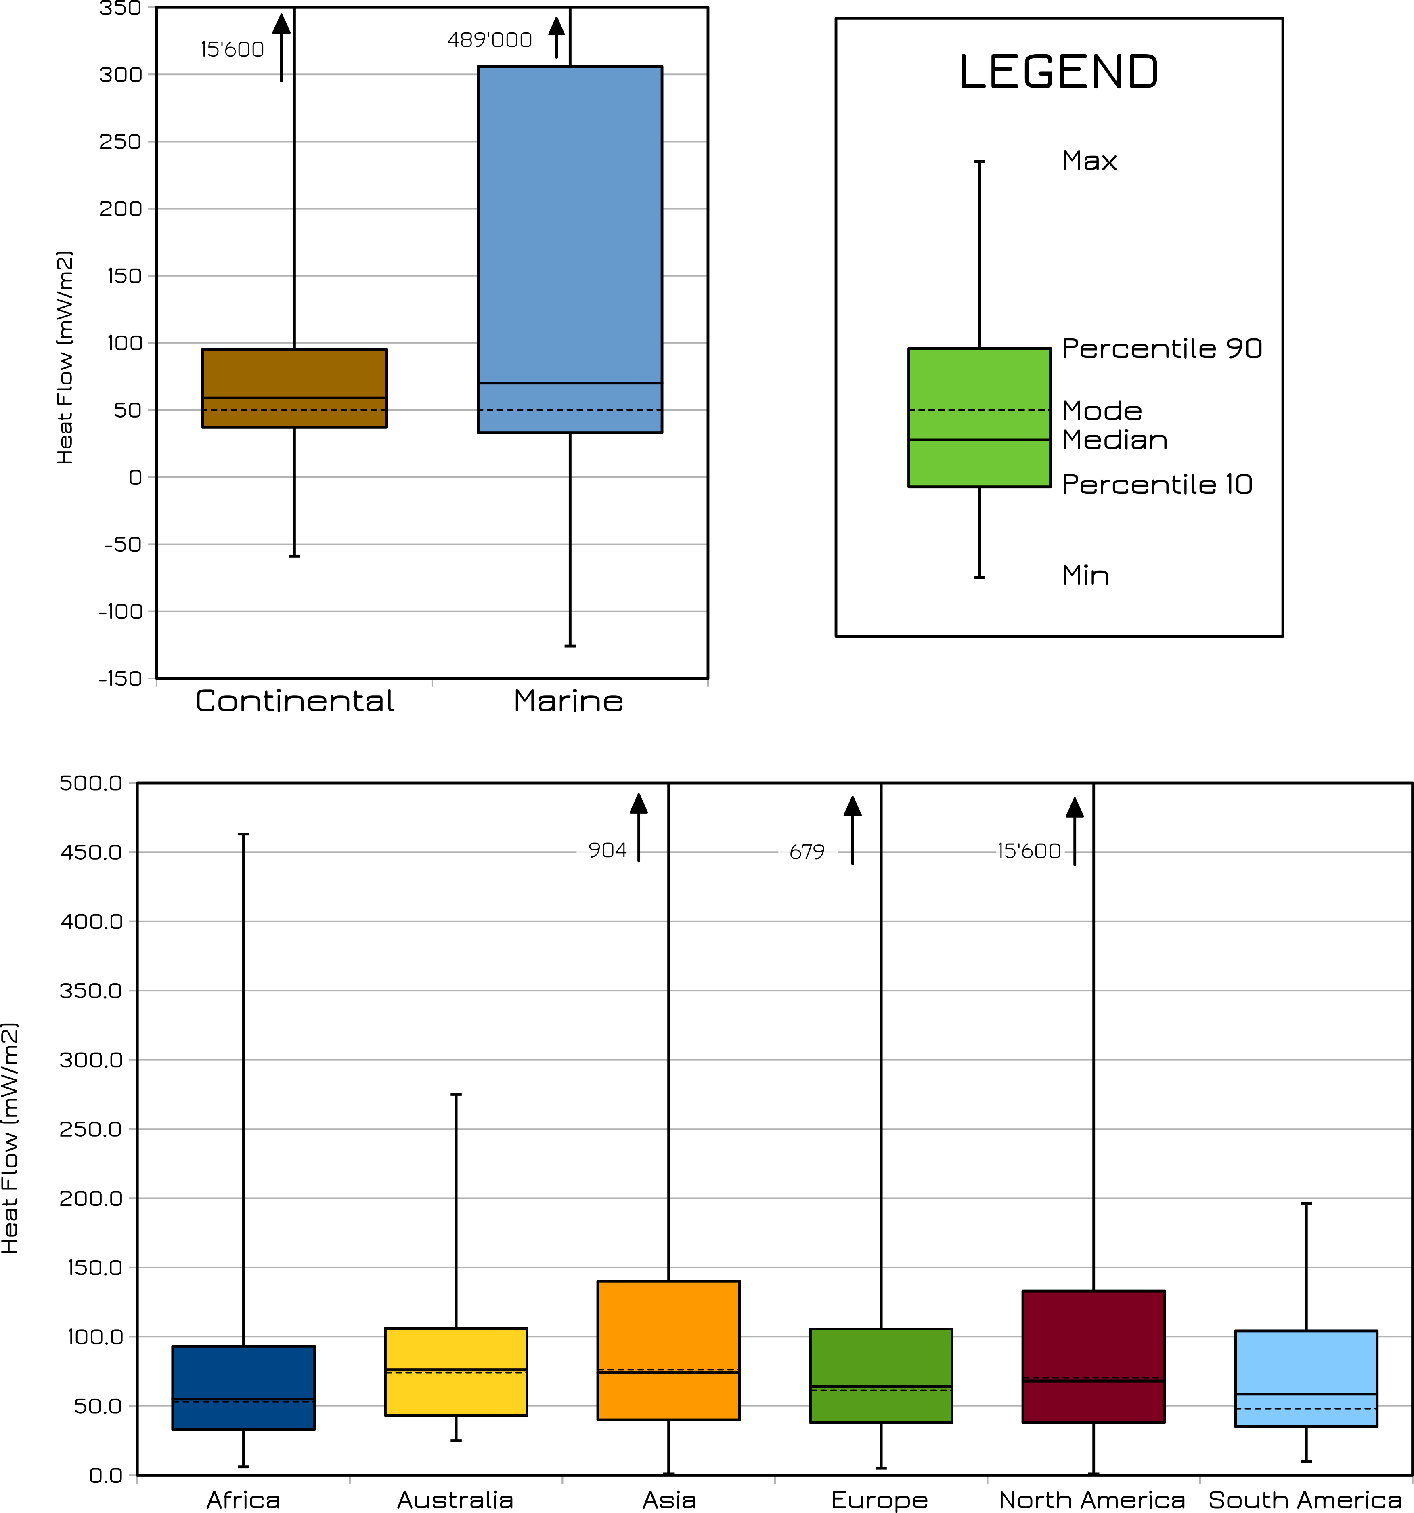
Box and Whisker Chart

Slide 7
Bar Chart
A bar chart, should be used to avoid clutter when one data label is long or if you have more than 10 items to compare.
Design Best Practices:
Use consistent colours throughout the chart
Select accent colours to highlight meaningful data points or changes over time.
Use horizontal labels to improve readability.
Start the y-axis at 0 to appropriately reflect the values in your graph.

Slide 8
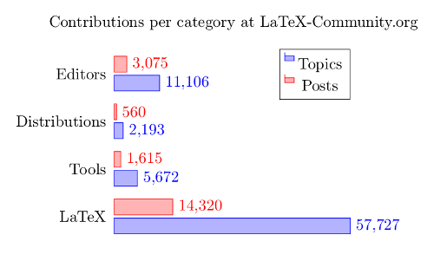
Bar Chart

Slide 9
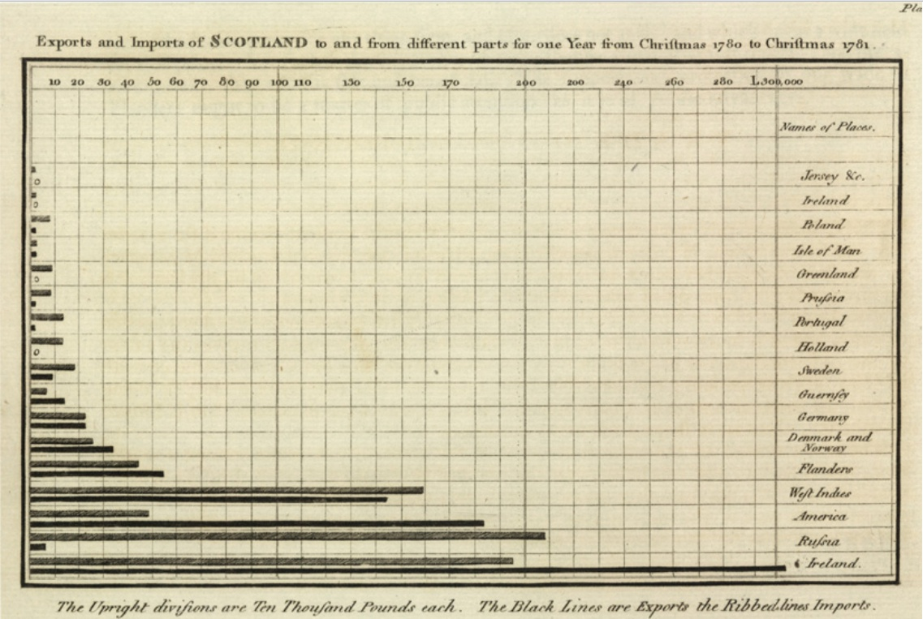
Bar Chart

Slide 10
Line Chart
A line chart reveals trends or progress over time.
Can show many different series of data.
You should use it when you chart a continuous dataset.
Design Best Practices:
Use solid lines only.
Don't plot more than four lines to avoid visual distractions.
Use the right height so the lines take up roughly 2/3 of the y-axis' height.

Slide 11
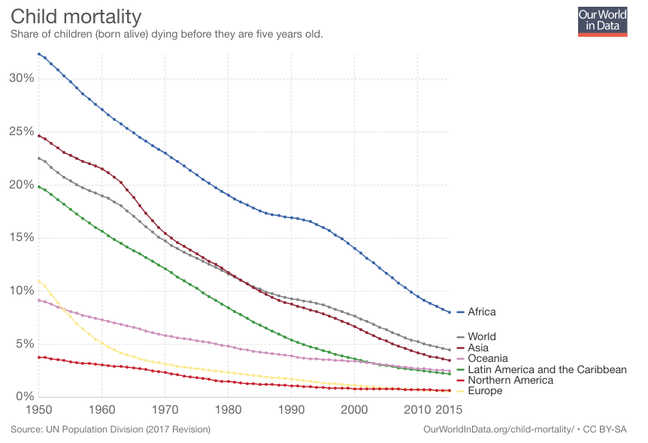
Line chart

Slide 12
Dual Axis Chart
A dual axis chart allows you to plot data using two y-axes and a shared x-axis.
Good for 2 or more datasets, grouped by the same category.
Show trends or lack of, between datasets.
Design Best Practices:
Use the y-axis on the left side for the primary variable because brains are naturally inclined to look left first.
Use different graphing styles to illustrate the two datasets.
Choose contrasting colours for the two datasets.

Slide 13
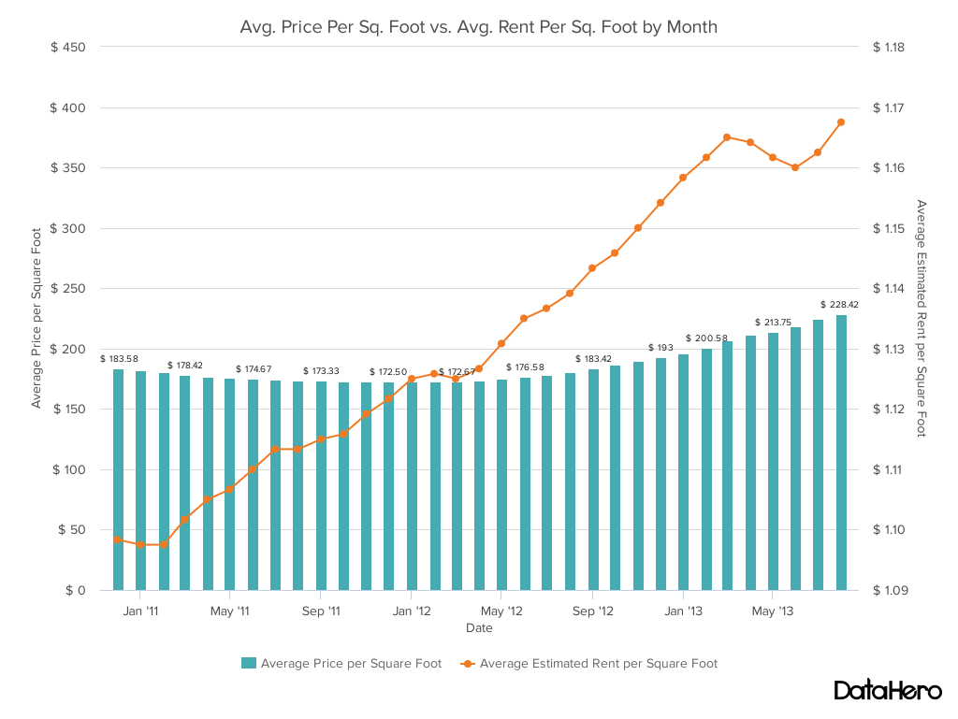
Dual Axis Chart

Slide 14
Area Chart
An area chart is a line chart with spaces between the x-axis and the line is filled with a color or pattern.
It helps you analyze both overall and individual trend information.
Design Best Practices:
Use transparent colours so information isn't obscured in the background.
Don't display more than four categories to avoid clutter.
Organise highly variable data at the top of the chart to make it easy to read.

Slide 15
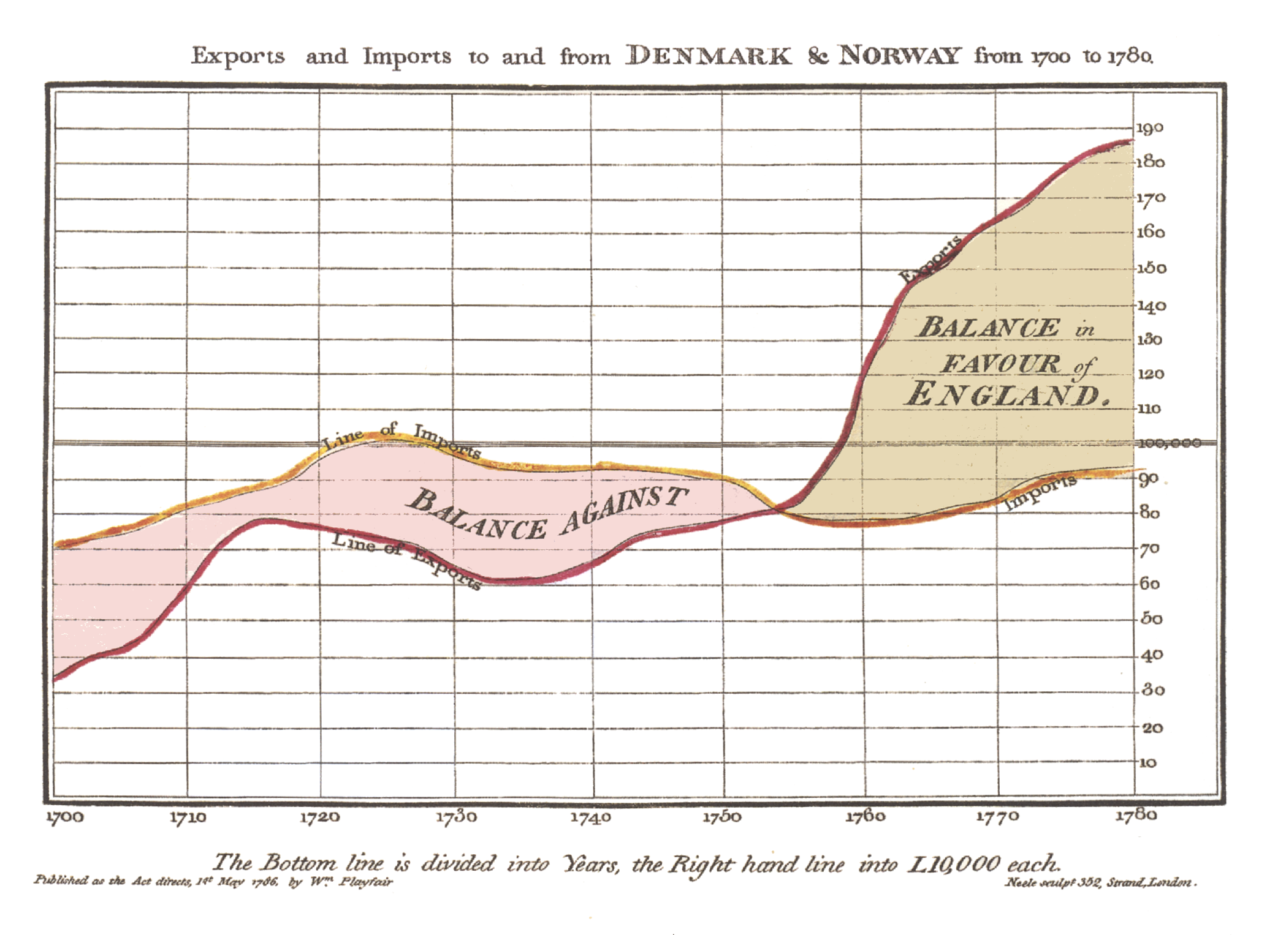
Area Chart

Slide 16
Stacked Bar
This should be used to compare many different items and show the composition of each item being compared.
Design Best Practices:
Best used to illustrate part-to-whole relationships.
Use contrasting coluors for greater clarity.
Make chart scale large enough to view group sizes in relation to one another.

Slide 17
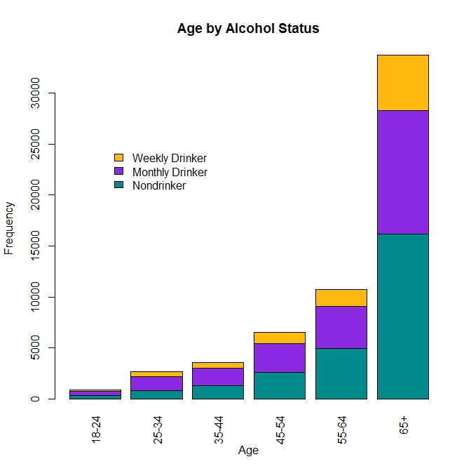
Stacked Bar

Slide 18
Pie Chart
A pie chart shows a static number and how categories represent part of a whole -- the composition of something.
A pie chart represents numbers in percentages, and the total sum of all segments needs to equal 100%.
Design Best Practices:
Don't illustrate too many categories to ensure differentiation between slices.
Ensure that the slice values add up to 100%.
Order slices according to their size.

Slide 19
Scatter Chart
Scatter charts show the relationship between two or more different variables
Use it when you want to highlight similarities in the dataset
Ease to identify outliers
Understand the distribution of your data.
Design Best Practices:
Include more variables, such as different sizes, to incorporate more data.
Start y-axis at 0 to represent data accurately.

Slide 20
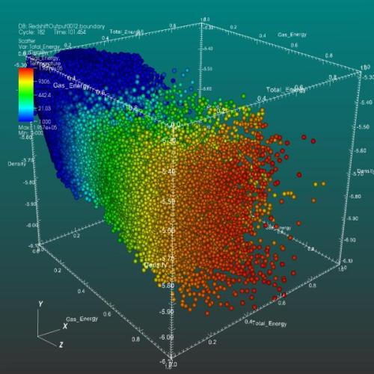
Scatter Chart

Slide 21
Bubble Chart
A bubble chart is similar to a scatter plot in that it can show distribution or relationship.
You can indicated by the size of an element with the size of the bubble.
Design Best Practices:
Scale bubbles according to area, not diameter.
Make sure labels are clear and visible.
Use circular shapes only.

Slide 22
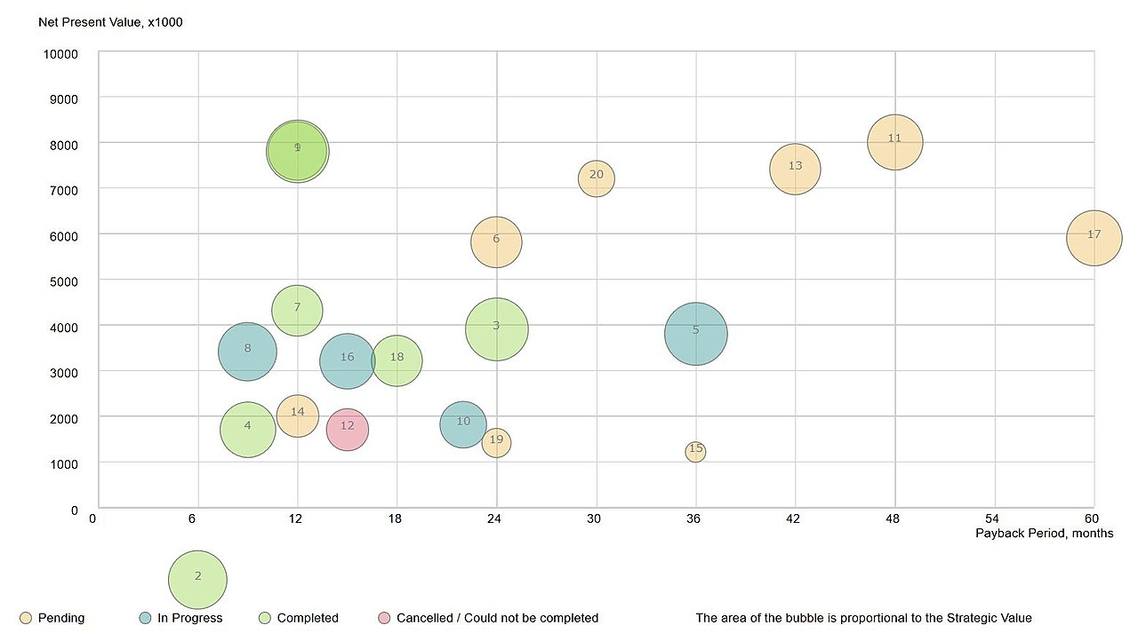
Bubble chart

Slide 23
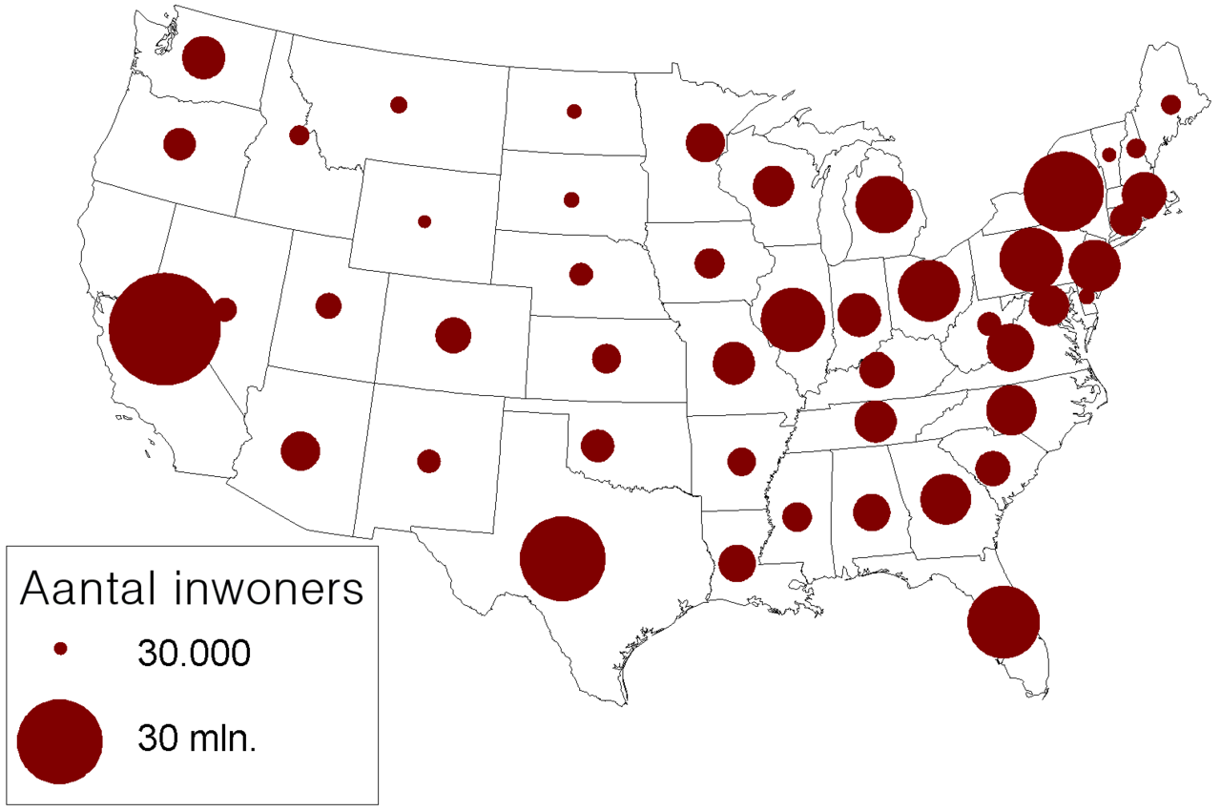
Bubble map
Notes:
aantal inwoners – population (dutch)

Slide 24
Bullet Chart
A bullet graph reveals progress toward a goal, compares this to another measure
Design Best Practices:
Use contrasting colors to highlight how the data is progressing.
Use one colour in different shades to gauge progress.

Slide 25
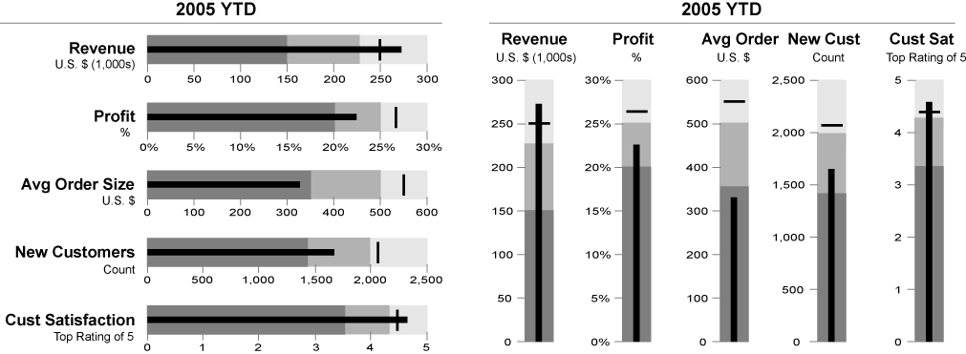
Bullet Chart

Slide 26
Spatial and maps
Information that is associated with geographical coordinates can be plotted spatially or on a map
Design Best Practices:
Use a basic and clear map outline to avoid distracting from the data
Use a appropriate colours to show trends
Center map around the data trends which are important to the audience

Slide 27
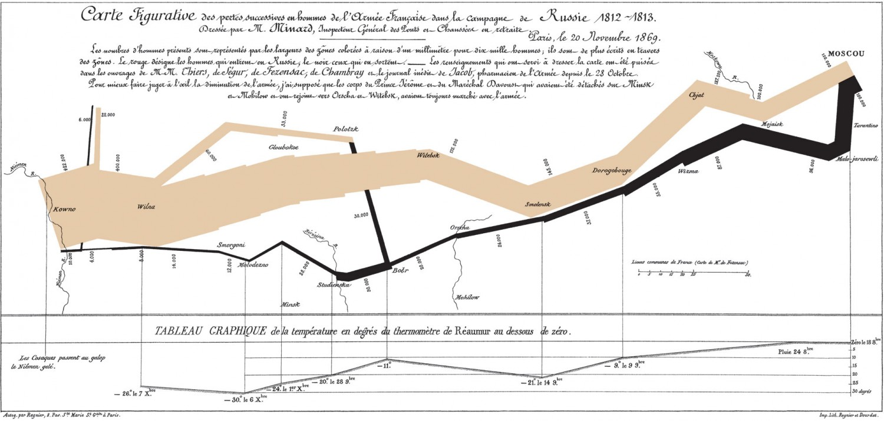
Spatial Map

Slide 28
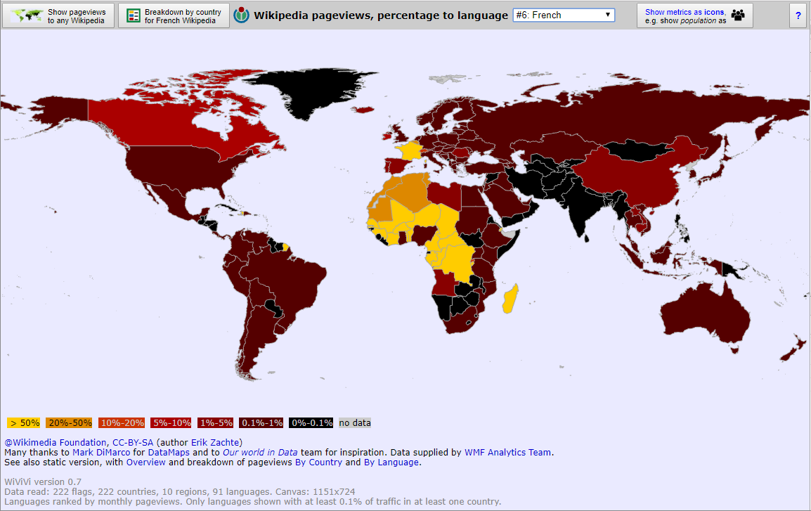
Map Chart

Slide 29
Heat Map
A heat map shows the relationship between two items and provides rating information, such as
high to low, or
poor to excellent.
Design Best Practices:
Use a basic and clear map outline to avoid distracting from the data.
Use a single colour in varying shades to show changes in data.
Avoid using multiple patterns.

Slide 30
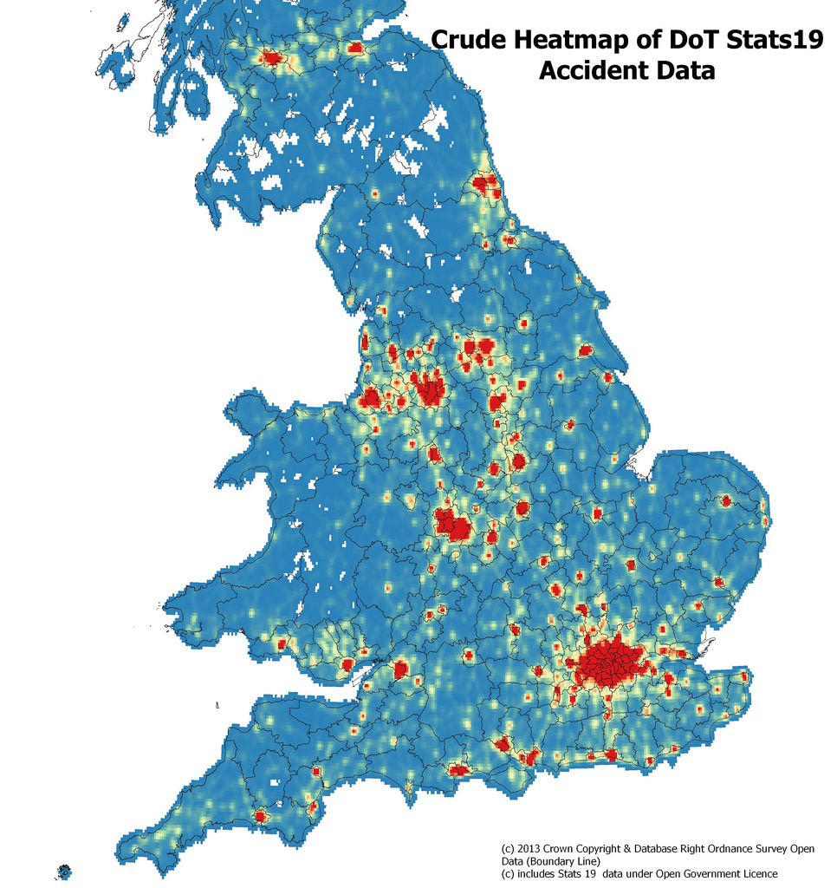
Heat Map

Slide 31
Choosing the right visualisation
Who is the audience?
What do they need to know?
What do they need to do with the data?

Slide 32
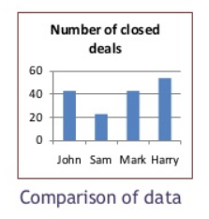
Do you want to compare values?
Charts are perfect for comparing one or many fields, and they can easily show the low and high values in the data sets.
To create a comparison chart, use these types of graphs:
Column
Bar
Line
Scatter Plot
Bullet

Slide 33
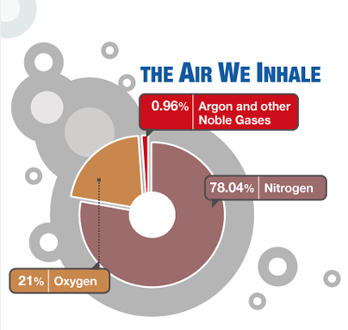
Do you want to show the composition of something?
This chart shows how individual parts make up the whole of something
Use these charts:
Stacked Bar
Stacked Column
Area
Pie Chart

Slide 34
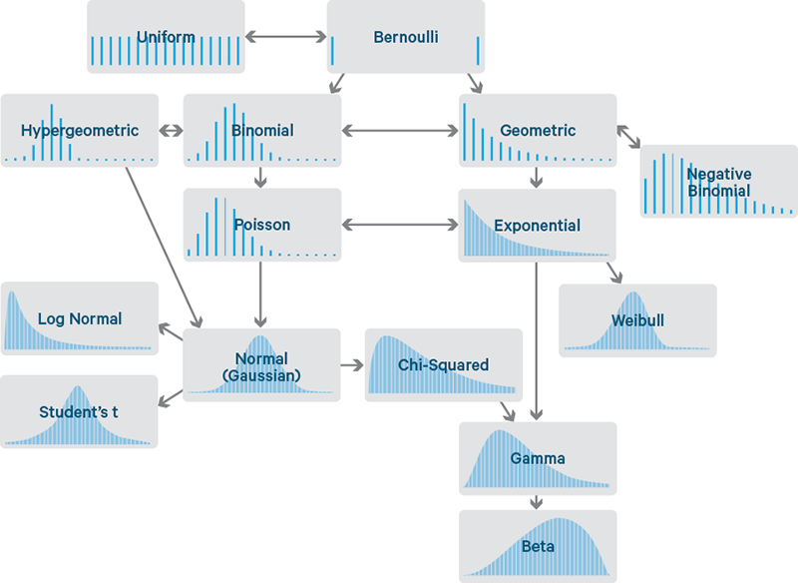
Do you want to understand the distribution of your data?
Distribution charts help you to understand outliers, the normal tendency, and the range of information in your values.
Use these charts to show distribution:
Scatter Plot
Line
Column
Bar

Slide 35
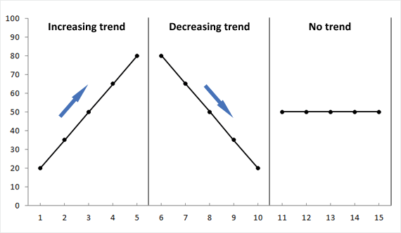
Are you interested in analyzing trends in your data set?
If you want to know more information about how a data set performed during a specific time period, there are specific chart types that do extremely well.
You should choose a:
Line Chart
Dual-Axis Line Chart
Column Chart

Slide 36
Do you want to better understand the relationship between values?
Showing how one variable relates to other variables.
Shows whether something positively effects, has no effect, or negatively effects another variable.
Use these charts:
Scatter Plot - Bubble Chart - Line Chart

Slide 37
What makes a good visualisation?
The data must mean something to the audience, help them:
Form a decision
Complete a task
It should show trends and relationships
If a user should focus on a certain part of the visualisation, then use shape, size, and colour to highlight it.
Notes:
https://www.youtube.com/watch?v=jbkSRLYSojo

Slide 38
What makes a good visualisation?
Limit Chart Clutter
It’s common to receive data with unnecessary information
It’s up to you to decide if certain information should be displayed visually
Limit Chart junk – keep it simple

Slide 39
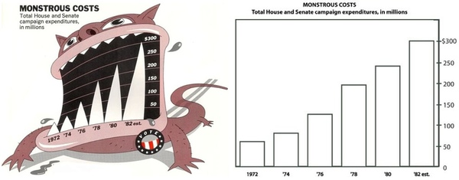
Chart Junk

Slide 40
Open Data Visualisation Examples

Slide 41
Carbon Culture
A community platform designed to help people use resources more efficiently
They work out how to help companies, charities and NGO can reduce their carbon footprints
Cabinet office
10 Downing Street
Tate Modern
They use open data to promote awareness

Slide 42
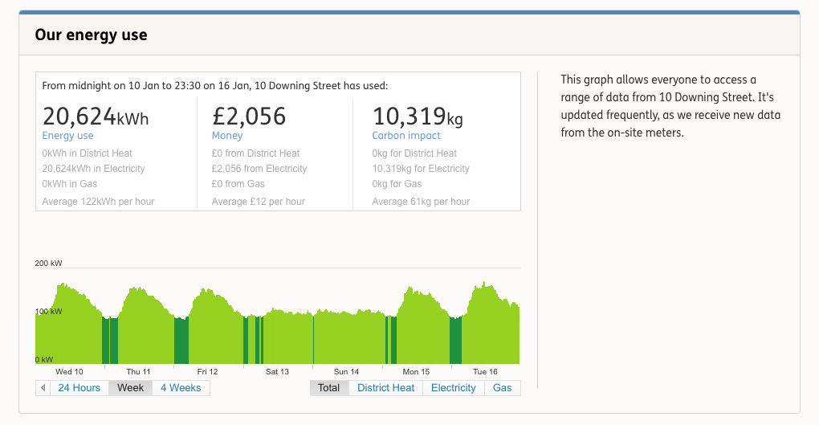
Carbon Culture - Visualisation
https://platform.carbonculture.net/places/10-downing-street/9/

Slide 43
The Guardian
https://www.theguardian.com/cities/2017/oct/04/hypnotic-beauty-public-transport-mapped
https://www.theguardian.com/global-development-professionals-network/2017/jan/03/using-data-visualisations-to-help-explain-the-global-obesity-explosion

Slide 44
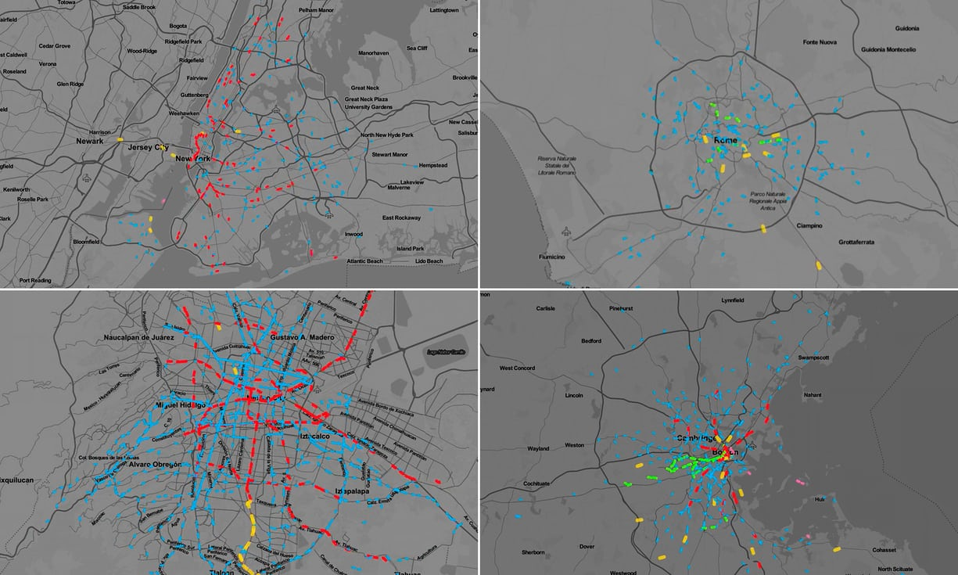

Slide 45
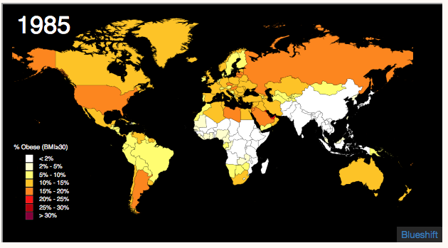
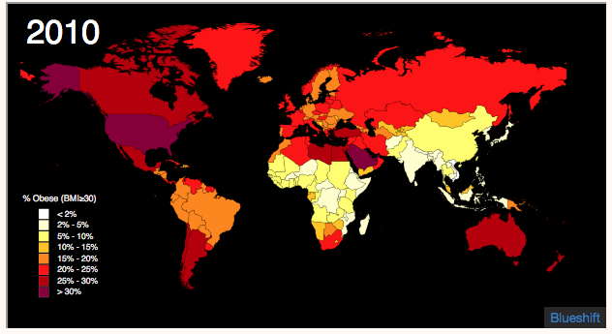

Slide 47
ARUP
UK based global engineering consultancy
Uses open data as a vital part of its work with smart cities
Uses public data about traffic, planning, and natural hazards

Slide 48
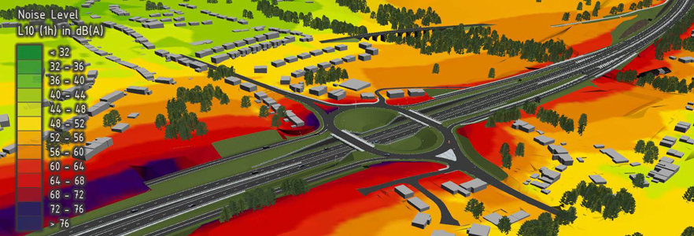
ARUP

Slide 49
Adzuma
A search engine that aggregates job adverts
Uses open data
Labour market statistics for itsJob index
https://www.adzuna.co.uk/jobs/salaries/software-developer#average_vs_vacancies

Slide 50
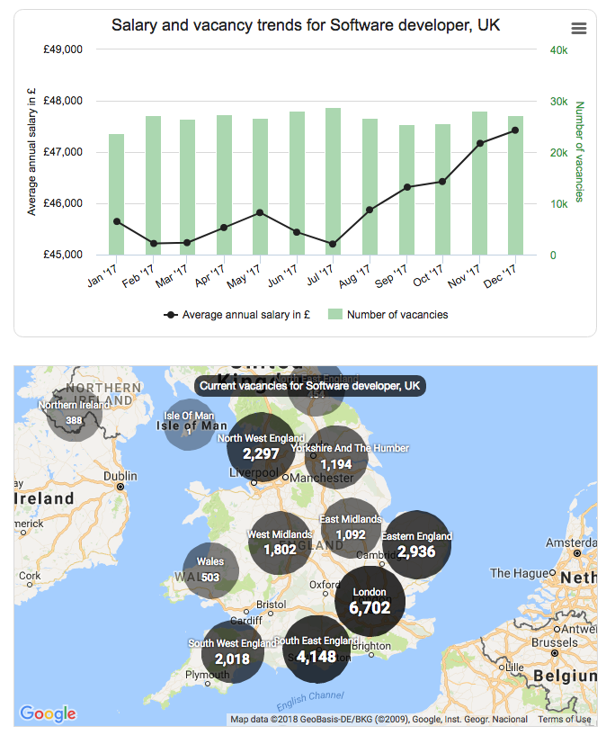
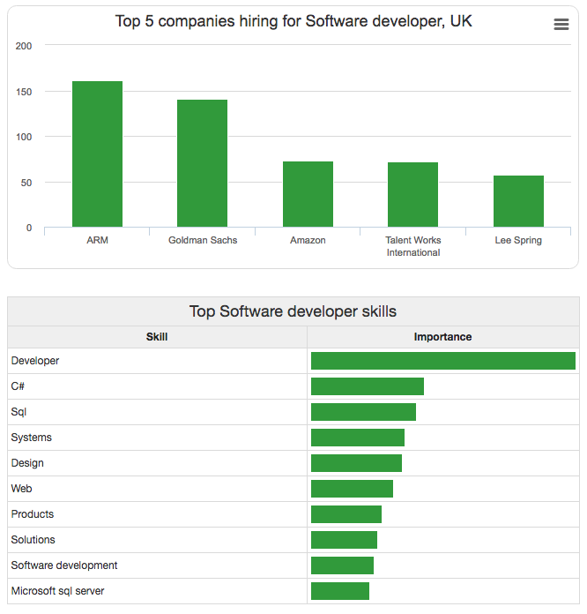
Adzuma

Slide 51
Doorda
Uses government datasets on a single map
Consultancy

Slide 52
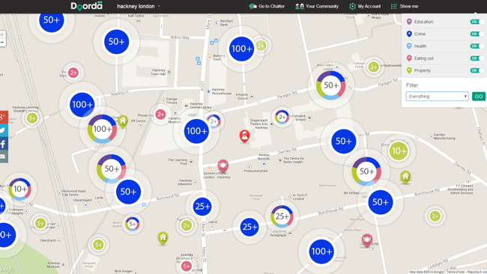
Doorda

