Slide 1
Pre-Analytics: Open Data Cleaning
COMP 6214
Heather Packer
16/01/18

Slide 2
Open Data Sets and Errors
Often errors aren’t noticed by data publishers
Data’s structure can change over the years
Datasets can be large, and publishers can have many datasets
Errors can be a result of human mistakes in data entry

Slide 3
Why is Pre-Analytics Important?
If data is not clean then any processing will still contain any issues
Any inconsistencies or errors can cause lack of trust
It easier to combine it with different datasets and gain deeper insights

Slide 4
Dirty Data
Dirty Data
Spelling or punctuation errors
Incorrect data associated with a field
Incomplete or outdated data
Duplicate data
Dirty Data is cleaned through Data Cleaning

Slide 5
Cleaning Data is Expensive
A recent study found that the process of preparing data for analysis can take anywhere between 60% and 80% of the time of a data-driven project.
To improve flawed data:
Find more data
Reason over existing data to infer clean values
Data Cleaning can vary depending on it’s use

Slide 6
Year | ONS_Code | Org_Code | Org_Name | Metric_Primary | Metric_Secondary | Value
15/16 | E92000001 | ENG | England | Gender | All persons | 9,929
15/16 | E92000001 | ENG | England | Gender | M | 2,573
15/16 | E92000001 | ENG | England | Gender | F | 7,356
15/16 | E92000001 | ENG | England | Gender | F | 7,356
2014/2015 | E92000001 | ENG | England | G | All pesons | 9,130
2014/2015 | E92000001 | ENG | England | G | Male | 2,496
2014/2015 | E92000001 | ENG | England | G | Female | 6,633
2015/16 | E92000001 | EN | England | AgeGroup | Under 16 | 3,415
2015/16 | E92000001 | EN | England | AgeGroup | 16-24 | 34.845
2015/16 | E92000001 | EN | England | AgeGroup | 25-34 | 90.480
2015/16 | E92000001 | EN | England | AgeGroup | 35-44 | 66.056
2015/16 | E92000001 | EN | England | AgeGroup | 45-54 | 84.143

Slide 7
Pre-Analytics
Data Profiling – process of examining the data
Data Cleaning – process of detecting and correcting
Data Validation – process of ensuring clean data
Data Enriching – process of adding additional data so that its fit for purpose

Slide 8
Data Profiling
Data Profiling – process of examining the data
Domain knowledge
Semantic Errors
Identify headers, attributes, properties of the data contained in your open data
Analyse what type of data you’d expect in these categories
Example: Year, ONS_Code, Org_Code, Org_Name, Metric_Primary, Metric_Secondary, Value
https://en.wikipedia.org/wiki/ONS_coding_system

Slide 9
Data Cleaning
Data Cleaning – process of detecting and correcting
Corrects errors
Interactively using a tool
Using scripts for batch/offline processing
Improve data quality
Validity
Accuracy
Completeness
Uniformity
Notes:
Validity – types, ranges, uniquiness, correct coding, cross-field validation
Accuracy – compare with a gold standard / different source
Completeness – all the fields are known
Consistency – different tables same dataset
Uniformity – eg data is recorded with the same units

Slide 10
Data Cleaning - Common Problems (1/3)
Wrong Formats
Dates can be written in inconsistent ways
Mixed data formats
8-sept-2018 vs 8/9/2018
8/9/2018 vs 9/8/2018
YYYY-MM-DD, dd MMM yyy HH:mm:ss.s TZD
Excel can incorrectly guess the format

Slide 11
Wrong Formats
Year | ONS_Code | Org_Code | Org_Name | Metric_Primary | Metric_Secondary | Value
15/16 | E92000001 | ENG | England | Gender | All persons | 9,929
15/16 | E92000001 | ENG | England | Gender | M | 2,573
15/16 | E92000001 | ENG | England | Gender | F | 7,356
15/16 | E92000001 | ENG | England | Gender | F | 7,356
2014/2015 | E92000001 | ENG | England | G | All pesons | 9,130
2014/2015 | E92000001 | ENG | England | G | Male | 2,496
2014/2015 | E92000001 | ENG | England | G | Female | 6,633
2015/16 | E92000001 | EN | England | AgeGroup | Under 16 | 3,415
2015/16 | E92000001 | EN | England | AgeGroup | 16-24 | 34.845
2015/16 | E92000001 | EN | England | AgeGroup | 25-34 | 90.480
2015/16 | E92000001 | EN | England | AgeGroup | 35-44 | 66.056
2015/16 | E92000001 | EN | England | AgeGroup | 45-54 | 84.143

Slide 12
Data Cleaning - Common Problems (2/3)
Multiple Representations
Inconsistent abbreviations
Differences in capitalisation, spacing and genders of adjectives can all cause errors
Duplicate Records
Can occur when datasets are combined
Mixed use of Numerical Scales
1,200,000 can be shortened as 1.2m
However smaller values 800,000 are written in full

Slide 13
Multiple Representations
Year | ONS_Code | Org_Code | Org_Name | Metric_Primary | Metric_Secondary | Value
15/16 | E92000001 | ENG | England | Gender | All persons | 9,929
15/16 | E92000001 | ENG | England | Gender | M | 2,573
15/16 | E92000001 | ENG | England | Gender | F | 7,356
15/16 | E92000001 | ENG | England | Gender | F | 7,356
2014/2015 | E92000001 | ENG | England | G | All pesons | 9,130
2014/2015 | E92000001 | ENG | England | G | Male | 2,496
2014/2015 | E92000001 | ENG | England | G | Female | 6,633
2015/16 | E92000001 | EN | England | AgeGroup | Under 16 | 3,415
2015/16 | E92000001 | EN | England | AgeGroup | 16-24 | 34.845
2015/16 | E92000001 | EN | England | AgeGroup | 25-34 | 90.480
2015/16 | E92000001 | EN | England | AgeGroup | 35-44 | 66.056
2015/16 | E92000001 | EN | England | AgeGroup | 45-54 | 84.143

Slide 14
Multiple Representations
Year | ONS_Code | Org_Code | Org_Name | Metric_Primary | Metric_Secondary | Value
15/16 | E92000001 | ENG | England | Gender | All persons | 9,929
15/16 | E92000001 | ENG | England | Gender | M | 2,573
15/16 | E92000001 | ENG | England | Gender | F | 7,356
15/16 | E92000001 | ENG | England | Gender | F | 7,356
2014/2015 | E92000001 | ENG | England | G | All pesons | 9,130
2014/2015 | E92000001 | ENG | England | G | Male | 2,496
2014/2015 | E92000001 | ENG | England | G | Female | 6,633
2015/16 | E92000001 | EN | England | AgeGroup | Under 16 | 3,415
2015/16 | E92000001 | EN | England | AgeGroup | 16-24 | 34.845
2015/16 | E92000001 | EN | England | AgeGroup | 25-34 | 90.480
2015/16 | E92000001 | EN | England | AgeGroup | 35-44 | 66.056
2015/16 | E92000001 | EN | England | AgeGroup | 45-54 | 84.143

Slide 15
Duplication Records
Year | ONS_Code | Org_Code | Org_Name | Metric_Primary | Metric_Secondary | Value
15/16 | E92000001 | ENG | England | Gender | All persons | 9,929
15/16 | E92000001 | ENG | England | Gender | M | 2,573
15/16 | E92000001 | ENG | England | Gender | F | 7,356
15/16 | E92000001 | ENG | England | Gender | F | 7,356
2014/2015 | E92000001 | ENG | England | G | All pesons | 9,130
2014/2015 | E92000001 | ENG | England | G | Male | 2,496
2014/2015 | E92000001 | ENG | England | G | Female | 6,633
2015/16 | E92000001 | EN | England | AgeGroup | Under 16 | 3,415
2015/16 | E92000001 | EN | England | AgeGroup | 16-24 | 34.845
2015/16 | E92000001 | EN | England | AgeGroup | 25-34 | 90.480
2015/16 | E92000001 | EN | England | AgeGroup | 35-44 | 66.056
2015/16 | E92000001 | EN | England | AgeGroup | 45-54 | 84.143

Slide 16
Mixed use of Numerical Scales
Year | ONS_Code | Org_Code | Org_Name | Metric_Primary | Metric_Secondary | Value
15/16 | E92000001 | ENG | England | Gender | All persons | 9,929
15/16 | E92000001 | ENG | England | Gender | M | 2,573
15/16 | E92000001 | ENG | England | Gender | F | 7,356
15/16 | E92000001 | ENG | England | Gender | F | 7,356
2014/2015 | E92000001 | ENG | England | G | All pesons | 9,130
2014/2015 | E92000001 | ENG | England | G | Male | 2,496
2014/2015 | E92000001 | ENG | England | G | Female | 6,633
2015/16 | E92000001 | EN | England | AgeGroup | Under 16 | 3,415
2015/16 | E92000001 | EN | England | AgeGroup | 16-24 | 34.845
2015/16 | E92000001 | EN | England | AgeGroup | 25-34 | 90.480
2015/16 | E92000001 | EN | England | AgeGroup | 35-44 | 66.056
2015/16 | E92000001 | EN | England | AgeGroup | 45-54 | 84.143

Slide 17
Data Cleaning - Common Problems (3/3)
Redundant Data/Summation Records
Rows that represent total amounts
Combined data in a column introduced to assist human readability
Mixed Ranges
Ie. numeric Age and salary
Spelling Errors

Slide 18
Redundant Data/Summation Records
Year | ONS_Code | Org_Code | Org_Name | Metric_Primary | Metric_Secondary | Value
15/16 | E92000001 | ENG | England | Gender | All persons | 9,929
15/16 | E92000001 | ENG | England | Gender | M | 2,573
15/16 | E92000001 | ENG | England | Gender | F | 7,356
15/16 | E92000001 | ENG | England | Gender | F | 7,356
2014/2015 | E92000001 | ENG | England | G | All pesons | 9,130
2014/2015 | E92000001 | ENG | England | G | Male | 2,496
2014/2015 | E92000001 | ENG | England | G | Female | 6,633
2015/16 | E92000001 | EN | England | AgeGroup | Under 16 | 3,415
2015/16 | E92000001 | EN | England | AgeGroup | 16-24 | 34.845
2015/16 | E92000001 | EN | England | AgeGroup | 25-34 | 90.480
2015/16 | E92000001 | EN | England | AgeGroup | 35-44 | 66.056
2015/16 | E92000001 | EN | England | AgeGroup | 45-54 | 84.143

Slide 19
Mixed Ranges
Year | ONS_Code | Org_Code | Org_Name | Metric_Primary | Metric_Secondary | Value
15/16 | E92000001 | ENG | England | Gender | All persons | 9929
15/16 | E92000001 | ENG | England | Gender | M | 2573
15/16 | E92000001 | ENG | England | Gender | F | 7356
15/16 | E92000001 | ENG | England | Gender | F | 7356
2014/2015 | E92000001 | ENG | England | G | All pesons | 9130
2014/2015 | E92000001 | ENG | England | G | Male | 2496
2014/2015 | E92000001 | ENG | England | G | Female | 6633
2015/16 | E92000001 | EN | England | AgeGroup | Under 16 | 3415
2015/16 | E92000001 | EN | England | AgeGroup | 16-24 | 34845
2015/16 | E92000001 | EN | England | AgeGroup | 25-34 | 90480
2015/16 | E92000001 | EN | England | AgeGroup | 35-44 | 66056
2015/16 | E92000001 | EN | England | AgeGroup | 45-54 | 84143

Slide 20
Spelling Errors
Year | ONS_Code | Org_Code | Org_Name | Metric_Primary | Metric_Secondary | Value
15/16 | E92000001 | ENG | England | Gender | All persons | 9929
15/16 | E92000001 | ENG | England | Gender | M | 2573
15/16 | E92000001 | ENG | England | Gender | F | 7356
15/16 | E92000001 | ENG | England | Gender | F | 7356
2014/2015 | E92000001 | ENG | England | G | All pesons | 9130
2014/2015 | E92000001 | ENG | England | G | Male | 2496
2014/2015 | E92000001 | ENG | England | G | Female | 6633
2015/16 | E92000001 | EN | England | AgeGroup | Under 16 | 3415
2015/16 | E92000001 | EN | England | AgeGroup | 16-24 | 34845
2015/16 | E92000001 | EN | England | AgeGroup | 25-34 | 90480
2015/16 | E92000001 | EN | England | AgeGroup | 35-44 | 66056
2015/16 | E92000001 | EN | England | AgeGroup | 45-54 | 84143

Slide 21
Other issues
Semantic errors
Out of range errors
Missing values eg N/A, none, nil, -, 99, 999, -1

Slide 22
Data Enrichment
Restructure data for analysis
Add additional datasets
Record linkage
Indexical datasets
Notes:
Record linkage can be very hard when two datasets don’t use the same primary keys. Have to do matching on fields somehow

Slide 23
Good Citizen
Reporting any errors found to publisher
Discussing any errors and corrections made on the data

Slide 24
Newer vs Older Open Data
Newer datasets | Older datasets
Unexploited data (improves USP) | Data already exploited
More errors | Fewer errors
Higher processing time required | Less processing time required
Less trusted | Kudos from established dataset

Slide 25
Tools

Slide 26
Data Validation
Open data in different formats
Linter or lint
A tool that analyses source code
Identifies errors, bugs, style errors

Slide 27
Data Validation
Tabular Data
CSVLint
Hierarchical Data
JSONLint

Slide 28
CSV Validation
CSV is a very simple format
First used in 1972 by Fortran
2005 as a MIME Content Type
2015 formal semantics defined
Easy to create files hard to use
Not all CSV files follow 2015
http://csvlint.io/

Slide 29
CSVLint.io
Encoding:
Odd characters, line breaks, stray/unclosed quotes, whitespace, use of UTF-8
Structure:
Blank rows, ragged rows
Empty or duplicate column names

Slide 30
CSVLint.io
Values:
Inconsistent types of values in a column
Schema using JSON Table Schema
Description of columns inc primary and foreign keys
Types for columns
Constraints – required, unique, length, min/max, pattern, enum
Missing values

Slide 31
JSON
https://jsonlint.com
Checks JSON document parses according to JSON specification
Strict interpretation of specification to improve interoperability
http://json-schema.org
Schema that describes a JSON document
Allows you to validate a JSON document against a schema

Slide 32
Tools to clean data
OpenRefine
Excel or similar spreadsheets
Bespoke Scripts
It’s important to keep a note of your changes for yourself and others

Slide 33
Open Refine
Google Open Refine processes dataset
Interactive Data Transformation (IDT) Tool
Open Refine runs locally on your machine
Data to remain private
Runs in a browser window on the refine home screen

Slide 34
Open Refine
An extremely powerful tool for data profiling & manipulation
It supports:
TSV, CSV, *SV, Excel (.xls and .xlsx)
JSON
XML
RDF as XML, Wiki markup
Google Data documents

Slide 35
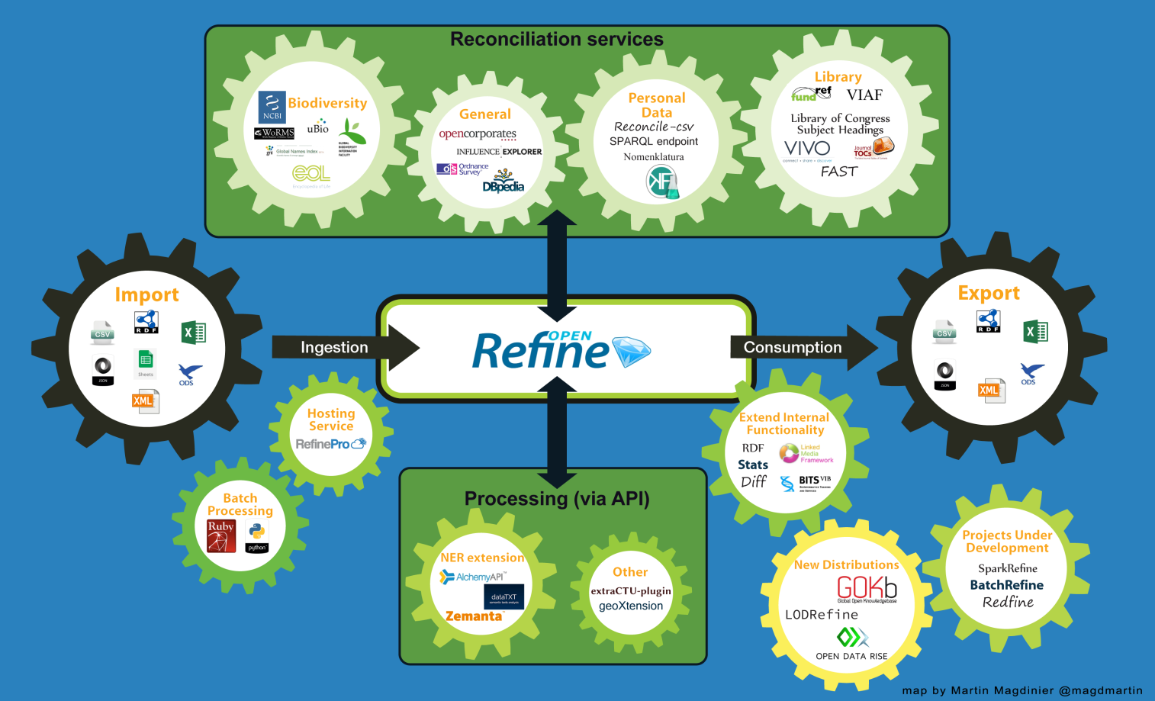

Slide 36
Open Refine Benefits
Open Refine is good for fixing:
Data formats
Multiple representations
Duplicate records
Redundant data
Mixed numerical scales
Mixed ranges

Slide 37
Open Refine Limitations
It is not a good tool for creating new datasets
Not useful for huge datasets
The amount of data that can be processed depends on the memory size
For a file size of 512MB, a simple operation can take more than 15 minutes which is not accepted in real-tine application
Use Open Refine as an offline data cleaning tool

Slide 38
Spreadsheet Applications
OpenRefine is a key tool for cleaning data.
However, its sometimes easier to fix some errors in a spreadsheet app:
Spelling errors
Redundant data
Numerical verification
Fixing shifted data

Slide 39
Coursework 1: Data Cleaning and Visualisation
Heather Packer
16/01/18

Slide 40
Coursework 1
US Government Projects dataset
Project Title
Agency
Start/end dates
Costings

Slide 41
Part 1 - Data Cleaning
Real dataset with artificial errors
There are 5 types of errors
There are more than 5 errors
Use OpenRefine

Slide 42
Part 2 - Data Visualisation
2 Visualisations, hosted on your home page
Use your cleaned data
You might want to restructure it for your visualisation
You have to use D3
You can either write your D3 visualisation
From scratch
Modify existing D3 graph but it must be tailored to your data (remember to include relevant titles, labels, and keys)
You do not have use all the data

Slide 43
Mark Distribution
Part 1
Cleaning and manipulation (5 marks)
Part 2
Choice of visualisation (5 marks)
Implementation (4 marks)
Interactivity (4 marks)
Completion (2 marks)

Slide 44
Overview
Deadline: March 15th 4pm
Worth 20% of your mark for this module
The usual late penalties apply for late handins (10% per working day)

Slide 45
Open Refine - Tutorial
https://secure.ecs.soton.ac.uk/notes/comp6214/2017/resources/Cleaning_Exercise.pdf
Dataset 1 – Department for Environment, Food & Rural Affair
https://data.gov.uk/dataset/agricultural_market_reports
Dataset 2 – UK GP Earnings
https://data.gov.uk/dataset/gp_earnings_and_expenses

Slide 46
D3 - Resources
https://www.gitbook.com/book/comp6234/3-html-css-and-javascript
https://www.gitbook.com/book/comp6234/4-data-to-charts
https://www.gitbook.com/book/comp6234/5-advanced-charts
https://www.gitbook.com/book/comp6234/6-legends-and-interactivity
https://www.gitbook.com/book/comp6234/7-maps

