Slide 1
Computer Applications
Introduction to GUIs in Python
Hugh Davis hcd@soton.ac.uk
Jian Shi
Yvonne Howard rfp@ecs.soton.ac.uk
Rikki Prince rfp@ecs.soton.ac.uk

Slide 2
This week:
Tkinter
Controls
Named arguments
Events

Slide 3
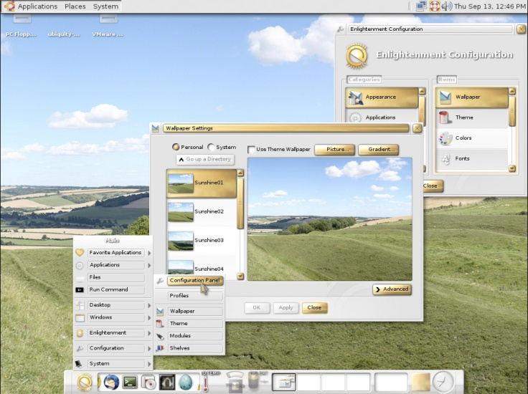
What are GUIs?
“Graphical User Interfaces” – as opposed to CLI
Typically WIMP: windows, icons, menus, pointers
Touch interfaces are post-WIMP
Pioneered at Xerox PARC (see “Mother of all demos”: http://www.youtube.com/watch?v=yJDv-zdhzMY)

Slide 4
Tkinter
A GUI library for Python
Comes with the standard distribution of Python
Official Python wiki page:
https://wiki.python.org/moin/TkInter
Good tutorials:
http://www.tutorialspoint.com/python/python_gui_programming.htm
http://effbot.org/tkinterbook/

Slide 5
Tkinter basics
import Tkinter
# Create window
main_window = Tkinter.Tk()
# add widgets
# ...
# Display window
main_window.mainloop()

Slide 6
Controls
Input and output
2 important lines:
button = Tkinter.Button(main_window)
button.pack()
Create and display

Slide 7
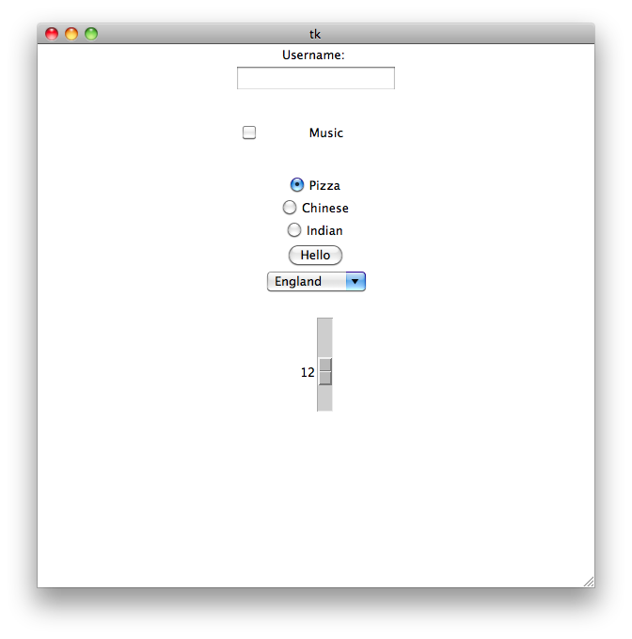
Tkinter.Label()
Tkinter.Entry()
Tkinter.Checkbutton()
Tkinter.Radiobutton()
Tkinter.Button()
Tkinter.OptionMenu()
Tkinter.Scale()

Slide 8
Controls
Another example
name = Tkinter.Entry(main_window)
name.pack()
Only have to provide parent window
http://www.tutorialspoint.com/python/python_gui_programming.htm

Slide 9
An Aside: Named arguments (1)
Function arguments have been in order so far
def resistance(voltage, current):
return float(voltage)/float(current)
R = resistance(240, 5)
Can change order:
R = resistance(current=5, voltage=20)

Slide 10
Named arguments (2)
Can also set defaults
def resistance(voltage=240,current=1):
return float(voltage)/float(current)
R = resistance(current=10)
R = resistance(voltage=20)

Slide 11
Controls with parameters
Another example
go = Tkinter.Button(main_window, text=“Click Me!”)
go.pack()
http://www.tutorialspoint.com/python/tk_button.htm

Slide 12
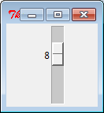
Controls with parameters
Another example
voltage = Tkinter.Scale(main_window, from_=5, to=15)
voltage.pack()
http://www.tutorialspoint.com/python/tk_button.htm

Slide 13
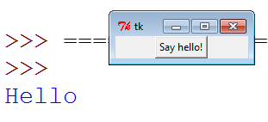
Events
Using functions
def print_hello():
print “hello”
hello = Tkinter.Button(main_window, text=“Say Hello”, command=print_hello)
hello.pack()

Slide 14
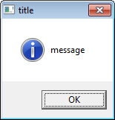
Message box
To get a pop up message box
import tkMessageBox
tkMessageBox.showinfo( “title”, “message”)

Slide 15
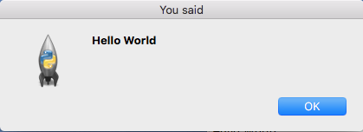
GETting Values
Some Controls provide input values
……….
name = Tkinter.Entry(main_window)
name.pack()
def res():
tkMessageBox.showinfo( "You said", name.get())
hello = Tkinter.Button(main_window, text="Press Me", command=res)
hello.pack()
main_window.mainloop()

Slide 16
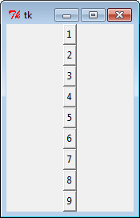
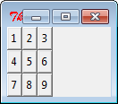
Layout
.pack() adds it in next
.pack( side = RIGHT) packs against right hand side
.grid(row=2, column=1) puts at grid cell (2,1)

Slide 17
GUIs Summary
Using Tkinter (import, create instance, mainloop() )
Initialise controls
Add controls using .pack() or .grid()
Use named arguments such as text to set the text and command to set the function to execute when clicked

