Slide 1
Open Data Formats
COMP 6214
Heather Packer
16/01/18

Slide 2
Lectures
Week | Tuesday 1000-1200 | Tuesday 1500-1600
1 | Introduction | Open Data Formats
2 | Open Data Pre-analytics | OpenRefine Demo
3 | Guest Lecture – David Tarrant | Open Data Visualisation
4 | Visualisation and D3 | D3 Demo
5 | tbc | tbc
6 | Guest Lecture – Ash Smith | tbc
7 | Guest Lecture – Chris Gutteridge | tbc
Easter Break

Slide 3
Open Data
Open data is data that anyone can access, use or share.
Open Data is for both humans and machines
The format of an open dataset refers to the way in which the data is structured

Slide 4
“To the extent practicable and subject to valid restrictions, agencies should publish information online in an open format that can be retrieved, downloaded, indexed, and searched by commonly used web search applications.
An open format is one that is platform independent, machine readable, and made available to the public without restrictions that would impede the re-use of that information”
Obama Administration

Slide 5
Open and Closed File Formats
Open file format is a file format storing digital data
It can be used and implemented by anyone
The format does not tend to have legal restrictions:
Copyrights
Patents
Trademarks
Closed file formats is a file format used by a company, organisation, or individual for their particular software or hardware

Slide 6
Open Data Formats and Interoperability
Standard file formats
Units
Metric/Imperial
Standard classifications
Ontologies
Schemas

Slide 7
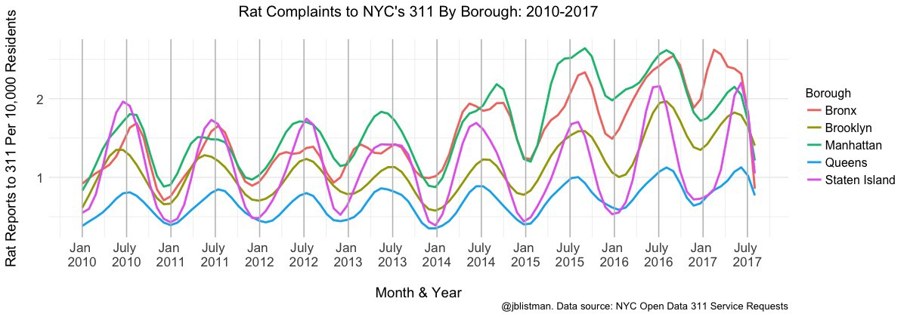
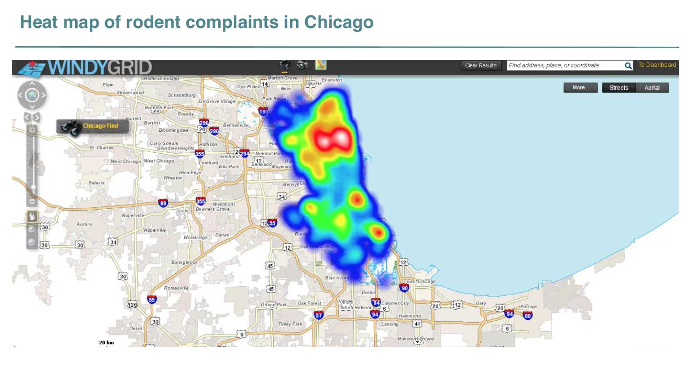
Open Data – What does it look like?

Slide 8
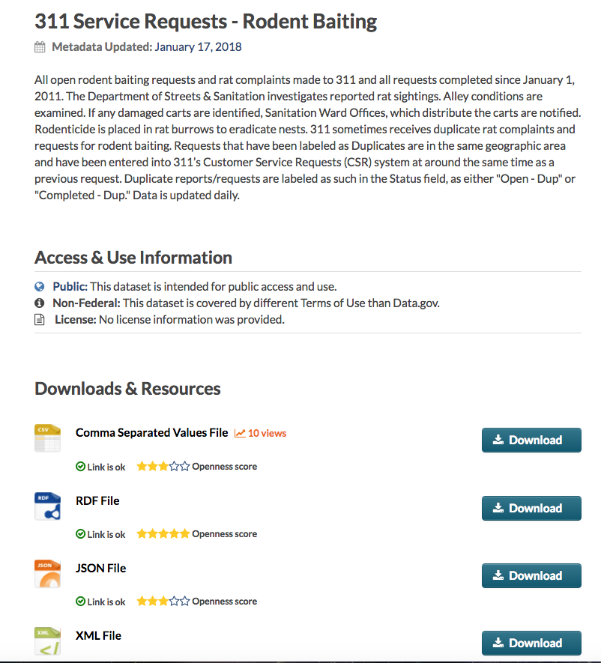
https://catalog.data.gov/dataset/311-service-requests-rodent-baiting-9f9be

Slide 9
The Structure of Data
Tabular data
Hierarchical data
Network data

Slide 10
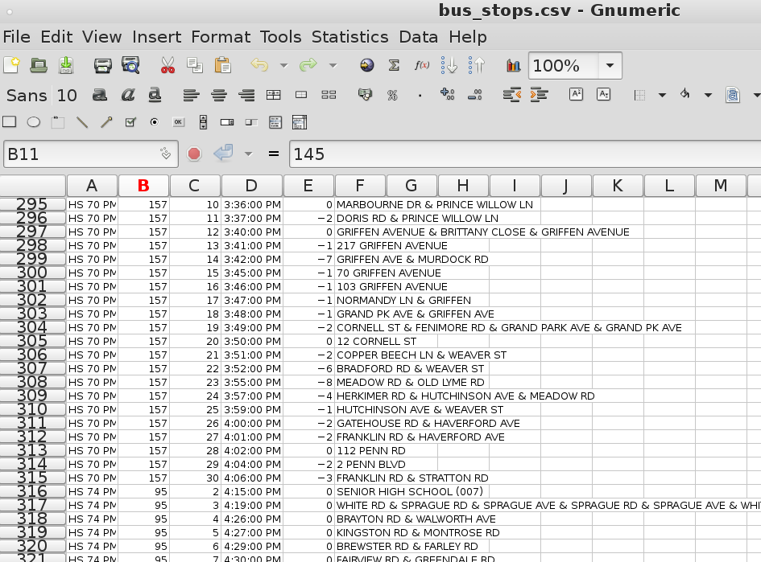
Tabular
Tabular is the most common structure for open data
Data is organised in to rows and columns
Separate entry for each record
CSV is a good format for this type of data

Slide 11
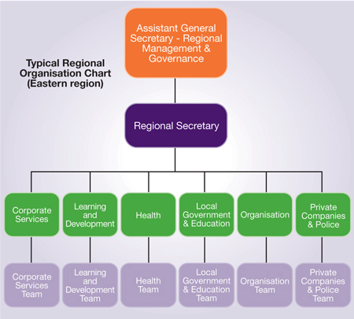
Hierarchical Data
Hierarchical data shows the relationships between data points
Family trees
JSON and XML are good formats for this type of data

Slide 12
Network Data
Network data can be modeled as a graph
Network structure data describes relationships
Friendships in social networks
The WWW

Slide 13
Tabular Data - Spreadsheets
Open data is sometimes in a spreadsheet format (xls or xlsx)
Can include macros and formulas

Slide 14
Tabular Data - Comma Separated Value Files
Data records one per row
Each record is one or more fields separated by a comma
Sometimes other delimiters are used eg tabs (TSV)
First record maybe a header providing the column name for each field
No macros or formulas

Slide 15
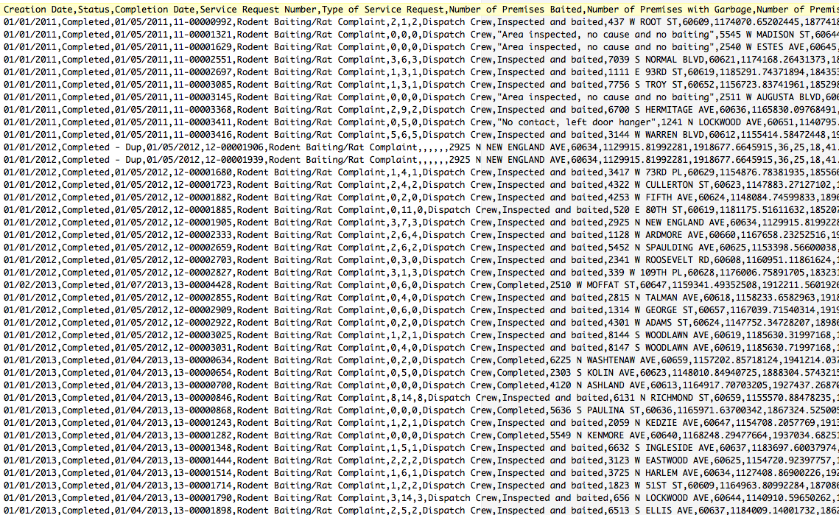
Tabular Data - Rodent Baiting CSV

Slide 16
Hierarchical Data - XML
XML is a widely used format for data exchange
Keeps structure in the data
Nested elements marked up using tags
Self-documenting
Namespaces

Slide 17
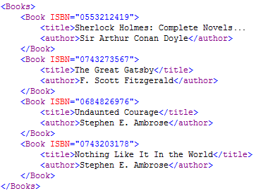
Hierarchical Data - XML Example

Slide 18
Hierarchical Data - XML Schema
Describes the structure of an XML document
Used to verify validity
Define types for elements and attributes:
Primitive data types (eg boolean, decimal, float, string date)
Complex data types control what attributes or child elements are allowed/required

Slide 19
Hierarchical Data - XML based formats
XML is widely used as the base for other formats
GML and KML – for expressing geographic data
MathML
RDF/XML

Slide 20
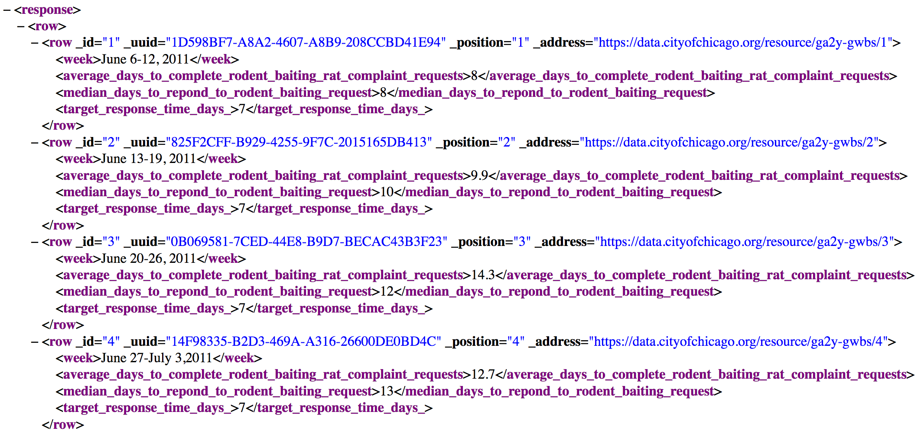
Hierarchical Data - Rodent Baiting XML

Slide 21
Hierarchical Data - JSON
JSON is a simple file format
Objects are surrounded by {}
Key Value pairs
Data types (strings, number, booelan array, object or null)
Lightweight, often used in web applications
Easy for programming languages to parse (JavaScript, Python, Java, C++, ..)

Slide 22
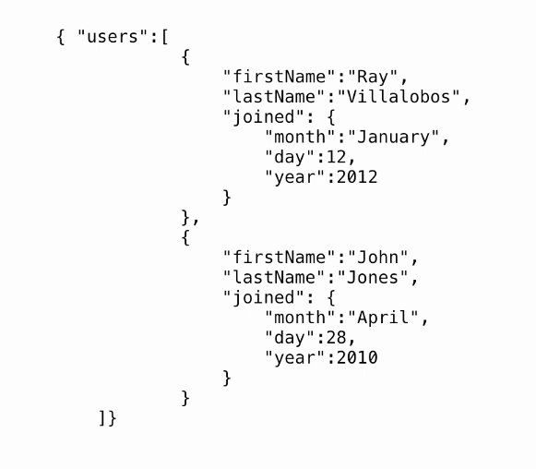
Hierarchical Data - Example JSON

Slide 23
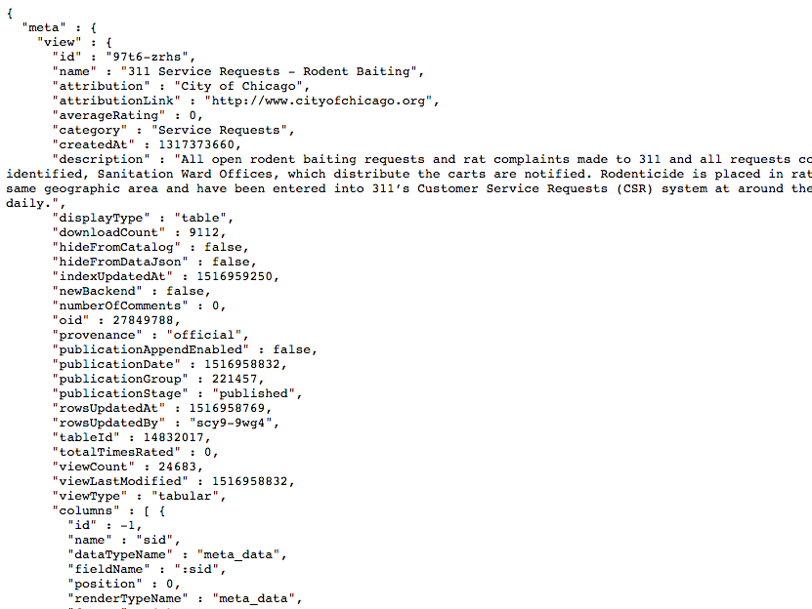
Rodent Baiting - JSON Format

Slide 24
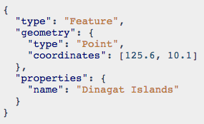
Hierarchical Data - GeoJSON
GeoJSON is a format for encoding a variety of geographic data structures

Slide 25
Hierarchical Data - JSON Schema
Defines the structure of JSON data
Useful for
Validation
Documentation
Similar to XML’s XML Schema
Recently standardised – growing support

Slide 26
Network Data - RDF
W3C recommended format for graphs
Represents data in a form that mages it easier to to combine data from multiple sources
Uses URIs

Slide 27
Network Data - RDF triples
<subject>
<predicate>
<object>

Slide 28
Network Data - RDF triples
Bob
knows
Alice

Slide 29
Network Data - RDF triples
http://example.com/bob
knows
http://example.com/alice

Slide 30
Network Data - RDF triples
http://example.com/bob
http://xmlns.com/foaf/0.1/knows
http://example.com/alice

Slide 31
Network Data - RDF triples
http://example.com/bob
foaf:knows
http://example.com/alice

Slide 32
Network Data - RDF triples
http://example.com/bob
rdf:type
foaf:person

Slide 33
Network Data - RDF triples
http://example.com/bob
schema:birthdate
“1990-07-04”^^xsd:date

Slide 34
Network Data - RDF triples
http://example.com/bob
foaf:topic_interest
https://www.wikidata.org/wiki/Q12418

Slide 35
Network Data - RDF triples
https://www.wikidata.org/wiki/Q12418
dcterms:title
“Mona Lisa”

Slide 36
Network Data - RDF triples
https://www.wikidata.org/wiki/Q12418
dcterms:title
“La Joconde”@fr

Slide 37
Network Data - RDF Graph Example

Slide 38
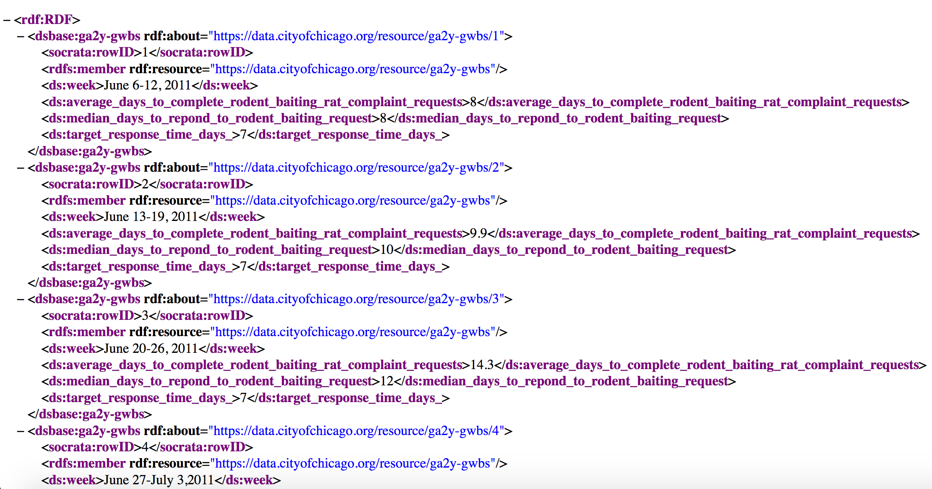
Rodent Baiting – RDF Format

Slide 39
Other Formats
Text documents
Plain text
Images
Proprietary (closed) formats

Slide 40
Summary
Open file formats
Three types of structures
Tabular
Hierarchical
Network (graph)
Tabular data is the most common open data
Most open data can be represented in more than one format

Slide 41
Practical tools
Conversion
CSV JSON - http://www.csvjson.com
JSON XML CAS - https://jsonformatter.org/
Validation
CSVLint - https://csvlint.io/
JSONLint - https://jsonlint.com/
Manipulation
https://csvkit.readthedocs.io/en/latest/
OpenRefine - http://openrefine.org/

