Slide 1
Welcome to Living and Working on the Web 2018
blog.soton.ac.uk/uosm2008/
#uosm2008

Slide 2
To begin….
Tutors:
Nic Fair – N.S.Fair@soton.ac.uk
Manuel Leon – M.Leon-Urrutia@soton.ac.uk
Meetoo.com ID: 184-474-034

Slide 3
The Web has changed the way we learn….

Slide 4
It has changed….
How we learn - networked learning
Why we learn - self-motivation and autonomy
What we learn - facts vs skills/literacies
Where we learn - anywhere we want
When we learn - whenever we like
From/with whom we learn - friends and peers, not ‘experts’

Slide 5
We need to develop our digital literacies and our learning networks….not just our knowledge

Slide 6
How the module works….
Module introductory video:
https://www.efolio.soton.ac.uk/blog/innovationinhe/2016/04/01/living-and-working-on-the-web-module-overview-interactive-video/

Slide 7
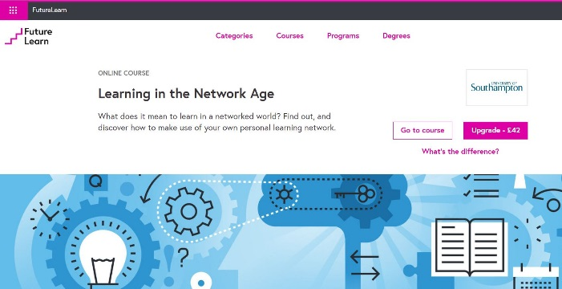
Your study pattern….
Explore
Research
BLOG
- Share your knowledge
Expand
Deepen
REFLECT
- Develop
SELF-ASSESS
Feedback
Improve
– Control your progress
COMMENT
Interact
Discuss
– Learn with others
Total of 5 Tasks:
Intro Topic (non-assessed)
Topic 1 (20%)
Topic 2 (20%)
Topic 3 (20%)
Final Course Reflection (40%)
Participate in ‘Learning in the Network Age’ MOOC

Slide 8
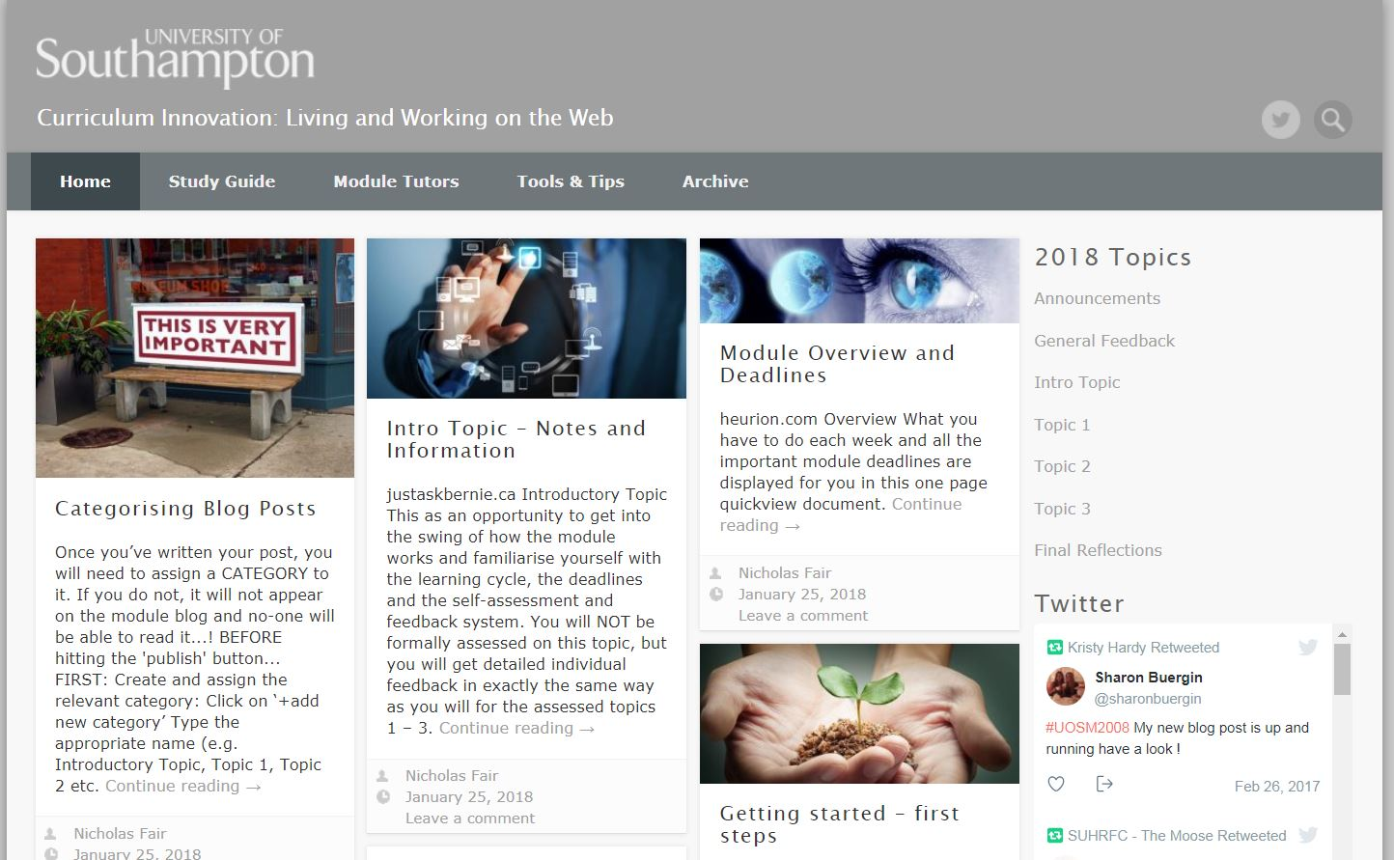
The blog is everything…
Study Guide
Getting Started
Module Overview and Deadlines
Tools & Tips
Technical Info
Topic Info
Tutor contact info

Slide 9
Key actions to do this week….
Read the Study Guide carefully and note all the key dates
Set up your blog – you can use your Soton blog (login to blog.soton.ac.uk), or establish your own Wordpress blog
Register with FutureLearn and Sign Up for the MOOC
Create a Gmail account (if don’t have one)
Create a Twitter account (if don’t have one / want to keep your existing one private)
Go to http://bit.ly/2gETRf3 and complete the online form
Attend drop-in session on Friday 2nd Feb if having any difficulties

