Slide 1
COMP1205
Technical Report –Dr. Su White
Typical mistakes from previous students
http://www.edshare.soton.ac.uk/xxxx/
Notes:
http://www.edshare.soton.ac.uk/15567/

Slide 2
General Rules
Before any hand-in you should have made sure you
  address all of the assessment criteria
Writing is a craft
  a good document will go through more than one revision
  There is never a perfect solution to a written problem

Slide 3
Assessment criteria mistakes
Students often
Fail to do one of the things you get marks for
Appear to give more importance to some criteria than others
Possible reasons?
  Rushed last minute?
  Lack of focus?
  Blink panic?
  No review of text

Slide 4
Last minute solution?
Use your time strategically
  What changes will get you more marks?
  Look at the assessment criteria carefully
  http://edshare.soton.ac.uk/19129/18/COMP1205%20Technical%20report%20spec%20and%20criteria%20combined.pdf

Slide 5
Review each assessment criteria
Objectively analyse your likely score
Or work out how to get some help with that task…
Decide how you might change the work
Evaluate how long that would take (how much effort)
Review the total set of possible changes
Make the most impactful effort
NEVER THROW AWAY EASY MARKS

Slide 6
A new year’s quiz
What do students do wrong?

Slide 7
Abstract
Quality of the abstract
The abstract should tell me
  why I need to read this
  what I will learn
  the important conclusion
It must be stand‐alone.

Slide 8
Mistakes
Confused and confusing
Does not follow suggested formats
Rambling
Reason? Probably rushed or left ‘til the last minute. Unlikely to have been reviewed.
Remember
your reader gets to the abstract first
it sets their expectations
make it good

Slide 9
Introduction
Quality of introduction:
Tells me
  what the question is
  what is the state of the art is in the area
  will reference current literature
  Think scope and scale

Slide 10
Mistakes
Repeats the abstract
Does not communicate why the problem is important or interesting
Does not indicate how big the problem is
Remember
the reader wants to be reassured that
you are competent
you have something interesting to say
Pay attention to how you write this section

Slide 11
Argument
Quality and clarity of argument /enjoyability
Narrative/story ties the report together
Makes even complex topics easier to understand.

Slide 12
Mistakes
The story is difficult to find
The writing has not been structured
Remember
Introduce each new idea with a new paragraph
Use sub headings to structure your work
Tables and diagrams can be used to explain structure
and make complex problems easier to understand

Slide 13
Overall analysis and conclusions
Quality of overall analysis and conclusions
Summarizes and analyzes what has been learned
  in order to synthesize and address answers to the questions asked in the introduction.
Discuss limitations of report /possibly suggesting further work.

Slide 14
Mistakes
The text is descriptive rather than analytical
No effort is made to discuss limitation of report
Remember
You need to give yourself time to reflect on what you have investigated
this will help you understand the limitations or your report,
Explain conclusions with recommendations or suggested further work
Wordless recreation can be valuable here
make thinking time

Slide 15
Literature
Quality of cited literature
Ideally peer‐reviewed,
  appropriately up‐to‐date.
Footnotes for refs. to material which might change e.g. websites

Slide 16
Mistakes
Only/mostly references from web sites are used
The literature is based on a few texts and mostly out of date
Remember
You will never cite every reference you look at
Some references tell you what to leave out
References will support your arguments
Don’t make claims which are not backed up

Slide 17
Structure and appearance
Structure and appearance of report
Excellent appearance.
Strong structure of main sections, well laid out.
Clearly structured and logical
Good/relevant diagrams/illustrations.

Slide 18
mistakes
The work is badly formatted
Pasted in text uses different fonts
Diagrams and tables do not have labels
Spelling mistakes and visually a mess
Remember
Allow sufficient time to review formatting
These are easy marks

Slide 19
Readability
Readability
how easy is it to read and understand this report?

Slide 20
Mistakes
Poor grammar
Words missing, the argument leaps around a lot
Remember
Proof reading by others & reading aloud can help spot confusion (e.g. text to speech)
You need time to correct this
make sure you schedule that time

Slide 21
References
References:
Correct use of citations/ references
Adheres to Harvard convention (Name, Date)

Slide 22
Mistakes
Students use number formats
Students use a mix of formats
Remember
University Library notes provide guidance
Cite them right can check text for you
References are used to find a copy of the source
make them complete

Slide 23
Academic Integrity
Quality of academic integrity and originality

Slide 24
Mistakes
Notes don’t get turned into final version
Over reliance on direct quotes
Panic cut and paste from many sources
Remember
We are hoping this will not be a problem
You have had a chance to see typical mistakes
Trust yourself to use your own writing
better learn how you need to improve you writing
than be penalised for poor academic integrity

Slide 25
Things you must do
Include
  academic integrity statement
  the summary of your brief
These go between the title page and the abstract
Best start the abstract on a new page – we have a word limit not a page limit
You must use the template provided – this is a professional development class. You are expected to demonstrate that you can use Word, since it is the the common business program

Slide 26
Academic Integrity Statement
Include on the page after your title page

Slide 27
Acknowledgements
Don’t include unless you have something to acknowledge

Slide 28
Word Limit
Do not exceed the word limit
You will have to trim what you have written
  This means you have to have a fair draft well before the actual deadline!
  A second pair of eyes can help you find ways to shorten and ways to clarify
  Friends or peers are good make good proof readers
  You can learn how to write better by reading other people’s work
  Sometimes a good diagram can save you lots of words
    Use a diagram to
      summarise a set of relationships
      Provide some insights

Slide 29
Reminders
The material which follows has appeared in previous lectures

Slide 30
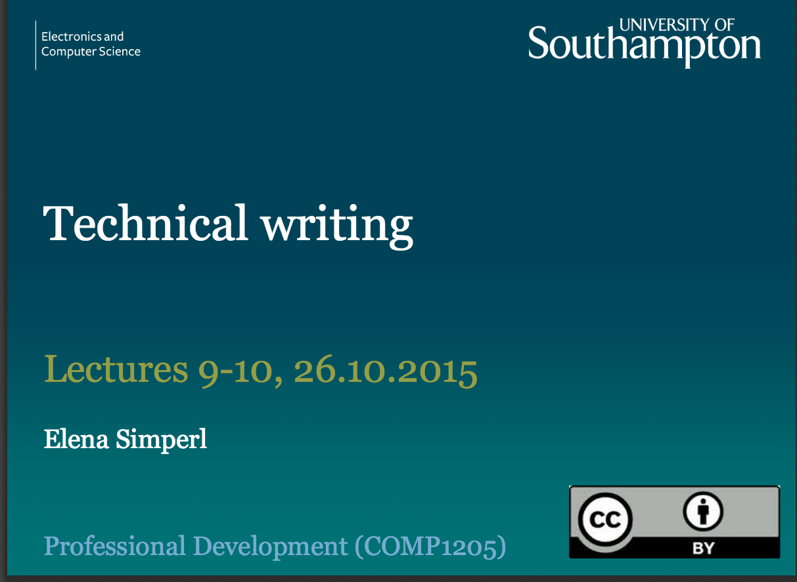

We have had the theory…
Lets imagine the process ☺
http://www.edshare.soton.ac.uk/15350/
http://www.edshare.soton.ac.uk/15127/

Slide 31

What do you want to learn today?
Think about how you write:
What can you already do well which will be useful?
Where are your weaknesses?
Based on this reflection
write down three things you would like to get out of the session today
Activity 1

Slide 32
You need to learn how to…
Organise writing clearly and logically
Handle evidence appropriately in writing to present a structured and logical argument
Explain concepts in formal context
Structure your work for correctly for the appropriate audience
Understand strategies for revision at the document, paragraph and sentence levels
Understand grammatical and stylistic usage
Be able to edit and refine your own written work

Slide 33
Sum wondeful peeple gt evrytng write 1st thyme
NB spell checkers
do not correct
all mistakes
Btw…
can you write down the correct version of my heading?
This information/class is not for you!!
But you may be able to help your friends and colleagues
You may learn from helping them
Activity 2
Notes:
Get feedback from class
Questions – did you get the corrections right first time?
Can someone write up the correct version
Simple example but shows how working with someone else can assist in revision

Slide 34
Think about the process and purpose of writing
Two minutes:
What is the purpose of
writing the technical report
  in this module
writing reports
  as part of your degree
writing
  in a professional context
Includes:
Learning how to write (and practicing)
Recording a process for ‘reproduction’
Demonstrating knowledge, skills and understanding
Communicating scientific or technical findings/discoveries/insights

Slide 35
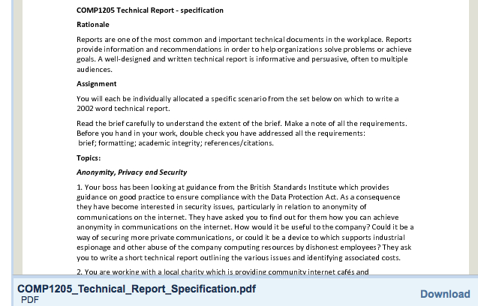
Look at the technical report spec’
http://www.edshare.soton.ac.uk/14582/

Slide 36
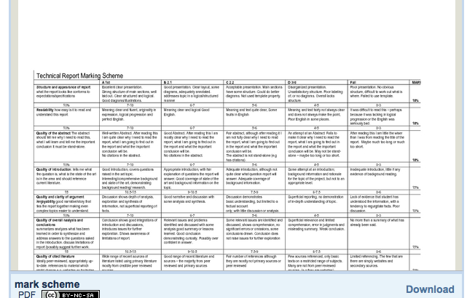
Look at the mark scheme
http://www.edshare.soton.ac.uk/15362/

Slide 37
The process – and pragmatics
orientate
plan
research
Write
think/reflect
record
refine
review
write
Your first draft will never be good enough to hand in!
Always hand in before the deadline

Slide 38
Before Getting Started
You wish to communicate “What you have found out”. If you didn’t find anything out : STOP!
Usually technical reports are intended to communicate new knowledge
“I had this hypothesis and I tested it like this; here are my results and this is what we learn from them”
BUT as a student
you are asked to write technical reports about things that you know that the person who reads it (the marker) will already know. Don’t worry – your marker is not your audience (see later) – and your task is still to express what *you* found out.

Slide 39
Use the process to learn about yourself
How do you think and learn?
How can you refine what you do?:
To work smarter not harder

Slide 40
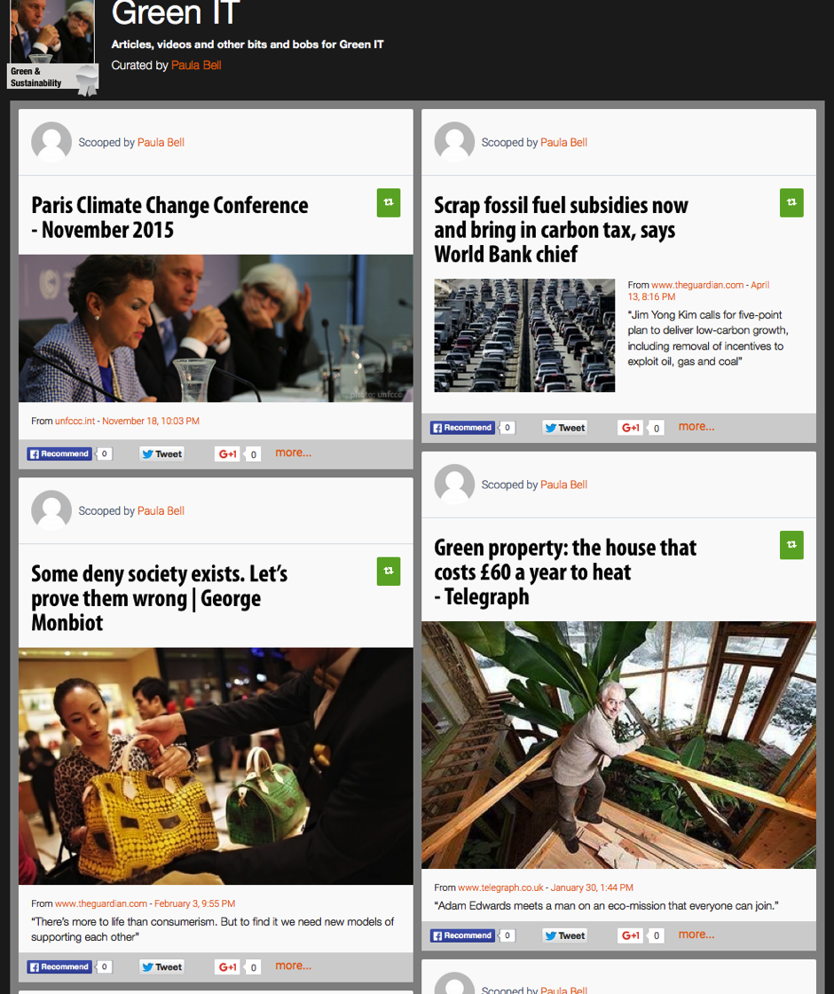
Working collaboratively can be more fun/productive…
But write your report individually
Find your own words
Select your quotes – and cite them accurately

Slide 41
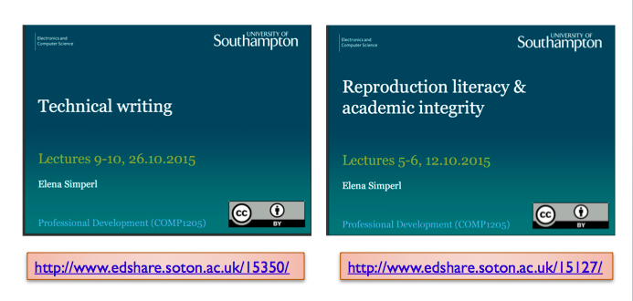
Bear in mind existing guidance
think/reflect
record
refine
review
write

Slide 42
What we know about plagiarism
People who are rushed:
  Take shortcuts
  May feel panicked
  May not make good decisions
…how to avoid it
  Carve our enough time
  Add a buffer for the unexpected

Slide 43
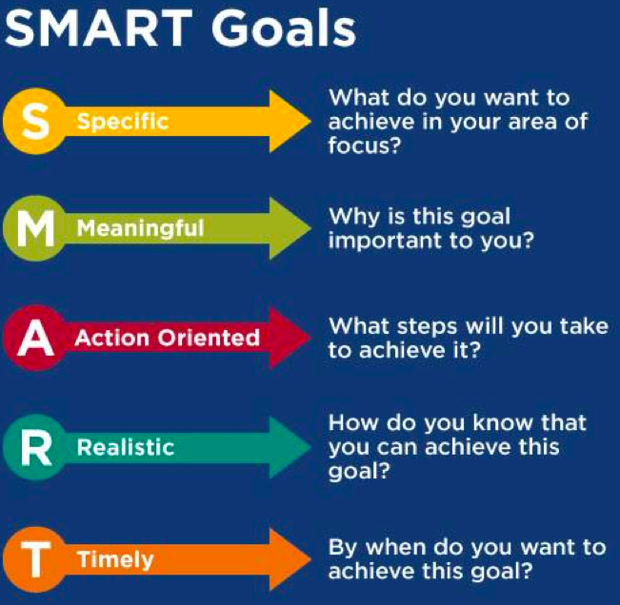
Advice includes
Set aside time for research and writing
challenge common assumptions
overcome procrastination
eliminate distractions
use a timer
set SMART goals
chunk your project into small tasks
track your progress
make yourself accountable

Slide 44
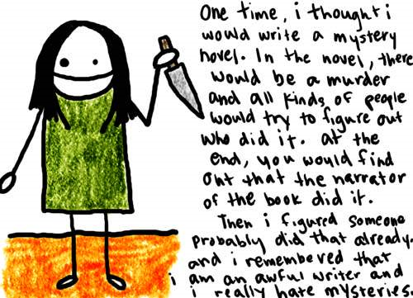
Reports are not personal
With thanks to nataliedee.com

Slide 45
Structure of a Technical Report
[Title page]
  name, affiliation, date, contact details, etc.
[Declaration]
  who did this work?
[Acknowledgement]
  to those who have helped or influenced your work
[Contents]
  sections, sub sections and page numbers (probably not sub sub sections)
Abstract
  stand-alone summary of report
Introduction
  provides the motivation and context and outlines other related work
Main technical sections
  theory, experimental method, results, discussion
Conclusions
  and appropriate future work
References
[Web References]
[Bibliography]
[Appendices]
  anything which would interfere with the continuity of the main report (typically detail)

Slide 46

Report function
  Abstract summarises the work presented
  Introduction (provides context)
  Itemise the key work(s)
  Identify where your contribution fits
  Present key ideas, describe methods
  Present Results
  Draw Conclusions
Remember Your report is not a detective novel!

Slide 47
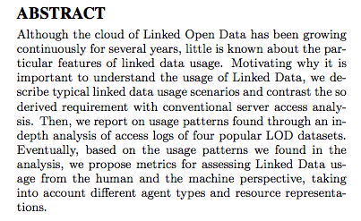
The Abstract
must be stand-alone
must not contain citations
is a concise summary – not a précis.
IS VERY IMPORTANT
Use four or five sentences.
  What is the problem, and why is it a problem?
  What is your idea for a suggested solution?
  How did test your idea?
  What results did you get?
  Why is that useful?
It’s a good idea to write the abstract before you begin (even if you re-write it after you finish)

Slide 48
Experimental Report Abstract
Tea drinkers report major differences in their satisfaction with cups of tea, even when they have been made from the same tea leaves.
One possible cause of this variability is the temperature of the water at the time it is poured over the tea leaves.
This report describes an experiment in which one hundred tea drinkers were asked their views on teas made with water at different temperatures.
The results demonstrate a significant preference for tea made with near boiling water.
The perceived quality of tea, particularly in the USA, would be much enhanced if caterers observed this convention.
(5 sentences, 98 words)

Slide 49
Work and improve over time
Have a plan
Do good work
Record your work
Analyse the results
Capture the whole process
Meet your deadlines
Some aspects will apply equally to:
Every written task
Use opportunities to refine your process
these are skills for life

Slide 50
Record an Audit Trail
References
Provide an audit trail
Acknowledge others’ work
Are concise
Should be replicable
List references
consistently,
correctly,
completely
They need to be:
complete and in a standard format
They need to contain:
enough detail to locate the same source again
Do not include:
ISBN
Library call numbers

Slide 51
Work smarter not harder
One touch
Write your bibliography as you go
Always get full references
Record how and when
Collect to a standard format

Slide 52
Information needed
Gather information before and during writing
Begin to organise information as you obtain it
Information from others:
record full bibliographic details
Information you generate:
keep a complete logbook record
Notes:
Southampton University Computer Services or SUCS provide a large number of public

Slide 53
Keep track of your sources
With notes, copies of articles, useful diagrams, etc.,
NB
Authors, complete name of work, editors if any, publisher, year/month of publication, volume no., page numbers
URL plus any clues as to original paper source.
If class notes, is there a printed textbook?
If a self-contained paper, look for any and all clues to find the original citation (e.g. author’s publication list on Web page).
Avoid plagiarism

