Slide 1
Dark Web and Policies
COMP 3220/6218
Heather Packer
30/10/17

Slide 2
Dark Web (Recap)
TOR network and browser is designed to keep its users anonymous
Data passed through the network is layered with encryption
Relay points (nodes) in the network unencrypt a layer and pass it on to the next node
A relay point only knows where data previously came from and where to sent it
A hidden service can be hosted on a TOR relay point

Slide 3
Uses of the Dark Web
Human rights activists use it to access social media or blog
One million internet users seek out a truly free internet on a daily basis
Opening up the system allows US Navy Intelligence to be anonymous
Whistleblowing
Hacktivism

Slide 4
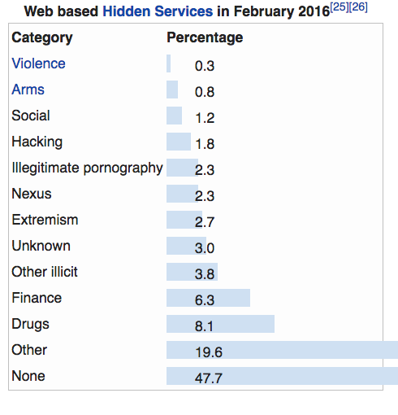
TOR Usage
TORs usage (2014)
1.5% of TOR users are accessing the Dark Web
98.5% use TOR to browse anonymously
In 2015 police reported that 80% of TORs traffic requests to hidden services, were to known sites that feature child abuse

Slide 5
Current Laws
Current laws are vaguely applicable to the dark web
Hacking is regulated by the Computer Misuse Act (UK) and Computer Fraud and Abuse Act (US), etc
Bans trespassing, unauthorised accessing and damaging computers
The DarkWeb enables hackers (Purchase malware, Collection of ransom from ransomware attacks
Bars trafficking, unauthorised computer access and computer espionage

Slide 6
Policy 1
What is the appropriate role for the government in the Dark Web?

Slide 7
Policy 1
What is the appropriate role for the government in the Dark Web?
Should anonymity on the web be banned?
How should we handle coordinating regulations internationally?
Some content all agree is illegal, some is not

Slide 8
Policy 2
What are the appropriate tactics for government intervention on the Dark Web?

Slide 9
Policy 2
What are the appropriate tactics for government intervention on the Dark Web?
What can we do to deter people from starting nefarious hidden services?
Should we make users accountable for their actions?
Is there a middle road between anonymous and transparent?

