Slide 1
The Deep Web
COMP 3220/6218
Heather Packer
30/10/17

Slide 2
Internet vs World Wide Web
Is the Internet and the WWW the same thing?

Slide 3
Internet vs World Wide Web
Is the Internet and the WWW the same thing?
The Internet is a global system
  Collection of interconnected computer networks
  Using Internet protocols to link devices
  Provides the backbone for services
    World Wide Web
    Email
    File sharing
    Darknets
    Social Networking (messaging)

Slide 4
Internet vs World Wide Web
Is the Internet and the WWW the same thing?
The Internet is a global system
  Collection of interconnected computer networks
  Using Internet protocols to link devices
  Provides the backbone for services
    World Wide Web (Surface and Deep Web)
    Email
    File sharing
    Darknets (Dark Web)
    Social Networking (messaging)

Slide 5
What is the Deep Web?
WWW content which is not indexed by standard search engines
Content of the deep web is hidden behind HTML forms
What is the Dark Web?
WWW content existing on darknets, overlay networks which use the Internet
They require specific software, configurations and authorisation to access

Slide 6
The Deep Web
Searching on the Internet today can be compared to dragging a net across the surface of the ocean. While a great deal may be caught in the net, there is still a wealth of information that is deep, and therefore, missed.
The reason is simple: Most of the Web's information is buried far down on dynamically generated sites, and standard search engines never find it.
Michael K. Bergman 2001

Slide 7

The Deep Web
Early estimates suggest it is 400-550 times larger than the surface web.
2001 - speculated it was 7.5 petabytes.
2004 - around 300,000 websites
2006 - 14,000 deep websites in the Russian WWW
Estimated that 99% of web content is hidden

Slide 8
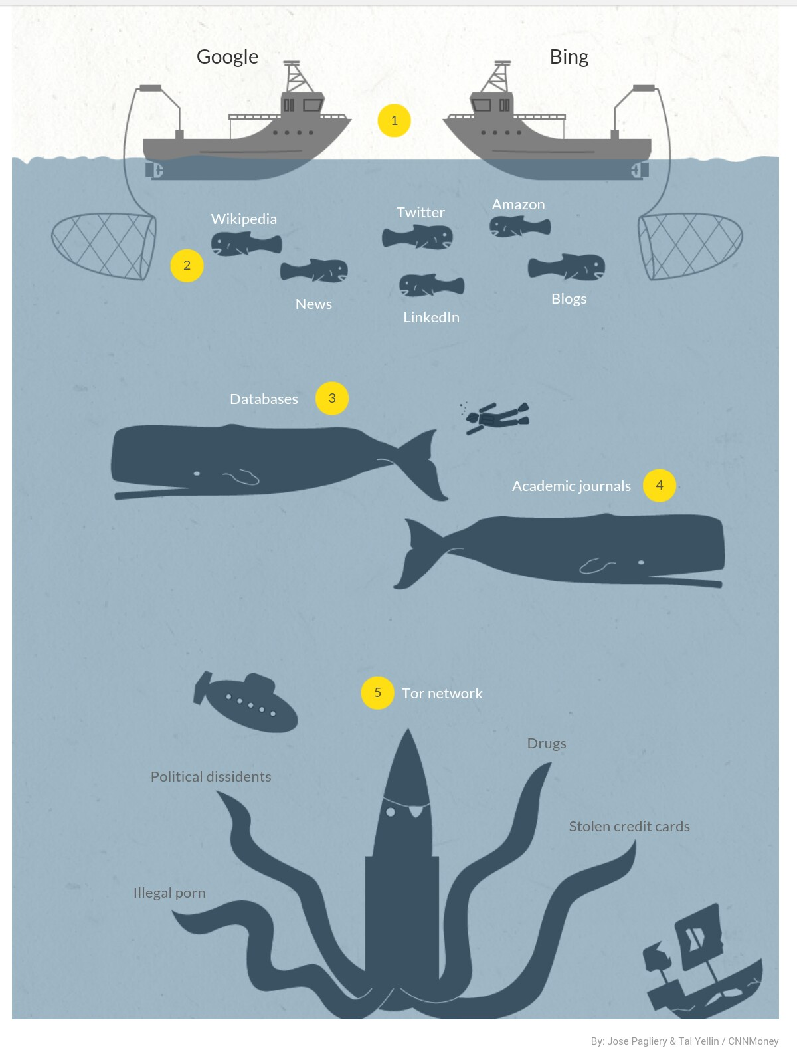
Levels of the Web
0. Common Web
Surface Web
Bergie Web
Deep Web
Dark Web

Slide 9
Level 0 – Common Web
Open to the public
  Search Engines
  Free news sites
  Wikipedia

Slide 10

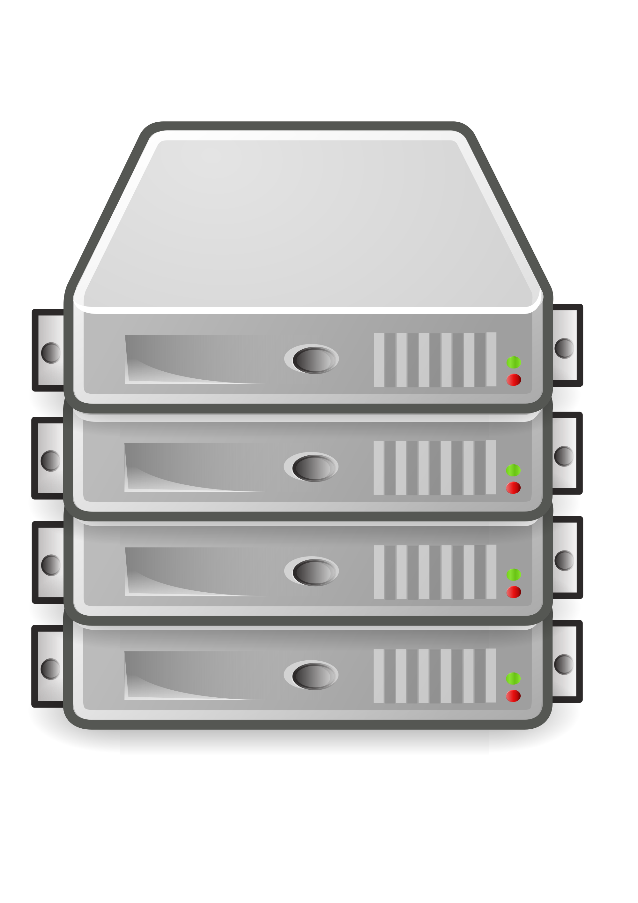

Web Browsers

Slide 11
Level 1 – Surface Web
Websites that have private areas, communication platforms
  Reddit
  Digg
Websites that have paywalls
  news

Slide 12
Level 2 – Bergie Web
WWW that is not indexed by search engines
Internet News groups
Underground forums
FTP Sites, HoneyPots
Google locked results

Slide 13
Level 3 – Deep Web
Unindexable by standard search engines
You have to be invited by someone
Hacker groups
Activist Communications

Slide 14
How to Prevent Indexing
Contextual web: pages with varying content for different access contexts:
  Block search engine IP addresses
  Block a specific previous navigation sequence
Dynamic content: returned in response to a submitted query or accessed only through a form
Limited access content: sites that limit access to their pages in a technical way
  Robots Exclusion Standard or CAPTCHAs
  no-store directive

Slide 15
How to Prevent Indexing
Non-HTML/text content: textual content encoded in multimedia (image or video) files or specific file formats not handled by search engines.
Private web: sites that require registration and login (password-protected resources).
Scripted content: pages that are only accessible through links produced by JavaScript as well as content dynamically downloaded from Web servers via Flash or Ajax solutions.
Unlinked content: pages which are not linked to by other pages.

Slide 16
Standard Web Crawlers Can’t Index
To discover content on the web, search engines use web crawlers that follow hyperlinks
This technique is ideal for discovering content on the surface web but is often ineffective at finding deep web content.
  These crawlers do not attempt to find dynamic pages that are the result of database queries due to the indeterminate number of queries that are possible.

Slide 17
User Form Interaction
(2) View form
Form page
(1) Download form
(4) Submit form
(3) Fill-out form
Web query front-end
(5) Download response
Hidden Database
(6) View result
Response page

Slide 18
Hidden Web Crawler
Form page
Internal Form Representation
Form analysis
Download form
Match
Task specific database
Web query front-end
Form submission
Hidden Database
Set of value-assignments
Download response
Response Analysis
Response page
Repository

Slide 19
Level 4 – Dark Web
Not accessible via the normal Internet.
Accessed by private or overlay networks, such as TOR

Slide 20
Web Browsers

Slide 21

Tor
The onion router
  TOR browser
  TOR network
Browse the web anonymously
Developed 1990s by US Naval Research Lab
  Protect US intelligence online

Slide 22
TOR Browsers

Slide 23
Web Browsers

Slide 24
Web Browsers

Slide 25
TOR Hidden Services
Can be used to create private websites and messengers
Can only be found using the TOR browser
Content remains within the TOR network – does not use exit nodes

Slide 26
Users and uses of the the Dark Web
Journalists
Activists
Countries that restrict or block websites
Nefarious purposes

Slide 27
Safety on the Dark Web
Use ToR browser
Do not install browser plugins for ToR
Disable all ability to run scripts on ToR
Use HTTPS versions of sites
Do not run executables or open documents while online
Only run/open files in a separate virtual machine with networking disabled
Ensure your application does not bypass ToR (such as BitTorrent)

Slide 28
Quiz

Slide 29
Quiz – Question 1
I’m running a website on the TOR network and I want to remain anonymous, do I:
  Log in at home?
  Log in at University?
  Log in at an Internet Cafe?
  Log in at random Internet Cafes, at different times?

Slide 30
Quiz – Question 1
I’m running a website on the TOR network and I want to remain anonymous, do I:
  Log in at home?
  Log in at University? (Harvard Bomb Threat 2013)
  Log in at an Internet Cafe?
  Log in at random Internet Cafes, at different times?

Slide 31
Quiz – Question 2
I’m running a website on the TOR network and I want to remain anonymous. I always use my favourite Internet Cafe, to check my website. Do I..
  Only log into my site and do nothing else
  Conceal my web browsing by looking at a lot of other common websites
  Check my Gmail while I’m there
  Use my credit card to pay for my coffee

Slide 32
Quiz – Question 2
I’m running a website on the TOR network and I want to remain anonymous. I always use my favourite Internet Cafe, to check my website. Do I..
  Only log into my site and do nothing else
  Conceal my web browsing by looking at a lot of other common websites
  Check my Gmail while I’m there
  Use my credit card to pay for my coffee

Slide 33
Quiz – Question 3
I’m running a website on the TOR network and I want to remain anonymous. I want to advertise my site, should I:
  Tell everyone I can about my site
  Advertise it on a forum related to my website, create a false identity and become apart of the community before advertising it
  Advertise it on a forum with my name
  Pose as a potential user of my website on a forum and ask if anyone has used it, using my name and a new account

Slide 34
Quiz – Question 3
I’m running a website on the TOR network and I want to remain anonymous. I want to advertise my site, should I:
  Tell everyone I can about my site offline
  Advertise it on a forum related to my website, create a false identity and become apart of the community before advertising it
  Advertise it on a forum with my name
  Pose as a potential user of my website on a forum and ask if anyone has used it, using my name and a new account

Slide 35
Quiz – Question 4
I’m running a website on the TOR network and I want to remain anonymous. I’m having problems connecting to TOR with PHP, do I:
  Ask a friend for help
  Post a question on Stack Overflow, with a false identity
  Post a question on Stack Overflow, with my name

Slide 36
Quiz – Question 4
I’m running a website on the TOR network and I want to remain anonymous. I’m having problems connecting to TOR with PHP, do I :
  Ask a friend for help
  Post a question on Stack Overflow, with a false identity
  Post a question on Stack Overflow, with my name

Slide 37
Quiz – Question 5
I’m running a website on the TOR network and I want to remain anonymous. I realised I’ve made a mistake, instead of posting with a false identity, I’ve asked a question using my name:
  Do I delete my post?
  Ask a the same question again with a false identity?
  Try to hide in plain site by posting many questions from different users that were more damning?
  Change my username and hope for an answer?
  All of the above?

Slide 38
Quiz – Question 5
I’m running a website on the TOR network and I want to remain anonymous. I realised I’ve made a mistake, instead of posting with a false identity, I’ve asked a question using my name:
  Do I delete my post?
  Ask the same question again with a false identity?
  Try to hide in plain site by posting many questions from different users that were more damning?
  Change my username and hope for an answer?
  All of the above?

Slide 39
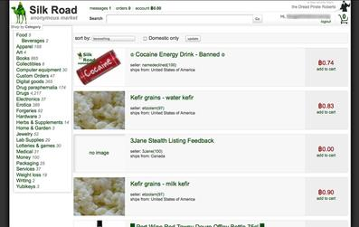
The Silk Road
Tor hidden service
An online black market
  Illegal drugs
Founded in Feb 2011
Shut down Oct 2013

Slide 40
The Silk Road
  Mistakes that Ross Ulbricht made
    Regularly log into the Silk Road from a single Internet Cafe
    He check his Gmail shortly before or after logging into the Silk Road
    He posed as a potential client on a forum and ask if anyone had used it, using his real name
    He post a question on Stack Overflow, with his real name and two hours after changed his username to another (frosty)
The FBI:
  Identified where the Silk Road was hosted (Asia)
  Found the first mention of the Silk Road using Google

Slide 41
Summary
Levels of the Deep Web
Level 0 Common Web
Level 1 Surface Web
Level 2 Bergie Web
  How you prevent indexing
  How to search non indexing pages
Level 3 Deep Web
Level 4 Dark Web
  TOR
  TOR Browser
  Safety considerations

