Slide 1
ALT Online Winter Conference 2017 Update
Kelly Terrell University of Southampton
@KellyATerrell K.Terrell@soton.ac.uk
#EdShare #altc
Notes:
This is a follow on from last years session to really give an update on what’s been happening and our some of our focus areas as we move forward
Appreciate that not everyone here will have seen last years session or be familiar with EdShare so I will give a really quick intro to start with and then move on to the more recent things
Last year I had to cram a lot in and ran out of time, so this time I’m really keen to give time over for you to ask me any questions you might have about EdShare about what it does, could do or what it would need to provide to work for you or your organisation. Also if there are any questions about how we run things behind the scenes or any questions about our community I will try to answer them all for you.
Also really keen to hear about what spaces you are using for sharing your teaching and learning materials – both closed in your institution, and open – how well do these work for you to facilitate sharing and collaboration

Slide 2
Digital content platform designed for sharing teaching and learning materials
Built on EPrints
Created as part of the University of Southampton EdSpace project (part of Jisc Institutional Exemplars programme)
“EdSpace was founded on the institutional need for a single, shared, safe, persistent, storage location for all manner of educational resources”
Built for sharing across university but acknowledgement of increasing activity around open educational resources (OERs)
2007 – 2009 : EdSpace Project
Notes:
EdShare is a digital content platform designed specifically for the sharing of teaching and learning materials. It is built upon EPrints which is an open source repository solution developed at University of Southampton and have now been running over 15 years ago and is used all over the world largely supporting open access but has branched out to become a solution for open data and open education resources.
EdShare originated from a research project ‘EdSpace’ for which the aim was to deliver institution wide infrastructure which would allow staff (and students) to share all manner of educational materials in a shared, safe, persistent storage location.
Also as part of a drive to encourage and facilitate greater sharing and collaboration across the university.

Slide 3
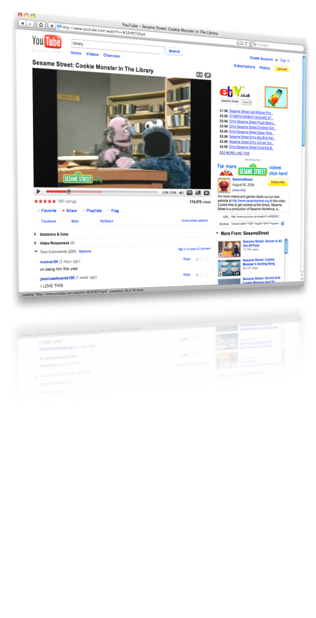
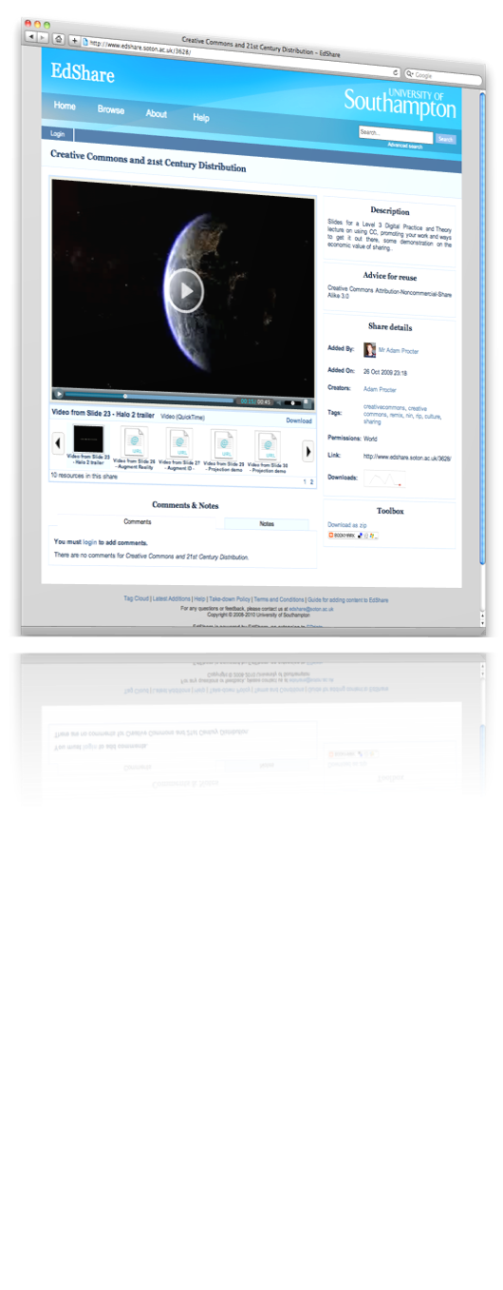
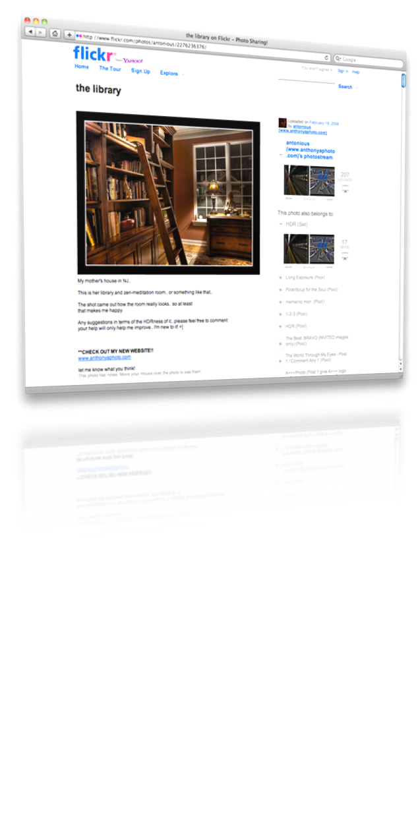
Key influences
Notes:
The design of EdShare was heavily influenced by media sharing sites.
These were examined to identify key factors in their success - things such as hosting, their ease of use, rapid upload to get content live, organisation options and user centric features
Also you’ll note the uploaded content dominates the display.
These were taken and reproduced where possible when designing EdShare
inline previews – EdShare support lots of different files types and will provide a preview wherever possible, be that presentations, documents or in this example video content
multiple ways of organising the content – collections or tagging
Individual users can also have a public profile to promote details about themselves as well as highight the work they have shared. This about showcasing excellent work people have shared and also to facilitate networking

Slide 4
EdShare Southampton was launched in 2008 edshare.soton.ac.uk
Further smaller research driven investment
EdSharev1 adopted by EPrints Services to provide EdShare to the wider education community
EdSharev2 was created as part of a major upgrade activity
2007 – 2009 : EdSpace Project
2009 – 2011: follow on EdSpace projects
2009 : Adopted by EPrints Services
2009 – 2015 : Multiple EdShare instances created via EPrints Services
2015 : Major upgrade to EdShare
2016 – 2017 : EdShare upgrade rolled out
Notes:
From this project EdShare Southampton was launched, and the project then received some smaller follow-on funding for specific development areas
This then became a supported service at Southampton and still is today
Once this was launched and the research project team shared their work there were lots of expressions of interests from other institutions and projects who wanted their own EdShare.
To respond to this need the generic EdShare offering was fully adopted by our enterprise group which is part of computer science school.
We then did some further work so it could be provided to others and through this created a number of instances – both institutional and subject specific.
A couple of years ago I did a major update to EdShare, this was largely behind the scenes, and it was to completely separate it from its original research project output state. Doing this update has now meant it is sustainable in the long term and is able to benefit from ongoing work happening in the EPrints space which is often generic in nature – such as searching, discoverability, statistics etc..

Slide 5
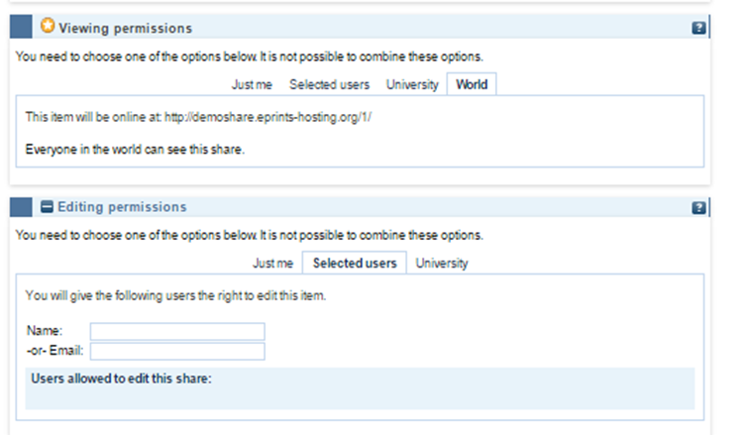
EdShare Features
Web 2.0 ethos
Immediate deposit
Varied viewing permissions
Shareable editing rights
Inline previews
Streaming video/audio
Embeddable HTML5 Player
Comments and Feedback
Community presence
CC licenses
Permanent URIs
Open metadata

Slide 6
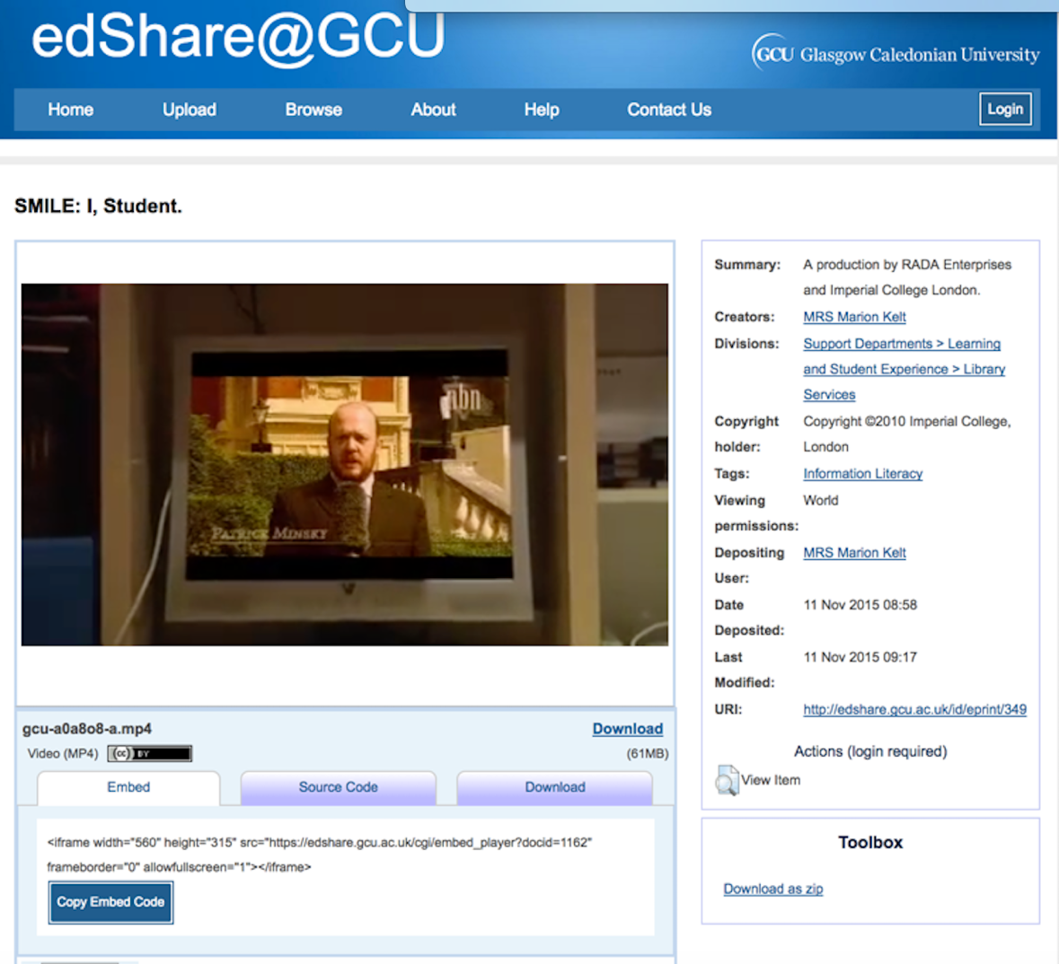
EdShare Features
Web 2.0 ethos
Immediate deposit
Varied viewing permissions
Shareable editing rights
Inline previews
Streaming video/audio
Embeddable HTML5 Player
Comments and Feedback
Community presence
CC licenses
Permanent URIs
Open metadata

Slide 7
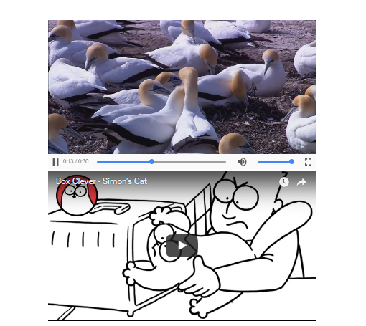
EdShare Features
Web 2.0 ethos
Immediate deposit
Varied viewing permissions
Shareable editing rights
Inline previews
Streaming video/audio
Embeddable HTML5 Player
Comments and Feedback
Community presence
CC licenses
Permanent URIs
Open metadata

Slide 8
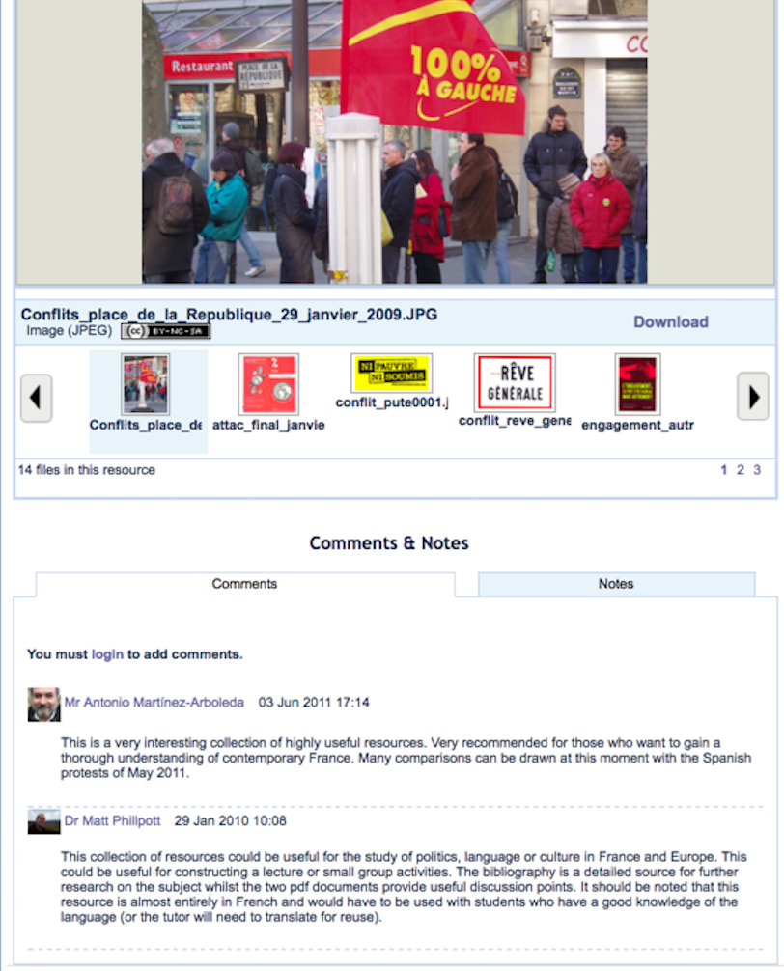
EdShare Features
Web 2.0 ethos
Immediate deposit
Varied viewing permissions
Shareable editing rights
Inline previews
Streaming video/audio
Embeddable HTML5 Player
Comments and Feedback
Community presence
CC licenses
Permanent URIs
Open metadata

Slide 9
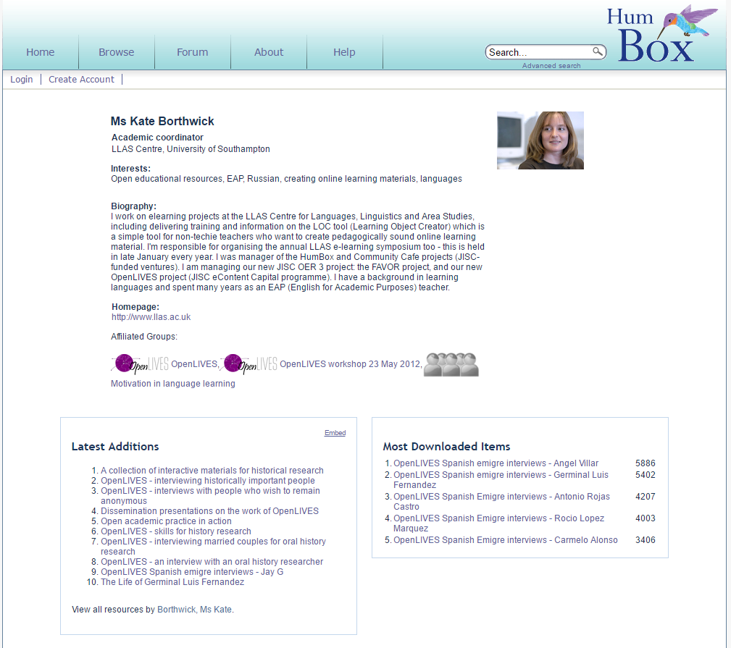
EdShare Features
Web 2.0 ethos
Immediate deposit
Varied viewing permissions
Shareable editing rights
Inline previews
Streaming video/audio
Embeddable HTML5 Player
Comments and Feedback
Community presence
CC licenses
Permanent URIs
Open metadata

Slide 10
EdShare Community
edShare@GCU
Launching early 2018
EdShare
And growing!
Notes:
These are the instance which are running on EdShare – a mixture of institutional spaces and community subject spaces.
The majority of these are all running the latest stable version of EdShare, and we are either in progress or have upgrades lined up for the others
Most recent addition in University of Glasgow who will be launching their EdShare in the new year.
One of the key things with this community is the how developments and improvements will emerge. When you have an EdShare it is not a fixed solution, it is incredibly flexible and adaptable, each of the instnaces you see here have been adapted and customised to meet local needs. Developments of course happen within our core team, but they will also happen with a single member of the community. Once complete they will often be added to the EdShare core so others can benefit.
Development effort and investment is distributed across the community.
ECS are currently working with EdShare beta release which will incorporate a number of the new developments I’ll be coming on to

Slide 11
Looking ahead
Greater support for day–to-day teaching delivery and learning activities
Support innovation
Add-on services to harness the collective set of open educational materials being released
Notes:
Whilst we continue to build new EdShare instances and work on developments with existing members we are always looking at what needs improving and what is coming next
1. This is really important. Whilst I’m attending with conferences such as this and hearing fantastic presentations about new practices people have been running with. I’ll come back and start thinking about ways in which we can adapt what we do, you have those moments where you get a blunt reminder that for many many people they are don’t know what OERs or Open Education is. In terms of sharing they are still doing some in a closed manner because they don’t know there is an alternative way or the benefits of perhaps considering a change. They’re under pressure they are focused on the students they have in front of them. We still have to go back to that original aim of the EdSpace project and see what else we can do to ensure EdShare works for them and their students.
2. We then also have people at the other end of the scale who want to push the boundaries. They are very happy to share and what it do more, they want to run informal course, they want to do new things and they need specific tools and services to do that. The institutional VLE particularly is simply not agile enough to support this, whereas EdShare is, for them EdShare is a key part of their teaching strategy going forward.
3. When we look at the growing community, running on shared standards we can then build add-on services on top of these. Very much work in progress, but to put that in context we currently have approximately XXXXX

Slide 12
Rich text description with complete flexibility to format and style as you wish, embed media
Private to you only, or share it publicly for others to view
Resources to display – either internal to the EdShare instance or external links
Lists, which can enable >>
Notes:
With this in mind, this one of the areas we a currently working on – looks exciting, bear with me!
Largely resource will be presented in isolation, they may be linked through tags, and you may have a resource which has multiple files, but it can be hard to see any sequence between them.
We have been working on a mechanism to provide another presentation layer for resources which aligns its self more closely to how staff and students are working but can also benefit external users of the materials.
I should emphasis this is still in development so the look of it will likely change. This is simply known as Lists at this point.
So the key things about your list is you have a rich text description with lots of flexibility of how it will appear you can embed images, videos, add links, style as you wish
As with resources, it can be private or you can share it so it is visible to anyone
And finally you have at the bottom the resources that are part of this list – these could be internal to this instance, or they could be external links elsewhere.
This is a generic list …

Slide 13
Presentation of modules
The same feature could be used for open courses
Notes:
One such use case can be for the presentation of modules.
This content was taken from a bespoke system we have running on our intranet. Very quickly and easily I have reproduced the same screen with same access point, but all of a sudden it is now open.
Isolated resources are immediately given greater context of use, and the ability to see them in a sequence.
Individual resources suddenly become much more useful to someone viewing them who is not a subsc

Slide 14
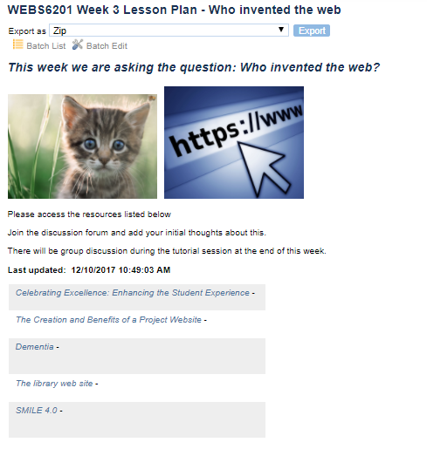
Lesson plans or Playlists
Notes:
Using the identical features, we can produce
Lesson plans, exact same thinking as the module - suddenly this content has been broken out of a closed bespoke system or simply a PDF
Playlist – user generated, either for their own purposes or for sharing.
People can subscribe or follow a module, lesson plans to receive updates.
We have the potential here to then start thinking about wiki-like behaviour and groups coming together to build a collection of resources and then that in itself becoming an open educational resource

Slide 15
Interface refresh & add-ons
Resource pages
Comments
Notes
Likes (acting as bookmark)
Statistics
Share
Downloads
User Dashboard/Home
My Resources
My Modules
My Playlists
Subscriptions
About me
…
Source: Pixabay
Notes:
We also in the early stages of refreshing the interface and introducing another presentation feature called ’panels’ and these are really containers, but will make it much easier to draw in content and tools without overloading the screen in one go.
On resources we’ll be introducing panels beneath previews:
User profiles will receive the same:
Main interface to the platform – bring content of relevance/interest to you, introducing more personalisation.
Nothing currently stopping any user (regardless of whether or not they belong to an institution being able to have an account) most just have this disabled.

Slide 16
EdShare.ac.uk
Add-on service connecting our distributed network of educational repositories
HUB
EdShare
edShare@GCU
Aiding discoverability of a vast collection of OERs
Notes:
We have started up edshare.ac.uk which is going to be our central access point for all things EdShare
The add-on service that I referenced earlier we are calling the EdShareHUB – this will be an EdShare instance itself but will be harvesting the open content from individual instances. Providing a single access point to raise discoverability of open content of these individual instances.
It will not host the files themselves but can act as a federated search across this community, and will grow as the community grows. We also did harvest a large number of the records which were present in Jorum before it completely closed, though not 100% again it is resources that may prove useful to others.
To give this a little context collectively there are XXXX open records currently.
We’ve had enquiries about people wanting to try out EdShare, so we’ll be adding this here.
We have also had enquiries whether an individual person could submit to EdShare – at the moment the only instance running are from institutions or subject specific, but the enquiry from someone who was not currently part of an institution or a subject area currently covered. So this has got us thinking about how EdShare.ac.uk could help support these individuals too.
Again much like the core development this space will be influenced by what the community would benefit from and of course funding that is available.

Slide 17
Any Questions?
Source: Pixabay

Slide 18
For further information contact Kelly Terrell EPrints Open Education Lead K.Terrell@soton.ac.uk @KellyATerrell
EdShare.ac.uk
www.eprints.org/edshare
Source: Pixabay

