Slide 1

Legal, Ethical and Professional Perspectives (LEPP)
- Workplace, copyright and Ethics
Dr Su White
Professional Development (COMP1205)
https://secure.ecs.soton.ac.uk/module/1617/COMP1205/33423/
http://www.edshare.soton.ac.uk/15567/
Notes:
(28) Health and Safety Authority (HSA) — Correct Sitting Position at a Desktop Computer - YouTube (28) Bullying and Harassment in the Workplace – Conflict Masters - YouTube (28) Employment Law Explained - YouTube (28) 14 Changes to UK law and policy from April 2017! - YouTube (28) Edward Snowden - Whistleblower - YouTube (28) Whistleblowing in the Workplace - Policy and Compliance - YouTube (28) U
nderstanding unconscious bias - YouTube
https://www.youtube.com/watch?v=dVp9Z5k0dEE&t=6s
https://www.youtube.com/watch?v=euwasyw-iNg
https://www.youtube.com/watch?v=-5sakGkmHh8
https://www.youtube.com/watch?v=kQRtVYBv4hI\
https://www.youtube.com/watch?v=ooNvhVZP_8g
https://www.youtube.com/watch?v=ooNvhVZP_8g
https://www.youtube.com/watch?v=cmKVdA4sPYw&t=16s
https://www.youtube.com/watch?v=PcsoeDpUSrs

Slide 2
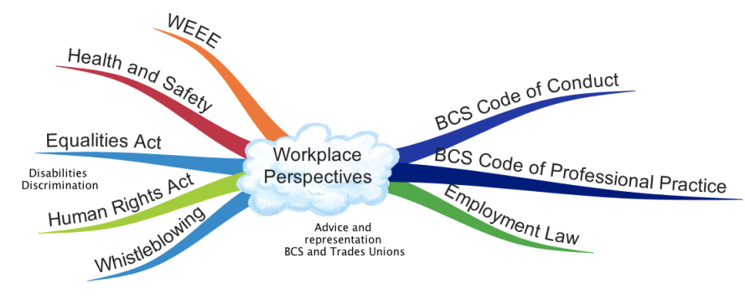
Workplace Perspectives

Slide 3
What is important…
Reminder: based on module needs and past experience

Slide 4
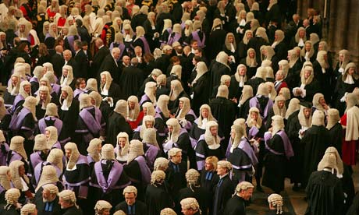
Reminder:
You are not learning to be a lawyer
But with this module
Develop legal awareness
Think about your
  rights
  responsibilities
Law in the workplace
Contracted to/retained by an employer
Employed in an organisation/business
Membership benefit
Professional bodies
Trades Unions

Slide 5
Consider the extent of the area
legal
ethical
workplace

Slide 6
Possible extent of professional and legal issues in the workplace
creative
commons
e-commerce
intellectual
property
professionalism
environment
green
ICT
code of
conduct
freedom
of
information
open
data
e-government
accessibility
open
source
employment
rights
globalisation
digital
futures
equality
security
defamation
File
sharing
inclusivity
computer
crime
academic
ethics
professional
bodies
linked
data
outsourcing
social
enterprises
health
and
safety
free
speech
civic
duty
digital
rights management
libel
surveillance
digital
divide
data
protection
hacking
morals
pornography
ethics
privacy
discrimination
censorship
copyright
responsibility
localisation

Slide 7
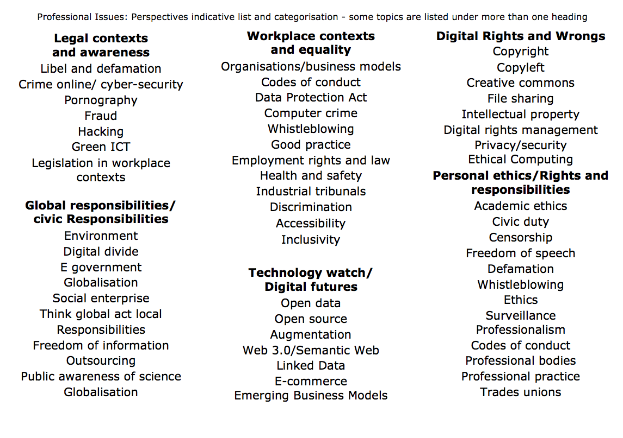

Slide 8
Workplace Issues
These slides are the content of this week’s material

Slide 9
Overview:
Workplace rights
Workplace responsibilities
Respecting others’ work
Self study - ownership

Slide 10
Key legal areas
Communications Act 2003 section 127 (Came into force 25th July 2003 replaced s43 Telecommunications Act 1984)
Computer Misuse Act 1990
Copyright design and patents 1988
Data Protection Act 1998
Defamation Act 1996
Digital economy act 2010
Electronic Commerce
(EC Directive) Regulations 2002
Electronic waste disposal
Equalities Act 2010
Health and Safety at work 1974
Harassment protection act 1997
Human rights act 1998
Malicious Communications Act 1988 section 1
Postal Services Act 2000 section 85 (commenced 26th March 2001)
Regulation of Investigatory Powers Act 2000
Which topics are relevant in the work context ?
Notes:
Which topics are relevant today?
They are identified on next slide

Slide 11
Workplace specific Areas
Communications Act 2003 section 127 (Came into force 25th July 2003 replaced s43 Telecommunications Act 1984)
Computer Misuse Act 1990
Copyright design and patents 1988
Data Protection Act 1998
Defamation Act 1996
Digital economy act 2010
Electronic Commerce
(EC Directive) Regulations 2002
Electronic waste disposal
Equalities Act 2010
Health and Safety at work 1974
Harassment protection act 1997
Human rights act 1998
Malicious Communications Act 1988 section 1
Postal Services Act 2000 section 85 (commenced 26th March 2001)
Regulation of Investigatory Powers Act 2000
Which topics are covered today?
Notes:
Which topics are relevant today?
They are identified on next slide

Slide 12
Broad Scope
Employment Legislation
  Getting a job
  Keeping a job
  Your rights whilst working
Equality in the workplace
  Equality Act 2010
  Sex Discrimination Act 1975
  Equal Pay Act 1970
  Agency Workers Regulations 2010
  Northern Ireland only
  Disabilities Discrimination Act 1995
Trades Unions
ACAS, and Employment Disputes
Harassment and Bullying
Whistleblowing
Health and Safety at Work
Professional Bodies
  Working Practice
  Codes of conduct

Slide 13
Can include…
Working time regulations
Trades Unions and Collective Rights
Part time Work
Fixed Term Work
Employment Tribunals and Dispute Resolution
Work and Parents/Care duties
Maternity
Parental Leave
Time off for Dependents
Employment Act 2002
Equality Act 2010

Slide 14
Employment….
Pay
National Minimum Wage
Employment Contracts and Conditions
Time off and Holidays
Flexible Working
Working Hours
Sickness Absence
Business transfers and takeovers
Starting a new job
Employment terms and conditions incorporate

Slide 15
Find out for yourself
Be able to:
Evaluate the strengths and benefits of a particular workplace
Take a view on good practice
Demonstrate your understanding
In interviews
In your working life
Your degree/future
Demonstrate, integrate, use
  A deeper understanding
  Equip yourself with the information to make informed personal decisions
  Practice the principles in your everyday life
Your will be ambassador’s for ECS

Slide 16
TAKING A
Workplace perspective
Walkthough some new areas

Slide 17

Why do we have equality legislation?
Discussion

Slide 18
Why we might want equality
Equal reward for equal effort/responsibility
Addressing unconscious/implicit bias
To counter/overcome
Institutional racism
Hostile workplace ‘cultures’
privilege or favouritism, nepotism

Slide 19
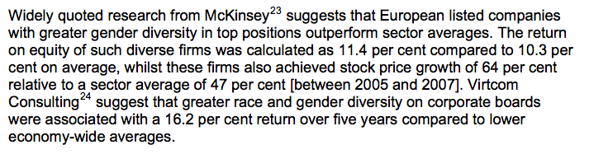
Business case
Department for Business Innovation and Skills, 2013. The Business Case for Equality and Diversity: a survey of the academic literature, London

Slide 20
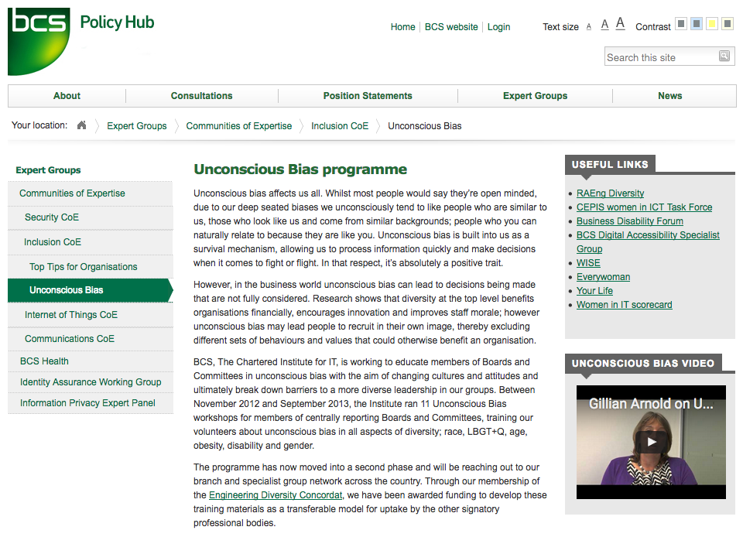
Important enough to make it a focus

Slide 21
RSA Video

Slide 22
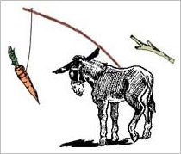
So why to we need legislation?
Encouragement and awareness alone seldom bring about change
The state has a responsibility
to be fair;
and to be seen to be fair (discuss!)

Slide 23
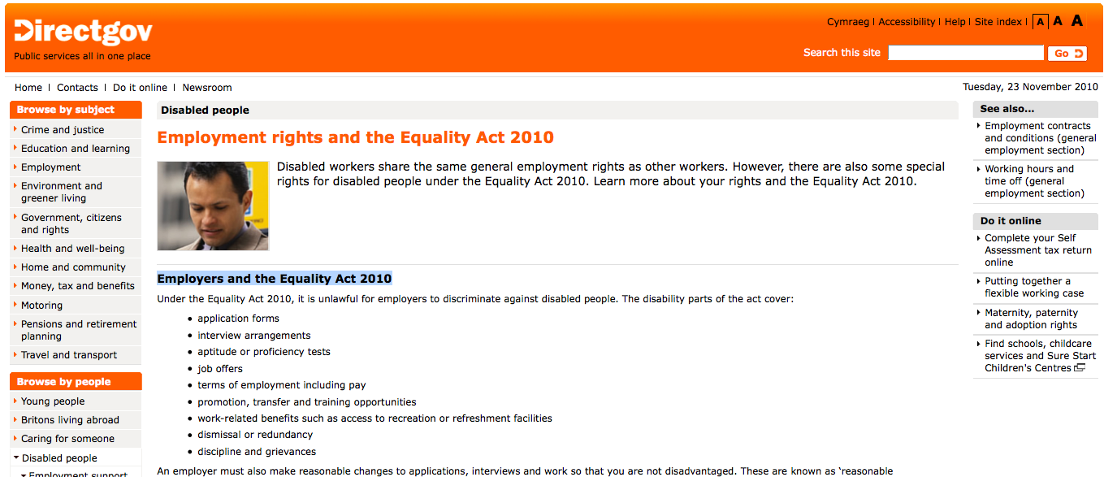
The Equality Act 2010
http://bit.ly/eqact2010

Slide 24

Key areas of the Equality Act 2010
Provide equality of opportunity
Respect protected characteristics

Slide 25
Extent of the legislation
Discrimination
Adjustments for disabled persons
Harassment
Victimisation
Disabilities can be
visible or invisible
Many types of behaviour can manifest as discriminatory
Act fairly – but also ensure fairness around you
Whatever your level of responsibility
Notes:
16.Gender reassignment discrimination: cases of absence from work 17.Pregnancy and maternity discrimination: non-work cases 18.Pregnancy and maternity discrimination: work cases 19.Indirect discrimination Adjustments for disabled persons Chapter 2 Prohibited conduct Discrimination 13.Direct discrimination 14.Combined discrimination: dual characteristics 15.Discrimination arising from disability
20.Duty to make adjustments 21.Failure to comply with duty 22.Regulations Discrimination: supplementary 23.Comparison by reference to circumstances 24.Irrelevance of alleged discriminator's characteristics 25.References to particular strands of discrimination Other prohibited conduct 26.Harassment 27.Victimisation

Slide 26
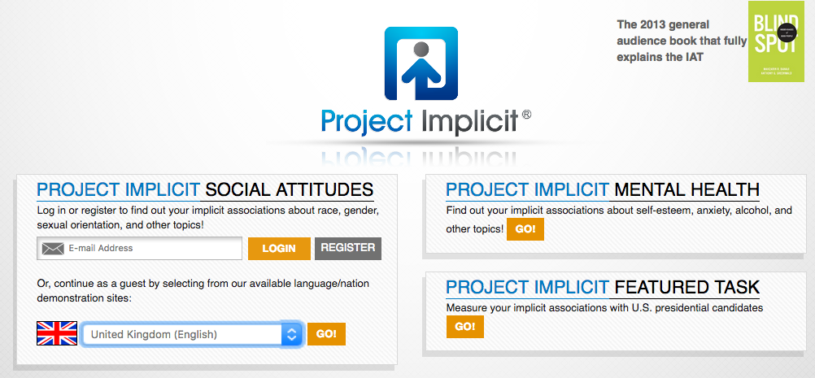
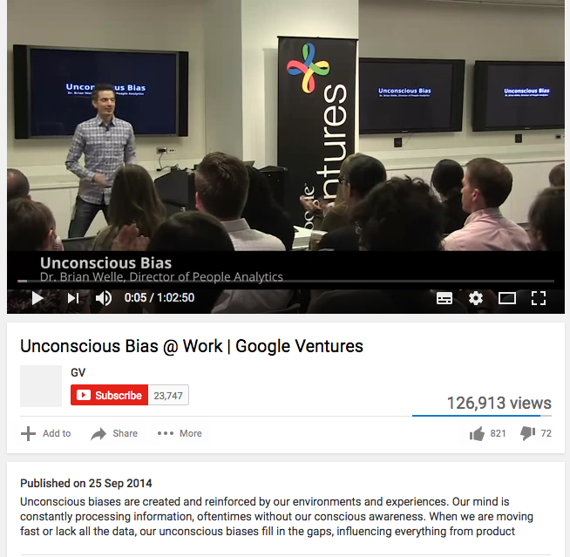
What can you do?
Watch the videos
https://implicit.harvard.edu/implicit/
Take the tests

Slide 27
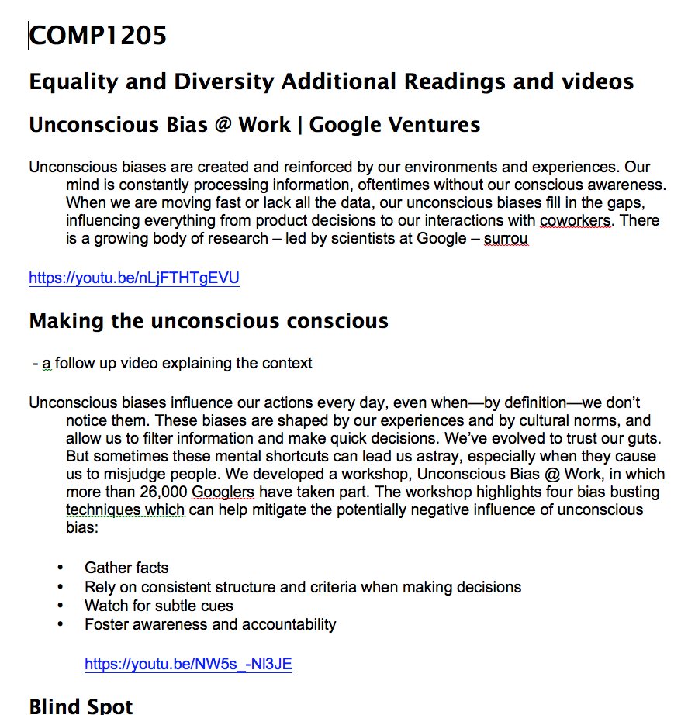
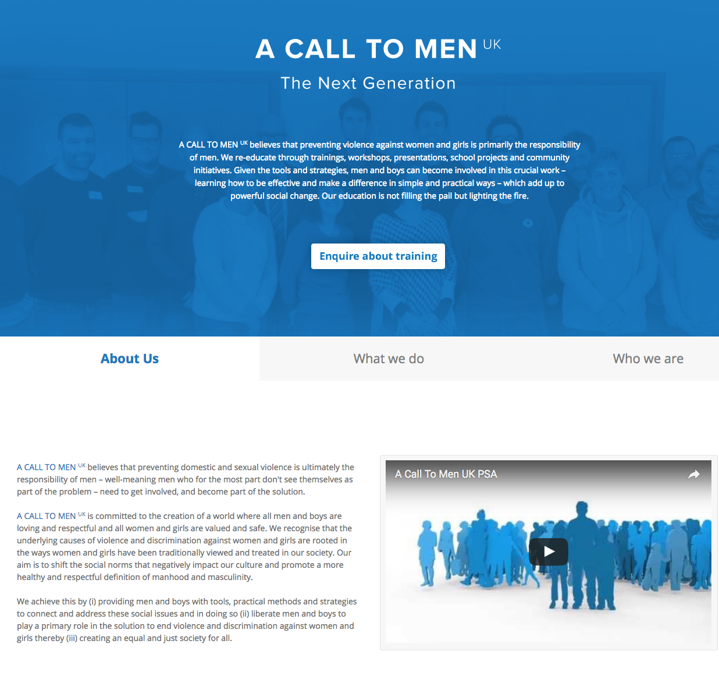
Follow up reading
Educate yourself
Think about how this can be applied in your immediate environment

Slide 28
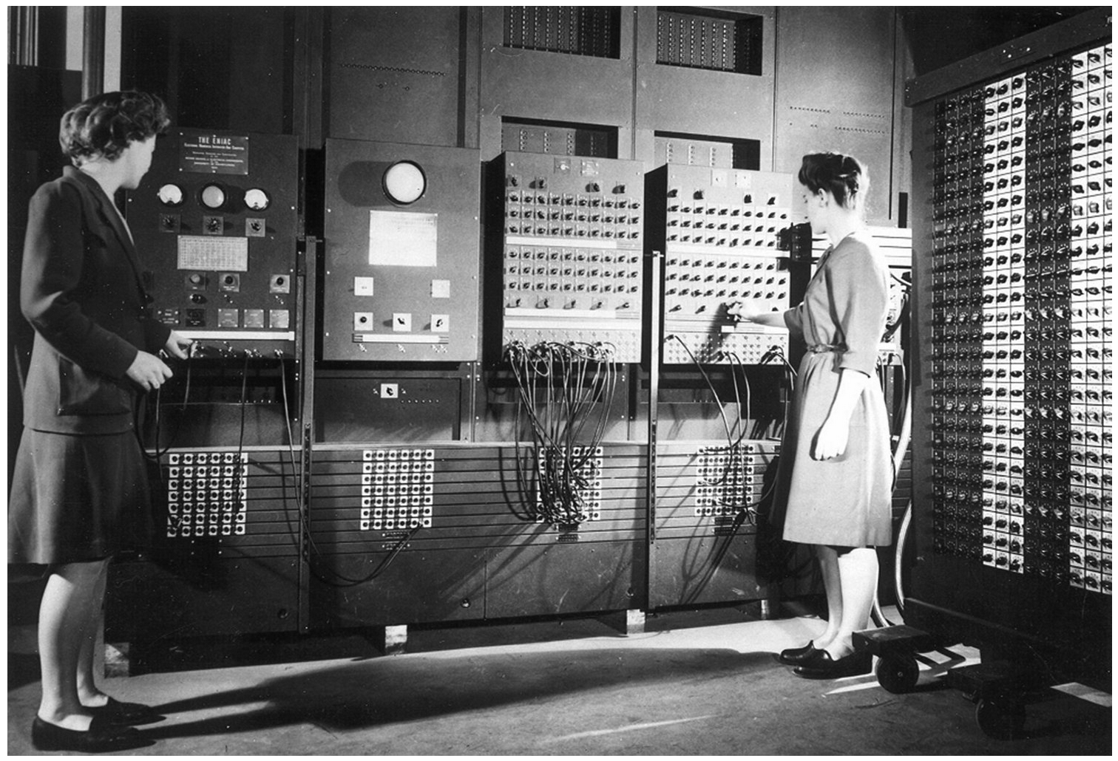
Find out about the workplace
The Forgotten Female Programmers Who Created Modern Tech

Slide 29
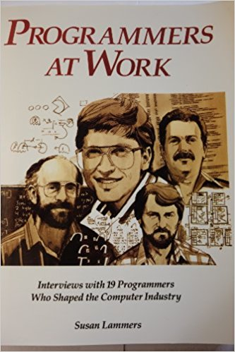

Who were the pioneers?
What did they do?
How did they do it??

Slide 30
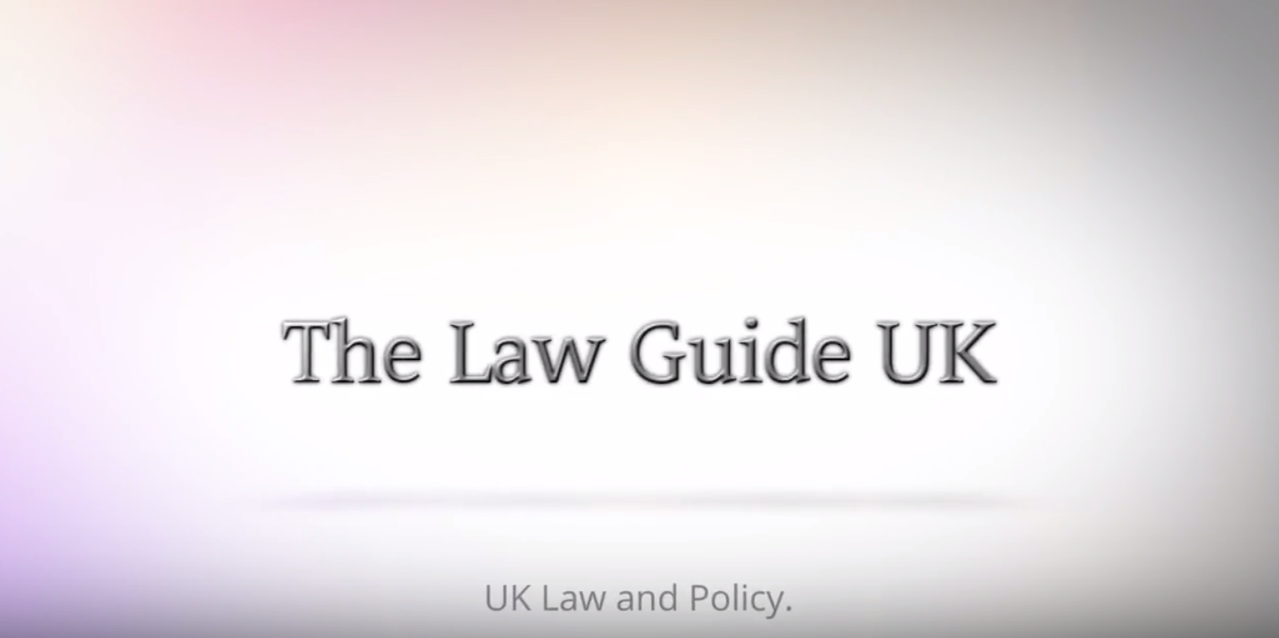
Don’t just look back, keep up and look forward!
https://youtu.be/kQRtVYBv4hI?t=7s
Video: 14 Changes to UK law and policy from April 2017!

Slide 31
Harassment
unwanted conduct
related to a relevant protected characteristic,
which has the purpose or effect of
violating an individual’s dignity or
creating and intimidating, hostile, degrading, humiliating or offensive environment for that individual
The Equality Act 2010

Slide 32
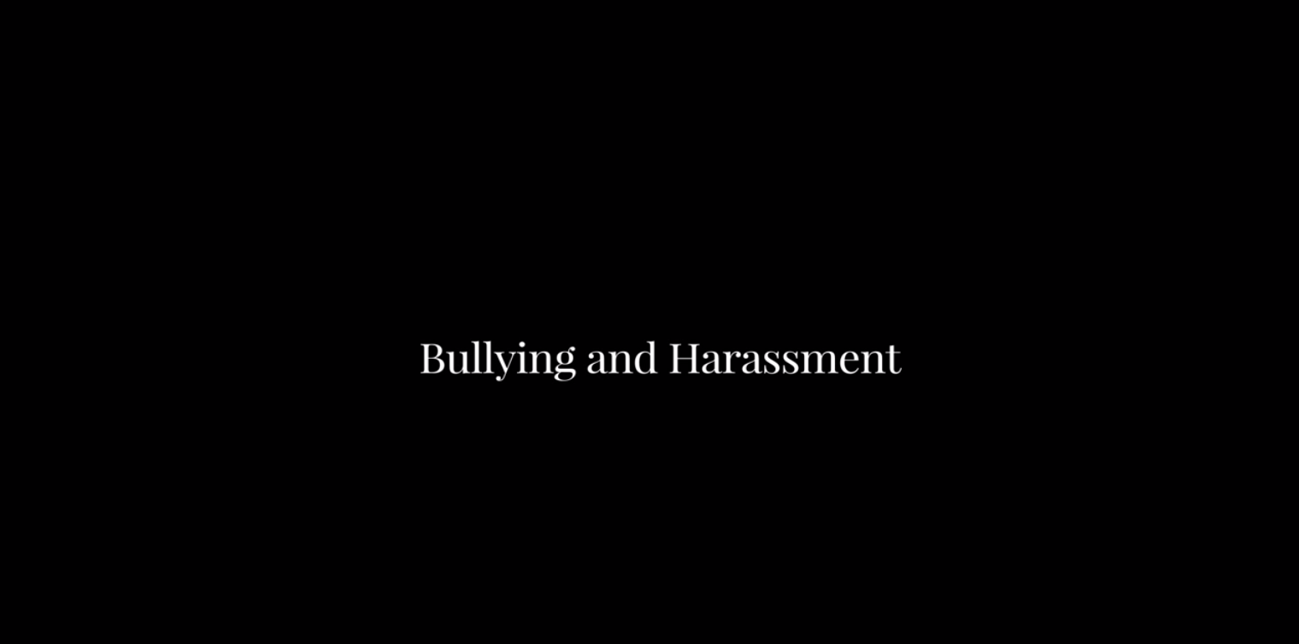
How to deal with harassment?
https://YouTube/cmKVdA4sPYw?t=14s

Slide 33
Dignity at work policy

Slide 34
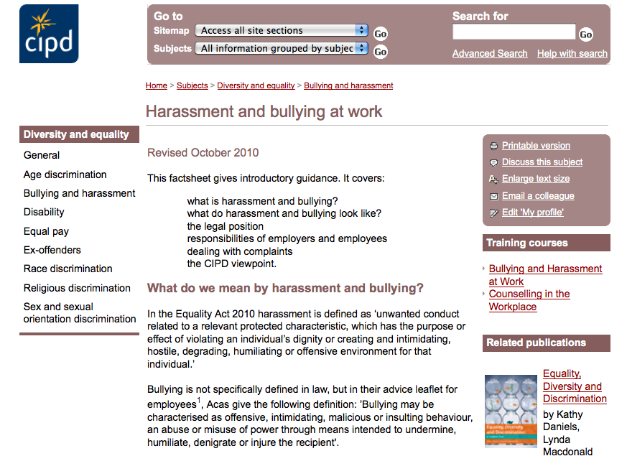
Chartered Institute of Personnel and Development
http://www.cipd.co.uk

Slide 35
We have the right to speak out and Question
perspectives

Slide 36
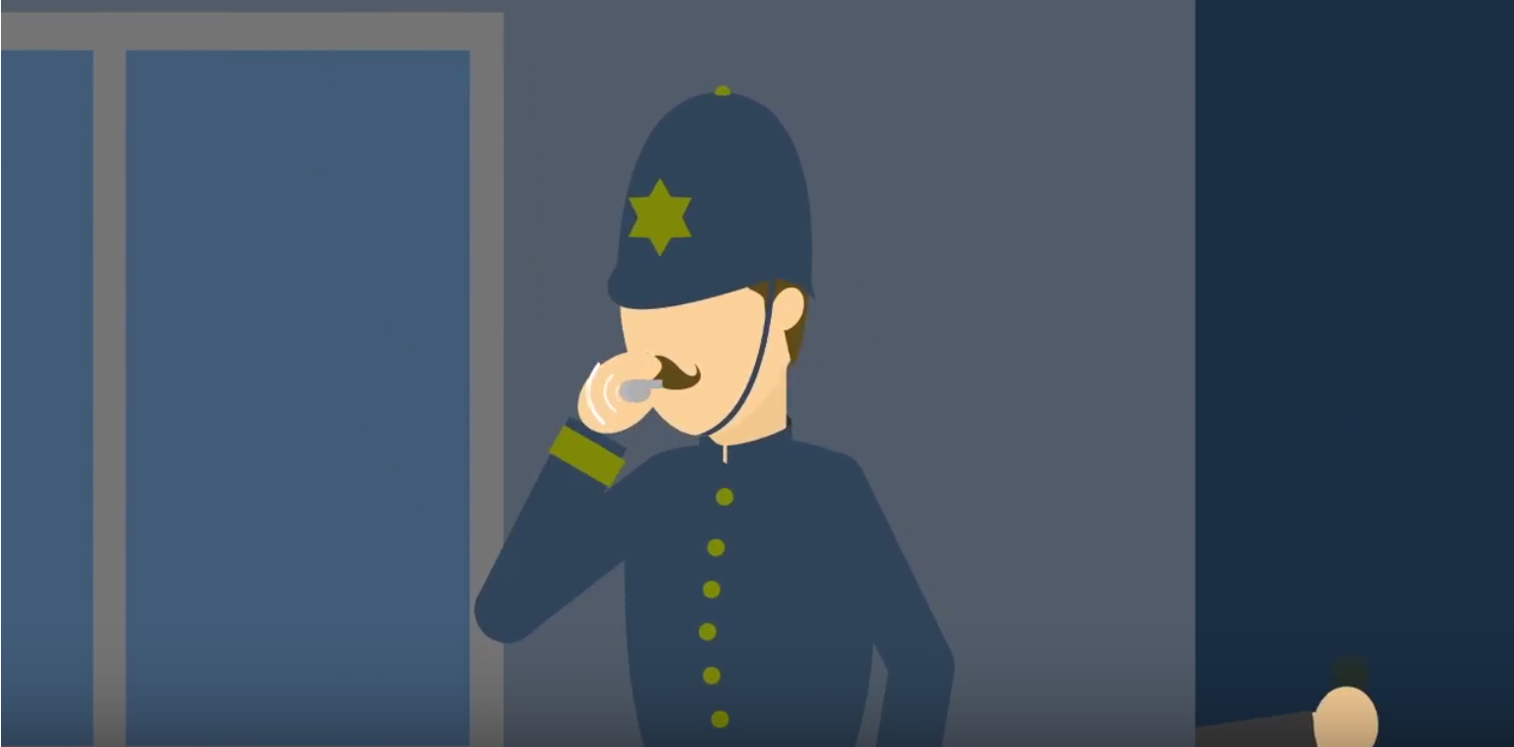
Video - Whistleblowing
https://youtu.be/euwasyw-iNg
Notes:
https://youtu.be/euwasyw-iNg

Slide 37
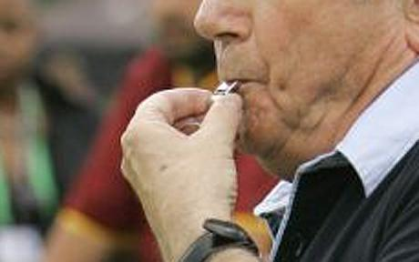
Whistleblowers…
an informant who exposes wrongdoing within an organization in the hope of stopping it; "the law gives little protection to … wordnetweb.princeton.edu/perl/webwn
A whistleblower is a person who alleges misconduct. More complex definitions may be used, but the issue is that the whistleblower usually faces reprisal. …en.wikipedia.org/wiki/Whistleblower
whistle-blower - One who reports a problem or violation to the authorities; especially, an employee or former employee who reports a violation by an employer
en.wiktionary.org/wiki/whistle-blower
whistleblowing - the disclosure to the public or to authorities, usually by an employee, of wrongdoing in a company or government department en.wiktionary.org/wiki/whistleblowing
whistle blower - An employee who has inside knowledge of illegal activities occurring within his or her organization and reports these to the public. investor.lilly.com/glossary.cfm
Any person who makes a disclosure about improper conduct by public bodies and public officers under the Whistleblowers Protection Act 2001 www.ombudsman.vic.gov.au/www/default.asp

Slide 38
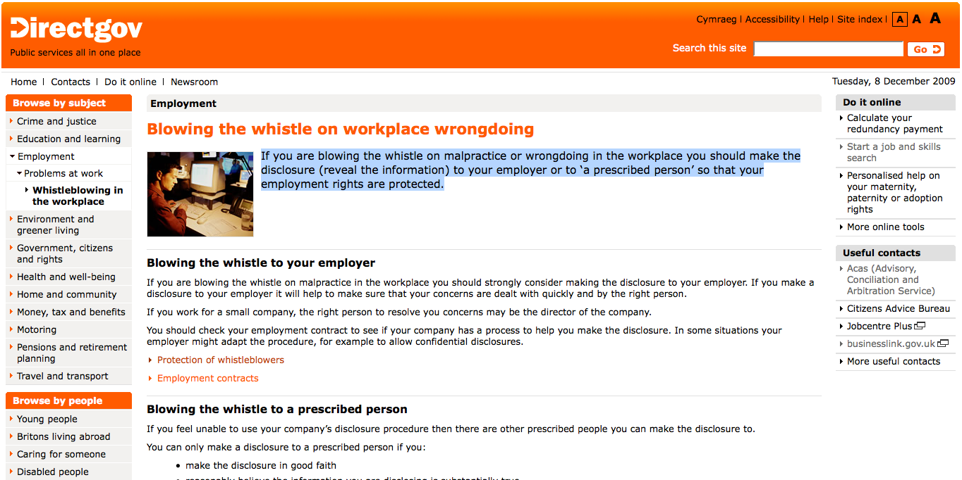
Whistleblowing rights
http://www.direct.gov.uk/en/Employment/ResolvingWorkplaceDisputes/Whistleblowingintheworkplace/DG_175821

Slide 39
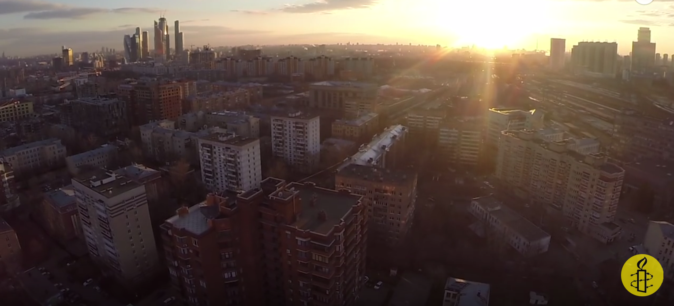
Edward Snowden
https://youtu.be/-5sakGkmHh8

Slide 40
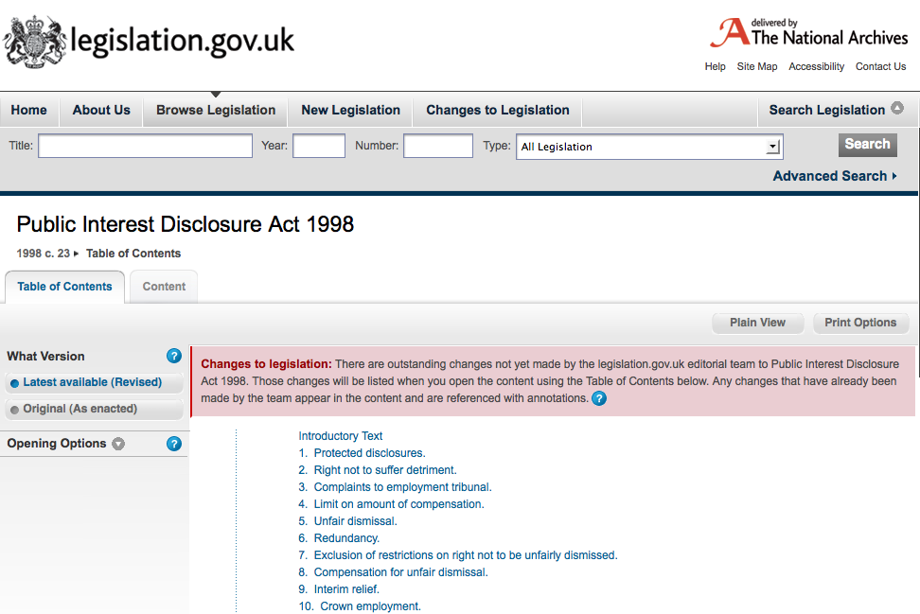
Public Interest Disclosure Act 1998
http://www.legislation.gov.uk/ukpga/1998/23/contents

Slide 41

Employment Tribunals
https://www.gov.uk/employment-tribunals

Slide 42

Arbitration and Conciliation
http://www.acas.org.uk/

Slide 43
Use ACAS before you go to tribunal
Early conciliation necessary before tribunal
Formal notification – via a form
Free service via impartial conciliator
Aims for rapid turn round
Can make a legally binding agreement
Or reference from ACAS to go to tribunal
Time limit – 3-6 months after early conciliation

Slide 44
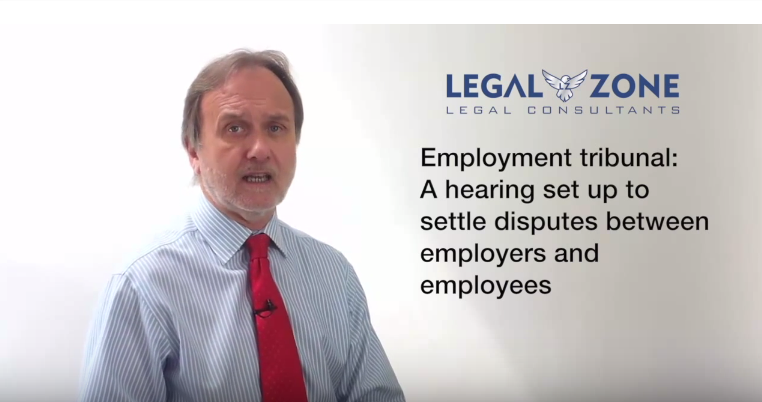
Procedures for employment tribunals
https://youtu.be/ooNvhVZP_8g

Slide 45
Tribunals can consider….
CEC 1975 | Colleges of Education (Compensation) Regulations 1975
COMAH 1999 | Control of Major Accident Hazards Regulations 1999
DCOA 1994 | Deregulation and Contracting Out Act 1994
DDA 1995 | Disability Discrimination Act 1995
DRC 1999 | Disability Rights Commission Act 1999
EE(Age) Regs 2006 | Employment Equality (Age) Regulations 2006
EE (Religion or Belief) Regs 2003 | Employment Equality (Religion or Belief) Regulations 2003
EE (Sexual Orientation) Regs 2003 | Employment Equality (Sexual Orientation) Regulations 2003
EPA 1970 | Equal Pay Act 1970
ERA 1996 | Employment Rights Act 1996
ERelA1999 | Employment Relations Act 1999

Slide 46
Tribunals can consider….
ETA 1996 | Employment (Industrial) Tribunals Act 1996
FTE 2002 | Fixed Term Employees (Prevention of Less Favourable Treatment) Regulations 2002
FWR 2002 | Flexible Working (Procedural Requirements) Regulations 2002 and Flexible Working (Eligibility, Complaints and Remedy) Regulations 2002
HSCE 1996 | Health and Safety Consultation with Employee Regulations 1996
HSWA 1974 | Health and Safety at Work Act 1974
MPL 1999 | Maternity and Parental Leave Regulations 1999
MPL 2002 | Maternity and Parental Leave (Amendment) Regulations 2002
NESE 1994 | Notification of Existing Substances (Enforcement) Regulations 1994
NMWA 1998 | National Minimum Wage Act 1998
PAL 2002 | Paternity and Adoption Leave Regulations 2002
PIDA 1998 | Public Interest Disclosure Act 1998
PTW 2000 | Part Time Worker (Prevention of Less Favourable Treatment) Regulations 2000

Slide 47
Tribunals can consider….
RRA 1976 | Race Relations Act 1976
SDA 1975 | Sex Discrimination Act 1975
SRSC 1977 | Safety Representatives and Safety Committees Regulations 1977
SSPA 1975 | Social Security Pensions Act 1975
STA 1994 | Sunday Trading Act 1994
TCA 2002 | Tax Credits Act 2002
TULR(C) 1992 | Trade Union and Labour Relations (Consolidation) Act 1992
TUPE 1981 | Transfer of Undertakings (Protection of Employment) Regulations 1981
TURER 1993 | Trade Union Reform and Employment Rights Act 1993
WTR 1998 | Working Time Regulations 1998
RT (WT) R 2005 | Road Transport (Working Time) Regulations 2005

Slide 48
Health and Safety at work
Another important topic area

Slide 49
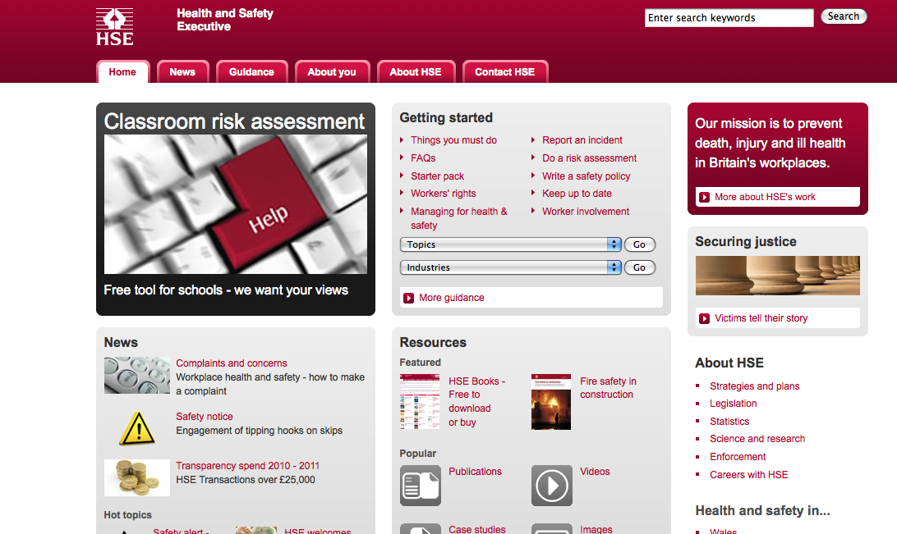
Health and Safety Executive
http://www.hse.gov.uk/
Notes:
Covers information on everything from workplace violence to electrical testing

Slide 50
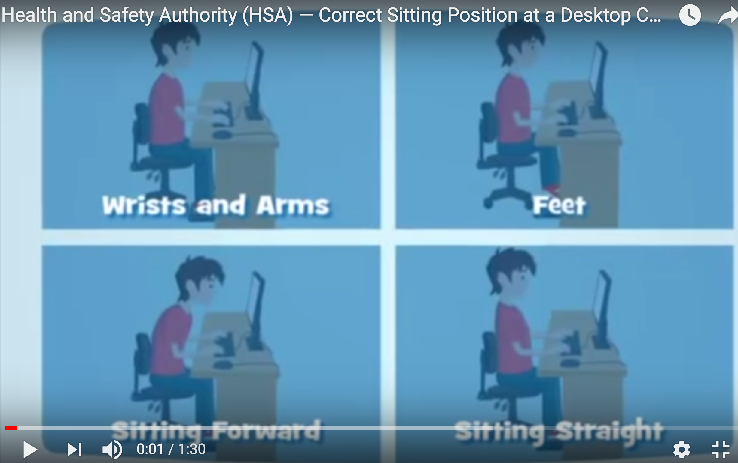
Look after! yourself
https://youtu.be/PcsoeDpUSrs

Slide 51
Health and Safety
General Environment
The Health and Safety at Work Act 1974
Computer Specific Environment
The Health and Safety (DSE) Regulations 1992

Slide 52

The IT workplace/Green IT

Slide 53

European directive
Waste electrical and electronic equipment recycling

Slide 54
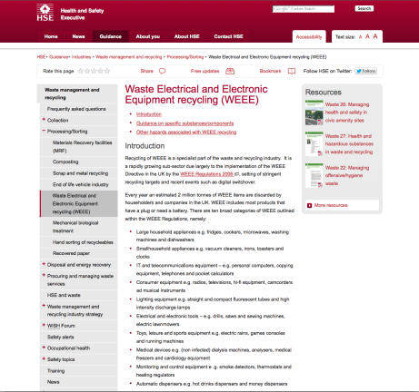
The legislation
http://www.hse.gov.uk/waste/waste-electrical.htm

Slide 55
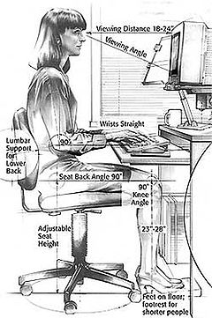
Customising the workplace
Sadly I was unable to obtain any images of male computer workers!

Slide 56
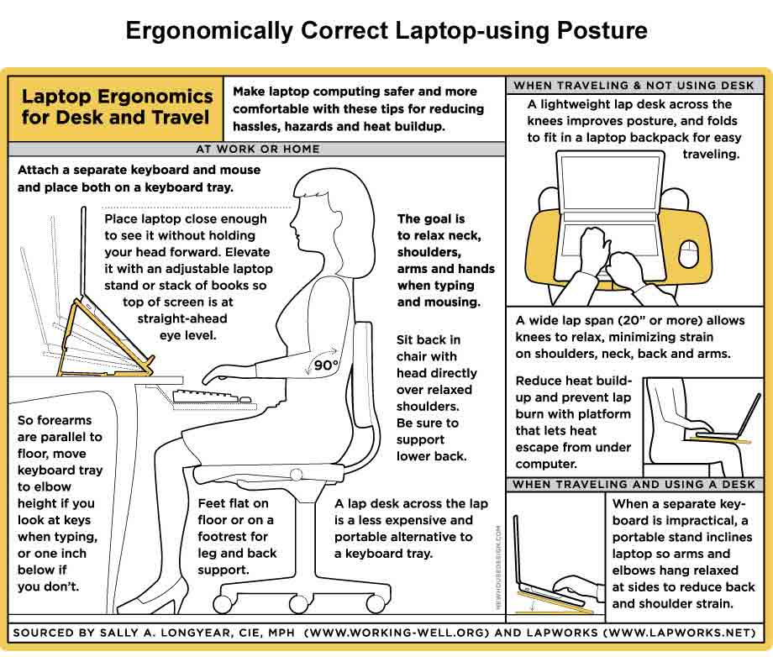
Managing your environment

Slide 57
Agencies and interest groups

Slide 58
Such as…
Government agencies
Charities and action groups
Professional bodies
Trades Unions
The next few slides give some examples, you need to familiarise yourself with these sources
Opportunities
  Revision for the stage test
  Preparation for the case study

Slide 59
Also useful sources of information
Be aware of agencies
Which can be useful for revision

Slide 60
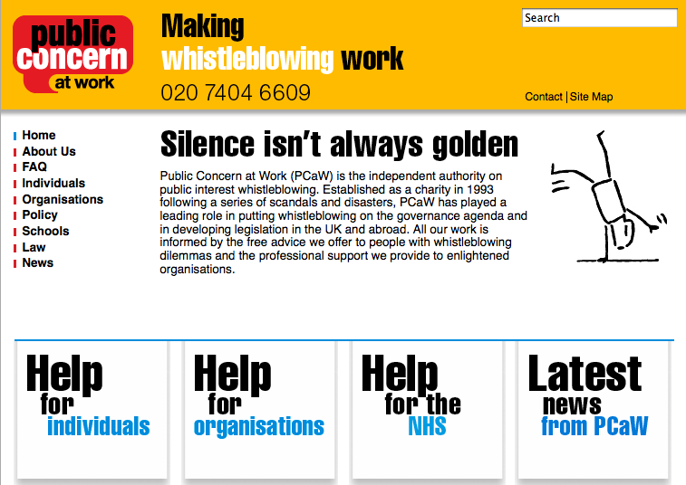
Public Concern at Work
http://www.pcaw.co.uk/

Slide 61
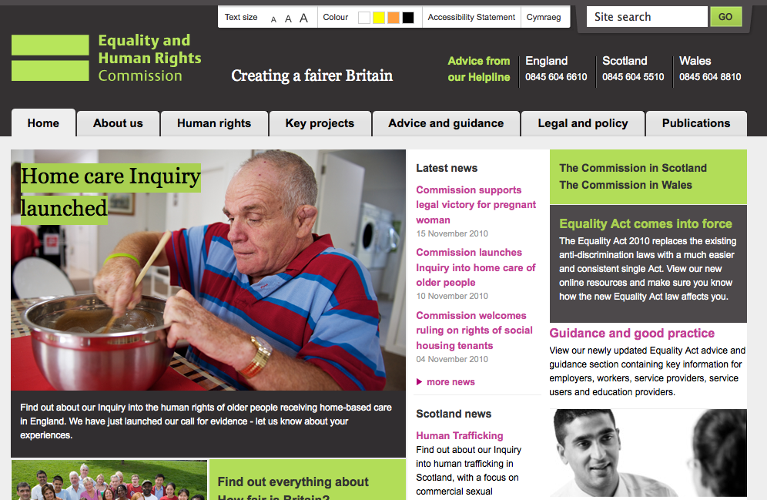
Equality and Human Rights Commission
http://www.equalityhumanrights.com/

Slide 62
Public Concern at Work
http://www.pcaw.co.uk/

Slide 63
Trades Unions
May be active in your workplace
There may be some kind of local workers group
May not be usual in your workplace
Like professional bodies they require a subscription
  They also are afforded some (limited) recognition in workplace law

Slide 64
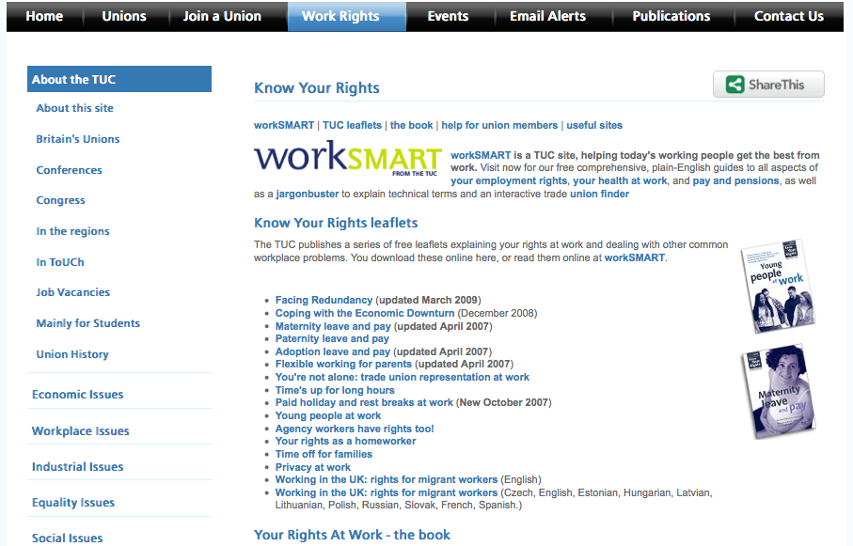
TUC
http://bit.ly/tucrights

Slide 65
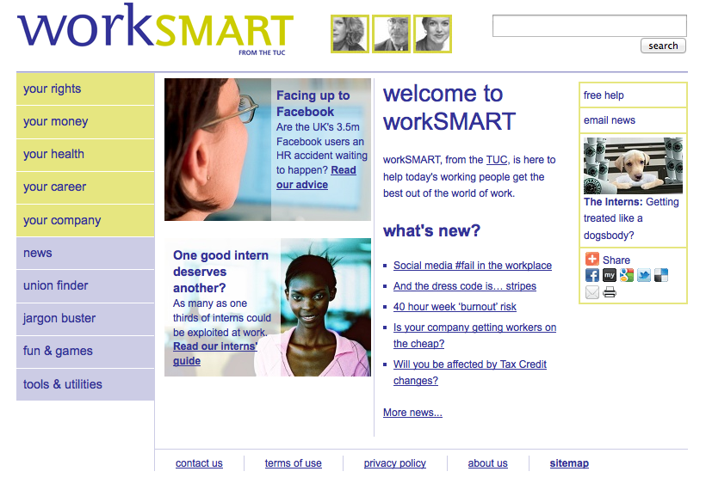
Worksmart (TUC)

Slide 66
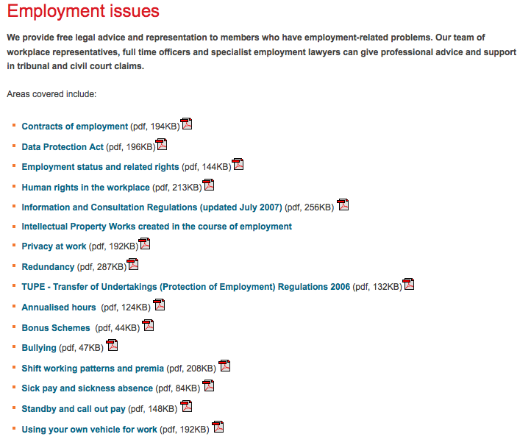

Employment Issues
Notes:
Typical areas in which a union might provide support

Slide 67
Arbitration and Conciliation
http://www.acas.org.uk/

Slide 68
BCS – professional body
Your degree is BCS accredited

Slide 69
Professional Bodies
Professional Bodies – and codes of conduct
- we covered codes of conduct and good practice
But they also usually offer the services of their legal departments

Slide 70
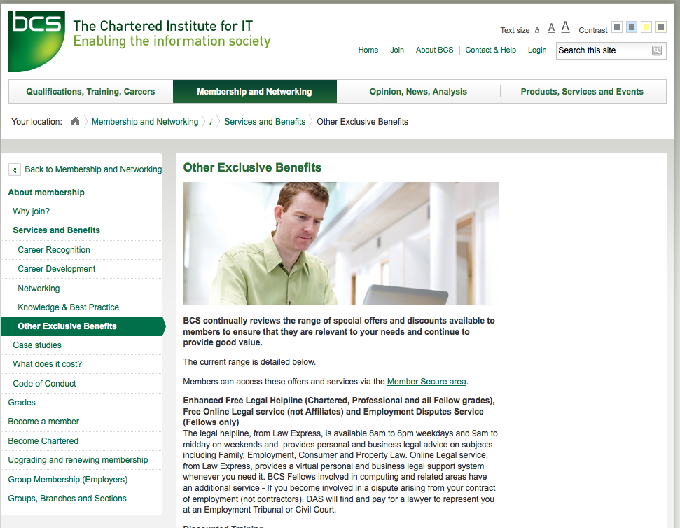
BCS Legal
http://www.bcs.org/category/9234

Slide 71
BCS - legal
“Enhanced Free Legal Helpline (Chartered, Professional and all Fellow grades), Free Online Legal service (not Affiliates) and Employment Disputes Service (Fellows only)
The legal helpline… provides personal and business legal advice on subjects including Family, Employment, Consumer and Property Law.
Online Legal service, from Law Express, provides a virtual personal and business legal support system whenever you need it.
BCS Fellows involved in computing and related areas have an additional service - If you become involved in a dispute arising from your contract of employment (not contractors), DAS will find and pay for a lawyer to represent you at an Employment Tribunal or Civil Court.

Slide 72
Professional Indemnity Insurance
protects against financially crippling/reputation-damaging claims by dissatisfied clients.
  Negligence: or breach of duty of care
  Intellectual property: unintentionally infringing on others’ copyrights, trademarks, broadcasting rights, any act of passing off
  Loss of documents/data: damaged, lost or stolen data and documents belonging to your clients
  Dishonesty: liability arising from the theft of your clients’ money

Slide 73
CIPD – already shown
http://www.cipd.co.uk

Slide 74
Copyright and IP

Slide 75
Notes
Copyright and IP
  Notes and links on legislation
Awareness issues
  Things you might find useful when applying for work

Slide 76
Tasks: Other key areas
Copyright Design and Patents Act
Review the slides, make notes
Related slides – rights and ownership online
http://www.edshare.soton.ac.uk/9939/
And now incorporated into the slides below

Slide 77
Acknowledgements
Sarosh Kahn and Laura German provided some of the basic material for this set, along with some structure.
Those slides have been modified and various additions and alterations made

Slide 78
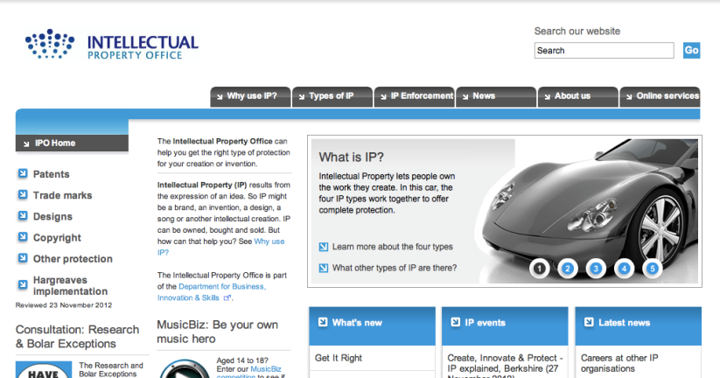
Intellectual Property

Slide 79
Copyright, Designs and Patents Act 1988
The Copyright, Designs and Patents Act 1988 is the current UK copyright law. This act gives the creators of literary, dramatic, musical and artistic works the right to control how their material may be used.
The Act details what types of work can be protected and the rights that a person has.
This Act is an extension to the previous copyright laws covered by the Copyright Act 1956, to encompass a larger scope of work.
Since 1988 the Act has had several amendments made to it.

Slide 80
What is copyright?
Copyright, unlike patents or trademarking is an automatic legal process which comes into effect as soon as a product or piece of work is created.
To qualify, said product or piece of work must be original and 'exhibit a degree of labour, skill or judgement.'
It is interesting to note that copyright comes into effect UPON PUBLICATION of the work, so if someone steals your idea and gets it published before you, you would be in breach of copyrighted work. (Copyright does not protect intangible things such as ideas, and there is no way to prove something ownership of something intangible).

Slide 81
What is copyright?
Copyright is a law that gives the author of certain types of work exclusive rights for a period of time.
It automatically covers your work, no need for registration
Copyright belongs to its author, but it can be sold or licensed to anyone.
  Once sold, the owner looses all rights
  Licensing gives certain rights to the licensees, even though the copyright is still the property of the owner.
  Licensees can also grant licenses to other people. Licences can be granted forever or for some fixed period.
Notes:
Copyright is a form of intellectual property that gives the author of an original work exclusive right for a certain time period in relation to that work, including its publication, distribution and adaptation, after which time the work is said to enter the public domain. Copyright applies to any expressible form of an idea or information that is substantive and discrete and fixed in a medium. Some jurisdictions also recognize "moral rights" of the creator of a work, such as the right to be credited for the work. Copyright is described under the umbrella term intellectual property along with patents and trademarks. http://en.wikipedia.org/wiki/Copyright

Slide 82





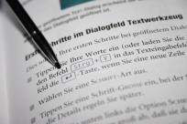
Copyright Law
Original Dramatic
Works
Original Musical
Works
Original Literary Works
Original Artistic
Works
The Copyright, Designs and Patents Act 1988 section 1(1) states that copyright subsists in accordance with Part one of the Act in eight categories of works.
Computer Programs/Databases
The Typographical Arrangement of Published Editions
Broadcasts
Films
Sound Recordings

Slide 83

Exclusive Rights of the Copyright Holder
To Copy the Work
To Communicate the Work to the Public
To Rent or Lend the Work to the Public
To Make an Adaptation of the Work or do any of the Above in Relation to an Adaptation
To Perform, Show or Play the Work in Public
To Issue Copies to the Public
The Copyright, Designs and Patents Act 1988, Section 16.
On the Web we are all used to hearing about widespread copyright infringement, particularly of music and films … But piracy is not new!

Slide 84
Copyright Law
Under official government legislation:
  "Where a literary, dramatic, musical or artistic work [or a film,] is made by an employee in the course of his employment, his employer is the first owner of any copyright in the work subject to any agreement to the contrary."
THIS INCLUDES SOFTWARE. This is very important for people with a future career in the IT industry, as if you create an original program under the instructions of your employer, you have NO claim in regard to the copyright of the work. This can, however, be re-negotiated before you start your employment.

Slide 85
Software copyright
UK copyright law was amended in 1992 to include computer programs under the category of literacy work.
Although there is no formal definition of what constitutes as a computer program, the following are covered under UK law:
  Source code
  Machine code
  Firmware
  Design materials
  Functional specification

Slide 86
Software copyright
A license to use a program is implied in the normal contract of sale, if no express provision is otherwise made.
Stature promises certain acts with regards to computer software as a basic right, which cannot be overwritten by any agreement, and includes:
  Back-up of licensed software
  Decompiling software (reversing the process of compiling)
  Observing and testing software to determines idea, principles and functionality
  Editing software for the purpose of bug fixing

Slide 87
Copyright Infringement
Copyright can be infringed in two ways:
Primary Infringement
  Anyone who performs an exclusive right of the owner, without permission.
Secondary Infringement
  Possessing, spreading or making copies
  Willingly permitting people to make copies
Notes:
In other words, when primary infringement occurs in a business.
This is a much more serious matter, and may result in criminal offence. In a magistrates Court, the penalties for distributing unauthorised files are a maximum fine of £5,000 and/or six months imprisonment. Whilst, on indictment (in the Crown Court) some offences may attract an unlimited fine and up to 10 years imprisonment.¹

Slide 88

Copyright Infringement
CDPA 1988, s.16(2): “Copyright in a work is infringed by a person who without the licence of the copyright owner does, or authorises another to do, any of the acts restricted by the copyright.”
Online Proclamations:
“I don’t own the rights to this – all credit goes to the author ☺!!!!”
- That’s nice, but it’s still infringement!
Permitted Acts

Slide 89
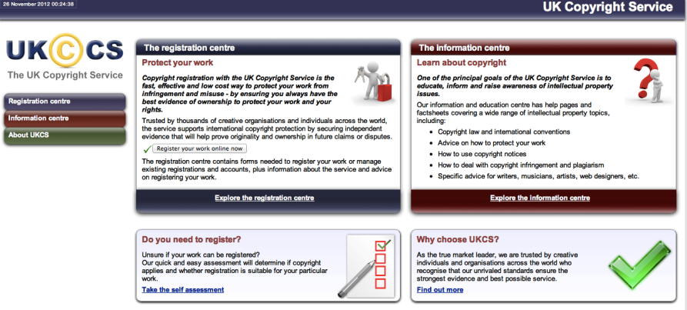
The UK Copyright Service website
http://www.copyrightservice.co.uk

Slide 90
“The Honest Musician's Fear of Accidental Plagiarism”
Available on BBC iPlayer http://www.bbc.co.uk/programmes/b00xw21s
“As Noel Gallagher put it rather bluntly when confronted about his musical influences: "There's twelve notes in a scale and 36 chords and that's the end of it. All the configurations have been done before.”
Singer and songwriter Guy Garvey [from Elbow], with the help of fellow songwriters Sir Tim Rice, Paul Heaton and John Barnwell, explores the legal pitfalls that can befall the honest musician and how to avoid them.”
(- BBC http://www.bbc.co.uk/programmes/b00xw21s.)

Slide 91
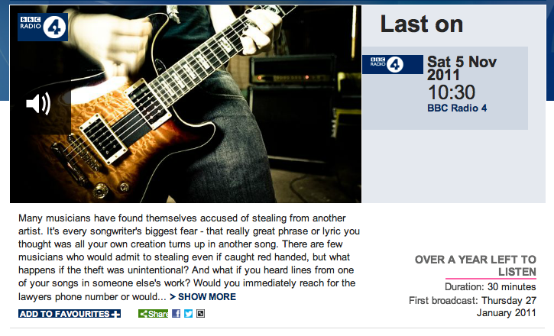
Still available – thank you BBC!
http://www.bbc.co.uk/programmes/b00xw21s

Slide 92
Solutions?

Slide 93

Creative Commons
“Share, Remix, Reuse – Legally”
(http://www.creativecommons.org.uk/ )
Creative Commons licensing is not an alternative to copyright law, but is compliant with the law!

Slide 94
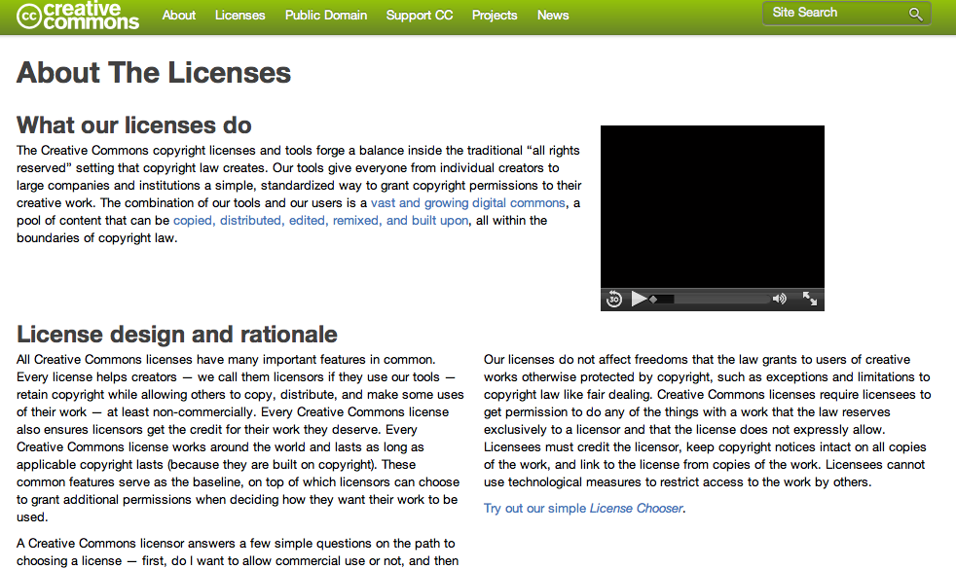
http://www.creativecommons.org/licenses/

Slide 95
Creative Commons
What is it?
  A non-profit organisation devoted to “expanding the range of creative works available for others to build upon legally and share”.
What does it do?
  The organisation has released a number of copyright-licences known as “Creative Commons licences” for free public use.
Who uses these licences?
  Wikipedia is the most well known user.
  Flickr, DeviantArt, xkcd and even Nine Inch Nails are also all users of Creative Commons licences.

Slide 96




The Licences
There are 4 original licenses:
  Attribution (by) – “You let others copy, distribute, display, and perform your copyrighted work - and derivative works based upon it — but only if they give credit the way you request.”
  NonCommerial (nc) – “You let others copy, distribute, display, and perform your work - and derivative works based upon it - but for noncommercial purposes only. “
  ShareAlike (sa) – “You allow others to distribute derivative works only under a license identical to the license that governs your work.”
  No Derivatives (nd) – “You let others copy, distribute, display, and perform only verbatim copies of your work, not derivative works based upon it.”

Slide 97
Combination Licenses
These licences can be combined to create different licenses:
Since NoDerivatives and ShareAlike licenses are mutually exclusive, that means there are 11 valid licenses.
CC found that 98% of users wanted Attribution, so they restricted it to six main licenses:

Slide 98
What can they apply to?
A creative commons license can apply to anything that is protected by copyright law.
Therefore a CC license can be applied to books, websites, blogs, photographs, films, videos, songs and any other audio and visual recordings, for example.
The licenses can theoretically be applied to Software or source code, but this is not recommended by CC since the licenses were not designed to apply to them.

Slide 99
What can they apply to?
A creative commons license can apply to anything that is protected by copyright law.
Therefore a CC license can be applied to books, websites, blogs, photographs, films, videos, songs and any other audio and visual recordings, for example.
The licenses can theoretically be applied to Software or source code, but this is not recommended by CC since the licenses were not designed to apply to them.
Notes:
A creative commons license can apply to anything that is protected by copyright law. Therefore a CC license can be applied to books, websites, blogs, photographs, films, videos, songs and any other audio and visual recordings, for example. The licenses can theoretically be applied to Software or source code, but this is not recommended by CC since the licenses were not designed to apply to them.

Slide 100
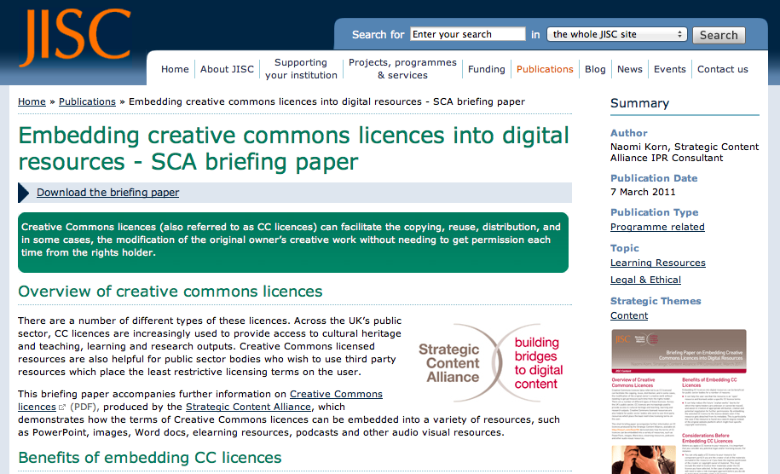
http://bit.ly/JISC-CCguide

Slide 101
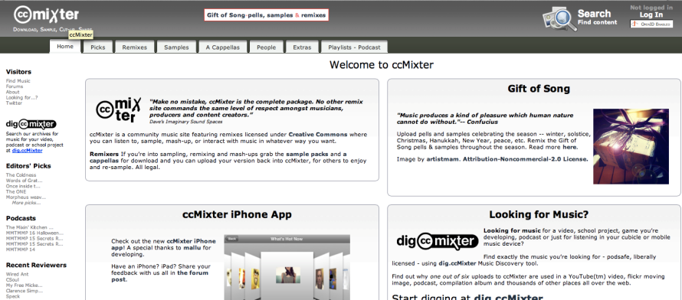
Mixter

Slide 102

http://www.behold.cc

Slide 103
Patents

Slide 104
What is a patent?
A patent is a license granted to an inventor, which gives the inventor the legal right to stop anyone else from making, using or selling the invention without his or her permission.[1]
[1] http://genome.wellcome.ac.uk/doc_WTD021006.html

Slide 105
Patents
Give the inventor the right to stop others from
exploiting their invention
without prior permission
for a fixed period of time typically
  20 years in the UK
  17 years in the USA.

Slide 106
A brief history of patents
The Patent Office, the administrator of patents and trademarks in the UK, was established in 1852 by the Patent Law Amendment Act.
Originally it was established to handle only patents however later in 1875 it was expanded to include industrial designs.
The Patent Act of 1977 updated these standards of the patent process.

Slide 107
What can be patented?
For an invention or idea to be patented it must
  Be capable of industrial application (invention that “can be made or used in any kind of industry, including agriculture”
  Must involve an inventive step (one which “is not obvious to a person skilled in the art”)
  Be an invention that is unique

Slide 108
What cannot be patented?
In comparison, there are a number of forms of invention that cannot be patented:
  Mathematical or scientific theories, methods or discoveries
  A way of doing business
  Method of medical diagnosis or treatment
  Computer programs or a presentation of information or an artistic work
  Any inventions that are “against public policy or morality”
The validity of a patent lasts for 5 years, after this time it must be renewed annually allowing a patent to stay active for a maximum of 20 years[1]
[1] http://www.ehow.co.uk/about_6669094_united-kingdom-patent-act.html

Slide 109
Patents
So…Invention
Can only be patented if
  it is new and demonstrates an inventive step
  has a practical application
  Isn’t in an excluded area.
Patent office will search
Existing patents and documentation
If anything is found
The application will be rejected.

Slide 110
Patents do not
Patents do not automatically cover inventions in the way copyright covers works.
Patents are issued by the state
Each patent only covers the country it was issued in
  In every country that the inventor wants protection
  It must be applied for

Slide 111
Patent Infringement
similar penalties to copyright infringement
Compensation needs to be paid to the owner.
The fine will usually take into consideration
  The amount the infringer would have paid to patent the design himself.
  If it can be proved that the person knew of an existing patent they will have to pay treble the amount.

Slide 112
Perspectives

Slide 113

Licences
“Click-wrap” licences;
unequal bargaining power;
Does anyone actually read them?
Can terms be changed unilaterally?

Slide 114

‘Hans Rosling’s New Insights on Poverty’
http://www.ted.com/talks/hans_rosling_reveals_new_insights_on_poverty.html
Available online – TED Talks.
19 mins. May 2007.

Slide 115

Criminality
Some examples:
Identity theft;
Fraud;
Organised Crime (i.e. paedophile rings);
Extremist Groups;
Malware …
Serious Organised Crime Agency
http://www.soca.gov.uk/
‘Smart phone malware highlighted by Get Safe Online Week ‘
http://www.soca.gov.uk/news/364-smart-phone-malware-highlighted-by-get-safe-online-week-

Slide 116
Further Info
The UK Copyright Service website:
  http://www.copyrightservice.co.uk/
The Copyright, Design and Patent Act:
  http://www.legislation.gov.uk/ukpga/1988/48/contents
UK Intellectual Property Office - http://www.ipo.gov.uk/
World Intellectual Property Organization –
http://www.wipo.int/portal/index.html.en
Serious Organised Crime Agency -http://www.soca.gov.uk/
UK Legislation - http://www.legislation.gov.uk/

Slide 117
Thinking about questions
Appendix

Slide 118
Freedom of Information Act
The Freedom of Information Act entitles an individual to request from a public authority:
  Any information held on the individual
  Any information held in electronic format on the individual
  Any information held in either paper or electronic format on the individual
  Any information at all

Slide 119
Privacy
A privacy issue is most likely raised when:
  Someone reports comments we have made at a public meeting
  Someone reports comments that they overhear us make to a friend in a public bar
  Your employer reads the contents of e-mails sent by you using the company system
  Someone reports the contents of a lecture we have given
  Someone reports comments we make in a private letter to a third party

Slide 120
Software Copyright
The copyright of software in the UK is currently covered by the _____________.
  Copyright Designs and Patents Act alone
  Copyright Designs and Patents Act and subsequent legislation
  The computer misuse act
  Digital Millennium Copyright Act
  The European Union Copyright Directive
Notes:
The copyright of software in the UK is currently covered by the _____________.
Copyright Designs and Patents Act alone
Copyright Designs and Patents Act and subsequent legislation
The computer misuse act
Digital Millennium Copyright Act
The European Union Copyright Directive

Slide 121
Purchase use and disposal
Which of the following does not require institutions to implement policies relating to the purchase, use and disposal of ICT equipment?
  The waste electrical and electronic equipment directive
  The reduction of hazardous substances directive
  The energy using products directive
  The disposal of hazardous substance directive directive
  The landfill reduction and management directive
Notes:
The waste electrical and electronic equipment directive
The reduction of hazardous substances directive
The energy using products directive
The disposal of hazardous substance directive directive
The landfill reduction and management directive
4&5 are not real directives

Slide 122
Copyright
Questions might be constructed around any of the following topics
Can copyright be inherited?Yes. The person who inherits the work will become the new owner.
What happens when a copyright expires?The work will fall into the public domain, making it available to anyone wishing to use, copy or reproduce the work. This is how so many companies can publish works by William Shakespeare,clas
What types of work are protected?
y literary, dramatic, design, musical or artistic work. So long as the work exhibits a degree of skill, labour or judgement.
How long does copyright last? This will depend on the work and nationality, but typically the work will be protected for either, 70 years from the death of the author, or if published 70 years from the date of first publication, sical composers etc.
Does the nationality of the author matter?
Under the terms of the Berne Convention, authors are automatically protected internationally, they may also enjoy additional rights as granted under national laws.
Does format or quality of the work matter?
The format of the work, i.e. Negatives or photographs, computer files or paper documents, does not matter, neither does the quality of the work.
Notes:
Can copyright be inherited?Yes. The person who inherits the work will become the new owner.
What happens when a copyright expires?The work will fall into the public domain, making it available to anyone wishing to use, copy or reproduce the work. This is how so many companies can publish works by William Shakespeare, classical composers etc.
What types of work are protected?Any literary, dramatic, design, musical or artistic work. So long as the work exhibits a degree of skill, labour or judgement.
How long does copyright last?This will depend on the work and nationality, but typically the work will be protected for either, 70 years from the death of the author, or if published 70 years from the date of first publication.
Does the nationality of the author matter?Under the terms of the Berne Convention, authors are automatically protected internationally, they may also enjoy additional rights as granted under national laws.
Does format or quality of the work matter?The format of the work, i.e. Negatives or photographs, computer files or paper documents, does not matter, neither does the quality of the work.

Slide 123
Thinking Task
Think about questions
Questions can be simple
  Testing knowledge
More complex
  Testing understanding
Even more complex
  Providing an opportunity to combine
    Knowledge, understanding and thinking skills
    In your groups design one example of each type of question which draws on the information provided

Slide 124
awareness issues
Appendix

Slide 125
Employment….
Employment terms and conditions incorporate
Pay
National Minimum Wage
Employment Contracts and Conditions
Time off and Holidays
Flexible Working
Working Hours
Sickness Absence
Business transfers and takeovers
Starting a new job

Slide 126
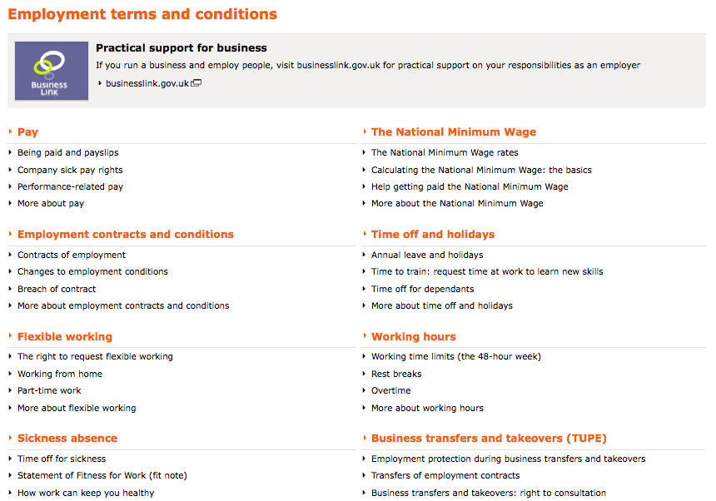
Sources of information…
http://bit.ly/g6jjrE

Slide 127
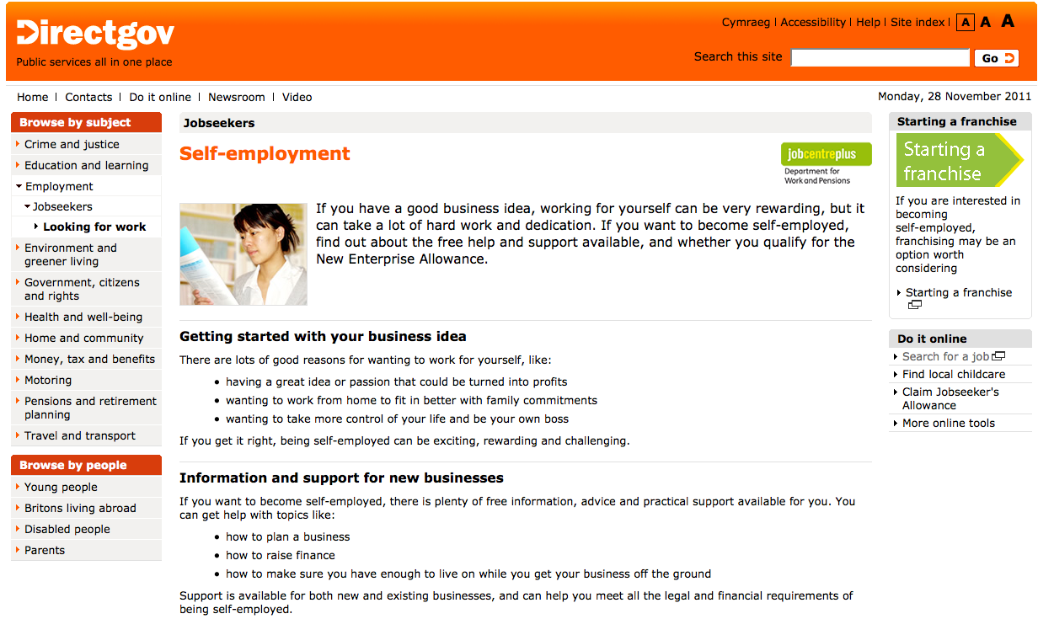
Self Employment

Slide 128
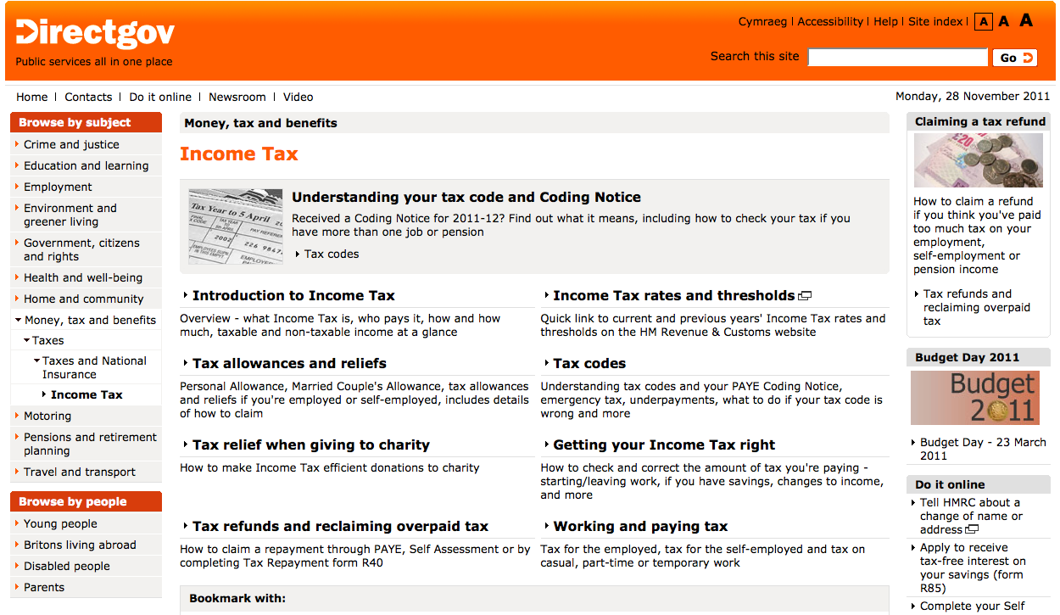
Income Tax

