Slide 1
Content Caches
COMP3220/6218
Heather Packer – hp3@ecs.soton.ac.uk
30/10/17

Slide 2
Motivation
Slashdot effect
“slashdotting” occurs when a popular website links to a smaller site, causing massive increase in traffic
This overloads the smaller site causing it to slow down or temporarily become unavailable
The name stems from the huge influx of web traffic that would result from the technology news site Slashdot linking to websites
Somewhat like a DDoS effect

Slide 3
Cache
The temporary storage (caching) of frequently accessed data for rapid access
Web documents
HTML pages
Images
Caches can be located at various points in a network
Reduces access time/latency for clients
Reduces bandwidth usage across slower links
Reduces load on a server

Slide 4
What Can be Cached?
Cache friendly:
Logos and brand images
Style sheets
Javascript files, site and library
Downloadable content
Media files
Be careful caching:
Data
HTML pages
Rotating images
Frequently modified Javascript and CSS
Content requested with authentication cookies
Never cache
Sensitive data
User-specific data that frequently changes

Slide 5
Terminology
Origin server – original location of content
Hit – response in cache
Miss – response is not in the cache
Stale content – Expired response
Cache hit ratio – hits:total requests
Validation – Check that cached response is most recent version
Invalidation – Removal of response before it expires, due to update on origin server

Slide 6
Different Web Caching Solutions
Browser Cache
Proxy Cache
Reverse Proxy Cache

Slide 7
Browser Cache
Browsers maintain a small cache
Stored locally
Cache for a single user or application
Browser sets a caching policy, deciding what data to cache
User specific content
Expensive content

Slide 8
Browser Cache
Local Machine
Origin Server
resource
Browser Cache

Slide 9
Browser Cache vs Cookies
Cache | Cookies
Stores files | Stores session info or tracking
Faster viewing | Preferences and targeting advertising
Stored locally | Stored locally

Slide 10
Tracking and Caches
Browser caches can also be used for tracking you
It is possible to track you cross-site and across browser restarts, even if you disable or clear cookies and LSO-cookies (flash cookies).
Browsers cache content based on the expiration headers provided by the server
A web application can include unique content in a page, and then use JavaScript to check if the content is cached or not in order to identify a user.
It is difficult to defend against unless you routinely (e.g. on closing the browser) delete all content.

Slide 11
Proxy Cache
Cache located close to the clients (hosted by University or Internet Service Provider)
Decrease bandwidth usage
Decreases network latency
Scale provides the main advantage: many users within the ISP may all be asking for the same web pages

Slide 12
Proxy Cache
Server
Local Machine
resource
Proxy Cache

Slide 13
Reverse Proxy Cache
Cache proxy located closer to the origin web server
Usually deployed by a Web host
Decreases load on the Web service (e.g. database)
Several reverse proxy caches implemented together can for a Content Delivery Network

Slide 14
Reverse Proxy Cache
Server
Local Machine
Reverse Proxy Cache
resource

Slide 15
HTTP with Last-Modified Header
GET Conditional GET
GET /HTTP/1
Host: comp3220.ecs.soton.ac.uk
Accept: */*
HTTP/1.1 200 OK
Date: Wed 15 Nov 2017 07:43:20 GMT
Connection: keep-alive
Content-Type: text/html; charset=UTF-8
Content-Length: 4003
Last-Modified: Tue 14 Nov 2017 08:00:20 GMT
GET /HTTP/1
Host: comp3220.ecs.soton.ac.uk
Accept: */*
If-Modified-Since: Tue 14 Nov 2017 08:00:20 GMT
HTTP/1.1 304 Not Modified
Date: Wed 15 Nov 2017 07:55:10 GMT
Connection: keep-alive
Last-Modified: Tue 14 Nov 2017 08:00:20 GMT
Etag: W/”f15-182e8c3024”

Slide 16
Caching Headers
Cache-Control flags
no-store - no-cache
max-age - must-revalidate
proxy-revalidate - no-transform
Last-Modified
Etag – used in validation
Content-Length – can be used in caching policies

Slide 17
HTTP with Cache-Control Header
GET GET
GET /HTTP/1,1
Host: comp3220.ecs.soton.ac.uk
Accept: */*
HTTP/1.1 200 OK
Date: Wed 15 Nov 2017 07:43:20 GMT
Connection: keep-alive
Content-Type: text/html; charset=UTF-8
Content-Length: 4003
Last-Modified: Thurs 7 Dec 2017 08:00:20 GMT
Cache-Control: max-age=86400
* No request sent *

Slide 18
Content Distributed Networks

Slide 19
Motivation Scenario
Stream video content to hundreds of thousands of simultaneous users
You could use a single large “mega-server”
Single point of failure
Point of network congestion
Long path to distant clients
Multiple copies of video sent over outgoing link
This solution doesn’t work in practice

Slide 20
Content Delivery Network
CDN a geographically distributed network of proxy servers (edge nodes)
Hosts static content (such as images, CSS and JS)
Data travels to user via the shortest path (reduced latency)

Slide 21
CDN
CDN Connection
User
Connection
User
Origin Server
Edge Server

Slide 22
CDN
Origin Server
Edge Server
Local Machine
Edge Server
Edge Server
Edge Server
Local Machine

Slide 23
Commercial CDNs
Limelight Networks
Level 3 Communications
Akamai Technologies
Amazon CloudFront
CloudFlare

Slide 24
Motivational Scenario
Streaming video to 100,000+ simultaneous users
Working Web solution: store/serve many copies of video at multiple geographically distributed sites (CDN)
Two strategies:
Push CDN servers deep into many access networks
Close to users
Used by Akamai, 1700 locations
Place larger clusters at key points in the network near internet exchanges
Used by Limelight

Slide 25
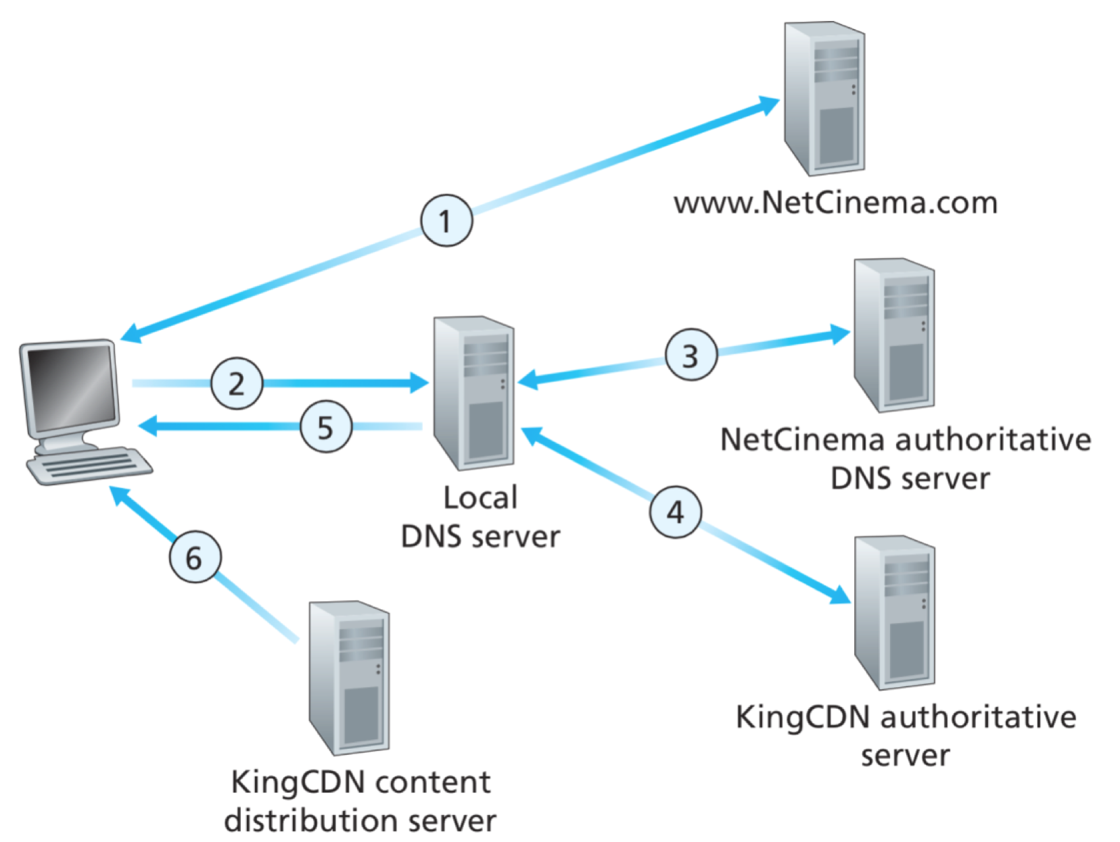
CDN: simple content access scenario
A client requests video from a service
http://video.netcinema.com/6Y7B23V
http://KingCDN.com/NetC6Y7B23V

Slide 26
CDN: simple content access scenario

Slide 27
CDN Cluster Selection Strategy
CDN DNS decides
Pick CDN node geographically closest to client
Pick CDN node with shortest delay (min hops) to client (CDN nodes periodically ping access ISPs, report results to CDN DNS)
Or let the Client decide – give client a list of several CDN servers

Slide 28
Case Study: Netflix’s first Approach
Owned very little infrastructure, uses 3rd party services
Own registration, payment servers
Amazon (3rd party) cloud services
Netflix uploads studio master to Amazon cloud
Create multiple version of movie (different encodings) in cloud
Upload versions from cloud to CDNs
Three 3rd party CDNs host/stream Netflix content: Akamai, Limelight, Level-3

Slide 29
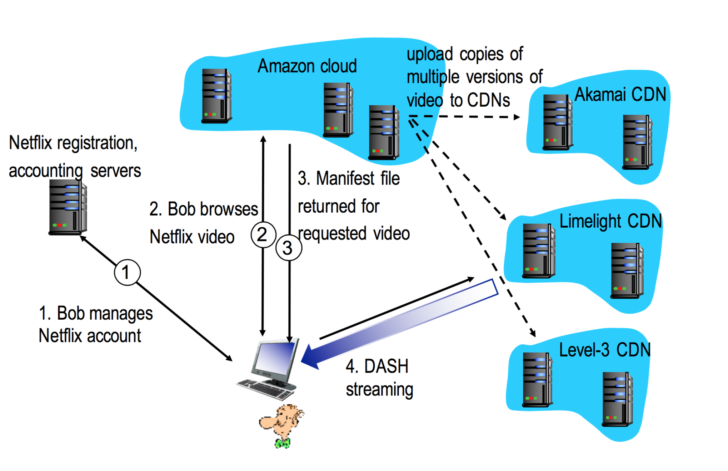
Case Study: Netflix

Slide 30
DASH
DASH - Dynamic Adaptive Streaming over HTTP
Server
Divides video files into multiple chucks
Each chunk stored encoded at different bit rates
Manifest file: provides URLs for different chunks
Client
Periodically measures server-to-client bandwidth
Consulting manifest, requests one chunk at a time
Chooses maximum coding rate sustainable given current bandwidth
Can choose different coding rates at different points in time (depending on available bandwidth at time)

Slide 31
MPEG-DASH Adoption
MPEG DASH is independent, open and international standard, which has broad support from the industry
HTML5 Media Source Extensions and HbbTV are MPEG-DASH enabled
Heavy plugins like Silverlight and Flash perform poorly and cause security issues

Slide 32
Netflix OpenConnect
High optimised for delivery large files
Data centers around the world
Client Intelligence
Calculates best edge server to use
Continually probes the best way of receiving content (automatically switches between different CDNs and different bitrate levels)

Slide 33
Summary
Caches
Browser
Proxy
Reverse Proxy
Cache Control Headers
Content Delivery Networks
CDNs in practice

