Slide 1
Web Advertising and Cookies
COMP3220/6218
Heather Packer – hp3@ecs.soton.ac.uk
27/11/17

Slide 2
Advertisers and Audience Templates
Advertisers are people who want to sell a product
They want to tell an audience about their product
An audience template is a document that describes their who they think their audiences is:
Socio-economic grouping
Income and personal finances
Family status
Home ownership
Past purchasing behavior
Location

Slide 3
Web Advertising
Web Advertising delivers promotional marketing messages to audiences
It provides a new way for advertisers to reach their target audience
Improves efficiency with profiling customers vs broadcast advertising methods

Slide 4
Terminology
Banner – the available space to place adverts on a web page
Impression – is an ad view
Click through – is when a person clicks on the ad
Click ratio – is the ratio of clicks vs views

Slide 5
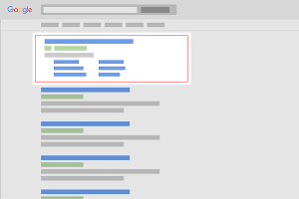
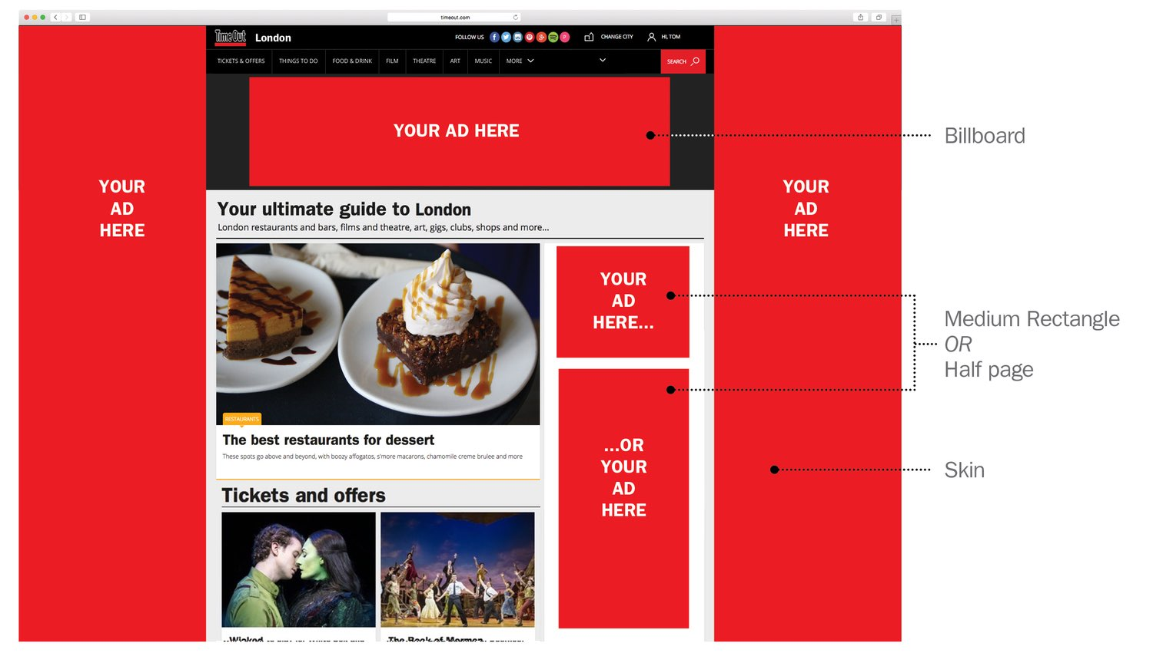
Online Advertisements
Each page may have multiple banners so more than one impression can be sold per page view
Ads do not have a standardised placement, but larger ones and ones in better positions typically cost more

Slide 6
Issues
The web advertising industry is about matching audience viewing a particular site with an audience template and hence an advert
Algorithmic Implementation
Millions of impressions per second
2 key problems
Providing mappings that satisfies the audience template
Action several mappings efficiently over time

Slide 7
Cost Models
CPM –Cost Per Mille (1,000 impressions)
Whether the ad is clicked is not taken into account.
Each time an ad is fetched, it is counted as one impression.
CPC – Cost per Click
an advertiser pays a publisher when the ad is clicked
CPA – Cost per Action
Mailing list
Buying an item Conversions
Request quote

Slide 8
Effectiveness and Pricing of Advertisement
Advertising spend for a given audience template is agreed in advance
Metrics for return on this investment are unreliable
Exposure models (demographic)
Click through rates
Actual purchases
Cost for acquisition of a new customer
Advertising companies compete to satisfy the audience template

Slide 9
Delivery Methods
Display Advertising (Banners)
Search linked ads (AdWords)
Context linked ads (AdSense)

Slide 10
Display Advertising
Banners, Videos, Rich Media, Overlays, Interstitials, Sponsorship
Standardized Ad shapes with images / video
Normally not related to content
Retargeting
Ad served to people who have already visited the advertiser’s website or are on a list of their customers

Slide 11
Search Linked Ads
Search Engines (SE) have huge audiences
Advertisers can place ads against keyword searches
SE can leverage their massive platform capabilities to action many such mappings at once
Highly effective since it reaches people when they are interested in a topic
Relevant, yet not obtrusive
October 2016: Google: 89.3%, Bing 4.36%

Slide 12
Search Linked Ads - Google Adwords

Slide 13
Auctions for AdWords
Find all ads whose keywords match the search terms
Ignore ads that are not eligible eg different country
Calculate Ad Rank
Only show ads with a sufficient Ad Rank; position also determined

Slide 14
Context Linked Ads - AdSense
Ads are related to the page they are displayed on
They use a keyword matching engine to match ads
Matching algorithm have been tweaked to deal with multiple topics on a page
Auctions mechanisms cater for ad position on page

Slide 15
AdWords vs AdSense
AdWords
Ad keywords match search phantom text
AdWords is on Google Search Engine Result Page (SERP)
Higher click through
AdSense
Ad keywords match page topic/s
AdSense is shown on web pages
Lower click through
Both use Auctions to select Ads to place on SERP or individual web page

Slide 16
Display Advertising Platforms
1
Publisher
Content
Server
2
3
User’s
Browser
Publisher
Ad
Server
4
5
6
Agency
Ad
Server

Slide 17
Display Advertising Platforms - Auction
DSP
Data
Management
Platform
Publisher
Content
Server
DSP
Supply
Side
Platform
Ad
Exchange
Demand
Side
Platform
User’s
Browser
Publisher
Ad
Server
Agency
DSP
Brand
Ad
Ex.
Agency
Ad
Server

Slide 18
Third Party Information
IP Address
User Agent
Cookies
IP Address
User Agent
Cookies
Referring URL
Location URL
Site specific
information
IP Address
User Agent
Cookies
Referring URL
Location URL
Site specific
information
Geo Location
Income Bracket
Recent User
Behaviour
Content Type
IP Address
User Agent
Cookies
Referring URL
Location URL
Site specific
information
Geo Location
Income Bracket
Recent User
Behaviour
Content Type
Advertiser Cookie
User’s browser Website Adds Ad server augmentation Advertiser Specific

Slide 19
Cookies

Slide 20
Browser Cookies
Information that a site saves to your web browser
Record your browsing activities
Pages content you looked at
When you visited
What you searched
You clicked on an ad

Slide 21
Cookies and HTTP
Scope of the cookie (Domain and Path)
HTTP Request Header – Browser sends cookies
Cookie: name1=value1; name2=value2
HTTP Response Header – Site sets cookies
Set-Cookie: name1=value1
Set-Cookie: name2=value2; Expires=Wed, 09 Jun 2021 10:18:14 GMT

Slide 22
First Party vs Third Party Cookies
First party cookies
Placed by a site when you visit it
Make your experience on the web more efficient
For example
Log-in name
Session
Preferences
Game scores
Items in your shopping cart

Slide 23
First Party vs Third Party Cookies
Third party cookies
Placed by someone other than the site you are on
Include an advertising network or a company that helps track website usage
Usually attached to images and other webpage components
eg invisible 1x1 images

Slide 24
Transient vs Persistent Cookies
Transient Cookies
help “sessionize” your experience on a website
“set” when we visit the site, it disappears when we leave

Slide 25
Transient vs Persistent Cookies
Persistent Cookies
Set the first time we visit the website
It will remain there for the duration that the website determines
Example:
Analytics cookies are typically 18 months
Other can be 18 months to 18 years
Help identify a unique browser to our website, closest thing to tracking a person/unique visitor
Can contain Personally Identifiable Information (PII) data
Random string of numbers or letters that only the company who set the cookie can read

Slide 26
Tracking
Ad agencies and analytics companies can track you across members of their network
May reconcile across multiple tracking networks
Understand your web-browsing activity in order to better profile you
Evercookies, Device fingerprinting, Cross-device tracking

Slide 27
What makes it easier to blend into the crowd?
Use a system configuration that many others use
Don’t install other fonts and browser plugins
Clear your cache and cookie each time you close your browser
Disable JavaScript and Flash
Many websites will not function unless enabled
Control which scripts are allowed to run
Some website may not function when certain scripts are blocked

Slide 28
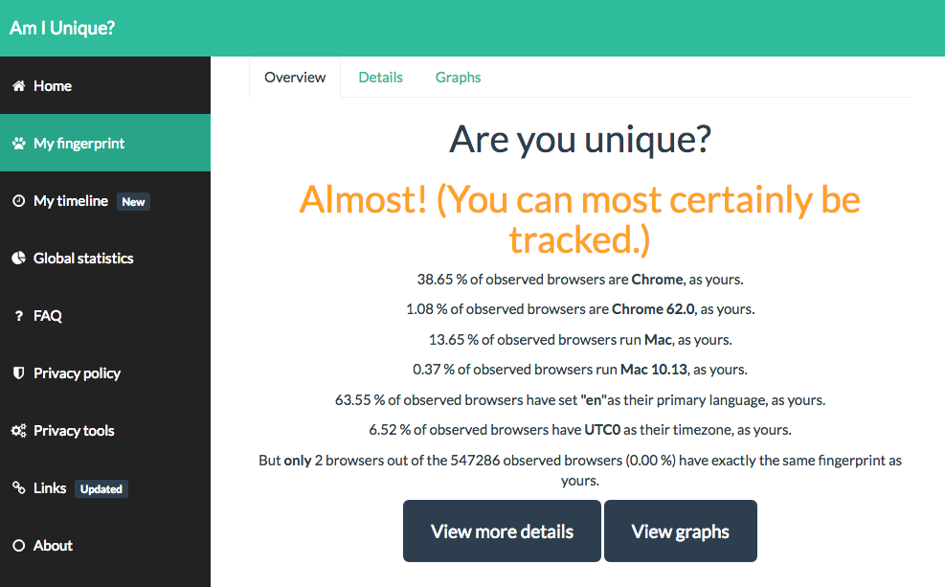
Am I Unique? amiunique.org

Slide 29
Cookie theft
Cookie store session data
Cookies are usually store as plain text
Use https
Encrypt your hard drive

Slide 30
Conclusions
Client server Web is private two-party communication
But adverts are from a third party, on behalf of a fourth party, mediated by a fifth party
Google try to occupy the whole service space themselves
Everyone else has to piece it together with different specialist services (market ecology)
Snooping to gain knowledge for the market to increase the value of transactions. Cookies!

