Slide 1
Web Search Engines
COMP3220/6218
Web Infrastructure/Architecture
Heather Packer hp3@ecs.soton.ac.uk
30/10/17

Slide 2
Specific Query – Gene database

Slide 3
Broad Query – Directory of Science

Slide 4
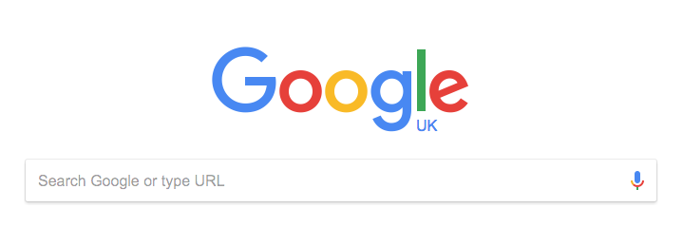
Vague Query – Search Engine

Slide 5
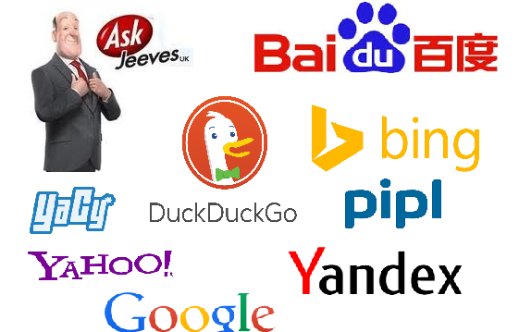
Search Engines
Search Engines refer to huge databases of internet resources
Users can search for information using keywords

Slide 6
Problems with searching
Users do not understand how to provide a sequence of words for searches
Users may get unexpected answers because they are not aware of the input requirement of the search engine.
For example, some search engines are case sensitive.
Users have problems understanding Boolean logic
Around 85% of users only look at the first page of the result, so relevant answers might be skipped.

Slide 7
Problem with the data
Distributed data with a high percentage of volatile data
Large volume
June 2000 Google full-text indexes of 560 million URLs
Unstructured data gifs, pdf, etc
Redundant data
Mirrors (30% pages are near duplicates)
Quality of data
False, poorly written, invalid, misspelt
Heterogeneous data – media, formats, languages, alphabets

Slide 8
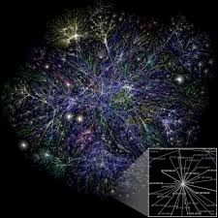
Simple Framework
Query Engine
Search
index
Interface
Web Crawler

Slide 9
Web Crawlers
Web Crawler, spider
Start at a webpage
Follow the hyperlinks that webpage points to
Then follows the links those webpages point to
Each page it visits it collects metadata about it
Title - Images
Content - URI
Stores a file for each resource, with its meta data in a search index

Slide 10
Web Crawlers
Issues with overloading web servers
Mechanisms for sites not wishing to be crawled
Robots.txt can request that only part of a web page to be crawled
Coordinating search
Parallel crawling
Which pages to request – Selection policy, Revisit policy
Many modern web pages are dynamic pages / use JavaScript heavily

Slide 11
Query Engine
Query’s for search terms returning matches
Matches are ranked using many features:
How times does the page contain the keywords
Do keywords appear in the title or url
Does it contain synonyms for your keywords
Is it from a quality source
What is it’s importance
How often a page is updated
Freshness of information
Page load time

Slide 12
History of Search Engines

Slide 13
Before Search Engines
Exploit hyperlink structure
Personal homepages with links
Directories
Word of mouth
Email, forums, Usenet

Slide 14
Timeline 90’s – Hand vs Crawler
June 1993
1st Web Robot
Wandex
Meausres size
Marh 1996
Larry Page
BackRub
SE
1998
Google Search
SE
Jan 1994
Altavista
Sept1993
1st Web SE
List
April 1997
Ask Jeeves
SE
Jul/Sept 1998
MSN Search
1995
LookSmart
Web Directory
May 1996
HotBot
SE
April 1994
Yahoo!
Web Directory
Oct/Nov 1993
2nd Web SE
List
Jul7 1994
Lycos
SE
Dec 1993
3rd Web SE
Crawler
Indexer
Seraching
1993 1994 1995 1996 1997 1998

Slide 15
Web services and Architectures
Hand curated catalogues
Crawlers and indexes
Centralised Search Engines
Distributed Search Engines
June 1993
1st Web Robot
Wandex
Meausres size
Jan 1994
Altavista
Sept1993
1st Web SE
List
1995
LookSmart
Web Directory
April 1994
Yahoo!
Web Directory
Oct/Nov 1993
2nd Web SE
List
Jul7 1994
Lycos
SE
Dec 1993
3rd Web SE
Crawler
Indexer
Seraching
1993 1994 1995 1996 1997 1998

Slide 16
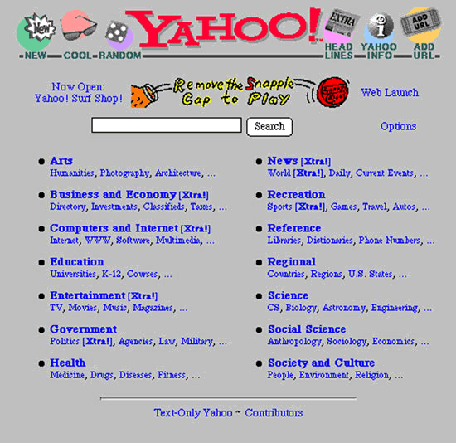
Yahoo!

Slide 17
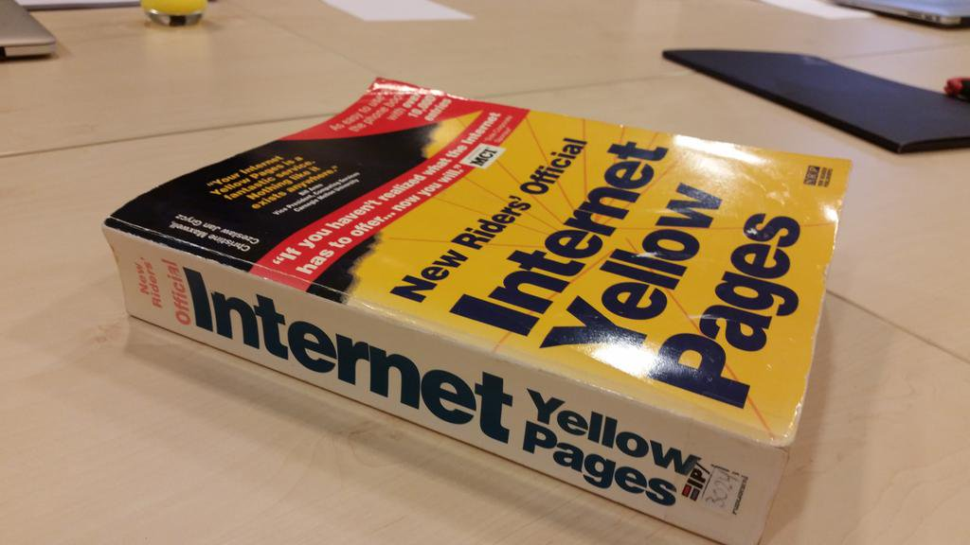
Internet Yellow Pages 1994

Slide 18
Web Crawlers
Wandex 1993 – size of the web
Web Crawler Dec 1993 - indexer
WebCrawler 1994 - indexed entire web page

Slide 19
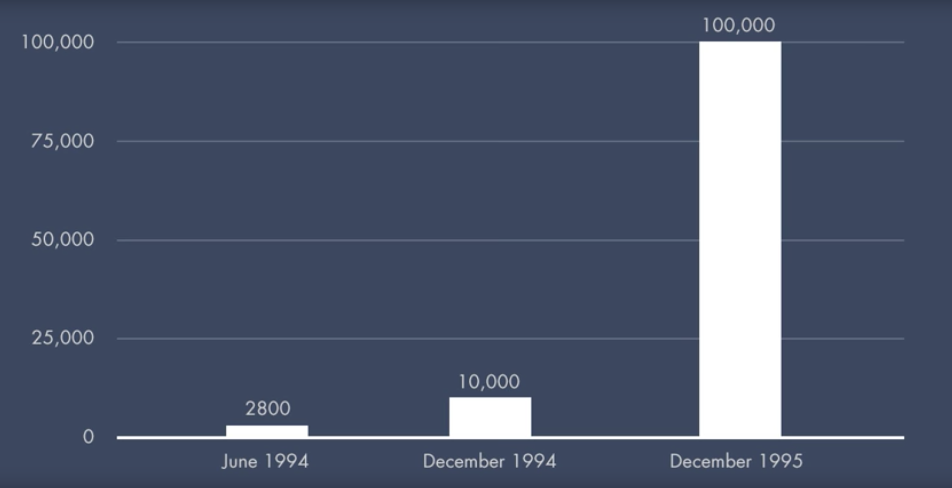
Number of Websites June 1994 - Dec 1995

Slide 20
Search Engines Issues
Scale
How to rank pages to give the best results
Spamming
Web searches favoured web pages with high keyword density
Keywords
Spelling mistakes

Slide 21
Timeline 90’s
June 1993
1st Web Robot
Wandex
Meausres size
Marh 1996
Larry Page
BackRub
SE
1998
Google Search
SE
Jan 1994
Altavista
Sept1993
1st Web SE
List
April 1997
Ask Jeeves
SE
Jul/Sept 1998
MSN Search
1995
LookSmart
Web Directory
May 1996
HotBot
SE
April 1994
Yahoo!
Web Directory
Oct/Nov 1993
2nd Web SE
List
Jul7 1994
Lycos
SE
Dec 1993
3rd Web SE
Crawler
Indexer
Seraching
1993 1994 1995 1996 1997 1998

Slide 22
BackRub
Utilised PageRank
More advanced than previous indexing
Used back links

Slide 23
PageRank
Assumes that more important websites are likely to receive more links from other websites
Similar to a voting:
where in links are votes
the quality of a vote is determined by the number of votes (in links)
Factors Considered:
Number of in links
Quality of in links
Web page’s context

Slide 24
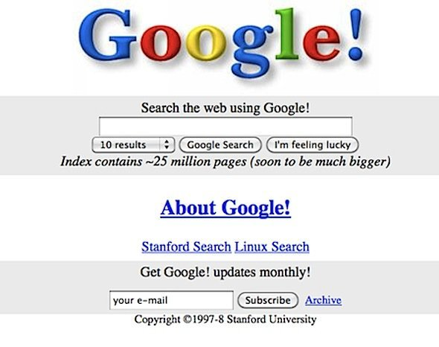
Google 1997-8

Slide 25
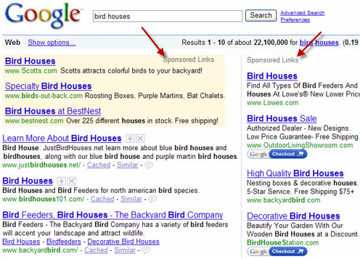
Google Adwords 2000

Slide 26
Relevancy
During 9/11 it was apparent that search engines did not cater of time-sensitive queries
This lead to Google developing Google News
The freshness of search engine’s index became more important

Slide 27
Google 2012
In 1999, it took Google one month to crawl and build an index of about 50 million pages.*
In 2012, the same task was accomplished in less than one minute.*
16% to 20% of queries that get asked every day have never been asked before.*
*Mitchell, Jon. "How Google Search Really Works." Readwrite. February 29, 2012.

Slide 28
Search Verticals
In a bid for content and market share, Search Engines develop other search verticals:
Books
Travel
Finance
Shopping
Scholar

Slide 29
Mobile Search
By 2015 mobile accounted for more than half of all search
Searches need to be context aware (location)
Limited screen and bandwidth means relevancy is critical
Boost mobile-friendly pages in ranking algorithm

Slide 30
More than a Search Engine
Calculator
Images
Infobox - structured information/queries
Translation
Mapping
Voice commands
Personal information eg search email, contacts, web

Slide 31
Search Engines Issues

Slide 32
Spamming
Most search engines have rules against:
Invisible text
Meta tag abuse
Heavy repetition
“domain spam”
Overtly submission of “mirror” sites in an attempt to dominate the listings for particular terms

Slide 33
Search Engine Optimisation
Whole industry exists trying to boost search ranking
Often gaming search ranking algorithms
Arms race between SEO and search engines

Slide 34
Google and other SEs are a Business
Search Engines record tracking information
Google saves every voice search
IP addresses
Location
Saves your searches
Google’s revenue is from adverts
Improve their revenue with targeted advertising
Google has a large research department
Improve their technology

Slide 35
Search Engines - Tracking
Oscobo – no cookies no tracking no ip address no location
Hulbee – no ip address, no browser, no cookies
MetaGer – no ip address, search info, no location no cookies, encrypted https, no sessions
Startpage – send to google, and uses its ip address, no session
Duckduckgo – no ip, search info, no location, no cookies, encrypted

Slide 36
Summary
What types of queries can be answered on the web
What search engines are
Their basic framework:
Web crawler
Search index
Query engine
Interface
The history of Search Engines
Issues with Search Engines

