Slide 1
Legal, Ethical and Professional Perspectives (LEPP)
Dr Su White
Professional development (COMP1205)
http://www.edshare.soton.ac.uk/15492/

Slide 2
Overview, Principles
guidance

Slide 3
High Level Objectives
Why we are here
To produce the best informed most widely educated CS and IT graduates in the country!
To help you learn how to argue and express yourselves with informed insight on current legal, ethical and professional
To help you better understand how you address ‘fuzzy’ tasks which complement your technical skills
Make it a worthwhile use of your time (for you and me!)
Give you an informed perspective overall – and specifically for for your group presentations and your individual Technical Reports

Slide 4
What are the Intellectual Challenges?

Slide 5
Intellectual Challenges
Research
Identifying new knowledge
Disseminating new knowledge
Integrating new knowledge
Building theory
Embrace a different world view
Outside your comfort zone
Requiring different approaches to thinking
A world where Truth is ‘negotiable’
Work across disciplines
Independent working , critical thinking, moving outside your comfort zone

Slide 6
Work smarter not harder
Work smarter not harder
Approaches
Intellectually
Understand your motivations
Imaginatively
Develop and use your creativity and imagination
Make your tasks enjoyable
Intuitively
Learn to know what works for you
Pareto principle
20% of the effort produces 80% of the result
… but think about it logically, rationally
One touch
Capture all the necessary information in a single touch
Follow up: Dan Pink – RSA Animate, see refs and links

Slide 7
There are supporting materials

Slide 8
So what is our focus?
Thinking space…
Notes:
Need to have some hand outs here
The start of a mindmap, other sets of resources…

Slide 9
Thinking time
Class exercise
What are the key legal issues?
Think, pair, share
Follow up questions (for reflection)
What do you think is the extent of legal and ethical perspectives?
Where and how might this be relevant in the remainder of your degree?

Slide 10
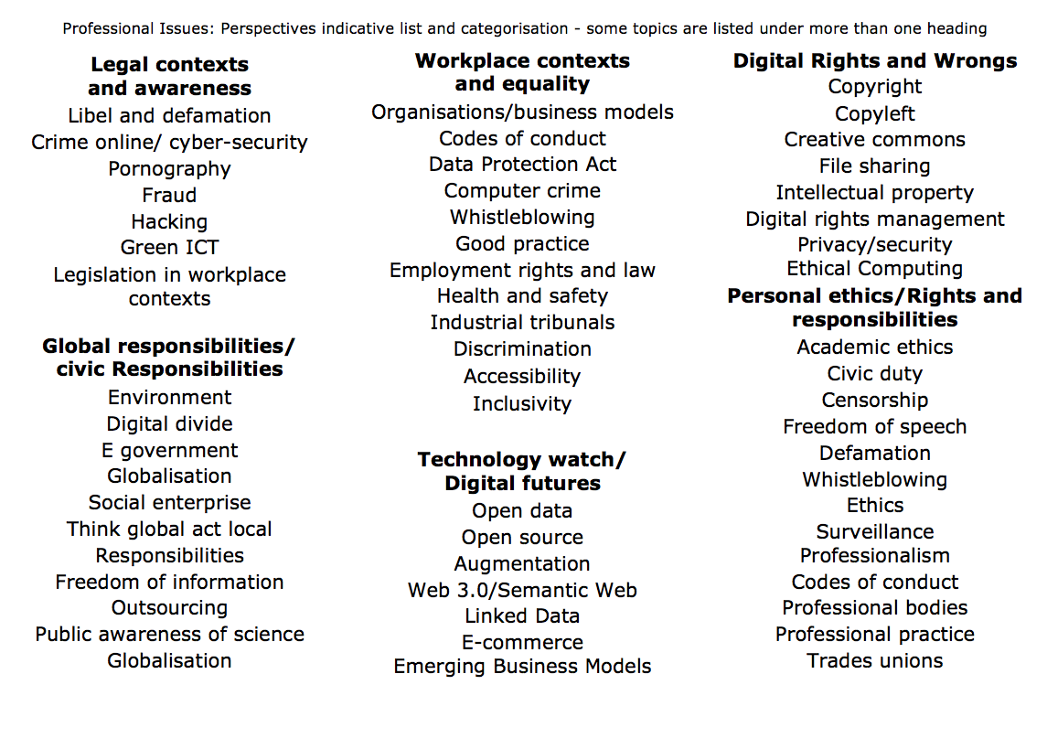
Establish your own method of organising the topics e.g.

Slide 11
professional and legal issues might include
environment
intellectual property
creative commons
e-commerce
freedom of information
green ICT
code of conduct
open data
open source
professionalism
employment rights
employment rights
e-government
digital futures
accessibility
file-sharing
globalisation
defamation
equality
semantic web
security
academic ethics
outsourcing
linked data
inclusivity
computer crime
health and safety
civic duty
localisation
professional bodies
free speech
digital rights management
libel
data protection
surveillance
social enterprises
hacking
pornography
responsibility
digital divide
discrimination
privacy
censorship
copyright
ethics
morals
Notes:
One copy print out for me

Slide 12
Legal & professional
Legal & professional
How you will know, how we will know
Why does it matter?
Your degree is accredited
Employers expect awareness
Choose the workplace which suits you
Think forward
NOTE
You are not expected to
be a lawyer
You are expected to
demonstrate and awareness of laws which impact on the workplace
Self check
Confidence
I have reviewed the slides
“I have watched the videos”
“I have read the notes”
“I have tackled the tasks”
“I have worked out how it is relevant to my plans”

Slide 13
How to approach the topics

Slide 14
Take ownership
What do you want to do?
What CS/IT areas really interest you?
Identify the topics where you plan to be an expert
This is a project for the whole of your degree
Explore, discuss, share develop your curiosity
If you can…
Prepare now for your final year project
Prepare now to know about your dream job

Slide 15
Our focus
Legislation of which you must be aware:
Data and Information
Workplace
Intellectual property
Ethical frameworks:
Understanding or developing your own framework
Understanding external frameworks which might bind you
Your task
To integrate your understanding in a useful and meaningful way

Slide 16
You are not learning to be a lawyer
But with this module
develop some legal awareness
think about your rights
think about your responsibilities
Identify your personal ethical perspectives
Data, information and life in a connected world
Workplace perspectives on data, information and life in a connected world

Slide 17
Understand the extent of the area
legal
ethical
workplace

Slide 18
Example: power & responsibility
Info Security
Data Privacy
common factors
Find the sweet spot between your developing technical expertise and a reflection on the implications of your behaviours or approach

Slide 19
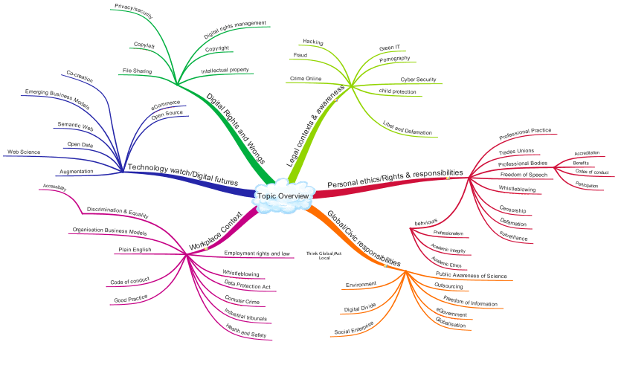
Legal areas
Information, Data and Living in a Connected World
Workplace perspectives: Rights and Responsibilities

Slide 20
Key topics for legislation
Privacy
Security
Slander, Libel and Defamation
Digital rights and ownership
Intellectual Property
Possible Perspectives
As an individual professional
As an employee
As an individual
As a citizen
You may have personal ethical views or have accepted/committed to to legal and ethical responsibilities

Slide 21
Index – read, watch, discuss, understand
Types of law in the UK
IT professional perspective
Online communications and legislation
Data Protection
A model for self study
Specific Tasks
Method is relevant to your group research and will be relevant to your technical reports

Slide 22
Types of law in the UK
Part of the big picture

Slide 23
Overview: Types of law in the UK
Statute law
Common law
International law

Slide 24
UK: Statute Law
Statute law
Made by government
legislation.gov.uk
Context
UK does not have a constitution
Constraints
International treaties
EU law
Acts of Parliament
Debated
House of Commons
House of Lords
Enacted
Royal Consent

Slide 25
Statutes are made by parliament
Example Digital Economies Act 2010

Slide 26
UK: Common Law aka Case Law
Common Law
Precedent of cases
Made by judges
Judgments and interpretation of statute law
Historical roots
In addition to what is covered by statute
Judges rôle
Interpret statutes
Follow precedent
Rule on ‘points of law’
Cannot create new areas of law

Slide 27
Common law examples
Where no statute exists
Confidentiality
Employees have duty of confidentiality to their employers
Extends beyond end of employment
Precedent established in previous court cases

Slide 28
International law: treaties
Government treaties
For example, trademarks, IP

Slide 29
European Legislation
Directives
Instruments
Regulations
Directives
Member states must update laws
Specifies outcome, not implementation
Can be implemented in parts
Example areas
Modernisation of professional qualifications
Restriction of hazardous substances
Energy efficiency/green IT
Packaging and packaging waste

Slide 30
Focus: criminal vs. civil
Criminal law
Behaviour forbidden/outlawed by state
In case law it can be identified as
Civil law
Rights & obligations
Business contracts
Implied contracts
Product liability
Vicarious liability
Employers may be liable for acts by employees e.g. slander, defamation, libel
R versus xxxxx

Slide 31
Civil and criminal law can both be relevant
Historically information was not regarded as property
But…
Scanning a book and publishing it on the internet?
Are the author’s and publishers right
Criminal?
Civil?

Slide 32
Key Areas
Communications Act 2003 section 127 (Came into force 25th July 2003 replaced s43 Telecommunications Act 1984)*
Computer Misuse Act 1990
Copyright design and patents 1988
Data Protection Act 1998
Defamation Act 1996
Disabilities Discrimination Act (NI only)
Digital Economy Act 2010
NB: Digital Economy Bill 2016-17
Electronic Commerce (EC Directive) Regulations 2002
Electronic waste disposal
Equalities Act 2010
Health and Safety at work 1974
Harassment Protection Act 1997
Human Rights Act 1998
Malicious Communications Act 1988 section 1
Postal Services Act 2000 section 85 (commenced 26th March 2001)*
Regulation of Investigatory Powers Act 2000
Remember – legislation is being revised as we study, and as your degree progresses the Crown Prosecution Service may be valuable in checking out current guidance http://www.cps.gov.uk/legal/

Slide 33
Ways of looking at UK law as an IT professional
The focus for this module

Slide 34
Data & Information perspectives (1&2)

Slide 35
Workplace Perspectives (3&4)
You may think of workplace perspective in this section!

Slide 36
You have to understand
Remember – legislation is being revised as we study, and as your degree progresses
e.g. check http://www.harassmentlaw.co.uk/ for updates wrt harrassment

Slide 37
TAKING AN IT perspective
Walkthrough some new areas

Slide 38
IT contexts
UK criminal law
By statute
examples
Digital Economies Act 2010
Computer Misuse Act 1990
Design Copyright and Patents Act 1988
UK Civil law
By case history
Issues:
buggy software
Rights:
when purchased software fails
when purchased software makes me lose money

Slide 39
New technologies -> ‘disruption’
Existing legislation
Was not prepared for new contexts
But…
Are there actually new crimes?
or …are there just new ways of committing old crimes
New legislation due to:
Moral panic
May need refinement
Appeals, civil action to augment legislation
Examples
Malicious hacking
Technological attack (viruses)
Perceived social threat

Slide 40
Legislation as response to change
Computer misuse act 1990
Fraud, hacking, viruses
other computer-related crime
Motivation
Overcome loopholes in existing legislation
Principles
Conduct which is criminal remains criminal when enabled by new means e.g. computer technology
But: Conduct which is not generally considered to be criminal does not become criminal because of the computer context
There are widespread criticisms of UK IT legislation see for example the report: Policing in an Information Age, Bartlett et al, 2013 Demos available from the Mendeley Group for COMP1205 https://www.mendeley.com/groups/3137931/comp1205/papers/

Slide 41
Computer Misuse Act 1990
Causing an computer to perform any function with intent to secure access to any program or data held within a computer
The access intended to be secured is unauthorised
The act is performed with knowledge lack of authorisation at the time of the alleged crime
Further offence
If (having gained unauthorised access) facilitate the commission of an offence
It is Illegal to use a computer to help set up a crime
Either by yourself
Or by any other person

Slide 42
Computer misuse act
A person is guilty of an offence if….
The commit any act which causes the unauthorised modification of the contents of a computer
At the time of the act they have
the requisite intent
and
the requisite knowledge

Slide 43
Computer fraud
Fraud
Gaining financial gain by deception
Theft
Taking with intent to permanently deprive
Using a computer to obtain money illegally is fraud
Computer fraud often conducted by insiders
Acting without authorisation

Slide 44
Data protection Act
Anticipating independent study
DPA videos: http://www.edshare.soton.ac.uk/10483/

Slide 45
First calibrate your existing knowledge…
Use this as a model for the way you approach any of the legal topics

Slide 46
Who?
According to the Data Protection Act (1998) "a person who (either alone or jointly or in common with other persons) determines the purposes for which and the manner in which any personal data are, or are to be, processed" is the definition of:
A data subject
A data processor
A data controller
The Data Protection Commissioner
Notes:
According to the Data Protection Act (1998) "a person who (either alone or jointly or in common with other persons) determines the purposes for which and the manner in which any personal data are, or are to be, processed" is the definition of: A data subject A data processor A data controller The Data Protection Commissioner Which of the following rights does an individual NOT have under the Data Protection Act (1998)? The right to prevent data about the individual being used for direct marketing The right to have inaccurate data corrected or erased The right to prevent data about the individual being held The right to find out what data is being held about the individual

Slide 47
What?
In the Data Protection Act, processing is defined as ___________ information.
Obtaining
Recording
Holding
Carry out any operation on
all of the above
None of the above

Slide 48
Rights
Which of the following rights does an individual NOT have under the Data Protection Act (1998)?
The right to prevent data about the individual being used for direct marketing
The right to have inaccurate data corrected or erased
The right to prevent data about the individual being held
The right to find out what data is being held about the individual

Slide 49
Why questions?
To evaluate your knowledge and understanding
To focus you on the topic under discussion ☺
To develop your critical thinking

Slide 50
Data Protection Act (1998) probably other sources…
Where to find the answers…

Slide 51
Where? …basics
Government Legislation
Data Protection Act
Read and understand
Set book (library)
Bott Chapter 14:
Data Protection,
Privacy
Freedom of Information
Other Sources
Information Commissioners Office
.gov.uk

Slide 52
ICO web site
http://www.ico.gov.uk/

Slide 53
Gov.uk

Slide 54
Further sources?
Search YouTube
But make sure you use your critical faculties!
See also Holt and Newton (2004) for more background

Slide 55
YouTube –use your critical faculties
http://bit.ly/9DHj2c

Slide 56
BCS – book details + download

Slide 57
Google it!

Slide 58
DPA - extent
From Edwards and Rodrigues, The right to privacy and confidentiality for children: the law and current challenges (2008)

Slide 59
Checklist (from ICO)
Do I really need this information about an individual?
Do I know what I'm going to use it for?
Do the people whose information I hold know that I've got it, and are they likely to understand what it will be used for?
If I'm asked to pass on personal information, would the people about whom I hold information expect me to do this?
Am I satisfied the information is being held securely, whether it's on paper or on computer?
And what about my website? Is it secure?

Slide 60
Checklist continued
Is access to personal information limited to those with a strict need to know?
Am I sure the personal information is accurate and up to date?
Do I delete or destroy personal information as soon as I have no more need for it?
Have I trained my staff in their duties and responsibilities under the Data Protection Act, and are they putting them into practice?
Do I need to notify the Information Commissioner and if so is my notification up to date?

Slide 61
Data must be
* Fairly and lawfully processed
* Processed for limited purposes
* Adequate, relevant and not excessive
* Accurate and up to date
* Not kept for longer than is necessary
* Processed in line with your rights
* Secure
* Not transferred to other countries without adequate protection

Slide 62
Think about these pointers
Sources
Via a library search
Through selective searching (government and official sites)
Through popular sources/feeds
Use this approach
For private study
For group preparation

Slide 63
There are some related resources in EdShare
http://www.edshare.soton.ac.uk/9625

Slide 64
Related topics…
Privacy and Ownership
Privacy
DPA ✓
Surveillance
Freedom of Information
Human Rights Act
Pointers plus private study

Slide 65
A model for self study
How to follow up these slides

Slide 66
Use the DPA example/model
This class has identified four topics which come within the frame of privacy
Use the range of sources shown for the DPA
identify information on each topic
Surveillance
Freedom of Information
Human Rights Act
Questions
Books
Guidance from official web sites – e.g. .gov.uk
The source legislation – http://legislation.gov.uk from the national archive
Business advice – business link – http://www.businesslink.gov.uk/
Public Services Portal – http://www.direct.gov.uk/
Library Searches http://www.soton.ac.uk/library/
YouTube searches http://www.YouTube.com/
Professional bodies – e.g. British Computer Society http://www.bcs.org/
Relevant to your technical report

Slide 67
Conducting private study
Find Information
Google searches for orientation
Keywords
Keywords + ‘tutorial’
Keywords + ‘quiz’
Keywords + ‘ac.uk’ | ‘.edu’
Critical reading of responses
Targeted searches to gather information
Further work to organise information
Organise/review
You might want to work alone
You might like to work together
Study groups
Peer review groups

Slide 68
Think about a bigger picture…

Slide 69
Starting points

Slide 70
Starting points

Slide 71
Data and Information (1&2)

Slide 72
Build up your knowledge step by step
Think about your ambitions…

Slide 73
Work smarter not harder
Work smarter not harder
Approaches
Intellectually
Understand your motivations
Imaginatively
Develop and use your creativity and imagination
Make your tasks enjoyable
Intuitively
Learn to know what works for you
Pareto principle
20% of the effort produces 80% of the result
… but think about it logically, rationally
One touch
Capture all the necessary information in a single touch
Follow up: Dan Pink – RSA Animate, see refs and links

Slide 74
Specific tasks
Before next week

Slide 75
DPA…
Watch, visit, study, review
Data Protection Act (from the ICO)
“The lights are on” http://youtu.be/wAe4358amJc
“Data Day Hygiene” http://youtu.be/CdYWoLC7TNI
Tick Tock http://youtu.be/Tdff6UPzvDQ
Visit and study
Information Commissioners Office http://ico.org.uk/what_we_cover/legislation

Slide 76
Independent Study
Watch
RSA Animation on Motivation
http://youtu.be/u6XAPnuFjJc
Investigate
Matt Syed: Bounce the myth of talent https://youtu.be/njae5qGhxEw
http://www.matthewsyed.co.uk/
Carol Dweck:
Mindsets http://mindsetonline.com/
Use your judgment to decide how carefully you work on a video, reading or task remember keeping up to date helps meet all of your deadlines

