Slide 1
The Web Standards Process
COMP3220 Web Infrastructure
COMP6218 Web Architecture
Dr Nicholas Gibbins – nmg@ecs.soton.ac.uk
2016-2017

Slide 2
How are web standards made?

Slide 3


Slide 4
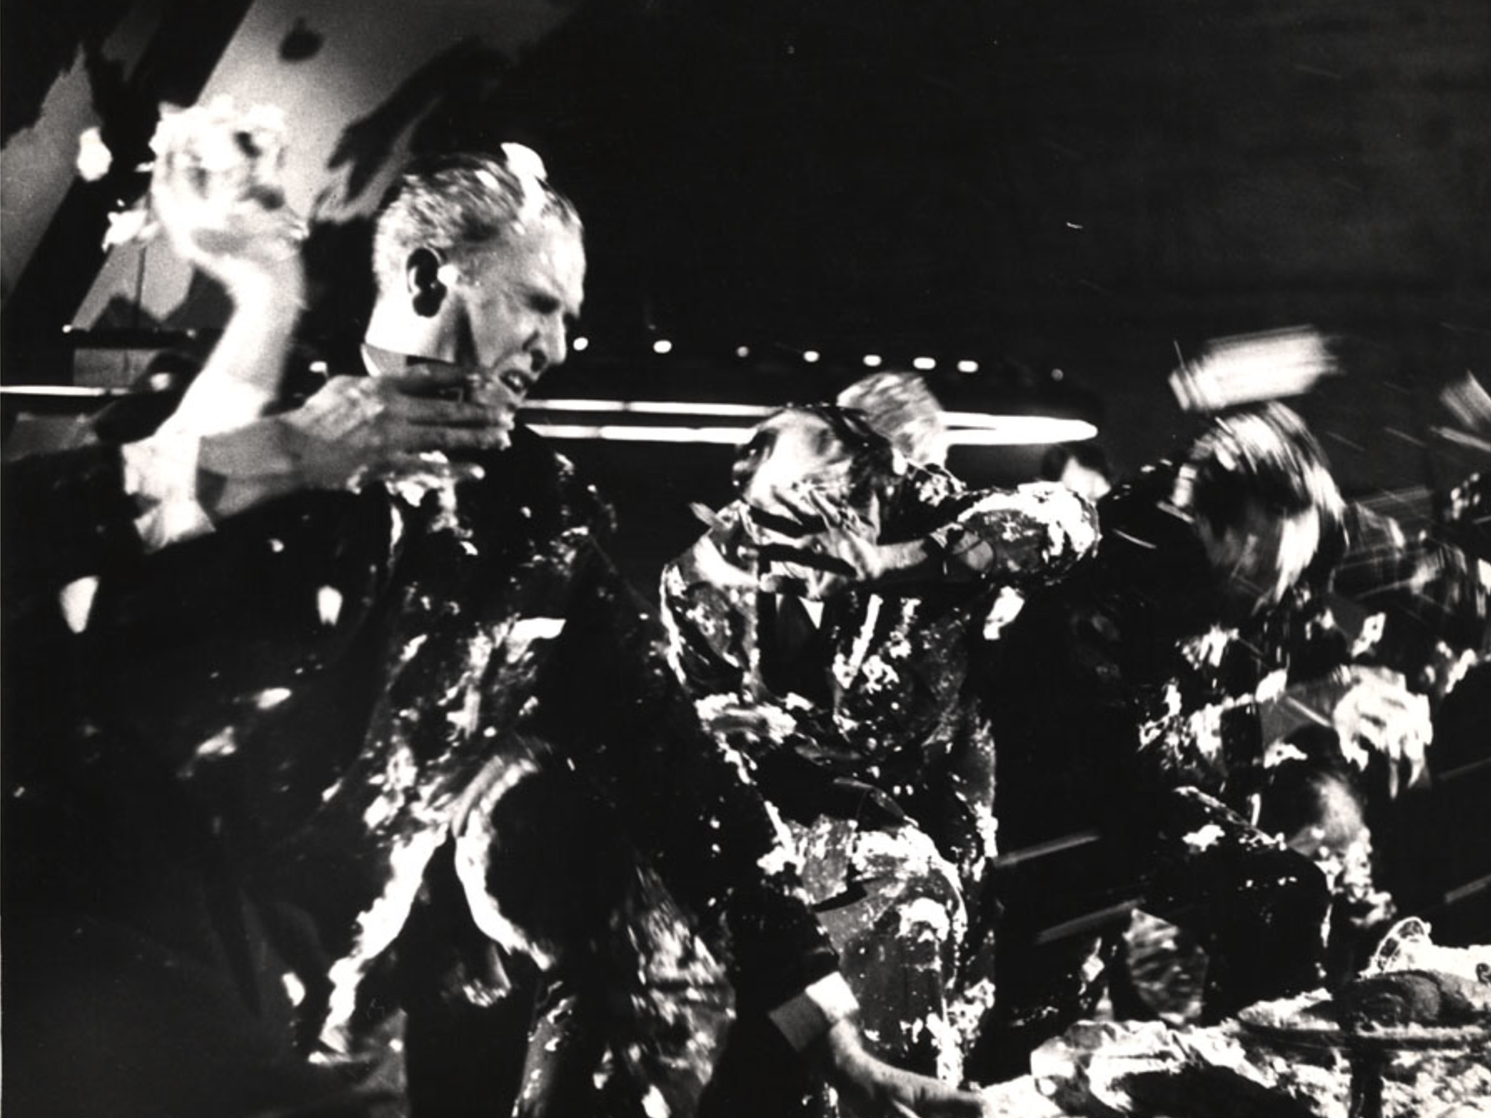

Slide 5
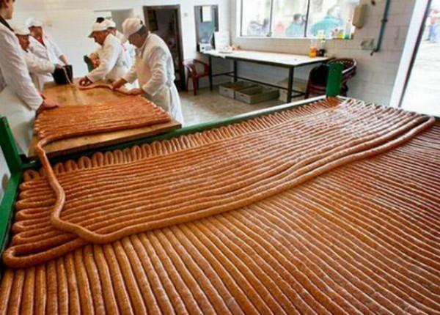

Slide 6
Who makes web standards?

Slide 7
What counts as a Web standards organisation?

Slide 8





Web Standards Organisations

Slide 9
IETF Structure and Process

Slide 10
The Internet Engineering Task Force
We reject: kings, presidents and voting.
We believe in: rough consensus and running code.
David Clark
Be conservative in what you send and liberal in what you accept
Jon Postel
Notes:
Formed in 1986
Consensus driven
Typical attendence at IETF meetings c. 1200 (from a maximum of ~2800 in 2000)

Slide 11
IETF Structure
Not a membership organisation – anyone can become involved
Formed in 1986
Overseen by the Internet Architecture Board (IAB)
Standards reviewed by the Internet Engineering Steering Group
Structured into:
  Working Groups: Chartered groups which are working towards the production of a standard)
  Birds of a Feather Groups (BoF): Informal discussion groups

Slide 12
IETF Document Types
Requests for Comments (RFC)
  Started as informal notes, have since become official Internet standards documents
Internet Drafts
  Preliminary technical specifications
  Only valid for six months, unless updated
  Removed from official repository on expiry

Slide 13
W3C Structure and Process

Slide 14
The World Wide Web Consortium
A membership organisation - must join in order to participate*
Key players:
  Director (TimBL)
  Team: Permanent staff, support workings of W3C
  Advisory Committee (AC): Contains a representative from each member organisation. Reviews proposals from Director
  Advisory Board (AB): Guides W3C in non-technical matters
  Technical Architecture Group (TAG): Coordinates cross-technology architecture developments
* with some exceptions

Slide 15
W3C Structure
Working Group
  Chartered for a specific duration to deliver a particular standard
Interest Group
  Chartered discussion forum
Community Group
  Discussion forum open to non-members

Slide 16
W3C Technical Report Type
Recommendation
Proposed Recommendation
Candidate Recommendation
Working Draft
  First Public Working Draft
  Last Call Working Draft
Note
  Member Note
  Working Group Note

Slide 17
W3C Technical Report Lifecycle
FPWD
WD
LCWD
CR
PR
REC

Slide 18
Case Study: HTML

Slide 19
The Evolution of HTML: 1991-1995
1990
HTML Tags
HTML DTD
HTML
HTML+
NCSA Mosaic released
IETF HTML WG founded
W3C founded
Netscape 0.9 released
1995
HTML 2.0
HTML 3.0
Internet Explorer released
2000
informal
Internet Draft
RFC
W3C WD
W3C REC
ISO Standard
Notes:
Oct 1991 HTML Tags
Jun 1992 HTML DTD first draft, 1.1 in Nov
Jan 1993 Mosaic released
Jun 1993 Hypertext Markup Language (Internet Draft)
Nov 1993 HTML+ (Internet Draft)
Sep 1994 IETF HTML WG founded
Oct 1994 W3C founded
Oct 1994 Netscape 0.9 released
Apr 1995 HTML 3.0 (Internet Draft)
Aug 1995 IE released
Nov 1995 HTML 2.0 (RFC1866)
Nov 1995 HTML Forms (RFC1867)
Dec 1995 IETF HTML WG disbanded
May 1996 HTML Tables (RFC1942)
Aug 1996 HTML Client-side Image Maps (RFC1980)
Jan 1997 HTML I18N (RFC2070)
Jan 1997 HTML 3.2 (W3C REC)
Dec 1997 HTML 4.0 (W3C REC)
Dec 1999 HTML 4.01 (W3C REC)
May 2000 ISO HTML (ISO/IEC 15445:2000)

Slide 20
Trouble in the Working Group
IETF HTML WG formed in September 1994
By 1995, the IETF HTML WG had grown unwieldy
  Over 100 members in the group
  “I came back after just three days away to find over 2000 messages waiting”
Disbanded in December 1995
W3C HTML Editorial Review Board formed in February 1996
  Became W3C HTML WG in December 1996

Slide 21
Embrace and Extend
“To a certain extent, Microsoft built its business on the Web by extending HTML features.”
Dave Raggett
By the mid-90s, Netscape and Microsoft were creating their own proprietary extensions to HTML
  <font>
  <marquee>
  <blink>
“This page is best viewed in browser X.”

Slide 22
De Jure versus De Facto Standards
De Jure: “according to law”
  De jure standards created to extend existing practice
  HTML 3.0, HTML 4.0, XHTML 1.0
De Facto: “as a matter of fact”
  De facto standards created to codify existing practice
  HTML 2.0, HTML 3.2

Slide 23
The Evolution of HTML: 1995-2000
1990
HTML Tags
HTML DTD
HTML
HTML+
NCSA Mosaic released
IETF HTML WG founded
W3C founded
Netscape 0.9 released
1995
IETF WG ends
HTML 2.0
HTML 3.0
Internet Explorer released
+ tables, forms
W3C HTML WG
XML
HTML 3.2
HTML 4.0
XML 1.0
HTML in XML
HTML 4.01
2000
ISO HTML
XHTML 1.0
informal
Internet Draft
RFC
W3C WD
W3C REC
ISO Standard
Notes:
Oct 1991 HTML Tags
Jun 1992 HTML DTD first draft, 1.1 in Nov
Jan 1993 Mosaic released
Jun 1993 Hypertext Markup Language (Internet Draft)
Nov 1993 HTML+ (Internet Draft)
Sep 1994 IETF HTML WG founded
Oct 1994 W3C founded
Oct 1994 Netscape 0.9 released
Apr 1995 HTML 3.0 (Internet Draft)
Aug 1995 IE released
Nov 1995 HTML 2.0 (RFC1866)
Nov 1995 HTML Forms (RFC1867)
Dec 1995 IETF HTML WG disbanded
Feb 1996 HTML ERB/WG formed
May 1996 HTML Tables (RFC1942)
Aug 1996 HTML Client-side Image Maps (RFC1980)
Nov 1996 XML WD
Jan 1997 HTML I18N (RFC2070)
Jan 1997 HTML 3.2 (W3C REC)
Dec 1997 HTML 4.0 (W3C REC)
Feb 1998 XML 1.0 W3C REC
Dec 1998 Reformulating HTML in XML
Dec 1999 HTML 4.01 (W3C REC)
Jan 2000 XHTML 1.0
May 2000 ISO HTML (ISO/IEC 15445:2000)

Slide 24
The Evolution of HTML: 2000-2010
HTML4.01
2000
XHTML 1.0
XHTML 2.0
Opera/Mozilla Paper
2005
2010
informal
Internet Draft
RFC
W3C WD
W3C REC
Notes:
2002 XHTML 2.0 FPWD
Jun 2004 Opera/Mozilla position paper on HTML voted down by W3C
Jun 2004 WHAT formed

Slide 25
Web Hypertext Application Technology WG
Formed in 2004 in response to perceived slow HTML standards development in W3C
Founder members: Apple, Mozilla and Opera
  Now includes Google (with move of HTML5 editor Ian Hickson)
Treats HTML 5 as a “living standard”, maintained by an “informed editor”
Membership types:
  Invitation-only Members
  Open Contributors

Slide 26
The Evolution of HTML: 2000-2010
HTML4.01
2000
XHTML 1.0
XHTML 2.0
Opera/Mozilla Paper
WHATWG formed
2005
HTML5
XHTML 2.0
W3C HTML WG formed
HTML5
XHTML 2.0 WG disbanded
2010
informal
Internet Draft
RFC
W3C WD
W3C REC
WHATWG
WHATWG
WHATWG
Notes:
2002 XHTML 2.0 FPWD
Jun 2004 Opera/Mozilla position paper on HTML voted down by W3C
Jun 2004 WHATWG formed

Slide 27
The Evolution of HTML: 2010-
2010
HTML5
HTML5 LCWD
W3C WHATWG CG formed
HTML5 CR
HTML5
2015
HTML5.1
HTML5.2
informal
Internet Draft
RFC
W3C WD
W3C REC
WHATWG
WHATWG
WHATWG
Notes:
2002 XHTML 2.0 FPWD
Jun 2004 Opera/Mozilla position paper on HTML voted down by W3C
Jun 2004 WHATWG formed
2 Nov 2017 HTML5.2 PR

Slide 28
Further Reading
The Tao of IETF
http://www.ietf.org/tao.html
W3C Consortium Process Document
http://www.w3.org/2015/Process-20150901/
A History of HTML (1998). From Raggett on HTML
http://www.w3.org/People/Raggett/book4/ch02.html

Slide 29
Next Lecture:
Intellectual
Property

