Slide 1
Telling Tales:
Hypertext Writing
COMP3220 Web Infrastructure
COMP6218 Web Architecture
Dr Nicholas Gibbins - nmg@ecs.soton.ac.uk
2017-2018

Slide 2
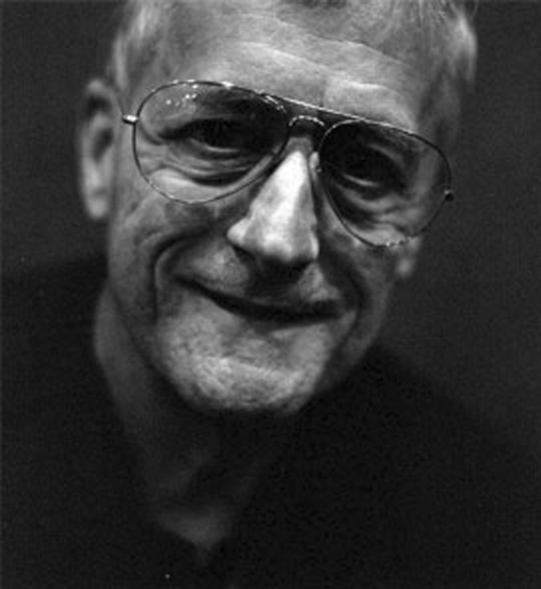
A Working Definition
By ‘hypertext’, I mean non-sequential writing - text that branches and allows choices to the reader, best read at an interactive screen. As popularly conceived, this is a series of text chunks connected by links which offer the reader different pathways.
Nelson, T.H. (1981) Literary Machines, Sausalito, CA: Mindful Press.

Slide 3
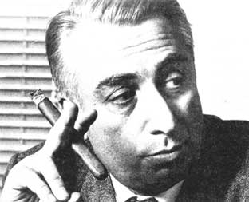
The Death of the Author
We know now that a text is not a line of words releasing a single ‘theological’ meaning (the ‘message’ of the Author-God) but a multi-dimensional space in which a variety of writings, none of them original, blend and clash.
To give a text an Author is to impose a limit on that text, to furnish it with a final signified, to close the writing.
Barthes, R.G. (1967) The Death of the Author. Aspen, no. 5-6.
Notes:
Post-structuralist
Text chunk == lexia

Slide 4
Hypertext and the Death of the Author
  “It is tempting to see hypertext as realizing Barthes' utopian dreams of a writing liberated from the Author. The ability for each reader to add to, alter, or simply edit a hypertext opens possibilities of collective authorship that breaks down the idea of writing as originating from a single fixed source.
  Similarly, the ability to plot out unique patterns of reading, to move through a text in an aleatory, non-linear fashion, serves to highlight the importance of the reader in the “writing” of a text - each reading, even if it does not physically change the words - writes the text anew simply by re-arranging it, by placing different emphases that might subtly inflect its meanings.”
Keep,C., McLaughlin, T. and Parmar, R. (1993-2000) The Electronic Labyrinth.
http://elab.eserver.org/
Notes:
Aleatory: dependent on the throw of a die

Slide 5
Forking Paths
“In all fictional works, each time a man is confronted with several alternatives, he chooses one and eliminates the others; in the fiction of Ts’ui Pên, he chooses— simultaneously—all of them. He creates, in this way, diverse futures, diverse times which themselves also proliferate and fork. Here, then, is the explanation of the novel’s contradictions.
Fang, let us say, has a secret; a stranger calls at his door; Fang resolves to kill him. Naturally, there are several possible outcomes: Fang can kill the intruder, the intruder can kill Fang, they both can escape, they both can die, and so forth. In the work of Ts’ui Pên, all possible outcomes occur; each one is the point of departure for other forkings.”
Borges, J.L. (1941) The Garden of Forking Paths, Translated from Spanish by Yates, D.A.

Slide 6

Ergodic Literature
http://www.flickr.com/photos/danielygo/5391176827/

Slide 7
Ergodic Literature
“ Ergodic […] derives from the Greek words ergon and hodos, meaning "work" and "path." In ergodic literature, nontrivial effort is required to allow the reader to traverse the text. If ergodic literature is to make sense as a concept, there must also be nonergodic literature, where the effort to traverse the text is trivial, with no extranoematic responsibilities placed on the reader except (for example) eye movement and the periodic or arbitrary turning of pages. ”
Aarseth, E. (1997) Cybertext: Perspectives on Ergodic Literature. Baltimore, MD: The John Hopkins University Press.
Notes:
Typically, the nontrivial effort manifests itself as a choice (possibly random) that is applied to the text.
Extranoematic: A process that occurs outside of the confines of human thought

Slide 8

Cent mille milliards de poèmes (1961)
Book of sonnets with ten alternatives for each of fourteen lines
  100,000,000,000,000 possible combinations
Queneau, R. (1961) Cent mille milliards de poèmes. Paris: Editions Gallimard.
Notes:
“One hundred thousand billion poems”
Oulipo group (Ouvroir de Littérature Potentielle) co-founded by Queneau with the mathematician François de Lionnais as a sub-branch of the Collège de ‘Pataphysique (”a society committed to learned and useless research”, following the writings of Alfred Jarry)

Slide 9
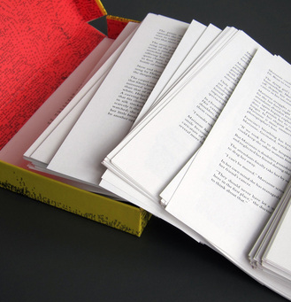
Composition No. 1, Roman (1962)
150 loose leaf pages
  Pages are to be shuffled before reading
  CONTENT WARNING!
Saporta, M. (1963) Composition No. 1, Roman. Translated from French by Howard, R., New York: Simon and Schuster.
Notes:
A permutational novel
5.7E262 possible readings

Slide 10

Hopscotch (Rayuela) (1963)
Structured as 155 chapters
  Chapters 57-155 designated as ‘expendable’
Two readings of the book:
  Chapters 1-56 in order
  All chapters, following the reading order given in the instructions: 73-1-2-116-3-…
Cortázar, J. (1966) Hopscotch. Translated from Spanish by Rabassa, G. New York: Pantheon Books.
Notes:
Two interwoven narratives:
Horacio Oliveira and La Maga in Paris
Traveler and Horacio in Argentina
Fourth key character, Morelli, an experimental novelist admired by Horacio and his friends who is involved in an accident
p.556 (§154)
“But what if we should make a mistake,” Oliveira said, “and get things all mixed up. There was a terrible complication in the first volume, this guy here and I argued hours on end as to whether there hadn’t been some mistake in the printing of the texts.”
“Who cares,” Morelli said, “You can read my book any way you want to. Liber Fulguralis, mantic pages, and that’s how it goes. The most I do is set it up the way I would like to reread it. And in the worst of cases, if they do make a mistake, it might just turn out perfect. [...]”

Slide 11
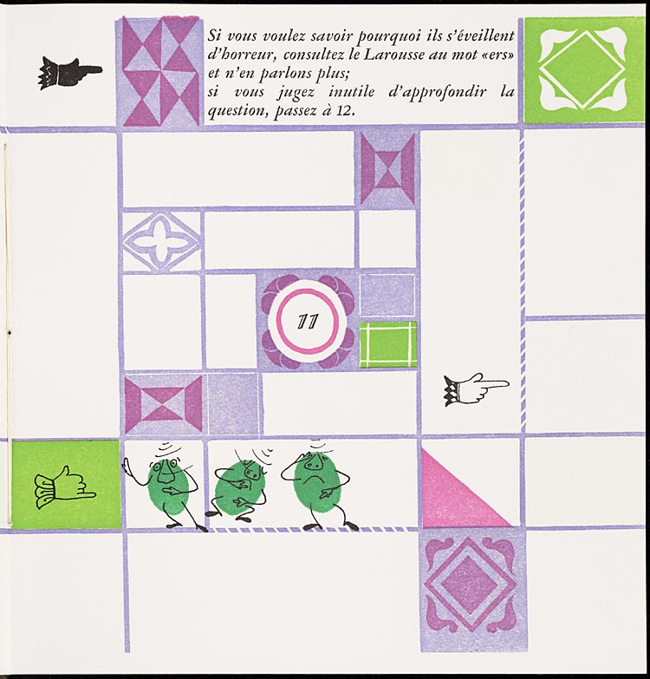
Un conte à votre façon (1967)
Numbered double-page spreads
  Story on verso pages
  Explicit choices on recto pages
Queneau, R. (1982) Un conte à votre façon, Paris: Kickshaws.
Notes:
“A story your way”
Do you wish to hear the story of the three alert peas?
11. They dreamed they would get their soup at the soup kitchen, and on opening their bowl they discovered that it was ers soup. In horror, they woke up.
If you want to know why they woke up in horror, look up the word “ers” in Larousse and say no more
If you feel that it is useless to pursue the issue, go to 12

Slide 12
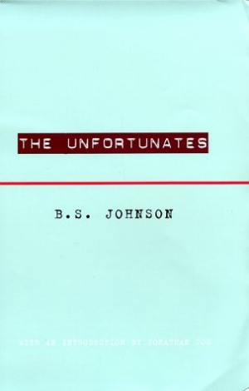
The Unfortunates (1969)
27 chapters, bound as pamphlets
  Designated first chapter
  25 chapters, to be read in any order
  Designated last chapter
Johnson, B.S. (1969) The Unfortunates, London: Secker and Warburg.
Notes:
Semi-autobiographical work
Narrator is a sports reporter (thinly veiled version of Johnson, himself a sports writer for the Observer) who travels to a city in the East Midlands (Nottingham) to cover a football match, and recalls the times that he’d been to the city before when visiting a close friend (a lecturer, who had since died of cancer).

Slide 13
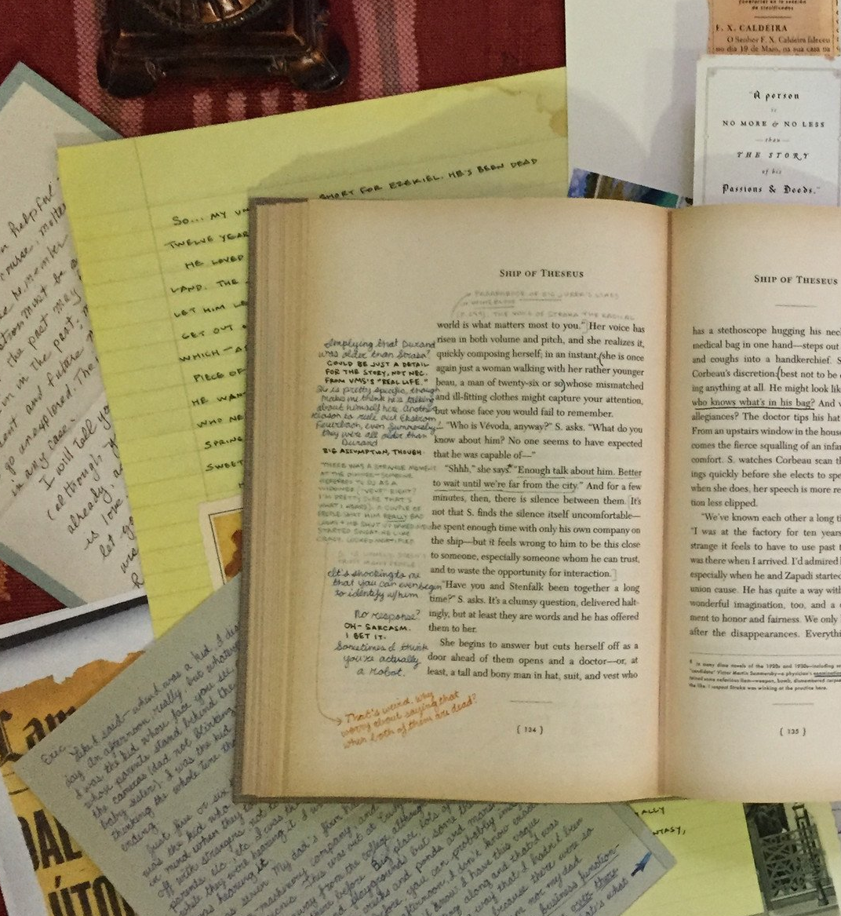
S. (2013)
A story within a story:
  Ship of Theseus, by “V.M. Straka”
  Annotations by previous readers (Eric and Jen)
  Physical artefacts contained within book
Dorst D. and Abrams, J.J. (2013) S., London: Canongate Books.
Notes:
More explicitly hypertextual than similar previous works – see Wheatley and Links’ Murder Off Miami.

Slide 14
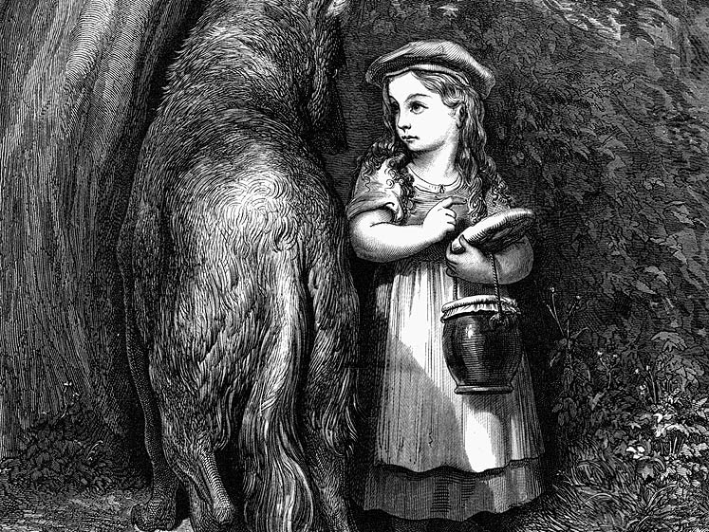
Story, Narrative and Text

Slide 15
Story, Narrative and Text
Narrative theory identifies three levels in fiction:
  Story: the content of a tale; the underlying events related in a tale (also referred to as fabula)
  Narrative: a recounting of a story; the reorganisation of events by time or point-of-view (also referred to as plot)
  Text: the signs (words, images) that are processed by the reader
Non-linearity may be introduced at any or all of these levels
Lowe, N.J. (2009) A Cognitive Model, In Reading Hypertext, Bernstein, M. and Greco, D. (eds), Watertown, MA: Eastgate Systems
Notes:
Story = Fabula
Narrative = Plot

Slide 16
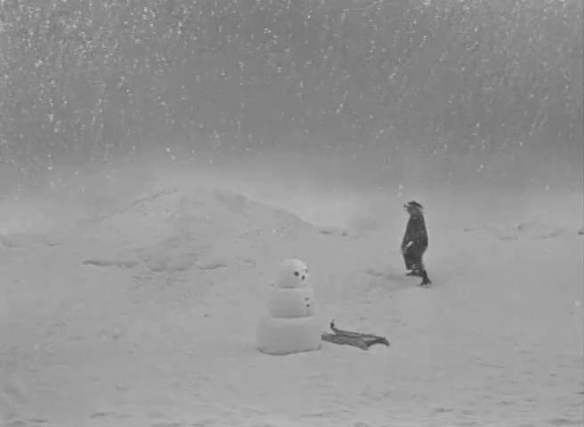
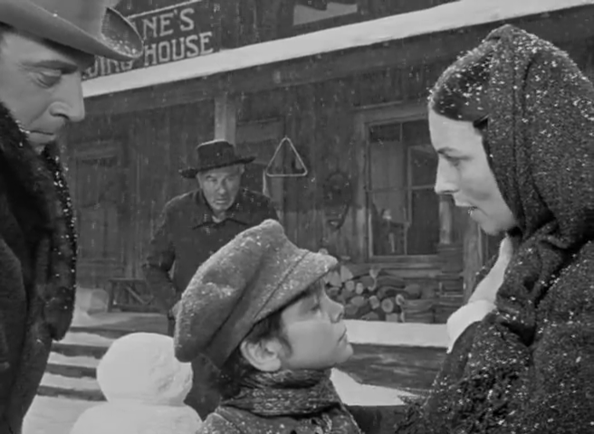
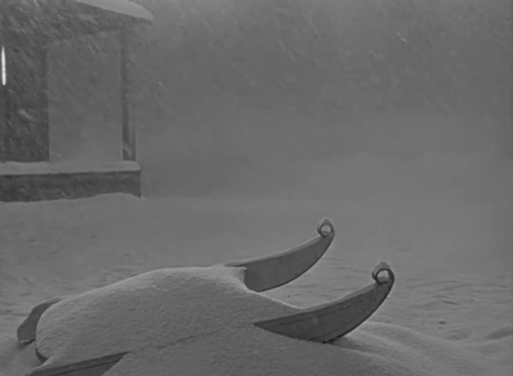
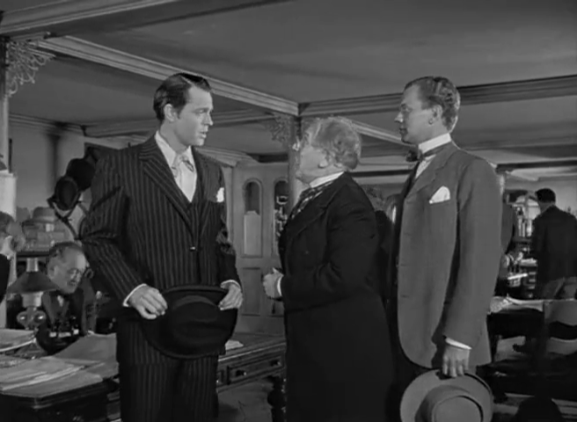
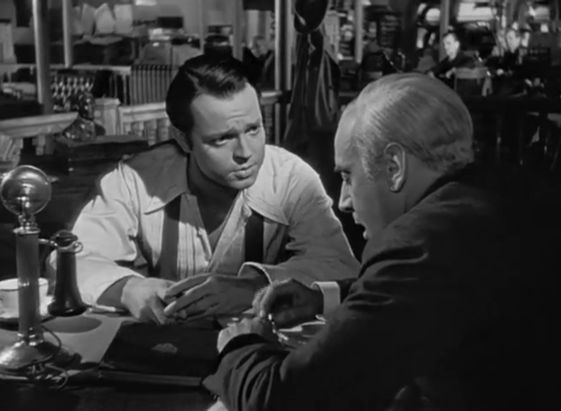
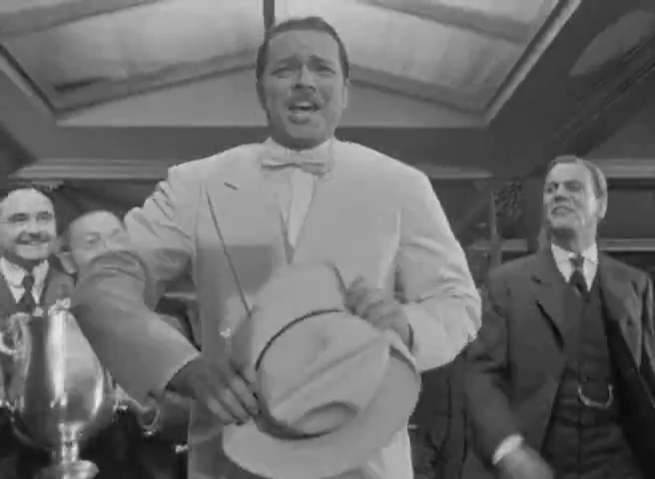
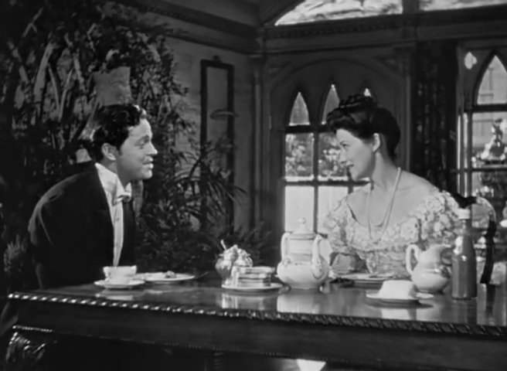
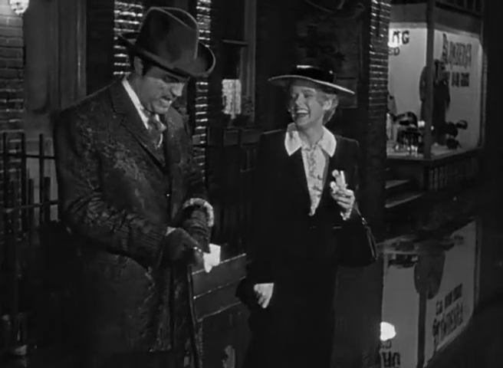
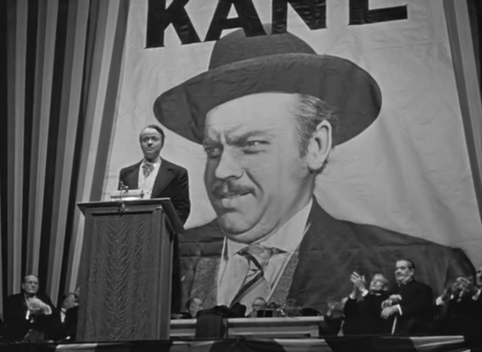
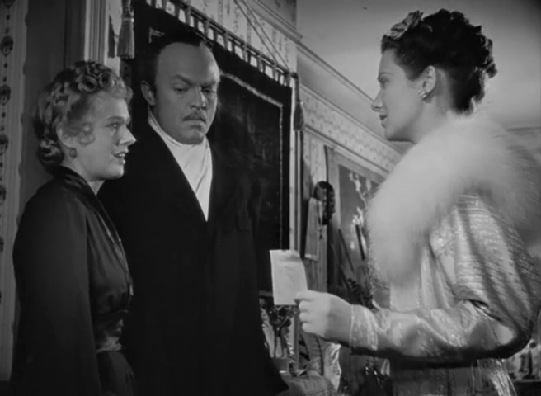
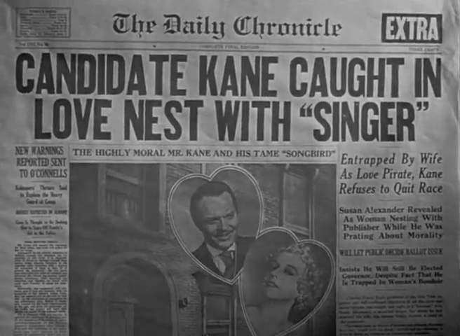
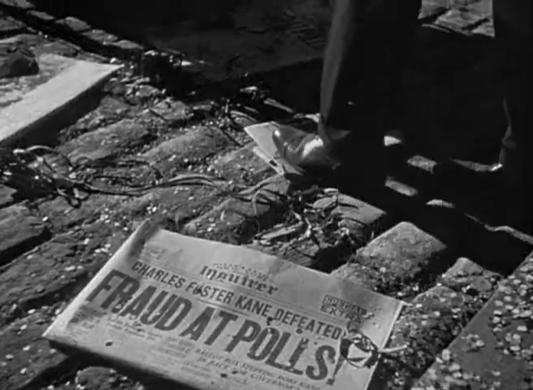
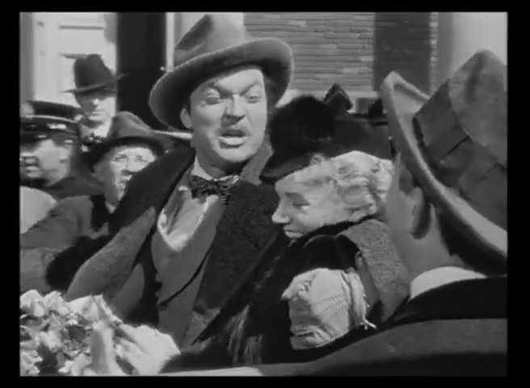
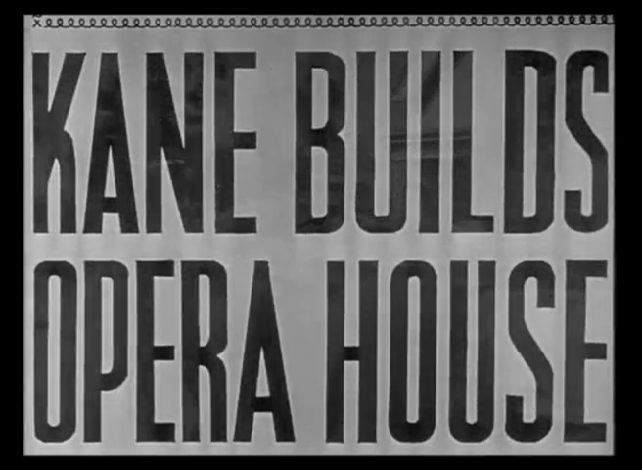
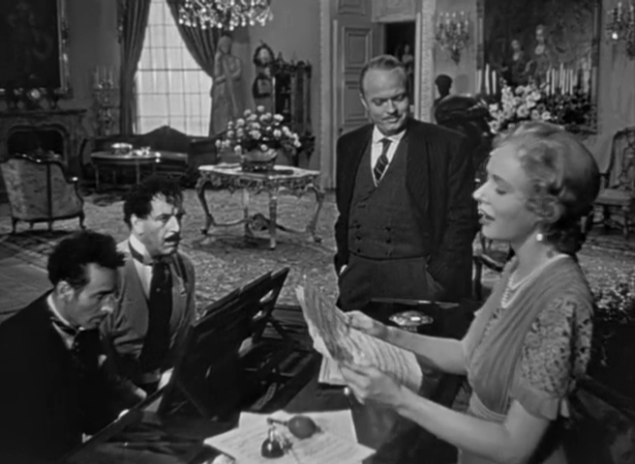
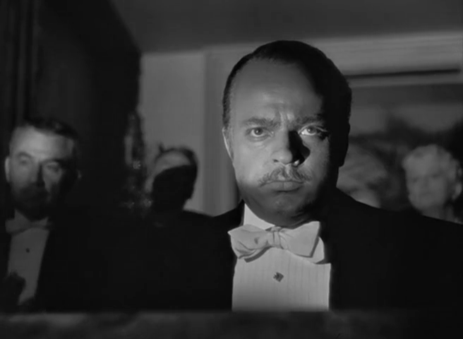
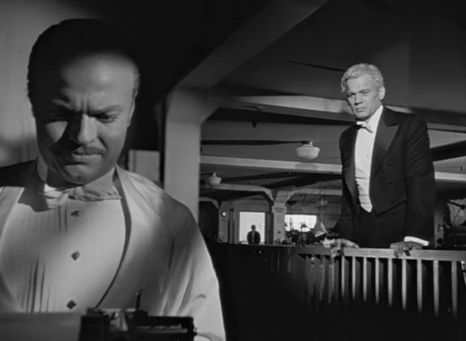
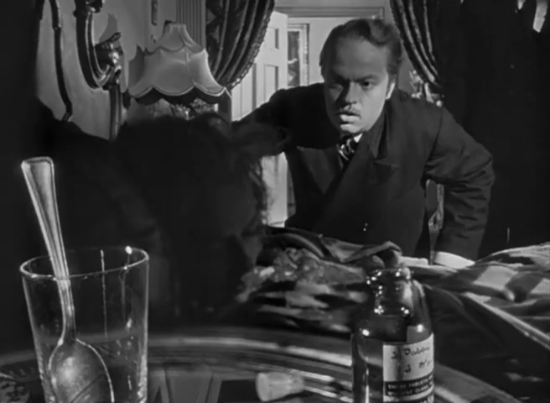
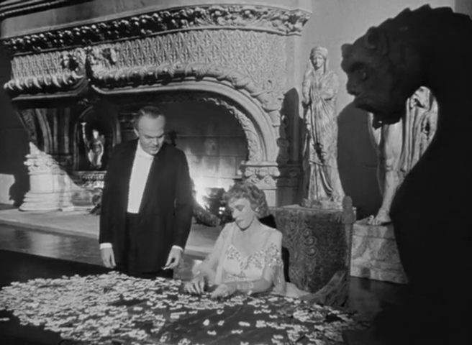
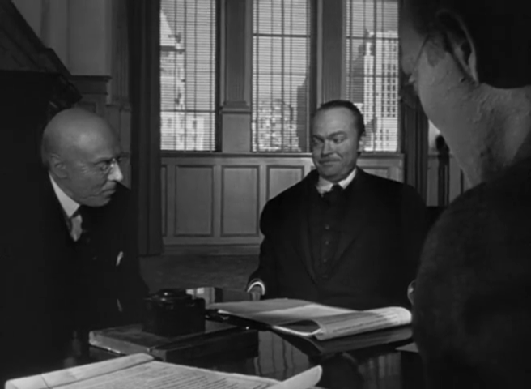
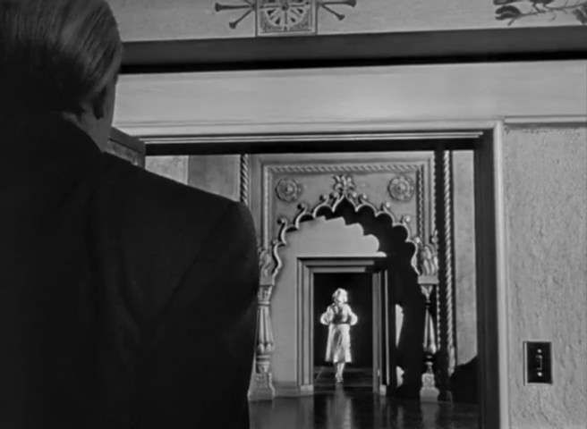
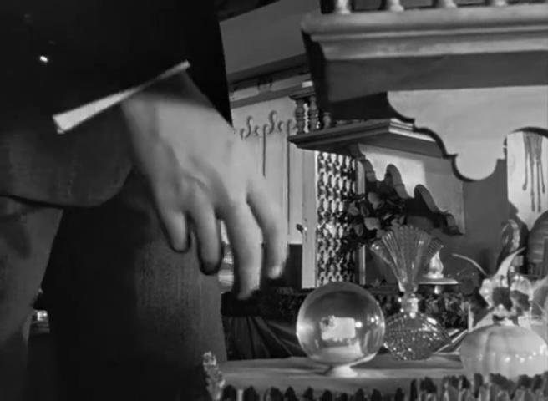
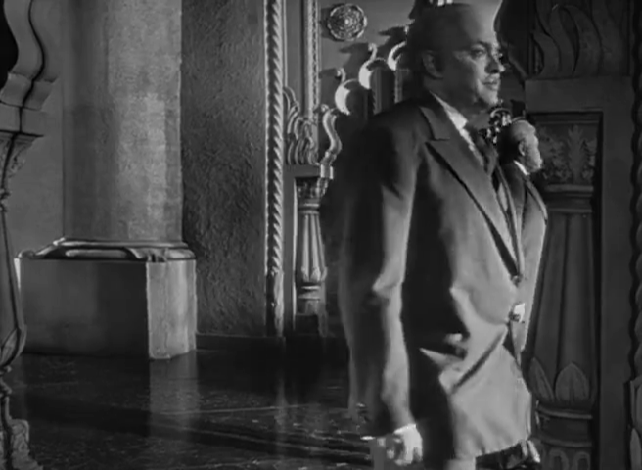
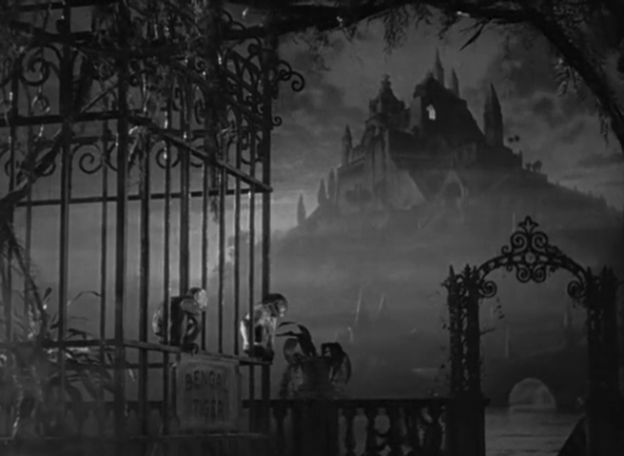
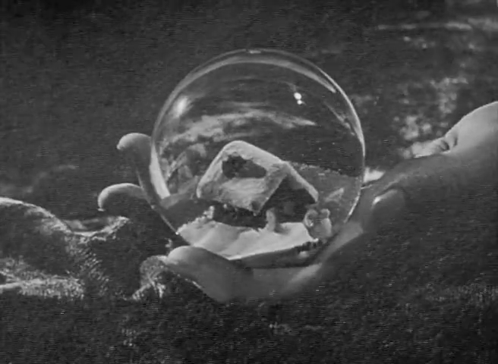
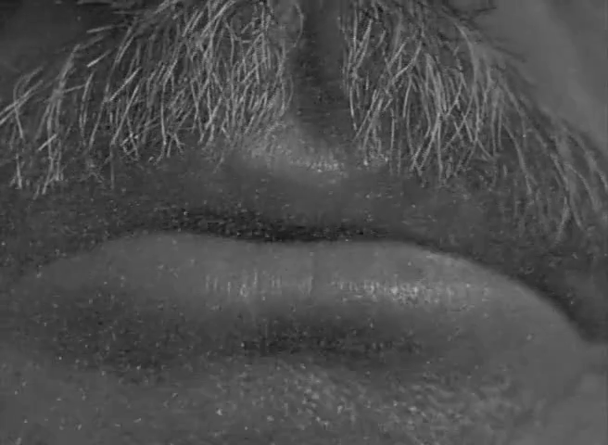
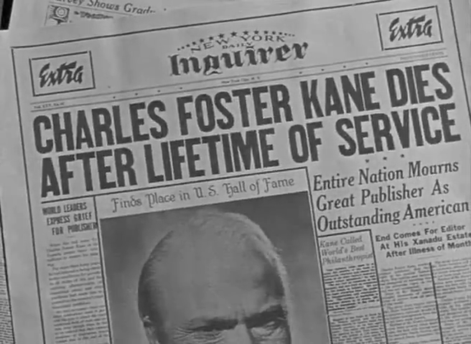
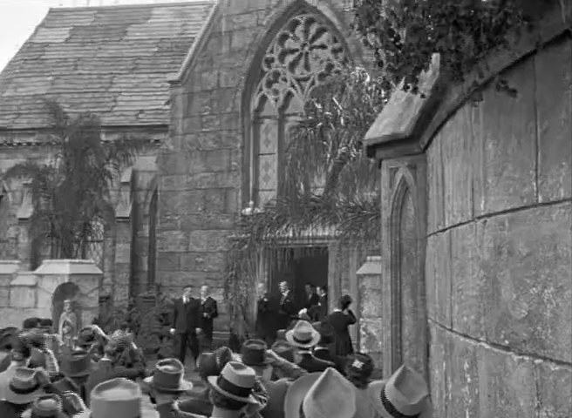
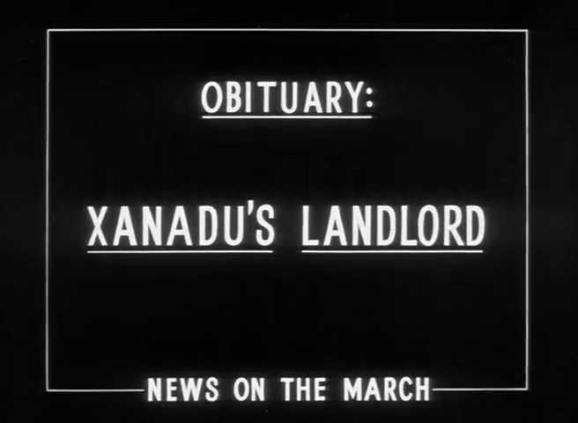
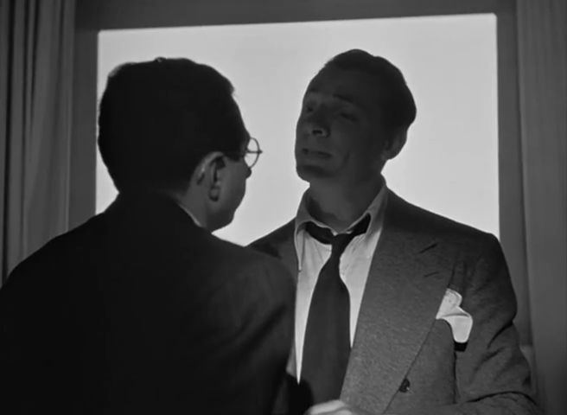
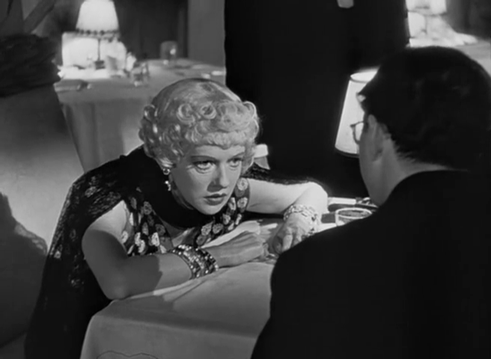
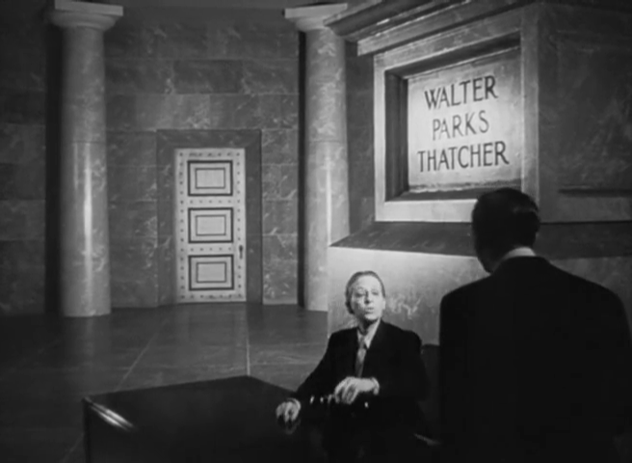
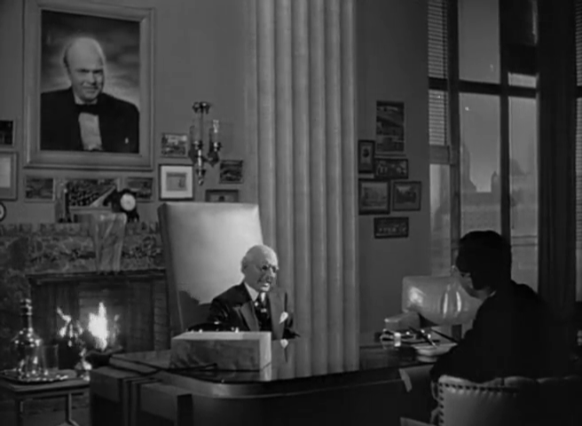
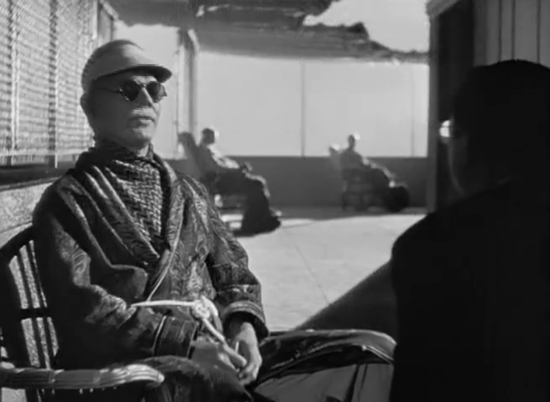
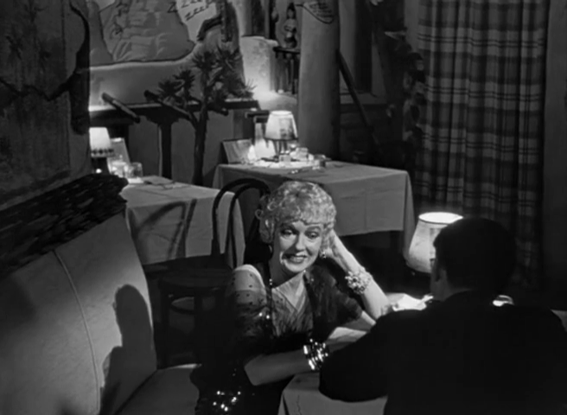
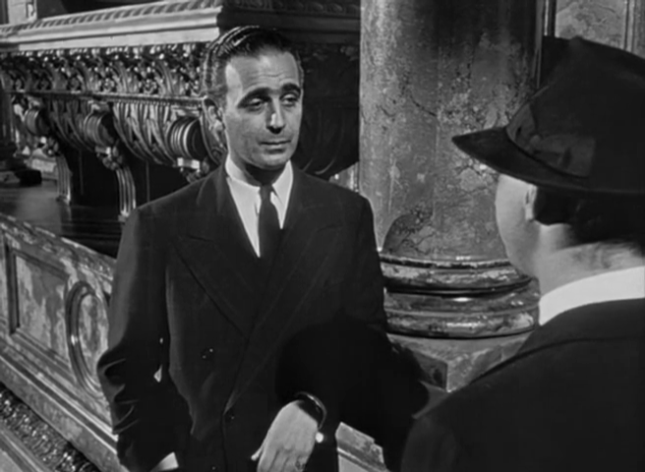
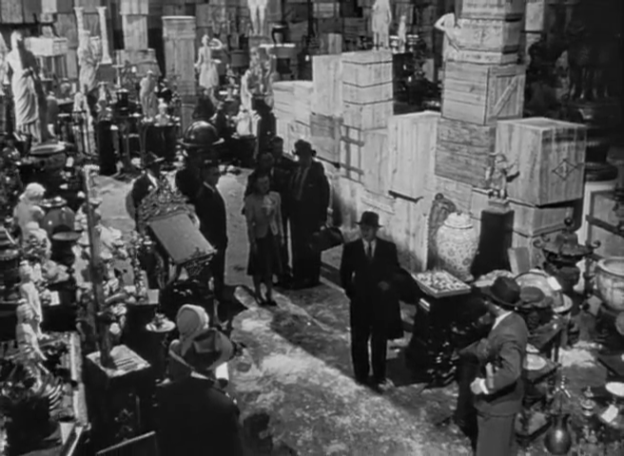
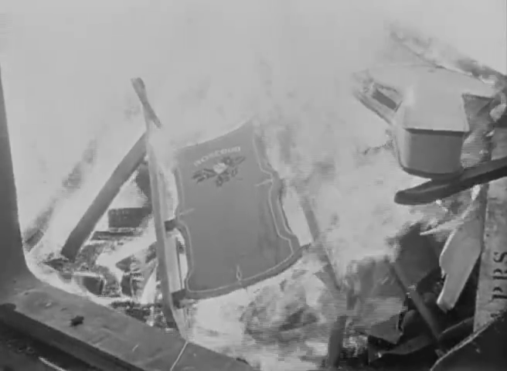
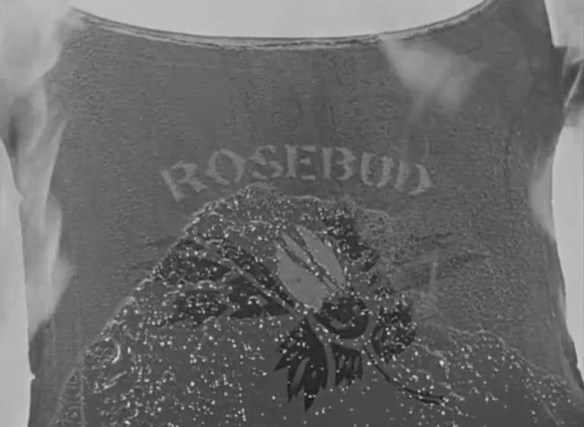
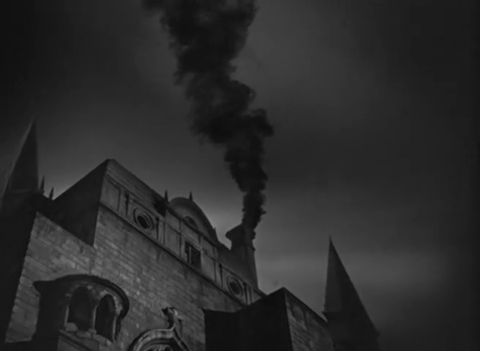
Story versus Narrative: Citizen Kane

Slide 17
Story versus Narrative: Citizen Kane
Notes:
Charles Foster Kane
Jerry Thompson (reporter)
Jedediah Leland (best friend)
Susan Alexander (mistress and second wife)
Mr Bernstein (employee)
Walter Parks Thatcher (guardian)
Emily Monroe Norton Kane (first wife)
Raymond (butler)

Slide 18
Story versus Narrative: Citizen Kane
Notes:
Other notable examples of non-linearity in film:
Citizen Kane (Orson Welles) – told as flashback/recounting
Short Cuts (Robert Altman) – multi-threaded narrative
Pulp Fiction (Quentin Tarantino) – multi-threaded and flashbacks
Timecode (Mike Figgis) – multiple simultaneous viewpoints
Film does not generally expect the audience to choose – non-ergodic.

Slide 19
Story versus Narrative: Citizen Kane
Notes:
Charles Foster Kane
Jerry Thompson (reporter)
Jedediah Leland (best friend)
Susan Alexander (mistress and second wife)
Mr Bernstein (employee)
Walter Parks Thatcher (guardian)
Emily Monroe Norton Kane (first wife)
Raymond (butler)

Slide 20

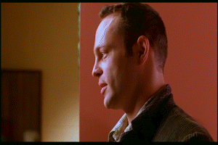
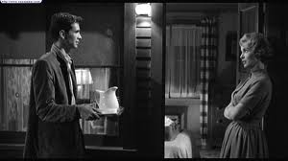
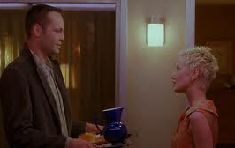


Narrative versus Text: Psycho
Psycho (1960)
Psycho (1998)
Notes:
Psycho

Slide 21

Hypertext Fiction
http://www.flickr.com/photos/nealy-j/4579505879/

Slide 22



Hypertext Fiction
A selection:
  Michael Joyce (1987) - afternoon, a story
  Stuart Moulthrop (1992) - Victory Garden
  Geoff Ryman (1996) - 253

Slide 23

afternoon, a story (1987)
"I want to say I may have seen my son die this morning.”
Non-linear narrative with default path
Notecard-like lexias
No explicit anchors; all words are anchors
Built as demonstration of the hypertext authoring system Storyspace
Joyce, M. (1990) afternoon, a story. Watertown, MA: Eastgate Systems.
Notes:
Follows the story of Peter, who begins his afternoon with the suspicion that the car crash he saw earlier might have involved his ex-wife.

Slide 24

Victory Garden (1992)
Follows a central character (Emily) and the interactions of those connected with her, set during Gulf War I.
Multiple non-linear narratives with default paths
Anchors indicate branches to other narratives
(initially hidden, but can be made explicit)
Provides a taxonomic overview map
Moulthrop, S. (1992) Victory Garden. Watertown, MA: Eastgate Systems.

Slide 25

253 (1996)
Descriptions of the 253 occupants (passengers plus driver) of a London Underground train
Extensive cross-referencing and footnotes support a non-linear narrative
Each description is 253 words long
Originally published on the Web
Ryman, G. (1998) 253: the print remix. London: Flamingo.

Slide 26
Hypertext Fiction
Academic study concentrates on literary hypertext
(c.f. literary fiction)
  Typified by non-linear narratives, rather than non-linear stories
What about the hypertext equivalent of genre or popular fiction?
Notes:
Doris Webster and Mary Alden Hopkins (1930) Consider the Consequences, New York: The Century Co.

Slide 27

Murder Off Miami (1936)
First of a series of “crime dossiers”
  Folder of documents relating to a murder case
  Not hypertextual, but with some ergodic character
Links J.G and Wheatley, D (1936) Murder Off Miami, London: Hutchinson & Co.

Slide 28

Lucky Les (1967)
Third person narrative
Coarse-grained, non-linear story
  Multi-page lexias corresponding to episodes in Les’ life
  Each episode concludes with an explicit choice for the reader
Hildick, E.W. (1967) Lucky Les: the adventures of a cat of five tales, Leicester: Brockhampton Press.

Slide 29

State of Emergency (1969)
Second person narrative
Non-linear story
  Multi-page lexias
Aimed at adults
  Simulation of government in a newly independent country
Guerrier, D. and Richards, J. (1969) State of Emergency: A Programmed Entertainment, London: Penguin
Notes:
See also: Tutortext, and programmed instruction (following the work of B.F. Skinner)

Slide 30


Choose Your Own Adventure (1979-)
Second person narrative
Again, non-linear story
  Single page lexias
  Numbered pages
  with explicit
  choices
See also interactive
fiction (Colossal Cave/
Advent, etc)
Montgomery, R.A. (1979) Journey Under the Sea. New York: Bantam Books.
Notes:
Ludic hypertext

Slide 31


Slide 32

Life’s Lottery (1999)
Increasing sophistication – not a children’s book!
  Lexias vary in size from a paragraph of a few sentences to several pages
  Non-linear story, but with an additional narrative if lexias are read in order, rather than by following the directions in the lexias
Newman, K. (1999) Life’s Lottery, London: Simon and Schuster.

Slide 33

Ludic Hypertext
http://www.flickr.com/photos/jamesrbowe/4001776922/

Slide 34
Ludic Narrative
Game + Story … but what’s in a game?
Different forms of play
  Competition (agon)
  Chance (alea)
  Simulation (mimicry)
  Disorientation (ilinx)
Different types of play
  Structured, explicit rules (ludus)
  Unstructured, spontaneous (paidia)
Caillois, R. (1961) Man, Play and Games. New York: Free Press of Glencoe.
Notes:
Les Jeux et les Hommes

Slide 35


Fighting Fantasy (1982-)
Combines CYOA-style second person narrative with Dungeons & Dragons-style rules
  Non-linear story
  Numbered paragraphs
  (more finely-grained
  narrative)
  Mixture of explicit
  and random choices
  (aleatory reading)
  External state
  (hit points, inventory, etc)
Jackson, S. & Livingstone, I. (1982) The Warlock of Firetop Mountain. Harmondsworth: Puffin.
Notes:
1980s fantasy boom – hypertext books!
Largely a paper-based fusion of role-playing games and computer adventure games
Ludic hypertext

Slide 36

Duel Master (1986-7)
Two-player gamebook (agon)
  Non-linear story
  Split across two paired books (even/odd numbered lexia)
  Shared state (keywords) and synchronisation
  Mixture of explicit
  and random choices
  (aleatory reading)
Smith, M. & Thomson, J. (1987) Arena of Death. London: Armada Books.

Slide 37

Being Elizabeth Bennet (2007)
Second person narrative
  Again, non-linear story
  Simple rules
  No aleatory aspects
Mimicry aimed at a different demographic to that of other gamebooks!
Campbell Webster, E. (2007) Being Elizabeth Bennet. London: Atlantic.
Notes:
See also do-over novels: Heather McElhatton’s A Million Little Mistakes
Arguably an alternative narrative in which the eponymous protagonist, having decided that she’s too clever and too confident for Mr. Darcy, sits down to write a comedy of manners beginning “It is a truth universally acknowledged…”

Slide 38
Dark Cults (1983)
Storytelling card game
  Story assembled from random selection of text fragments (alea)
  Aim is to improvise a narrative around the story
Rules ensure well-formed stories
  Card types limit which cards may be played next
Integral competition (agon)
  Play alternates between players (Life and Death)
  Scores assigned to different card types for each player
Rahman, K. (1983) Dark Cults. Theilman, MN: Dark House Publishing.
Notes:
See also: Bernstein’s Card Shark

Slide 39







Dark Cults (1983)
Rahman, K. (1983) Dark Cults. Theilman, MN: Dark House Publishing.

Slide 40
Card Shark
A Card Shark node (or card) contains some text, typically a brief, focused passage
Each card may also specify constraints on the context in which it may appear
Reader receives seven random cards, based on constraints chooses which card to visit next, repeats
Social Shark: collaborative, competitive reading
  Readers take it in turns to play cards
  Points awarded to readers for the playing of particular cards
Bernstein, M. (2001) Card Shark and Thespis: exotic tools for hypertext narrative.
Proceedings of the 12th ACM Conference on Hypertext and Hypermedia, pp 41-50..

Slide 41

Hypertext Comics
http://www.flickr.com/photos/dolmansaxlil/5606944557/

Slide 42

Hypercomics (1986-)
Early hypertext comics based on gamebooks
  Dice Man 1-5 (1986)
  You are Maggie Thatcher (1987)
Typically second person narrative
  Numbered frames/pages
  Explicit choices in captions
  Ludic elements
Talbot, B. et al, (1986) House of Death. Dice Man, no. 1, IPC Magazines.

Slide 43

Carl (2001)
Implicit choices in alternate frames
  Relies on left-to-right, top-to-bottom reading conventions
  Spatial juxtaposition of frames on the printed page permits multiple reading paths
Examined by Scott McCloud in Understanding Comics (1993)
McCloud, S. (2001) Choose Your Own Carl. http://www.scottmccloud.com/
Notes:
Hypertextual narrative – reading order is left/top to right/bottom
Many other examples (albeit less hypertextual) that rely on spatial juxtaposition to indicate parallel action - Dave Sim’s Cerebus, Alan Moore’s Watchmen

Slide 44

Meanwhile (2010)
Visual grammar for linking:
Tabs for inter-page navigation
Shiga, J. (2010) Meanwhile. New York: Amulet Books.
Notes:
Comment on visual grammar
Non-linear story

Slide 45

Jimmy Corrigan (2001)
Ware, C. (2001) Jimmy Corrigan: The Smartest Kid On Earth, London: Jonathan Cape.
Notes:
Linear story, but with sections of non-linear narrative that are read as a gestalt.

Slide 46

Hypertext Poetry
http://www.flickr.com/photos/rossap/4160004956/

Slide 47

Hypertext Poetry
Rosenberg, J. (2005) Diagrams Series 6, #1.

Slide 48

Hypertext Drama
http://www.flickr.com/photos/slimjim/2169745303/

Slide 49
Drama vs. Hyperdrama
Traditional drama:
  presents the playwright’s (and director’s) preferred account (narrative) of a story
  distinguishes between on-stage and off-stage
Hyperdrama:
  allows the audience to follow different narratives (and to choose when to switch narratives)
  continues action off-stage
Deemer, C. (1999) The New Hyperdrama: How hypertext scripts are changing the
parameters of dramatic storytelling.
Notes:
http://www.ibiblio.org/cdeemer/newhype.htm
See also: interactive drama

Slide 50

Rosencrantz and Guildenstern are Dead (1966)
Additional narrative centred on minor characters in Hamlet
Non-ergodic, therefore not hyperdrama
Stoppard, T. (1973) Rosencrantz and Guildenstern are Dead. London: Faber and Faber.
Notes:
First staged in 1966
Example of a boundary case – the audience can’t choose to leave Hamlet or R&G and follow the other play, so this isn’t ergodic and therefore not hyperdrama.
(it is however intertextual – in semiotic terms, Hamlet is the hypotext and R&G is the hypertext)
See also Alan Ayckbourn’s Norman Conquests (Table Manners, Living Together, Round and Round the Garden) from 1973, and his later House and Garden (from 1999) in which the two plays are performed simultaneously.

Slide 51

Night of January 16th (1935)
Courtroom drama by Ayn Rand, centred on a murder trial
Members of the audience are selected to form a jury
The jury’s verdict determines the ending of the play (ergodic)
Rand, A. (1936) Night of January 16th: a comedy-drama in three acts. New York: Longmans & Co.

Slide 52

Kinoautomat (1967)
Czech experimental interactive film
First shown at Expo 67 in Montreal
Film is stopped at intervals and audience is asked how they think the film should be continued
Audience votes on two options (red/green) with the majority determining the future path of the film (ergodic)
Činčera, R., Roháč, J. and Svitáček, V (1967) Kinoautomat: Človĕk a jeho dům.
Notes:
Satire of democracy – audience choice doesn’t actually affect the outcome.

Slide 53

Tamara (1981)
Play takes place in a large house
Actors perform simultaneously in up to nine different rooms
Spectators must choose which actor(s) they follow (ergodic)
Multiple narratives
Krizanc, J. (1989) Tamara: A play. London: Methuen Drama.
Notes:
Based on 1927 diary entries of the housekeeper at Il Vittoriale, the villa of Gabriele D'Annunzio.
Tamara de Lempicka invited to paint D’Annunzio’s portrait.
Play ran for ten years in Los Angeles

Slide 54

Timecode (2000)
Film composed of four overlapping narratives
Filmed simultaneously as four continuous 90-minute takes
Screen divided into quarters, all four films projected at same time
Audience ‘choose’ which sub-film to watch (ergodic)
Figgis, M. (2000) Timecode. Screen Gems (distributor).

Slide 55
Summary

Slide 56
Summary
Non-linearity is the essence of hypertext
  Hypertext fiction may be non-linear in story, narrative or text
  Non-linearity may equally apply to poetry, comics, film and drama
Hypertext is also ergodic
  Non-trivial effort typically manifests itself as choice
  May also involve ludic elements

Slide 57
Next Lecture:
Open Hypermedia

