Slide 1
Trailblazers:
Hypertext History
COMP3220 Web Infrastructure
COMP6218 Web Architecture
Dr Nicholas Gibbins - nmg@ecs.soton.ac.uk
2017-2018

Slide 2
Revisiting Nelson’s Definition
The history of hypertext is intrinsically bound up with the history of knowledge organisation
Nelson, T.H. (1965) A file structure for the complex, the changing and the indeterminate.
Proceedings of the 20th ACM National Conference..

Slide 3
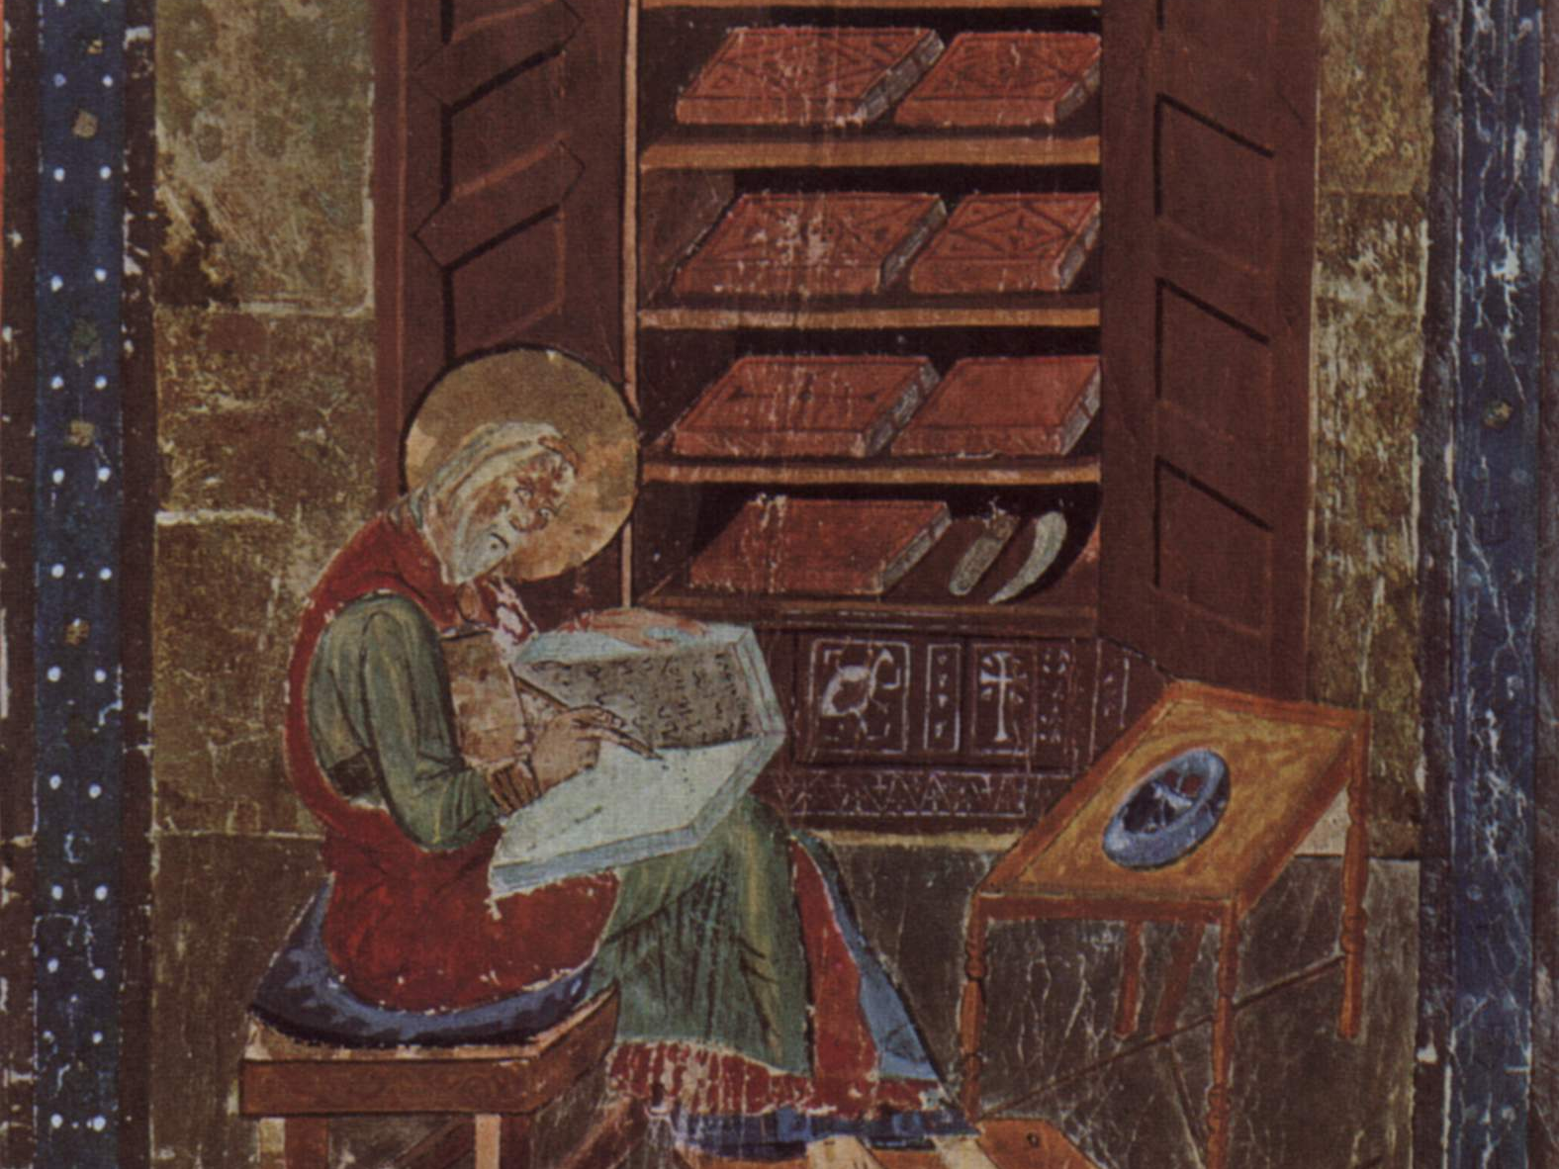
From the Middle Ages to the Age of Enlightenment
St Cuthbert Gospel, C7th England

Slide 4
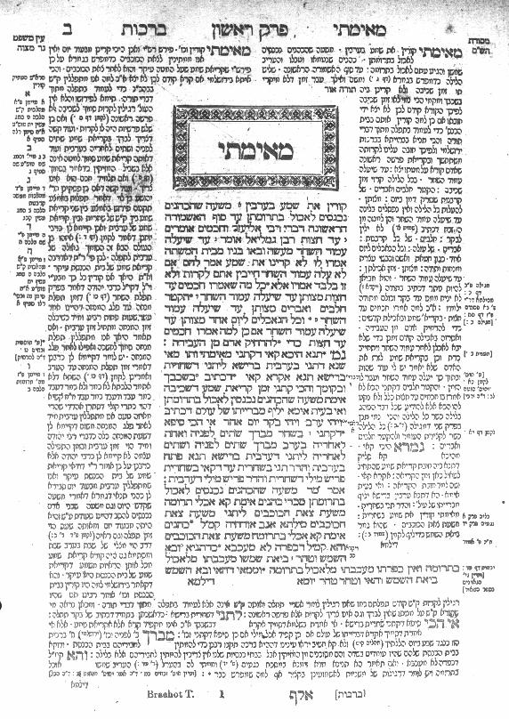
The Talmud
Central text of Rabbinical Judaism
Encoding of oral tradition
Commentaries on original text
Commentaries on commentaries
Notes:
Central text: the law (Mishnah c. 220 CE), legal analysis (Gemara, c. 450CE)
RH: early medieval commentaries by Rabbi Shlomo ben Yitzhak (Rashi, C11-12)
LH: medieval commentaries (Tosaphot, C12-13)
Outer columns: modern commentaries, cross references

Slide 5
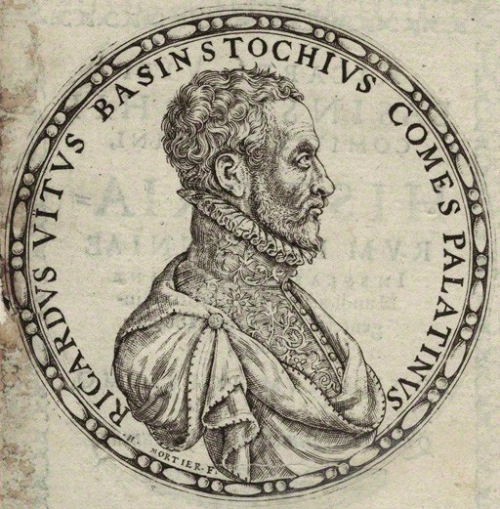
Richard White of Basingstoke
dunce
Author of Historiarum libri cum notis antiquitatum Britannicarum (1597-1607)
"as bees take honey from different flowers, so we must take materials from all sorts of different authors and, once they have been systematically collected, store them away, as it were, in the proper combs.”
One of the earliest scholars to make use of endnotes.
Notes:
“History books with notes of British Antiquities”
Facts mainly taken from Annio di Viterbo’s Antiquitatum Variarum (1498) (thus largely fabricated)

Slide 6
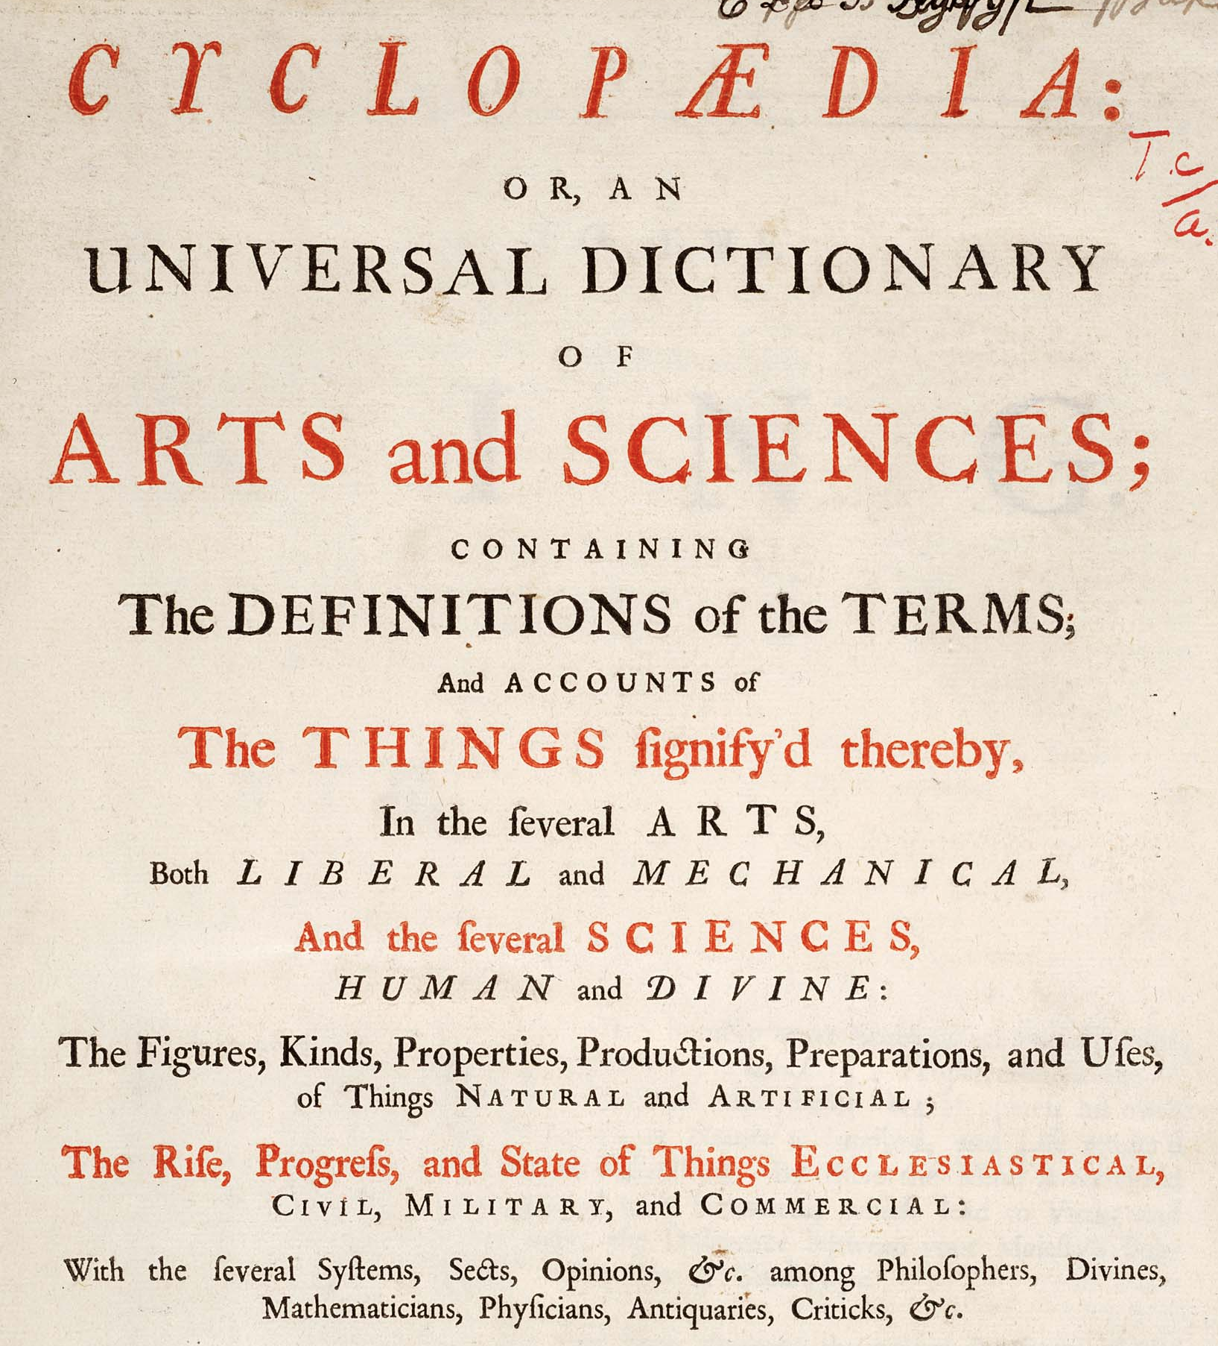
The Birth of the Modern Encyclopedia
Comprehensive in scope, systematic in organisation
Ephraim Chambers’ Cyclopædia in 1728
Denis Diderot’s Encyclopédie in 1751
Common features:
Subject-based classification of entries
Cross-references between entries
Notes:
Encyclopaedia, or a Systematic Dictionary of the Sciences, Arts, and Crafts

Slide 7
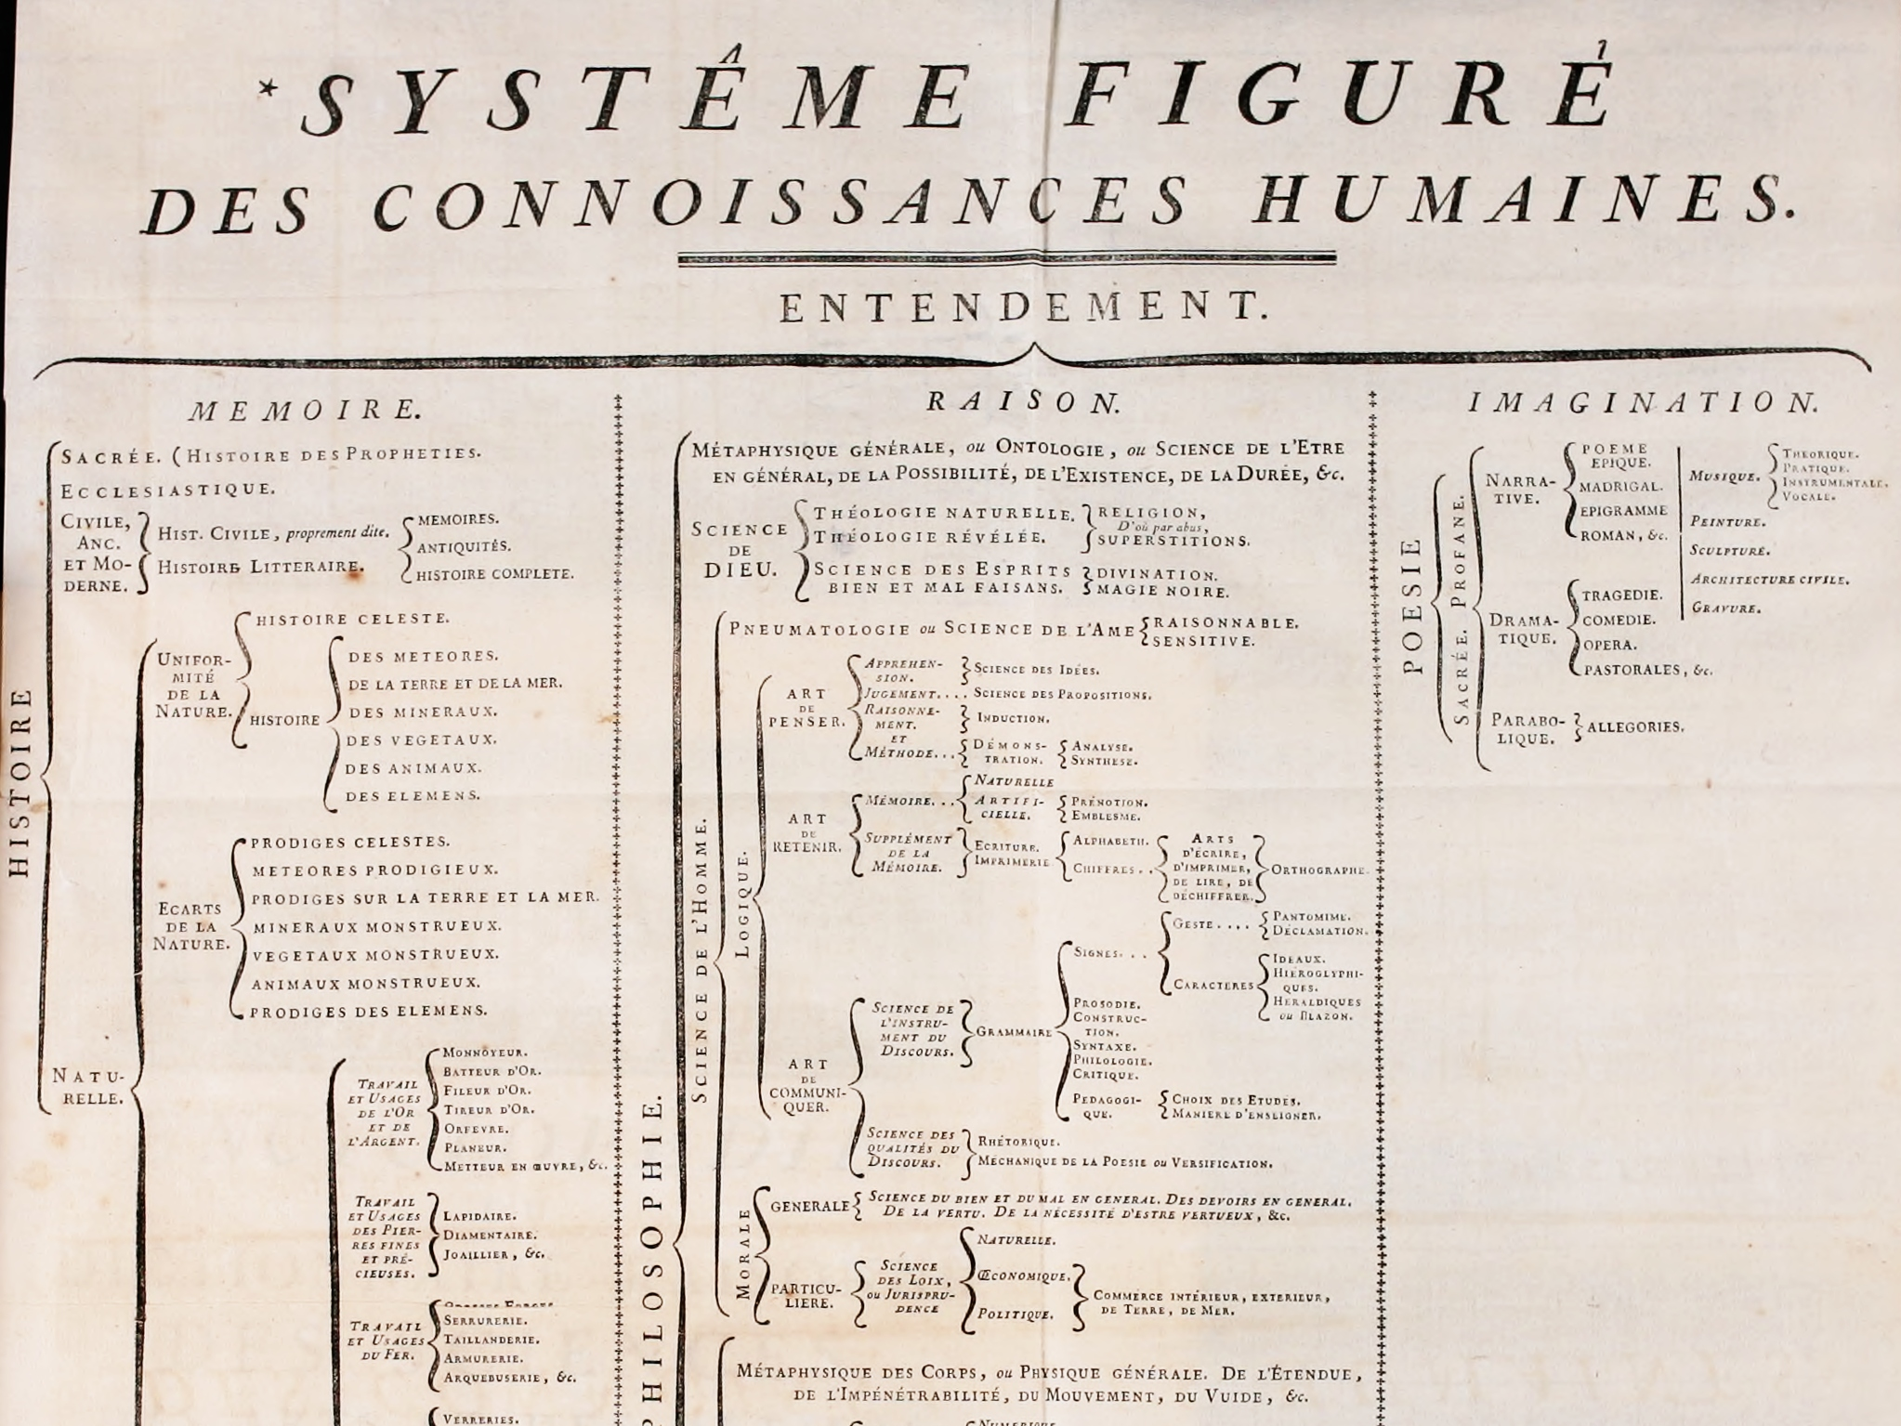
Wikimedia Commons

Slide 8
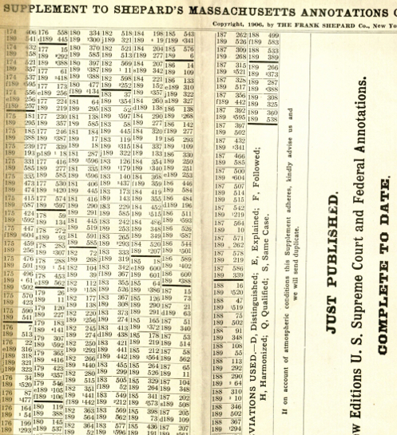
Legal Citations
Knowledge organisation in a specialist domain
Practice of referring to court decisions, statutes, etc that support a proposition
“Which cases cite this case?”
  Hand-annotation
  Shepard’s Adhesive Annotations (1875)
  Shepard’s Citations
  (early C20th)
Notes:
Hand annotation – marginal notes added to the volumes (US Reports, etc) in a lawyer’s library
Adhesive Annotations – perforated notes that only needed to be stuck to the appropriate page
Shepard’s Citations – cross-references stored in separate volume
Shepardizing

Slide 9
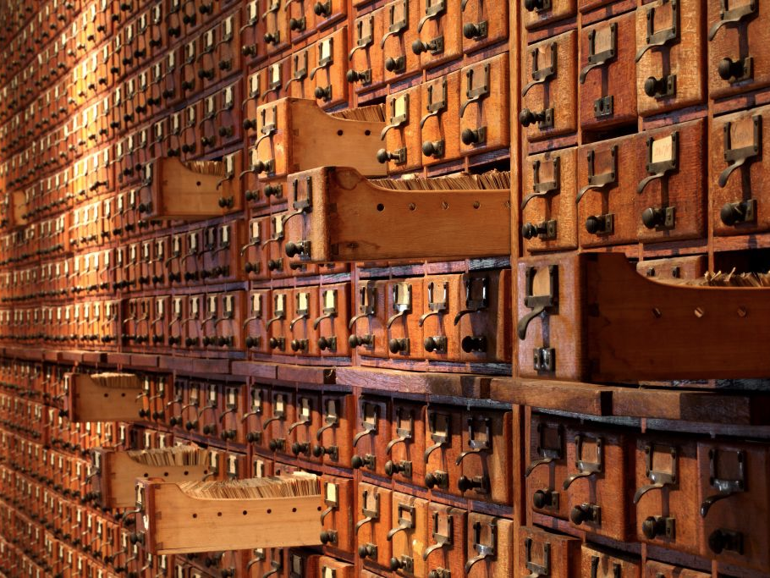
Organising Utopia
Notes:
The history of hypertext is closely related to the history of information science and information management

Slide 10
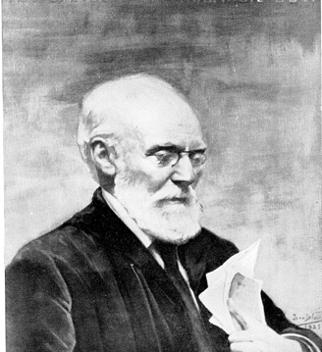
Paul Otlet
Belgian lawyer, internationalist and ‘father of Information Science’
Created the Universal Decimal Classification for libraries
(still in use around the world)
With Henri La Fontaine, established the Répertoire Bibliographique Universel in 1895
Notes:
Pronounced “otley”
UDC is Dewey based – Melville Dewey agreed to modifications, as long as UDC was not translated into English
RBU – fee-based service
15 million 3x5 index cards by 1934
“What works have been written by this or that author?” and “What has been written on this or that subject?”
La Fontaine received the Nobel Peace Prize in 1913 for his work as the head of the International Peace Bureau, and was the Belgian delegate at the Versailles Peace Conference in 1919

Slide 11
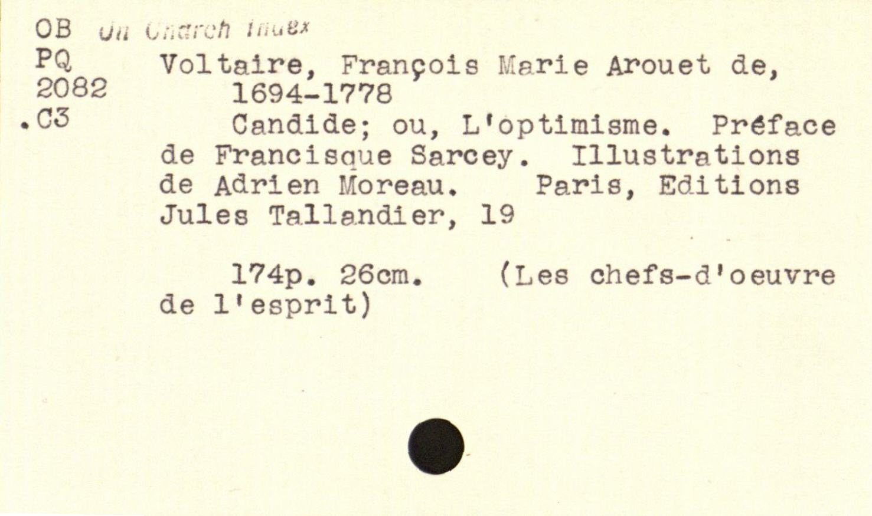
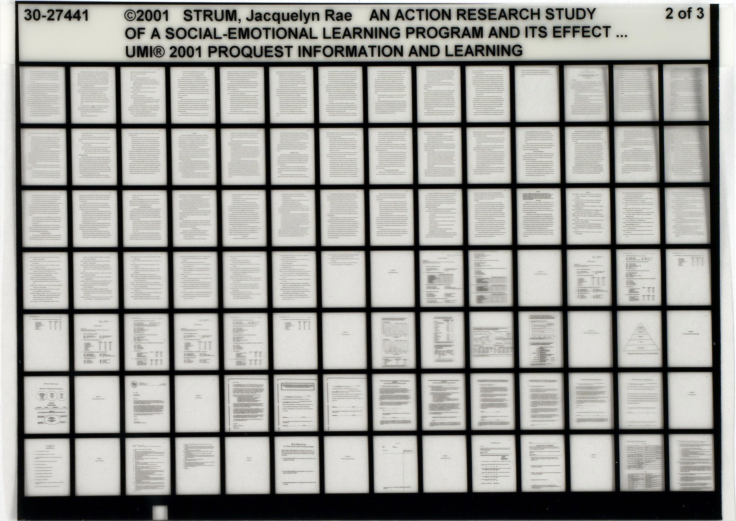
Notes:
Championed the standard 3” x 5” index card
Standard microfiche proposed in 1906

Slide 12
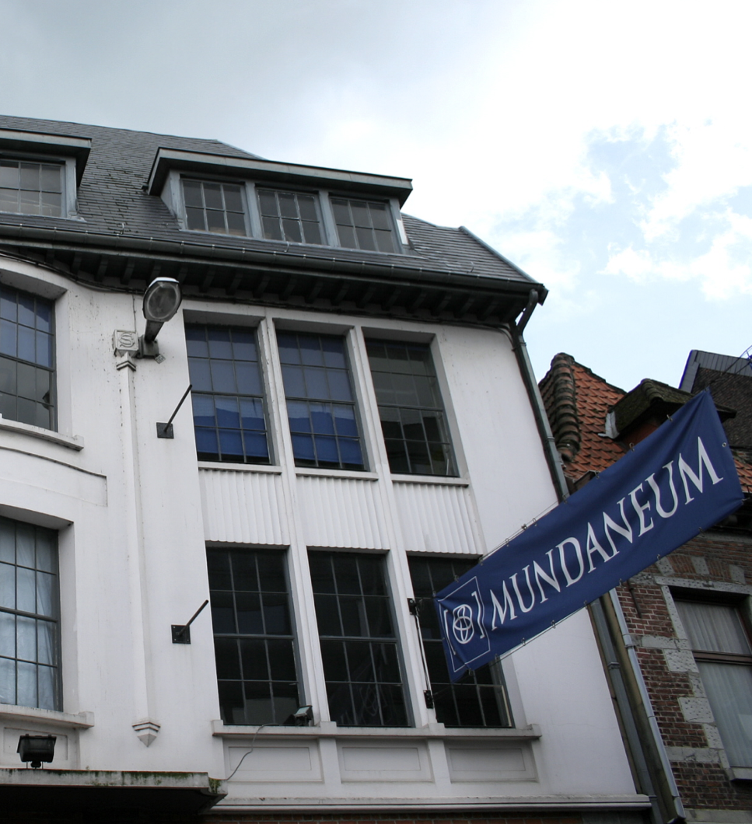
The Mundaneum
A central repository for all the world’s knowledge!
First envisaged in 1910 by Otlet and La Fontaine
Built on the earlier Repertoire Bibliographique Universel
With support from the Belgian government, established in Brussels in 1919
Rayward, W.B. (1994) Visions of Xanadu: Paul Otlet (1868-1944) and Hypertext. Journal of
the American Society of Information Science, 45(4), pp. 235-250.
Notes:
Mundaneum – the World Palace
Indexed using UDC
100,000s of files, 1,000,000s of images
Cards contain both bibliographic and substantive information
Image above is in Mons (current location of the Mundaneum)

Slide 13
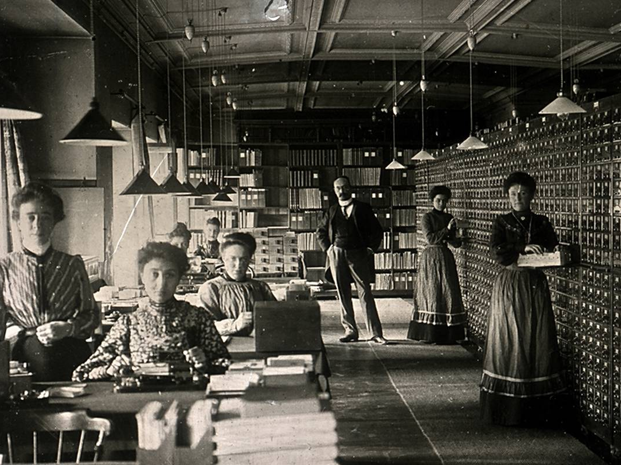
Mundaneum Archive Centre
Notes:
The RBU - Otlet visible at back
Human-driven search engine – still a common enough occurrence as late as the 1950s as to be the subject of a romantic comedy starring Katharine Hepburn and Spencer Tracey (Desk Set, 1957)

Slide 14
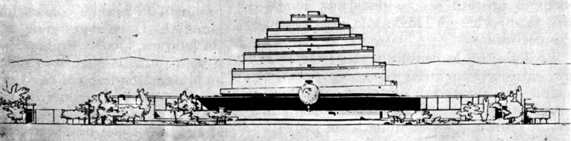
The World City
Otlet’s visionary plan for a city that brings together international institutions, containing the Mundaneum at its heart
  Design by Le Corbusier in 1929, to be built outside Geneva alongside the palace of the League of Nations
  Meanwhile, Brussels site closed after the Belgian government withdrew funding for the Mundaneum in 1934...
Notes:
Le Réseau Universel d'lnformation et Documentation

Slide 15
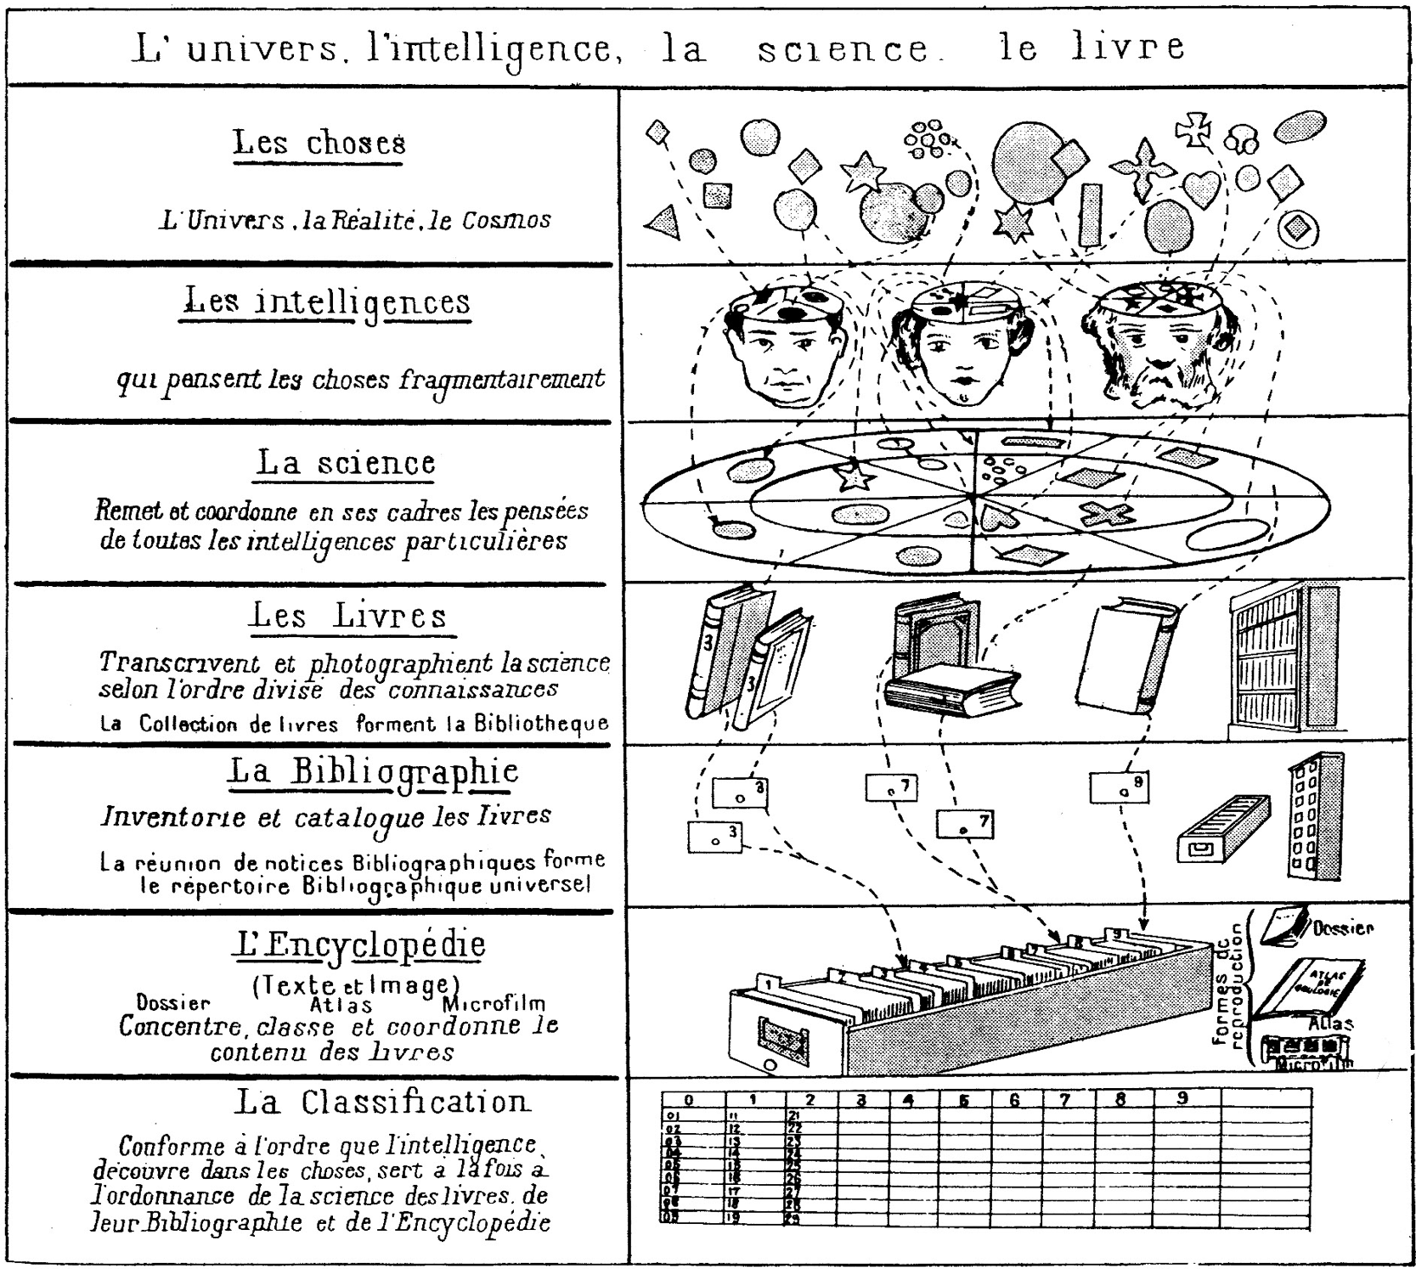
Otlet, P. (1934) Traité de Documentation. Brussels: Editiones Mundaneum, p.41.
Notes:
THINGS: the universe, reality, the cosmos
Our MINDS think about fragments of things
SCIENCE manages and coordinates our thoughts
BOOKS transcribe science by areas of knowledge (a collection of books forms a library)
The BIBLIOGRAPHY inventories and catalogues books (the collection of bibliographic entries forms the Universal Bibliographic Index (RBU))
The ENCYCLOPEDIA concentrates, classifies and coordinates the content of books
CLASSIFICATION serves science, books, the bibliography and the encyclopedia at the same time, following the patterns that minds discover in things,

Slide 16
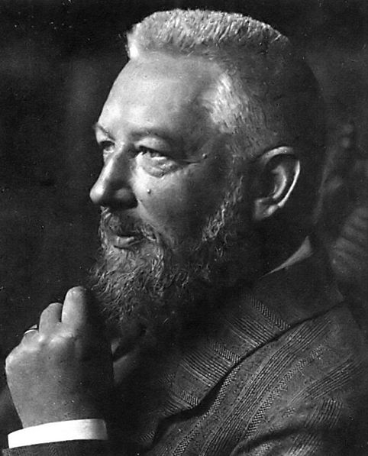
Wilhelm Ostwald
German chemist and Nobel Prize winner
Inspired by Otlet, established Die Brücke (The Bridge) using his prize money
Hapke, T. (1998) Wilhelm Ostwald, the “Brücke” (Bridge), and Connections to Other Bibliographic Activities at the Beginning of the Twentieth Century. Proceedings of the 1998 Conference on the History and Heritage of Science Information Systems. pp.139-147.
Notes:
Ostwald process – manufacture of nitric acid – Nobel in 1909
Coined the term “mole”
Brücke collaborators: Adolt Saager and Karl Bührer

Slide 17

Die Brücke
International Institute for the Organizing of Knowledge Work
Short-lived – in operation from 1911 to 1913
Reduced literature to small units of recorded knowledge (‘monos’) that could be arranged and linked with other units
Monos categorised using Dewey Decimal Classification
Notes:
The monograph principle (described by Otlet, possibly as a result of his acquaintance with Ostwald) – one sheet, one topic
Mono – small card/leaflet in a standardised format (weltformat)
Gehirn der Welt - World Brain
Linked via classification

Slide 18
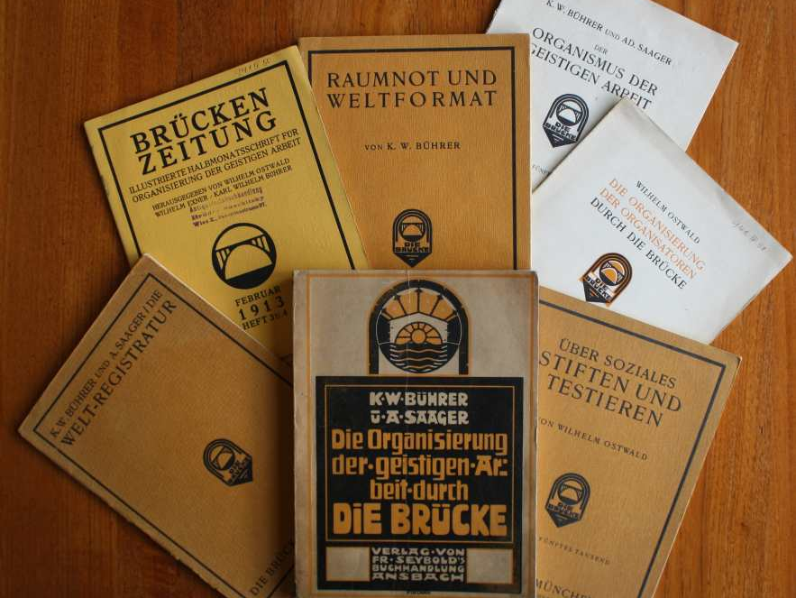
Technical University of Hamburg-Harburg
Notes:
Weltformat – based on work of Karl Bührer (of the Central Swiss Geo-Commercielle society), who founded the “International Mono Society” –
standardised formats – adapted to form basis of ISO A,B,C,D series paper sizes
Weltformat I – 1cm x 1.41cm
Weltformat II – 1.41cm x 2cm
Weltformat X (22.9cm x 32.4cm) corresponds to ISO C4.

Slide 19
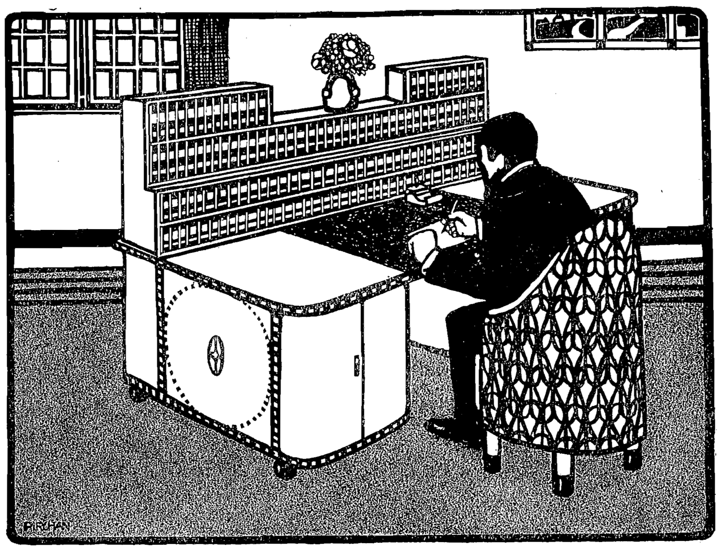
Bührer, K.W. (1912) Raumnot und Weltformat. München: Die Brücke, p.15.
Notes:
Lack of Space and the World Format

Slide 20
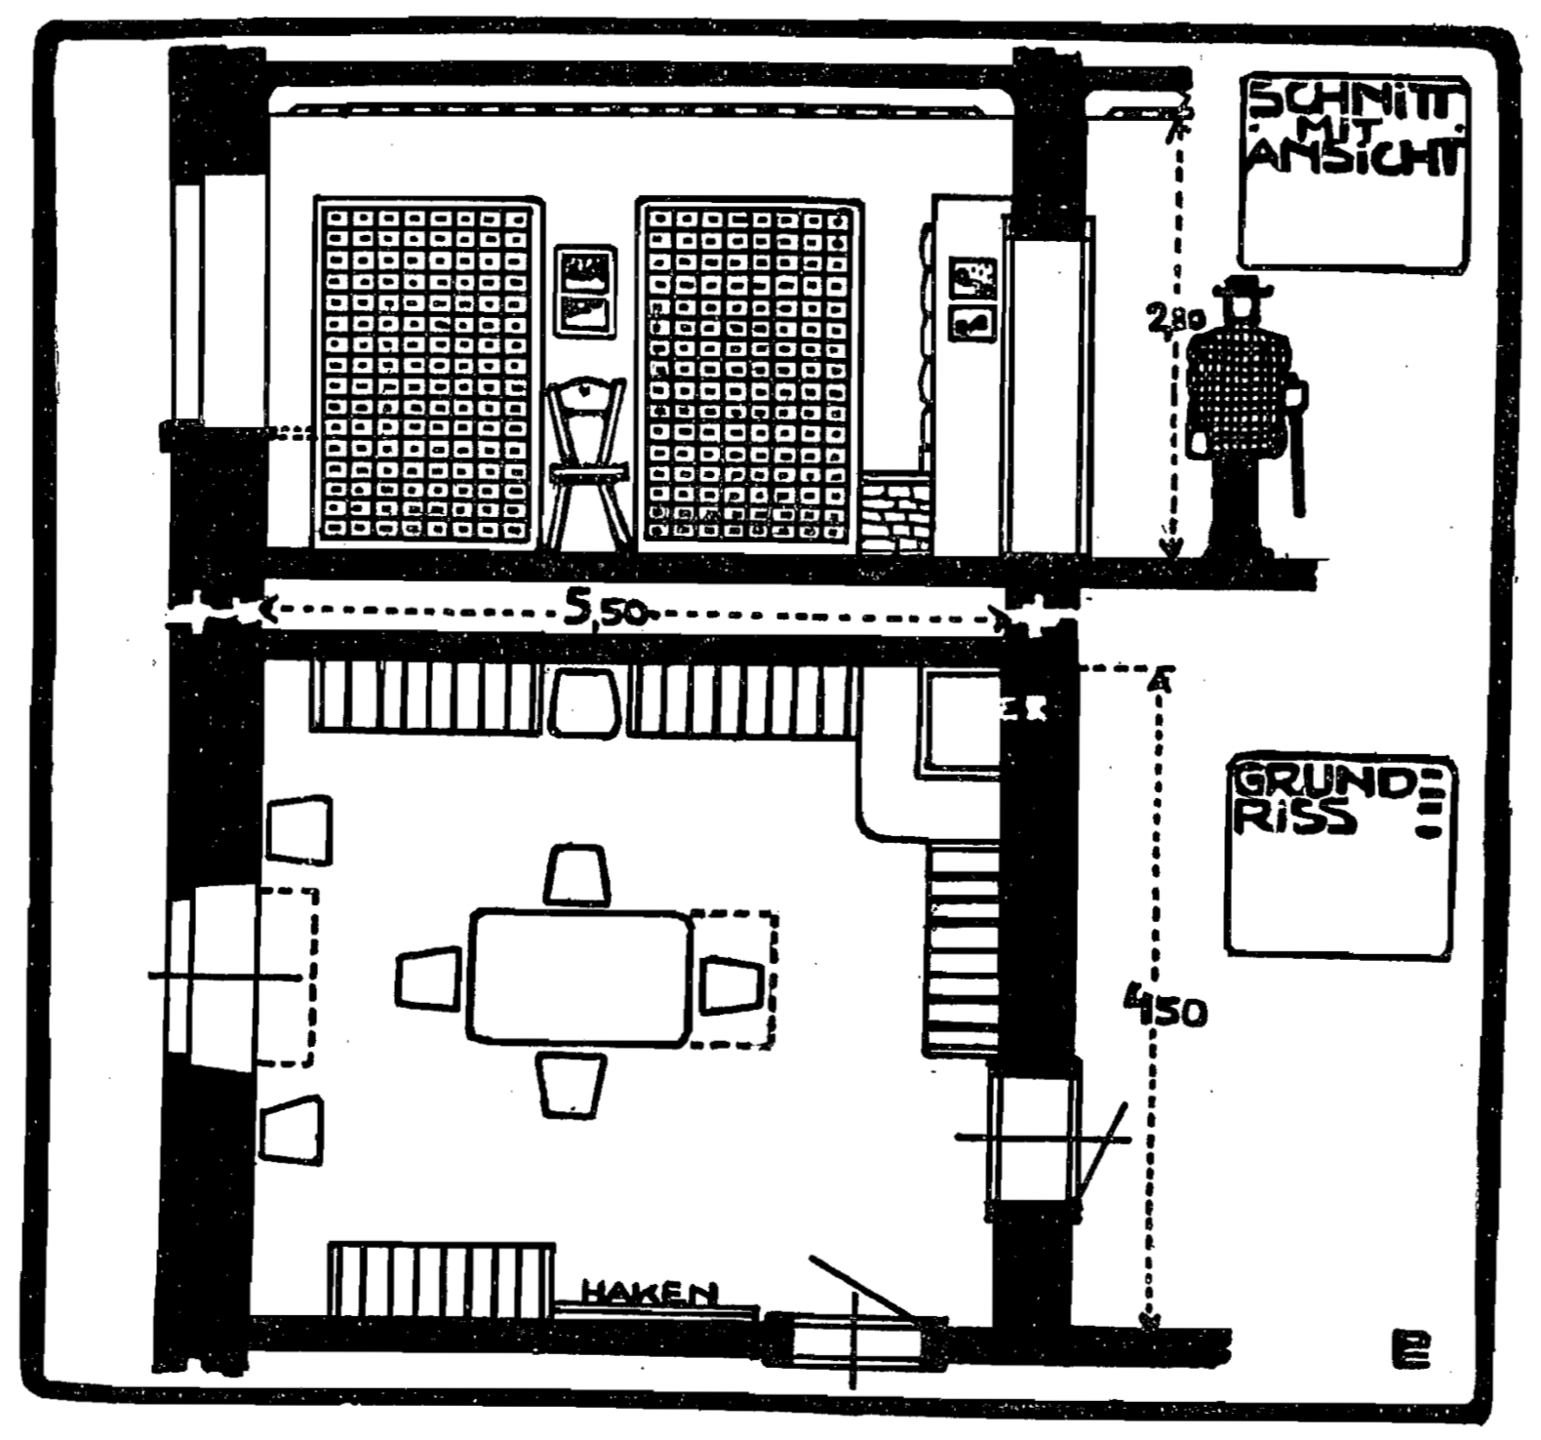
Bührer, K.W. (1912) Raumnot und Weltformat. München: Die Brücke, p.21.

Slide 21
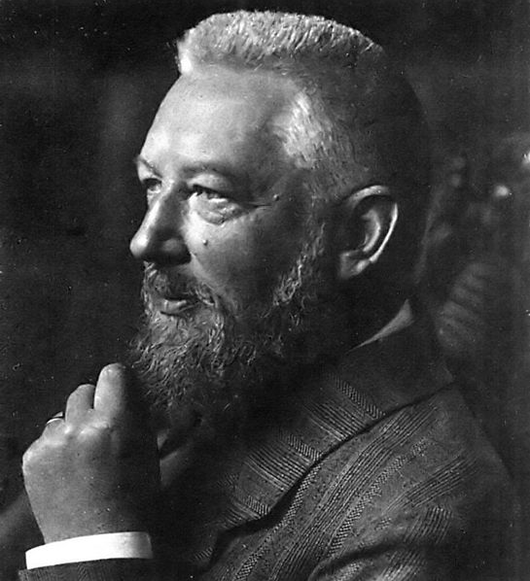
Die Brücke
Die Brücke is planned as a central station, where any question which may be raised with respect to any field of intellectual work whatever finds either direct answer or else indirect, in the sense that the inquirer is advised as to the place where he can obtain sufficient information
Ostwald, W. (1913) Scientific Management for Scientists. Scientific American, 108(1), pp. 5-6.
Notes:
Bankrupt in 1913, abolished in 1914

Slide 22
Das Gehirn der Welt
[The] cerebral results of creative minds have already assumed a thoroughly international character. [...] Every member of this small community of intellectual leaders works essentially for himself, and the happiness of the individual depends on whether he can connect with his fellow workers, who perhaps live far from him in another country and in another language.
Ostwald, W. (1912) Das Gehirn der Welt. München: Die Brücke.

Slide 23
Das Gehirn der Welt
Thus we conclude that, with the best attitudes and the broadest and most noble mindsets of such organisational idealists, the means to harness such great thought for the intellectual benefit of mankind is a central organ, so to speak a brain of the whole world.
Ostwald, W. (1912) Das Gehirn der Welt. München: Die Brücke.

Slide 24
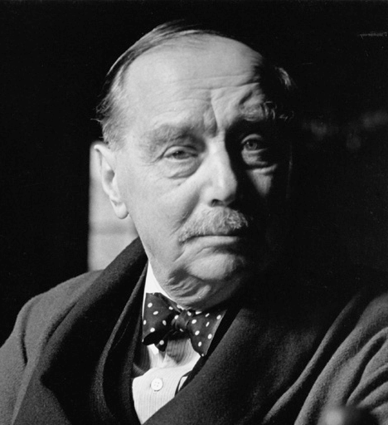
The World Brain
It is probable that the idea of an encyclopaedia may undergo very considerable extension and elaboration in the near future [...] the core would be a world synthesis of bibliography and documentation with the indexed archives of the world. A great number of workers would be engaged perpetually in perfecting this index of human knowledge and keeping it up to date.
Wells, H.G. (1938) World Brain, London: Methuen and Co. Ltd.
Notes:
Posits a World Encyclopedia as a continuation of the work of Diderot et al
Explicitly draws the link with internationalist organisations like the League of Nations.
“The time is close at hand when any student, in any part of the world, will be able to sit with his projector in his own study at his or her convenience to examine any book, any document, in an exact replica."

Slide 25

The World Brain
!
Notes:
This description seems awfully familiar...

Slide 26
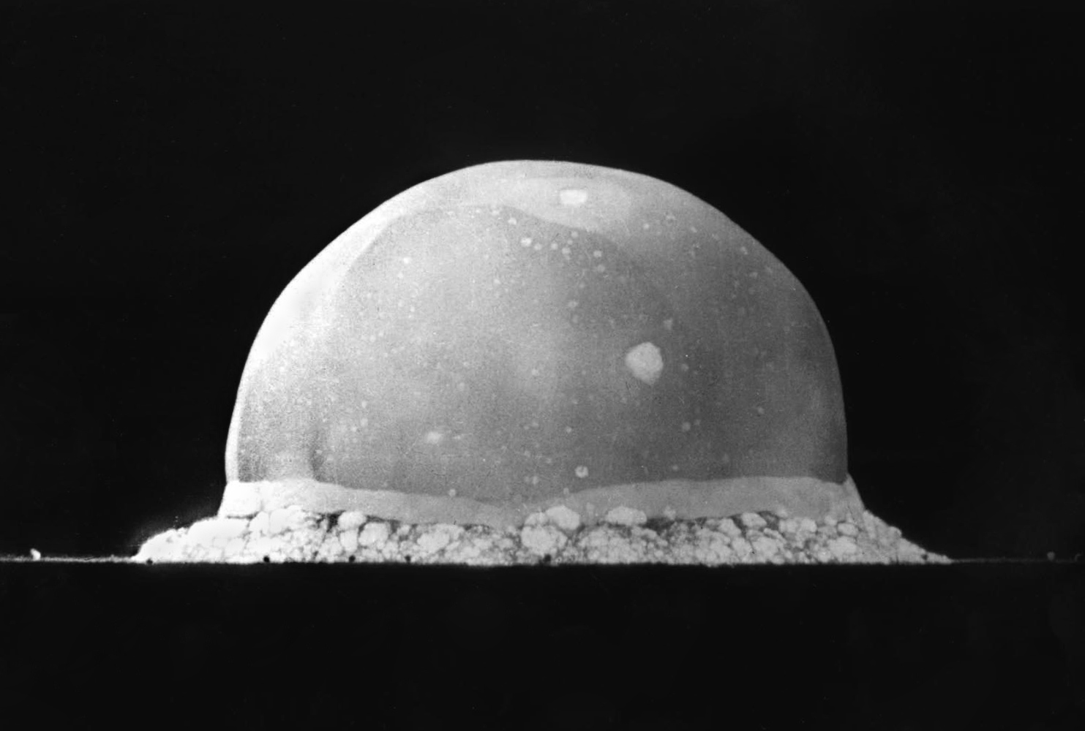
Interlude, 1939-1945
Wikimedia Commons
Notes:
Mundaneum damaged in 1940 during German occupation
Otlet died in 1944

Slide 27
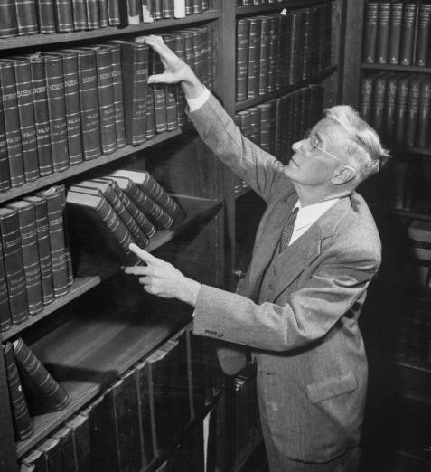
Vannevar Bush
US engineer, inventor and science administrator
Co-founder of Raytheon
Vice-president of MIT
Chair of the National Advisory Committee for Aeronautics
Director of the US Office of Scientific Research and Development during WWII
De facto director of the Manhattan Project until 1943
Notes:
Vice-president of MIT in 1932
While a professor at MIT, had Claude Shannon as a PhD student (information theory)
NACA – predecessor of the National Aeronautics and Space Administration

Slide 28
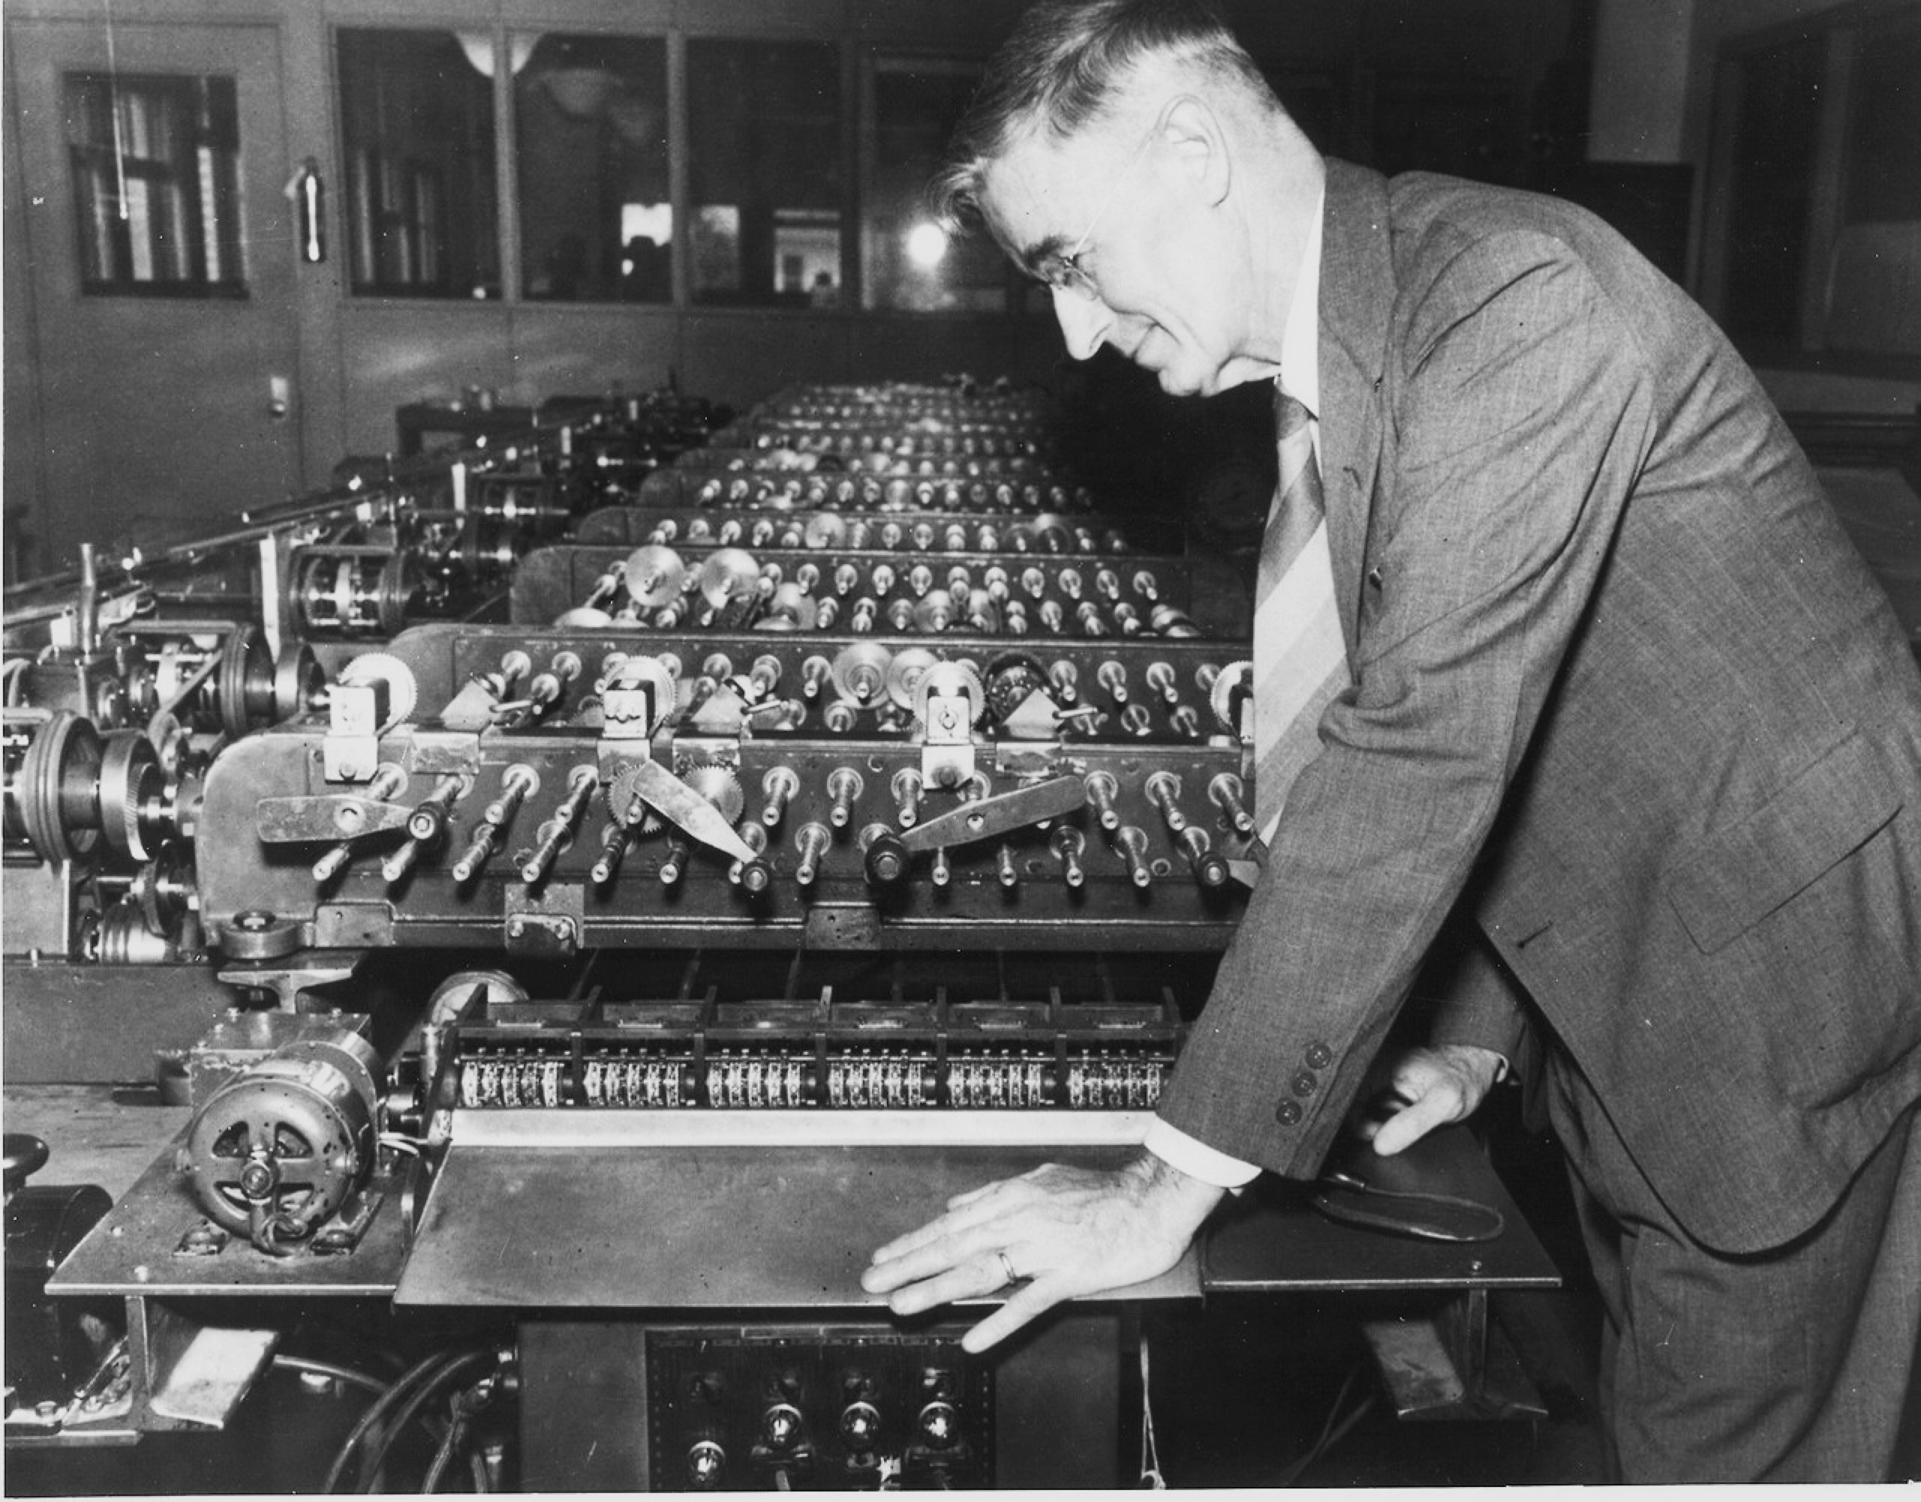
Zachary, G.P. (1995) Vannevar Bush, IEEE Spectrum, 32(7) pp. 65-69.
Notes:
Differential Analyser – analogue computer built in 1931
Work on the Differential Analyser informed US developments in military fire control (everything from the Norden Bombsight to the Mark I Fire Control Computer, both of which were in use as late as the Vietnam War)

Slide 29
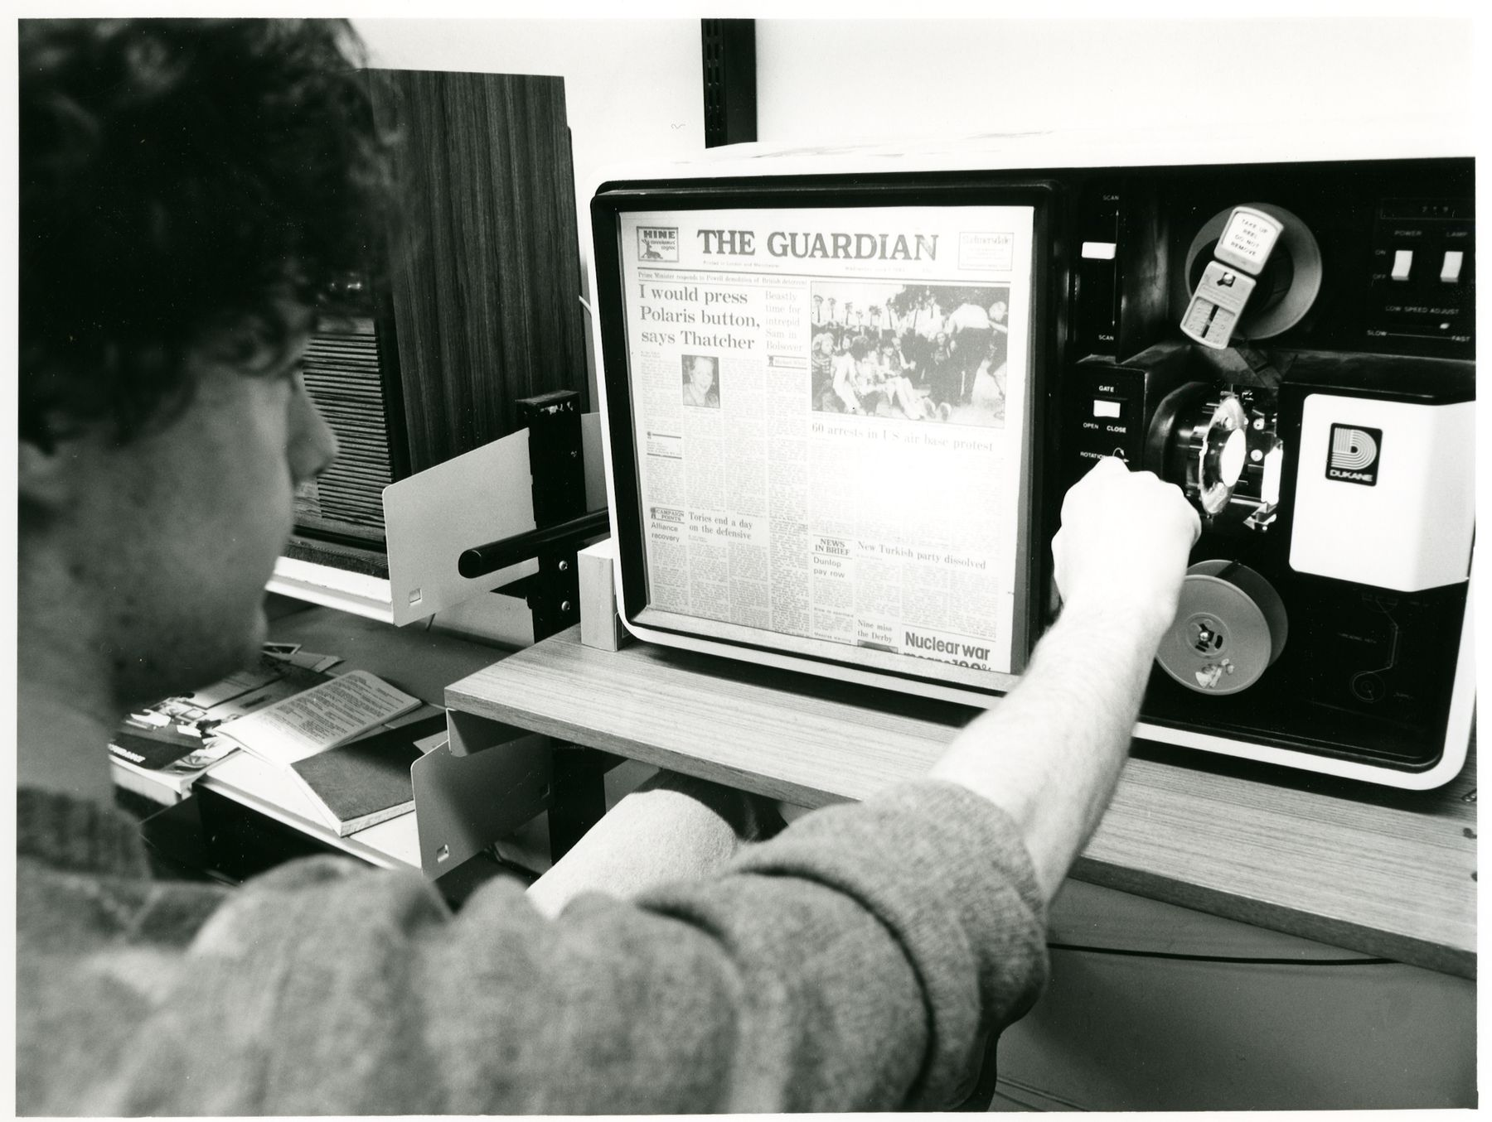
Clifford Whitworth Library, University of Salford, c.1985

Slide 30
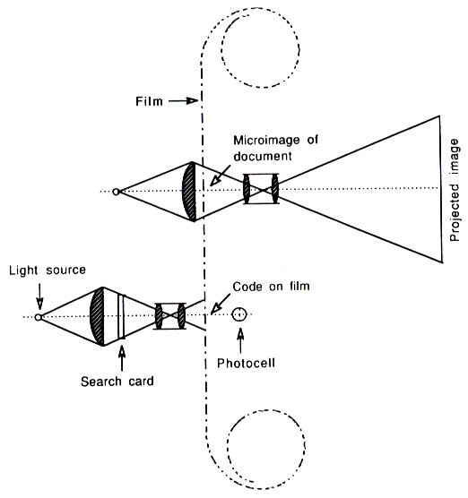
The Rapid Selector
Buckland, M.K. (1992) Emanuel Goldberg, electronic document retrieval, and Vannevar Bush's Memex. Journal of the American Society of Information Science, 43(4), pp. 284-294.
Notes:
Photoelectric microfilm selector developed at MIT in 1938
Based on earlier (patented!) work by Emanuel Goldberg of Zeiss Ikon (US Patent 1838389) from 1931 (the Statistical Machine)

Slide 31
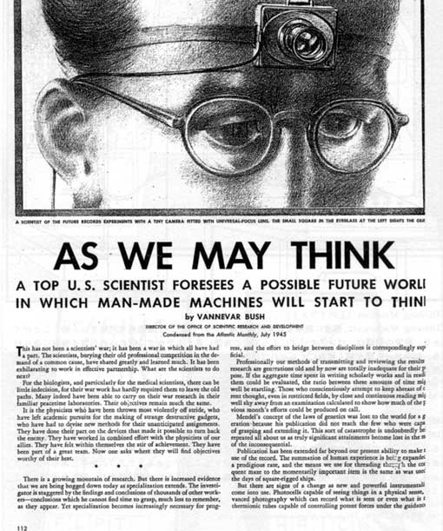
As We May Think
“The difficulty seems to be, not so much that we publish unduly in view of the extent and variety of present-day interests, but rather that publication has been extended far beyond our present ability to make real use of the record.”
Bush, V. (1945) As We May Think. The Atlantic Monthly, 176, pp.101-108.
Notes:
July 1945

Slide 32
As We May Think
“Our ineptitude in getting at the record is largely caused by the artificiality of systems of indexing. […] Having found one item, moreover, one has to emerge from the system and re-enter on a new path.”
“The human mind does not work that way. It operates by association. With one item in its grasp, it snaps instantly to the next that is suggested by the association of thoughts.”
“…the speed of action, the intricacy of trails, the detail of mental pictures, is awe-inspiring beyond all else in nature.”

Slide 33
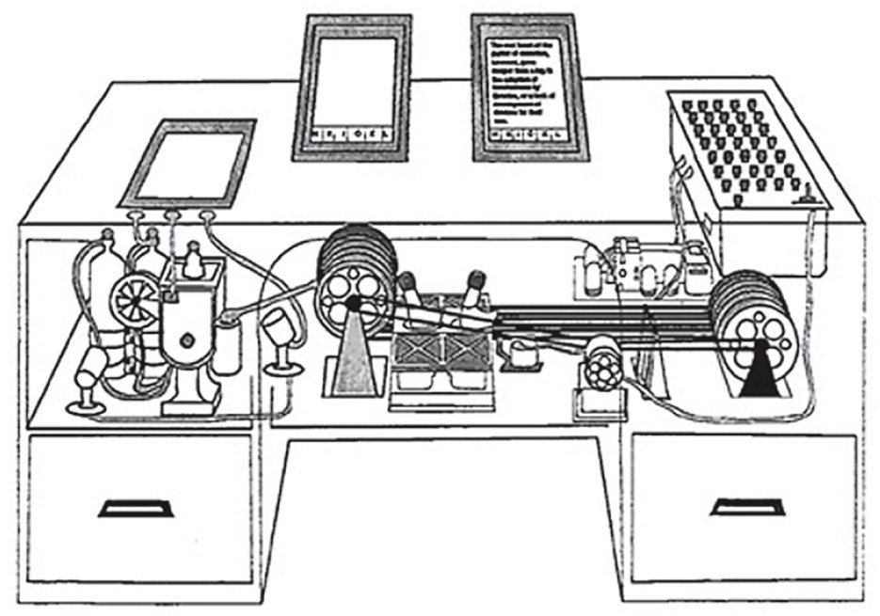

Slide 34
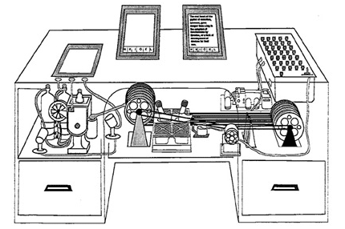
The Memex
An electro-mechanical analogue device for organising knowledge: microfilm, photocells and typewriter.
Allows user to create:
Associative trails – arbitrary sequences of pages
Skip trails – relevant summaries
Commentaries on works
Notes:
Ideas first formulated c. 1932.

Slide 35
A Salient Prediction
“Wholly new forms of encyclopedias will appear, ready made with a mesh of associative trails running through them, ready to be dropped into the memex and there amplified.”

Slide 36
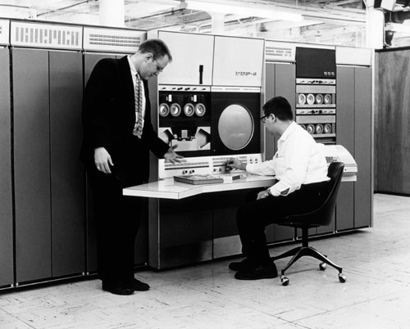
The Information Age
Computer History Museum
Notes:
Standing: Gordon Bell
architect of the PDP-4 and PDP-6, VP in charge of the development of the DEC VAX.
In later years, the experimental subject of the Microsoft MyLifeBits project – lifelogging experiment inspired by Bush’s Memex
Seated: Alan Kotok
As an undergraduate, helped develop the first video game: Spacewar
While at Digital in 1994, encouraged Berners-Lee to start a new organisation at MIT to coordinate Web development
Associate chairman of W3C from 1997

Slide 37
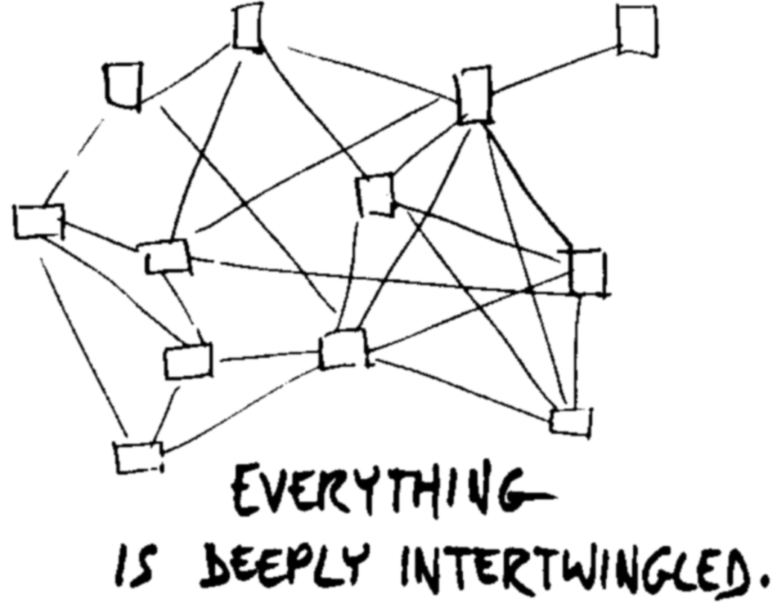
Nelson, T.H. (1974) Computer Lib/Dream Machines. Chicago, IL: Nelson, T.H.
Notes:
In an important sense there are no "subjects" at all; there is only all knowledge since the cross-connections among the myriad topics of this world simply cannot be divided up neatly.
Hypertext at last offers the possibility of representing and exploring without carving it up it all destructively.

Slide 38
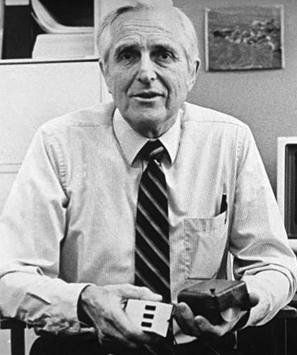
Doug Engelbart
Member of the Stanford Research Institute and founder of the Augmentation Research Center
ARC played key role in early Internet history
Notes:
ARC played key role in early history of the Internet
First message on ARPANET was between ARC computer and UCLA
ARC-run ARPANET reference library service turned into InterNIC (domain name and IP address allocations until 1998 -> ICANN)
When ARC folded in the 70s, many researchers went to Xerox PARC

Slide 39
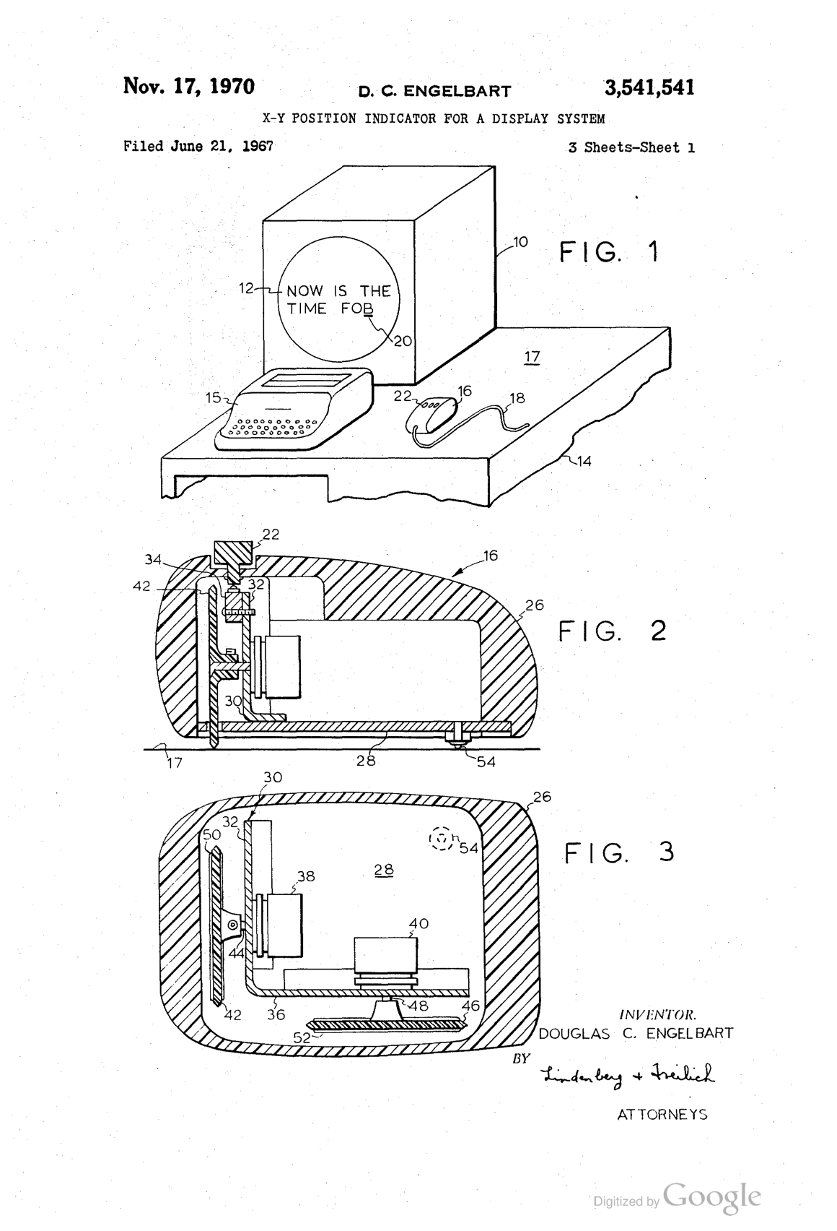
Notes:
Invented the computer mouse

Slide 40
Augmenting Human Intellect
a new stage of human evolution, characterized by
"automated external symbol manipulation”
“we are concentrating fully upon reaching the point where we can do all of our work on line — placing in computer store all of our specifications, plans, designs, programs, documentation, reports, memos, bibliography and reference notes, etc., and doing all of our scratch work, planning, designing, debugging, etc., and a good deal of our intercommunication, via the consoles”.
Engelbart, D.C. and English, W.K. (1968) A research center for augmenting human intellect.
Proceedings of the 1968 Fall Joint Computer Conference, San Francisco, CA. pp. 395-410

Slide 41
NLS – the oN-Line System
Timesharing computer with multiple consoles
UI features:
  Windowed display
  Mouse
  Chorded keyboard
  Videoconferencing
  Links in content

Slide 42
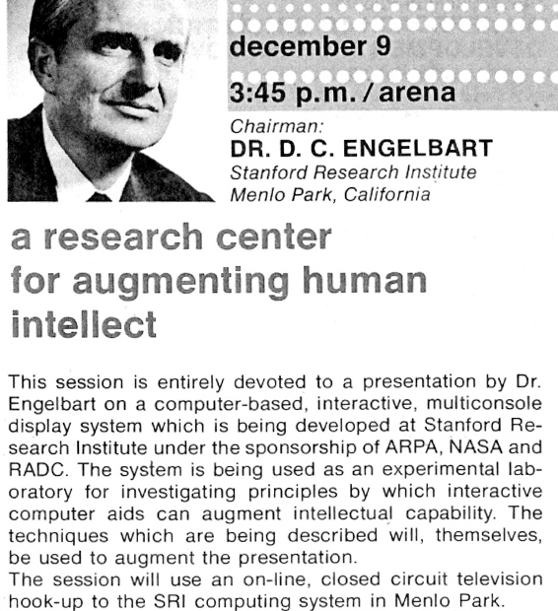
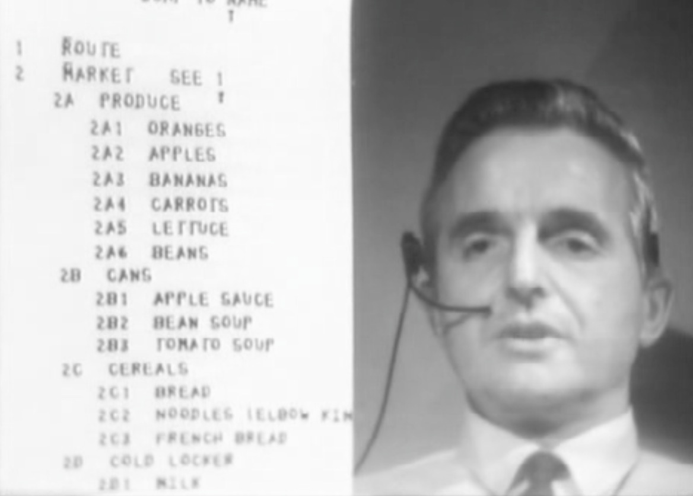
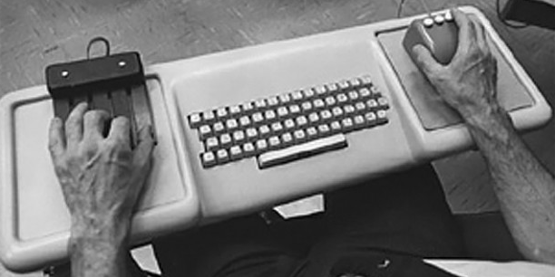
The Mother of all Demos
http://sloan.stanford.edu/MouseSite/1968Demo.html
Notes:
First demonstrated in December 1968 at the Fall Joint Computer Conference in San Francisco
Hypertext, the mouse, chording keyboard, videoconferencing, CSCW, computer generated slides.

Slide 43
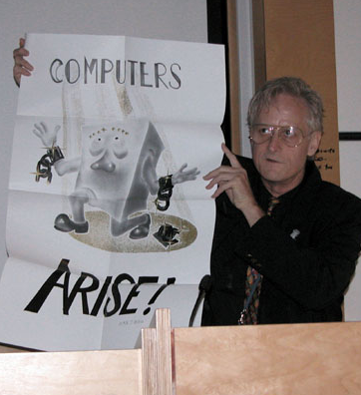
Ted Nelson
Sociologist, philosopher and film maker
Coined the term “hypertext”
“A user interface should be so simple that a beginner in an emergency can understand it within ten seconds.”
“Most people are fools, most authority is malignant, God does not exist, and everything is wrong.”
Notes:
Son of Ralph Nelson and Celeste Holm

Slide 44
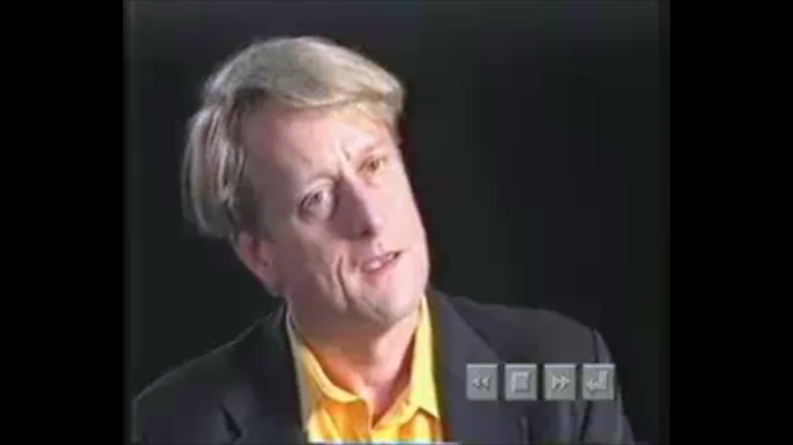
Hyperland (1990) TV Programme.

Slide 45
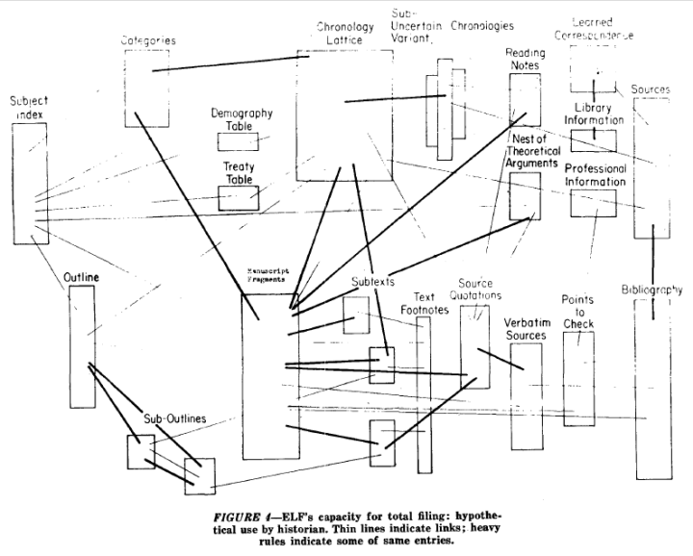
Notes:
A File Structure for the Complex, the Changing and the Indeterminate."
Proceedings of the ACM 20th National Conference (1965), pp. 84-100

Slide 46

Computer Lib/Dream Machines
“No one's life has yet been simplified by a computer.”
Two books in a dos-a-dos binding:
Computer Lib is a clarion call for people to understand computers deeply
Dream Machines is a sketch of the flexible media potential of computers
Nelson, T.H. (1974) Computer Lib/Dream Machines. Chicago, IL: Nelson, T.H.
Notes:
"Down with Cybercrud"
anti centralisation
democratisation of computing – computer experts intentionally obscure

Slide 47
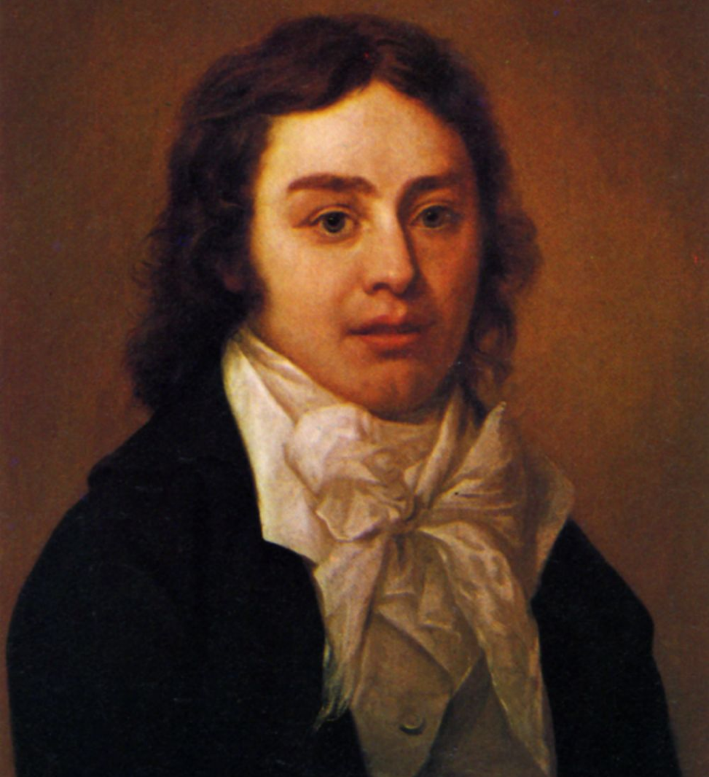
A Vision in a Dream
In 1797, Samuel Taylor Coleridge wrote the poem Kubla Khan after awaking from an opium dream:
In Xanadu did Kubla Khan
A stately pleasure-dome decree: Where Alph, the sacred river, ran Through caverns measureless to man
Down to a sunless sea.
He was interrupted by a visitor from Porlock, and never completed the poem…

Slide 48
Project Xanadu
Founded in 1960, still ongoing (famously never completed)
Hugely influential, nonetheless
Described in Dream Machines, and Nelson’s subsequent book Literary Machines
Nelson, T.H. (1993) Literary Machines. Sausalito, CA: Mindful Press.
Notes:
"longest-running vaporware story in the history of the computer industry” – Gary Wolf in WiReD
First demo version in 1972
With Roger Gregory, Mark Miller, Stuart Greene in 1979
1983-1992 – With Autodesk
1992- Xanadu Operating Company
Open-sourced in 1998
2007 - XanaduSpace
Literary machines – first published 1980

Slide 49
Project Xanadu Mission Statement
DEEP INTERCONNECTION WITH INTERCOMPARISON AND RE-USE
Since 1960, we have fought for a world of deep electronic documents-- with side-by-side intercomparison and frictionless re-use of copyrighted material.
We have an exact and simple structure. Our model handles automatic version management and rights management through deep connection.
Today's popular software simulates paper. The World Wide Web (another imitation of paper) trivializes our original hypertext model with one-way ever-breaking links and no management of version or contents.
WE FIGHT ON.

Slide 50
Project Xanadu
Intercomparison of parallel documents
World-wide publishing without barriers
Links that don't break
Versioning
Transclusion
Transcopyright

Slide 51
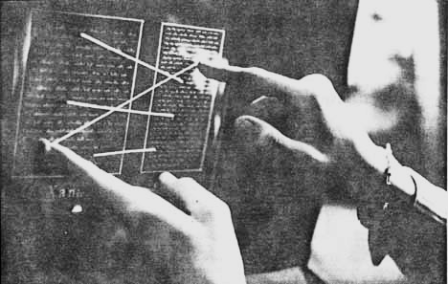
Nelson, T.H. (1972) As We Will Think. Proceedings of Online 72 Conference, Uxbridge, England.

Slide 52
Every Xanadu server is uniquely and securely identified.
Every Xanadu server can be operated independently or in a network.
Every user is uniquely and securely identified.
Every user can search, retrieve, create and store documents.
Every document can consist of any number of parts each of which may be of any data type.
Every document can contain links of any type including virtual copies ("transclusions") to any other document in the system accessible to its owner.
Links are visible and can be followed from all endpoints.
Permission to link to a document is explicitly granted by the act of publication.
Every document can contain a royalty mechanism at any desired degree of granularity to ensure payment on any portion accessed, including virtual copies of all or part of the document.
Every document is uniquely and securely identified.
Every document can have secure access controls.
Every document can be rapidly searched, stored and retrieved without user knowledge of where it is physically stored.
Every document is automatically moved to physical storage appropriate to its frequency of access from any given location.
Every document is automatically stored redundantly to maintain availability even in case of a disaster.
Every Xanadu service provider can charge their users at any rate they choose for the storage, retrieval and publishing of documents.
Every transaction is secure and auditable only by the parties to that transaction.
The Xanadu client-server communication protocol is an openly published standard. Third-party software development and integration is encouraged.

Slide 53
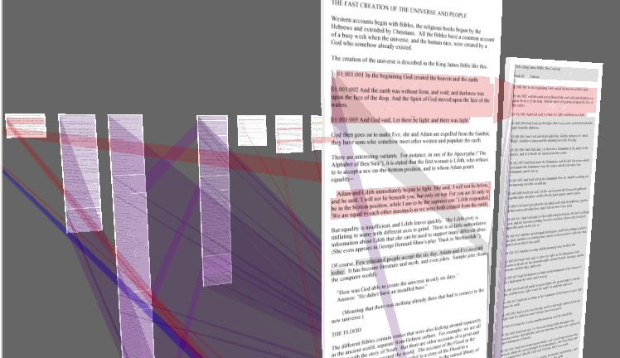
XanaduSpace

Slide 54
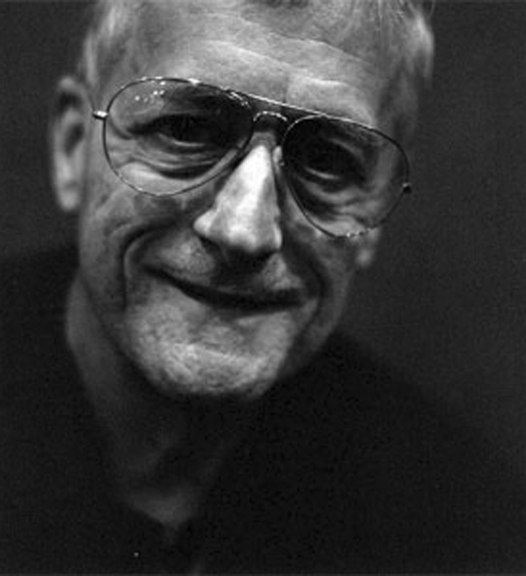
Nelson on the Web
The Xanadu project did not ‘fail to invent HTML’. HTML is precisely what we were trying to PREVENT - ever-breaking links, links going outward only, quotes you can't follow to their origins, no version management, no rights management.

Slide 55

Hypertext Systems
http://www.flickr.com/photos/mwichary/2355783479/

Slide 56
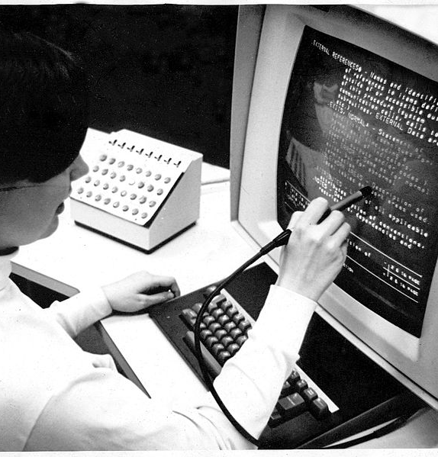
HES/FRESS (1967)
Hypertext Editing System developed at Brown University
Used by NASA to produce and manage documentation for the Apollo programme
Carmody, S. et al (1969) A Hypertext Editing System for the /360. Pertinent Concepts in Computer Graphics: Proceedings of the Second University of Illinois Conference on Computer Graphics, pp.291-330.
Notes:
Ted Nelson was involved with this project
File Retrieval and Editing System

Slide 57
ZOG (1975)
Developed at Carnegie Mellon University
Features:
Early proponent of the “card” or “frame” model of hypertext
(c.f. index cards)
One-way links, embedded in frames
Commercialised as KMS
Robertson, G. et al (1981) The ZOG approach to man-machine communication. Int. J. Man-Machine Studies, 14, pp.461-488.

Slide 58
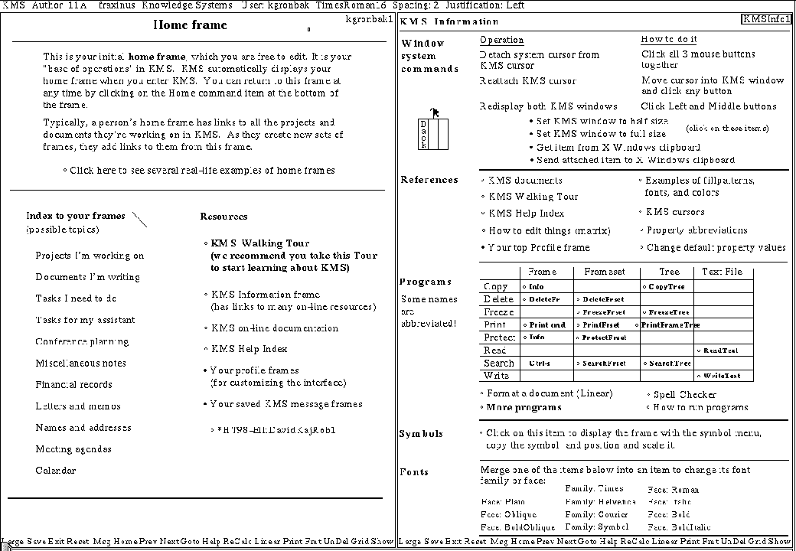
Knowledge Management System (1983)
Akscyn, R.M. et al (1988) KMS: A distributed hypermedia system for managing knowledge in organizations. Communications of the ACM, 31(7), pp. 820-835.
Notes:
Frame-based, with hierarchy of frames
Typical side-by-side display
Interpreted scripting language
Distributed!

Slide 59
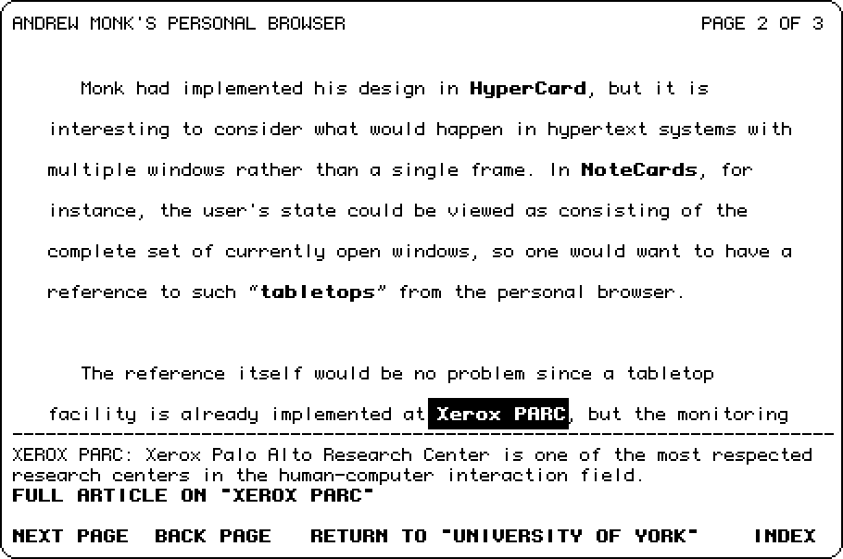
Hyperties (1983)
Developed by Ben Schneiderman at the University of Maryland
Features:
Link previews
Links point to whole documents

Slide 60
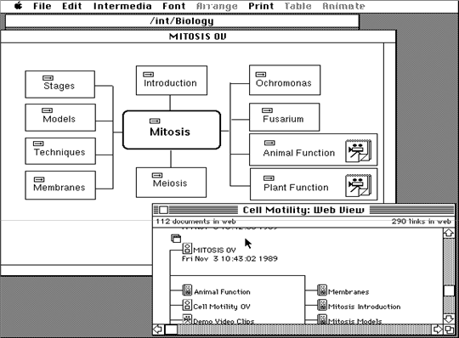
Intermedia (1985)
Developed at Brown University
Features:
A/UX-based
Bidirectional linking
Graphics
Garrett, L.N. et al (1986) Intermedia: issues, strategies, and tactics in the design of a hypermedia document system. Proceedings of the 1986 ACM conference on Computer-supported cooperative work, pp.163-174.

Slide 61
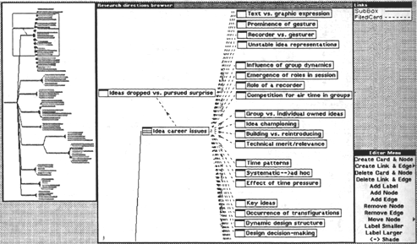
NoteCards (1985)
Developed at Xerox PARC (Trigg, Moran and Halasz)
Features:
Hierarchical browser
Programmable API
Graphics
Halasz, F.G. et al (1986) NoteCards in a Nutshell. SIGCHI Bulletin, 18(4), pp.45-52.

Slide 62
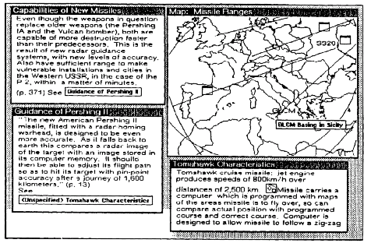
NoteCards: Showing card with iconic anchors

Slide 63
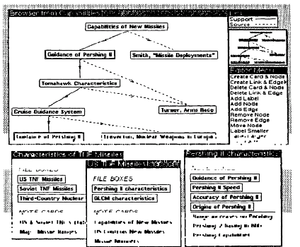
NoteCards: Showing browser

Slide 64
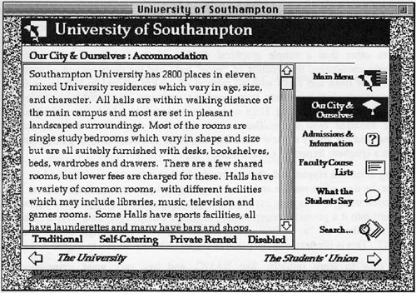
Hypercard (1987)
Developed by Apple Computer Inc., and bundled with new Mac SEs.
Features:
OO programming language (Hypertalk)
Graphics
Widely used for application development

Slide 65
Conklin on Hypertext

Slide 66
Hypertext: An Introduction and Survey
“The concept of hypertext is quite simple: windows on the screen are associated with objects in a data base and links are provided between these objects, both graphically (i.e. as labelled icons) and in the data base (i.e. as pointers).”
Conklin, J. (1987) Hypertext: An introduction and survey. IEEE Computer, 20(9), pp.17-41.

Slide 67
Macro Literary Systems
Large on-line libraries in which inter-document links are machine supported; all publishing, reading, collaboration, and criticism takes place within the network
e.g. Memex, NLS/Augment, Nelson's Xanadu

Slide 68
Problem Exploration Tools
Tools to support early unstructured thinking on a problem when many disconnected ideas come to mind
  Early authoring and outlining
  Problem solving
  Programming and design
e.g. IBIS
Notes:
IBIS – Conklin’s own work
typed links for recording and structuring discussions

Slide 69
Structured browsing Systems
Smaller-scale systems for teaching, reference, and public information, where speed of access and ease of use is crucial
  Typically designed only for reading, not for authoring
e.g. ZOG/KMS, Hyperties

Slide 70
General Hypertext Technology
Research platforms to allow experimentation with a range of hypertext applications; most commonly applied to reading, writing, collaboration
e.g. NoteCards, Intermedia, HES/FRESS

Slide 71
The Essence of Hypertext
Nodes
  The power to chunk information
Links
  Importance of speed of link resolution
  Direction/arity?
  Names?
  Properties?
  End as region or node?
  Reference by name or by value
  Display characteristics?

Slide 72
The Essence of Hypertext
Trees (strict hierarchies) or networks of links
Clusters of Links (webs/linkbases?)
Clusters of Nodes (Composites)
History
Trails
Authoring and Annotating!
Browsers (meaning node level)

Slide 73
Disadvantages of Hypertext
Disorientation
  The tendency to lose one's sense of location and direction in a non-linear document
  “Lost in Hyperspace”
Cognitive overhead
  The additional effort and concentration necessary to maintain several tasks or trails at one time.

Slide 74
Halasz on
Hypertext

Slide 75
Reflections on Notecards
In 1989, Halasz identified seven issues for the next generation of hypertext systems:
  Search and query
  Composites
  Virtual Structures
  Computation over networks
  Versioning
  Support for collaboration
  Extensibility
Halasz, F. (1989) Reflections on Notecards: seven issues for the next generation of hypermedia systems, Communications of the ACM, 31(7), pp. 836-852.
Notes:
Member of the Notecards team at Xerox

Slide 76
The seven issues
Issue 1: Search and query in a hypermedia network
  Link Navigation is not always the best way to find things
  Better might be Content Based or Structural Search
Issue 2: Composites - augmenting the basic model
  A way of representing and dealing with sets (or sub-networks) of nodes and links as unique entities separate from their components
Issue 3: Virtual structures
  Virtual Structures would be created by a query and would be equivalent to virtual tables in a relational database

Slide 77
The seven issues
Issue 4: Computation in (over) hypermedia networks
  The idea is to provide APIs to allow cards to be orchestrated and scripts to be executed when certain events occur
Issue 5: Versioning
  Halasz argued that versioning was a natural feature of OSs that got lost with DOS. Versioning of HTs is difficult.
Issue 6: Support for collaborative work
Issue 7: Extensibility and tailorability
  The ability to change the system to extend and change behaviours, have different appearances and use different hypertext models
Notes:
Issue 4 – Trellis (more later)

Slide 78
Halasz on
Hypertext
(part 2)

Slide 79
Seven Issues Revisited
Halasz gave a keynote at Hypertext ‘91 in San Antonio that reconsidered and amended his seven issues:
  Ending the tyranny of the link
  Open Systems
  User interfaces for large information spaces
  Very large hypertexts
http://www2.parc.com/spl/projects/halasz-keynote/

Slide 80
Ending the Tyranny of the Link
Hypermedia that includes non-network structures as well as virtual structures on an equal footing with network structures.
  Wider variety of hypermedia “data models”
  Provides increased opportunity for integration with a variety of complementary systems and technologies

Slide 81
Open Systems
“The monolithic hypermedia system of the
1980s is no longer a viable species (!)”
Introduction of open hypermedia systems:
  Decompose HT system into separate components
  Define communications protocols and formats for coordination

Slide 82
User Interfaces for Large Information Spaces
Interfaces that allow users to manipulate large network structures on a workstation screen is a long-standing problem for many hypermedia systems
  Many previous systems used some form of network browser, but not always successfully

Slide 83
Very Large Hypertexts
Very large: >10s or 100s of thousands of documents (!)
  Large hypertexts uncommon at this time
  One of the main selling points in the hypertext vision has been its proficiency in helping to manage VERY LARGE document collections
Challenge is to build a useable industrial-strength hypertext system capable of handling 10,000 documents (!)

Slide 84

…and then the
Web happened

Slide 85
1990
Three new Hypertext systems made their first appearance
  The World Wide Web
  Hyper-G
  Microcosm
The above list is roughly in ascending order of the degree to which they addressed Halasz’s seven issues…
…and in descending order of their uptake

Slide 86
Web Growth 1991-2015
Netcraft (2015) Web Server Survey.

Slide 87
What is (was) the Web?
The idea of a boundless information world in which there is:
  A system of identifiers for resources (URIs)
  A network protocol that can be used to interact with those resources (HTTP)
  A mark-up language used for representing resources (HTML) which every client must understand how to render - and which can contain links to other resources

Slide 88
Next Lecture:
HTML5 APIs

