Slide 1
Web Formats
COMP3220 Web Infrastructure COMP6218 Web Architecture
Dr Nicholas Gibbins – nmg@ecs.soton.ac.uk
2017-2018

Slide 2
Web Formats
HTML is the main Web format
Many other formats in use on the Web
Many other formats use Web standards
NOTE: This lecture goes into a lot of detail, but for illustrative purposes only. You should be broadly familiar with the range of formats, what they’re for and (roughly) how they work

Slide 3
Scalable Vector Graphics

Slide 4
Scalable Vector Graphics
XML-based language for describing 2D graphics
Resolution independent
Support for Javascript event handlers
Support for manipulation via DOM
Uses CSS for styling and animation
Integrates with HTML5

Slide 5
SVG Example
<svg height="150" width="400" xmlns:xlink="http://www.w3.org/1999/xlink"> <defs> <linearGradient id="grad1" x1="0%" y1="0%" x2="100%" y2="0%"> <stop offset="0%" style="stop-color:rgb(255,255,0);stop-opacity:1" /> <stop offset="100%" style="stop-color:rgb(255,0,0);stop-opacity:1" /> </linearGradient> </defs> <ellipse cx="200" cy="70" rx="85" ry="55" fill="url(#grad1)" /> <text x="0" y="15" fill="blue" transform="rotate(30 20,40)">I love <a xlink:href="http://www.w3.org/SVG/" target="_blank">SVG</a></text> </svg>

Slide 6
MathML

Slide 7
MathML
XML-based language for expressing mathematical expressions
Integrates with HTML5
Two sub-languages:
Presentation-oriented (for display)
Semantics-oriented

Slide 8
Semantic MathML
<math xmlns="http://www.w3.org/1998/Math/MathML”> <apply> <eq/> <apply> <plus/> <apply> <power/> <ci>a</ci><cn>2</cn> </apply> <apply> <power/> <ci>b</ci><cn>2</cn> </apply> </apply> <apply> <power/> <ci>c</ci><cn>2</cn> </apply> </apply> </math>
a² + b² = c²

Slide 9
Presentational MathML
<math xmlns="http://www.w3.org/1998/Math/MathML"> <mrow> <msup><mi>a</mi><mn>2</mn></msup> <mo>+</mo> <msup><mi>b</mi><mn>2</mn></msup> <mo>=</mo> <msup><mi>c</mi><mn>2</mn></msup> </mrow> </math>
a² + b² = c²

Slide 10
Web Data

Slide 11
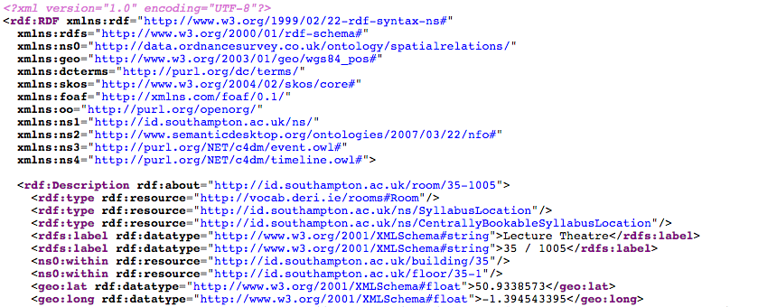
Structured and Linked Data on the Web
Subject of a later lecture on this module
Covered (in considerable depth) in COMP6215 Semantic Web Technologies next semester

Slide 12
Office Open XML

Slide 13
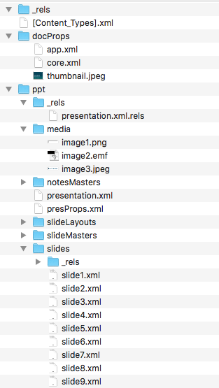
Open Office XML
Microsoft’s XML-based format
Proprietary format, but much clearer than pre-2007 formats
ZIP file of directory hierarchy containing XML files
docprops contains metadata
ppt/slides contains slides
Ppt/media contains images
_rels translates file names into XML attribute values

Slide 14
<?xml version="1.0" encoding="UTF-8" standalone="yes"?> <p:sld xmlns:a="http://schemas.openxmlformats.org/drawingml/2006/main" xmlns:r="http://schemas.openxmlformats.org/officeDocument/2006/relationships" xmlns:p="http://schemas.openxmlformats.org/presentationml/2006/main"> <p:cSld><p:spTree><p:nvGrpSpPr><p:cNvPr id="1" name=""/><p:cNvGrpSpPr /><p:nvPr /></p:nvGrpSpPr><p:grpSpPr><a:xfrm><a:off x="0" y="0"/><a:ext cx="0" cy="0" /><a:chOff x="0" y="0"/><a:chExt cx="0" cy="0" /></a:xfrm></p:grpSpPr><p:sp><p:nvSpPr><p:cNvPr id="2" name="Title 1" /><p:cNvSpPr><a:spLocks noGrp="1"/></p:cNvSpPr><p:nvPr><p:ph type="ctrTitle" /></p:nvPr></p:nvSpPr><p:spPr/><p:txBody><a:bodyPr/><a:lstStyle /><a:p><a:r><a:rPr lang="en-GB" dirty="0" smtClean="0"/><a:t>Web Formats</a:t></a:r><a:endParaRPr lang="en-GB" dirty="0"/></a:p></p:txBody></p:sp><p:sp><p:nvSpPr><p:cNvPr id="3" name="Subtitle 2"/><p:cNvSpPr><a:spLocks noGrp="1"/></p:cNvSpPr><p:nvPr><p:ph type="subTitle" idx="1" /></p:nvPr></p:nvSpPr><p:spPr/><p:txBody><a:bodyPr /><a:lstStyle/><a:p><a:r><a:rPr lang="en-GB" dirty="0" smtClean="0" /><a:t>COMP3220 Web Infrastructure</a:t></a:r><a:r><a:rPr lang="en-GB" dirty="0"/><a:t /></a:r><a:br><a:rPr lang="en-GB" dirty="0" /></a:br><a:r><a:rPr lang="en-GB" dirty="0" smtClean="0"/><a:t>COMP6218 Web Architecture</a:t></a:r><a:endParaRPr lang="en-GB" dirty="0" smtClean="0" /></a:p></p:txBody></p:sp><p:sp><p:nvSpPr><p:cNvPr id="4" name="Text Placeholder 3"/><p:cNvSpPr><a:spLocks noGrp="1"/></p:cNvSpPr><p:nvPr><p:ph type="body" sz="quarter" idx="10"/></p:nvPr></p:nvSpPr><p:spPr /><p:txBody><a:bodyPr/><a:lstStyle/><a:p><a:r><a:rPr lang="en-GB" dirty="0" smtClean="0" /><a:t>Dr Nicholas Gibbins </a:t></a:r><a:r><a:rPr lang="mr-IN" dirty="0" smtClean="0"/><a:t>–</a:t></a:r><a:r><a:rPr lang="en-GB" dirty="0" smtClean="0"/><a:t> </a:t></a:r><a:r><a:rPr lang="en-GB" dirty="0" err="1" smtClean="0"/><a:t>nmg@ecs.soton.ac.uk</a:t></a:r><a:endParaRPr lang="en-GB" dirty="0" smtClean="0" /></a:p><a:p><a:r><a:rPr lang="en-GB" dirty="0" smtClean="0"/><a:t>2017-2018</a:t></a:r><a:endParaRPr lang="en-GB"

Slide 15
ePub

Slide 16
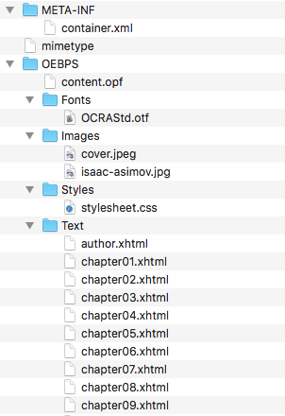
ePub Format
Open vendor-neutral standard for e-books defined by IDPF (now part of W3C)
Optional DRM layer
ZIP file of directory hierarchy containing XML and HTML files
META-INF/container.xml
OEBPS/content.opf
Use of HTML allows resizable and reflowable content – essential for adapting to a wide variety of readers

Slide 17
META-INF/container.xml
Points to OPF package which describes the other components of the document
<?xml version="1.0" encoding="UTF-8"?> <container version="1.0” xmlns="urn:oasis:names:tc:opendocument:xmlns:container"> <rootfiles> <rootfile full-path="OEBPS/content.opf" media-type="application/oebps-package+xml"/> </rootfiles> </container>

Slide 18
OEBPS/content.opf
Three key components:
Metadata about document
Manifest listing files that comprise document
Spine giving table of contents

Slide 19
<?xml version="1.0" encoding="utf-8" ?> <package unique-identifier="uuid_id" version="2.0" xmlns="http://www.idpf.org/2007/opf"> <metadata xmlns:dc="http://purl.org/dc/elements/1.1/" xmlns:dcterms="http://purl.org/dc/terms/" xmlns:opf="http://www.idpf.org/2007/opf" xmlns:xsi="http://www.w3.org/2001/XMLSchema-instance"> <dc:identifier id="uuid_id" opf:scheme="uuid"> df3d24ec-aa53-4a72-9075-e97b5b7bc26f</dc:identifier> <dc:title>The Stars, Like Dust</dc:title> <dc:creator opf:file-as="Asimov, Isaac" opf:role="aut">Isaac Asimov</dc:creator> <dc:language>en</dc:language> </metadata> <manifest> <item href="Images/cover.jpeg" id="cover" media-type="image/jpeg"/> <item href="Styles/stylesheet.css" id="css" media-type="text/css"/> <item href="Text/cover.xhtml" id="cover.xhtml" media-type="application/xhtml+xml"/> <item href="toc.ncx" id="ncx" media-type="application/x-dtbncx+xml"/> <item href="Text/chapter01.xhtml" id="chapter01.xhtml" media-type="application/xhtml+xml"/>

Slide 20
<spine toc="ncx"> <itemref idref="cover.xhtml"/> <itemref idref="title.xhtml"/> <itemref idref="chapter01.xhtml"/> <itemref idref="chapter02.xhtml"/> <itemref idref="chapter03.xhtml"/> ... </spine> </package>

Slide 21
OEBPS/toc.ncx
Defines the reading order (navigation) for the document

Slide 22
OEBPS/toc.ncx
<?xml version="1.0" encoding="utf-8" ?> <!DOCTYPE ncx PUBLIC "-//NISO//DTD ncx 2005-1//EN" "http://www.daisy.org/z3986/2005/ncx-2005-1.dtd"> <ncx version="2005-1" xmlns="http://www.daisy.org/z3986/2005/ncx/"> <head> <meta content="df3d24ec-aa53-4a72-9075-e97b5b7bc26f" name="dtb:uid"/> <meta content="1" name="dtb:depth"/> </head> <docTitle><text>The Stars, Like Dust</text></docTitle> <navMap> <navPoint id="navPoint-1" playOrder="1"> <navLabel><text>ONE: The Bedroom Murmured</text></navLabel> <content src="Text/chapter01.xhtml"/> </navPoint> <navPoint id="navPoint-2" playOrder="2"> <navLabel><text>TWO: The Net Across Space</text></navLabel> <content src="Text/chapter02.xhtml"/> </navPoint>

Slide 23
OEBPS/Text/chapter01.xhtml
<?xml version="1.0" encoding="utf-8"?> <!DOCTYPE html PUBLIC "-//W3C//DTD XHTML 1.1//EN" "http://www.w3.org/TR/xhtml11/DTD/xhtml11.dtd"> <html xmlns="http://www.w3.org/1999/xhtml"> <head> <link href="../Styles/stylesheet.css" rel="stylesheet" type="text/css"/> </head> <body> <h1>ONE: The Bedroom Murmured</h1> <p>The bedroom murmured to itself gently. It was almost below the limits of hearing—an irregular little sound, yet quite unmistakable, and quite deadly.</p> <p>But it wasn’t that which awakened Biron Farrill and dragged him out of a heavy, unrefreshing slumber. He turned his head restlessly from side to side in a futile struggle against the periodic burr-r-r on the end table.</p> <p>He put out a clumsy hand without opening his eyes and closed contact.</p> <p>“Hello,” he mumbled.</p>

Slide 24
Other eBook formats
Other common ebook formats take similar approach (ZIP of files including HTML)
Kindle (.azw)
Mobipocket
Apple iBooks

Slide 25
Portable Document Format

Slide 26
Portable Document Format
Not “of the Web”, but important for the Web
8.5bn HTML documents in Google
2.3bn PDF documents in Google
Structured for rendering of pre-formatted documents
Set characters from fonts at position
Draw lines (etc) at position
No structure to text: no paragraphs, headings, lists, etc
Often used as official format of record
Searchable – unlike scanned documents

Slide 27
PDF History
Derived from Adobe’s earlier PostScript language
Subset of PostScript’s page description language (but not a programming language like PostScript)
Other features
Font embedding in documents
Structured object storage, with data compression
Access control and DRM
Extensible metadata
Fillable forms, annotations
Links!

Slide 28
Sample PDF
First Page
%PDF-1.0 1 0 obj << /Type /Catalog /Pages 3 0 R /Outlines 2 0 R >> endobj 2 0 obj <</Type /Outlines /Count 0>> endobj 3 0 obj << /Type /Pages /Count 1 /Kids [4 0 R] >> endobj
4 0 obj << /Type /Page /Parent 3 0 R /Resources << /Font << /F1 7 0 R >> /ProcSet 6 0 R >> /MediaBox [0 0 612 792] /Contents 5 0 R >> endobj 5 0 obj << /Length 44 >> stream BT /F1 24 Tf 100 100 Td (Hello World) Tj ET endstream endobj
Root Object
Outlines Object
Drawing commands for first page
Page List
BeginText, use font F1 at size 24, move to (100,100), draw the text “Hello World”, EndText

Slide 29
Sample PDF
Definitions for first page
Index
6 0 obj [/PDF /Text] endobj 7 0 obj << /Type /Font /Subtype /Type1 /Name /F1 /BaseFont /Helvetica >> endobj
xref 08 0000000000 65535 f 0000000009 00000 n 0000000074 00000 n 0000000120 00000 n 0000000179 00000 n 0000000322 00000 n 0000000415 00000 n 0000000445 00000 n trailer << /Size 8 /Root 1 0 R >> startxref 553 %%EOF
Fonts for first page
Number of objects, ID of root

Slide 30
Next Lecture: Trailblazers

